Slide 1
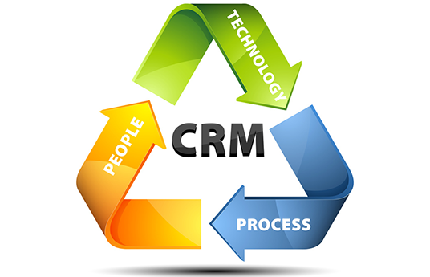
CRM Implementation Council Briefing June 18, 2013 Joannes Vlachos – Head ERP Division

Slide 2
CRM Project – Council Briefing
Agenda
Time | Topic | Presenter
15 – 30 minutes | What is CRM? | Yannis Vlachos
 | Project Background
 | Objectives
 | Project Approach
 | Timeline
 | What does it mean for you?
 | Q&A | All

Slide 3
CRM Project – Council Briefing
What is CRM?
“Customer” Relationship Management (CRM)
IT Platform (software)
Contains tools and best practices on how to manage the relationship with its Members and Partners
Replaces and/or integrates with existing IT systems such as GD/TIES, Registration, HR, etc.
…To serve you better…..

Slide 4
CRM Project – Council Briefing
Background
Many, fragmented (CRM) enhancement requests
Execution of Action 8 documented in the IT / IM strategy document of 2009; Section 3.3.5. Collaboration and Client Focus
…Establishment of a single corporate Customer Relationship Management (CRM) tool to empower Member States, Sector Members, Associates, and the Union through the availability of online interaction and electronic collaboration facilities.
…The goal will be to provide a single, integrated CRM solution for the automated management of clients, events, electronic subscription services, information reuse, automatic notification, etc.

Slide 5
CRM Project – Council Briefing
Project Scope
We will implement:
Event Management
Registration
Room Management
Plan and execute events such as Conferences, Study Group Meetings
e-Commerce
Sales and Marketing
Contact & Account Management

Slide 6
CRM Project – Council Briefing
Objectives
Rationalize and modernize current (ITU) Systems landscape
Harmonize business processes such as meeting registration and customer interaction
Improve efficiency & effectiveness in ITU operations and resources
Enable ITU to provide innovative services towards Members, Sector Members, Associates, Academia, and other partners
Improve the quality of “customer” service & satisfaction

Slide 7
CRM Project – Council Briefing
Approach

Slide 8
CRM Project – Council Briefing
Timeline
2013 |  |  |  |  |  |  |  |  |  |  |  | 2014
Jan | Feb | Mar | Apr | May | Jun | Jul | Aug | Sept | Oct | Nov | Dec | Jan | Feb
CRM Work
Package:
CRM RDS
CRM Fit/Gap
& BBP
Realization
Final
Prep
Next Steps
K.O.
26 Feb.
15 May
12 July
14 Nov.
G.L.
21 Dec.
Legacy Systems
Impacted:
Migration/
Integration
GD/TIES
TIS
COMPASS
DMS
EDRS
MMS
RMS
GEM
GD/TIES
8
8
Notes:
8

Slide 9
CRM Project – Council Briefing
How will it affect you?
Global Directory / TIES will be replaced
Registration
Communication / interaction
Room Management
Document Management System (DMS) will remain
Access Control & Badging will remain (for now)
Next step: Mobility

Slide 10
CRM Project – Council Briefing
Want to get involved?
Contact membership@itu.int

Slide 11
Thank You! Q & A
CRM Project – Council Briefing
Questions

