Slide 1
Notes:
Intro for an exciting event coming up: BYND 2015 – the Global Youth Summit.
As you know, the Summit will take place in Costa Rica 9 – 11 September 2013.
Beyond-2015 refers to the current efforts in the UN system to lay out the post-MDG sustainable development agenda.
One of the main objectives of the Summit is to give youth a platform to shape this agenda…to tell world leaders about the kind of world they want. To give them a voice and the tools to change the world.

Slide 2
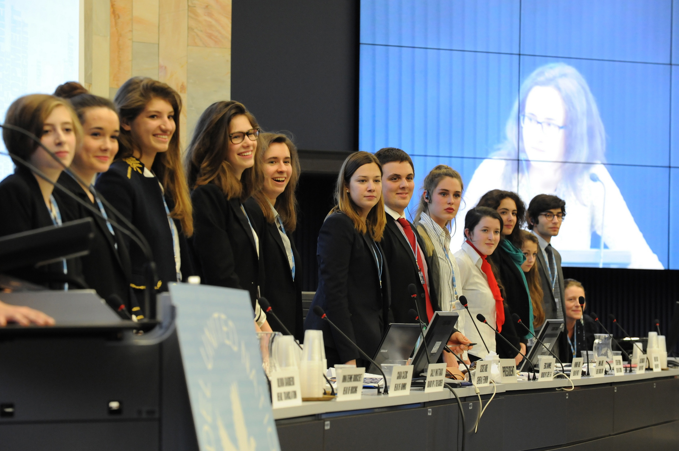
Change-makers. Innovators. Entrepreneurs.
Inspire youth.
To change their world using ICTs….
Notes:
No one needs to tell young people about the importance of ICTs. They are the most avid users of these technologies.
Instead, our aim is to mobilize youth to use these technologies to change their world in a positive way.
Luckily there are many remarkable youth doing exactly this in different parts of the world. We want to bring change-makers, innovators and entrepreneurs together to share their stories and inspire others.

Slide 3
Not a typical UN event
A crowd-sourced global open platform
Online discussion & engagement with Kofi Annan
Channel for youth to speak to leaders
What is the world they want post-2015
Notes:
Not a typical UN Summit. Light on protocol, speeches. Interactive format. Workshops. Young leaders playing moderating roles. 500 youth in Costa Rica, but through our partners, we will reach out to many more on line.
Online conversation and engagement in the lead up to and during the Summit. Kofi Annan series + crowdsourcing platform. You can contribute your ideas and projects – video, blogs, songs… Mr Annan in our studio later this afternoon to do second dialogue.
We will give an unprecendented voice to youth. A direct channel to world leaders. We will crowd-source the programme and outcomes of the Summit in the coming weeks and months. The President of Costa Rica will take the crowd-sourced priorities of youth to the next General Assembly in New York, just days after the Summit.

Slide 4
Summit Themes
Tracks | Issues to be discussed
Get ahead | Employment and Entrepreneurship Innovation
Respect your environment | Sustainable development Climate change Environmental protection
Be smart, be safe | Cybersecurity Child online protection
Be healthy | Sport Lifestyle awareness Mobile health
Change your world | Post 2015 global agenda Citizenship and governance

Slide 5
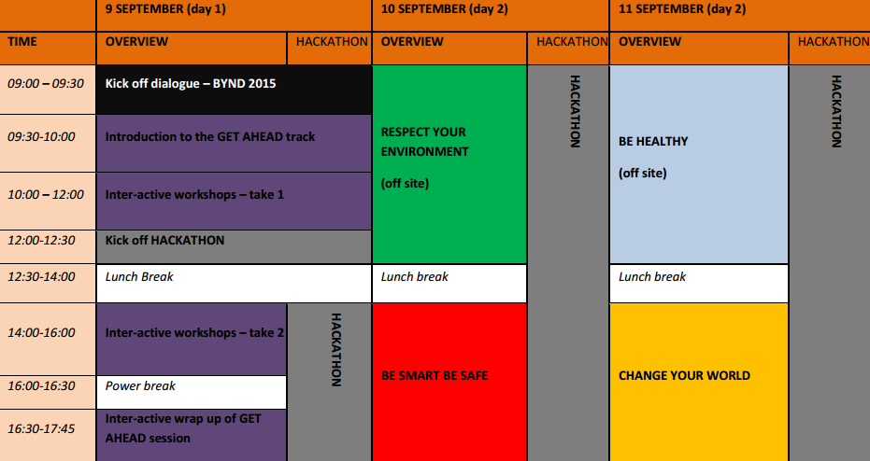
Provisional Programme

Slide 6
Summit Wow Factor
500 hyper-connected young leaders in dynamic environment
Chance to build their own summit
Build up through crowdsourcing
Multiple sites – truly global summit
Notes:
Summit Wow Factor
500 hyper-connected youth in a dynamic environment. No paper. Mobile app for programme. Real time voting on topics, on site and online.
Chance to build their own summit programme. Select their topics, off site visits.
Build up through crowdsourcing
Multiple sites

Slide 7
Summit Themes
Ambitious Plan. Prestigious partners.
Notes:
We have an amazing line up of partners. And we could not do this summit without their support.
UN agencies – UNICEF, UNESCO, WHO, ILO …
America Movil, Telefonica, Microsoft, Google, PriceWaterHouse Coopers, Ooredoo, Intel, Cisco, Kofi Annan Foundation.

Slide 8
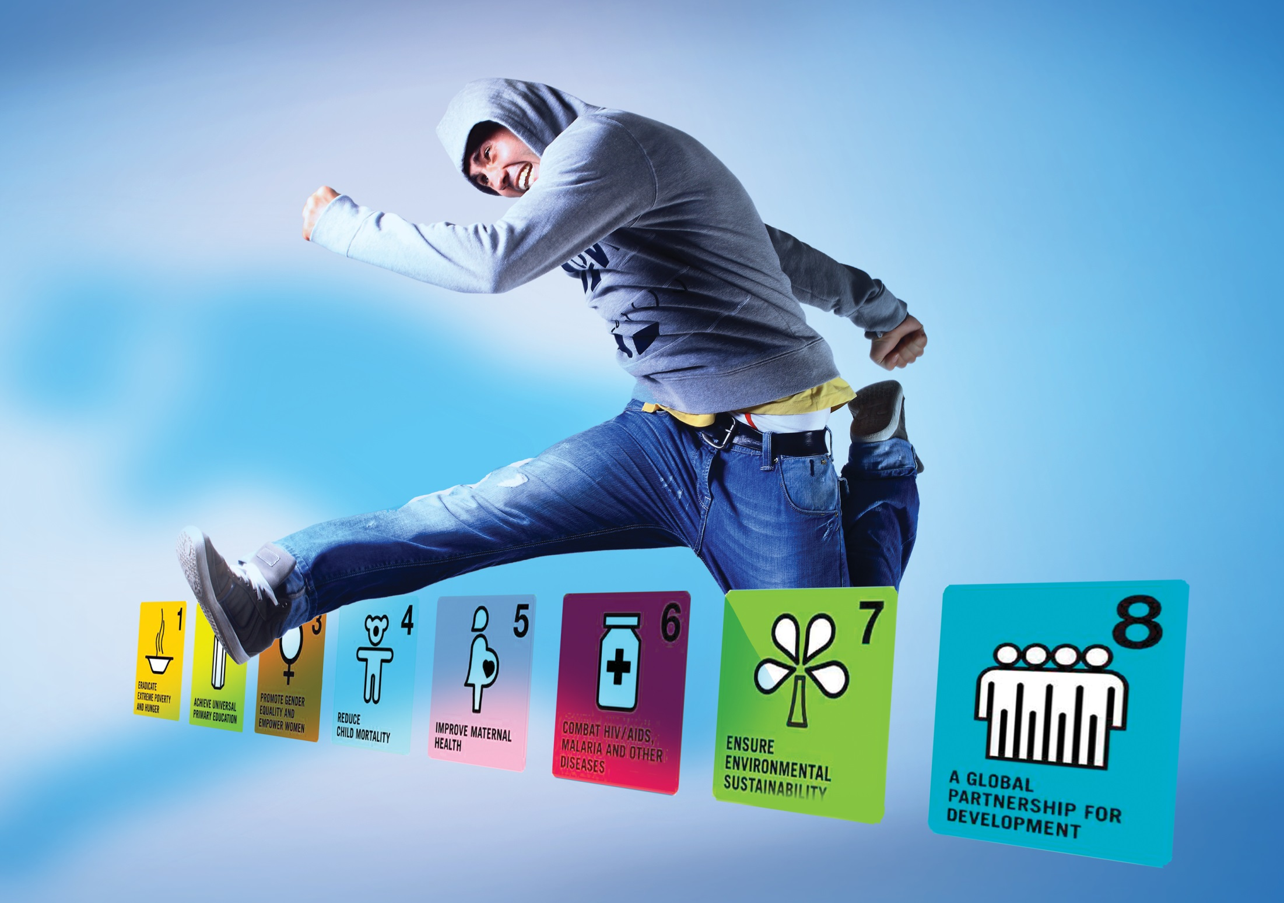
Why Involve your Young Leaders?
Leadership roles in Advisory Group
Moderating roles in Crowdsourcing
Showcase Their Projects and Ideas
Debate with Peers and Global Leaders
Notes:
Next Steps
Local content and language

Slide 9
For more info:
bynd2015@itu.int
Notes:
Thank you for your time.
Happy to provide more information.

