Slide 1



HIPSSA Project
Support for Harmonization of the ICT Policies
in Sub-Sahara Africa
Overview of the Model Law on Electronic Transactions and Electronic Commerce
Tana Pistorius
Notes:
Bonjour à tous,
Je suis tres heureux d‘être parmi vous aujourd‘hui.
Je voudrais remercier Mr. Kamdem pour son invitation a l‘atelier.
Permettez-moi de me presenter.
Je viens de rejoindre le bureau de regional de l‘UIT pour l‘Afrique d‘Addis Abeba pour coordonner le projet d‘harmonisation reglementaire de l‘UIT et de la CE en Afrique sub-saharienne
Je travaillais precedemment chez le regulateur français l‘ARCEP au service economique.
Je m‘occupais de travaux de modelisation technico-economique et j‘etais plus particulièrement en charge de l‘évaluation du cout du service universel et de la terminaison d‘appel mobile dans les departements français d‘outremer.

Slide 2

Realities of Law: Barrier
Paper-based commercial rules
  Manuscript signature witnessed
  Vulnerability of consumers
Legal effect of an email
  Received; read
  Systems are down; delete it

Slide 3
OBJECTS
Trusted business environment
  Legal certainty
  Protection of individuals
Clarify marketplace rules
  E-records; authentication etc.

Slide 4
OBJECTS (cont.)
Promotes public confidence
  Integrity and reliability of electronic records and electronic commerce
  Fosters the development of electronic signatures to lend authenticity and integrity to correspondence in any electronic medium

Slide 5
Three pillars
General enabling
Electronic transactions
E-commerce

Slide 6
General enabling
Ch1: Definitions & Interpretation
Definitions
Interpretation
Ch 2:
Legal Recognition
Legal recognition of electronic information
Legal recognition by parties
Ch 3:
Legal Effect
Sphere of application
Writing
Signature
Secure signatures
Incorporation by reference

Slide 7
Electronic Transactions
Ch 4: Legal recognition
Formation & validity
Ch 5: Time & place
Variation by agreement
Time of dispatch
Time of receipt
Place of dispatch and receipt
Time of contract formation

Slide 8
Electronic commerce
Ch 6: Attribution
Electronic communications
Ch 7: Electronic evidence
Original information
Production of documents
Ch 11: Service Providers
Secure electronic signatures
On-line safe harbours
Requirements
Ch 8-10:
Consumer protection
Record retention
On-line consumers
On-line marketing
Automated message systems
Admissibility

Slide 9
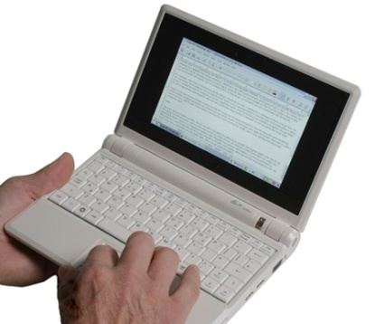

WRITING
Legal recognition: Requirement of writing met:
  data messages
  accessible in a manner usable for subsequent reference

Slide 10

Electronic signatures
Data attached to or logically associated with data indented to be signature

Slide 11
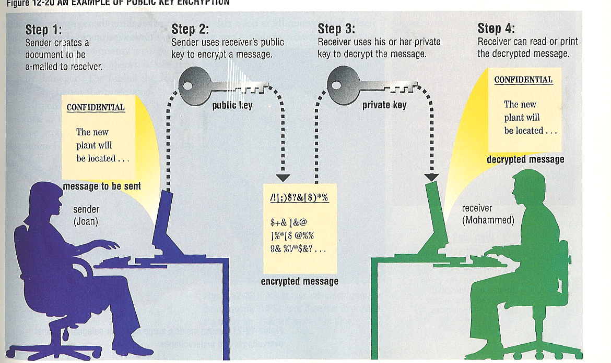
SIGNATURE
Law requires: regulations

Slide 12
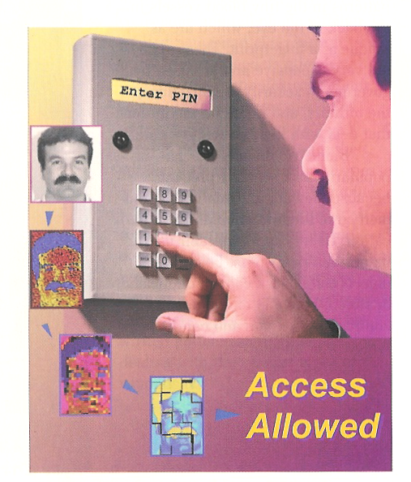
Enabling environment
Parties – appropriate transaction
SECURE electronic signatures -regulations
Recognition of foreign signatures

Slide 13
ADMISSABILITY
Admissibility and evidentiary weight
Original
Retention of records
Production of documents
  ? STANDARD

Slide 14
E-CONSUMERS
Automated message systems
  Electronic agents
  keystroke errors
Obligations of suppliers
Performance
Cooling off
  CONTRACTS EXCLUDED

Slide 15
SPAM
On-line marketing
  Opt in
  CRIMINAL

Slide 16
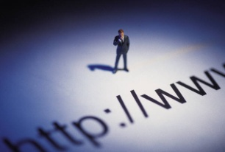
Service provider liability
Limitation of liability
  Mere conduit;
  caching;
  hosting &
  information location tools
No general obligation

Slide 17
Exceptions & interpretation
Exclusions from application
Freedom of contract
No party forced to transact electronically
ENABLING

Slide 18


QUESTIONAIRE
Exclusions
  TYPES OF INFORMATION; SIGNATURE CONTRACTS EXCLUDED?
SECURE SIGNATURES
REQUIREMENTS
  SANS 21188; ITU X.509; PKI
Admissibility – rules of court
E-Consumers - sufficient
ISPs

Slide 19
THANK YOU…
Tana Pistorius
ITU INTERNATIONAL EXPERT
pistot@unisa.ac.za
Research Professor: UNISA
Union Internationale des Télécommunications International Telecommunication Union
Notes:
Merci de votre attention.
Je me tiens a votre disposition pour repondre a vos questions.
Je peux vous faire parvenir par email une version electronique de ce support de presentation.
Sachant que nous abordons tout juste le lancement de ce projet, les informations contenues dans cette presentation sont susceptibles a certaines evolutions.

