Slide 1
HIPSSA Project
Support for Harmonization of the ICT Policies in Sub-Sahara Africa
Overview of the Electronic Transactions and Communications Bill
Presentation Two: 4th of March 2013
Notes:
Bonjour à tous,
Je suis tres heureux d‘être parmi vous aujourd‘hui.
Je voudrais remercier Mr. Kamdem pour son invitation a l‘atelier.
Permettez-moi de me presenter.
Je viens de rejoindre le bureau de regional de l‘UIT pour l‘Afrique d‘Addis Abeba pour coordonner le projet d‘harmonisation reglementaire de l‘UIT et de la CE en Afrique sub-saharienne
Je travaillais precedemment chez le regulateur français l‘ARCEP au service economique.
Je m‘occupais de travaux de modelisation technico-economique et j‘etais plus particulièrement en charge de l‘évaluation du cout du service universel et de la terminaison d‘appel mobile dans les departements français d‘outremer.

Slide 2
Parts VII-XIII
Cryptography providers
Secure signatures
Domain names
ISPs
Exclusions
Powers

Slide 3
PARTS VII-VIII
Register of cryptographic products and services;
Secure e-communications & secure electronic signatures

Slide 4
Section 42
Cryptography providers
Register of cryptography providers
Minister appoint DG
Definitions
Cryptography product
Cryptography provider

Slide 5
Part VII
Register
Information – identify; not trade secrets iro product/service (s 42)
Compulsory – (s 43)
Tanzania:
premises; person makes use; uses for purpose of business
S 44 Register confidential – exceptions
Offences; official request; cyber inspectors;

Slide 6
Secure electronic communication S 45
E-Signature
Security procedure is verified
Prescribed by Regulations or
Commercially reasonable security procedure agreed to by parties
= secure electronic communication

Slide 7
Security procedure
Procedure to:
Verify record is that of person;
Detecting changes;
Verify in relation to e-record:
Initial record remained intact/has been altered since secure e-signature was affixed.

Slide 8
Commercially reasonable procedure
Commercial circumstances at the time including:
Nature of transaction;
Sophistication of parties;
Volume in type of transaction;
Availability of alternatives;
Cost; and
General procedures for similar transactions.

Slide 9
Electronic signatures
Data attached to or logically associated with data indented to be signature
+27833761560
pistot@unisa.ac.za
Secure electronic signature is required where law requires a signature

Slide 10
Secure e-signatures s 46
Secure e-signature = application of technology ito Regulation & can verified that e-signature:
Unique to person using it;
Capable of identifying person;
Created using means – sole control;
Linked to e-communication manner if altered, alteration detectable and/or signature invalid
at time was made

Slide 11
PRESUMPTIONS S 47
Secure e-communication not altered;
SIGNATURE
Is signature of person to whom correlates;
Affixed by that person intention of signing
No presumptions authenticity, integrity if not secure communication or signature

Slide 12
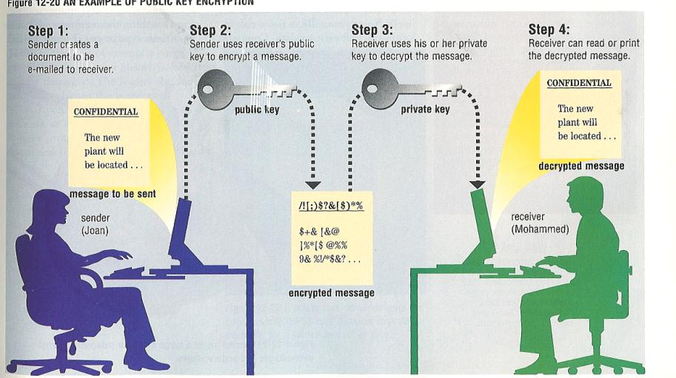
ONE FORM OF SECURE E-SIGNATURE

Slide 13
Digital signatures 48-70;73-74
Secure signature – PKI licensing and certificates –E.g.: Appointment of Controller and other officers; Reliance on certificates; Trustworthy system; Disclosure; Issue of certificate; Generating key pair; Acceptance of certificate; Control of private key; Initiating suspension or revocation of certificate; etc.

Slide 14
Signature Regulations Part VIII
S71 Security procedures; technical requirements;
S 72 Recognition of foreign certification authorities;
Proposal to include PKI provisions
Technical capacity; technological developments; media neutrality; different levels of reliability

Slide 15
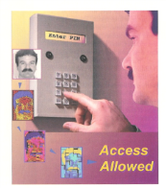
Enabling environment
Parties – appropriate transaction
Regulations:
Technical requirements for SECURE electronic signatures
Recognition of foreign signatures

Slide 16
Parts IX-X
Proper administration of the .tz DNS to benefit of citizens

Slide 17
Parts IX-X: Domain names s 77-86
Doain names
ccTLD – national asset
Establishment tznic for.tz DNS
Establishment, memo & articles;
Procedure establishment of tznic
Board of directors; staff; finances
Regulations
Resolution of tm/dn disputes
ICANN re-delegation requirements

Slide 18
Badge of origin; Distinctive Use in commerce | Identifier of IP address Generic, descriptive Commercial or non-commercial
Territorially based Same mark different goods or services | Global gTLD or ccTLD Unique - First come first serve Cybersquatting Typo-squatting

Slide 19
Parts XI
Provide for CODE OF CONDUCT of ISPs
Protect ISPs from indirect liability

Slide 20
Part XI: Service providers
ISPs
S 87: Recognition representative body
Code of conduct; membership criteria, adherence to adequate standards & monitoring & enforcing
S 88: Limitation only:
for members
Adopted & implemented code

Slide 21
Limitation of liability
S 89-92
89: Mere conduit;
90: Caching;
91: Hosting &
92: Information location tools
93: Take-down notification
94-95 No general obligation & other rights not affected

Slide 22
S 89 Mere Conduit
Mere conduit - Access to for for operating facilities for transmission, routing or storage of e-communications if:
Does not initiate
Or select recipient;
automatic, technical;
no modification

Slide 23
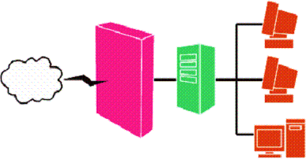
S 90 Caching: automatic intermediate storage of data
Does not modify; conditions of access; rules updating; rights management information; removes or disables access

Slide 24
S 91 Hosting
No knowledge;
no facts or circumstances; take-down upon receipt
Source: http://jumpdog.us

Slide 25
S 92 Information location tools
No knowledge; no facts or circumstances;
No financial benefits;
Removes access to link after info
Source: http://webchannel.ae/

Slide 26
PARTS XII XIII
Powers of the Minister
Exclusions

Slide 27
Minister’s Powers S 96
Exclusions
Powers
Designate entity as public body
Electronic signatures – reliable as secure
Secure signatures for specific purposes
Formats for communication of info;
Exclude transactions, documents or rules of law from application
Any other purpose

Slide 28
Part XIII Saving provisions
E-signature or e-communication not applicable to:
Immovable property; long term lease; bill of exchange; will; trust; family law & personal status; power of attorney; judicial notification & court decisions; amendments to or termination of health insurance & life insurance; etc.
Other laws not affected

Slide 29
Implementation
Regulations:
E-government requirements;
Cryptography registration;
Security procedures – secure e-communications
Secure signature requirements;
Recognition of foreign e-signatures
Domain name ADR
Representative body: ISPs

Slide 30
THANK YOU…
Tana Pistorius
ITU INTERNATIONAL EXPERT
pistot@unisa.ac.za
Research Professor: UNISA
Union Internationale des Télécommunications International Telecommunication Union
Notes:
Merci de votre attention.
Je me tiens a votre disposition pour repondre a vos questions.
Je peux vous faire parvenir par email une version electronique de ce support de presentation.
Sachant que nous abordons tout juste le lancement de ce projet, les informations contenues dans cette presentation sont susceptibles a certaines evolutions.

