Slide 1
HIPSSA Project
Support for Harmonization of the ICT Policies
in Sub-Sahara Africa,
TRAINING /DATA PROTECTION LAW
Pria Chetty,
International Legal Expert on Data Protection
Baraka Kanyabuhinya,
National Legal Expert, Data Protection
Notes:
.

Slide 2
Summary of the Content
Information privacy and data protection in Tanzania
What is Personal Information? How is it Processed?
What is Sensitive Information?
Who is a Data Subject?
Who is a Data Controller?
Who is a Data Processor?
What are the principles of data protection?
Governing Trans-border flow of personal information
Establishing accountability and oversight for personal information protection

Slide 3
Overview of Training
Legal theoretical basis: law, policy, regulation
Conveyance of key terminology and principles
Practical explanations
Case Studies
News Headlines
Interactive breakout sessions
Discussion

Slide 4
SESSION ONE:
1.1 INFORMATION PRIVACY LAWIN tanzania

Slide 5
Constitution
Article 16(1) of the Constitution of the United Republic of Tanzania states, inter alia: Every person is entitled to respect and protection of his person, the privacy of his own person, his family and of his matrimonial life and respect and protection of his residence and private communications.
Article 16 (2), further cements the need to enact law that protects and guarantees the right to privacy: For the purpose of preserving the person’s right in accordance with this article, the state authority shall lay down legal procedures regarding the circumstances, manner and extent to which the right to privacy…may be encroached upon without prejudice to the provisions of this Article.

Slide 6
Privileged Communications
Lawyer-Client Relationship
Doctor-Patient Relationship
Child Proceedings- Court of Law
Bank-Customer Relationship
Privacy between Spouses
Secrecy of correspondence, confidentiality and integrity - postal items
Human DNA Regulation
Prohibition of Publication of Identity by Court of Law
National Security
Anti Money Laundering
Journalism

Slide 7
Limitations to the Right to (Information) Privacy
Limitation to Constitutional Right to Privacy
The Anti-Money Laundering Act 2006
The DNA Act
Terrorism
Exceptions -Electronic and Postal Communication Act, Doctor-Patient Relationship
Several permitted Disclosures

Slide 8
SESSION ONE:
1.2 PURPOSE OF DATA PROTECTION LAW IN TANZANIA

Slide 9
Privacy and Data Protection Law
Privacy is a basic right, which permits individuals to decide the manner, and extent to which information concerning them should be shared with others. Currently Tanzania lacks an effective legal regime on data protection. Absence of a comprehensive Data protection law exposes subjects to threats of enjoyment of the right of privacy. It also poses a great threat on misuse of information and data base protection.

Slide 10
Data Protection Law
The purpose of promulgating a new law is to cure a certain mischief. Incidences of violation of right to privacy, misuse of information and unauthorized data access are on tremendous increase and counter-intervention cannot wait longer. Unwanted phone calls, loss of data, unauthorized intrusion to sim cards, sim swapping and unsolicited emails (spam) are common incidences, violating the right to privacy
See the Business Times Dated 22 December 2010, at http://thecitizen.co.tz/business/-/6535-misuse-of-ict-alarms-government

Slide 11
Case Study 1
Subscribers of mobile phone companies in Tanzania have, for a long time now, complained about the 'irritating' unsolicited messages (SMS) and phone calls, which are sometimes charged.
It has been a trend by mobile phone operators to send unsolicited text messages and making phone calls to their customers informing them about new products, services and offers. http://www.africanliberty.org/content/tanzania-analogue-digital-new-era-tanzania-broadcasting

Slide 12
Purpose of Data Protection Law
Give effect to right to privacy
ICT technology developments impacts right to the protection of personal data in commercial activities as well as in electronic government (eGov) activities
Responds to illegitimate and unlawful monitoring of personal communications
Responds to direct marketing concerns involving PI
Address inconsistencies - automated decision making
Data protection regulation - ensure that the benefits of using information and communication technologies is not concurrent with weakened protection of personal data
Harmonised approaches

Slide 13
Practical Objectives of Law
Give effect to principles of data protection
Place limitations on the processing of personal data
Provide for the rights of the data subject
Describe the responsibilities of the Data Controller
Establishment of the Data Protection Authority
  Combat violations of privacy likely to arise from the collection, processing, transmission, storage and use of personal dataactivities

Slide 14
Case studies
Torbay Care Trust in Torquay was fined £175,000 after it published the sensitive details of over 1,000 employees on the Trust’s website. The data covered individuals’ names, Dates of birth, National Insurance numbers, Religion and Sexuality

Slide 15
Summary of finding in Torbay Care Trust
We regular speak with organizations across the health service to remind them of the need to look after people’s data. The fact that this breach was caused by Torbay Care Trust publishing sensitive information about their staff is extremely troubling and was entirely avoidable. Not only were they giving sensitive information out about their employees but they were also leaving them exposed to the threat of identity fraud. (Stephen Eckersley, Head of Enforcement)

Slide 16
Belfast Trust fined £225,000 after leaving thousands of patient records in disused hospital
News release: 19 June 2012: Belfast Health and Social Care (BHSC) Trust has been served with a Civil Monetary Penalty (CMP) of £225,000 following a serious breach of the Data Protection Act (DPA)
The breach involved the sensitive personal data of thousands of patients and staff, and included medical records, X-rays, scans and lab results, and staff records including unopened payslips.

Slide 17
What happened to the News of the World!
The closure of the News of the World, the best-read Sunday newspaper in the English language, is a stark illustration of the reputational and commercial damage that can result from privacy-intrusive practices carried out in the name of ‘investigative journalism’.

Slide 18
News World
This case demonstrates that data protection applies even in relation to the publication of material in the media. However, in such cases, the issue to be considered in the first instance is whether a general public interest could be deemed to apply to the publication of the material. If it does then the general requirements of data protection are set aside. However, if no public interest could legitimately be claimed, then the media must have due regard to their data protection obligations

Slide 19
SESSION TWO:
PERSONAL INFORMATION
PROCESSING

Slide 20
Data Controller
“data controller” or “controller” refers to any natural person, legal person or public body which alone or jointly with others determines the purpose and means of processing of personal information. Where the purpose and means of processing are determined by or by virtue of an act, decree or ordinance, the controller is the natural person, legal person or public body has been designated as such by or by virtue of that act, decree or ordinance.

Slide 21
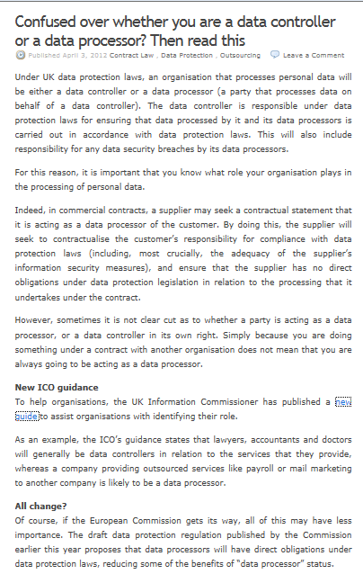
http://techblog.brodies.com/2012/04/03/confused-over-whether-you-are-a-data-controller-or-a-data-processor-then-read-this/

Slide 22
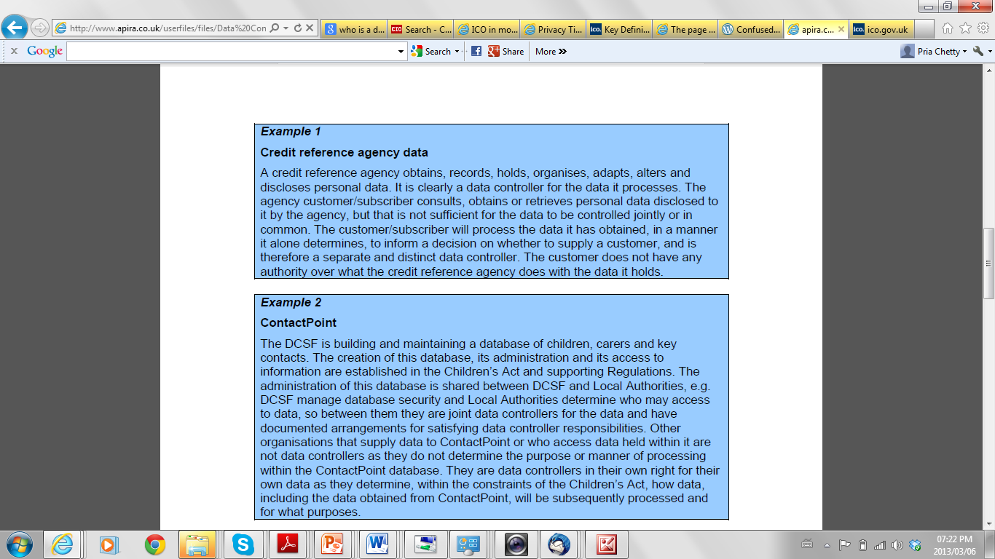
http://www.apira.co.uk/userfiles/files/Data%20Controllers%20in%20common.pdf

Slide 23
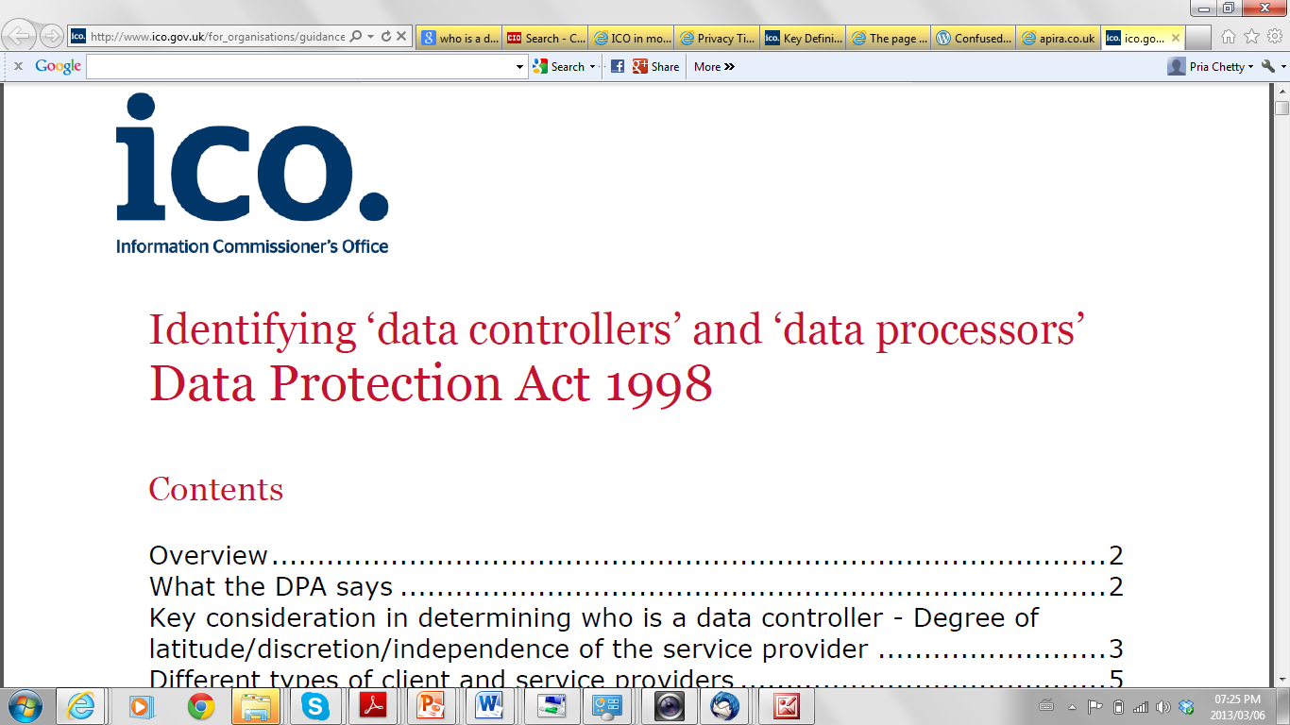
http://www.ico.gov.uk/for_organisations/guidance_index/~/media/documents/library/Data_Protection/Detailed_specialist_guides/data_controllers_and_data_processors.ashx

Slide 24
Defining Personal Information
information about an identifiable individual that is recorded in any form, including, without restricting the generality of the foregoing:-
information relating to the race, national or ethnic origin, religion, age or marital status of the individual; information relating to the education or the medical, criminal or employment history of the individual or information relating to financial transactions in which the individual has been involved; any identifying number, symbol or other particular assigned to the individual; the address, fingerprints or blood type of the individual; the name of the individual where it appears with other personal information relating to the individual or where the disclosure of the name itself would reveal information about the individual; correspondence sent to a data controller by the individual that is explicitly or implicitly of a private or confidential nature, and replies to such correspondence that would reveal the contents of the original correspondence; and the views or opinions of any other person about the individual.

Slide 25
Processing of Personal Information
processing: refers to any operation or set of operations which is performed upon personal information, whether or not by automated means, such as obtaining, recording or holding the data or carrying out any operation or set of operations on data, including –
(a) organization, adaptation or alteration of the data;
(b) retrieval, consultation or use of the data; or
(c) alignment, combination, blocking, erasure or destruction of the data

Slide 26
Activity 1
Form a group that represents a business entity or public authority e.g. bank, insurance company, hospital, university
Discuss and list examples of personal information held by the entity
Discuss and list examples of how such personal information is processed
Discuss examples of how such personal information may be misused or mishandled
Time allocation – 10 to 15 minutes

Slide 27
Sensitive Personal Information
“sensitive personal information” (a) refers to genetic data, data related to children, data related to offences, criminal sentences or security measure, biometric data as well as, if they are processed for what they reveal, personal information revealing racial or ethnic origin, political opinions, religious or philosophical beliefs, affiliation, trade-union membership, gender and personal information concerning the health or sex life of the individual (b) refers to any personal information otherwise considered by Tanzanian law as presenting a major risk to the rights and interests of the data subject, in particular unlawful or arbitrary discrimination.

Slide 28
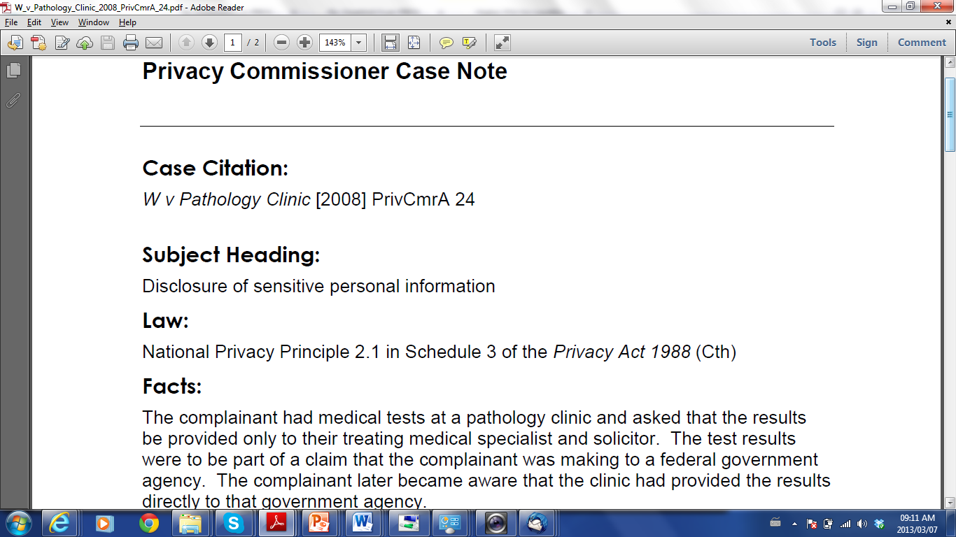
Australian Privacy Commissioner case
Information was disclosed for a purpose other than the primary purpose for which it was collected, and the disclosure was not permitted by any of the exceptions the Commissioner formed the view that the disclosure was an interference with the complainant's privacy
Conciliation and Settlement
http://www.privacy.gov.au/materials/types/casenotes/view/5977

Slide 29
Activity 2
Discuss and list examples of sensitive personal information held by the entity
Discuss and list examples of how such sensitive personal information is processed
Discuss and list examples of how such sensitive personal information may be mishandled and the arising harm to individual
Time allocation – 10 minutes

Slide 30
SESSION THREE:
PROTECTION OF PERSONAL INFORMATION

Slide 31
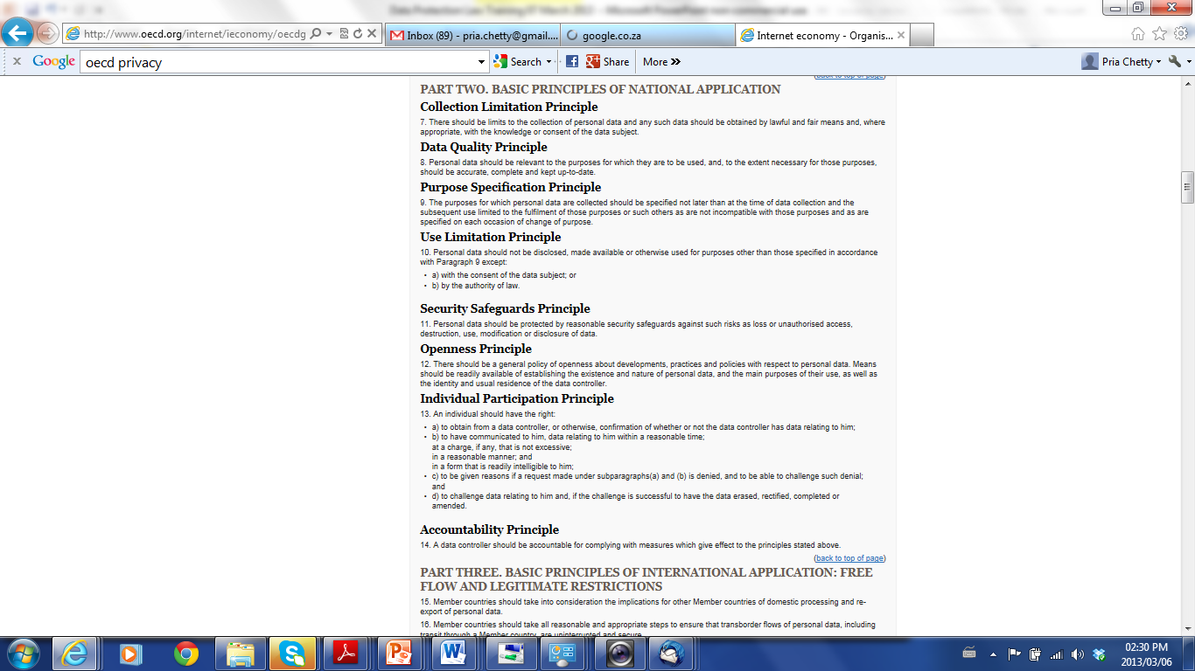
OECD Principles
Source: OECD
www.oecd.org

Slide 32
Key Provision Principles of TZ Data Protection Bill
Collection of personal information
Source of personal information
Accuracy of personal information to be checked before use
Limits on use of personal information
Limits on disclosure of personal information
Condition for use or disclosure of personal information
Storage and security of personal information
Retention and disposal of personal information
Correction of personal information
(public authority)
Data Controller to ensure compliance
Sensitive Personal Information
Limitations and Exceptions

Slide 33
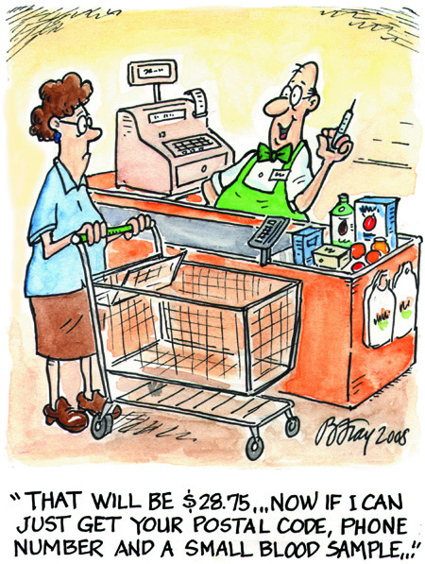
Principle: Purpose of Collection
Image Source: Office of Privacy Commissioner (OPC)

Slide 34
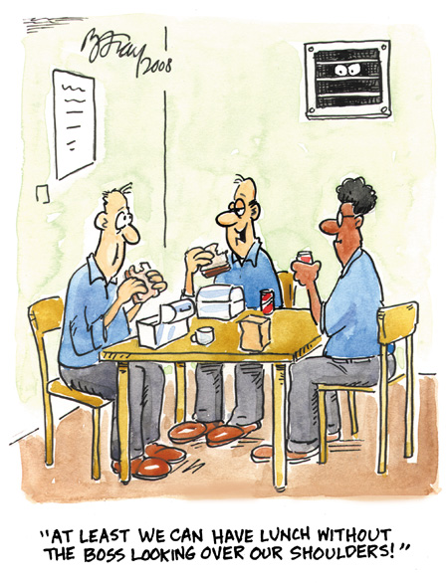
Principle:
Purpose of Collection
Image Source: Office of Privacy Commissioner (OPC)

Slide 35
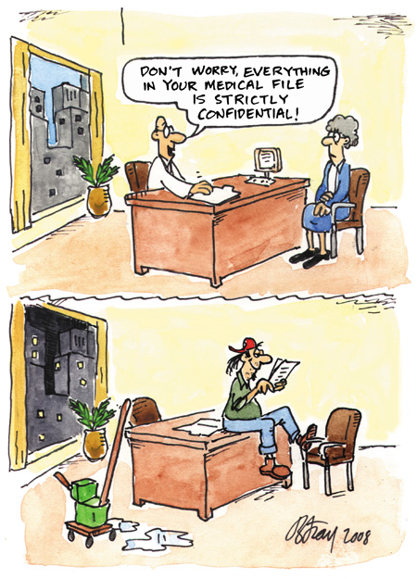
Principle:
Security Safeguards
Image Source: Office of Privacy Commissioner (OPC)

Slide 36
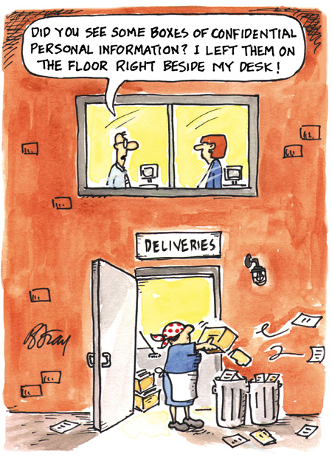
Principle:
Security Safeguards
Image Source: Office of Privacy Commissioner (OPC)

Slide 37
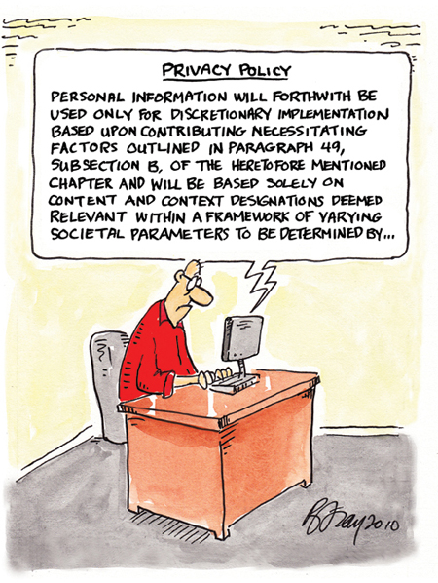
Principle:
Notification
Image Source: Office of Privacy Commissioner (OPC)

Slide 38
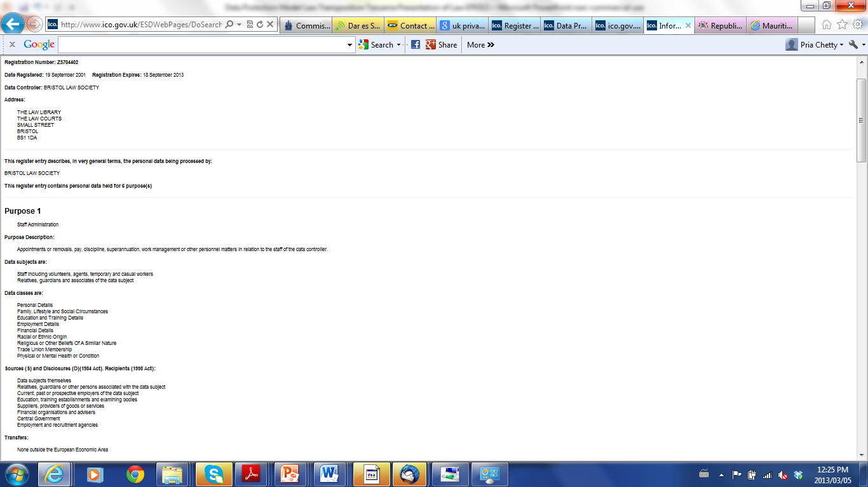
Principle:
TransparencyOpenness,
Limits on use and disclosure
Image Source: Office of UK Privacy Commissioner Website

Slide 39
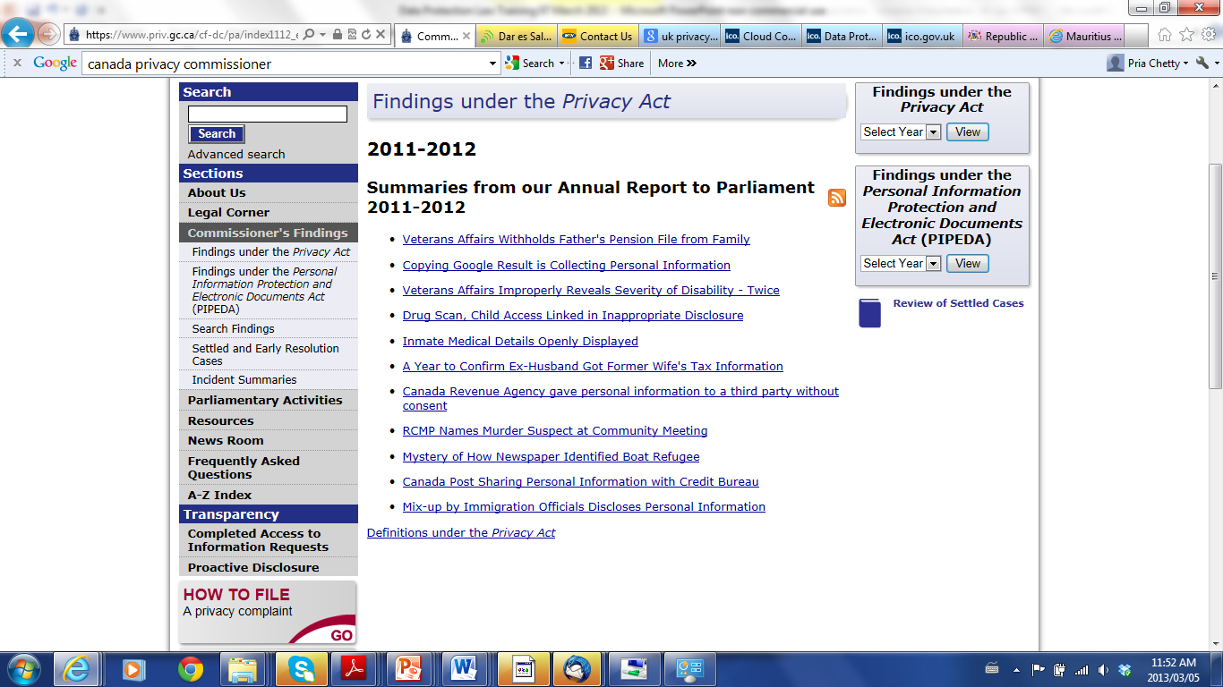
Incidents of Violation
Source: Office of Privacy Commissioner (OPC) Website

Slide 40
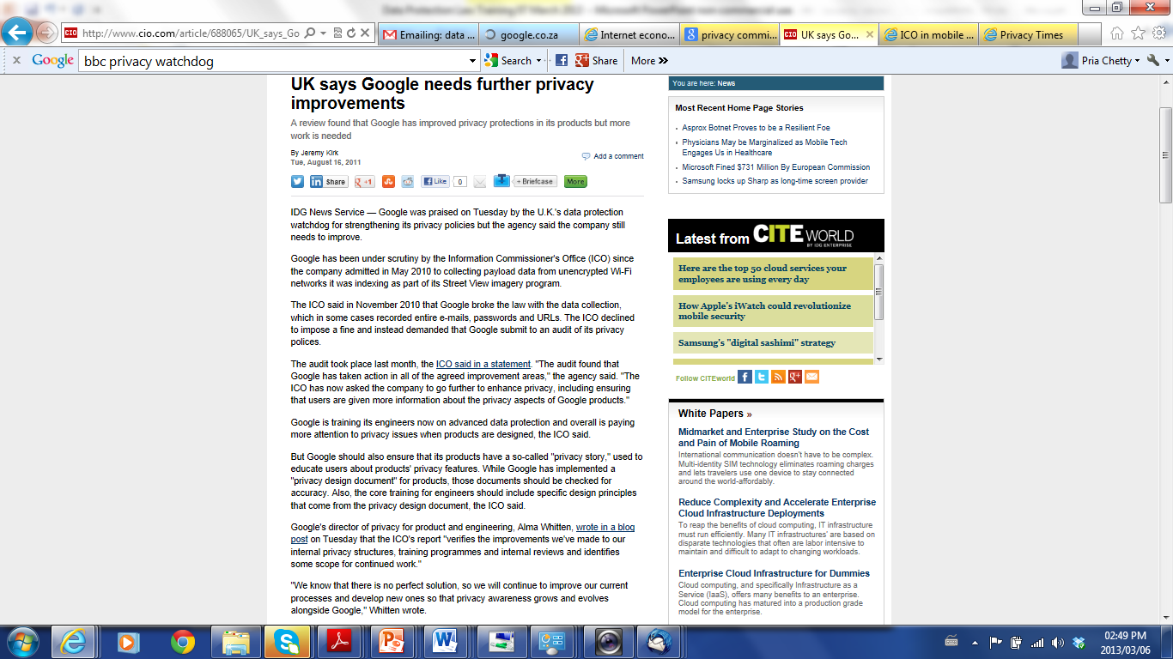
Principles: TransparencySecurity Safeguards
Source:
www.cio.com

Slide 41
Data Controller – Ultimate Responsibility
“data controller's representative” or “controller's representative”: refers to any natural person, legal person or public body permanently established on the territory [of the concerned country], who takes the place of the data controller in the accomplishment of the obligations set by the present model law
“data processor” refers to a natural person, legal person, or public body which processes personal information for and on behalf of the controller and under the data controller’s instruction, except for the persons who, under the direct authority of the controller, are authorised to process the data.
“data protection officer” or “DPO” refers to any individual appointed by the data controller charged with ensuring, in an independent manner, compliance with the obligations provided for in this law

Slide 42
Implementation
Policies
Contracts
Privacy Policy (internal)
Privacy Policy (external)
Information Security Policy
Monitoring Policy
Records Management Policy
Consent
Third Parties
Data Processors
Data Controller’s Representative
Employees/ Contractors
Technical
Compliance
Assessments

Slide 43
Activity 3
Discuss challenges associated with implementation of the requirements and the impact on the entity:
Security Safeguards
Collection from source
Limits on Retention of Personal Information
Limits on disclosure of Personal Information
Time allocation – 15 minutes

Slide 44
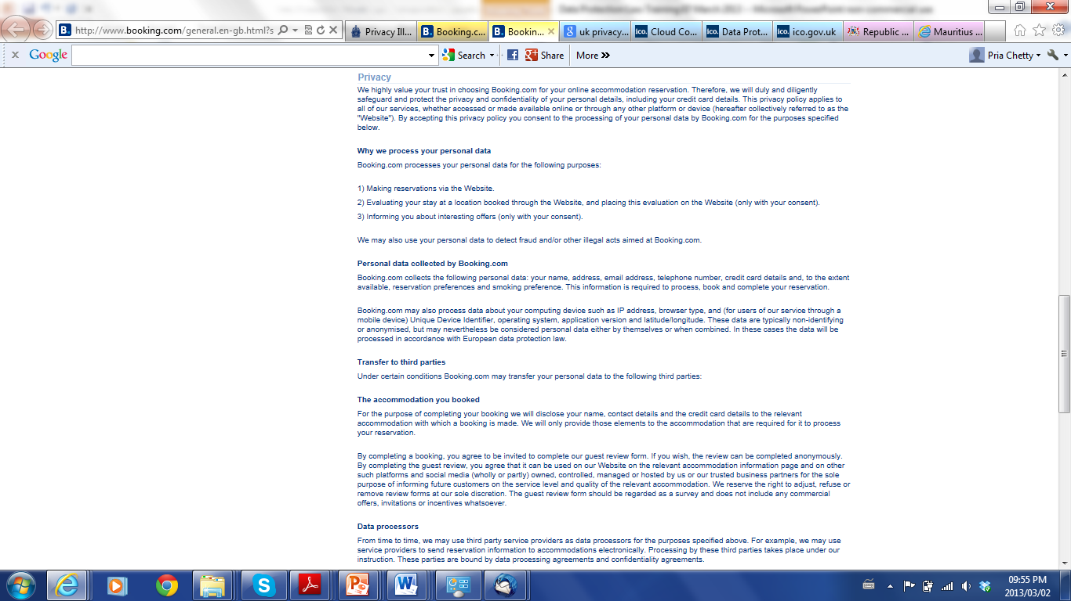
Privacy Policy of Booking.com
www.booking.com
Last update: July 2012

Slide 45


Slide 46
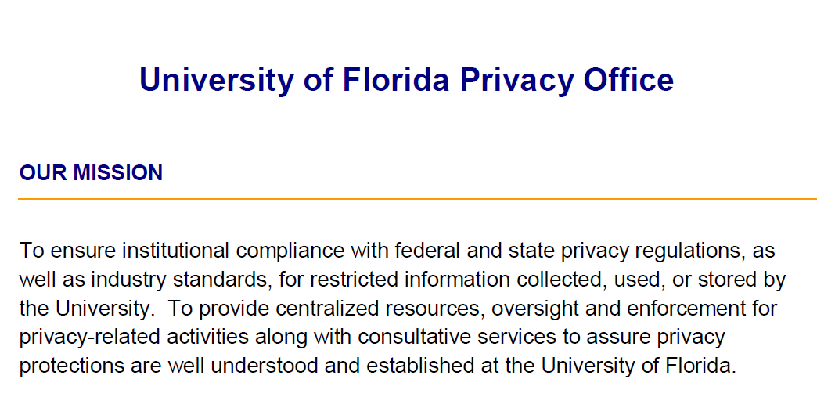

Slide 47
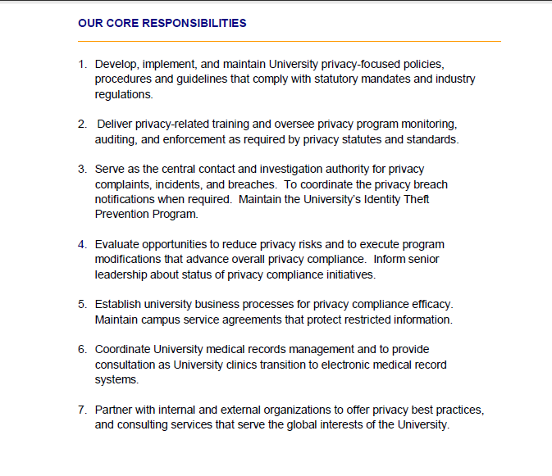
Source: University of Florida

Slide 48
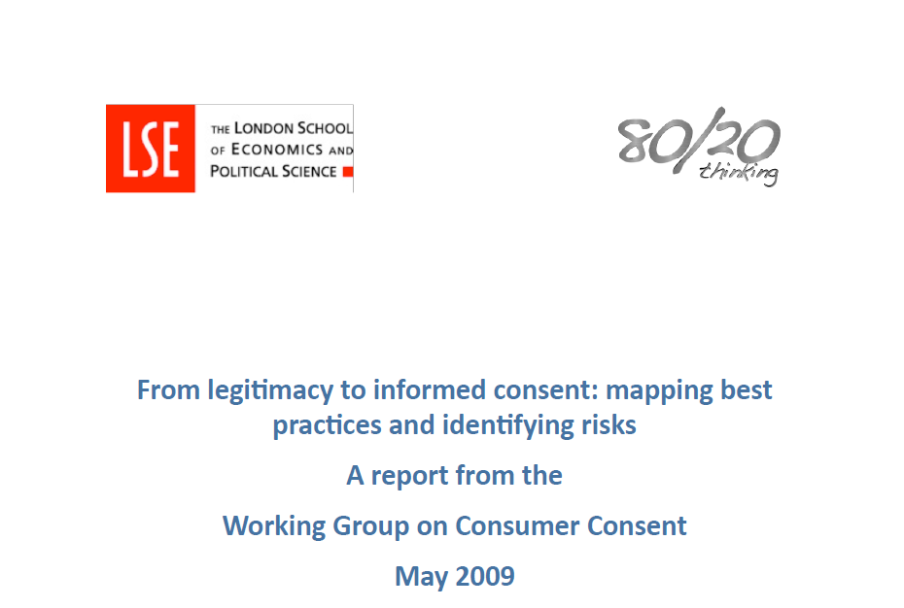

Slide 49
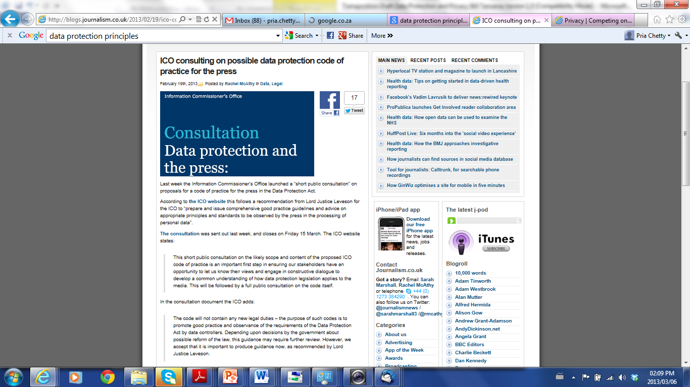
Source:
http://blogs.journalism.co.uk/2013/02/19/ico-consulting-on-possible-data-protection-code-of-practice-for-the-press/

Slide 50
Activity 4
Draft Privacy Policy for your entity. Include (examples):
Describe PI collected
Describe the purpose of collection
Describe the third parties with whom information will be shared
Describe policy on marketing to individuals using PI
Provide contacts and date of draft/ update
Time allocation – 15-20 minutes

Slide 51
SESSION FOUR:
TRANSBORDER FLOW OF PERSONAL INFORMATION

Slide 52
Limitations on Transborder Flow
Member State with Harmonised Law
recipient establishes that the data is necessary
for the performance of a task carried out in the public interest
pursuant to the lawful functions of a data controller
legitimate interests of DS not prejudiced
subject to conditions
Necessity?
What are the lawful functions of the data controller?
Contractually specified?

Slide 53
Limitations on Transborder Flow
Non-Member State with Harmonised Law/ Third Countries
adequate level of protection is ensured in the country of the recipient and the data is transferred solely to permit processing otherwise authorised to be undertaken by the controller
subject to due diligence assessment and further conditions

Slide 54
Due Diligence Assessment
assessed in the light of all the circumstances surrounding the relevant data transfer(s),
particular consideration to be given to the nature of the data, the purpose and duration of the proposed processing, the recipient’s country, the relevant laws in force in the third country and the professional rules and security measures which are complied with in that recipient’s country

Slide 55
Commissioner Deeming
categories of processing - transfer of personal data to countries outside (i) Tanzania and (ii) SADC is not authorized
authorize a transfer or a set of transfers of personal information to a recipient country outside Tanzania or SADC which does not in its laws ensure an adequate level of protection - controller satisfies the Commissioner that it shall ensure adequate safeguards with respect to the protection of privacy and fundamental rights and freedoms of the data subjects concerned, and regarding the exercise of the data subject’s rights such safeguards can be appropriated through adequate legal and security measures and contractual clauses in particular

Slide 56
Conditions – Not Adequate Level of Protection
data subject consent
transfer necessary - performance of a contract or implementation of precontractual measures -response to DS request
transfer necessary - conclusion or performance of a contract concluded/ 2b concluded between the controller and a third party in interest of DS
transfer necessary public interest grounds, or for the establishment, exercise or defense of legal claims;
transfer is necessary-protect the legitimate interests of DS subject; and
the transfer is made from a public register (and legally sanctioned)

Slide 57
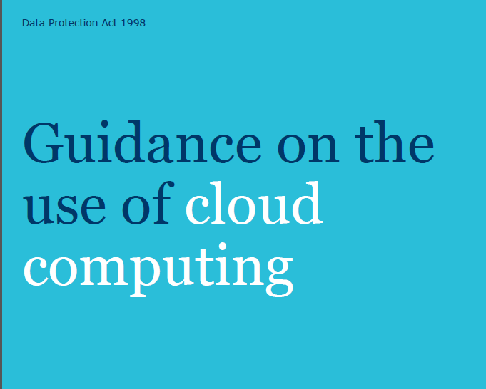
Issued by the UK Information Commissioner
http://www.ico.gov.uk/

Slide 58
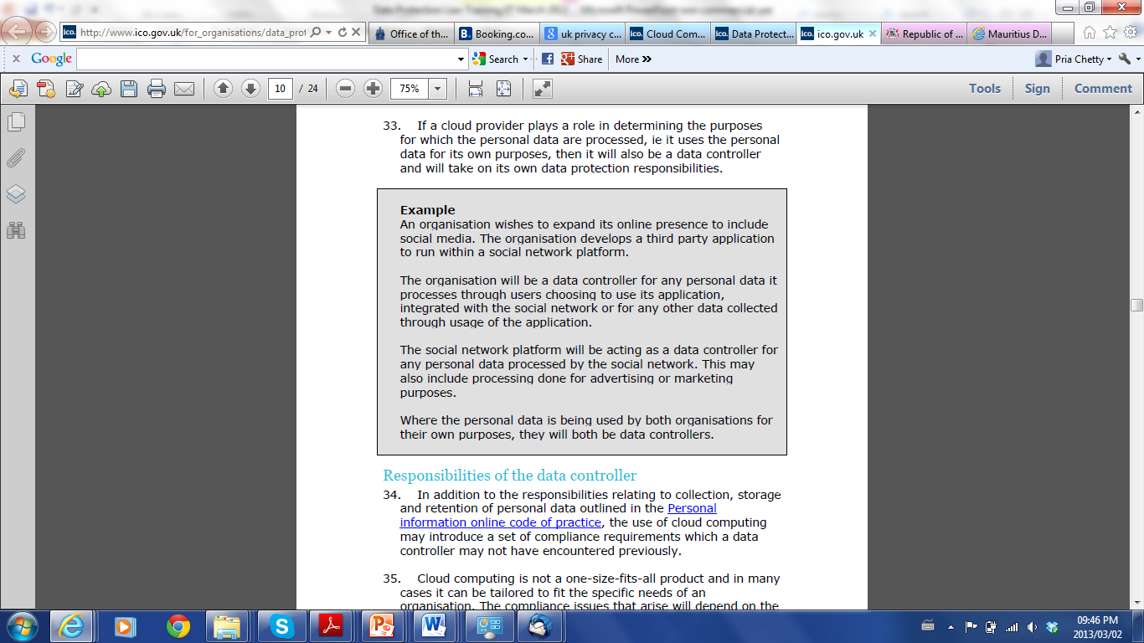
Source: Guidance on the use of Cloud Computing, issued by the UK Information Commissioner
http://www.ico.gov.uk/

Slide 59
SESSION FIVE:
DATA PROTECTION COMMISSIONER

Slide 60
Functions of Commissioner
 | (a) | monitor compliance by data controllers…
 | (b) | to provide advice to data controllers…
 | (c) | to receive and investigate complaints…
 | (d) | to inquire generally into any matter, including any enactment or law, or any practice, or procedure…
 | (e) | undertake educational programmes…
 | (f) | to make public statements…
 | (g) | to receive and invite representations from members of the public…

Slide 61
Functions of Commissioner
 | (h | to consult and co-operate with other persons …
 | (i) | to make suggestions to any person…
 | (j) | to undertake research into, and to monitor developments in, data processing and computer technology…
 | (k) | to examine any proposed legislation (including subsidiary legislation or proposed policy of the Government)…
 | (l) | to report (with or without request) to the Minister…
 | (m) | to report to the Minister from time to time on the desirability of the acceptance, of any international instrument…

Slide 62
Functions of Commissioner
 | (n) | to gather such information…
 | (o) | to do anything incidental or conducive…
 | (p) | to exercise and perform such other functions, powers, and duties …
 | (q) | pronounce administrative sanctions as permitted by the Act or ancillary regulations in the case of violation of the provisions of this law…
 | (r) | create, maintain and update the register…
 | (s) | receive notifications required in terms of this Act…
 | (t) | receive and consider for approval draft, modification(s) or extension(s) of the codes of conduct …
 | (u) | establish mechanisms of cooperation with other commissions or other data protection authorities…
 | (v) | participate in any international and regional cooperation and negotiation on matters of data protection impacting Tanzania.

Slide 63
Functions of Commissioner
(2) In the exercise of the function, the Commissioner and the office of the Commissioner shall remain independent from the influence of instruction of any other public or private entity.
(3) The Commissioner may apply for a Court order for the expeditious preservation of any personal information where it has reasonable grounds to believe that such information is vulnerable to loss or modification. Where the Court is satisfied that an order may be made under this paragraph, it shall issue a preservation order specifying a period which shall not be more than 90 days during which the order shall remain in force. The Court may, on application made by the Commission extend the period specified in previous Paragraph (2) for such time as the judge thinks fit.

Slide 64
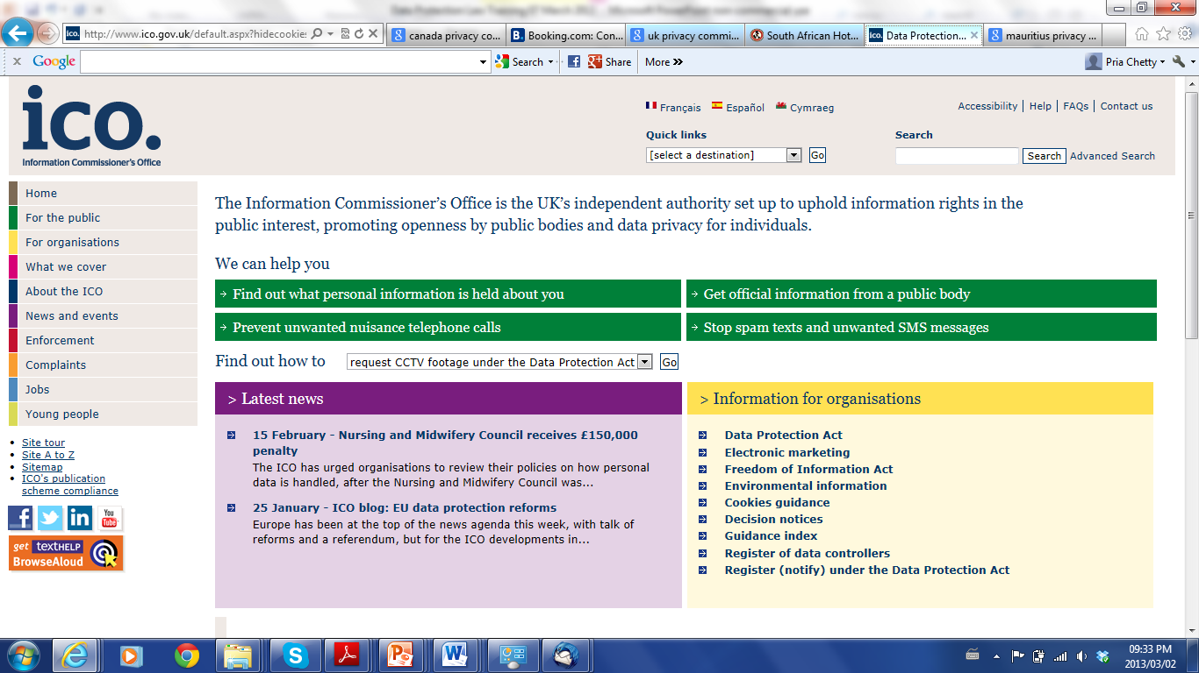
www.ico.gov.uk

Slide 65
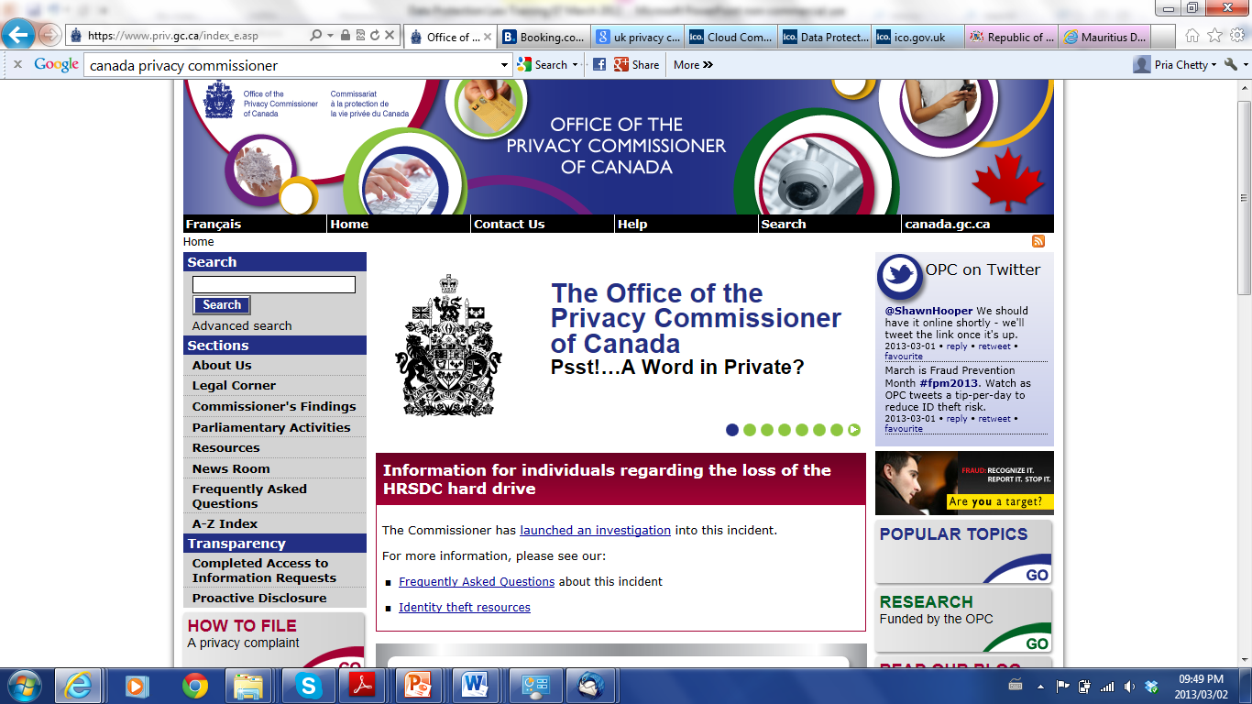
https://www.priv.gc.ca/index_e.asp

Slide 66
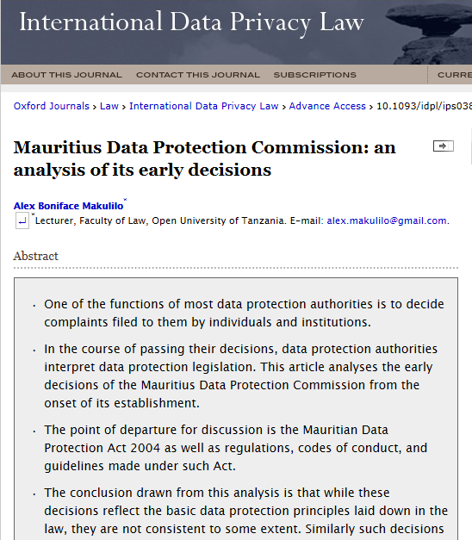
International Data Privacy Law (2013) doi: 10.1093/idpl/ips038 First published online: January 25, 2013

Slide 67
Thank You
Questions?
Pria Chetty
ITU International Expert: Data Protection
Baraka Kanyabuhinya
ITU National Expert: Data Protection

