Slide 1
HIPSSA Project
MINISTRY OF INFORMATION AND COMMUNICATIONS TECHNOLOGY (MICT)
TRANSPOSITION OF SADC CYBERSECURITY MODEL LAWS INTO NATIONAL LAWS FOR NAMIBIA, 2013
An Overview of the SADC Model Law on Electronic Transactions and Electronic Commerce
Support for Harmonization of the ICT Policies
in Sub-Sahara Africa
Notes:
Bonjour à tous,
Je suis tres heureux d‘être parmi vous aujourd‘hui.
Je voudrais remercier Mr. Kamdem pour son invitation a l‘atelier.
Permettez-moi de me presenter.
Je viens de rejoindre le bureau de regional de l‘UIT pour l‘Afrique d‘Addis Abeba pour coordonner le projet d‘harmonisation reglementaire de l‘UIT et de la CE en Afrique sub-saharienne
Je travaillais precedemment chez le regulateur français l‘ARCEP au service economique.
Je m‘occupais de travaux de modelisation technico-economique et j‘etais plus particulièrement en charge de l‘évaluation du cout du service universel et de la terminaison d‘appel mobile dans les departements français d‘outremer.

Slide 2

Legal barriers/uncertainties
1. Commercial rules: ink & paper
  Sign & write
2. Legal effect of a data message
  Systems are down

Slide 3

Enabling environment
1. Commercial rules: ink & paper
  Sign & write
2. Legal effect of an email
  Objective rules –
    Received; read
    Rules for risk allocation

Slide 4
GUIDING PRINCIPLES
FUNCTIONAL EQUIVALENCE
  Transposition of paper-based to electronic
Media neutrality
  Provisions not tied to a technology
Best practices

Slide 5
UNCITRAL ML UNCITRAL MLES UNCITRAL Convention
COMESA ML
Supplementary Law for Digital Transactions for ECOWAS
Legislation of SADC members UETA
ETA
UECA
Draft AU Cyber
security Convention
Common-
wealth Model Laws
OECD Guidelines
HIPCAR Model Law

Slide 6
I. GENERAL
ENABLING
II. Electronic transactions
III. E-commerce
IV. Consumer protection
V. Service provider liability
FIVE PARTS

Slide 7
GENERAL ENABLING
Ch1: Definitions & Interpretation
Definitions
Interpretation
Ch 2:
Legal Recognition
Legal recognition of electronic information
Legal recognition by parties
Ch 3:
Legal Effect
Sphere of application
Writing
Signature
Secure signatures
Incorporation by reference

Slide 8
Definitions
Definitions
  Automated message system
  Consumer
  DATA MESSAGE
  ELECTRONIC COMMUNICATION
  ELECTRONIC SIGNATURE
  INFORMATION SYSTEM / SERVICES
  Secure electronic signature

Slide 9
Electronic communication
Data message – information generated; sent; received or stored by electronic magnetic or optical means and includes
  EDI; e-mail; mobile video and audio recordings
Electronic communication: communication by means of data mesages

Slide 10

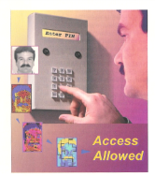
Definition: Electronic signature
Data attached to or logically associated with data indented to be signature
                +27833761560
                pistot@unisa.ac.za

Slide 11
Secure Electronic signature
  Signature duly recognised in terms of Regulations; created and can be verified through the application of security procedures that ensures that an electronic signature:
    Is unique to person using it;
    Capable of identifying person;
    Created using means – sole control;
    Linked to e-communication manner if altered, alteration detectable and/or signature invalid

Slide 12
INTERPRETATION & SPHERE OF APPICATION
Interpretation – reference to law – statutory, common law etc. Applicability
Scope: applies to all electronic transactions unless excluded
Nothing requires a person
  Agreement may be inferred
Party may set its own rules
Parties may vary

Slide 13
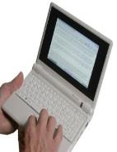

Legal effect: WRITING
Legal recognition
Requirement of writing met:
  data messages
  accessible in a manner usable for subsequent reference
Exclusions:
  Questionnaire

Slide 14
Legal Effect: Electronic signatures
Where law requires a signature - secure electronic signature
  Regulations: accredited authentication products or services
  Recognition of foreign signatures
  International technical standards
Parties – appropriate transaction

Slide 15
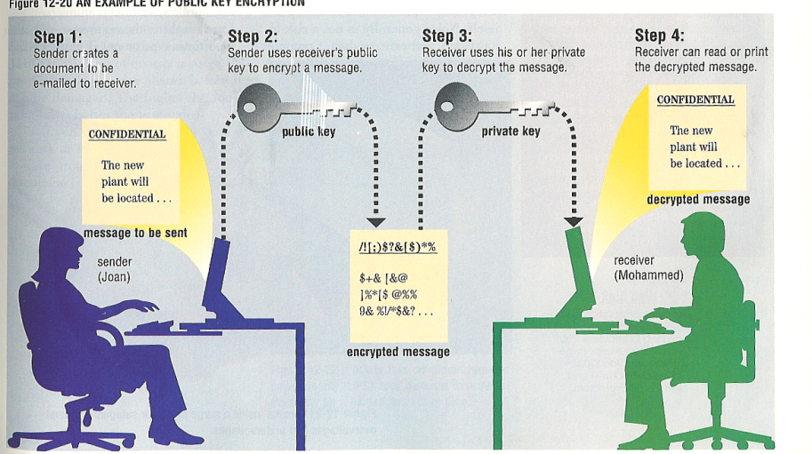

SIGNATURE
Law requires: regulations

Slide 16
Secure e-signatures
Excluded:
  Contracts – immovable property
  Contracts – long term lease
  Wills
  Bills of exchange
  Any other laws or statute as may be prescribed
Questionnaire

Slide 17

Incorporation by reference
Information not in public domain – referred to – deemed to be part of electronic communication
Standard terms; notices
Issues –
  Terms not visible
  Links down

Slide 18
ELECTRONIC TRANSACTIONS
Ch 4: Legal recognition
Formation & validity
Ch 5: Time & place
Variation by agreement
Time of dispatch
Time of receipt
Place of dispatch and receipt
Time of contract formation

Slide 19
Contract formation
Legal recognition of electronic transactions formed through e-communications
Invitation to make offers – UNECIC
Time and place of sending; receipt & contract formation;
Automated message system & natural person – no opportunity to correct errors – right to withdraw

Slide 20
ELECTRONIC COMMERCE
Ch 6: Attribution
Electronic communications
Ch 7: Electronic evidence
Original information
Production of documents
Secure electronic signatures
Record retention
Admissibility

Slide 21
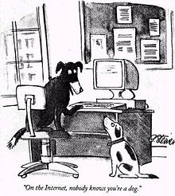
Peter Steiner The New Yorker 5 July 1993

Slide 22
Attribution
Electronic communications – that of originator if sent by:
  originator;
  Person that had authority;
  Info system programmed to operated automatically– malfunctioned
Secure signature:
  deemed applied holder
  deemed valid & applied properly

Slide 23
Electronic evidence
Admissibility & evidentiary weight
  Non-application of best evidence rule
  Factors evidentiary weight
Original
Retention of records
Production of documents

Slide 24

CONSUMER PROTECTION
Ch 8-10:
CONSUMER PROTECTION
  Obligations of suppliers
  On-line marketing

Slide 25
E-CONSUMERS
Obligations of suppliers
  Contact details; Description of goods/services – informed choice; Full price; Secure payment system; Terms - full record; review, correct & withdraw
Performance
Cooling off
    CONTRACTS EXCLUDED a-k (financial services; custom made; foodstuffs; on-line gambling; books etc.)

Slide 26

On-line marketing
Aka unsolicited commercial communications
  Opt in OR
  opt out – Questionnaire
Recent commercial transaction; similar
Not bound;
Penalties
SPAM

Slide 27
SERVICE PROVIDER LIABILITY
  On-line safe harbours
  Requirements
Ch 11: Service Providers

Slide 28


Service provider liability
Limitation of liability
  Mere conduit
  Caching
  Hosting
  Information location tools
No general obligation to monitor
Does not affect – contractual obligations; licensing/regulatory regime; additional rights to limitation of liability

Slide 29
Transposition objectives
Model Law - current 2010 Bill
Take note of national policy; existing legislation –
2010 Use of Electronic Transactions and Communications
Stakeholder inputs

Slide 30

QUESTIONAIRE
Exclusions
  Electronic writing and signing
  Additional?
SECURE SIGNATURES
  REQUIREMENTS
  Foreign signatures

Slide 31
QUESTIONAIRE
E-Consumers –
Cooling off right
NB: E-government services
  Own requirements production; signing; filing; etc. - Regulations
ISPs
  Representative body – all WASPS and ISPs

Slide 32
THANK YOU…QUESTIONS/DISCUSSION
Tana Pistorius
ITU INTERNATIONAL EXPERT
pistot@unisa.ac.za
Research Professor: UNISA
Union Internationale des Télécommunications International Telecommunication Union
Notes:
Merci de votre attention.
Je me tiens a votre disposition pour repondre a vos questions.
Je peux vous faire parvenir par email une version electronique de ce support de presentation.
Sachant que nous abordons tout juste le lancement de ce projet, les informations contenues dans cette presentation sont susceptibles a certaines evolutions.

