Slide 1
HIPSSA Project
MINISTRY OF COMMUNICATION, SCIENCE AND TECHNOLOGY (MCST)
TRANSPOSITION OF SADC CYBERSECURITY MODEL LAWS INTO NATIONAL LAWS FOR LESOTHO, 2013
CAPACITY BUILDING e-COMMERCE SADC Model Law on Electronic Transactions and Electronic Commerce
4TH APRIL 2013
Support for Harmonization of the ICT Policies
in Sub-Sahara Africa
Notes:
Bonjour à tous,
Je suis tres heureux d‘être parmi vous aujourd‘hui.
Je voudrais remercier Mr. Kamdem pour son invitation a l‘atelier.
Permettez-moi de me presenter.
Je viens de rejoindre le bureau de regional de l‘UIT pour l‘Afrique d‘Addis Abeba pour coordonner le projet d‘harmonisation reglementaire de l‘UIT et de la CE en Afrique sub-saharienne
Je travaillais precedemment chez le regulateur français l‘ARCEP au service economique.
Je m‘occupais de travaux de modelisation technico-economique et j‘etais plus particulièrement en charge de l‘évaluation du cout du service universel et de la terminaison d‘appel mobile dans les departements français d‘outremer.

Slide 2
CONTENTS
  SCOPE
  CASE STUDIES
  SOURCES
  CHALLENGES & RULES OF INTERPRETATION
  TRANSPOSITION

Slide 3
SCOPE
SERVICE PROVIDER ROLES & OBLIGATIONS
EVIDENCE RULES
  PRINCIPLE
  HOW IT IS APPLIED (CASE STUDIES)
  LESSONS LEARNED

Slide 4
Service Provider Roles
SADC MODEL (Part 10) & Draft LS Law Part IX & COMMUNICATIONS ACT (S44)
Message relay(Conduit)
Host (Avail 3rd Party Information for public access)
Cashing (3rd Party Information location & Temporary Storage)
No authority to Authenticate nor change contents

Slide 5
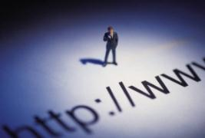
Mere Conduit
Mere conduit - Access to for for operating facilities for transmission, routing or storage of e-communications if:
  Does not initiate
  Or select recipient;
  automatic, technical;
  no modification

Slide 6
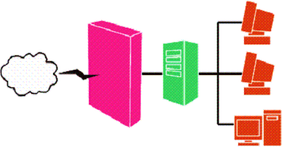
Caching: automatic intermediate storage of data
Does not modify; conditions of access; rules updating; rights management information; removes or disables access

Slide 7

Hosting
No knowledge;
no facts or circumstances; take-down upon receipt
Source: http://jumpdog.us

Slide 8

Information location tools
No knowledge; no facts or circumstances;
No financial benefits;
Removes access to link after info
Source: http://webchannel.ae/

Slide 9
APPLICATION
  CASE STUDY LIABILITY
  SERVICE PROVIDERS

Slide 10
LIABILITY – SERVICE PROVIDERS
  A Paris court dismissed a lawsuit against YouTube filed by French television, saying the video-sharing website was not obligated to control content of uploaded material
  Read more at: http://phys.org/news/2012-05-french-court-youtube-obligated-content.html#jCp

Slide 11
LIABILITY – SERVICE PROVIDERS
  YouTube cannot be held responsible for screening images uploaded on its site, a Spanish court said on throwing out a case brought by a local TV channel over alleged copyright infringement
  Read more at: http://phys.org/news204443124.html#jCp

Slide 12
EVIDENCE RULES
  SOURCES
  (e-documents)

Slide 13
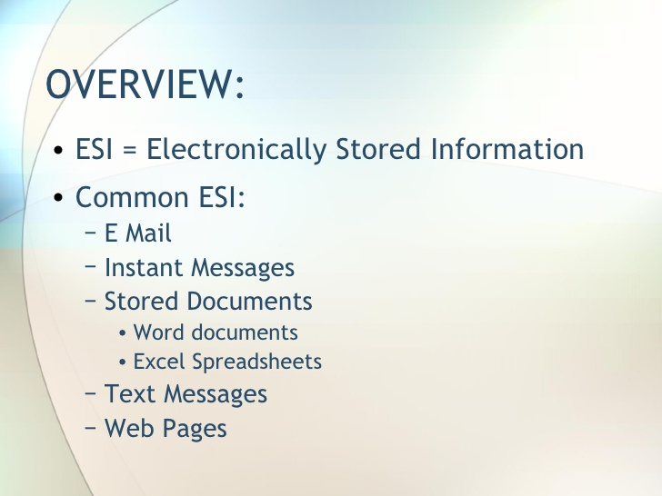
e-EVIDENCE

Slide 14
EVIDENCE RULES
  CHALLENGES
  CASE STUDIES
  &
  RULES OF INTEPRETATION

Slide 15
e-EVIDENCE (challenges)
RELEVANCE (does it prove existence of any fact?)
AUTHENTICATION (is it real?)
ORIGINAL FORM (has it been tampered with after creation?)
UNFAIR PREJUDICE (will its in-admission prejudice the case?)
HEARSAY (does deponent have 1st hand knowledge?)
BEST EVIDENCE (is it the best evidence in the circumstances?)

Slide 16
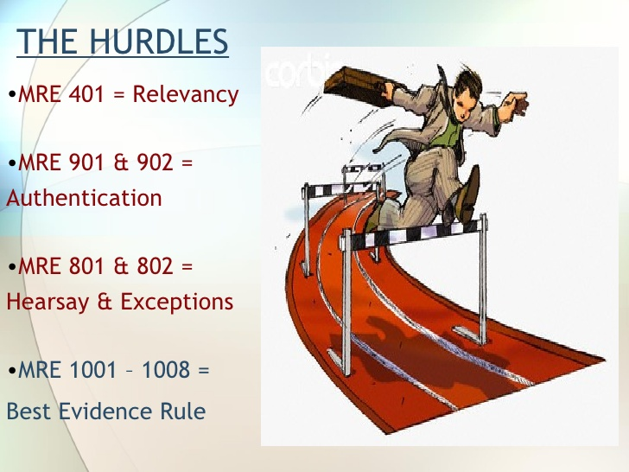
e-EVIDENCE (challenges - US)

Slide 17
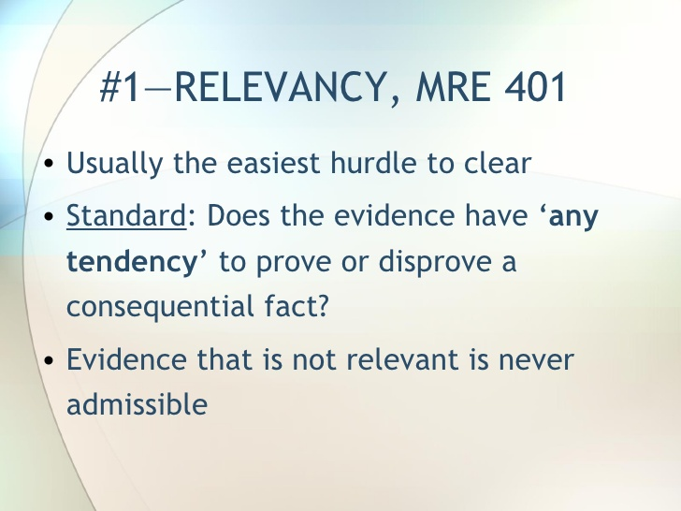
HOW ARE THE CHALLENGES ADDRESSED – Case Studies - US
  RELEVANCE
  SA – computer print out held correct & reliable (Gamede & Ors Vs the State – AR43/08)
  US – computer programs contained in computer discs (Gates Rubber Vs Bando Chemicals 1996

Slide 18
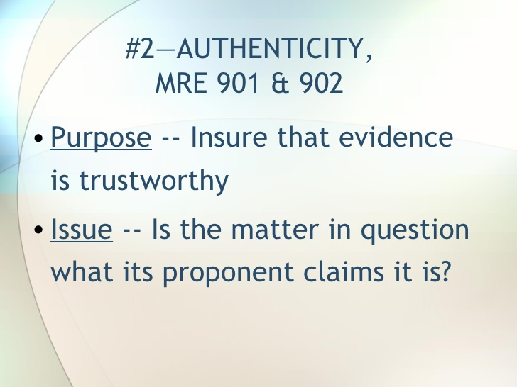
HOW ARE THE CHALLENGES ADDRESSED – Case Studies - US
  Authenticity

Slide 19
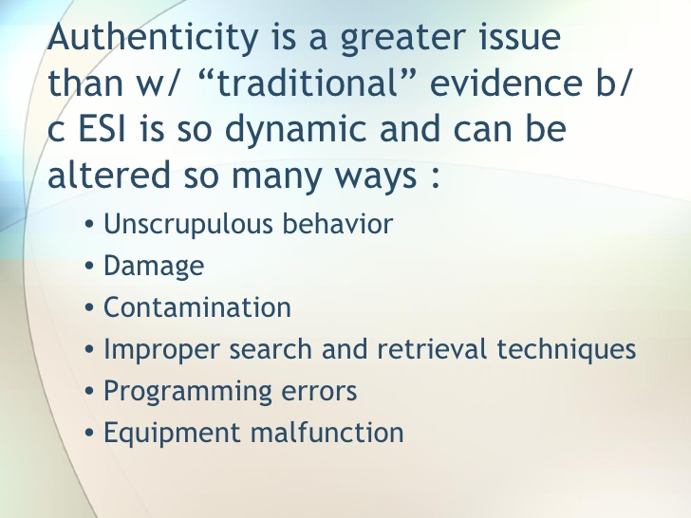
HOW ARE THE CHALLENGES ADDRESSED – Case Studies - US
  Authenticity

Slide 20
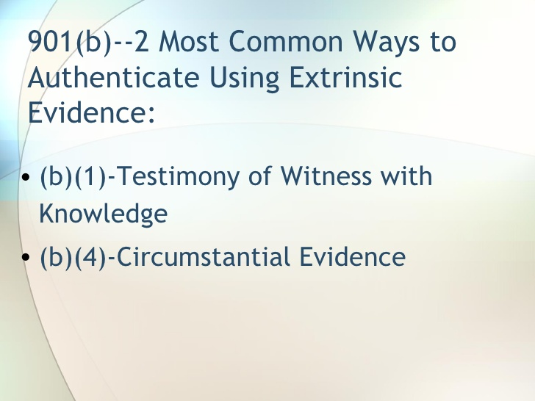
HOW ARE THE CHALLENGES ADDRESSED – Case Studies - US
  Authentication

Slide 21
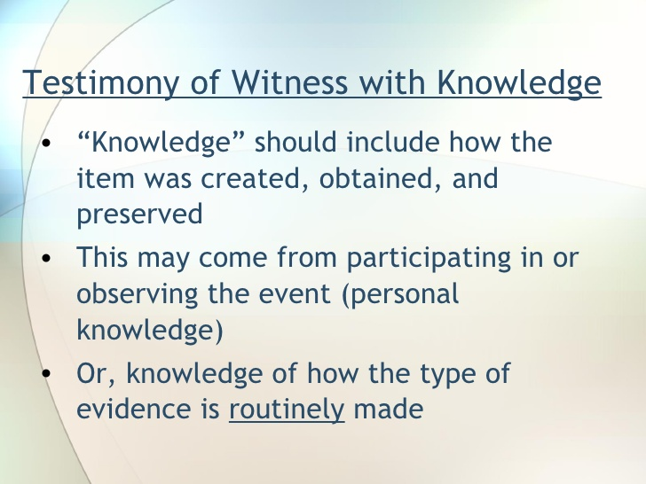
HOW ARE THE CHALLENGES ADDRESSED – Case Studies - US
  Authentication

Slide 22
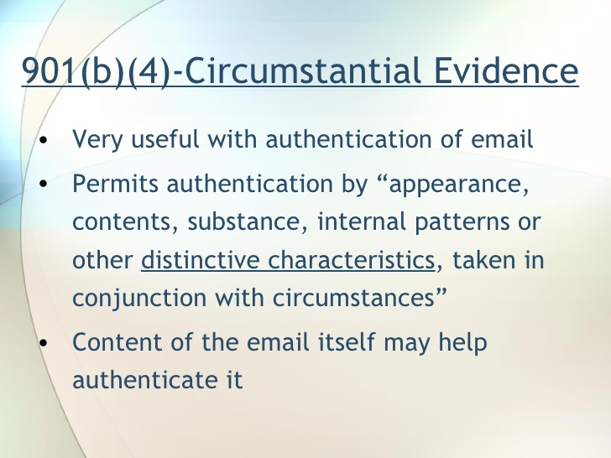
HOW ARE THE CHALLENGES ADDRESSED – Case Studies - US
  Authentication

Slide 23
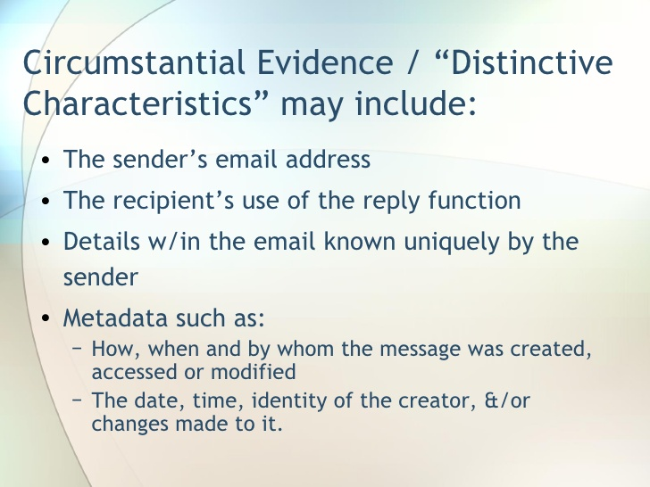
HOW ARE THE CHALLENGES ADDRESSED – Case Studies - US
  Authentication

Slide 24
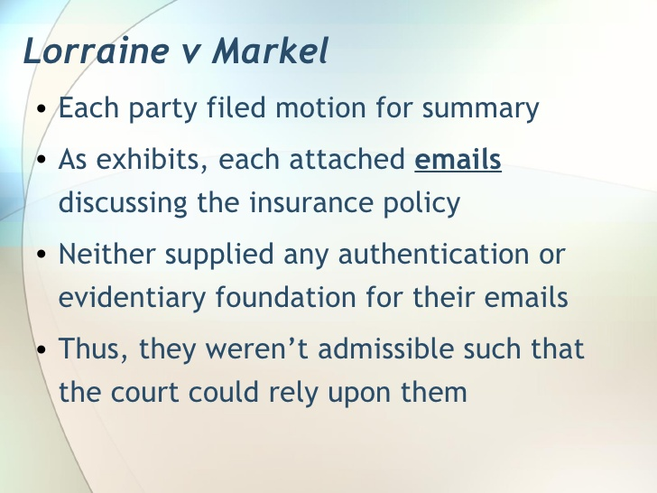
HOW ARE THE CHALLENGES ADDRESSED – Case Studies - US
  Authentication (rule)

Slide 25
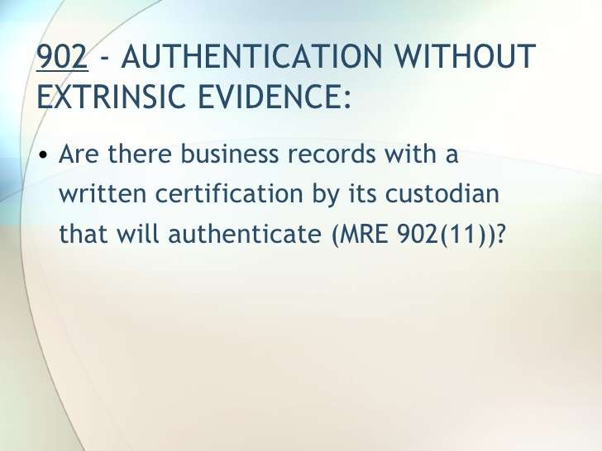
HOW ARE THE CHALLENGES ADDRESSED – Case Studies - US
  Authentication - business

Slide 26
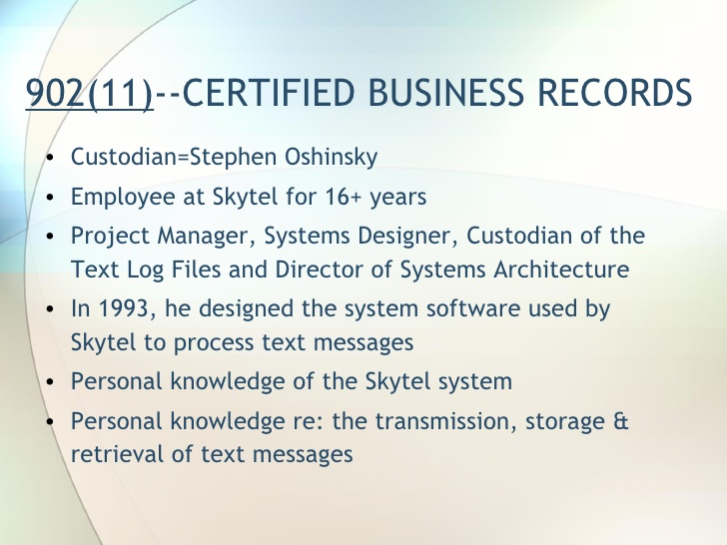
HOW ARE THE CHALLENGES ADDRESSED – Case Studies - US
  Authentication- business

Slide 27
HOW ARE THE CHALLENGES ADDRESSED – Case Studies - US
  Original Form
  information – not capable of tampering/change
  Chain of custody for the document
  Storage – controlled access

Slide 28
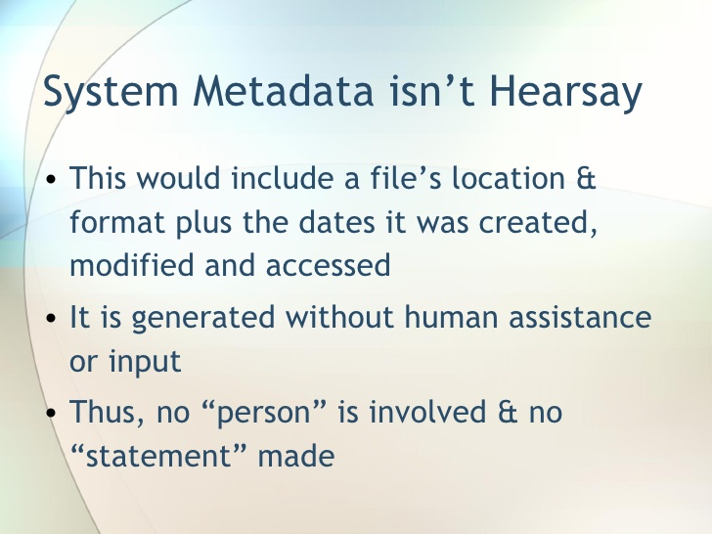
HOW ARE THE CHALLENGES ADDRESSED – Case Studies - US
  HEARSAY

Slide 29
HOW ARE THE CHALLENGES ADDRESSED – Case Studies Other
  HEARSAY (Tanzania Report)
The details on the stolen motor car were recorded on a card by the worker responsible and the completed card was photographed and recorded on microfilm. Decision; By a 3-2 majority, the house of Lord held that this evidence would be inadmissible for hearsay. As the prosecution had failed to produce evidence demonstrating reason why the workers responsible for making the original records could not give, there was no justification for admitting the microfilm.
R v. Spiby; Evidence from a Machine-generated documents showing phone calls being made from a certain Hotel Room in France to the defendant's telephone in England was admitted as evidence. Court argument: The hearsay rule does not apply to statements containing information recorded by a machine-There was no human intervention.

Slide 30
HOW ARE THE CHALLENGES ADDRESSED – Case Studies - US
  BEST EVIDENCE
  Duplicates admissible (where originals lost/destroyed or cannot be obtained by any judicial means/ process) unless
  – questions raised re authenticity & Originality
  If in the circumstances it would be unfair to admit them in lieu of originals

Slide 31
EVIDENCE RULES
  TRANSPOSITION SADC MODEL
  &
  DRAFT BILL

Slide 32
SERVICE PROVIDER LIABILITY
  SADC MODEL
  – RECONGNISES THE SAFE HARBOURS (CHAP 10 for conduit, hosting & cashing)
  DRAFT BILL
  LIMITATION OF LIABILITY SERVICE PROVIDERS (S.44, 45, 46 & 47)
  NO OBLIGATION TO MONITOR CONTENT (S.49)

Slide 33
EVIDENCE RULES
  RELEVANCE
  SUBSUMED IN ORIGINALITY RULE

Slide 34
HOW ARE THE CHALLENGES ADDRESSED
  AUTHENTICATION
  MODEL & DRAFT BILL (S.20)
  Established (business)if:
  communication is made by/on behalf in course of business & certified as correct & rules of law (common/self regulating codes) as evidence of facts contained
  Conditions to be met – reliability, integrity, identifiable manner of originator & reliable information systems
  Thakeli Vs Rex (manipulation of computer data – refuted expert witness with control over data )

Slide 35
HOW ARE THE CHALLENGES ADDRESSED
  AUTHENTICATION
  MODEL & DRAFT BILL
  Established (Other)
  NOT ADDRESSED – RELIANCE ON JUDICIAL INTEPRETATION
  See Thakeli Vs Rex - C of A(CRI) NO.10/2009 – (phone records authenticating link to accused through unique pin no’s assigned to employees)

Slide 36
SADC & LESOTHO PERSPECTIVE
  ORIGINALITY
  MODEL & BILL (S.19)
  Requirement is met if:
  reliable assurance on integrity
  capable of display in form to the person to whom it is presented
  Criteria – information unaltered
  Assessment – to take account of all relevant circumstances

Slide 37
HOW ARE THE CHALLENGES ADDRESSED
  INTEGRITY
  MODEL & DRAFT BILL (S.22)
  Maintained if:
  There is reliable means to ensure integrity of information & info is readily accessible & usable for subsequent reference
  Conditions – complete & unaltered save changes in course of communication, storage or display

Slide 38
HOW ARE THE CHALLENGES ADDRESSED
  UNFAIR PREJUDICE
  MODEL & BILL (S.20)
  Evidence not to be excluded
  (a)simply by virtue of being in electronic form(b)If it is best evidence available
  Weighting to consider
  (a)reliability of generation, storage or communicated (b)maintenance of integrity (c) identifiable originator

Slide 39
HOW ARE THE CHALLENGES ADDRESSED
  HEARSAY
  MODEL & BILL
  (NOT ADDRESSED – RELIANCE ON JUDICIAL INTEPRETATION)

Slide 40
HOW ARE THE CHALLENGES ADDRESSED
  BEST EVIDENCE RULE
  MODEL & DRAFT BILL
  (See Unfair Prejudice)

Slide 41
?…
Nthabiseng Motjolopane
ITU NATIONAL EXPERT
&
pistot@unisa.ac.za
Research Professor: UNISA
Union Internationale des Télécommunications International Telecommunication Union
Notes:
Merci de votre attention.
Je me tiens a votre disposition pour repondre a vos questions.
Je peux vous faire parvenir par email une version electronique de ce support de presentation.
Sachant que nous abordons tout juste le lancement de ce projet, les informations contenues dans cette presentation sont susceptibles a certaines evolutions.

Slide 42
THANK YOU…
Nthabiseng Motjolopane
ITU NATIONAL EXPERT
&
pistot@unisa.ac.za
Research Professor: UNISA
Union Internationale des Télécommunications International Telecommunication Union
Notes:
Merci de votre attention.
Je me tiens a votre disposition pour repondre a vos questions.
Je peux vous faire parvenir par email une version electronique de ce support de presentation.
Sachant que nous abordons tout juste le lancement de ce projet, les informations contenues dans cette presentation sont susceptibles a certaines evolutions.

