Slide 1
HIPSSA Project
Support for Harmonization of the ICT Policies
in Sub-Sahara Africa
TRANSPOSITION OF SADC CYBERSECURITY MODEL LAWS INTO NATIONAL LAWS FOR THE KINGDOM OF LESOTHO, 2013
.ls DNS and Doamin name regulalion
MINISTRY OF COMMUNICATION, SCIENCE AND TECHNOLOGY (MCST)
5th of April 2013
Notes:
Bonjour à tous,
Je suis tres heureux d‘être parmi vous aujourd‘hui.
Je voudrais remercier Mr. Kamdem pour son invitation a l‘atelier.
Permettez-moi de me presenter.
Je viens de rejoindre le bureau de regional de l‘UIT pour l‘Afrique d‘Addis Abeba pour coordonner le projet d‘harmonisation reglementaire de l‘UIT et de la CE en Afrique sub-saharienne
Je travaillais precedemment chez le regulateur français l‘ARCEP au service economique.
Je m‘occupais de travaux de modelisation technico-economique et j‘etais plus particulièrement en charge de l‘évaluation du cout du service universel et de la terminaison d‘appel mobile dans les departements français d‘outremer.

Slide 2

Introduction
Computers connected Internet Protocol (IP) addresses
Easier to remember computer names than IP addresses or numerical strings
  www.sabinet.co.za or 198.54.80.16?
First come-first-serve

Slide 3
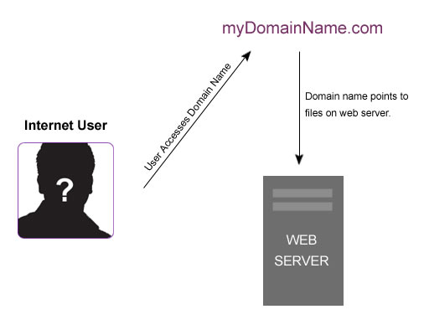
Domain name: web site
http://www.youtube.com/watch?feature=player_detailpage&v=2ZUxoi7YNgs

Slide 4

WHY
On-line presence
  Worldwide
  Unique
Open & closed systems

Slide 5
Levels of Domain names
246 million top-level domains
generic Top Level Domains (gTLDs) such as .com .gov .mil .cat .edu, - soon thousands
  Also regional gTLDs - .eu and .asia .AFRICA
ccTLDs
  .tz is the country code Top Level Domain (ccTLD) for Tanzania
co.ls & org.ls = second level domain (SLD or 2LD) of the .ls name space

Slide 6
Registries:
They run & maintain the registries
They have the skills & capacity
Registrars:
They sell & grow the .ls namespace

Slide 7
.ls Registry 1993
Sponsoring Organisation - National University of Lesotho
Administrative Contact - ICT Manager
Lesotho Communications Authority
Technical contact (Registry) - Rhodes University primary name server
2 private second-level domains .quadrant.ls and .nul.ls. The latter is used by the NUL

Slide 8

.ls Registrars
.ac.ls- (2000) academic or educational organisations NUL
.co.ls – (1999) commercial – Leo (Pty) Ltd
.net.ls – (2000) networks NUL
.gov.ls – (1999) Ministry
.org.ls – (1999) non-profit – Leo (Pty) Ltd
.parliment.ls (2005) Ministry
2 private SLDs - .quadrant.ls and .nul.ls. The latter is used by the NUL

Slide 9
.ls Domain Dame Space
Doain names
ccTLD – national asset – international recognition: GAC principles –
  http://youtu.be/BPHx87hysr0

Slide 10
Strings - GAC’s Beijing
Consumer protection
Strings - regulated market sectors
Competition issues
Strings inherent government functions and/or activities
Protection of geographic names
IP rights strings aimed at the distribution of music, video and other digital material

Slide 11
Communications Act 2012
General powers of the Authority
S 5(1) provides the power to the Authority to:
(w) Designate an entity to administer Internet domain names
Proper administration of the .ls DNS to benefit of citizens

Slide 12
Why intervention?
.ls DNS commissioned without clear framework
Ad-hoc policy & structure (SLD)
SLDs not operational
Lack of compliance with broader national priorities
Re-delegation to .ls entity – ICANN process
Zone file at RU

Slide 13
Regulations
.ls entity
Board of directors:
  Representative stakeholders
  staff;
  Finances - audits
  Annual reports

Slide 14
FUNCTIONS
Administer the .ls DNS
Comply with international best practices
License registries/central registry
Registrars licenses and operations according to charters

Slide 15
Functions (cont.)
Publish guidelines:
  General administration of .ls DNS
  Requirements/procedures for registration – contract
  Maintenance of public access to repositories
Public policy role -

Slide 16
Regulations/Directives
Objective standards for registries; registrars
Pricing policy
Open/closed second level-domains
Creation level second-domains
Resolution of rights owners /domain name disputes – ADR disputes

Slide 17
Cybersquatting
Squat illegally in cyberspace…
Peta v Dougherty
Peta = People for the Ethical Treatment of Animals
Peta.org

Slide 18

National ADR
Nominet – UK
Australia .au ADR
New Zealand
South Africa chapter in ECT Act: Zadna non-profit company; control of Minister of Communications
Accredited 2 providers
  SAIIPL & NAF

Slide 19






Complainant
4
4
1
2
3
1
4
4
Adjudicator
1
4
2
3
Registrant

Slide 21
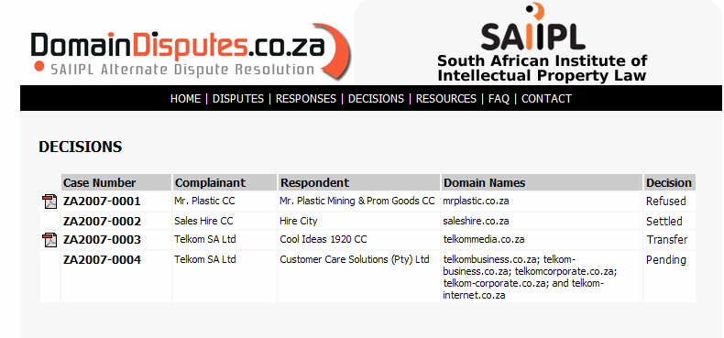
DECISIONS OF THE ARBITRATOR
An Arbitrator may make the following decisions :
REFUSE DISPUTE ( e.g. No merits in claim, reverse domain name high jacking etc.)
TRANSFER DOMAIN NAME ( e.g. Cyber squatting, Passing off ,Typo Squatting etc.)
MAKE SETTLEMENT A BINDING DECISION ON PARTIES

Slide 22




Badge of origin; Distinctive Use in commerce | Identifier of IP address Generic, descriptive Commercial or non-commercial
Territorially based Same mark different goods or services | Global gTLD or ccTLD Unique - First come first serve Cybersquatting Typo-squatting

Slide 23



People Eating Tasty Animals is in no way connected with, or endorsed by, People for the Ethical Treatment of Animals.
Individuals and organizations whose names appear here do not necessarily endorse the contents of this page.
A resource for those who enjoy eating meat, wearing fur and leather, hunting, and the fruits of scientific research (and more!).
Meat | Leather | Fur | Taxidermy | Hunting | Fishing
Pets | Research | Miscellaneous |  | Comments | Hate Mail

Slide 24
Limits of tm remedies
Peta’s problem…
Use in course of trade: passive holding or non-use
Use in relation to unrelated goods/services or non-commercial use?
Only one domain name registration not differentiation of different proprietors for identical marks for different goods / services conflicting marks – eg Exel /Excel

Slide 25
People Eating Tasty Animals is in no way connected with, or endorsed by, People for the Ethical Treatment of Animals.
Individuals and organizations whose names appear here do not necessarily endorse the contents of this page.
A resource for those who enjoy eating meat, wearing fur and leather, hunting, and the fruits of scientific research (and more!).
Meat | Leather | Fur | Taxidermy | Hunting | Fishing
Pets | Research | Miscellaneous |  | Comments | Hate Mail

Slide 26
Limits of tm in the on-line world
Use in course of trade: passive holding or non-use
Use in relation to unrelated goods/services or non-commercial use
Only one domain name registration not differentiation of different proprietors for identical marks for different goods / services – eg. Exel/Excel Prince/Prince
Cybergriping

Slide 27

Protest sites
Telkomsucks.co.za
F*cktelkom.co.za
Hellkom.co.za
Tarnishment?

Slide 28
ICANN 1999: UDRP
4(a)(i) Identical or confusingly similar
4(a)(ii) Registrant no rights or legitimate interests
4(a)(iii) Registered in bad faith
  Intention to extort
  Registered to prevent the use of the TM as a DN
  For commercial gain
2008 2 329 WIPO adjudications 1 085 NAF

Slide 29

4(a)(i) Identical or confusingly similar
Disregard punctuation design elements
Punctuation/spelling
  www.Joecatoon.com = www.JoeCarton.com
  standerdbank.co.za = standardbank.co.za
  Typo squatting: Jews for Jesus v Brodsky
  E.g. JewsForJesus.com =
  Jews f r Jesus

Slide 30

Addition of generic/descriptive words
www.vogueMag.com

Slide 31

UDRP 4(a)(iii) Registered in bad faith
  Registered to prevent the use of the TM in a DN
  For commercial gain
    Landing pages – click income
ZA2007-0007 fifa.co.za.
  Not the extent to which the registration will prejudice FIFA’S funding of WORLD CUP tournaments, licensing and franchising efforts, but the potential for it to do so

Slide 32



madonna.com
Madonna Cicone p/t/a Madonna v Dan Parishi
Madonna – dictionary meaning
Disclaimer – Madonna; Church; Madonna Hospital
Not bona fide offering of goods & services
  Intentionally trade on another’s fame
DN transferred

Slide 33

Legitimate Interests/ Lack of bad faith
Lack of bad faith registration:
  No knowledge of mark; without intent to take advantage of Complainant’s rights;
Lack of bad faith use: bona fide offering of goods or service
  Complete lack of evidence that the DN – generic term – related in any way to Complainant’s mark (kiwi polish v kiwi search engines)

Slide 34

G. A. Modefine S.A. v. A.R. Mani
Case No. D2001-0537
"ARMANI" "GIORGIO ARMANI" "EMPORIO ARMANI"
Anand Ramnath Mani is the Respondent’s real name
No evidence that Registrant used domain name to take advantage /no evidence of confusion
No basis to peruse Complaint
Facts not disclosed
http://marketing.blogs.ie.edu/archives/2007/09/armani_goes_onl.php

Slide 35
Conclusion
DNS plays an important part in Lesotho’s ICT
Compelling policy imperatives for the management of the .ls DNS
Regulations should be adopted for
  Authority; responsibilities regisrty; registrars and policy directives
  ADR proceedings and accreditation of providers

Slide 36
THANK YOU…
Tana Pistorius
ITU INTERNATIONAL EXPERT
pistot@unisa.ac.za
Research Professor: UNISA
Union Internationale des Télécommunications International Telecommunication Union
Notes:
Merci de votre attention.
Je me tiens a votre disposition pour repondre a vos questions.
Je peux vous faire parvenir par email une version electronique de ce support de presentation.
Sachant que nous abordons tout juste le lancement de ce projet, les informations contenues dans cette presentation sont susceptibles a certaines evolutions.

