Slide 1
HIPSSA Project
Support for Harmonization of the ICT Policies in Sub-Sahara Africa
TRANSPOSITION OF SADC CYBERSECURITY MODEL LAWS INTO NATIONAL LAWS FOR THE KINGDOM OF LESOTHO, 2013
Overview of the Electronic Transactions and Communications Bill
MINISTRY OF COMMUNICATION, SCIENCE AND TECHNOLOGY (MCST)
4th of April 2013
Notes:
Bonjour à tous,
Je suis tres heureux d‘être parmi vous aujourd‘hui.
Je voudrais remercier Mr. Kamdem pour son invitation a l‘atelier.
Permettez-moi de me presenter.
Je viens de rejoindre le bureau de regional de l‘UIT pour l‘Afrique d‘Addis Abeba pour coordonner le projet d‘harmonisation reglementaire de l‘UIT et de la CE en Afrique sub-saharienne
Je travaillais precedemment chez le regulateur français l‘ARCEP au service economique.
Je m‘occupais de travaux de modelisation technico-economique et j‘etais plus particulièrement en charge de l‘évaluation du cout du service universel et de la terminaison d‘appel mobile dans les departements français d‘outremer.

Slide 2
OVERVIEW
CRYPTOGRAPHY & SIGNATURES
OBLIGATIONS OF ON-LINE TRADERS:
Information to be made available
Automated transactions

Slide 3
CRYPTOGRAPHY AND SIGNATURES

Slide 4
Cryptography
Purpose of Cryptography:
That such data or ELECTRONIC COMMUNICATIONS can be accessed or put into an intelligible form only by certain persons.
That the authenticity or integrity of such is capable of being ascertained,
The integrity of the data of data message;
That the source of the data or data message can be correctly ascertained.

Slide 5
Registration
Wide net – provided to persons in Lesotho; used in Lesotho etc.
S.28 (REGISTRATION)
S.29 (COMPULSORY REGISTRATION)
cryptography services providers
Information in the register:
used to and may lead to a successful tracing of a cryptography user, or
assist a law enforcement officer in obtaining a decryption court order

Slide 6
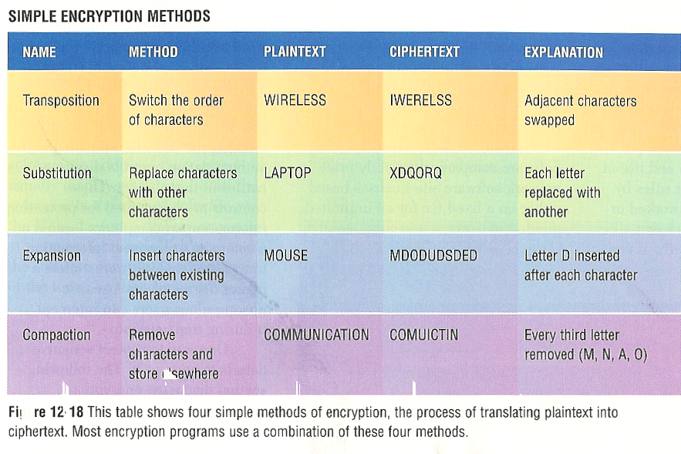
Encryption methods

Slide 7
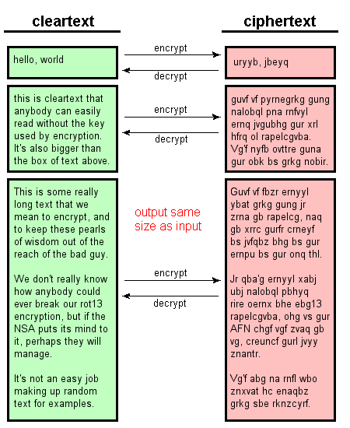

Slide 8
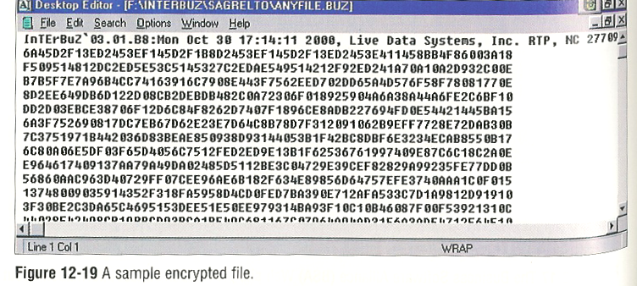
Encrypted text

Slide 9
Electronic signatures
Data logically associated, attached to incorporated in an electronic communication intended by user to serve as signature
Electronic signatures all technologies:
digital pen, PIN codes, scanned signatures, password

Slide 10
Electronic signatures
Data attached to or logically associated with data indented to be signature

Slide 11
SIGNATURE Lesotho Bill(S.9)
Where law requires signature of a person an electronic signature will be deemed to be valid , provided the electronic signature meets the requirements as prescribed by Regulation

Slide 12
Definition of a secure electronic signature
Uniquely linked to user
Capable of identifying user
Created using means maintained sole control of user
Linked to electronic communication in such a manner subsequent changes noted

Slide 13
SIGNATURE
Where a secure electronic signature is used, it is regarded as being valid and properly applied, unless the contrary is proved.

Slide 14
DRAFT BILL PROVISIONS
Electronic Signatures (S.9)
Not to be denied legal effect simply by virtue of their electronic nature
Conditions are satisfied if:
Identification and intention regarding the signature;
At the time the method was used it was as reliable as was appropriate
Parties may agree to use the method they deem appropriate

Slide 15
Electronic signature technology
Single key encryption
Public key encryption
Biometric recording

Slide 16
Biometric recording
Pen & digitising pad hard copy signature
Data records biometric characteristics e.g. speed acceleration & verified against biometric signature data
Numerical identifier encrypted with biometric signature data
Also fingerprints, retina prints etc.

Slide 17
Example Public Key Encryption

Slide 18
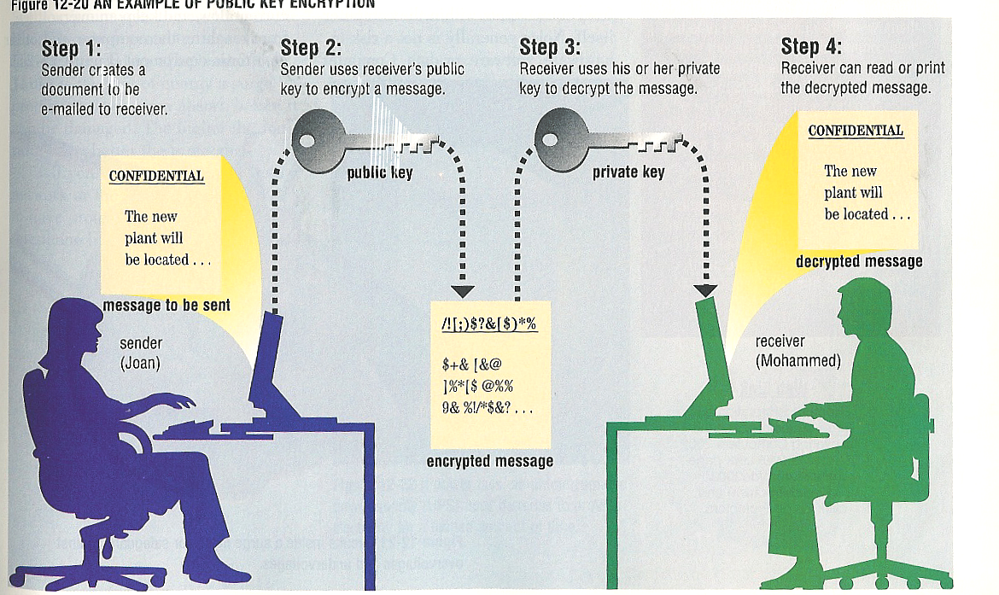
Public Key Encryption

Slide 19
Create digital signature
Encrypt the hash (message digest) 1A01B56EB33FA84A 39EEDDD927977726 38331E94
Use RSA method:
n = number 1024 bits long, which is the same as 128 bytes, similarly for d
So what we are planning to do is to raise the hash to the power d, then take the result modulo n.

Slide 20
correct the spelling of "withdrawal".
Hash Function: MD5
Hash value: 8BDF43C9BC320AE8
Message digest: 874E9EED73DDCF55
Previous message digest: 1A25CF6990F82C0RIPEM128

Slide 21
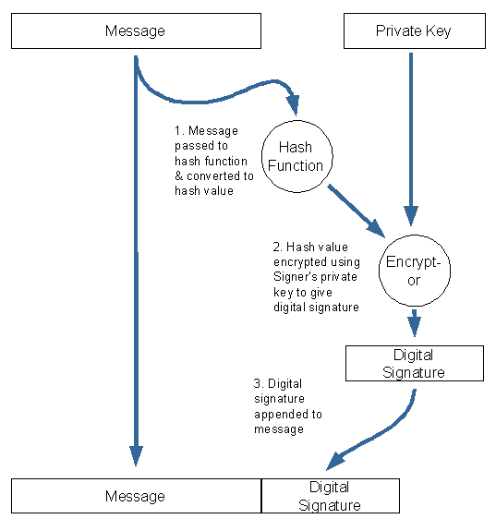
Signing: Private key

Slide 22
Digital signature
sig =149522ECA960A6B4 A46F1546B6D5F74B C3570CD7DD981EA10B506B346FB159BE 7F7BAA26F6A8A143 090B4D0A944AE4D796C17A4587267B05 A991D76EDE989583 9E47C19054CDB8185BD21EE36BAC9803 CE005383A1083AB5 79411AB26BE286311BF17D021002B6D5 2EE82CEB2FC554A8 BDE5874D82B20B9F21EBD65F5FD93102
This is the digital signature that is sent along with the letter to Senator Till to verify its authenticity, as well as the identity of the signer.

Slide 23
Recipient verify the signature
hash* = 1A01B56EB33FA84A 39EEDDD927977726 38331E94 if nothing in the message was altered. Next he compares hash* to the decrypted value of sig to see if they are the same.
To decrypt sig, he looks up Greater Caribbean Bank's public key (e,n), see if it corresponds

Slide 24
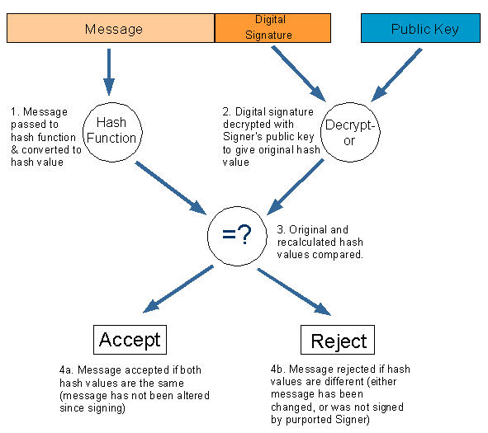
Verification

Slide 25
Public Key Encryption

Slide 26
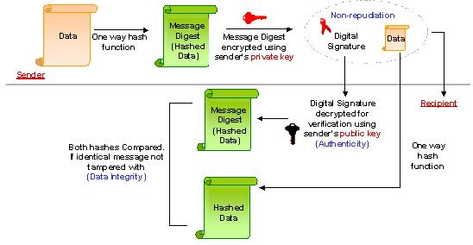
Illustration

Slide 27
Value
Digital & Electronic Signatures’ advantages:
authenticates and identifies e-commerce parties;
authorises transactions;
provides proof of messages sent &
verifies integrity of info sent over Internet

Slide 28
Value of Secure signatures
Authentication product = accredited, the status of the electronic signature it supports changes to that of advanced electronic signature. This process leads the way in ensuring that electronic communications take place confidentially while at the same time ensuring authenticity, non-repudiation and that the integrity of the communication remains intact.

Slide 29
Obligations of on-line traders
Offering goods & services by way of electronic transaction

Slide 30
Consumer = any
person who uses
information system
services to purchase
or offer to purchase
goods otherwise than
for the purpose of
resale

Slide 31
Information to be made available (S.37)
11 pieces of info, e.g
Full contact details place of the business; e-mail address and telefax number;
Full information re goods or services, quality and characteristics – informed decision;
The full price, additional costs such as transport and taxes;
Payment systems;
Terms of agreement & manner access & full record
Us | Contact Us | Price List | Terms and conditions

Slide 32
Links to terms & conditions: Incorporation by reference
Information incorporated into an agreement is regarded as having been incorporated into an electronic communication.
Best practices for incorporation: Ticket cases

Slide 33
Ticket cases:
Was notice of kind expected
Binding if clear, even if not read
T&C on tickets binding agreement

Slide 34
Were terms expected?
Yes
No
Would reasonable person have
noted the incorporation?
Not bound
Yes
No
Bound whether terms
were read or not.

Slide 35
Best practices links:
Referred to in a way in which a reasonable person would have noticed the reference thereto and incorporation thereof
Font size / colour
Place on web page

Slide 36
Example
New Tariffs New Telkom tariffs w.e.f. 1 August 2007... more>>Buy a PC from Telkom! Buy a PC on your Telkom account for as little as R219.37 per month... more>>Telkom PrepaidFone Waya-Waya Stay connected all year for R120 and ringa waya-waya more>>Moving home? Now Telkom SmartMoves has an easy to use service to inform your friends and family your new contact details in one go!....... more>>Let your opinion be heard... Have your say and earn exciting rewards... more>> Home |PAIA |Terms & Conditions |Proudly South African © Telkom SA Limited. 2007. All Rights Reserved

Slide 37
© IN TERMS OF SECTION 11 OF THE ELECTRONIC COMMUNICATIONS AND TRANSACTIONS (ECT) ACT 25 OF 2002 AND THE COMMON LAW OF CONTRACT, THESE TERMS AND CONDITIONS ARE VALID, BINDING AND ENFORCEABLE AGAINST ALL PERSONS THAT ACCESS THE TELKOM WEBSITE, WEB PAGES OR ANY PART THEREOF.
IF YOU DO NOT AGREE TO BE BOUND BY THESE TERMS AND CONDITIONS YOU MAY NOT USE THE TELKOM WEBSITE. REASONABLE USE OF THE TELKOM WEBSITE SHALL AUTOMATICALLY BIND THE USER TO THIS AGREEMENT.
DEFINITIONS AND INTERPRETATION
Hyperlinks herein to legal documents should be deemed part of these terms and conditions in terms of section 11(3) of the ECT Act. The fact that some or all of the hyperlinks may, from time to time, be non-operational, shall not affect the validity and interpretation of these terms and conditions.
f) Telkom's Standard Terms and Conditions for the provision of Public Switched Telecommunication Services (also referred to as the "Abridged Conditions of Contract")". Please click here to access the
Abridged version
as well as the complete set of Terms and Conditions.
Online Bill Terms and Conditions
Ease-e-Bill Terms and Conditions

Slide 38
Validity?
Hyperlinks herein to legal documents should be deemed part of these terms and conditions in terms of section 11(3) of the ECT Act. The fact that some or all of the hyperlinks may, from time to time, be non-operational, shall not affect the validity and interpretation of these terms and conditions.

Slide 39
Best practices links:
Referred to in a way in which a reasonable person would have noticed the reference thereto and incorporation thereof
Font size / colour
Place on web page
Links MUST work

Slide 40
Transacting with electronic agents

Slide 41
Automated transaction (S.16)
“Automated transaction" VALID means an electronic transaction conducted by electronic agents
Website transaction
Electronic communication
Not reviewed

Slide 42
E-shopper keystroke error (S.17)
No legal effect where a natural person interacts directly with the automated message system and has made an error and­—
(i) the automated message system did not provide that person with an opportunity to correct the error;
Return or destroy the consideration in accordance with instructions – benefit materially

Slide 43
Consumer Remedies (S. 37)
If supplier fails to provide (1) all the information or (2) the opportunity to review and correct:
Purchaser may cancel within 14 days after receipt of goods or services
If cancelled consumer must return performance/cease using service
Supplier: refund minus direct costs of returning goods
Right of Review/correction & withdrawal

Slide 44
Cooling-off period (S.39)
Cancel without reason, and without penalty
any transaction and related credit agreement:
Goods: within 7 days of receipt
Services: 7 days after conclusion of agreement
Where payment has already been made prior to cancellation, Consumer is only liable for the cost of returning the goods
The consumer is entitled to a full refund – must be made within 30 days from date of cancellation

Slide 45
Excluded from cooling off: Corporate consumers
Financial Services, investment services and banking, insurance and re-insurance; securities
Auctions
Supply of foodstuff, beverages
Personalized goods or deteriorate or expire
Unsealed audio or video recordings or computer software.
Sale of newspapers, periodicals, magazines or books.
For provision of gaming and lottery services.
Provision of accommodation, Transport; Catering or leisure services – dates;
Minister - regulations

Slide 46
Exclusion of rights
Apply to all traders based in Lesotho– place of business; incorporated;
Protections are applicable to all consumer transactions despite the applicable legal system.
Public policy

Slide 47
Website compliance
Interface design: information given
Links must be “up”
Opportunity to prevent & correct errors
Secure payment mechanism – update regularly
Cooling off
May not exclude consumer rights

Slide 48
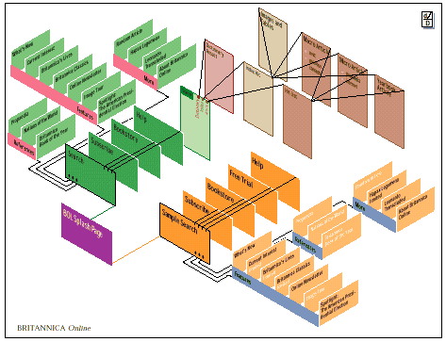
Website design
Information
Links
Security
Errors: review & confirmation of correctness
Transactional interface
T&C Content; Manner of display; copy T&C - audit of applicabe terms& time lag

Slide 49
THANK YOU…
Tana Pistorius
ITU INTERNATIONAL EXPERT
pistot@unisa.ac.za
Research Professor: UNISA
Union Internationale des Télécommunications International Telecommunication Union
Notes:
Merci de votre attention.
Je me tiens a votre disposition pour repondre a vos questions.
Je peux vous faire parvenir par email une version electronique de ce support de presentation.
Sachant que nous abordons tout juste le lancement de ce projet, les informations contenues dans cette presentation sont susceptibles a certaines evolutions.

