Slide 1
HIPSSA Project
Support for Harmonization of the ICT Policies in Sub-Sahara Africa
Mandla Msimang, ITU Expert
DAY 2: COUNTRY CASE STUDIES
TANZANIA

Slide 2
Legal Mandate and Institutional Framework
Legal Mandate: clear legal mandate in the law to support or address the concept of Universal Access and Service (UAS)
2003 National Information and Communications Technology (ICT) Policy - universal access a key policy issue, i.e. “bringing access to the more remote areas of the country and those under served in urban areas.”
2006 Universal Communications Service Access Act - sets the legal framework for establishing a USF, the Universal Communications Service Access Fund, in Tanzania (also referred to in this presentation as “UCAF Act”).
2010 EPOCA – folows on this and setion 17 provides that “an individual licence shall include terms and conditions set by the Authority including quality of service, licensed area… universal service obligation…”

Slide 3
Legal Mandate and Institutional Framework
Good governance
EPOCA
requirement to hold a public enquiry before a decision to “grant, renew or cancel a licence with an exclusivity period or universal service obligation” or before adopting a “code of conduct” .
annual consultative process “with such persons and organizations as the [regulator] may consider necessary or desirable to consult for the purpose of effectively carrying out its functions” is mandated .
a “public register” of regulatory information and decisions is required to be kept and made available .
UCAF Act
Constitution and Appointment of of Board (Part III)
Code of Conduct
Conflict of interest
Removal of Board members
Accounts and financial audits
Performance Audit

Slide 4
Legal Mandate and Institutional Framework
Policy Co-ordination: The law/legal mandate provides for coordination of policies at national level (UAS is coordinated with ICT4D, ICT4E, national poverty reduction strategies, MDG, cyber strategies, etc.)
No overall legal requirement for UAS policy co-ordination, BUT the regulator is required to “establish and maintain a system of coordination, cooperation and consultation” with the broadcasting regulator and any other similar bodies .

Slide 5
Legal Mandate and Institutional Framework
Range of Services: Legal mandate and institutional framework cater for Internet, broadband and broadcasting services in addition to fixed and mobile voice services
EPOCA
universal communication services are defined as “a defined minimum set of communications services of specified quality which is available to all users independent of their geographical location, and in the light of specific national conditions, at an affordable price.”
UCAF Act
“universal service” in UCAF Act holds exact same definition as “universal communicaion service” in EPOCA
TCRA is responsible for postal, electronic communications or content services, which could reasonably be interpreted to include broadcasting, Internet and broadband.

Slide 6
Legal Mandate and Institutional Framework
Consultation: The law/legal mandate clearly directs the ministry to develop a UAS Policy after consultation with relevant stakeholders
The 2010 EPOCA and the UCAF Act place no requirement for the development of an overall national UAS policy.

Slide 7
Legal Mandate and Institutional Framework
Accountability: The law clearly mandates the regulator or identifies a designated agency for the implementation of the UAS Policy and clearly specifies its mandate
The 2006 Universal Communications Service Access Act makes UCAF responsible for a range of UAS issues and interventions.
UCAF is overseen by a Board (Chairman, 8 Non-Executive Members, Manager) which is appointed by the Minister and includes, private sector, TCRA, Consumer representative, amongst others (Section 7)
Manager appointed by the Minister (Section 9)

Slide 8
Objectives, Principles and Scope
UAS Goals: Basic definition of US and US Areas…
UCAF Act:
Although ‘universal services’ is defined in the 2006 Universal Communications Service Access Act, no clear distinction is drawn between it and universal access.

Slide 9
Objectives, Principles and Scope
A series of objectives of USF are specified in the law, including (Section 5) of UCAF Act:
ensuring the “availability of communication services in rural and urban under-served areas”;
promoting the “participation of the public and private sector in the provision of universal service”;
creating a “framework for an open and efficient access to and use to and use of communication networks and services”; and
promoting “widespread provision of quality services at affordable rates”

Slide 10
Objectives, Principles and Scope
Range of Services: Services beyond fixed and mobile voice (Internet / broadband / broadcasting) are included
Broadcasting, the Internet and broadband are not specifically included, but the definition of communications services is sufficiently wide to as to enable their inclusion at the discretion of the regulator.
Periodic Review: Periodic review of Universal Access and Service objectives, principles, scope, targets and obligations is provided for
The 2006 Universal Communications Service Access Act does not mandate a periodic review of UAS parameters.

Slide 11
Variety of Strategies and Policies
USOs:
2006 UCAF Act provides for the imposition of USOs upon designated “universal service provider[s]” to roll out networks and provide services in “specified universal service area[s]” or nation-wide”

Slide 12
Variety of Strategies and Policies
Liberalisation:
Tanzania has put in place a number of elements of telecommunications reform,
establishing a sector regulator, amongst whose mandated objectives was to “promote competition in providing for telecommunication and postal services” and whose authority includes the “power of licensing and regulating telecommunication systems and services”
2005 - adopted a converged and open licensing framework,
Over 13 network facilities, 13 network services, 61 applications services, 45 radio content services, and 27 TV content services .
Major providers of telephony services include: Vodacom, Airtel, Tigo, Zantel and TTCL.

Slide 13
Variety of Strategies and Policies
Strong Regulatory Framework: Flexible Spectrum Policy, Effective Competition Law/principles (control of dominance), Access and Interconnection (including local loop unbundling, asymmetric interconnection), Co-location and Infrastructure Sharing
TCRA an established regulator
Pro-competition approach
Clear mandate between UCAF and TCRA
Converged regime

Slide 14
Variety of Strategies and Policies
Funding: the definition of a range of UAS financing mechanisms, including the establishment of a Universal Service Fund;
2006 Universal Communications Service Access Act 2006 does not provide clear criteria for determining which operators are subject to universal service obligations in Tanzania.
Although the law provides that the USF may “designate an operator as universal service provider”, it specifies no criteria from doing so, and merely defines a universal service provider as “a person designated to provide universal services”.

Slide 15
Variety of Strategies and Policies
Supply-side Innovation:
provisions that allow for interconnection and access provisions to be included in licences, and to regulate tariffs.
Much of the funding undertaken by UCAF is intended to increase the supply of networks and services.
Converged licensing regime has also helped to increase the supply of ICT networks and services,
Demand-side Innovation:
No specific demand-side innovation strategies are provided for in terms of the legislation. Although projects exist….

Slide 16
Monitoring, Enforcement and Sanctions
Key elements
Scope of USOs:
“who” to be determined by UCAF
Review Process:
There is no full and formal review process around USOs required in terms of the 2006 UCAF Act, although there is a requirement to “conduct research into and keep abreast of developments in the rural and urban under-served areas regarding communication services and information technologies”

Slide 17
Monitoring, Enforcement and Sanctions (2)
Differentiation:
There are no criteria for distinguishing between operators in respect of USOs
UCAF is however required to “designate universal service providers with obligation to provide universal service in accordance with laid down criteria” , the development of such criteria is left up to the UCAF.
Publication of Obligations
Every designated “universal service provider” is required to submit to the USF for approval a “policy statement” and “ project proposal” , setting out how the imposed USO will be met. This approval process and its requirements are set out in some detail in the Act.

Slide 18
Monitoring, Enforcement and Sanctions (3)
Monitoring:
UCAF monitors progress
UCAF has the “right to request any person to submit any information for the purpose of carrying out its functions”
UCAF must “publish the performance of the universal service provider required to meet the services targets” set out in the USOs (s17).
Act makes no specific provision for penalties to be imposed if a universal service provider fails to meet the required targets. All that is set out is the requirement to “establish compensation schemes in the event of failure... to meet the [supply-time and QoS] targets” set out in the USOs. (s 13(3))

Slide 19
Financing of UAS
Range of Mechanisms
The 2006 Universal Communications Service Access Act establishes the UCAF as the primary financial mechanism to support UAS, both through subsidising USOs and through support for UAS projects.
Funding Criteria
Much of the funding via the UCAF is directed at ‘universal service providers’ to support and subsidise their delivery on USOs, Project proposals to meet USOs are required to satisfy a number of criteria as “appropriate” and “adequate” interventions before they receive the approval of the USF.

Slide 20
Financing of UAS
Sources of Funds (UCAF Act , Sections 2 and 3)
“funds as may be appropriated by the Parliament...;
sums of money allocated by way of subventions by the [regulator];
universal service levy [imposed on] holders of communication licences; grants, donations, bequests or other contributions”. The “manner and percentage by which a holder of a communications licence shall pay universal service levy” is subject to and effected by regulation issued by the Minister.

Slide 21
Funds
Project Selection:
UCAF at early stages of project identification through least cost subsidies (tenders due Nov 2011)
Consultation with operators

Slide 22
QoS
QoS requirements: include clearly specified QoS components (supply of services, customer complaints and redress, faults, service quality, provision of designated USO services including free emergency calls, billing)
Detailed QoS parameters are set out by regulation in respect of each category of licence issued by the TCRA (regulator)
QoS Monitoring: regular and independent assessment, and the results made publicly available;
There is no evidence that QoS compliance is regularly or independently assessed or the results published.

Slide 23
QoS
QoS Review: QoS components and benchmarks are regularly reviewed through a process of public stakeholder consultation
The 2005 ( Quality of Service) Regulations specified that the regulator “may review the quality of services parameters from time to time‘…..Regulations republished under EPOCA in 2011

Slide 24
Consumer Policy
Charters: consumer protection requirements (e.g. customer service charters) are specified, publicised and binding;
A detailed “Consumer Care System”, dealing, inter alia, with complaints procedures, provision of information, an “outage credit system”, customer contracts and billing is set out via specific regulation
Consumer Protection Regulations set out in considerable detail a procedure for dealing with consumer complaints, which makes it clear that the regulator should only be approached “where a customer... is dissatisfied with the licensee’s response”

Slide 25
Consumer Policy (2)
Scope: consumer protection requirements exist in respect of all relevant services (fixed, mobile, Internet, broadband, broadcasting);
There is no requirement in the 2005 Consumer Protection Regulations for operators to inform consumers of their rights, although they are “required to notify customers about the availability of consumer complaint procedures”. Information on consumer rights is, however, available on the web site of the regulator.
Review: consumer protection criteria and requirements are subject to regular review with stakeholder participation.
Issued on 2005 initially and reviewed under EPOCA in 2011

Slide 26
Market info/ Status
Competitive licensing framework
Access to EASSY, SEACOM and TEAMS
National ICT Backbone (PPP)
Tertiary Education Network (TENET) linked to NICTBB
School Connectivity Plan
ICT equipment has certain tax exemptions
Rollout obligations (but not USOs per se)
UCAF now established (and active)

Slide 27
UCAF Implementation Status
November 2011 UCAF issued a tender to subsidise rollout in designated underserviced areas in Tanzania
The identified coverage within the tender was 139 named villages in 20 districts (named in bid documents)
The award was to be split into 4 separate but contiguous bidding lots (areas).
The maximum allowed subsidy for any area was determined
Only 1 was bid received and it was above th maximum allowable subsidy
Other operators did not bid. Some reasons they gave - ARPUs overestimated, costs underestimated, selection areas not ideal, areas would be commercially unviable even after the - - - UCAF subsidies were offered, period to respond was too short (2 months)
As such, the process is being reconsidered and the tender likely to be re-issued.
Source: UCAF briefing

Slide 28
School Connectivity Status
Ministry of Science Commununcations and Technology initiated a project with ITU to assess how Tanzania can meet its 2015 MDG commitments
School connectivity plan (following slides) was developed
Currently pilot projects underway

Slide 29
“Connectivity”
Connectivity to Broadband across the country
256 Kbps (national definition)
Enables high speed, always on connection
Allows for transmission of voice, data and video

Slide 30
School Connectivity Opportunity
30

Slide 31
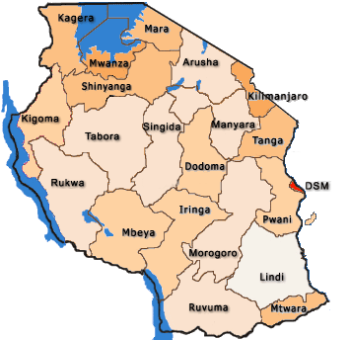
Government Secondary Schools
Mapped onto population density (Census, 2002)
178
121
227
94
135
113
128
202
255
538
171
153
140
152
97
182
214
112
222
126
236
31

Slide 32
Government Primary Schools
Mapped onto population density (Census, 2002)
991
694
1168
489
1096
882
622
496
945
715
538
707
506
345
522
1046
896
804
464
726
613
32

Slide 33
Technology/Infrastructure Opportunities
Fibre Optics – NICTBB, Seacom, EASSY
DSL (Digital Subscriber Line)
Mobile Broadband includes EDGE,CDMA EV-DO, and HSDPA (3G) - Dar es salaam, Pwani, Morogoro, Dodoma Mwanza, Mbeya, Arusha, Mtwara, Kagera, Lindi, Tabora, Kilimanjaro, Tanga, Singida, Shinyanga, Iringa, Mara.
WiMAX - used mainly by ISP’s in city centres. WiMAX network in major cities including Dar es salaam, Mwanza, Dodoma, Kilimanjaro, Arusha, and Mbeya.
Satellite technology - many of the schools pilot projects, including eSchools, rely on VSAT (high costs).
33

Slide 34
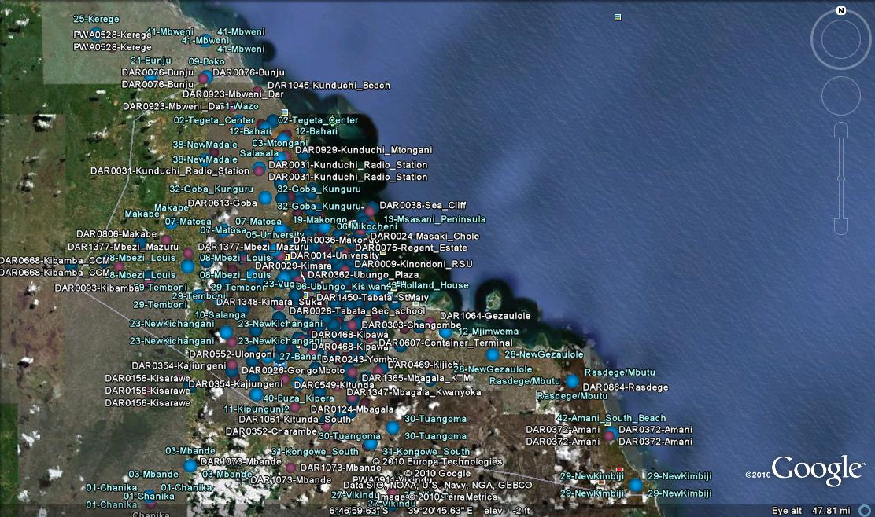
Dar es Salaam Coverage (an example)

Slide 35
School Funding
Government
In 2009/10 budget - TSH 6.066 trillion ($4 billion).
Budgetary allocation for education is the highest - over TSH 1 trillion ($660 million) , i.e. 18 percent of total government budget,2009.
Assume annual spending on education will increase to approximately TSH 1.6 trillion ($1 billion) by 2015.
Pressure on the budget in light of recent national policy of having schools for each ward and even village, dramatically increasing the number of schools.
Schools
Government revenues collected through school fees are low as only approximately 75 percent of fees due are collected (at secondary school level).
UCAF, TEA (and REA) budgets
Donor Funding
Private sector Projects
35

Slide 36
Total Cost of Ownership
Source: UNESCO
36

Slide 37
2015 Targets
Secondary Schools
Connect ALL government secondary schools
Computer/student ratio of 1:15;
Computer: teacher ratio of 1:1
Primary Schools
Connect 50% of primary schools
Computer/student ratio of 1:45 in connected schools
Teachers Colleges
Connect 100 %of Teacher’s Colleges
Link Teachers College connectivity programme to the Secondary School connectivity program
Persons With Disabilities
100 % of schools for PWD connected
100 % of computers and computer labs that are rolled out accessible for PWD
Content and software
language appropriate, age appropriate and locally relevant at all schools with connectivity

Slide 38
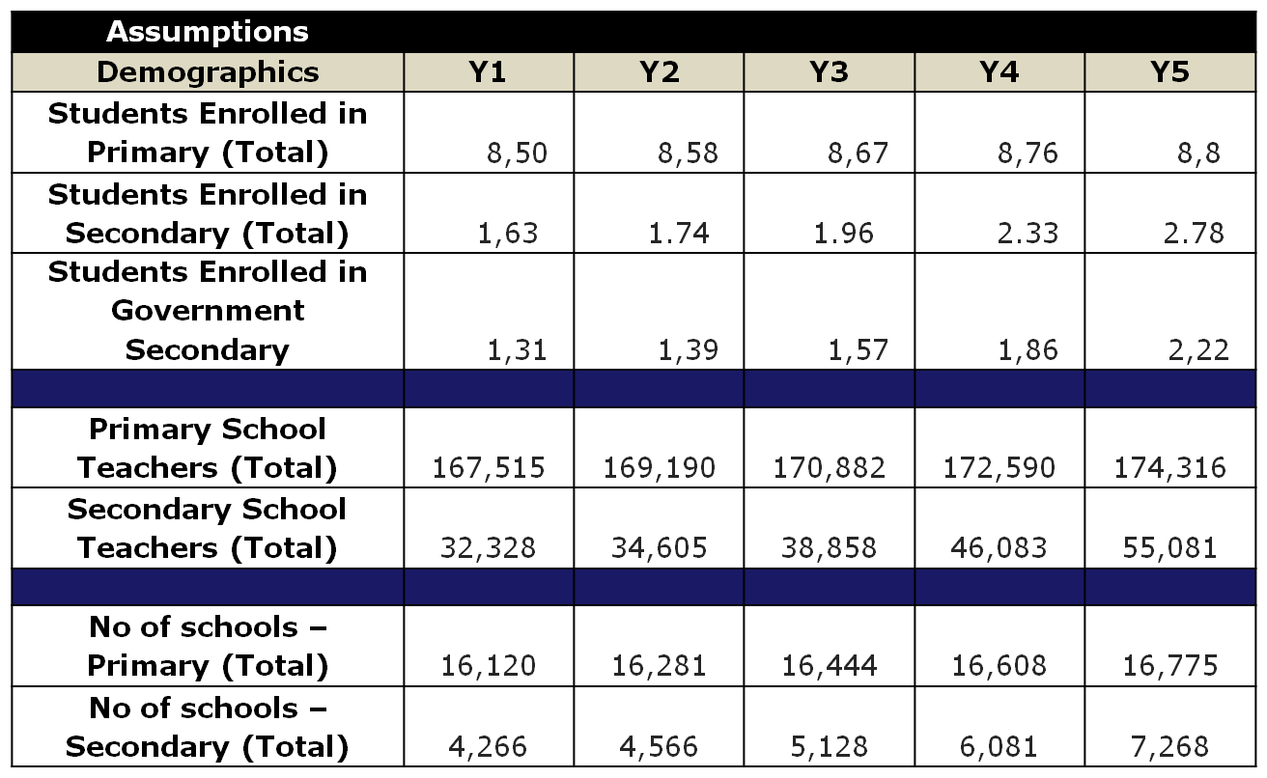
Key Assumptions
38

Slide 39
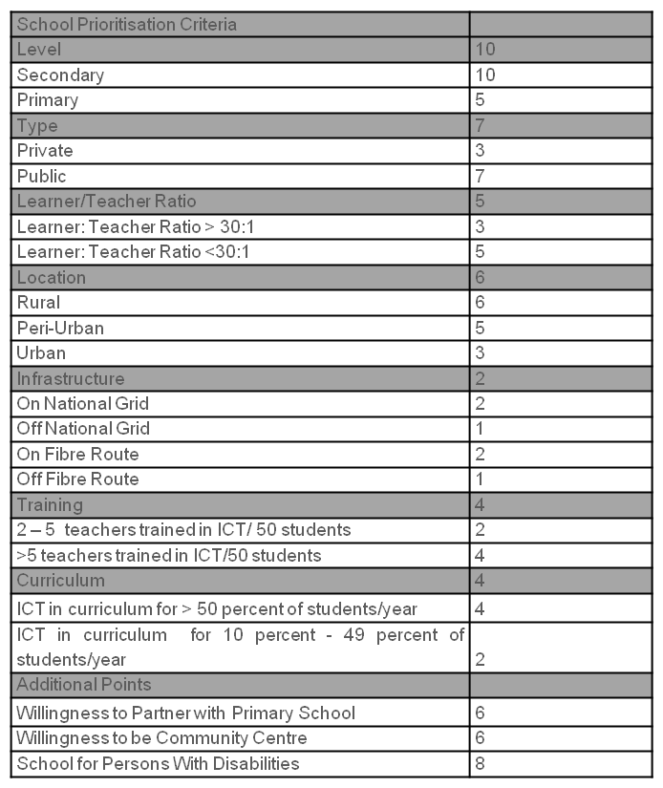
Schools Scorecard
Prioritise
Government Secondary
On Grid / On Fibre
Learner/Teacher Ratio
ICT Trained teachers at school
ICT in curriculum
Extra Points
Partnering with Primary
Community Access
PWD
39

Slide 40
Thank You!
Mandla Msimang
Managing Director
Pygma Consulting, South Africa
Email: mmsimang@pygmaconsulting.com
Web: www.pygmaconsulting.com

