Slide 1
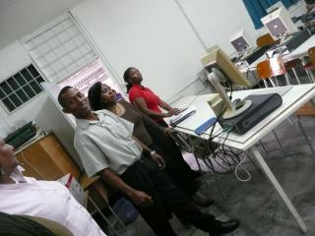
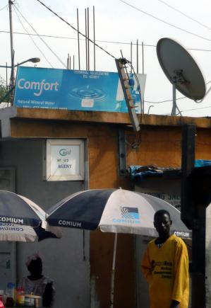
Session 1: Overview of The Current Situation
21 June 2012
Libreville, Gabon
Sofie Maddens-Toscano
ITU Expert

Slide 2
Introduction
What are the numbers/Where are the gaps?
What are countries seeking to achieve – Scope of UAS?
Which mechanisms to achieve such goals?
How to finance UAS?

Slide 3
Market Gap
The market gap (Zone 1) refers to the difference between the level of penetration that can be reached under current plans and conditions and the level that the market could achieve by means of an ideal regulatory and legal environment
This gap could be eliminated with adequate changes in current regulations and should not require use of public funds

Slide 4
Access Gap
The access gap, represents that portion of the market that even under an ideal legal and regulatory environment would not necessarily be covered by operators due to its high cost and/or low income level or would be covered at a later stage
In order to increase coverage beyond the Market Efficiency Frontier into the access gap, public subsidies are to be considered
Within the access gap, there are different levels of penetration : the sustainability coverage gap and the universal coverage gap

Slide 5
Access Gap
Access Gap:
Sustainable coverage gap: the portion of the market that could be operated on a commercially viable basis, once the necessary investments have been funded by public subsidy – in this case, public financing works as a “jump-start”
Universal coverage gap: the portion of the market that could never be operated on a commercially viable basis, but would require public subsidy both for investment and operation – the issue here is the cost of sustainability and the balance with other public sector priorities

Slide 6
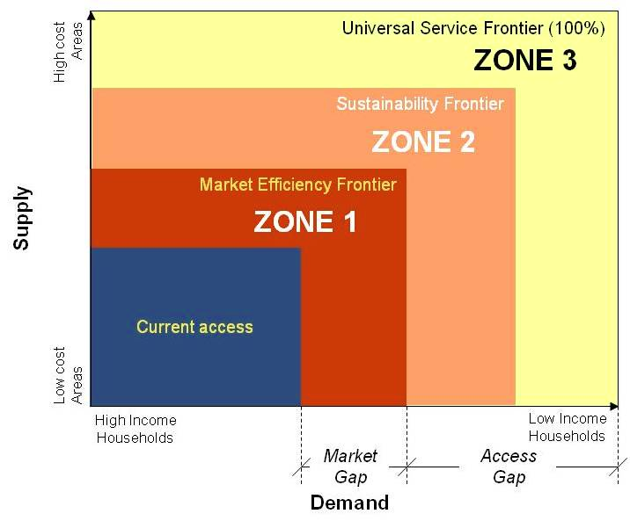
Definitions

Slide 7
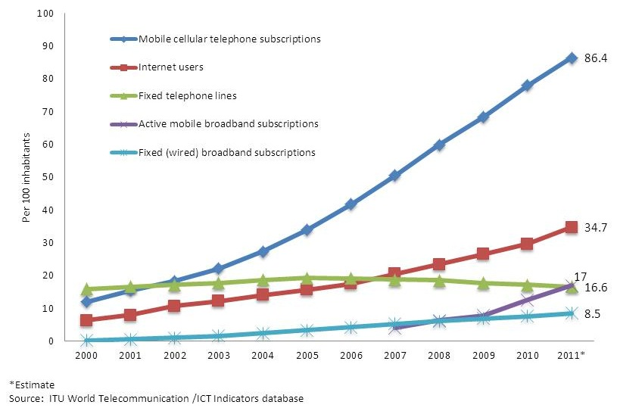
Global ICT Developments, 2000-2011
5.9 billion Mobile cellular subscriptions in 2011*
2.4 billion Internet users in 2011*
1.19 billion Mobile broadband subscriptions in 2011*
Notes:
Internet users reached worldwide an estimated 2.4 billion by the end of 2011, with over one-third of the world’s population now online. However, at the start of 2012, almost two out of every three people are still not yet using the Internet, with even fewer connected via a broadband connection.
Fixed broadband penetration level stands at 4.8 in developing countries compared to 26% in developed countries and Europe.
Mobile broadband has grown fast and reached an estimated 1.19 billion subscriptions in more than 160 countries by the end of 2011.

Slide 8
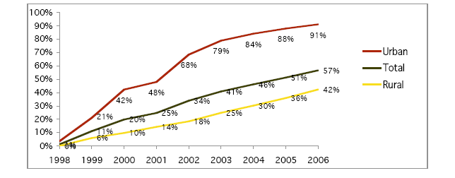
Africa: GSM Mobile Coverage
Source: http://infrastructureafrica.afdb.org/system/files/BP10_ICT_sector_summary.pdf
The number of mobile subscribers in 53 countries in Africa jumped more than 15 times—from 15 million in 2000 to 267 million in 2007. By 2006, 57 percent of Africans were living under the footprint of the mobile networks – by By 2015, the total number of connections is estimated to reach 84% of the total African population
Source: GSMA/ATKearney, Driving Economic and Social Development through Mobile Services, 2011 Mobile Observatory

Slide 9
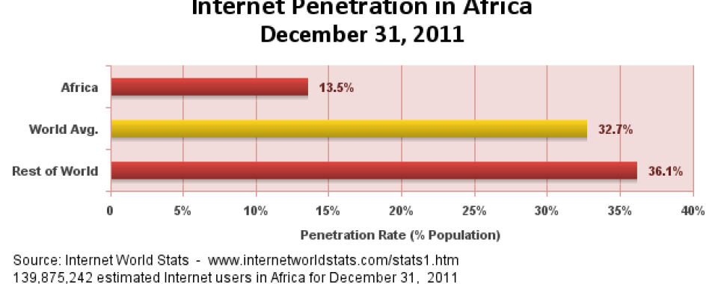
Africa: Internet Users
Africa’s Internet and Broadband sector have grown with improvements in infrastructure, the arrival of wireless access technologies and lower tariffs

Slide 10
Scope of UAS Policy
At present, technological change is increasingly challenging the existing policies relating to universal access and service (UAS)
This is forcing regulatory authorities to rethink the universal service obligations they impose on their carriers and financing mechanisms and to establish a framework that will enable the government to carry out their policy in a converging telecommunications sector

Slide 11
Scope of UAS Policy
Although there is no fixed or standard definition for universal access and service, currently established UAS policies typically seek to meet the following objectives: availability, affordability and accessibility
Given the importance of new technologies in reaching un-served and under-served rural populations, countries around the world are analyzing and even looking to modify their policies by incorporating new technologies and relying on them to reach rural populations
There is a strong case for an expansion of the “social inclusion” objective to include broadband connectivity, telephony service coverage, and Internet access, aimed at medium‐sized rural communities

Slide 12
Scope of UAS Policy
Today, the scope of UA and US include:
Telephony (voice calls and text messages), offering one-to-one communication as well as content distribution to a wider group
Narrowband and broadband Internet, providing e-mail, live-chats, web-browsing, content distribution, Voice Over IP (VoIP) and IP Television (IPTV), among many other applications and services – here though accessibility through instruction and assistance and content that is useful and appealing is particularly important
Radio and television broadcasting. broadcasting is increasingly being considered, due to the convergence of technologies and triple-play offers by service providers (e.g., cable TV operators also providing telephone and Internet services). UAS policies exploring the inclusion of broadcasting are emerging

Slide 13
Scope of UAS Policy
Examples
definitions in ECOWAS-UEMOA vary with most countries referring to voice, but a few countries like, for example, Ghana have considered including a wider range of services and include voice, data transmission, Internet access, access to relevant local content and broadband, in the scope of “basic.”

Slide 14
Scope of UAS
Examples
EU member states must ensure:
Ability to make and receive local, national and long distance calls, fax communications, and to have functional access;
Access to directory and enquiry services;
Availability of public pay phones;
Disabled have access to the same services at an affordable price.
Connection that provides “functional” Internet access.
Response to reasonable requests to install a telephone line, offering the same prices irrespective of location.

Slide 15
Scope of UAS
Uganda
Ensure universal availability of connections by every person or individual households to public communication networks through inter alia pay phones, community tele centers, tele boutiques, kiosks, cafes or community communications internet access terminals

Slide 16
Scope of UAS
Uganda
connection to a fixed communication network able to support voice telephony, fax and data transmission;
reasonable geographic access to public call boxes across Uganda;
the ability of consumers to access emergency and free services, operator assistance and directory inquiry services;
the ability to meet needs of people with disabilities, the delivery of affordable basic communication services to all customers on reasonable request;
providing customers with disabilities with the same or equivalent services as all other customers so as to have access to the same level of universal service

Slide 17
Scope of UAS
Today, over 40 countries include broadband in their universal service or universal access definitions
In February 2000, the Estonian Riigikogu (Parliament) enacted the new Telecommunications Act, adding Internet access to its universal service list. It has also been indicated that internet access is a legal right
India was one of the first countries to include broadband in the mandate of its universal service fund in 2006
Switzerland included broadband in the scope of the Universal Service Obligations since 2008
In Finland broadband access is a legal right

Slide 18
Scope of UAS Policy
UAS needs to be accessible and affordable as well as available - the definition of the scope might include:
Times of day when there is access to the service;
Type of shelter for the terminals;
Access to and usability of the terminal for people with physical disabilities;
Convenience and pleasantness of location for all target groups of users (e.g., women might not wish to enter a bar to use a service);
Quality of service (network reliability, fault repair times and call quality for telephony and prescribed down and upstream data rates for the Internet service).
Payment methods (e.g., cash or prepaid cards) and for prepaid cards, availability of sales outlets; and
Personal support for using the services

Slide 19
Scope of UAS
Why Regulate in a Networked Society?
Global Symposium of Regulators - 2011 Best Practice Guidelines
Including broadband Internet access in the universal service definition can be a first step to bridging the looming digital divide.
Universal service programs could be financed by revenues raised from the activities of a wide range of market players as well as from alternative sources.
Smart subsidies can be used to avoid distorting the market while furthering universal service goals.
Global Industry- Regulators Dialogue
Notes:
The global community of regulators has further recognized various options for policy-makers and regulators to create incentives for the private sector to invest in the ICT sector, such as: adopting enabling policies, simplifying licensing regimes, making available more spectrum, reducing regulatory obligations and offering tax incentives.
Reviewing existing ICT policy and regulatory frameworks to adapt to the fast-changing digital environment is an on-going process that requires coordination with multiple stakeholders to develop forward-looking approaches to attract and secure investment.
If I may offer here some overall advice, the consensus of global experts, as expressed in the best practice guidelines drawn up by Global Symposium for Regulators, is that including broadband internet access in the definition of universal service can be a highly effective first element in bridging the digital divide.
Moreover, it is similarly recognized that these universal service programs can be financed by revenues raised from the activities of a wide range of market players, as well as from alternative sources. Indeed, these guidelines note that smart subsidies can be used to achieve universal service goals without distorting the market. The next meeting of this Global Symposium will take place in Colombo, Sri Lanka, on 2-4 October [2012].
Happily, the broadband ecosystem is well understood in South-Eastern Europe. And in any case, the 2020 targets of the EU Digital Agenda challenge many economies from this part of Europe to ensure that ICTs remain on the top of their agenda.
Over 130 governments have today adopted or are planning to adopt a national policy, strategy or plan to promote broadband.
Many of the region’s countries have already adopted such documents. Such is the case in Macedonia, Montenegro, Romania, Serbia and Slovenia. They generally share a common focus on building nationwide broadband infrastructure, on stimulating demand through the promotion of online services and applications, and on extending connectivity to provide universal access. I should note here that assisted by ITU experts, Albania is engaged drafting a strategic plan along these lines.

Slide 20
Evolution of Scope of UAS
Regulation, licensing, competition, technology, price of technologies, appearance of new services or applications, and overall economic environment all have an impact on limits and can change nature end extent of market and of access gap
Need to continually review universal access policies and mechanisms

Slide 21
Evolution of Scope of UAS
Latin America
many locations included in Universal Access tenders for basic telephony during the late 1990s are now being reassessed due to the arrival of mobile networks to these locations
satellite-based services located in these areas are being relocated (in most cases, at the operator’s request) to more isolated areas

Slide 22
Evolution of Scope of UAS
Europe
After sector liberalization, US defined as “safety net” to avoid social exclusion and potential lack of services due to market failure.
Revision of the concept by the EC every three years (Annex V, Dir. 2002/22/EC)

Slide 23
Evolution of Scope of UAS
Europe
Services included in the definition of US (Dir. 2002/22/EC):
connection to the public telephone network at a fixed location (capable of supplying "functional Internet access¡¨ limited to a single narrowband network connection);
access to publicly available telephone services (including geographical averaging of retail prices and social tariffs); and
directories and directory enquiry services, public pay telephones, and special measures for disabled users
Possible expansion of the set of services:
Member States are free to include other services in the scope of universal service but the provision of those may not be imposed on the universal service provider. The cost of these services must be borne by the state budget not by the universal service provider, nor by other telecom operators through the universal service fund

Slide 24
Evolution of Scope of UAS
Europe
The assessment for the revision is based on three criteria (art. 25 and Annex V of Dir. 2002/22/EC)
Coverage and take-up: is a specific service available to and used by a majority of consumers?
Does the lack of availability or non-use by a minority of consumers result in social exclusion?
Does the availability and use of a special service convey a general net benefit to all consumers such that public intervention is warranted?

Slide 25
Evolution of Scope of UAS
Europe
Third periodic review of the USO scope (2011 Communication):
The European Commission will not expand the scope of the universal service obligation to include broadband connections and mobile services.
Broadband and mobile not included in USO scope, but Citizens’ Rights Directive broaden Member States’ flexibility for likely broadband inclusion
It considers that further guidance (following revision of Dir. 2002/22/EC) on the implementation of the USO will be necessary, for example on the flexibility that member states have to define functional internet access beyond a narrowband connection

Slide 26
Mechanisms to Achieve UAS
International best practices show that key elements to achieve an effective framework to address universality include:
defining the institutional framework for the definition and implementation of UAS policy and regulation;
defining the scope of UAS, thereby ensuring that the services are available and accessible and that the price of communications is affordable;
Carefully defining and updating regulatory reform including licensing, spectrum management, access and interconnection
defining innovative mechanisms (which should not be limited to the creation of a Universal Service Fund)

Slide 27
Mechanisms to Achieve UAS
Regulatory Measures
Access and Interconnection – asymmetric interconnection, infrastructure sharing and co-location, national roaming
Spectrum – flexible spectrum policies
Licensing – local licenses, use of licensing process and revenues
Taxation – reduction of taxes and VAT
OBA – smart subsidies for UAS

Slide 28
Mechanisms to Achieve UAS
A study on the performance of Latin American universal service strategies found that just by addressing regulatory bottlenecks, penetration throughout the region could increase by approximately 10 percent
In Sub‐Saharan Africa, a recent study concluded that cell phone coverage could increase in at least 95 percent throughout the analyzed countries with the appropriate regulatory environment.

Slide 29
Financing of UAS
Recently, countries have also adopted more integrated strategies for the development and financing of telecommunications services
This is particularly true in the case of universal access and financing of large infrastructure projects, including projects to extend broadband services
The reason for such an integrated approach is simple: the country must quantify the resources and investment required, and it must develop a comprehensive plan at the national level in relation to the size of the stakes

Slide 30
Financing of UAS
The financing of Universal Access and Service has gone through various stages, ranging from the application of revenues from cross-subsidies to finance non-profitable areas under a monopolistic scenario, to the creation of Universal Service Funds funded solely from operator levies so as to be able to finance universality projects in a competitive market
Important is that countries do not focus solely on the creation of a Universal Service Fund and see it as the only way in which universality will be achieved, but that such Funds are seen as a tool amongst tools
Do not forget demand creation!

Slide 31
Financing of UAS
Variety of Financing Mechanisms
Traditionally, ICT infrastructure financing came either from government budgets and revenues generated by the state post and telecommunications authorities, or from donor and international financial institution (IFI) programs supporting major capital infrastructure investments

Slide 32
Financing of UAS
Variety of Financing Mechanisms
Internal Cross-Subsidies
General Government Budget Contributions/Grants
Interconnection Surcharges
Municipal network alternatives and funding approaches
Public-Private Partnerships (PPPs)
Pay or Play mechanisms
Virtual USF
Demand Creation

Slide 33
Financing of UAS
Variety of Financing Mechanisms
In Latin America, of the 19 countries covered by a Regulatel study, nearly all countries have implemented various mechanisms that directly or indirectly aim to increase investments and access to telecommunications infrastructure in high‐cost rural and low‐income areas:
Universal Service Funds (USFs) that provide partial subsidies for programmes largely aimed at stimulating private sector provision of infrastructure in rural or unserved regions (12 countries out of 10 are using funds)
Other financing methods and project initiatives by national, state and local governments, cooperatives, NGOs and others (13 countries).
An increasing number of private operators are also putting in place programmes aimed at expanding coverage in high cost rural areas and to increasing demand among lower income consumers;
State‐mandated and controlled approaches using cross subsidies and other financing mechanisms aimed at state‐owned companies

Slide 34
Financing of UAS
US Example
In the US, universal service fund monies have not adequately responded to the evolution of technology and as such have not supported service provision to rural areas of the country.
On February 17, 2009 President Obama signed into law the American Recovery and Reinvestment Act of 2009.
This law allocates monies and requires the establishment of grant programs to fund the deployment of broadband infrastructure to rural America, and to help facilitate broadband use and adoption.
These monies are distinct from the formal universal subsidy system that exists in the US.

Slide 35
Financing of UAS
US Example
Specifically, the law allocated $4.7 billion to the Department of Commerce’s National Telecommunications Information Administration to establish a Broadband Technology Opportunities Program (BTOP). The goal of the program is to expand broadband to sustain provision of services to areas where deployment may have not been economically viable.
The law also allocated $2.5 billion to the Department of Agriculture’s Rural Utilities Service to expand broadband to rural areas.

Slide 36
Financing of UAS
US Example
Under the BTOP Program NTIA consulted with the regulator (the Federal Communications Commission)
Guidelines for grant applications were developed with public meetings convened to solicit input from interested parties.
Funding was available until September 30, 2010
Broadband deployment projects were to be completed within two years of the award
The goal of the program was to provide access to unserved (rural) and underserved (low income) areas of the country.

Slide 37
Financing of UAS
Demand Creation
Low purchasing power, low usage, and seasonal income are some characteristics that reduce the expected revenues that operators could realize.
Demand creation policies can encourage operators to invest in otherwise unprofitable areas
government transfers for every new connection in rural and low‐income areas
Institutional demand creation – anchor institutions for community access, education, health, administration, municipalities

Slide 38
Financing of UAS
The UA projects in Kenya include:
School-based ICT Centers
Community ICT Access Points
ICTs for People with Disabilities
Digitization of Secondary School Curriculum
Computerization of Health Centers
Research and Development

Slide 39
References and Further Reading
Muente‐Kunigami, A. and Navas‐Sabater, J., Options to Increase Access to Telecommunications Services in Rural and Low-income Areas, available at: http://siteresources.worldbank.org/EXTINFORMATIONANDCOMMUNICATIONANDTECHNOLOGIES/Resources/282822-1208273252769/Options_to_Increase_Access_to_Telecommunications_Services_in_rural_and_Low-Income_Areas.pdf
GSR 2009 Background Paper, Sofie Maddens, Trends in Universal Access and Service Policies at http://www.itu.int/ITU-D/treg/Events/Seminars/GSR/GSR09/doc/USPolicy_ITUEC.pdf.
Regulatel, Peter A. Stern and David N. Townsend, New Models for Universal Access to Telecommunications Services in Latin America: Lessons from the Past and Recommendations for a New Generation of Universal Access Programs for the 21st Century (2007) at http://www.regulatel.org/SU_Peter_31_08_07/Full_report-COMPLETE-June_11,2007.Edited_PAS_v.1.pdf.
Infodev ict Regulation Toolkit, available at: http://www.ictregulationtoolkit.org/en/Sections.html#3126
ITU/EC HIPSSA, Update of SADC Guidelines on Universal Access and Service and Assessment Report, available at: http://www.itu.int/ITU-D/projects/ITU_EC_ACP/hipssa/Activities/SA/CRASA/UAS%20Final%20Draft%20Report.pdf

Slide 40
Thank You!
Sofie Maddens-Toscano
Managing Director
Pygma Consulting International LLC
Email: smaddens@pygmaconsulting.com
Web: www.pygmaconsulting.com

