Slide 1






FOURTH SADC DIGITAL BROADCASTING MIGRATION FORUM,
27-30 AUGUST 2012
MANAGING DTT HARMFUL INTERFERENCE
ENGR. EDWARD I. AMANA

Slide 2
ABSTRACT:
This paper takes a look at the issues of Harmful Interference in Digital Terrestrial Television – DTT and how to manage them.
QUESTIONS:
What is Harmful Interference?
What are the Sources of Harmful Interference in DTT?
How do we manage them?

Slide 3
INTRODUCTION:
When we transmit a signal, either from a Television Studio or from an outside event like from the sporting fields, we expect a faithful reproduction of such signals on the television receivers tuned to such an event.
Ideally, the received signals should be without distortions and without intrusion or interference from any other source.
This might have been achievable if we have only one transmitter using the available spectrum. Unfortunately, in the real world this is not so
To say there is an excess demand on the useable spectrum by various services with different characteristics is an understatement.

Slide 4
On daily basis new technologies are evolving that is putting new demands on the already scarce spectrum.
In the Broadcast Arena, we are currently dealing with the issues of Transition from Analogue to Digital Broadcasting, which is already putting a lot of strain on the available Broadcast Spectrum because, during the transition period we have to contend with transmitting both Analogue and Digital Broadcasting ( Double Illumination or Simulcasting )
During this period, the integrity of the Analogue Signal has to be maintained while the Digital Broadcasting is being introduced.
To compound matters, different standards and formats of Digital Broadcasting have evolved and are still evolving:

Slide 5
Standard Definition Television – SDTV.
High Definition Television – HDTV.
Ultra High Definition Television – UHDTV.
3-Dimentional Television – 3-DTV.
And in the Digital Transmission Arena we have different transmission format like:
DVB-T
DVB-T2
DVB-H / H2
ATSC / ATSC MOBILE
CMMB.
MEDIAFLO
DMB-T/H.
ISDB-T / ISDB – International
The development in the Telecommunications Industry is even more rapid:

Slide 6
from:
GSM
WiMax
WiFi
IMT.
All these new technologies forces changes in the use of available spectrum and places a lot of burden on the Regulator

Slide 7
HARMFUL INTERFERENCE:
The fundamental characteristic of Radio Waves is that:
Every transmitter has an impact on every receiver.
Signals cannot be stopped.
They can only be attenuated either by:
  Frequency or
  Distance
Any radio system must therefore take cognizance of the level of the unwanted or interfering signals it either generates or receives.

Slide 8
HARMFUL INTERFERENCE:
Harmful Interference can therefore be simply defined as any external signal that renders the receivers reproduction of it’s wanted signal intolerable.

Slide 9
SOURCES OF HARMFUL INTERFERENCE
To properly understand the sources of interference it is necessary to take a cursory look at how the spectrum is managed:
In most countries we have what is often referred to as Command & Control Regulation:
The National Regulator controls access to spectrum by:
  Dividing the Spectrum into Bands, taking into cognizance International Agreements such as the allocations in the ITU-R Radio Regulations
  Allocating bands to services
    Broadcasting
    Mobile
    Fixed etc.
  Determine if there should be Guard Bands and if so, how wide.
  Decide the approach for licensing each band.

Slide 10
SOURCES OF HARMFUL INTERFERENCE
  Issuing Licenses to each spectrum user to meet their demand for the radio spectrum with well spelt out licensing conditions.
There are 3 common approaches to licensing and each has it’s implication on harmful Interference:
SITE LICENSING: Here different operators are licensed to use the same band but are constrained geographically so that the same band can be used many times. Under the Command & Control Model these will be managed by the Regulator, who would plan the deployment and parameters of each site.
Block Licensing: Here a block of Spectrum with a given Geographic & Frequency extent is delegated to an operator that can deploy at will the equipment that meet the license conditions

Slide 11
SOURCES OF HARMFUL INTERFERENCE
3. LICENSE EXEMPT: These are unlicensed spectrum that operate on general operating rules such as very low power e.g. 2.4 GHz. Used for Bluetooth, WiFi etc.

Slide 12
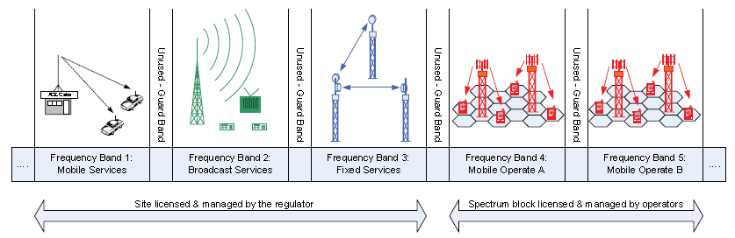
ALLOCATION OF BANDS TO SERVICES & OPERATORS

Slide 13
INTERFERENCE IN A DTT NETWORK:
Irrespective of what ever Transmission Standard adopted by a Nation,
Depending on the landmass of the country a network of several transmitters have to be deployed for effective National Coverage.
Every transmitter within the Network is allocated a Bandwidth to ensure successful transmission.
As we said earlier: Every transmitter has an impact on every receiver.
Every transmitter has the following potential for causing interference:

Slide 14
Unwanted emissions consist of:
  Out-of-band emissions: immediately outside the necessary bandwidth and resulting from the modulation process
  Spurious emissions: outside the necessary bandwidth, including:
    harmonic emissions,
    parasitic emissions,
    intermodulation products and
    frequency conversion products.

Slide 15
Unfortunately, Receivers cannot effectively Screen Out Signals in Adjacent Channels to the wanted Signal.
Therefore overlapping of signals from transmitters operating on adjacent channels can cause Harmful Interference to a Receiver within the Region of Overlap.
The Diagram below shows in a very simple manner, the interference environment:

Slide 16
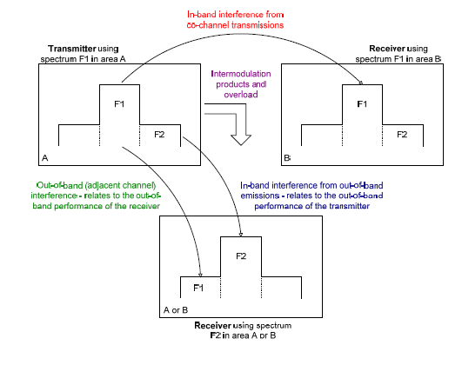
TYPES OF INTERFERENCE

Slide 17
MANAGING INTERFERENCE
Managing Harmful Interference in DTT starts from the Regulator.
The Command & Control Regulation is most effective in containing interference – although most operators will prefer a Liberalized Spectrum Environment.
Fortunately the Transition from Analogue to Digital Broadcasting has resulted in an advocacy for a Common Signal Carrier. The Regulator must therefore be involved in the National Coverage Network Planning, taking into cognizance all the potentials for interference in giving out the equipment specifications. These will include:
  Transmitters
  Receivers and
  Set Top Boxes.

Slide 18
MANAGING INTERFERENCE
Each Transmitter Site must be Licensed with a clear specification of:
  Antenna Height Above Sea Level
  Effective Radiated Power
  Polarization and
  Radiation Pattern – ( Omni-Directional / Directional or Cardioid )
Cross Boarder Interference is a much more serious issue.
Very often a lot of countries like to deploy powerful transmitters at the boarders to their neighbouring country.
There is therefore a need for coordination between neighbors to avoid Harmful Interference.

Slide 19
MANAGING INTERFERENCE
Before the Roll-out of the DTT Network, the Regulator must ensure compliance to Specifications by carrying out an Acceptance Test / Type Approval of Transmitters / Receivers.
The Regulator must also carry out Field Strength Measurements to ascertain the Coverage Area of each Transmitter and note areas of overlapping signals from two different transmitting stations and ascertain the possibility of Interference.

Slide 20
MANAGING INTERFERENCE
SITE SHARING:
Encouraged for:
  Economic and
  Environmental reasons
To avoid Interference at these Sites, there must be adequate Frequency Separation between the various Services that are sharing the Site.

Slide 21
CONCLUSION
WE have defined Harmful Interference
Identified the main Sources of Interference and
Proffered some solutions to Managing Harmful Interference
However, the job of the Regulator does not stop with the final copmmissioning of the Broadcasting Network. The Regulator has to constantly monitor the transmission for compliance.

Slide 22
THANK YOU ALL

