Slide 1
Framework for Development of ICT strategies using
ICT indicators
Regional Workshop on
“ICT indicators from Strategy to Impact”
Sharm ElSheikh, Egypt, 8-9 June 2012
Mansour Farah,
Consultant on ICT4D
Notes:
This template can be used as a starter file for presenting training materials in a group setting.
Sections
Right-click on a slide to add sections. Sections can help to organize your slides or facilitate collaboration between multiple authors.
Notes
Use the Notes section for delivery notes or to provide additional details for the audience. View these notes in Presentation View during your presentation.
Keep in mind the font size (important for accessibility, visibility, videotaping, and online production)
Coordinated colors
Pay particular attention to the graphs, charts, and text boxes.
Consider that attendees will print in black and white or grayscale. Run a test print to make sure your colors work when printed in pure black and white and grayscale.
Graphics, tables, and graphs
Keep it simple: If possible, use consistent, non-distracting styles and colors.
Label all graphs and tables.

Slide 2
Topics
Introduction
Components of an ICT Strategy
ICT indicators in selected components
Conclusion
Notes:
Give a brief overview of the presentation. Describe the major focus of the presentation and why it is important.
Introduce each of the major topics.
To provide a road map for the audience, you can repeat this Overview slide throughout the presentation, highlighting the particular topic you will discuss next.

Slide 3

Introduction
Notes:
This is another option for an Overview slides using transitions.

Slide 4
What are ICT strategies?
Strategies direct the body of policies and provide a framework for their implementation with clear goals
ICT strategies analyse priorities and constraints and set courses of action to reach stated objectives
Effective ICT strategies are the result of consultation with all stakeholders (academia, business sector, industry and NGOs)
ICT strategies incorporate quantitative targets, timeframe and a monitoring & evaluation mechanism with success criteria
To be realistic, ICT strategies should take into consideration institutional and operational issues
e-Strategies for specific sectors (e.g. commerce, government, learning and health) are plans based on the selection of scenarios and options for applying ICT to these sectors
ICT strategies are essential to unleash the full potential of ICT4D
Notes:
Give a brief overview of the presentation. Describe the major focus of the presentation and why it is important.
Introduce each of the major topics.
To provide a road map for the audience, you can repeat this Overview slide throughout the presentation, highlighting the particular topic you will discuss next.

Slide 5
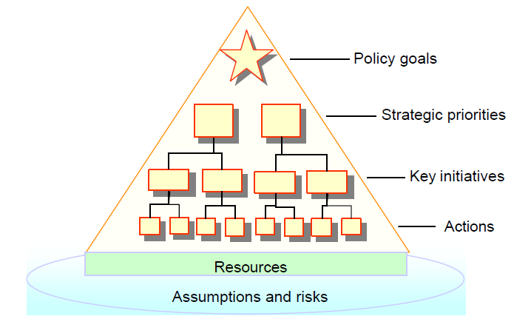
The ICT Strategy Pyramid
Source: “E-Strategies Monitoring and Evaluation Toolkit”, World Bank, 2005
Notes:
Give a brief overview of the presentation. Describe the major focus of the presentation and why it is important.
Introduce each of the major topics.
To provide a road map for the audience, you can repeat this Overview slide throughout the presentation, highlighting the particular topic you will discuss next.

Slide 6
Why use indicators in ICT strategies?
Evidence-based ICT policies and strategic planning
Common reference framework for ICT strategies
Down-to-earth goals, avoiding errors of the past and unrealistic/costly strategies
Evaluating ICT strategies impact, compare their achievements and consolidating them at various levels
Agreed upon systematic tool to monitor and evaluate implementation
Notes:
Give a brief overview of the presentation. Describe the major focus of the presentation and why it is important.
Introduce each of the major topics.
To provide a road map for the audience, you can repeat this Overview slide throughout the presentation, highlighting the particular topic you will discuss next.

Slide 7
Components of an ICT strategy
Notes:
This is another option for an Overview slides using transitions.

Slide 8
Components of an ICT strategy*
Assessment
Consultation plan
Strategic plan
Action plan for implementation
Institutional mechanisms for implementation and supervision
Monitoring and evaluation mechanisms
(*) Labelle, Richard, ICT Policy Formulation and e-Strategy Development – A Comprehensive Guidebook, UNDP-APDIP, 2005
Notes:
Give a brief overview of the presentation. Describe the major focus of the presentation and why it is important.
Introduce each of the major topics.
To provide a road map for the audience, you can repeat this Overview slide throughout the presentation, highlighting the particular topic you will discuss next.

Slide 9
Assessment
Describes the current status, with a critical view and comparative analysis
Identifies and rates the needs and challenges
Based on consultation, research, facts and figures, perceptions and observations
Provides the groundwork for devising the strategy and building plans of actions
An e-readiness assessment is essential for national strategies.
Notes:
Give a brief overview of the presentation. Describe the major focus of the presentation and why it is important.
Introduce each of the major topics.
To provide a road map for the audience, you can repeat this Overview slide throughout the presentation, highlighting the particular topic you will discuss next.

Slide 10
E-readiness assessment
Rapid assessment tools to measure the diffusion and potential for taking advantage of ICTs in a country
Should cover remote, rural and disadvantaged areas
E-readiness methodologies should be people-centred
E-readiness assessment needs to be inclusive, i.e. adapted to the needs of all people, including the marginalized, the poor, rural dwellers and others
Notes:
Give a brief overview of the presentation. Describe the major focus of the presentation and why it is important.
Introduce each of the major topics.
To provide a road map for the audience, you can repeat this Overview slide throughout the presentation, highlighting the particular topic you will discuss next.

Slide 11
Consultation plan
Consultations should be on-going and involve all stakeholders at different stages of developing an ICT strategy
Increasing the chances of success of ICT strategy by increasing the likelihood of meeting the needs of stakeholders and priorities of people
Marginalized groups (women, poor, rural dwellers, youth and handicapped) to be represented in consultations
Notes:
Give a brief overview of the presentation. Describe the major focus of the presentation and why it is important.
Introduce each of the major topics.
To provide a road map for the audience, you can repeat this Overview slide throughout the presentation, highlighting the particular topic you will discuss next.

Slide 12
Strategic Plan
The strategic plan is the core of the strategy
For each priority area:
  explains the basic ideas related to this area
  provides targets to be reached
  explains the actions to be taken by all stakeholders to reach these targets
The strategic plan is dynamic and changes over time
It is a rolling plan with a continuing time horizon of about three years and a predetermined medium-to-long term horizon
Notes:
Give a brief overview of the presentation. Describe the major focus of the presentation and why it is important.
Introduce each of the major topics.
To provide a road map for the audience, you can repeat this Overview slide throughout the presentation, highlighting the particular topic you will discuss next.

Slide 13
Action plan
The action plan for implementation develops the strategic plan and includes:
  detailed projects, their outcomes and indicators of success
  intended results and their justification
  risk assessment and mitigation
  cost and other detailed resource requirements
  schedule for implementation
Notes:
Give a brief overview of the presentation. Describe the major focus of the presentation and why it is important.
Introduce each of the major topics.
To provide a road map for the audience, you can repeat this Overview slide throughout the presentation, highlighting the particular topic you will discuss next.

Slide 14
Institutional mechanisms for implementation and supervision
An organization is designated as responsible for the strategy and its implementation
Usually associated with a high-level government decision-making body
Has the authority and full support of the chief executive and government
The organization responsible for implementation may be separate from the institution responsible for supervision
Notes:
Give a brief overview of the presentation. Describe the major focus of the presentation and why it is important.
Introduce each of the major topics.
To provide a road map for the audience, you can repeat this Overview slide throughout the presentation, highlighting the particular topic you will discuss next.

Slide 15
Monitoring and evaluation (1)
M&E in all layers of the ICT strategy pyramid
M&E to be designed during development of the ICT the strategy and before implementation starts
M&E should start taking its role within the strategy as early as possible
M&E should be designed in two ways:
  within specific activities (or “modules”)
  for the strategy as a whole
Notes:
Give a brief overview of the presentation. Describe the major focus of the presentation and why it is important.
Introduce each of the major topics.
To provide a road map for the audience, you can repeat this Overview slide throughout the presentation, highlighting the particular topic you will discuss next.

Slide 16
Monitoring and evaluation (2)
Comprehensible and usable by internal participants (government, enterprises, NGOs) and external stakeholders (investors, donors, partners)
Powerful instrument to make a strategy more meaningful and convincing
Requires attention be given from the start to:
  methodological aspects, i.e. relevant tools to monitor and evaluate progress
  institutional and strategic aspects, i.e. ways and means to adapt to local constraints and maximize ownership by stakeholders
Notes:
Give a brief overview of the presentation. Describe the major focus of the presentation and why it is important.
Introduce each of the major topics.
To provide a road map for the audience, you can repeat this Overview slide throughout the presentation, highlighting the particular topic you will discuss next.

Slide 17
ICT indicators in selected components
Notes:
This is another option for an Overview slides using transitions.

Slide 18
Assessment
Essentially based on core ICT indicators and WSIS targets indicators
Additional sector specific indicators may be needed
Indicator values should differentiate city dwellers from rural/remote area
Examples:
  Core ICT indicators A1-A10 for infrastructure, HH1-HH12 for access, ED1-ED8 for education
  WSIS target indicators 6.1-6.7 for government connection and 9.1-9.4 for local digital content
Notes:
Give a brief overview of the presentation. Describe the major focus of the presentation and why it is important.
Introduce each of the major topics.
To provide a road map for the audience, you can repeat this Overview slide throughout the presentation, highlighting the particular topic you will discuss next.

Slide 19
Strategic plan
For each priority area and each goal, ICT indicators are used to specify the targets to be reached
ICT indicators and their target values may change over time since the strategic plan is a dynamic and rolling plan
Indicators/target values for each goal should be expressed either as percentage increase with respect to corresponding assessment values
Notes:
Give a brief overview of the presentation. Describe the major focus of the presentation and why it is important.
Introduce each of the major topics.
To provide a road map for the audience, you can repeat this Overview slide throughout the presentation, highlighting the particular topic you will discuss next.

Slide 20
Monitoring and evaluation (1)
Uniform methodology for monitoring and evaluation, e.g. the Logical Framework Analysis
For each project, an overall objective is provided, project purpose, intermediate results and activities
Performance indicators based on agreed upon concrete and realistic outcomes are monitored periodically
Success indicators, measurable and directly related to the outcomes, are determined at earliest stages of project planning and implementation
An ICT observatory or equivalent structure may be in charge of monitoring, evaluation and follow-up of the strategy
Notes:
Give a brief overview of the presentation. Describe the major focus of the presentation and why it is important.
Introduce each of the major topics.
To provide a road map for the audience, you can repeat this Overview slide throughout the presentation, highlighting the particular topic you will discuss next.

Slide 21
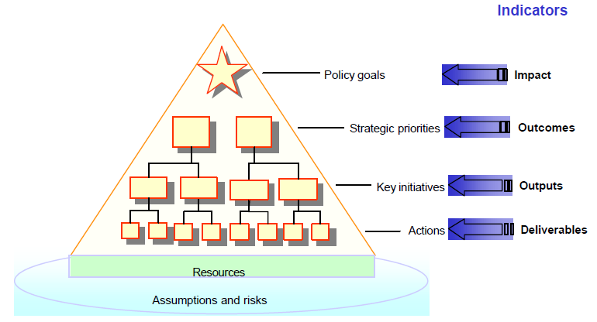
Monitoring and evaluation (2)
Source: “E-Strategies Monitoring and Evaluation Toolkit”, World Bank, 2005
Notes:
Give a brief overview of the presentation. Describe the major focus of the presentation and why it is important.
Introduce each of the major topics.
To provide a road map for the audience, you can repeat this Overview slide throughout the presentation, highlighting the particular topic you will discuss next.

Slide 22
Monitoring and evaluation (3)
  Policy objectives (longer-term and society-wide) traditionally assessed in terms of ‘impact’, i.e. in rather broad and largely un-quantified ways
  Strategic priorities are more quantifiable, but limited to broad aggregates (or percentages of the national population); hence ‘outcomes’, i.e. society-wide indicators
  Indicators for the implementation layers of key initiatives and specific actions, are easier to design and use
  Outputs (e.g. number of PCs installed in classrooms) and deliverables (e.g. number of PCs delivered to schools in a certain region).
Notes:
Give a brief overview of the presentation. Describe the major focus of the presentation and why it is important.
Introduce each of the major topics.
To provide a road map for the audience, you can repeat this Overview slide throughout the presentation, highlighting the particular topic you will discuss next.

Slide 23
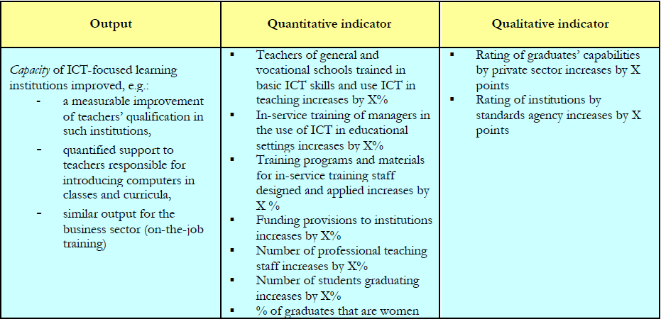
Monitoring and evaluation (4)
Source: “E-Strategies Monitoring and Evaluation Toolkit”, World Bank, 2005
Notes:
Give a brief overview of the presentation. Describe the major focus of the presentation and why it is important.
Introduce each of the major topics.
To provide a road map for the audience, you can repeat this Overview slide throughout the presentation, highlighting the particular topic you will discuss next.

Slide 24
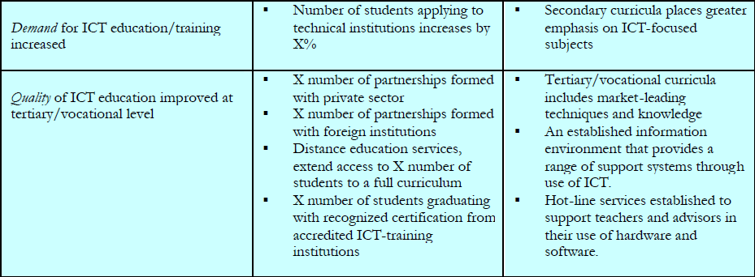
Monitoring and evaluation (5)
Source: “E-Strategies Monitoring and Evaluation Toolkit”, World Bank, 2005
Notes:
Give a brief overview of the presentation. Describe the major focus of the presentation and why it is important.
Introduce each of the major topics.
To provide a road map for the audience, you can repeat this Overview slide throughout the presentation, highlighting the particular topic you will discuss next.

Slide 25
Conclusion
Notes:
This is another option for an Overview slides using transitions.

Slide 26
Conclusion
ICT indicators, whether core or more sophisticated indicators, should be an integral part of ICT strategy development
The framework provides a methodology for making ICT strategy formulation and development related to evidence and to realities on the ground
A participatory approach is essential for success and ICT indicators constitute the cohesive material
Monitoring and evaluation constitute the backbone of any ICT strategy and make it more meaningful
Notes:
Give a brief overview of the presentation. Describe the major focus of the presentation and why it is important.
Introduce each of the major topics.
To provide a road map for the audience, you can repeat this Overview slide throughout the presentation, highlighting the particular topic you will discuss next.

Slide 27
References
ITU, National e-Strategies for Development – Global Status and Perspectives 2010, ITU, March 2011
Labelle, Richard, ICT Policy Formulation and e-Strategy Development – A Comprehensive Guidebook, UNDP-APDIP, 2005
Partnership on Measuring ICT for Development, Core ICT Indicators 2010, ITU, 2010
Partnership on Measuring ICT for Development, Measuring the WSIS Targets – A Statistical Framework, ITU, 2011
World Bank, E-Strategies Monitoring and Evaluation Toolkit, World Bank, 2005
Notes:
Give a brief overview of the presentation. Describe the major focus of the presentation and why it is important.
Introduce each of the major topics.
To provide a road map for the audience, you can repeat this Overview slide throughout the presentation, highlighting the particular topic you will discuss next.

Slide 28
Thank you! mansour.farah@gmail.com

