Slide 1

ICT Measurement and Impact
June 2012

Slide 2
Jordan..
Leadership Vision
Human Resources
Infrastructure/Connectivity
Investment Environment
Demonstrated Capability
Political Stability
Ease of Access
Gateway to the Region

Slide 3
REACH Initiative
Vision of His Majesty King Abdullah II
Private Sector Leadership &
Partnership with Government
Regulatory Framework
Enabling Environment and Infrastructure
Advancement of National IT Programs
Capital and Finance
Human Resources Development

Slide 4
As a Result
Best public-private relationship in the region
Over 20 laws enacted to create a suitable investment climate
Labor, Intellectual Property, Private Shareholding Firm….
Separation of policy, regulation and operation in telecom sector
Region’s most liberalized and competitive telecom market
One of the region’s most connected countries
14% corporate tax rate and 0% income tax up to USD50K income
Special Economic Zones with 5% tax rates and a host of incentives
The region’s top source for ICT talent
Destination for Microsoft, Cisco, HP, Oracle, Ericsson among others

Slide 5
National ICT Strategy 2007-2011
35,000 jobs
$ 3 billion revenue
50% Internet penetration

Slide 6
Achievements and Goals
$3,000
$2,500
$2,000
$1,500
$1,000
$500
2000
2009
2000
2009
2011
2000
2009
2011

Slide 7
ICT Diffusion
Connectivity
National Broadband Network
Connected: 463 schools, 123 government and hospitals/health centres, 8 universities and 23 community colleges
Enabling new niches: health and education
Content
National e-Government Program
Mature Content Industry (localized and Arabic content)
E-Learning

Slide 8
ICT Diffusion
Ability to use technology
Jordan Education Initiative
100 Discovery Schools and expansion to include more schools across the Kingdom: Transforming Education by using ICT tools
Knowledge Stations
Royal Initiative with +180 Stations across the Kingdom providing ICT training and access to ICT tools to community free or for minimal fees
Bridge Initiative
MoICT initiative to build capacity of ICT graduates and enable them for job market (ICT Training Academy)

Slide 9
ICT Measurement and Impact
To develop an evidence-based approach to ICT policy-setting and decision making taking into consideration international standards.
To assess impact and developments of ICT sector.

Slide 10
Households and Enterprises Survey
Survey ICT use in households and enterprises on annual basis.
To provide data and information on ICT penetration and diffusion as a linchpin for policy accountability.

Slide 11
Annual ICT Industry Statistics
An annual survey on ICT & ITES Industry Statistics based on ISIC 4.0 system in cooperation with Information Technology Association (int@j).
To demonstrate the sector’s growth in terms of numbers and to determine the growth in market size, exports, investments, and employment.

Slide 12
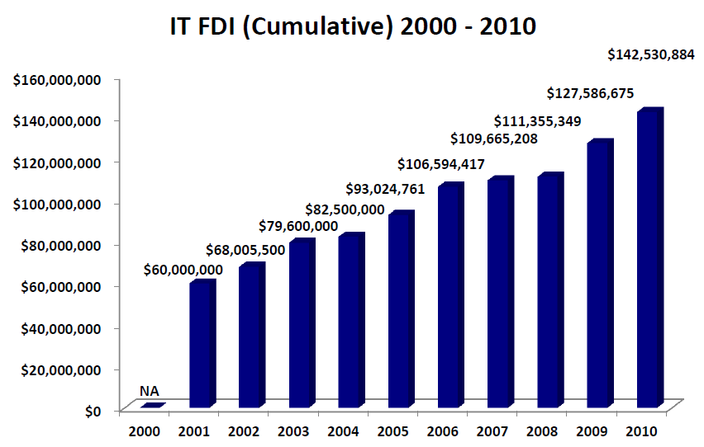
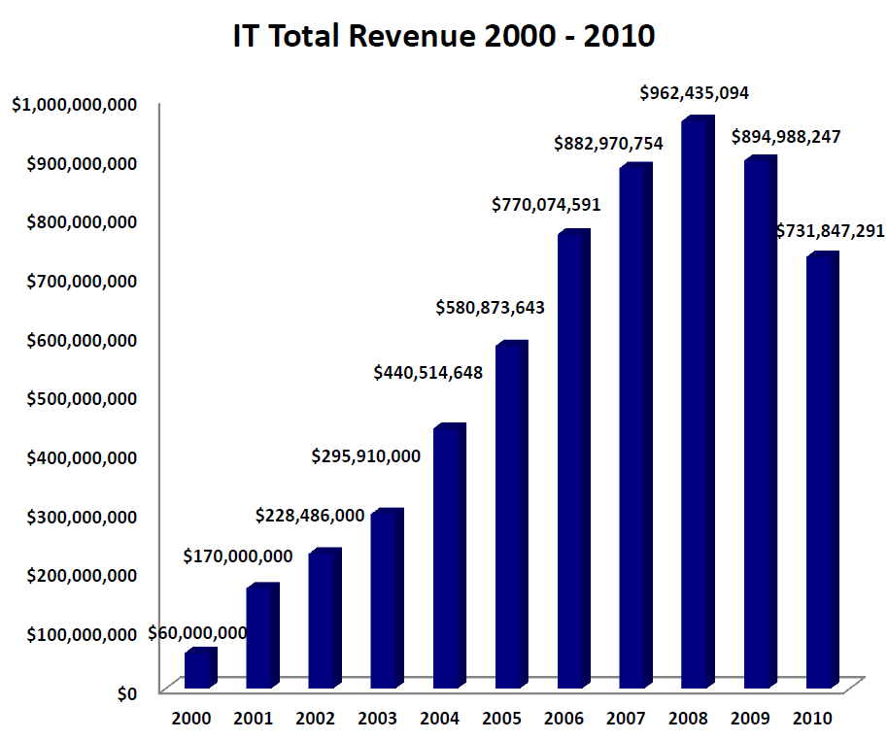
Sample …
http://www.moict.gov.jo/en-us/homepage/studiesandreports.aspx

Slide 13
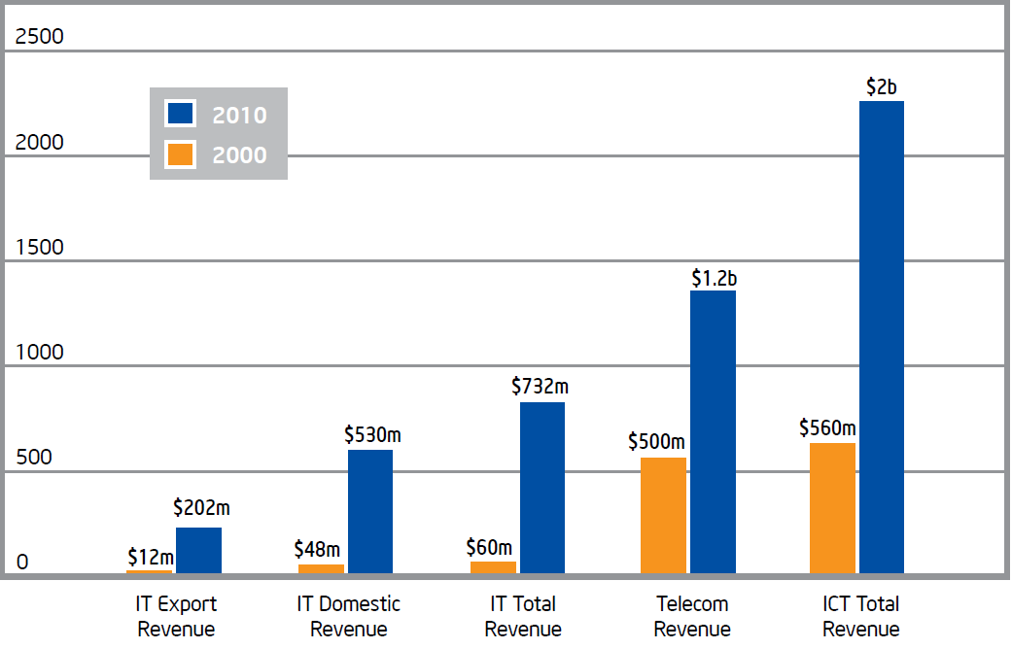
Sample …

Slide 14
Assessment of the Economic Impacts of ICT in Jordan
To assess the impacts of the ICT developments across the various Jordanian economical sectors, in addition to the overall Jordanian economy level.
Main indicators:
ICT contribution to the GDP reached to 14.1% in total of Jordan’s economy,
this figure comprises of 9.5% as a direct contribution by the ICT sector and 4.62% by enabling the other economical sectors considered as indirect contribution to GDP.

Slide 15
Sample…
ICT Impact on Employment is 84,154 Jobs
http://www.moict.gov.jo/en-us/homepage/studiesandreports.aspx
ICT Impact on Productivity and Labor Productivity

Slide 16
Workforce in Jordanian ICT Industry: Evaluation and Needs Assessment
To assess the needs of the ICT sector in terms of required workforce skills, knowledge and experience while taking into consideration the rapid development and arising needs of the ICT sector.
Key Result:
39% of the employers were indifferent in their choice, 36% prefer public graduates, and only 11% prefer private universities.
Enhance Government’s role as a player in enabling partnership among the private sector, educational institutions, and research centers.
Government shall impose the integration of innovation systems within universities and educational systems.

Slide 17
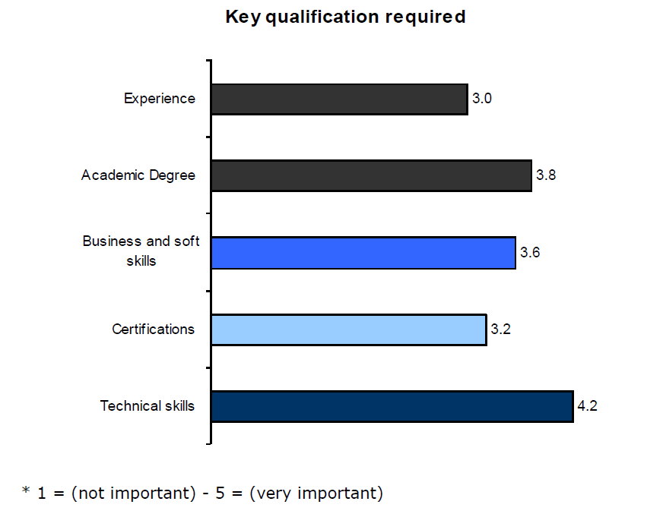
Sample…
Key qualifications required by the ICT companies when hiring a new employee
More than 40% indicated that fresh graduates do not have skills for the job role of “Business Analyst”.
82% of the ICT employees are holding a Bachelor degree; 98% of them are local universities’ graduates while 2% are foreign universities’ graduates.
http://www.moict.gov.jo/en-us/homepage/studiesandreports.aspx

Slide 18
ICT Diffusion and Use in Schools in Jordan
To measure and examine the readiness and the use of ICT in all schools in Jordan.
To create a national database on the readiness and use of ICT infrastructure.
To support and inform the policy makers in their decisions to invest in ICT in education.
To assist in developing plans, strategies and programs that support educational development based on the educational reform for the knowledge economy.
To help the private sector companies/organizations in their strategic planning regarding the use of ICT in education in Jordan.

Slide 19
Sample …
Schools with at least one computer lab
Students per computer ratio

Slide 20
Sample…
Schools with access to Eduwave
http://www.moict.gov.jo/en-us/homepage/studiesandreports.aspx

Slide 21

Jordan ICT Info Database
National ICT Information Committee
To identify the Key Performance Indicators (KPIs) on national Level, and collect and update information accordingly.
To identify and unify the source of Information nationally.
To act as a single source of Information for National and International organizations.

Slide 22

Jordan ICT Info Database
MoICT developed a national level database of ICT Key Performance Indicators (KPI)- (DevInfo Tool).
To be available online for all interested stakeholders
http://ictinfo.moict.gov.jo
Analysis tool
Monitoring Tool

Slide 23
Thank you

