Slide 1


Next Generation ICT Indicators: Challenges and Opportunities
Dr Tim Kelly,
Lead ICT Policy Specialist, World Bank
ITU Regional Workshop on ICT Indicators, Sharm El-Sheikh June 8 2012

Slide 2
Agenda
If you could only collect one ICT indicators, what would it be?
Historically
Now
Broadband pricing
Fixed
Mobile
What indicators should we be collecting tomorrow?
Usage
Applications
Impact
Price / Price margins
World Bank (2012) Information and Communication for Development: Maximising Mobile
Sneak preview

Slide 3
If you could collect only one ICT indicator, what would it be?
In the 1970s, Fixed lines per 100 inhabitants
In the 1980s, Fax machines per 100 inhabitants
In the 1990s, Price of a 3 minute international call
In the 2000s, Mobile subscriptions per 100 inhabitants
So what should it be in the 2010s?
Smartphones?
Social media users?
Mobile broadband users?
IP addresses?
International data traffic?

Slide 4
The Key ICT Indicator
Price per 1 Mbit/s of broadband internet (fixed) Price per 1GB of data (mobile)
Why?
Price is the key indicator for consumers
Internet connectivity will be the platform for most ICT services (voice, data, video, mobile BB, social media etc)
Broadband connectivity is critical to competitiveness
Using a standard measurement (1 Mbit/s or 1GB) makes comparisons simpler and more meaningful

Slide 5
Fixed broadband pricing
Price per 1 Mbit/s per month
Note: Entry level unlimited packages of at least 1 Mbit/s download speed, largest operator
Source: Adapted from incumbent operator tariff info.

Slide 6
Mobile broadband pricing
Note: Postpay plans offering minimum of 1GB. * includes certain amount of free voice calls/SMS. ** Speed reduced after exceeding cap (all others require extra payment. Source: Adapted from operator tariff plans.
6

Slide 7
What indicators should we be collecting tomorrow?
Usage
Actual bandwidth consumed per inhabitant (downloaded/uploaded)
Social media use
ICT contribution to GDP (%)
Applications
Range of applications available / % of locally-developed applications
Number of users of mobile money, eHealth, eGovernment etc
Impact
What difference does ICT really make?
Savings for users (cash/time)
Efficiency gains (reduction in waiting time etc)
Reduction of price and information asymmetries
Prices / price margins
Unit prices (per SMS, per call, per financial transaction etc as well as per Mbit/s)
Margin between wholesale and retail broadband prices (per Mbit/s)

Slide 8
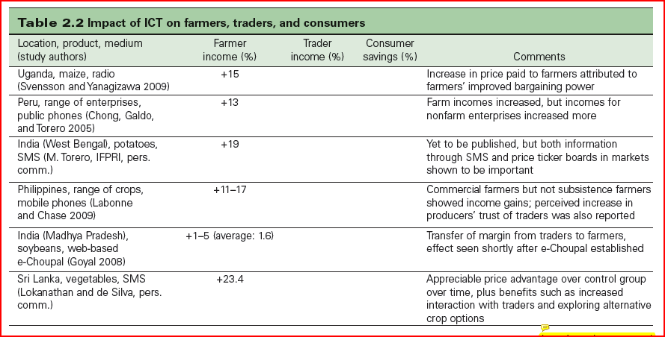
Example of impact evaluation
Source: World Bank ICT in Agriculture eSourcebook, (2012) www.ICTinAgriculture.org

Slide 9
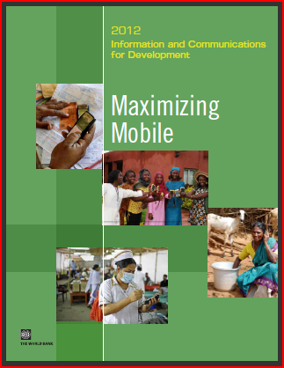
Information and Communications for Development 2012: Maximizing Mobile
Overview
Agriculture
Health
Financial Services
Entrepreneurship and Employment
Government
Mobile Broadband
Statistical Appendix
Available 9 July 2012

Slide 10
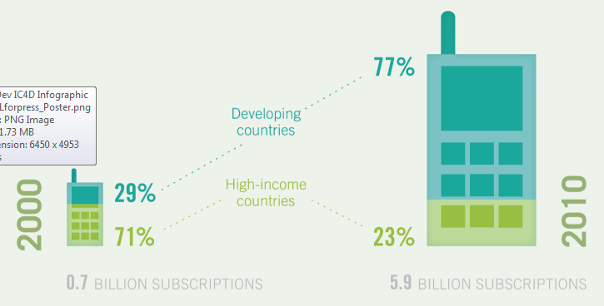


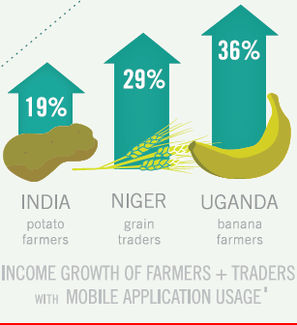
IC4D 2012: Main Messages
Around three-quarters of the World’s inhabitants now have access to a mobile phone
The developing world is “more mobile” than the developed
Mobile phones empower users enrich lifestyles and livelihoods and boost economic growth
Near ubiquity brings new opportunities
Engaging mobile applications for development requires an enabling ecosystem
The mobile revolution is right at the start of its growth curve

Slide 11
For more information …
www.worldbank.org/ict/ic4d2012
www.eTransformAfrica.org

