Slide 1


ENHANCING LIFE
Fiber in the Access: A Game Changer
Gamal Hegazi
Founding board member,
Chair Technology committee
FTTH Council MENA
Regional Arab ITU 2012
Sharm , June, 2012

Slide 2
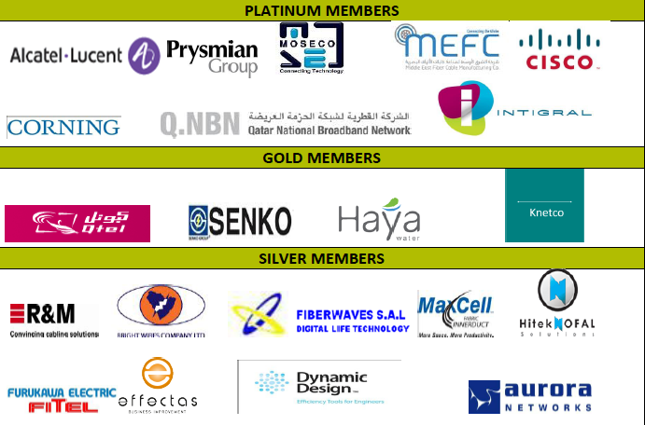
The FTTH Council MENA
FTTH Council MENA is founded as non-profit organization in since 2011 with the mission to accelerate the FTTH deployment in Middle East and North Africa.
Our members are from the main FTTH industry players of the region including Vendors, National and Private Networks, Governments, Service operators, Utilities. Since July 2011, 8 Platinum members, 4 Gold and 9 Silvers and 4 ongoing.
ENHANCING LIFE

Slide 3

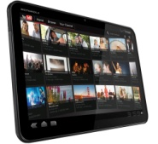
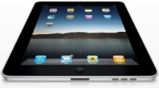





Data and Video Explosion
Fix BB users [M]
37% of internet traffic during primetime is online video
600
300
2007
2011
2015
Users
680M fixed BB users by 2015
Devices
1.2 billion IP-enabled devices by 2014
Video
~ 70% of internet traffic by 2014
x
x
… DRIVING EXPONENTIAL INCREASE IN NETWORK CONSUMPTION
Sources: Bell Labs analysis
Notes:
It is all about video. In US, today 37% of internet traffic during primetime is on-line video, and in few years it will increase to 70%.
Our networks have to cope with: more devices (mobile, tablets, 3DTV etc) + more users + more video content

Slide 4
Global Broadband penetration
Studies showed that the current household Broadband penetration in the Middle East and Africa region is only 10% vs. the other regions.
ENHANCING LIFE

Slide 5
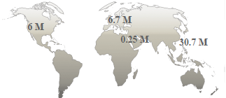
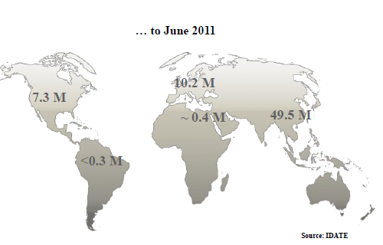

Global FTTH/B Market
From June 2010…
ENHANCING LIFE
Notes:
5

Slide 6
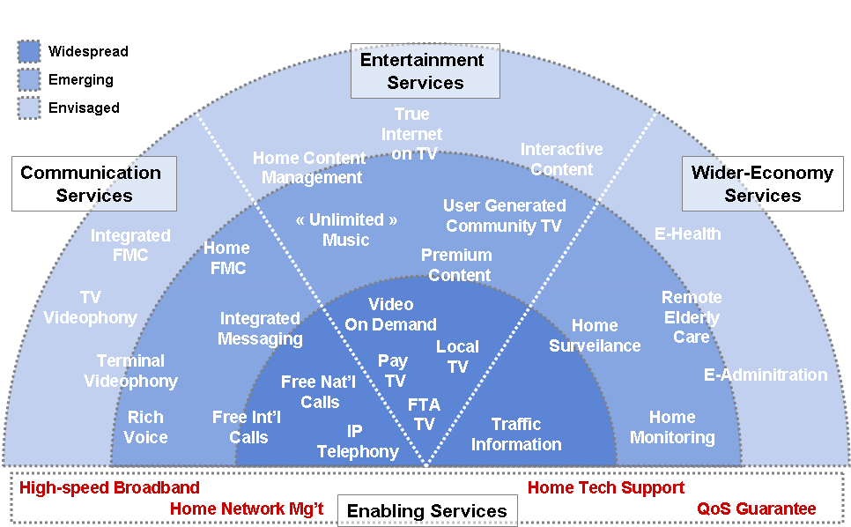
Connected Experience… Connected Life… Connected Home…
Transformation of society is happening
Residential Customers
Enterprise Customers
Fiber-To-The-Home
Fiber-To-The-Office
Quality of Experience matters
Enterprise rethink “converged”

Slide 7

Benefits for Business and the Nation at large
FTTH
Cloud Computing
Telepresence: High quality video comms
Intelligent Power Grid
Virtual companies:
on demand enterprises
E-Government
Online Entertainment
E-Education
E-Health
FTTH

Slide 8
Benefits for the users and consumers
Browsing
Home Monitoring
IPTV & HD and 3D VoD
Enhanced Video-Communications (e.g. care for elderly people)
FTTH
100+ Mbit,
IP Phone
Online Gaming
no delays
interactive environments
virtual communities
ENHANCING LIFE
ENHANCING LIFE

Slide 9
Expected continuous bandwidth growth
50 Mb/s / sub (100 Mb/s peak)
20 Mb/s
HSI
VoIP
OTT
SD
SD VoD
HD
HD VoD
3DTV
Femto
20% CAGR expected bandwidth growth
Sources: FTTH Council; Operators; Alcatel-Lucent
Global peak and average bandwidth have demonstrated their ability to grow consistently. 100Mbps will eventually become commonplace.

Slide 10


Various Architectures to reach the customers
PON or P2P 100+ Mb/s
ADSL2+ ~10-20 Mb/s
FTTH
VDSL2 ~30 Mb/s
VDSL2 bonding ~60 Mb/s
VDSL2 ~30 Mb/s
CENTRAL OFFICE
FTTN
FTTB or FTTC
Mobile
VDSL2 & vectoring ~50-100 Mb/s
VDSL2 vectoring ~100 Mb/s
Notes:
Broadband services adoption is fast, massive and addictive (example of social networks amongst young people).
Adoption of BB is not linked only to entertainment - it is an engine for socio-economic development and influence every aspect of our lives, including business, health, security etc. New services are emerging every day, putting more requests on the networks.
Although everybody is aware that all-fiber networks is the target solution, the question is how are we getting there. The road to all-fiber will not be the same for everybody and in many cases we will have mix of technologies, including legacy copper/cable, new fiber deployments and wireless.
While technology innovations allow for bandwidth and service evolution, the next challenge is to make efficient and smart networks to manage increased traffic streams and variety of services. This session will explore how to make fiber network ready to deliver any type of service in any type of business model

Slide 11

FTTH is a broadband service enabler
Real speed
Download of 6.5 Gbyte DVD-film:
10 Mbit/s DSL: 1.44 hours
100 Mbit/s FTTH: 8.6 min
=
INTERACTIVITY
+
Symmetry
Upload of 300 holiday-photos (700 Mbyte):
1 Mbit/s Upstream: 92 minutes
10 Mbit/s Upstream: 9 minutes
100 Mbit/s Upstream: 56 seconds
FTTH improves the way
people live and work with symmetry and speed
and interactivity
Notes:
11

Slide 12











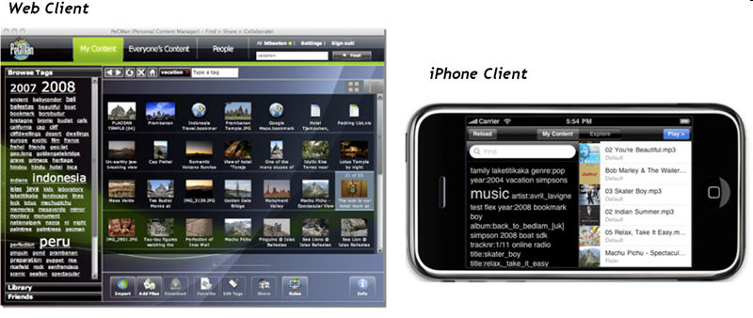
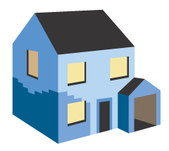
A New connected experience
Home Management
Communication
Digital
Life
Console
Self Service Console
Customer
Service
Console
“Cloud”
Service Management Platform
Managed Multimedia
HDM
HSM
Home View
BCM
Web Applications
FTTH
Internet
Connected Digital Home
Enable media sharing
Enable bandwidth
Enable applications
10G PON
Utilities Provider
Security Provider
>1000
GPON
Healthcare Provider
Home Control Provider
> 1000
Service
Platform
500
500
VDSL2
100
LTE
100
DL Speed [Mbps]
ADSL2+
HSPA+
24
Aggregate content in an easy way
Organize all your personal content
Secure access to your personal content
Share effortlessly
24
SHDSL.bis
10
10
ADSL2
APP 1
APP 2
APP 3
APP 4
8
ADSL
Home Gateway
4
HSPA
1
GPRS
UMTS
device discovery
0,512
sensor abstraction
2000
2002
2004
service creation
2000
2006
2008
2010
2012
2012

Slide 13
Decision Criteria Flow Chart
Designated Area (Available Power)
YES
NO
Available Copper
Brown Field
Green Field
Network Overlay
Sub-Urban
Dense
Reusable Copper
Available Duct
NO
ALT-2
Alternate
NO
FTTH
FTTB
ALT-1
YES
YES
FTTB/H
Copper Maintenance
New Duct.
New Civil Work.
New Cabinet/Manhole
FTTC/N

Slide 14



FTTH Economics and Business Cases
Market Driven
Risk Driven
Policy Driven
FTTH CAPEX (€/subs)
Tier 1 cities
Tier 2 & sub-Urban
Rural
Fiber drop
Dark Fiber
Fiber drop
Fiber drop
Trenching/ducts
Dark Fiber
Dark Fiber
Trenching ducts
Trenching/ducts
Engineering
Engineering
OSP engineering
Home HW
Home HW
Home HW
Network HW
Network HW
Network HW
Pay back period
~4 years
~8 years
> 20 years
Note: 30% take rate
The private players alone are not coping with the cost (pay back period?)…
Notes:
14

Slide 15
FTTH ECONOMICS: Public-Private GEOGRAPHICAL SEGMENTATION
100 %
Market Driven
Risk Driven
Policy Driven
Services
Private €
Fraction public to private investment
Active
Passive
Public €
0 %
Low
Socio-economic impact of fiber
High
Socio-economic impact | Low/Medium | Medium | High
Investor Payback Time | ~5 year | ~10 year | ~20 year
Public Sector Intervention | Access to infra, RoW, in-house labeling.. | Ducts, sewers, dark fiber. Active? | Passive, active. Utility services?

Slide 16
MENA FTTH Homes Passed indicators
NUMBER OF HOMES PASSED BY FTTH/B, 2010-2011 (000)
Country | 2010 | 2011 | Y-o-Y Growth
The Gulf Countries:
Bahrain | 7.9 | 10.1 | 27%
Kuwait | 65.0 | 80.7 | 24%
Oman | 7.7 | 10.1 | 31%
Qatar | 13.3 | 77.7 | 486%
Saudi Arabia | 29.5 | 115.2 | 290%
UAE | 985.7 | 1,186.8 | 20%
African Countries:
Algeria | 3.0 | 20.0 | 567%
Egypt | 55.3 | 57.3 | 4%
Morocco | 0.1 | 0.1 | 67%
South Africa | 19.5 | 23.8 | 22%
Tunisia | 3.2 | 5.0 | 56%
The Levant Countries:
Iran | 0.0 | 0.0 | 0%
Iraq | 2.5 | 8.0 | 220%
Jordan | 2.0 | 2.6 | 32%
Lebanon | 4.7 | 5.0 | 6%
Syria | 0.8 | 1.2 | 50%
Overall | 1,200.2 | 1,603.7 | 34%
Source: Pyramid Research, based on operator data
ENHANCING LIFE

Slide 17
Opportunities: FTTH Homes subscribed
COUNTRIES | NUMBER OF HOMES PASSED BY FTTH/B 2011 | FTTH/B SUBSCRIBERS 2011 (000) | TAKE RATE
UAE | 1,186.80 | 445.2 | 38%
Saudi Arabia | 115.2 | 35.4 | 31%
Kuwait | 80.7 | 5.4 | 7%
Qatar | 77.7 | 6.1 | 8%
Egypt | 57.3 | 4.9 | 9%
Algeria | 20 | 0.6 | 3%
Bahrain | 10.1 | 3.1 | 31%
Oman | 10.1 | 1.6 | 16%
Iraq | 8 | 0.6 | 8%
Tunisia | 5 | 1 | 20%
Lebanon | 5 | 0.5 | 10%
Jordan | 2.6 | 0.6 | 23%
Syria | 1.2 | 0.4 | 33%
Morocco | 0.1 | 0.1 | 100%
32% average take rate
ENHANCING LIFE

Slide 18
MENA dynamics
Main architecture deployed
Dwellings deployed
30% SDU
70% FTTB
30% FTTH
70% MDU
Source: FTTH Council

Slide 19
FTTH BUSINESS MODELS ALONG THE 3 LAYERS
Vertically Integrated
Passive Sharing
Active Sharing
Full separation
Service
Vertically Integrated Operator
Vertically Integrated Operator
Vertically Integrated Operator
Vertical Service Provider
Vertical Service Provider
Vertical Service Provider
Retail Service Provider
Retail Service Provider
Retail Service Provider
Retail Service Provider
Retail Service Provider
Retail Service Provider
Active
Vertical Infrastructure Provider
Network Operator
Passive
Infrastructure Owner
Infrastructure Owner
Competition
Infrastructure Competition
Service Competition
Regulation
Access to public infrastructure
Regulated passive wholesale
Regulated active wholesale
Regulated passive & active wholesale

Slide 20
FTTH a key economic driver
FTTH is a critical driver for the knowledge economy
Deployment of FTTH creates jobs
New services create GDP growth, not only from ICT industry (entertainment industry etc.)
FTTH creates business opportunities & competitiveness
Operators: increased ARPU (30%!), lower churn-rate, OPEX savings
Businesses: new ways of working, reduced travel & office rental costs, better time management, more innovation, better competitiveness
Regions/Municipalities: retain and attract more businesses & investment, offer cost-efficient services to the community, increase local competitiveness
Notes:
20

Slide 21

After Jordan 2009, Lebanon 2010, Egypt 2011... Qatar in December 2012!
www.ftthcouncilmena.org
ENHANCING LIFE

Slide 22
THANK YOU
شــكــرا“
www.ftthcouncilmena.org
ENHANCING LIFE

