Slide 1


ITU Regional Workshop on “ICTs for Women's Empowerment in the Arab Region” Kuwait, 5-6 Oct. 2011
The effect and impact of the gender dimension in rural development projects : women’s empowerment

Slide 2
TAOURIRT TAFOUGHALT
RURAL DEVELOPMENT PROJECT
(IFAD – Kingdom of Morocco)

Slide 3
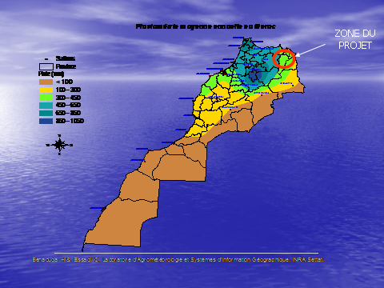

Slide 4
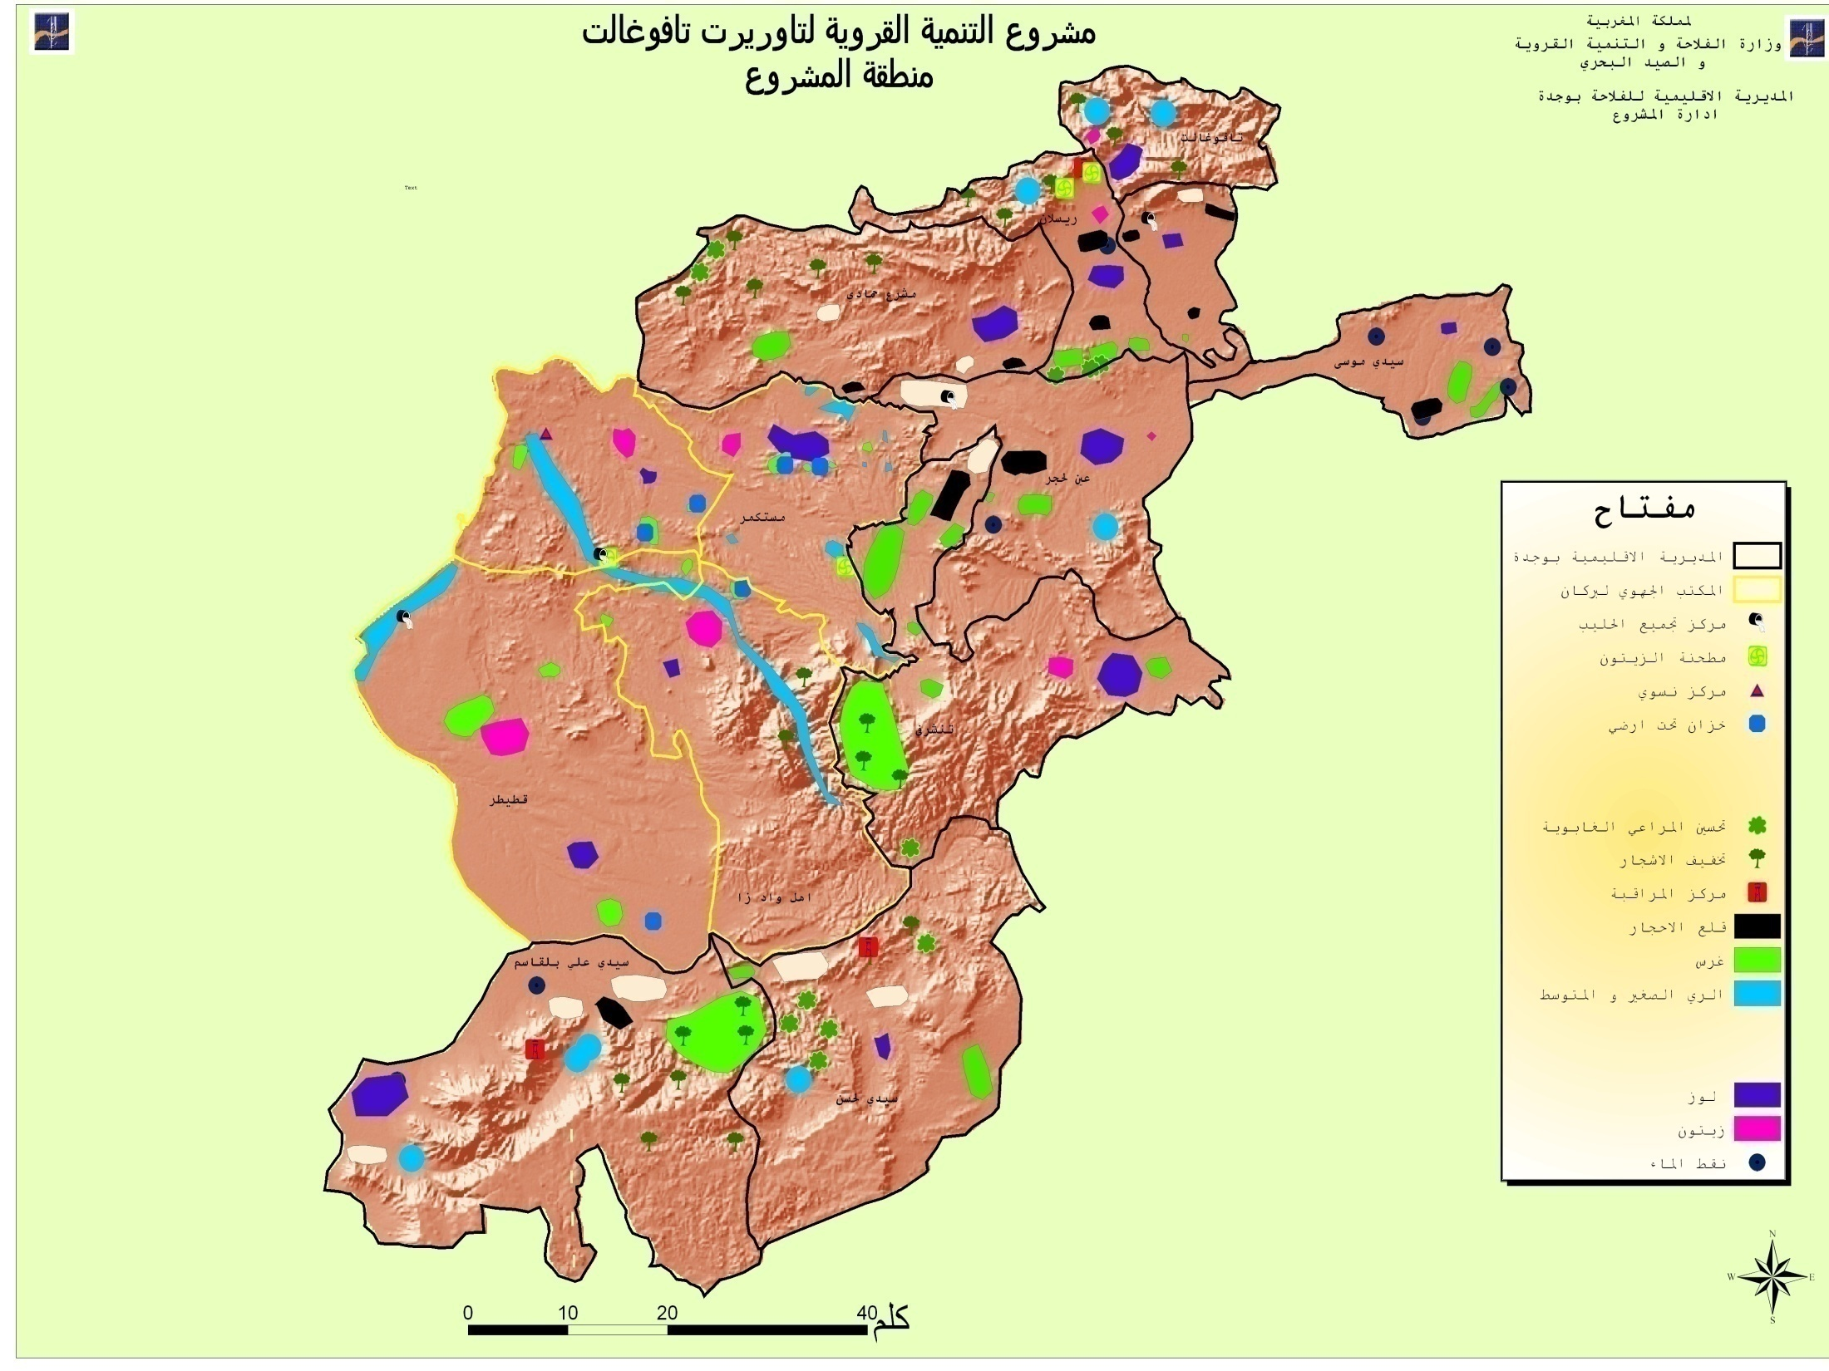

Slide 5
PROJET AREA
101 000 INHABITANTS
14 000 HOUSEHOLDS
17 400 FARMERS
FARMERS WITHOUT EDUCATION : 84 %

Slide 6
SITUATION BEFORE PROJECT
Degradation of natural resources
Households poverty
Low agricultural productivity

Slide 7
SITUATION BEFORE PROJECT
Limited water resources
Women with unstable socio economic situation
Access of rural women to resources is limited

Slide 8
SITUATION BEFORE PROJECT
lack of health infrastructure in project area
The enrolment rate in the project area
70% for boys 50% for girls

Slide 9
High percentage of women’s illiteracy
ICTs are not available
Inernet users

Slide 10
WOMEN ACTIVITIES
Livestock
Firewood
Transportation of water
Handicraft

Slide 11
GENERAL OBJECTIVE OF PROJECT
Improving socio economic conditions of people living in the project area
Improving the quality of life of the rural women
Protecting the environment and preserving the natural ressources

Slide 12
SPECIFIC OBJECTIVES OF P R O J E T
Rational management of rangelands, forests, and available water resources
Increasing added value to agricultural production
Socio economic promotion of women and young rurals

Slide 13
PROJECT COMPONENTS
IMPROVING AGROPASTORAL
IMPROVING SYLVOPASTORAL
IMPROVING USEFUL AGRICULTURAL LAND
IMPROVING IRRIGATION
PROMOTION OF RURAL WOMEN (IGA)

Slide 14
OBSTACLES(Barriers)
ACCESS TO INTERNET (in general provided in others languages, internet penetration, traditional technology, Video, Films, Photos)
ACCESS TO RESOURCES
CONTROL OF RESOURCES
Gender stereotypes
EDUCATION AND LITERACY NEEDED (use of ICTs)

Slide 15
THE PROJECT APPROACH
The gender approach as an analytical tool in rural development projects to provide opportunities for women to maintain their income to an acceptable level and to ovoid their marginalization (the implementation of the gender approach in the field)

Slide 16
The contribution of women engineers in the rural development projects (an opportunity to benefit from ICTs in order to develop skills)
Apply participatory approach and gender analysis in the project design and implementation
Apply Geograpgic Information System (GIS)

Slide 17
The contribution of women engineers in the rural development projects
technical support
training course
Literacy classes
techniques and development of feasibility studies
practical applications
Management

Slide 18
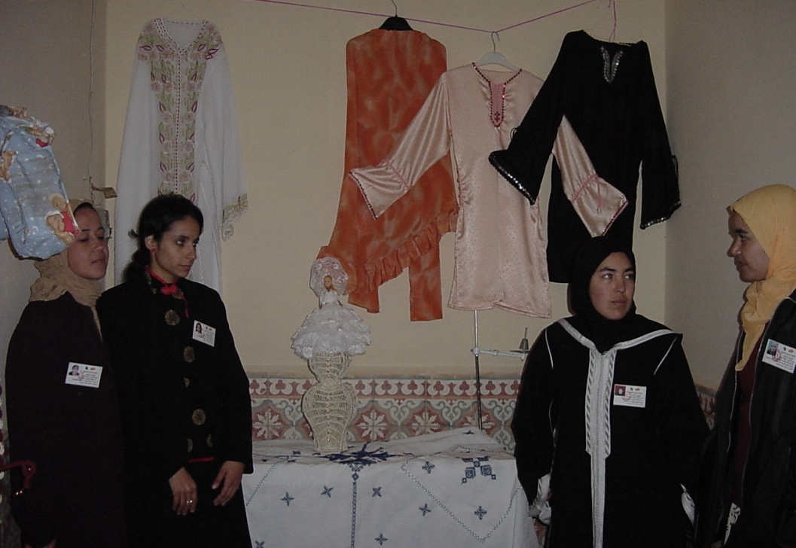
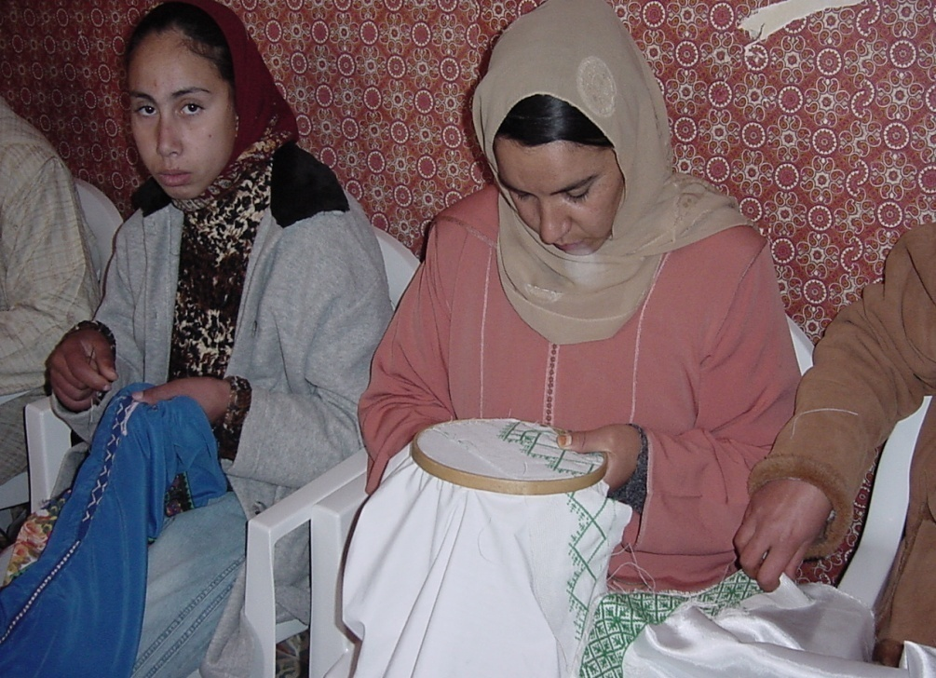
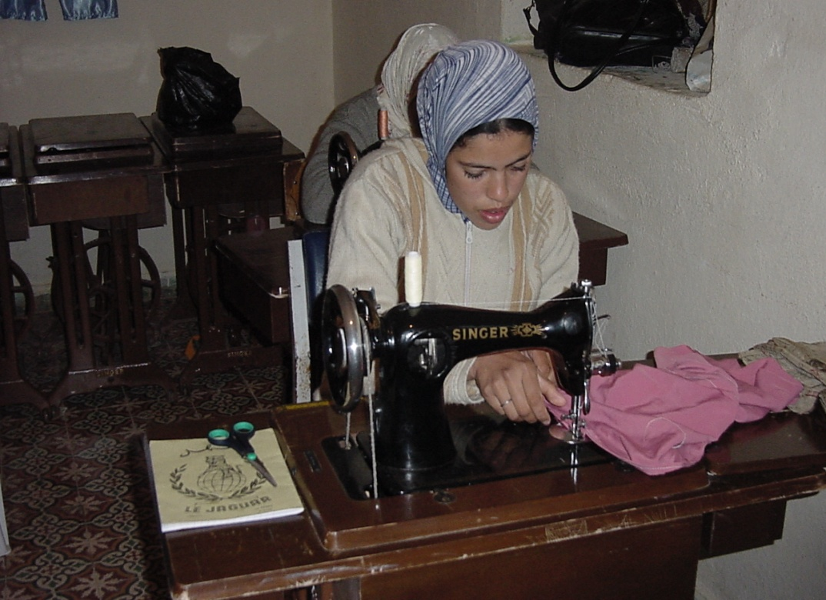
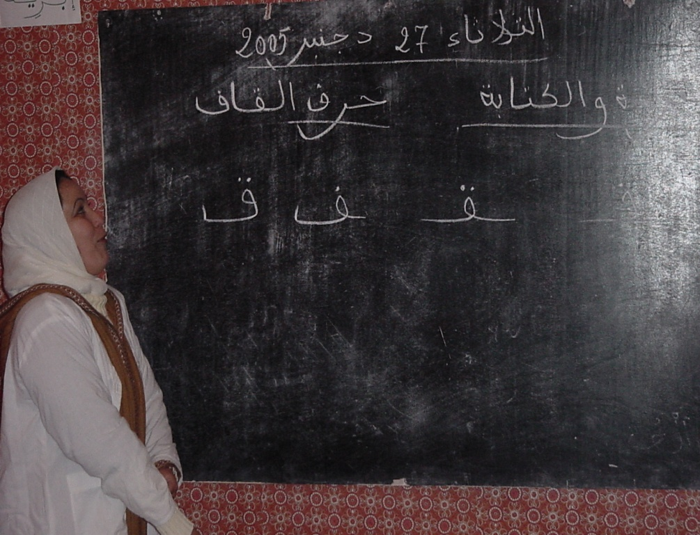

Slide 19
The contribution of women engineers in the rural development projects
Accounting Animal Production (Livestock development)
Crop Production
organisation of the women in associations
development of human and natural capital

Slide 20
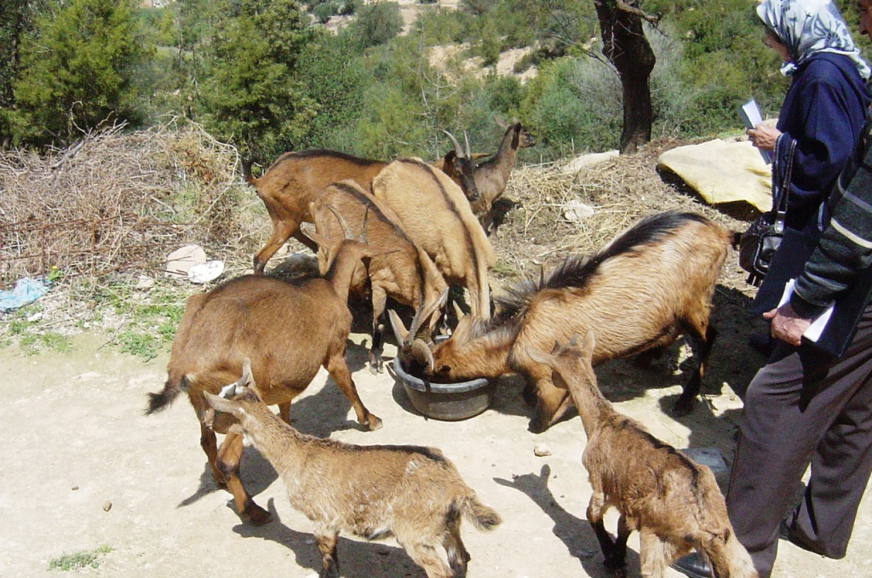

Slide 21
The contribution of women engineers in the rural development projects
market analysis
communication skills
negotiation skills
capacity building
Coaching
Extension

Slide 22
KARIANET
Knowledge Acces in Rural Interconnected Areas Network
Network based on ICTs
Improve communication between members

Slide 23
KARIANET
Rural development projects (SWOT)
Facilitate access to information
Experiences (Best Practices from projects )
Skills developed
Opportunity to share Knowledge by internet

Slide 24
The effect and impact : quantitative measurements
Indicators (logical framework - PM- ICTs )
COST-BENEFIT ANALYSIS

Slide 25
FINANCIAL EVALUATION

Slide 26
Switching Values at 13.5%
==========================
Appraisal Switching Percentage
Stream Value Value Change
-------------------------------------------------------
B1 72779.4 39329.3 -46.0%
C1 39329.3 72779.4 85.1%
-------------------------------------------------------
Net Present Value at OCC 13.5% = 33450.0
Internal Rate of Return = 64.3%

Slide 27
Internal Rates of Returns
B1 UP 10% UP 20% UP 50% DOWN 10% DOWN 20% DOWN 50%
C1 64.273 71.209 77.576 94.253 56.593 47.879 2.620
UP 10% 57.328 64.273 70.604 87.054 49.559 40.598 -99.803
UP 20% 50.924 57.934 64.273 80.584 42.981 33.616 -99.810
UP 50% 33.616 41.244 47.879 64.273 24.386 11.909 -100.000
DOWN 10% 71.942 78.926 85.374 102.377 64.273 55.682 16.644
DOWN 20% 80.584 87.675 94.253 111.696 72.849 64.273 28.099
DOWN 50% 116.922 124.805 132.186 151.992 108.436 99.207 64.273

Slide 28
ECONOMIC EVALUATION

Slide 29
Switching Values at 13.5%
==========================
Appraisal Switching Percentage
Stream Value Value Change
-------------------------------------------------------
B1 72779.4 48139.9 -33.9%
C1 48139.9 72779.4 51.2%
-------------------------------------------------------
Net Present Value at OCC 13.5% = 24639.5
Internal Rate of Return = 33.9%

Slide 30
Internal Rates of Returns
B1 UP 10% UP 20% UP 50% DOWN 10% DOWN 20% DOWN 50%
C1 33.888 38.145 41.993 51.853 29.082 23.491 -9.347
UP 10% 29.546 33.888 37.777 47.631 24.582 18.688 -99.806
UP 20% 25.463 29.929 33.888 43.793 20.274 13.950 -99.817
UP 50% 13.950 19.119 23.491 33.888 7.455 -1.855 -100.000
DOWN 10% 38.591 42.802 46.639 56.565 33.888 28.505 1.761
DOWN 20% 43.793 47.997 51.853 61.915 39.141 33.888 10.103
DOWN 50% 64.893 69.361 73.523 84.610 60.049 54.732 33.888

Slide 31
MONITORING AND EVALUATION SYSTEM CONCLUSIONS

Slide 32
Best practices shared (KARIANET)
Household poverty reduced
Capacity of rural women was strengthed
Rural poverty was reduced espcially among rural women
Nutrition Improvement

Slide 33
The work of rural women Reduced
produvtivity increased
women's income improved
household food security improved
Business opportunities for women imroved
Women ecnomic empowerment

Slide 34
Thank you for your attention
Mohammed BEN HAFOUNE
Engineer. Agricultural Economics
benhafou@yahoo.fr
benhafoune@yahoo.fr

