Slide 1
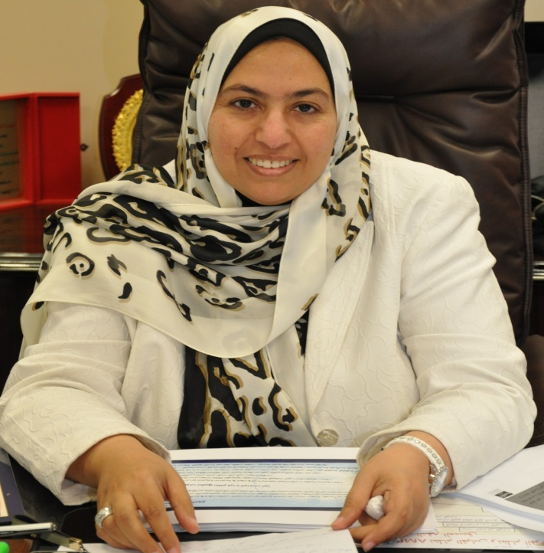
Curriculum Vitae
Name: Iqbal Ahmed AL-Tayar
Education: Bachelor of Mechanical Engineering
Kuwait University
Professional experience:
- First engineer in the ministry site in the water sector projects
- Director of technical control since 1992
- saving team manager of the sector (government and private)
- Member of the National Committee for green buildings.
- Professor of the Public Authority for Applied Education and Training since 2000
- Professor in the rehabilitation program the ministry of new engineers
- Member of the Association of Engineers
- Expert and member of the Judicial Arbitration Commission at the Ministry of Justice
- Expert and member of the Bar Center schedule of arbitrators for arbitration
- Member of the U.S. global in the Kuwait Centre for Commercial Arbitration
- Member of the World Organization of American Value Engineering (save)
And a certificate from the architect of my values ​​Saif International Association of America.
- Member of the Association of Energy Engineers U.S..
- Member of the ASHRAE HVAC

Slide 2






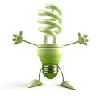


MEW EFFORTS
IN REDUCING ELECTRICITY
AND WATER CONSUMPTION
IN GOVERNMENT AND PRIVATE
SECTORS IN KUWAIT
State of Kuwait
Ministry of electricity and water
Engineer: Iqbal AL-Tayar

Slide 3
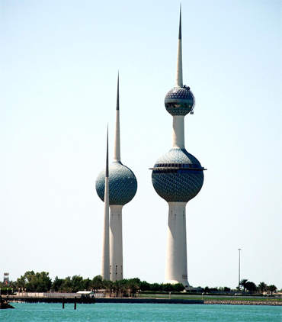
Introduction
State of Kuwait achieved a tremendous growth in all the sectors, which increased the demand & consumption of electric power.
From 80’s M.E.W start awareness Campaign.
From 2003 M.E.W start Energy conservation projects with KISR.
summer 2006, the start of Disaster of a programmed energy cutting in all Kuwait areas.
The government planning to the establishment Executive Committee of the rationalization in Government and Private Buildings.

Slide 4

Government Plan
Rationalizing Electricity Consumption
Governmental Buildings
Private Buildings
Private Residence
Ministries buildings & Institutions
Banks, Hotels, & Commercial complexes

Slide 5
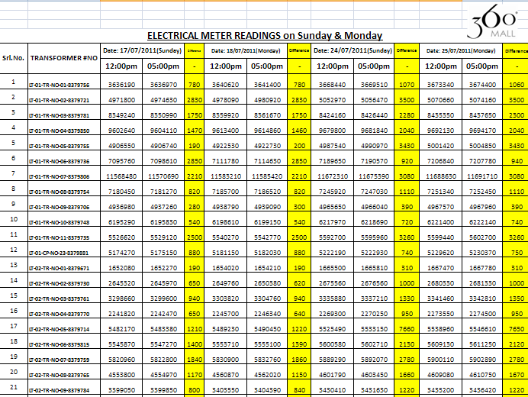
Electrical Meter Reading

Slide 6
Monthly Saving in Summer 2011

Slide 7
Total Saving in Summer 2011

Slide 8
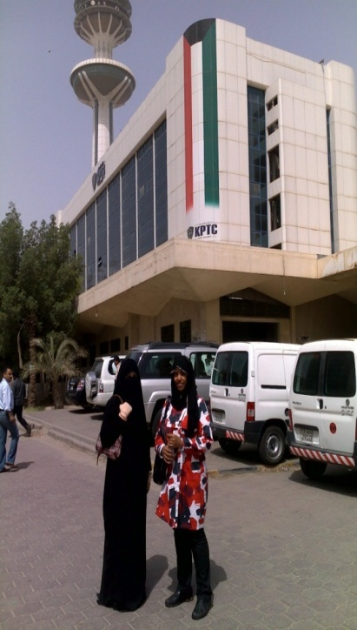
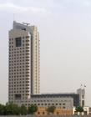

Governmental Buildings
Electricity Rationalizing
Green Buildings ( Ministries Complex).
Improve all codes.
Prepaid system.
Smart Operating for air conditioning & lighting to reduce electrical load during peak hours, using fluorescent lights…
Awareness Campaign for the employees(Brochures, posters ... ).

Slide 9
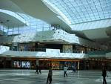
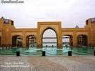

Private Buildings
Electricity Rationalizing
Smart Operating for air
conditioning & lighting to reduce
electrical load during peak hours,
using fluorescent lights…
Expeditions are held in the malls.
Awareness Campaign for the citizens included:
Participating in expeditions,
Seminars are held ( Schools, Universities),
Media campaigns ( TV, Radio, Brochures).

Slide 10
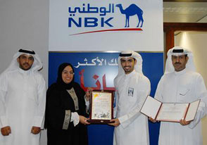
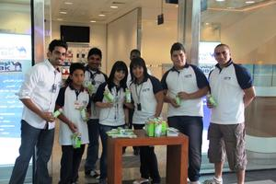
Kuwait National Bank
NBK recently launched its energy conservation awareness campaign tagged "Put your energy into saving energy". NBK volunteers handed out 10,000 long life energy-saving light bulbs at the Avenues Mall.

Slide 11
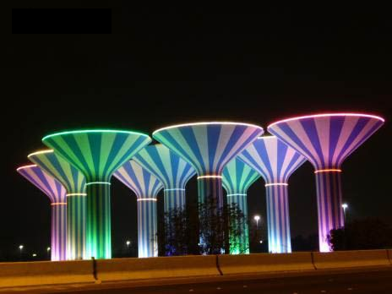
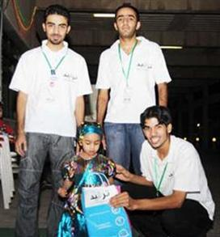

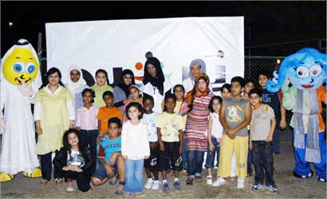
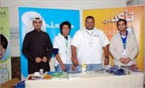
Private Residence
Electricity Rationalizing
Awareness Campaign for the citizens included:
A campaign for Society of Engineers cost 10 million K.D
Distribution of water conservation tools
Participating in expeditions,
Seminars are held ( Schools, Universities),
Media campaigns ( TV, Radio, Brochures).

Slide 12
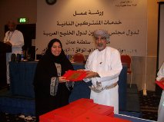
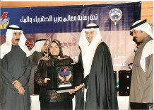
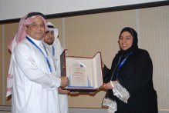
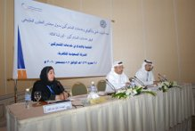
Awards

Slide 13

Conclusion
Work Hand in Hand
For a Green Environment

