Slide 1
Spectrum Economics
By: TRA, UAE at the ITU Regional Workshop on
Efficiency of the Frequency Spectrum Use in the Arab Region;
Amman-Jordan, 5-7 Dec. 2011

Slide 2
Objective
The objective is to give an introduction to the economic aspects of spectrum management
The economic aspects require an understanding of “Economics”
Introduce participants to the ITU work on spectrum economics

Slide 3
Contents
Features of Radio Spectrum
Spectrum Market: Supply and Demand
Spectrum Economics
Resolution 9
ITU-R SM 2012
Strategies for economic approached
Value of spectrum

Slide 4

Quotation: ITU Secretary General
Today, there is virtually no aspect of our lives which does not make use of the radiofrequency spectrum in some way.
Many spectrum management tasks and issues go well beyond the limits of engineering science, and require legal and economic experience.
Speech by ITU Secretary-General, Dr Hamadoun I. Toure
Middle East Spectrum Conference 2011
29 March 2011, Dubai, United Arab Emirates

Slide 5
Features of radio spectrum
Spectrum is a finite and scarce resource.
Spectrum is an intangible resource freely available to society.
Spectrum is owned by the state (it is a public resource (asset)) and leased (spectrum rights) under various terms to users.
Spectrum is available in same quantity to each state and is considered as a national natural resource.
Spectrum does not get depleted with use.
Spectrum can be put into several uses
Not all spectrum is the same
Spectrum is the lifeline (prime asset) for all wireless services
Some wireless services generate good economic benefit
Depending on the level of need, some may value spectrum more
Spectrum management (administrative, legal, technical and economics)
Poor management, more entropy, lower economic efficiency
Notes:
If we look at all the text (Bold and in blue), these are all economic terms. Words commonly used in everyday life acquire very specific technical meanings in economics.

Slide 6
Not all spectrum is equal
Electromagnetic spectrum
Electric
Waves
Radio
Waves
Infra-red
Visible
Light
Ultra
Violet
X-Rays
Gamma
Rays
Cosmic
Rays
Radio Spectrum
“Sweet spot”
UMTS
FSS
TETRA
DECT
Wi-Fi
LTE
GSM
Long Wave Radio
Medium Wave Radio
FM Radio
Microwave Radio Links
TV
VLF
LF
MF
HF
VHF
UHF
SHF
EHF
3
30
300
3
30
300
3
30
300
kHz
MHz
GHz
Increasing Range
Decreasing Bandwidth
Decreasing Range
Increasing Bandwidth
RESULT: Sweet spots or beach front property based on the economic benefits that can be generated e.g. cellular applications
Notes:
The demand for spectrum is impacted by the application (public, safety, private, science, etc)
Propagation, technical parameters, availability of equipment, antenna size are the other factors which affect the demand for certain portions

Slide 7
Spectrum market: Supply & Demand
The demand for spectrum in certain bands has grown markedly and more often demand is greater than available supply .
The willingness of users to pay for certain spectrum impacts the demand.
The demand for spectrum increases as the price of spectrum falls.
Unlike in most markets, spectrum prices are determined via an administered process.
One of the aims of administered spectrum pricing is to ensure that supply and demand for spectrum are balanced.
Balance on the Spectrum market can be achieved by price-setting methods implementation for Spectrum Management.

Slide 8
What are the objectives of spectrum pricing?
Mechanisms to assist financing national spectrum management? | 
Additional tools to assist when demand exceeds supply? | 
Opportunities to decrease national regulation? | 
Mechanisms to increase flexibility to respond quickly to market needs? | 
A “Spectrum Tax” to raise revenue for the government? | 
A complete replacement for “traditional” spectrum management? | 

Slide 9
Strategies for economic approaches
What are the underlying principles to finance the maintenance & development of national spectrum management?
What economic approaches have been, or are intended to be used to promote efficient national spectrum management?
What are the advantages and disadvantages of the various economic approaches?
What are the factors (e.g. geographical, topographical, infrastructural, social, legal) that could affect these approaches and how would they vary with the use of radio in a country and the level of that country’s development?
Comparison of the benefits and costs of particular spectrum management options (e.g. in terms of employment or Gross Domestic Product)

Slide 10
Legal principles
Property of the State, managed in the interests of the national community.
State can ask the users to pay spectrum usage fees.
Planning, management and monitoring require equipment & investment, spectrum occupants also to pay administrative fees (service fees)
The Law defines the rights and fees and who collects
All spectrum fees must respect rules of transparency, objectivity, proportionality and non-discrimination (Be simple to read)
The rules must be stable over time with the necessary visibility.
In return for the fees, users enjoy protection under the relevant provisions of the regulations in force. By contrast, users on secondary basis (e.g. SRDs) are not protected and should therefore not be required to pay fees.

Slide 11
Economic principles
Spectrum managers want Optimum spectrum occupancy and effective frequency utilization.
Reasons for the fees should be outlined.
Enable achievement of the budgetary objective
Not to clash with the economic objectives for national development and the development of new services
Should systematically take account of inflation and the evolving status of the spectrum manager’s budget
Constitute a tool for spectrum management
Take account of all the benefits that occupants derive from the spectrum
Should not disrupt the market

Slide 12
Reality principles
Fees should not be introduced for collective use of spectrum (license exempt)
Choice of parameters to be used for fee calculation, should be easy to verify for values to be declared by the users (e.g. height of a station antenna or number of mobile stations in a private network).
Fee system should be based on a consensus among all the players through public consultation
Checks on collection and penalties be clearly defined
Regulatory impact assessment be used for evaluating the results of the fees system in terms of benefits accrued.

Slide 13
Spectrum Economics: A sovereign right
CS 195, 196 and RR Preamble 0.2 and 0.3
“Members shall endeavour to limit the number of frequencies and the spectrum used to the minimum essential ………”
“…….. Radio frequencies ….. Are limited natural resources and they must be used rationally, efficiently and economically, in ………”
ITU Conventions:
Article 11 deals with ITU-R Study Groups.
CV 155 “ These studies shall not generally address economic questions, but when they involve comparing technical or operating alternatives, economic factors may be taken into consideration”
Article 17 deals with ITU-D Study Groups.
CV 214 “… shall deal with specific telecommunication questions of general interest to developing countries enumerated in No. 211 …….”
CV 211 (WTDC) “…… They shall serve as a forum for the study of policy, organizational, operational, regulatory, technical, and financial questions, ………..”

Slide 14
Spectrum economics studies at ITU: History
In early 1990s computer systems became popular and spectrum management records were transferred on automated systems.
In 1995 the Spectrum Management Handbook was issued.
The 1995 Radio Assembly recommended that ITU-R SG1 study on an urgent basis “Economic Approaches to National Spectrum Management” and accelerate the development of a report.
ITU-R Report SM.2012-1 was issued (1997)
The main purpose of the report is to describe to developing countries methods of obtaining adequate financial resources to implement an effective national spectrum management system. The development of this report was primarily for the ITU-D sector and was accomplished in cooperation with ITU-D members.
WTDC-98 adopted Resolution 9: “Review of national spectrum management and use of the spectrum”. In 1999 a joint ITU‑R/ITU‑D group was established
WTDC-02 revised Res 9 and included in the scope of the Joint Group, a report in answer to Question 21/2 "Calculation of frequency fees"
Notes:
http://www.itu.int/ITU-D/study_groups/SGP_2006-2010/documents/resolution_9.html

Slide 15
Spectrum economics studies at ITU: Res 9
Report on Res 9 was presented to WTDC-06.
WTDC‑06 requested the Joint Group to continue the development of the "Spectrum Fees" database and provide additional guidelines and case studies, based on practical experiences of administrations in the field of spectrum fees.
In 2007, Administrative Circular CA/167 was circulated with a 3 part questionnaire.
Part III of the questionnaire deals with the "calculation of spectrum fees“ containing questions on national methods for calculating fees for spectrum use
Electronic format of a document structure bringing together the calculation formulas and frequency fee amounts applied by different countries for different radiocommunication usages in the various frequency bands concerned.
Report on Res 9 was presented to WTDC-10.
Draft mandate for study period 2010-14 also submitted to WTDC-10
Notes:
BDT Focal Point for Res 9 is Mr. Istvan Bozsoki
BR Focal Point for Res 9, is Mr Philippe Aubineau

Slide 16
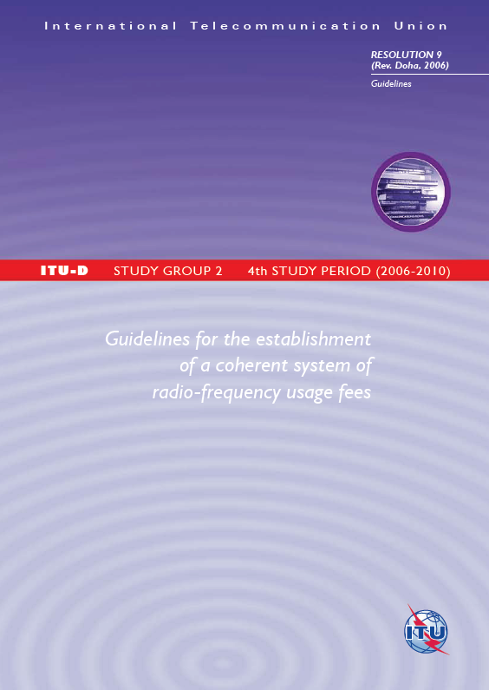
Res 9 Guidelines
BDT has published “Guidelines for the establishment of a coherent system of radio-frequency usage fees” based on the work undertaken during the study period 2006-10
Guidelines are other than the report on Res 9
Contents of the report
    Basic principles (Legal, economic, reality)
    Guidelines for the establishment of administrative fees
    Guidelines for the establishment of spectrum fees
    Recommendations for international comparison of the fees applied
    Outline of recommended fee system
    Examples of fees applied by administrations (France, UAE, Switzerland, Côte d’Ivoire)
Notes:
http://www.itu.int/dms_pub/itu-d/opb/stg/D-STG-SG02.FEES-1-2010-PDF-E.pdf

Slide 17
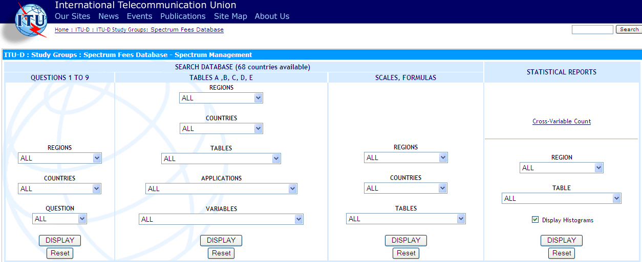
Res 9: Spectrum Fees Database
This database allows for viewing of data relating to the calculation of frequency fees. The information is based on the replies to the Questionnaire on national radio frequency spectrum management (administrative Circular CA/12 - CA/120) to seek information needed for responding to Resolution 9 of the World Telecommunication Development Conference (Rev. Istanbul, 2002).
Last date when an administration changed its information: Monday, October 27, 2003
Reference: http://www.itu.int/ITU-D/study_groups/SGP_2002-2006/SF-Database/
Notes:
Good database but limited to 68 country responses in 2003

Slide 18
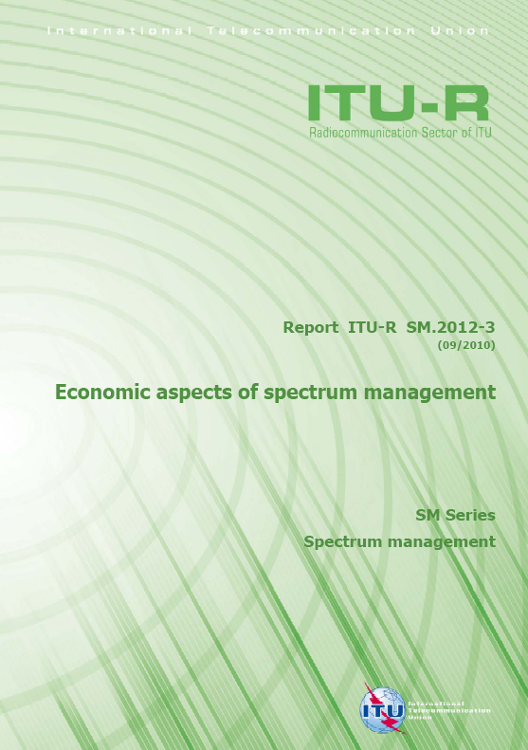
Report ITU-R SM.2012-3
Comprehensive document on Economic aspects of spectrum management
Contents of the report
    Introduction to economic considerations
    Strategies for spectrum financing mechanisms
    Assessment of the benefits of using the radio spectrum
    Guidelines on methodologies for the establishment of spectrum fees formula and system
    Administration’s experience regarding the economic aspects of spectrum management
    References
    Glossary
    Annex 1: Examples of Spectrum Fees Decree
Report available at www.itu.int/dms_pub/itu-r/opb/rep/R-REP-SM.2012-3-2010-PDF-E.pdf

Slide 19
What is spectrum economics?
Economic approaches to national spectrum management and their financing

Slide 20

Spectrum shopping
HF
1/2X $
VHF
XX $
UHF
XXXX $
SHF
XXX $

Slide 21
Spectrum scarcity increase with time
The technological advancements have made it feasible for higher spectrum to be used at lower costs
Time
VLF
LF
MF
HF
VHF
UHF
SHF
EHF
...
VLF
LF
MF
HF
VHF
UHF
SHF
EHF
...
VLF
LF
MF
HF
VHF
UHF
SHF
EHF
...
VLF
LF
MF
HF
VHF
UHF
SHF
EHF
...
VLF
LF
MF
HF
VHF
UHF
SHF
EHF
...
Radio spectrum
Reference: ITU Document JGRES09/004-F, ITU-D\SG-D\SG02\000\075E

Slide 22
Spectrum price increase with time
The spectrum price has increased in recent years due to:
The deregulation and liberalization of electronic communication markets
The privatization and "merchandizing" of the public domain
Awareness of the value of the spectrum
Worldwide competition between multinational operators.
Radio spectrum access cost
Time
Reference: ITU Document JGRES09/004-F, ITU-D\SG-D\SG02\000\075E

Slide 23
Value of spectrum
The value of spectrum is reflected in two inherent rents: scarcity rent and differential rent.
Scarcity rent exists because demand for spectrum, at least in certain bands and at certain times, exceeds supply at zero price.
Differential rent: Each frequency band possesses specific propagation characteristics that make it suitable for specific services. Having access to the most suitable band minimizes the cost.
Shared use of spectrum may be efficient, but may cause mutual harmful interference, thus reducing the band’s value in that area at that time.
Spectrum availability based on constraints like protection of other services in same or adjacent bands also significantly reduces the value.

Slide 24
Pareto Optimality Criterion
For any resource, the primary economic objective is to maximize the net benefits to society that can be generated from that resource
Distribution of resources, when it is impossible to redistribute so as to make at least one individual better off without making another worse off is called Pareto Optimality Criterion
In SM, there will always be at least one person made worse off by any decision, hence “Potential Pareto Optimality Criterion” is used: “redistribution of resources leads to an increase in overall social welfare and therefore should take place if those that are made better off by that redistribution could, in principle, fully compensate those that are made worse off and still receive greater benefits than was the case prior to the redistribution”

Slide 25
References for further reading
ITU Handbook on National Spectrum Management - Chapter 6: Spectrum Economics with
    Annex 1: An application of spectrum pricing
    Annex 2: Cost of spectrum redeployment
ICT Regulation Toolkit Module 5 - Chapter 5: Spectrum Pricing http://www.ictregulationtoolkit.org/en/Section.1280.html
Draft Interim Report on Res 9 from Co-Chairmen
http://www.itu.int/md/D10-SG02-C-0075/en

Slide 26
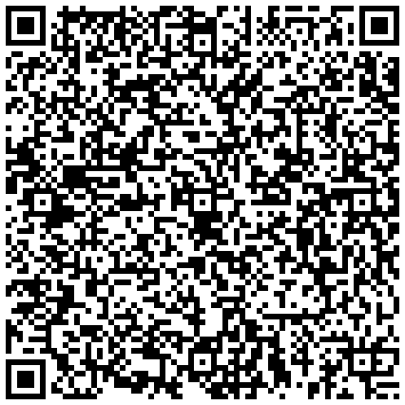
Thank you
Contact:
Hasan Sharif
Senior Manager Spectrum Strategy
TRA, PO Box 26662, Abu Dhabi, UAE
E-mail: hasan.sharif@tra.gov.ae

