Slide 1

TRANSITION
FROM ANALOGUE TO
DIGITAL
BROADCASTING
BDT activities
István Bozsóki
ITU/BDT/IEE/TND
1

Slide 2
The challenges of Switchover
Legal and Political issues
  Program editors, Licensing, number and ownership of Multiplexes, Network Operators, Public TV services, commercial TVs, local TV Standards, Analogue Switch Off (ASO), etc
Technical issues
  Standards, compression system (MPEC2/MPEG4), Spectrum availability, network planning (MFN/SFN), coverage areas, end users equipment (Set-Top Box/ D-TV), etc.
Economical related issues
  Introduction of new business model, transition costs, subsidizing vulnerable people, etc.
Allocation of Digital dividend
2
2

Slide 3
ITU Activities for the Transition
Regional Radiocommunication Conference 2006 (RRC-06)
  Frequency plan for the digital terrestrial broadcasting
  Deadline to switch over for region 1 countries: 17 June 2015 (some countries and bands 2020)
Software Packages for spectrum management
  Compatibility analysis in the GE 06 Frequency bands
  Spectrum Management Systems for Developing Countries (SMS4DC)
Recommendations, Reports and Handbooks on digital broadcasting technologies
ITU-D Question 11-3/2
Workshops, trainings
Roadmap assistance to Members States in the developing countries.
3
3

Slide 4
Roadmap
A roadmap
is a management forecasting tool
Directed to the implementation of strategy and related to project planning
Matching short-term and long-term goals
Indicating the main activities needed to meet these goals
Roadmap development has three major uses
Helping to reach consensus about requirements and solutions
Providing a mechanism to help forecast the key milestones
Providing a framework to help plan and coordinate the steps needed
4
4

Slide 5
Approach and Working Methods
NRT
National Roadmap Team (NRT) works as advisor bringing wider stakeholder focus
Assists to develop the roadmap and prepares agreed parts.
Established by Minister/decree/law ..
Government Agencies
Responsible for establishing policy and Government endorsement, legislation, and budgets for Government funded activity
Preparing Regulations, Licence models, Service/Spectrum planning, standards etc
Legal aspects of Licence allocation process/licence issue and oversight.
Broadcasters Transmission Providers
Transmission Network Construction / Operation
Recovery of Analogue equipment post switch off
Working with all of the above on Analogue Switch Off Processes
Providing programming for the digital network
ITU Expert
Introduce the ITU developed Guidelines for Migration as a resource
Facilitate NRT in development of Roadmap / Transfer knowledge
Share experience of other countries as relevant to the discussion
Consults with NRT, and other stakeholders to clarify needs of the country
Assist with framework and content of roadmap document
5
5

Slide 6
Guideline: Situation and challenge
Situation
ITU/BDT activity on the implementation of regional initiatives projects approved by WTDC-06
Supported by ITU and Korea Communications Commission (KCC), Republic of Korea
Challenge
DTTB and MTV is being implemented in all Regions
Analogue switch-off has been completed in a number of European countries and in the USA
According to the GE06 Agreement, analogue TV will no longer be protected after 17 June 2015
  In a number of countries, including 31 African countries, not after 17 June 2020 in Band III
Digital TV has proven its success
  Countries not preparing for DTTB and MTV introduction should start rather sooner than later
6
6

Slide 7

Posted on ITU web for free download
http://www.itu.int/publ/D-HDB-GUIDELINES.01-2010/en
7
7

Slide 8
Guideline: Scope and objective
Scope
Guidelines on
  Transition from analogue TV to Digital Terrestrial Television Broadcasting (DTTB)
  Introduction of Mobile Television Broadcasting (MTV)
Identification of
  The policy, economic and technology choices
  Their potential impact DTTB and MTV introduction
Providing many practical examples and references to documents for additional or more detailed information
Objective
To assist the African countries in making their own roadmap
  To shift smoothly from analogue to DTTB and MTV
To provide information regarding the cost benefit analysis of policy decisions and best practices
8
8

Slide 9
7.12.2011
ITU Regional Workshop , Amman, Jordan
9
9
9

Slide 10
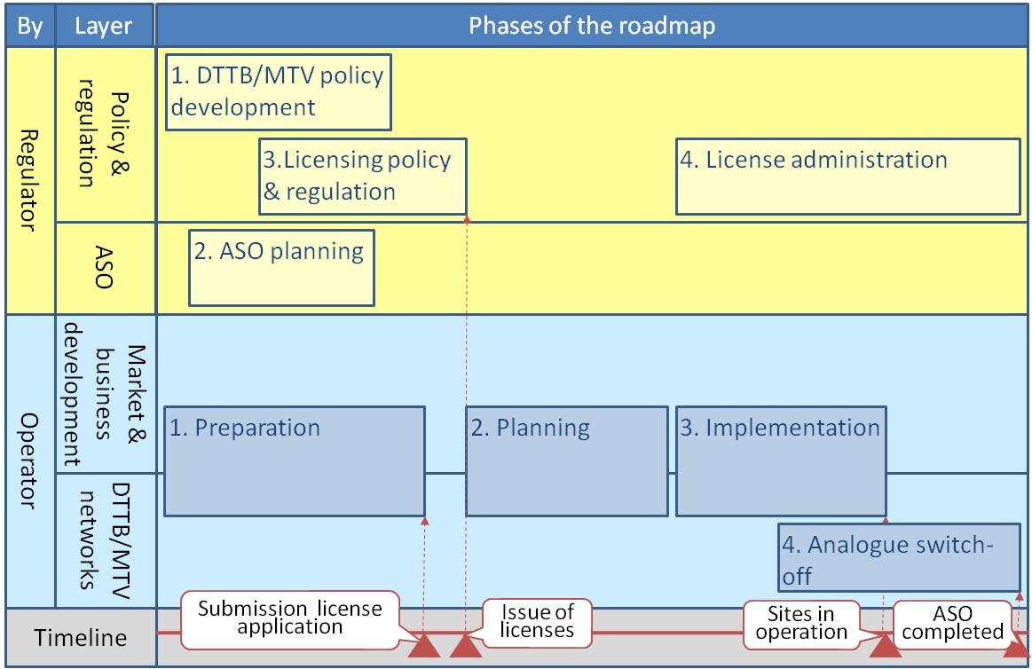
Guideline: Phases of the roadmap
10
10

Slide 11
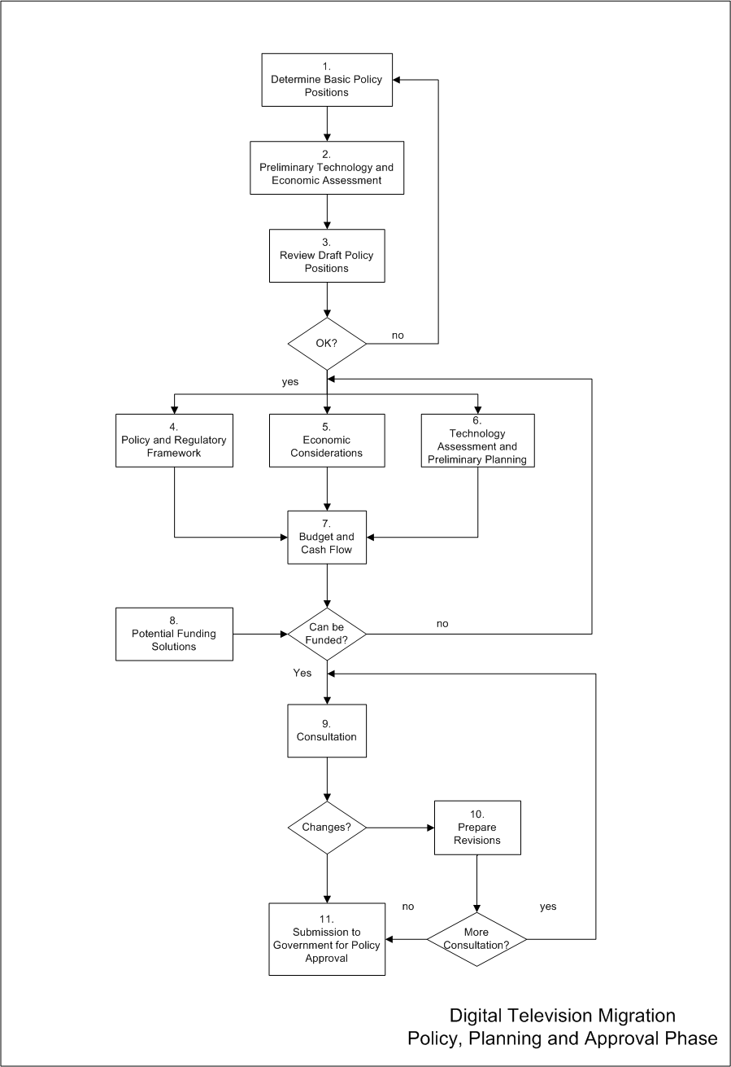
Policy Decision Process Flow
7.12.2011
ITU Regional Workshop , Amman, Jordan
11
11
11

Slide 12
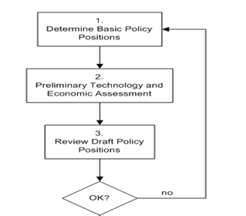
Policy Decision Process Flow
7.12.2011
ITU Regional Workshop , Amman, Jordan
12
12
12

Slide 13
Policy Decision Process Flow
7.12.2011
ITU Regional Workshop , Amman, Jordan
13
13
13

Slide 14
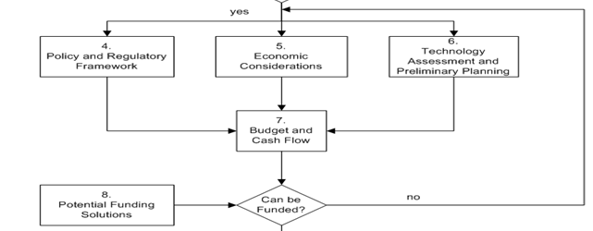
Policy Decision Process Flow
Draft policy
7.12.2011
ITU Regional Workshop , Amman, Jordan
14
14
14

Slide 15
Policy Decision Process Flow
7.12.2011
ITU Regional Workshop , Amman, Jordan
15
15
15

Slide 16
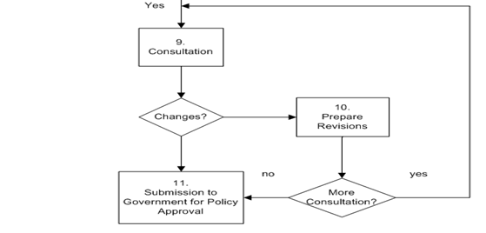
Policy Decision Process Flow
Fund OK
7.12.2011
ITU Regional Workshop , Amman, Jordan
16
16
16

Slide 17
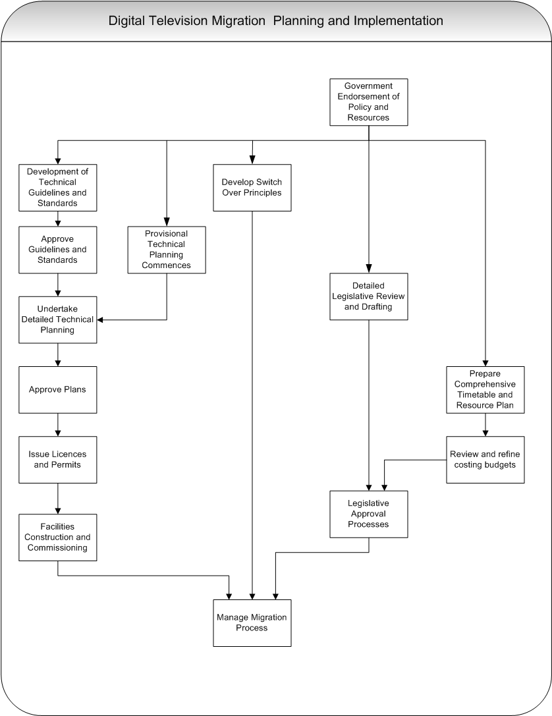
Migration Planning and
Implementation
7.12.2011
ITU Regional Workshop , Amman, Jordan
17
17
17

Slide 18
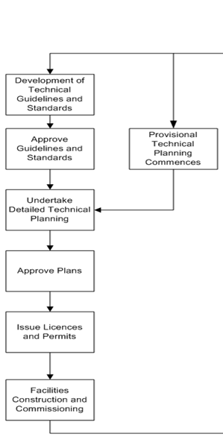
Migration Planning and Implementation
(technical part)
Policy and
resources
7.12.2011
ITU Regional Workshop , Amman, Jordan
18
18
18

Slide 19
Migration Planning and
Implementation
7.12.2011
ITU Regional Workshop , Amman, Jordan
19
19
19

Slide 20
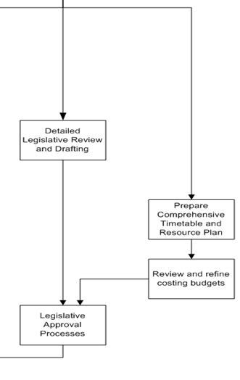
Migration Planning and Implementation (legislative part)
Policy and
resources
7.12.2011
ITU Regional Workshop , Amman, Jordan
20
20
20

Slide 21
Migration Planning and
Implementation
7.12.2011
ITU Regional Workshop , Amman, Jordan
21
21
21

Slide 22
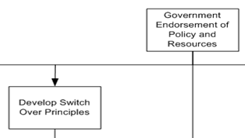
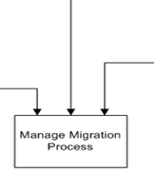
Migration Planning and Implementation
Legislative
Technical
7.12.2011
ITU Regional Workshop , Amman, Jordan
22
22
22

Slide 23
Guideline: Asia Pacific Revisions
ASIA PACIFIC UPDATE
WTDC 10 assigned priority to assisting developing countries in Asia Pacific on digital migration including archives
Guidelines Updated to reflect the different ITU rules and requirements in Region 3 (Asia Pacific)
Addition of New Chapter on Archives Migration
Survey conducted to identify needs and to select 5 pilot countries with whom to develop migration roadmap models for AP
23
23

Slide 24
Assistance provided by BDT
Africa
Guidelines
Three countries selected for implementation of the Guidelines (i.e. preparation of the roadmap)
  Ethiopia, Mali, Angola
  Project managers: Mr. Guejo Jo, Mr. Kikwon Kim
Additional assistance:
  Zambia (workshop)
  Congo, Uganda, Swaziland, Burkina Faso (assessment)
  Requested: Rwanda
AUB: Afrovision (planned project)
24
24

Slide 25
Assistance provided by BDT
Asia Pacific
Guideline extension for Asia Pacific will be published soon
Guideline for migrating archives will be published soon
Five countries selected for implementation of the Guidelines
  Mongolia , Cambodia, Tonga, Sri Lanka, Nepal
  Cooperation with ABU
Additional assistance:
  Bhutan (assessment)
  Co-organizing workshops, seminars with ABU and AIBD
  Thailand (training – postponed to March 2012)
Workshop in Vietnam in May 2011 (BR and BDT cooperation)
Cooperation agreement among ITU-ABU-AIBD
Conversion of analogue archives to digital
25
25

Slide 26
Assistance provided by BDT
CIS
Assistance:
  Coordination of terrestrial digital TV broadcasting in the border area of Kyrgyz Republic, Tajikistan Republic and Uzbekistan Republic:
      solution of the frequency allotments coordination problems in the border areas during the implementation of digital television in the above mentioned countries
  Georgia (assessment)
  Organizing workshops, seminars in the region
Project in Kyrgyzstan
  Interactive Multimedia Digital Broadcasting (IMDB) Networks in the Kyrgyz Republic (area with mountainous terrain)
26
26

Slide 27
Assistance provided by BDT
EUR
PP Resolution 126
  Assisting Serbia
Ministerial Roundtable in Belgrade, Serbia, 2009
Regulatory Roundtable in Györ, Hungary, 2011
Workshops
Web portal (Romania)
Americas
Suriname: workshop
Participation at the CBU General Assembly (2010)
CoE workshops (Jamaica, Trinidad and Tobago, 2010 Dec)
CBU-ITU workshop in Barbados (2011 August)
27
27
27

Slide 28
Accessibility
Report
Making Television Accessible
  http://www.itu.int/ITU-D/sis/PwDs/Documents/Making_TV_Accessible-E-BAT.pdf
28

Slide 29
Regional initiatives
In all the regions Digital broadcasting and transition
  Africa
  Asia Pacific
  Arab
  Americas
  Europe (Central and Eastern Europe)
  CIS
29
29

Slide 30
Conclusions
Transition to DTTB and the introduction of MTV services is a complex process
  Involving decisions on key topics and choices of 41 functional building blocks
A successful transition to DTTB and the introduction of MTV services requires:
  Strong leadership of government
  Firm decision of analogue TV switch-off date
  Close cooperation of Regulator and market parties
  Clear and timely regulatory framework (including decisions on the “Digital Dividend”)
  Adequate information and assistance to viewers
30
30

Slide 31
Thank you !
István Bozsóki
ITU/BDT/IEE/TND
istvan.bozsoki@itu.int or tnd@itu.int
31

