Slide 1
Subscriber Demands and Network Requirements – the Spectrum Capex trade-off
Hugh Collins

Slide 2
Agenda
Traffic modelling principles
Service modelling
Data: the growth area
Mobile network dimensioning
Spectrum Efficiency Tool: modelling the relation of spectrum, traffic and network dimensioning

Slide 3
Traffic Modelling Principles

Slide 4
Traffic modelling principles
The network must carry the offered traffic!
… but carrying all traffic is hard to do – traffic peaks can be very high
  Partly a technical problem – spectrum is limited, so networks have limited capacity but traffic peaks can be far above average traffic
  Therefore an economic problem also – if the network is built to handle the peaks, then it is very under-used for most of the time
“Grade of Service” – probability of network busy
  Calls fail, data transmitted slowly or delayed
  Wireless networks usually designed to reject about 2% of voice calls in the busy hour
For voice use Erlang B; For Data use Erlang C

Slide 5
The Erlang B formula
Erlang B calculates the probability of blocking
  The probability that a call arriving at a link or switch (with a defined capacity) finds the link/switch busy
Erlang B is used for low latency traffic such as voice or video calls
  P_{b} = Probability of blocking (%)
  m = number of servers/ circuits/ links/ lines
  E = λh = total amount of traffic offered (Erlangs)
    (Arrival rate x average holding time)

Slide 6
Calculating Erlang B

Slide 7
The Erlang C formula
Erlang C calculates the probability of waiting in a queuing system
  If all servers are busy when a request arrives, the request is queued
  An unlimited number of requests may be held in the queue simultaneously
Erlang C used for data traffic
  P_{W} = probability of queuing for a time > 0 secs (%)
  m = number of servers/ circuits/ links/ lines
  E = total amount of traffic offered (Erlangs)

Slide 8
Calculating Erlang C

Slide 9
Service modelling

Slide 10
Categorising subscriber services
Before we can dimension, we need to understand the services and their traffic requirements
Various methods of categorising can be used
One potential way is presented in ITU-R Rec M.816¹:
  Speech: Toll quality voice (64kb/s on a fixed network, much less than this on a mobile network)
  Simple messaging: User bit rate of 14 kb/s
  Switched data: User bit rate of 64kb/s
  Asymmetrical multimedia services
    Medium multimedia: User bit rate of 64/384 kb/s
    High multimedia: User bit rate of 128/2000 kb/s
  High interactive multimedia: User bit rate of 128/128kb/s
    Faster services represented as multiples of this
However service speeds have risen in the past decade!
¹ ITU-R Recommendation M.816 - Framework for services
supported by International Mobile Telecommunications-2000

Slide 11
Typical service characteristics
Some typical values are shown below, but local data should be used where available
 | Busy Hour Call Attempts |  | Call duration (seconds) |  | Activity factor
 | Pedestrian | Vehicular | Pedestrian | Vehicular | Pedestrian | Vehicular
Speech | 0.8 | 0.4 | 120 | 120 | 0.5 | 0.5
Simple messaging | 0.3 | 0.2 | 3 | 3 | 1 | 1
Switched data | 0.2 | 0.02 | 156 | 156 | 1 | 1
Medium multimedia | 0.4 | 0.008 | 3000 | 3000 | 0.003/ 0.015 | 0.003/ 0.015
High multimedia | 0.06 | 0.008 | 3000 | 3000 | 0.003/ 0.015 | 0.003/ 0.015
High interactive multimedia | 0.07 | 0.011 | 120 | 120 | 1 | 1
Source: ITU-R Report M.2023 – Spectrum requirements for IMT-2000

Slide 12
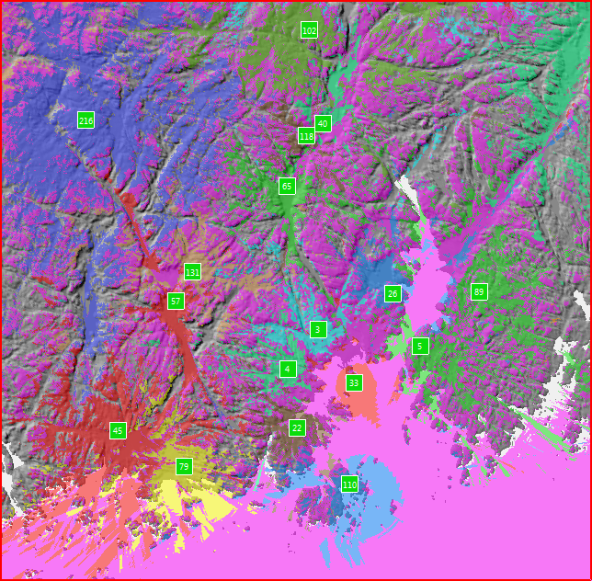
Service demands will also vary by location
Different areas will provide:
  Different population densities
  Different service mixes
  Different service demands
  Different service time profiles
Consider, for example:
  Hot spots
  Airports
  Railway or bus stations
  Cafes
  Sports stadiums
  Hot routes
  Motorways/ highways
  Railway lines

Slide 13
Service demands vary by time
Our earlier service characteristics were partly defined by Busy Hour Call Attempts (BHCA)
  But voice and data busy hours are typically different
  And data typically has similar use across a number of hours

Slide 14
Data: the growth area

Slide 15
Data applications
E-mail:
  Message 5-10 kbytes
  Attachment 20-1000+ kbytes
  10 messages in busy hour?
  → average 1 Mbyte per user in busy hour
  Symmetrical up and down
Internet browsing:
  Download 40 pages in busy hour
  Average 50 kbytes per page
  → average 2 Mbytes per user in busy hour
  Asymmetrical: more down than up
Streamed audio:
  128 kb/s
  Average say 5 mins in busy hour
  → average 4.8 Mbytes per user in busy hour
  Downstream
Streamed video:
  512 kb/s
  Average say 5 mins in busy hour
  → average 19.2 Mbytes per user in busy hour
  Downstream

Slide 16
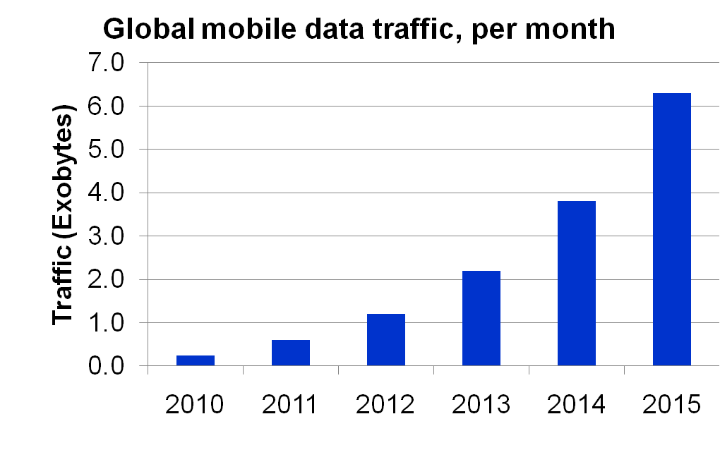
Data growth
Global mobile data traffic is growing very fast:
  Nearly tripled year-on-year, for the past 3 years!
  In March 2010, Ericsson reported that global mobile data traffic overtook mobile voice traffic
CAGR 92%
Source: Cisco Visual Networking Index 2011

Slide 17
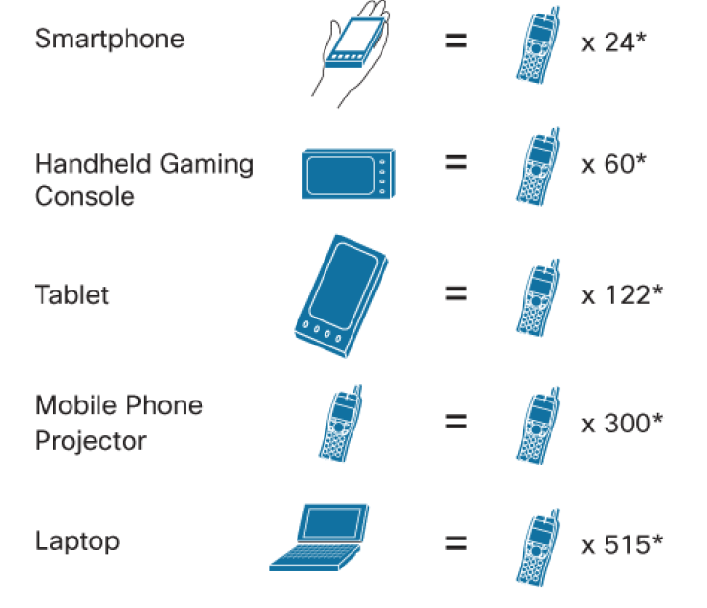
Driven by devices
The introduction of smarter mobile devices drives
data increases (as well as the applications used!)
Source: Cisco Visual Networking Index 2011

Slide 18
Mobile network dimensioning

Slide 19

Example: A mobile network
BTS
BSC
GMSC
BSC
BTS
MSC
BSC
VLR
Other
Networks
BSC
HLR
BSC
MSC
GMSC
BTS
VLR
BSC
BTS
BSC
MSC
BSC
VLR
BTS
GMSC
BSC
Radio Layer
MSC Layer
Transit Layer. May not exist in all networks

Slide 20
Network components to be dimensioned
Radio Access Network:
  eNode-B/ Node-B/ BTS
  RNC (Radio Network Controller) or BSC (Base Station Controller)
  Access links/ backhaul
Core Network:
  Links: for example STM-1, Gigabit Ethernet, 10GE
  Routers, Switches
  Databases: for example HLR, VLR
  Network operations and management
Application Platforms:
  Data/ Internet access
  Voicemail
  MMS/ SMS
  etc

Slide 21
Network component capacities
In radio networks, the relevant measures of capacity are:
  connected subscribers
  voice minutes
  megabytes of traffic
  erlangs of traffic
  service platform usage

Slide 22
Challenges created by traffic growth
There are many! And the whole network is affected
Some examples:
  More sites/ smaller site radii
  Increase in backhaul capacity
    Movement towards high capacity microwave/ fibre
  Need for Evolved Packet Core
    To facilitate improved session, mobility and QoS management
  Improvements in ‘back-office’
    For example, the challenges faced in billing to measure ‘caps’ and charging
  Improvements in network monitoring and management
    To identify and removing bottlenecks
    To optimising equipment performance and interworking
… additional investment required

Slide 23
Spectrum Efficiency Tool:
modelling the relation of spectrum, traffic and network dimensioning

Slide 24
Main network dimensioning dependencies
QoS
Services
Traffic
Site count /
Network cost
Available
spectrum
RAN site
Capacity

Slide 25
A typical network dimensioning process
Set the objectives, for example:
  The technology to be used
  The geographic and population coverage
  The traffic throughput
  The Quality of Service
  With the spectrum available, these parameters determine the network’s capacity
Obtain the geographic and population data
  Population by administrative region
  Define/ designate and use types; rural, suburban and urban
Compute the number of sites required to meet the objectives
  Thereby the network design/architecture
  Thereby the network cost

Slide 26
Site / spectrum requirements modelling
An engineering model to generate dimensioning of radio network under varying assumptions of:
  Subscriber numbers / market share
  Services provided / traffic offered
  Spectrum available
Illustrates how changing subscriber demands can have a significant impact on the network
  The spectrum versus sites trade-off
  The cost versus capacity versus QoS trade-off
Developed to examine and optimise spectrum allotment / assignment decisions

Slide 27
Model overview

Slide 28
Basis for spectrum calculation
Based on ITU-R Recommendation M.1390 - Methodology for the Calculation of IMT-2000 Terrestrial Spectrum requirements
For each service:
where:
F_{Terrestrial}= Terrestrial component spectrum requirement (MHz)
β = Guard band adjustment factor (dimensionless)
α_{es} = Geographic weighting factor (dimensionless)
T_{es} = Traffic (Mb/ s / cell)
S_{es} = Net system capability (Mb/ s / MHz / cell)

Slide 29
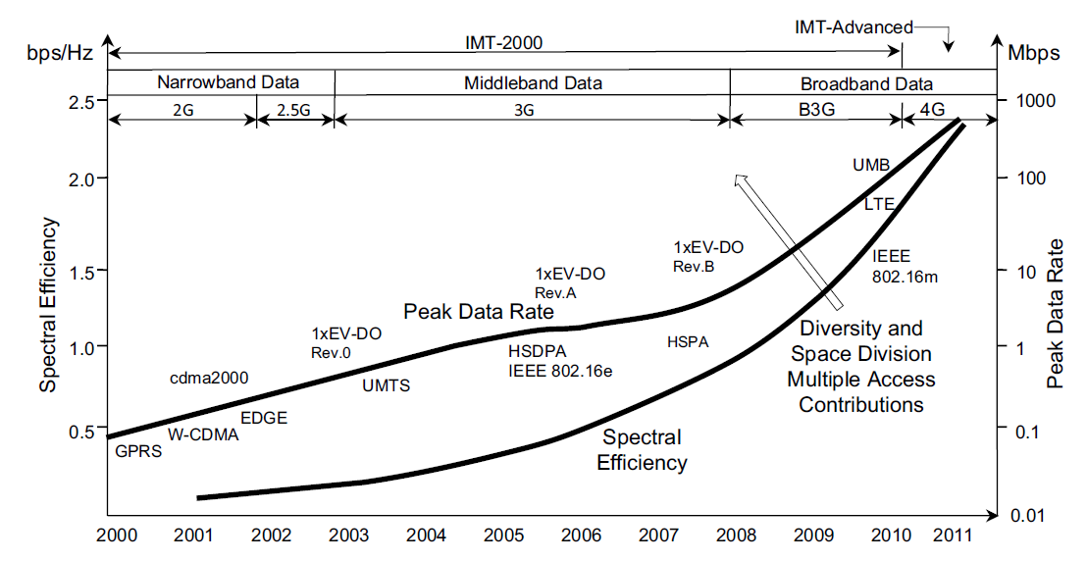
Net system capability
Accounts for underlying modulation & multiple access factors ...
  ... as well as radio resource management factors
  Such as power control, discontinuous transmission, frequency reuse pattern, band splitting/grouping, frequency hopping, adaptive antennas
Net system capability for different evolutions of systems, Hideaki Takagi and Bernhard H. Walke (2008), Spectrum Requirement Planning in Wireless Communications, pp56, John Wiley & Sons Ltd

Slide 30
Spectrum requirements calculation overview

Slide 31
Setting accessible population data
Defining how the population in each region is split between each geotype ....
... and then defining what percentage of this population is accessible

Slide 32
Setting administrative area data
Terrain type, city type and geotype define how signals propagate in the link budgets

Slide 33
Setting target coverage levels
Define the target coverage
  In this example, defined by existing operator coverage levels
Population factor estimates the ratio of population living in the coverage area

Slide 34
Calculating cell area
Cell area together with population, geographic and coverage data enable subscriber densities to be calculated

Slide 35
Setting services and use statistics
Define what services are used and how they are used
  The above example relates to 3G
  Traffic metrics based on ITU-R Report M.2023 - Spectrum Requirements for IMT 2000, but real observed traffic figures should be used wherever possible

Slide 36
Calculating spectrum required
The traffic offered by each service can be calculated
This can be aggregated and mapped to traffic channels
  Using Erlang B and Erlang C, as appropriate
From this, the amount of required spectrum can be derived (using the ITU-R Rec. M.1390 formula)
  To meet demanded traffic, as driven by the subscriber numbers
  Based on calculated site numbers

Slide 37
Spectrum requirements planning
The spectrum calculation is made many times by varying the cell radius factor
The results can then be graphed, and interpreted ...

Slide 38
Typical output: spectrum versus site count

Slide 39
Interpreting the curves

Slide 40
Simple 2-operator example, 36MHz available

Slide 41
Thank you
Any questions?

