Slide 1
Spectrum Management From an Operator’s Viewpoint
ITU Regional Workshop on Efficiency of the Frequency Spectrum Use in the Arab Region, Amman-Jordan, 5-7 Dec. 2011

Slide 2
Contents
Omnitele in brief
Current issues in spectrum management for mobile operators
Examples of recent regulatory actions
Conclusions

Slide 3

OMNITELE IN BRIEF
Straightforward | Trusted | Intelligent
Consultancy & professional engineering services
Mobile networks & spectrum management
Operators and regulators
Europe, Middle East, Africa

Slide 4
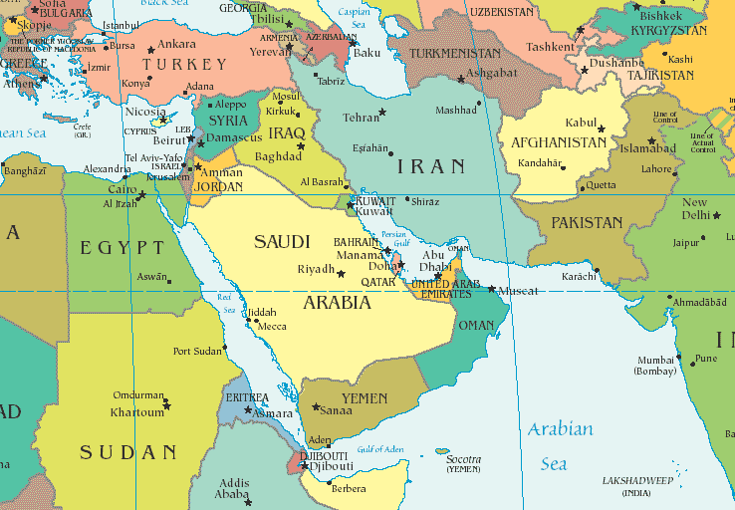
References in The Region
TRC Spectrum Management Assistance
JTC: GSM business & technical plan & WAN procurement
Government & bank: Feasibility study of first private mobile operator and network procurement management
NIC: Feasibility study of data communications
Review of the second and third GSM licensing award procedures for ITU, ordered by the Iranian Government
For PTCL: High capacity transit network bid evaluation; Tender evaluation of CCBS
For PTML: Network expansion strategies and procurement; GSM network acceptance tests; GSM vendor selection
Strategic opportunities during market de-regulation, Engro
Valuation of mobile cellular license for Rupali
GSM network audit & vendor selection assistance for MTC
Audit and 2nd carrier strategy for mobile broadband for Wataniya
GSM 1800 feasibility study for market entrant
Network performance and service quality benchmark, 2001
Audit of revenue forecasts and estimation of non-network OPEX, 2006
Wataniya Int’l: Assistance in GSM license application
NATCO and HSA: Analyse strategic options of a new mobile operator
GSM & 3G network quality audits for Batelco
GSM/GPRS radio network audit 2005; Radio network optimisation and planning 2006, both for Qtel

Slide 5
Contents
Omnitele in brief
Current issues in spectrum management for mobile operators
Examples of recent regulatory actions
Conclusions

Slide 6
RF Spectrum, A Mobile Operator’s View
Band | Uplink | Downlink | Total FDD | Comments
800 MHz | 832-862 | 791-821 | 2 x 30 MHz | Digital dividend, coming to market
900 MHz | 880-915 | 925-960 | 2 x 35 MHz | Originally GSM, recently UMTS
1800 MHz | 1710-1785 | 1805-1880 | 2 x 75 MHz | GSM capacity
2100 MHz | 1920-1980 | 2110-2170 | 2 x 60 MHz | Original UMTS
2600 MHz | 2500-2570 | 2620-2690 | 2 x 70 MHz | LTE
A mobile operator endeavours to use the available frequencies optimally to
Serve private and corporate customers
Satisfy voice and data traffic needs
Support a selection of technologies

Slide 7
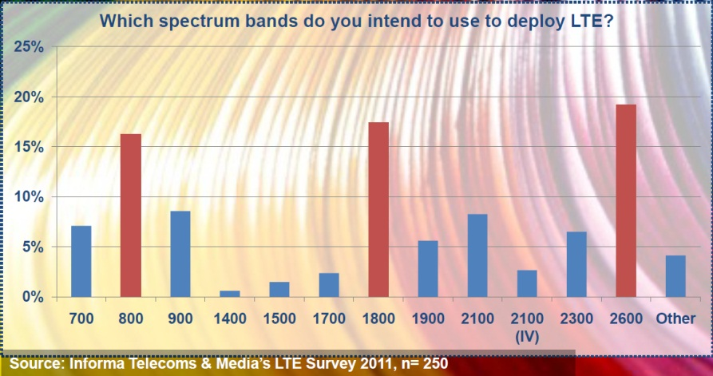
Happening Today: LTE
Why are 800, 1800 and 2600 popular?

Slide 8
Coverage vs. Capacity
Operator X receives a license in a country
License obligation: cover 90 % of population
Operator X deploys footprint in a low frequency
Wide coverage, moderate capacity

Slide 9
Coverage vs. Capacity
Market develops, traffic and number of customers grow
Need to increase capacity in hot spot areas
Operator X deploys extra capacity in a high frequency
Increased capacity in parts of the licensed area

Slide 10
Coverage vs. Capacity
Market develops further, early days of mobile data
Need to further increase capacity in hotspots
Operator X deploys an even high frequency
Peak capacity in parts of the licensed area

Slide 11
Today’s Potential Situation
Operators seek an efficient combination of frequencies both below and above 1 GHz
LTE 2600
UMTS 2100
LTE 1800
GSM 1800
GSM 1800
LTE 800
GSM 900

Slide 12
Back to LTE…
LTE 2600 MHz launched mainly for marketing purposes, “capacity layer”
LTE 1800 MHz gaining popularity
  Time to market advantage compared to LTE 800
  Reusing spectrum and infra saves CAPEX
  Band is widely available globally, although occupied by GSM
High interest towards 800 MHz
  Enables cost-efficient mobile broadband
  Regulatory challenges remain in many markets

Slide 13
So What Happens With LTE 1800 Deployment?
Voice is still the key!
No VoLTE so far
Part of voice capacity in 1800 MHz taken by LTE
Voice = 80 % revenue
Operators will react by demanding new spectrum assignments and by optimising usage of their current holdings to protect their income.

Slide 14
Where To Place Voice Replaced by LTE 1800?
Band | GSM | UMTS | LTE
800 MHz |  |  | x
900 MHz | x | x
1800 MHz | x |  | x
2100 MHz |  | x | (x)
2600 MHz |  |  | x
Available on just a few markets; reserved for LTE
In full use, GSM and UMTS
Available, but costly coverage
Reserved for LTE; hotspot frequency
Enabling efficient use of spectrum is further increasing in importance.

Slide 15
Making Room In The 900 MHz Band
Currently occupied by GSM and UMTS, no LTE deployments
GSM phase-out?
YES, because:
Outdated technology
Inefficient frequency usage
Growing demand for mobile broadband
No, because:
Current handset base
Coverage
Roaming
Operators will draw their own conclusions – all they need is technology neutrality

Slide 16

Future of the 2100 MHz Band
Currently occupied practically exclusively by UMTS
Interesting for capacity reasons, too costly for wide coverage
Will be in even higher demand as mobile broadband takes up

Slide 17
800 MHz And 2600 MHz
Digital dividend 800 MHz
  Potential auction gains for governments
  Suitable for coverage
  Cost effective for operators to deploy in 900 MHz grid
2600 MHz
  Not in very high demand
  Suitable for capacity
  Relatively expensive to build as new BTS needed

Slide 18
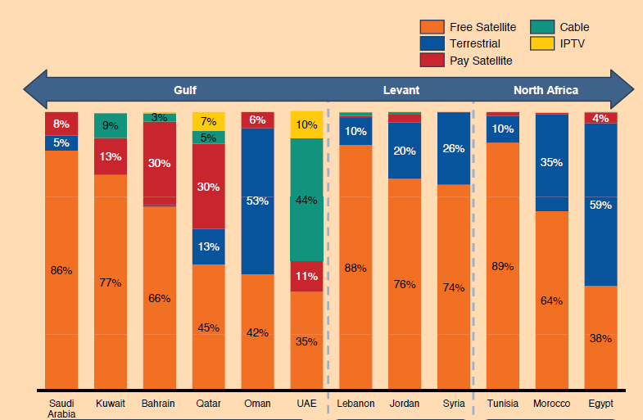
800 MHz: How Much Spectrum Is Needed for TV?
Source: Arab Media Outlook 2009-2013
Many countries in the region seem to be mostly covered by non-terrestrial tv
Mobile broadband demand is increasing
Is the 800 MHz band still needed for TV?

Slide 19
FDD vs. TDD
 | FDD | TDD
Advantages | More widely deployed by vendors More experience by operators | More unused spectrum available Suitable for growing mobile data traffic
Challenges | Limited number of frequencies available Unproportional division for DL and UL | A limited offering of equipment and handsets No critical mass of users
FDD valued much higher than TDD in Germany and Sweden
TDD just beat FDD in Norway and Finland
TDD and FDD valued equally in Belgium
Market situations were different

Slide 20
Future Spectrum Usage?
MHz
2,500
LTE
LTE
LTE
2,000
3G
3G
3G/LTE
GSM
GSM/LTE
LTE
1,800
900
GSM/3G
GSM/3G
3G/LTE
Analog TV
LTE
LTE
470
-
862
DVB-T
LTE
DVB - T
200
VHF
VHF
VHF
2010 2015 2020

Slide 21
Contents
Omnitele in brief
Current issues in spectrum management for mobile operators
Examples of recent regulatory actions
Conclusions

Slide 22
Spectrum Re-arrangement – A Regulator’s Dilemma
Consistency of decisions
Equal vs. equitable treatment of current operators
How many operators in the market?
What is the optimal spectrum cap?
Renewals – to favor status quo or not to favor?
Compensation for losses
Preparation period
A few real-life examples will demonstrate the complexity and good practices

Slide 23
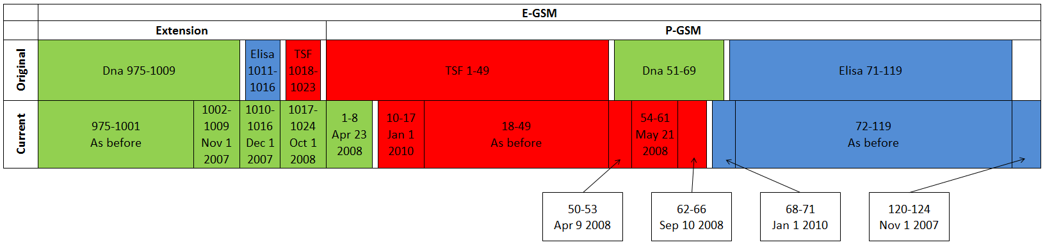
Finland 900 MHz in 2007
Operator-initiated re-farming of the 900 MHz in Finland, 2007
No changes to mobile licenses, only to frequency assignments
Regulator goal #1: efficient frequency use
Regulator goal #2: even distribution of the band
Market shares etc. did not matter
  Extension part of band (non-P-GSM) not seen as problem
  Phased process (over two calendar years)
No compensation, no charges
Also a liberalisation case
  Technology-neutrality allowed (UMTS/3G)
  The new frequency assignments will remain valid until 31 December, 2015

Slide 24
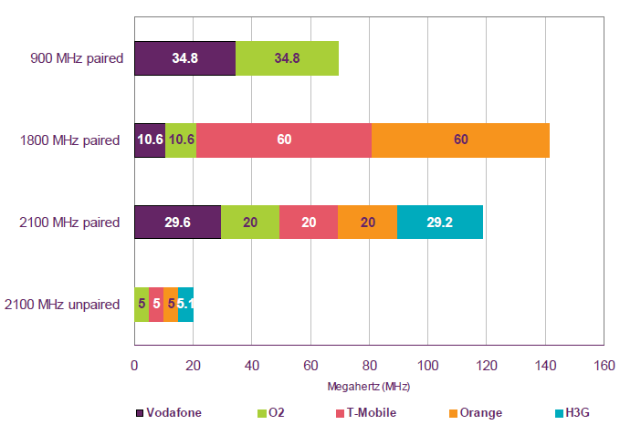
UK 900 & 1800 MHZ, 2007 ->
UK, liberalisation of the 900 and 1800 MHz
Long process, start in 2007, still on-going
Options for liberalisation
  A: Liberalisation in the hands of the incumbents
  B: Regulated access
  C: Partial spectrum release (1, 2 or 3 blocks)
  D: Full spectrum release
  E: Wait and see
After 1st consultation, going for C (2x2.5 MHz from both incumbents) in the 900 MHz and A in the 1800 MHz
After 2nd consultation, going for A in both bands
  Orange and T-Mobile merger to EE formed a stronger counter force to the incumbents in 900 MHz
  Release of 2x15 MHz in the 1800

Slide 25
Sweden 900 MHz (1)
An operator-initiated process
  The 4 existing operators sent a joint application to PTS in November 2008
  Completed in March 2011
Refarming, liberalisation and renewal in one go
  No fees included
  No changes in annual payment practices
The key objectives
  To put frequencies into efficient use
  To make room for another operator

Slide 26
Sweden 900 MHz (2)
Four existing licenses were renewed for 15 years
All licenses will remain valid until end of 2025
All are entitled to use GMS, UMTS and / or LTE
Can be seen as a negotiation based solution
Competition & efficient use of frequencies
Re-farming, liberalisation and renewal
No fees paid

Slide 27
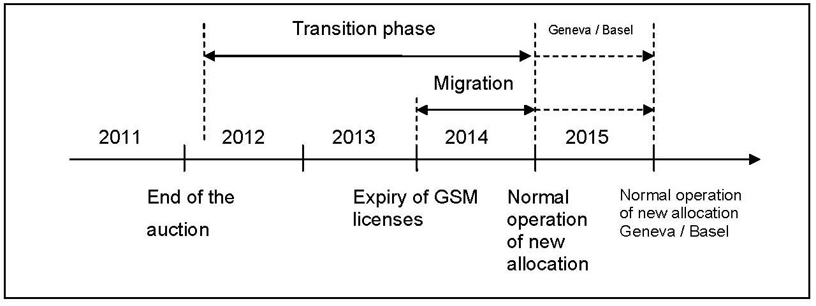
Switzerland
Original GSM licences were awarded by a beauty contest in 1998 (one earlier based on the law)
  These licences were renewed and liberalised in 2009 (no payments)
  These licences will expire in the end of 2013 without any renewal option
  The regulator is dissatisfied with the high price level
A big bang auction scheduled for early 2012
  Includes frequencies at 800, 900, 1800, 2100 and 2600 MHz
  All the frequencies that are free or will become free during 2013 – 2017
  No privilege to the existing or new players
  Several different spectrum caps included
No regulator-led renewals
Market-led refarming & technology choices

Slide 28
Contents
Omnitele in brief
Current issues in spectrum management for mobile operators
Examples of recent regulatory actions
Conclusions

Slide 29
Conclusions
Market: mobile broadband boom
Technology: LTE emerging
Frequencies: lower frequencies for coverage, higher for capacity
Operators: seeking for consistent regulation
Recipe for a healthy market:
Simple regulatory principles to guide the use of simple regulatory tools
Principles:
Consistency
Fairness
Openness
Simplicity
Tools:
Liberalisation
Re-farming
Re-allocation
Compensatory measures

Slide 30
For more information, please contact
Sampsa Laamanen
Principal Consultant
Sampsa.Laamanen@omnitele.com
+358 44 906 4217
or
Bassam Hatahet
General Manager
Bassam.Hatahet@omnitele.com
+962 796 050 023
+966 566 666 930

