Slide 1

Version 3
István BOZSÓKI
BDT/IEE/TND

Slide 2
Content of the presentation
History of SMS4DC
Main Functions of SMS4DC
  Administrative Functions
  Engineering Functions
  Geographic Map Display functions
Samples for the different functions
How to obtain SMS4DC
Future developments

Slide 3
History
ITU-R and ITU-D cooperation
1995 BASMS (FoxPro)
1997 WinBASMS
WTDC March 2002: further developments
2002 ITU-R SG1: Rec. ITU-R SM.1604
Consolidated technical specification: 2004
2007 first quarter: Version 1
2008 first quarter: Version 2
2009 third quarter:Version 3
2012 first quarter: Version 4

Slide 4
Main Functions of SMS4DC/1
Administrative Functions
  Relational database management
  Recording frequency application, frequency assignment, licensing, coordination data, import data from BRIFIC & SRS
  Producing electronic notices, print license, invoice & spectrum fee
  Security features: Multi level access enables system administrator to define users and groups with different access levels

Slide 5
Main Functions of SMS4DC/2
Engineering Analysis Functions
  Enhanced analysis tools for frequency arrangement, assignment, coordination and interference calculation
  Propagation models based on ITU-R latest recommendations available at the time of development
  Coverage area, field strength, field strength contour, microwave link calculations, network coverage and best server calculation
    Azimuth, elevation and horizon elevation for earth stations
  Link to monitoring software

Slide 6
Main Functions of SMS4DC/3
Geographic Map Display Function
  User friendly interface, displaying of DTM, capability of importing standard mapping formats including Globe map, displaying of other higher resolution maps and export to Google Earth
  Online latitude, longitude and altitude presentation, overlaying, Scrolling and Zooming functionality capability of handling vectors,
  Providing multiple entry functions, menu items, assigning new stations on map and searching and displaying a station or group of stations on map.

Slide 7
STRUCTURE OF SMS4DC
Monitoring

Slide 8
DATABASE STRUCTURE (terrestrial)
Owner
Name, address, contact and classification
1:n
License
License ID, status, duration and etc.
1:n
1:n
1:n
Payments
Invoices
Station
Station name, location, type and etc.
1:n
Name, model, radiated power, serial number and etc.
Equipment
1:n
1:n
Name, gain, pattern, Beamwidth, and etc.
Assigned frequency, reference frequency, bandwidth and etc.
Antenna
Frequency
1:1
1:n
Azimuth and effective height
Effective height
Link
Receiving area information
1:1
1:1
1:n
Coordinated administrations
Pattern
Filter
Coordination

Slide 9
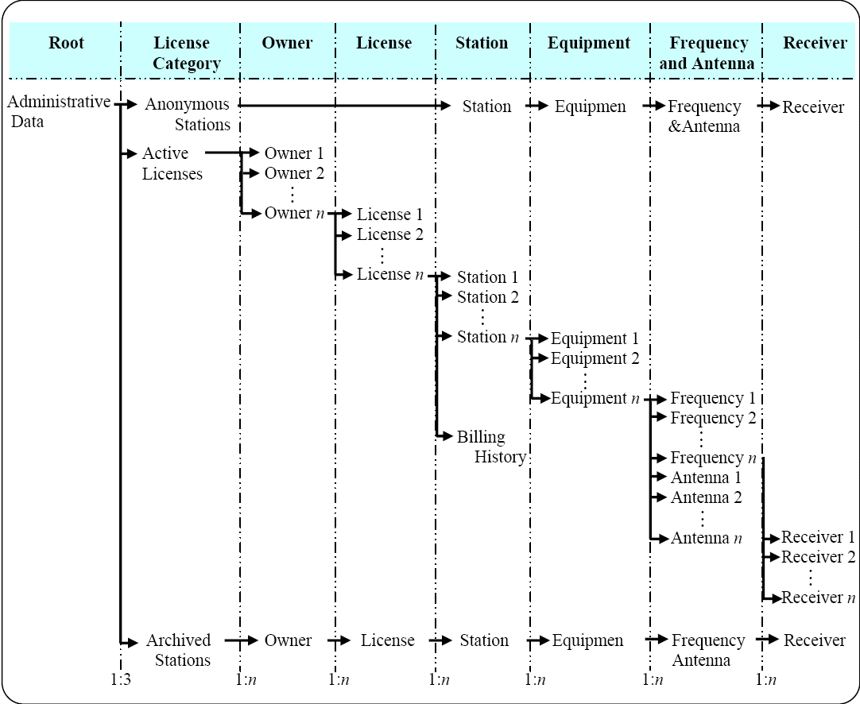
Flow of Data Entry

Slide 10
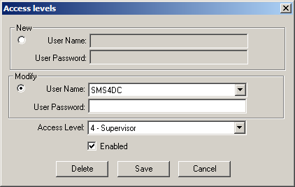
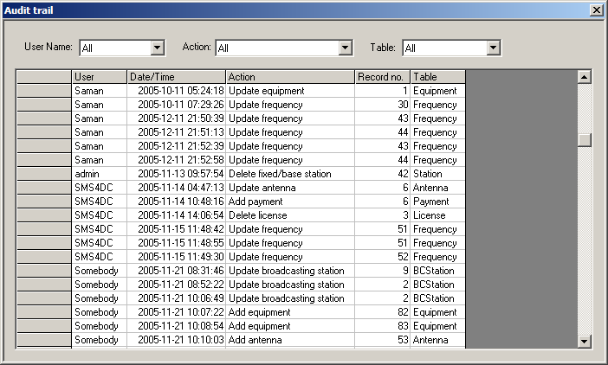
Supervisory tasks
SMS4DC’s Administrative Functions
User access →
Backup/Restore
Audit control

Slide 11
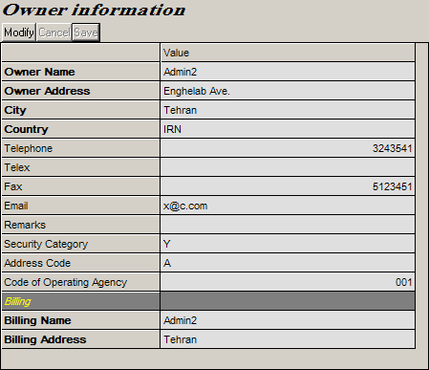
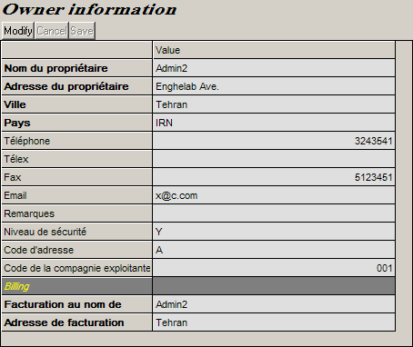
Data capture screens
SMS4DC’s Administrative Functions

Slide 12
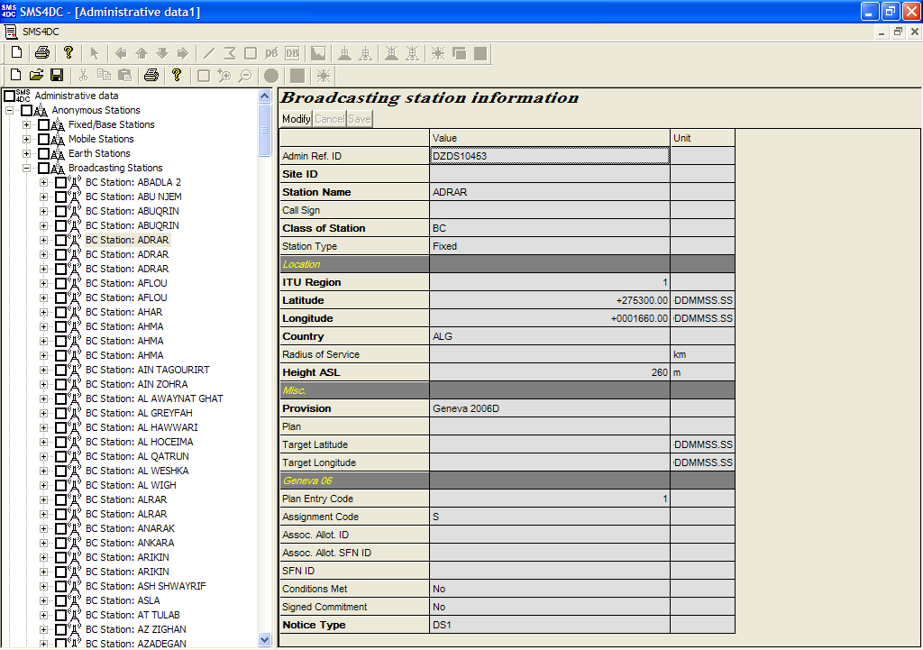
SMS4DC’s Administrative Functions
Broadcasting Station Information
Data Entry Table

Slide 13
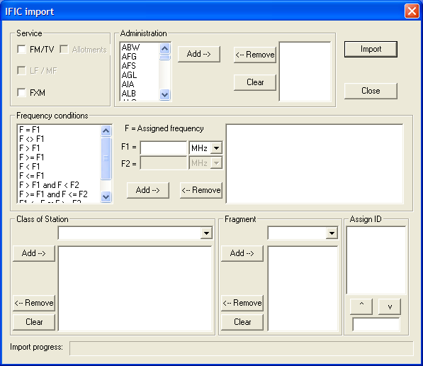
SMS4DC’s Administrative Functions
Dialog box for importing data from BRIFIC (Terrestrial)

Slide 14
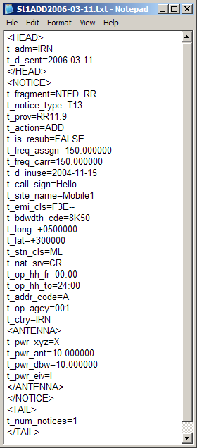
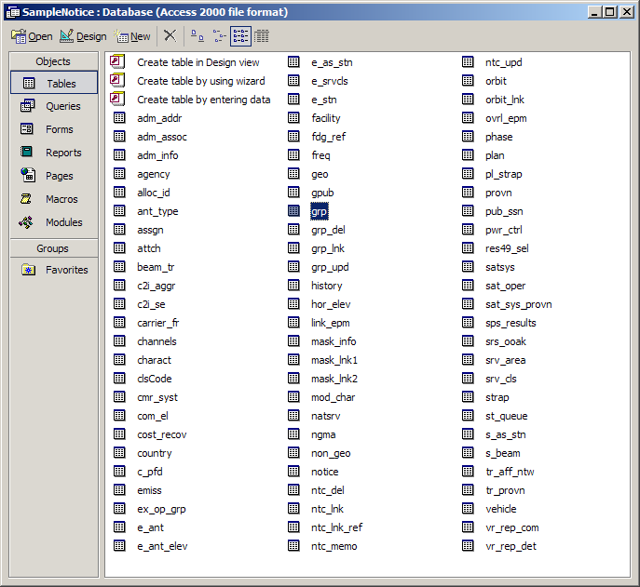
Electronic notices to BR
SMS4DC’s Administrative Functions
Fixed, Land mobile, Broadcasting
Earth station

Slide 15
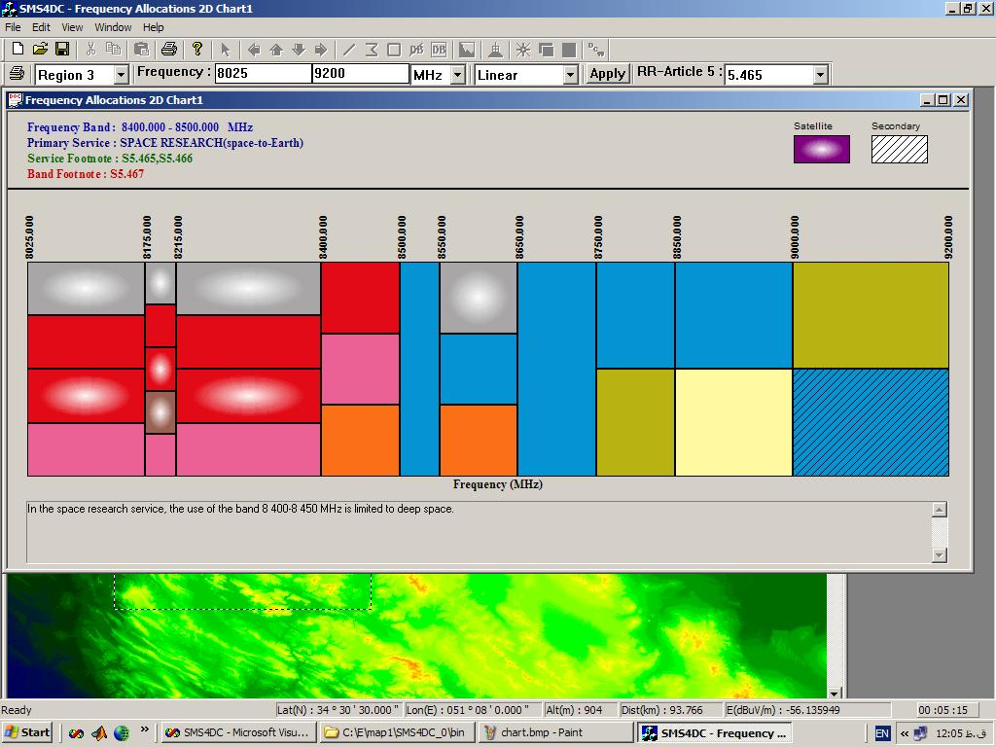
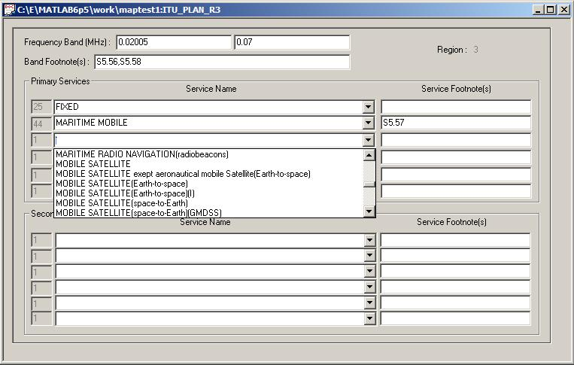
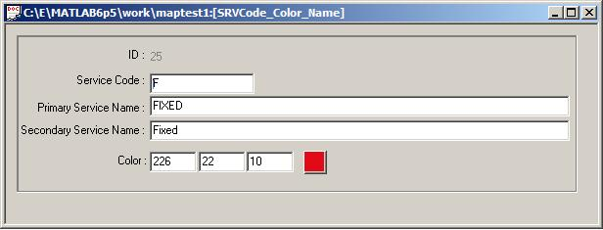
SMS4DC’s Engineering Functions
International & National frequency allocations table (chart)

Slide 16
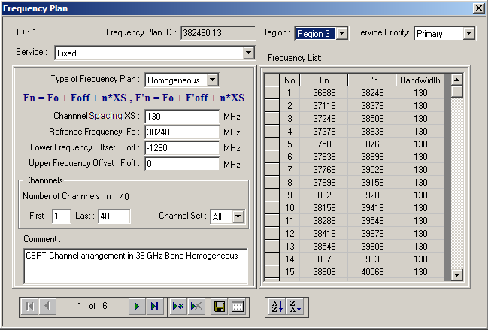
SMS4DC’s Engineering Functions
Frequency arrangement (Homogeneous)

Slide 17
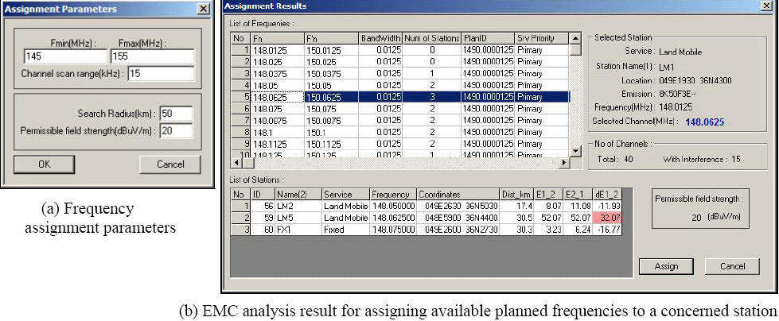
SMS4DC’s Engineering Functions
Frequency assignment parameters & EMC analysis results

Slide 18
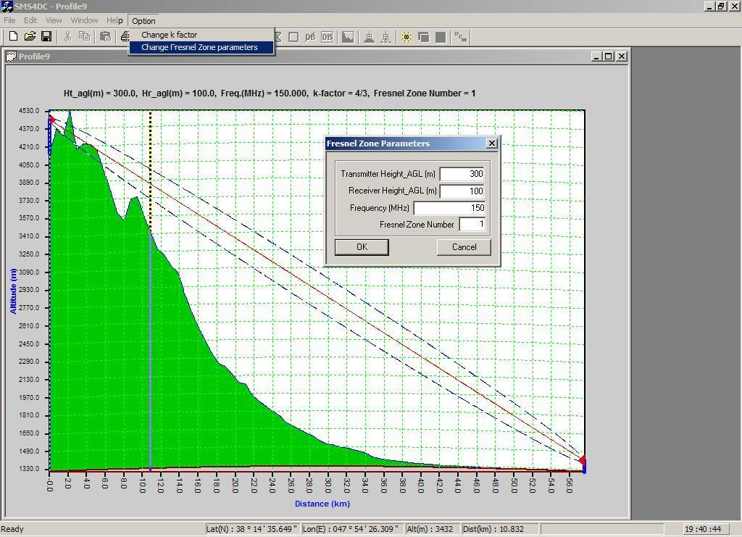
SMS4DC’s Engineering Functions
Path profile with Fresnel Zone

Slide 19
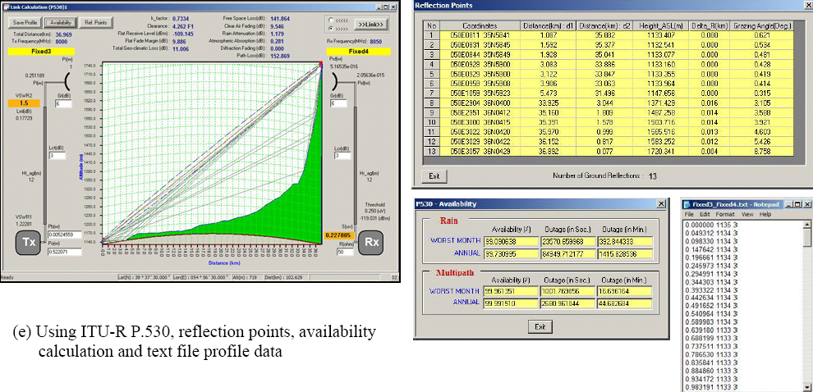
SMS4DC’s Engineering Functions
Link Calculation Dialog box using different propagation models

Slide 20
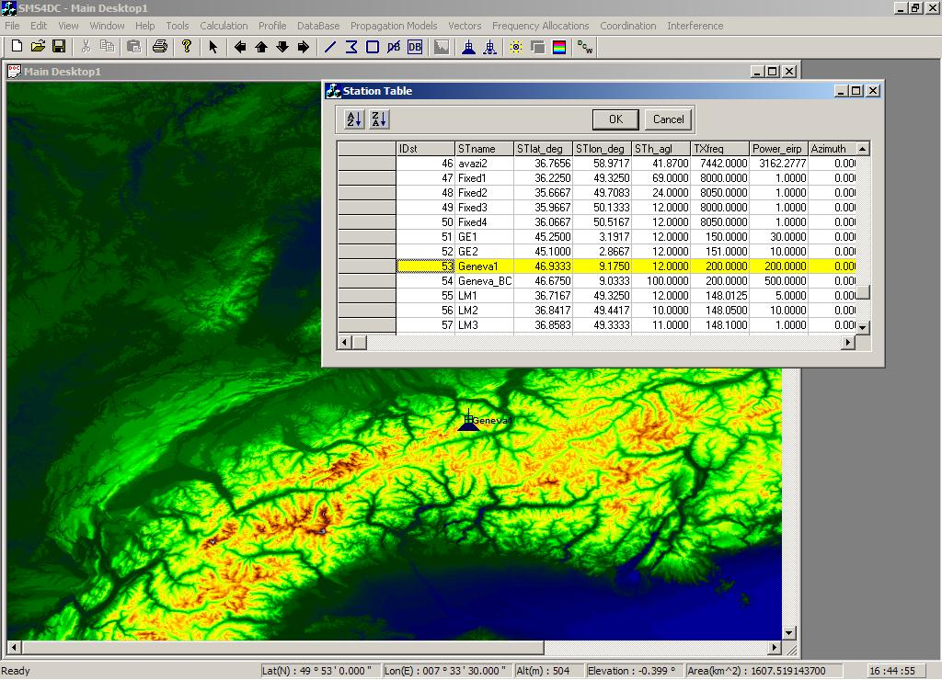
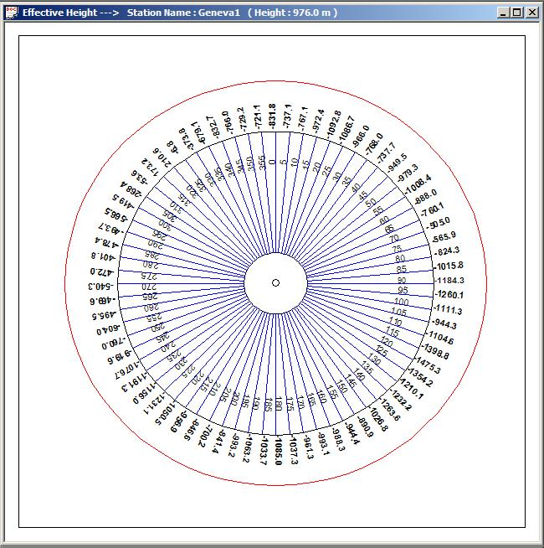
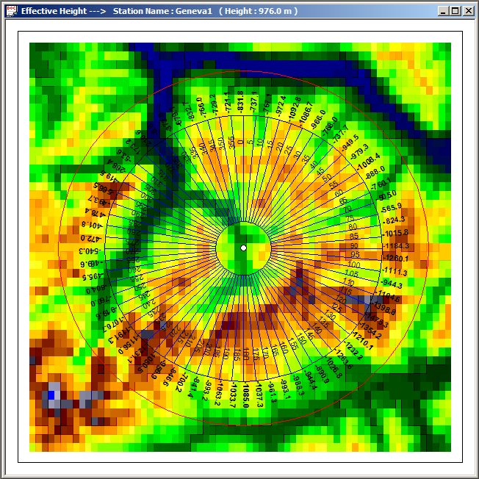
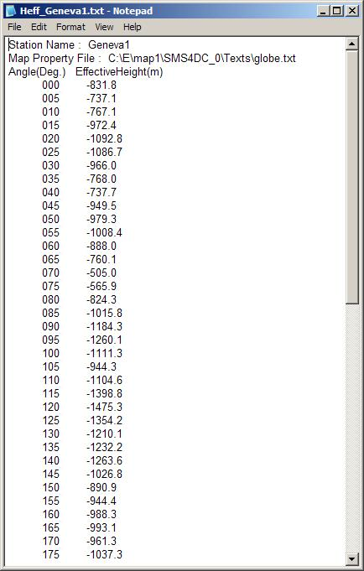
SMS4DC’s Engineering Functions
Spreadsheet of stations and h_{eff} calculation
Selected station
Effective height calculation
result

Slide 21
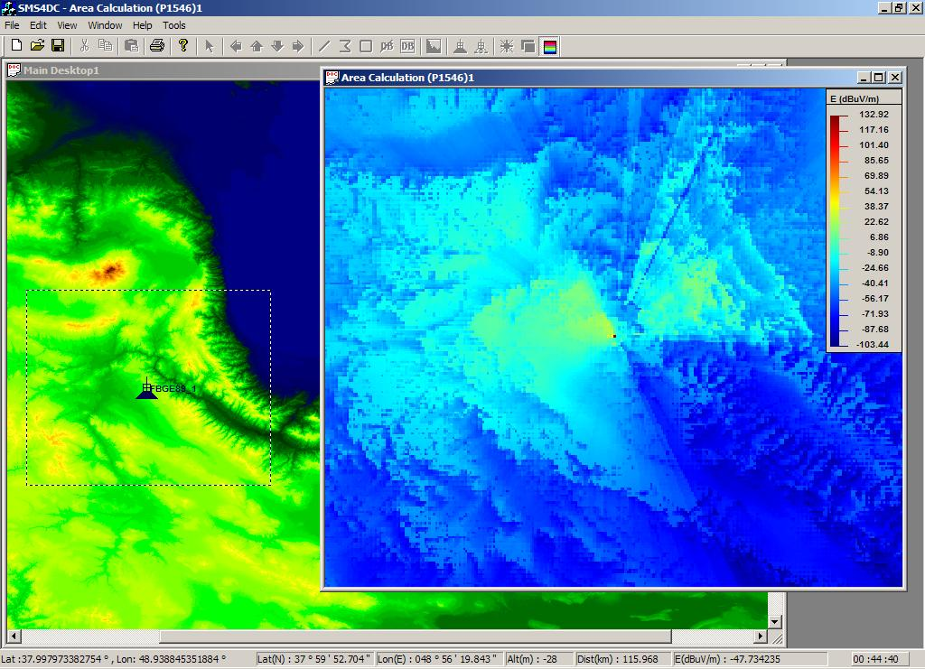
SMS4DC’s Engineering Functions
Area calculation using ITU-R P.1546 propagation model

Slide 22
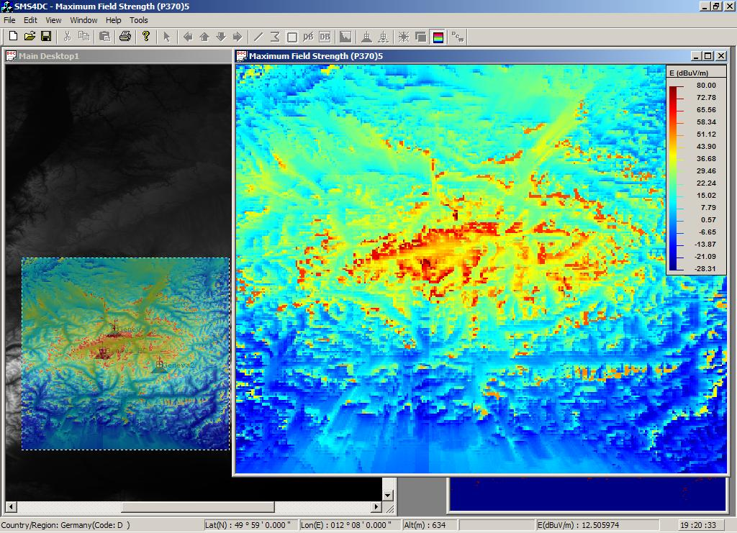
SMS4DC’s Engineering Functions
Network Processor : Maximum Field Strength

Slide 23
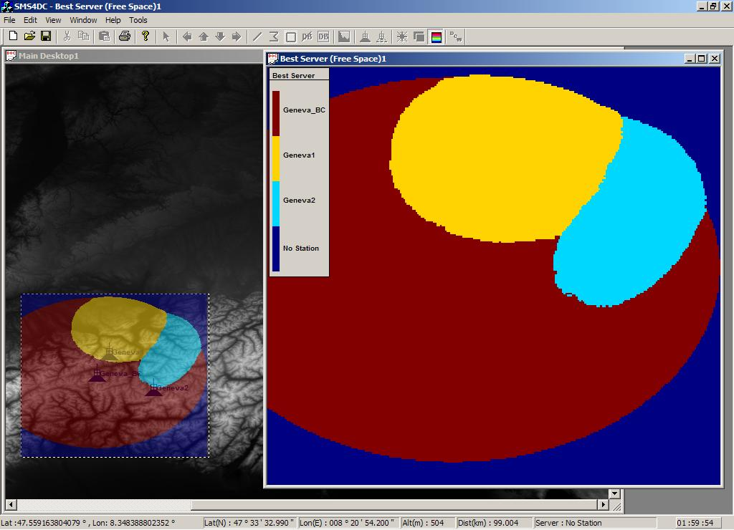
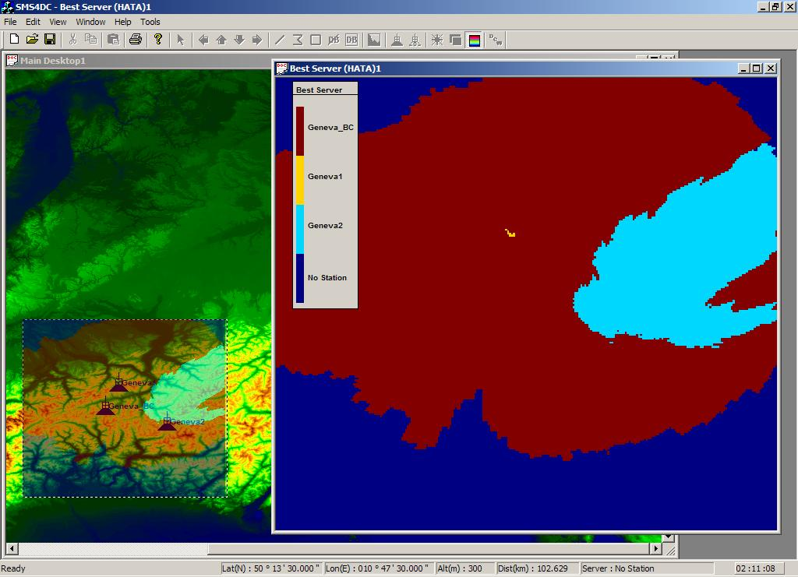
SMS4DC’s Engineering Functions
Network Processor : Best Server
(a) Free-Space propagation model
(b) Okumura-Hata propagation model

Slide 24
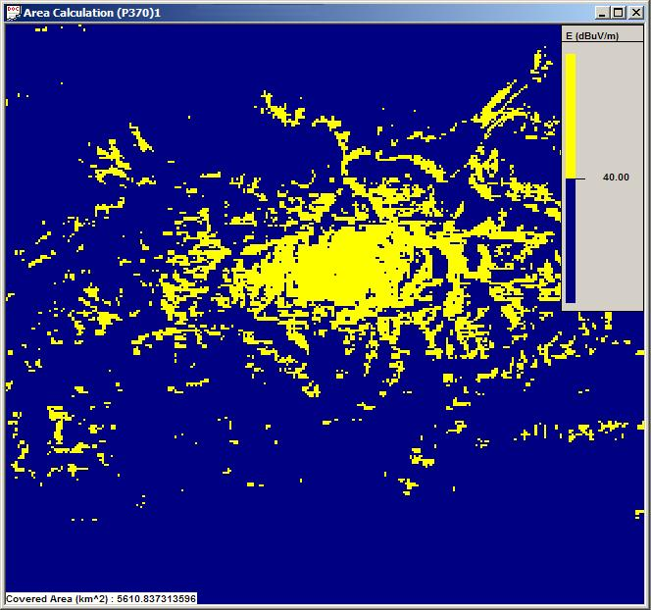
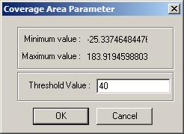
SMS4DC’s Engineering Functions
Coverage Area calculation
E < Threshold Value
E > Threshold Value

Slide 25
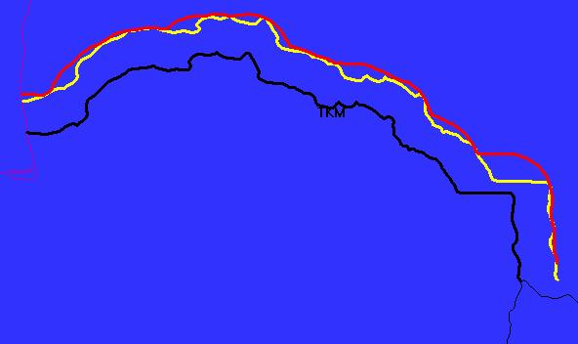
SMS4DC’s Engineering Functions
Borderline frequency coordination
Border
Xkm Line
Cross Border Range (CBR)

Slide 26
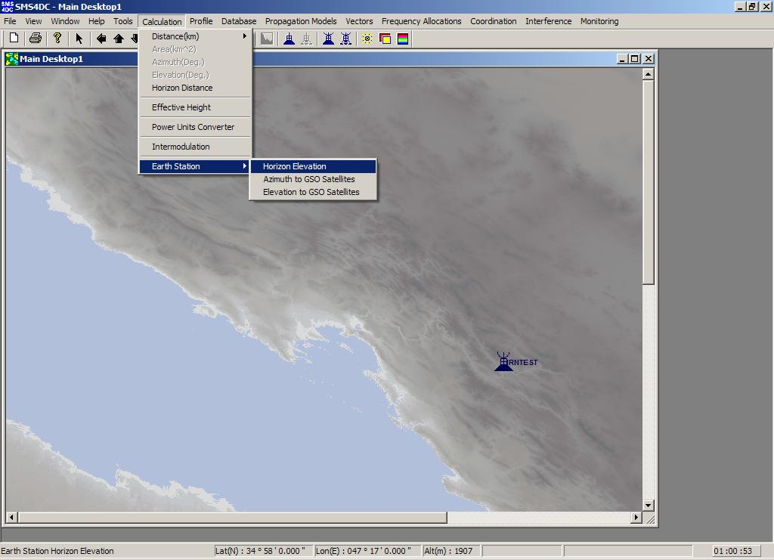
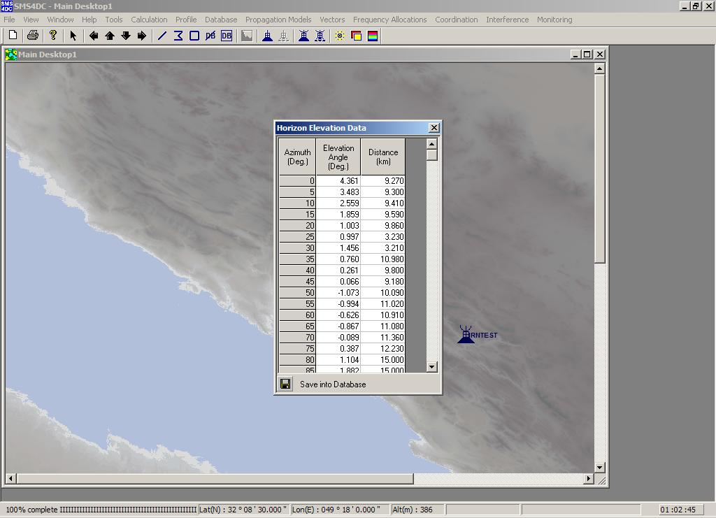
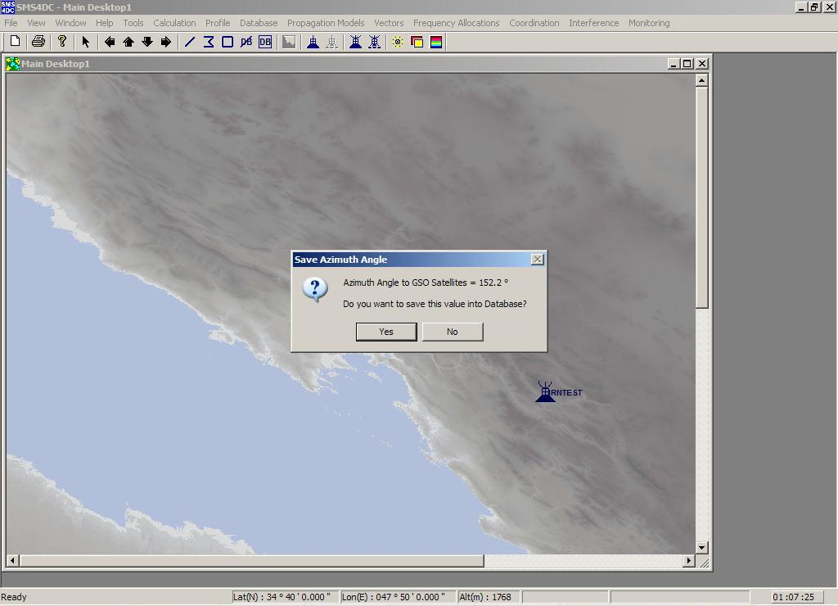
SMS4DC’s Engineering Functions
ES horizon elevation, azimuth, elevation

Slide 27
SMS4DC’s Engineering Functions
Calculations according to the Final Acts of the GE06 Plan
Coverage and service area calculation
Stage 1 – Calculation of noise-limited coverage area
Stage 2 – Identification of interferers
Stage 3 – Calculation of the test points for the interference-limited coverage
Calculation of interference caused by
Interferer Station/ Assignment/Allotment to
Victim Stations/Assignments/ Allotments
- BCBT to Digital BCBT or to Analogue BT;
- FXM to Digital BCBT or to Analogue BT;
- BCBT to FXM
Official results from the BR !

Slide 28
Integration with spectrum management
Recommendation ITU-R SM.1537 “Automation and integration of spectrum monitoring systems with automated spectrum management” recommends that administrations which intend to procure new spectrum management and monitoring systems should consider procuring an integrated, automated system using a common relational database

Slide 29
Functional elements in Spectrum Management

Slide 30
Integration monitoring with spectrum management
  This database provides the following functionalities and advantages:
  remote access to system resources
  frequency assignment and licensing
  automated measurement of signal parameters
  automated occupancy measurements with optional direction finding measurements
  Interference resolution
  scheduling of measurements for immediate or future execution
  modern GUI

Slide 31
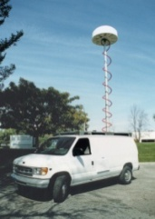
Integrated national system
SPECTRUM MANAGEMENT
SPECTRUM MONITORING
!
Supervision
Administration
XXXXXXXXXXXXX
XXXXXXXXXXXXX
XXXXXXXXXXXXX
Applications
Complaints
Notifications
XXXXXXXXXXXXX
XXXXXXXXXXX
XXXXXXXXXXXXX
XXXXXXXXXXXXX
XXXXXXXXXXXXX
Engineering
Planning
Assignment
Verification
Control
Accounting
Fees
Billings
Fines

Slide 32
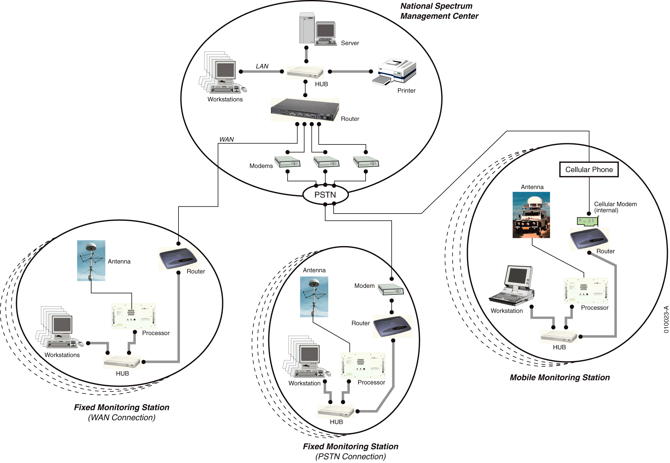
Networking of integrated system

Slide 33
Available systems for integration
Spectrum Management Systems:
  SMS4DC (ITU) interfaced with monitoring equipment of:
    Thales; (Grintek)
    R&S (TCI)
  LSTelcom
  ATDI
  TCI

Slide 34
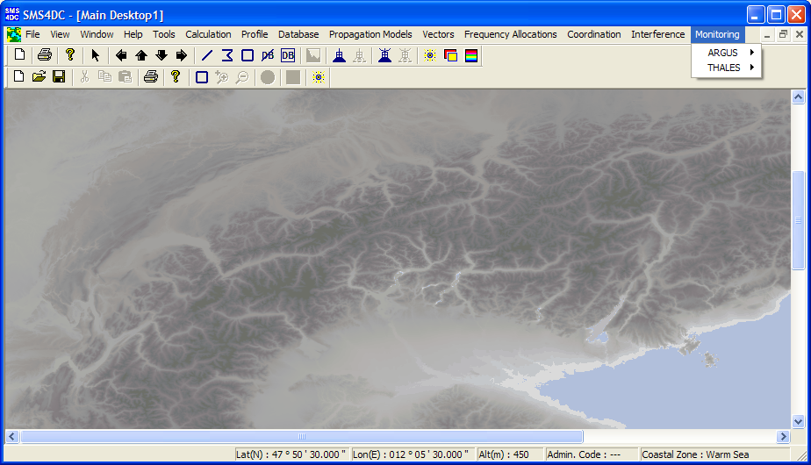
SMS4DC’s Engineering Functions
SMS4DC and monitoring software interface

Slide 35
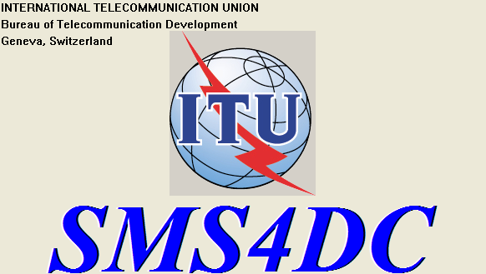
SMS4DC’s Engineering Functions
SMS4DC and monitoring software interface
Monitoring request to SMS4DC
1
Outbox
2
MONITORING
SOFTWARE
Results
4
3
Inbox

Slide 36
SMS4DC’s Engineering Functions
SMS4DC and monitoring software interface
SMS4DC order to monitoring
1
Inbox
2
Order(s)
MONITORING
SOFTWARE
Results
4
3
Outbox

Slide 37
SMS4DC’s Engineering Functions
SMS4DC and monitoring software interface
description
Experiences from the development of the interface to the two systems
General interface description
Provided to ITU-R WP1/C, September 2010

Slide 38
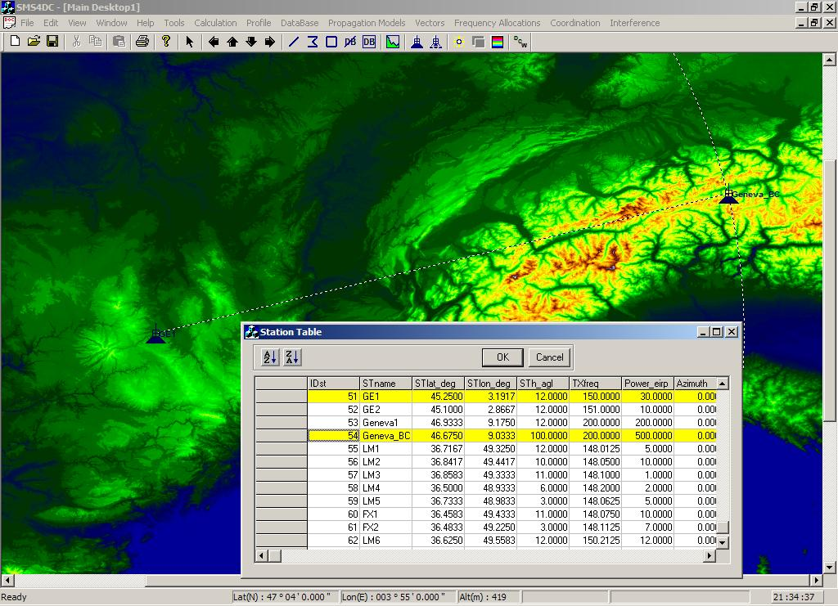
Geographic Map Display functions
Drawing line from database

Slide 39
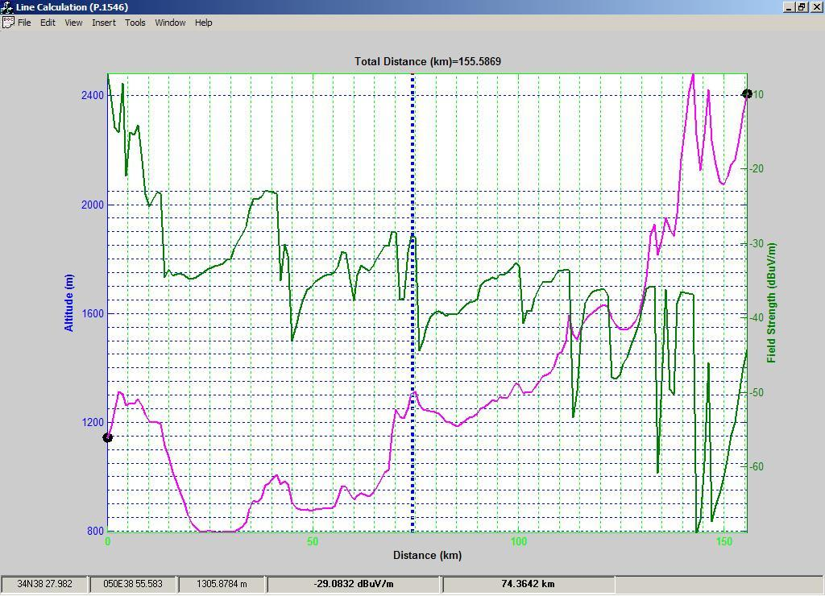
Geographic Map Display functions
Field-strength along a line

Slide 40
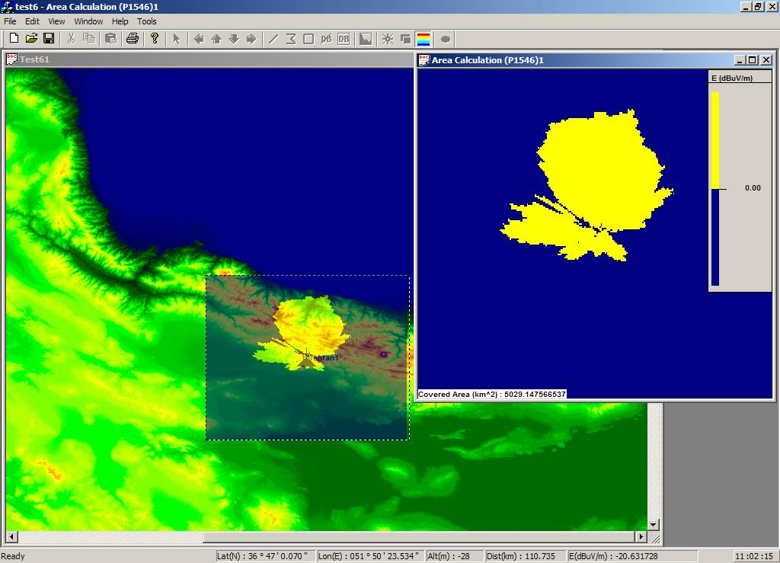
Geographic Map Display functions
Overlay possibility

Slide 41
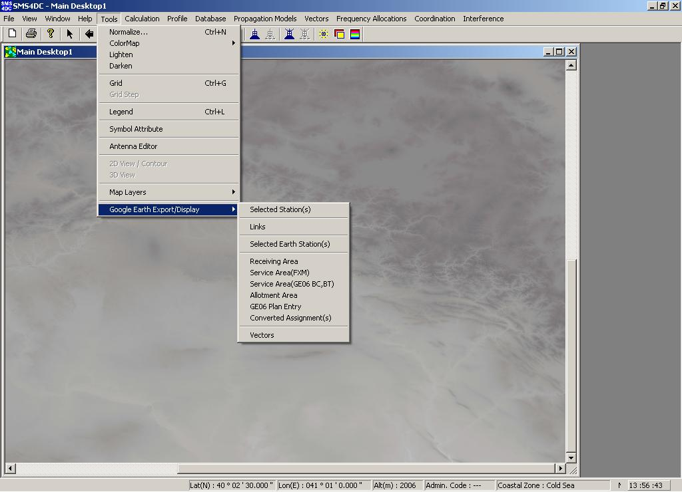
Geographic Map Display functions
Google Earth export

Slide 42
Geographic Map Display functions
Google Earth – results to export
Selected Stations (Including Earth Stations)
Selected Links
Receiving Area
Service Area
Allotment Area
GE06 Plan Entry
GE06 Converted Assignments
Vectors
Area Propagation Calculation
Maximum Field Strength Calculation
Best Server Calculation
Field Strength Contour

Slide 43
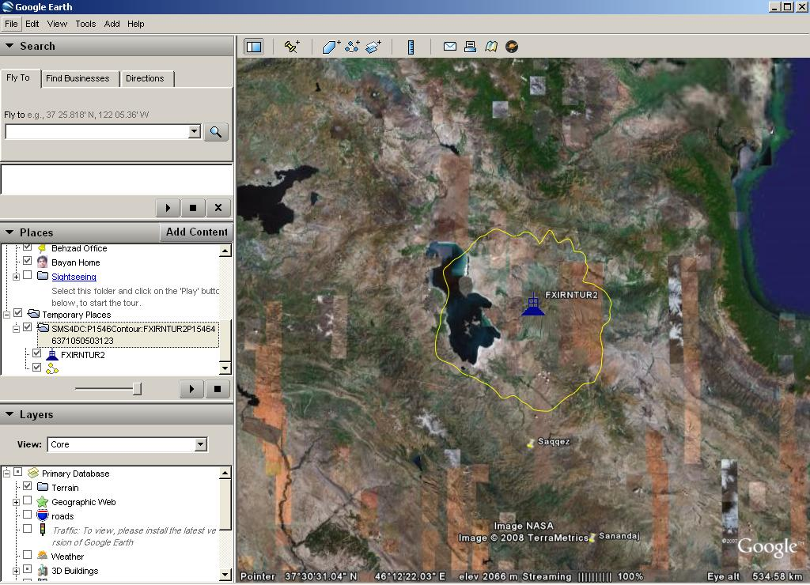
Geographic Map Display functions
Google Earth Display - Field Strength Contour (P.1546)

Slide 44
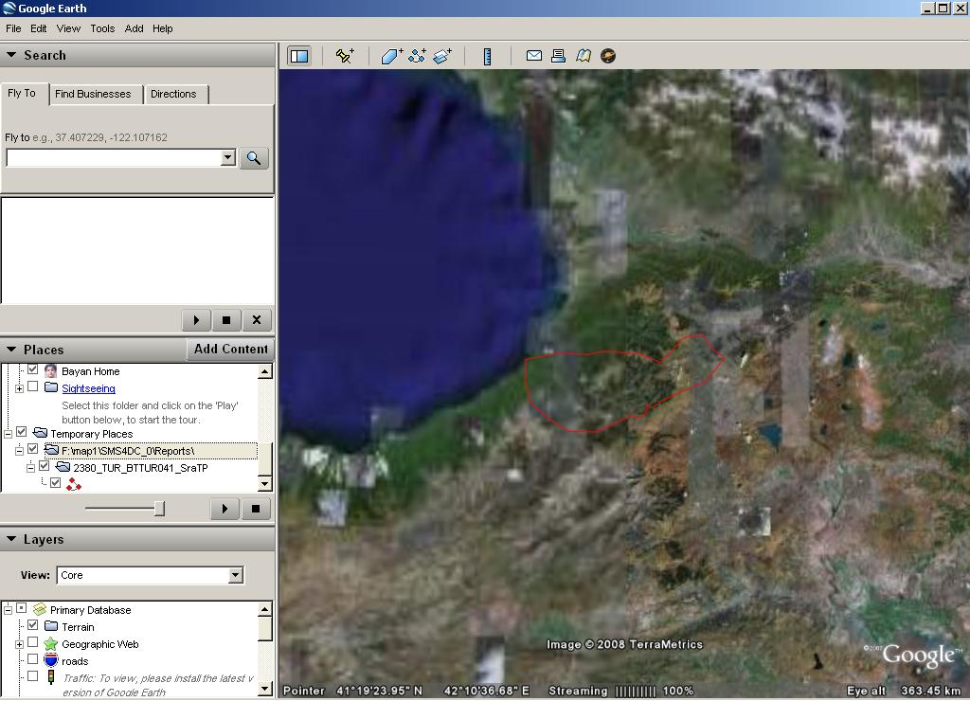
Geographic Map Display functions
Google Earth Display – GE06 Service area

Slide 45
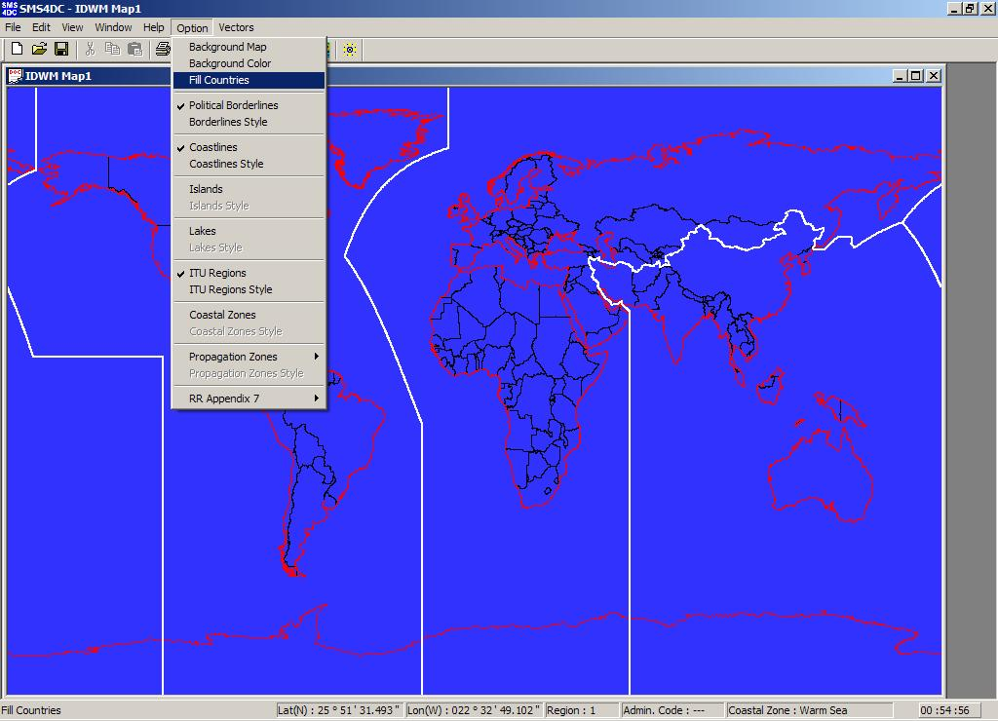
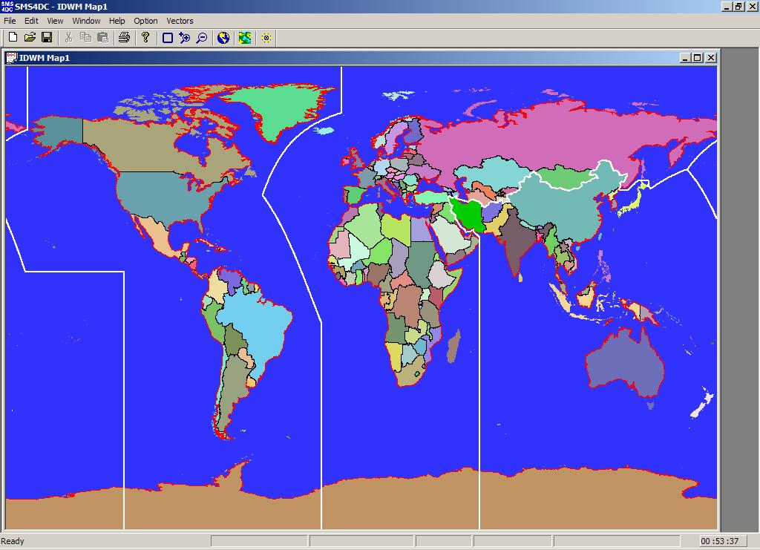
Geographic Map Display functions
Fill countries

Slide 46

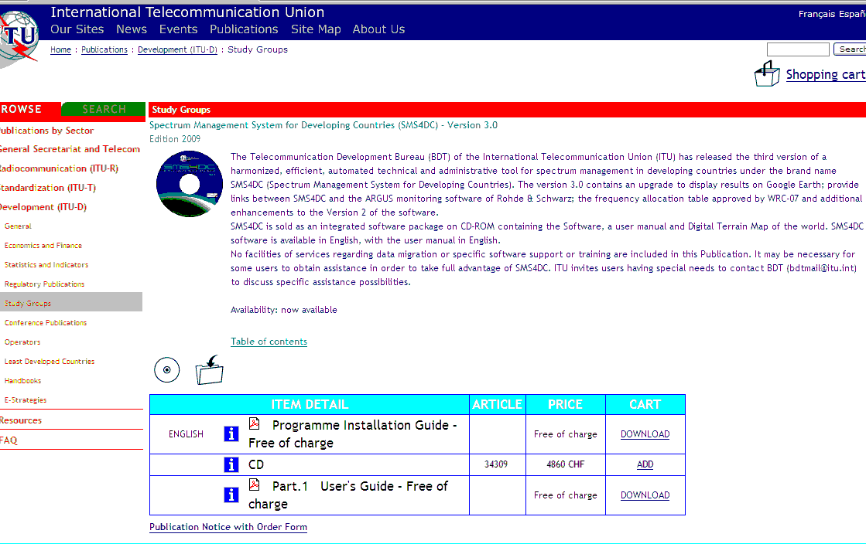
How to order SMS4DC
http://www.itu.int/publ/D-STG-SPEC-2009-V3.0/en

Slide 47
How to order SMS4DC
Annual licensing fee
Annual licensing fee in Swiss francs | Catalogue Price (software) annual licensing fee: CHF 4 860.– (for a single workstation) Member State Administrations and Sector Members: –15% Administrations of the least developed countries: – 80% Libraries of educational institutions: – 80%
Price for software installed on one single or multiple workstation(s)
Number of workstations | 1 | 2-3 | 4-5 | 6-10
Annual licensing fee (in Swiss francs) | 4 860.– | 7 290.– | 8 260.– | 9 720.–

Slide 48
Version 4
French
Additional monitoring system

Slide 49
Future developments
Addition of new services (e.g. radionavigation, maritime mobile)
SMS4DC web-site
Purchase follow-up
On-line training material

Slide 50
http://www.itu.int/ITU-D/tech/spectrum-management/SMS4DC.html sms4dc@itu.int
ITU: Committed to connecting the World

