Slide 1
Emerging topics In data, application and infrastructure protection
Taher Elgamal
ITU 12-2011

Slide 2
Agenda
The current security model
Gaps and threats
Protecting assets
Better security models
The future

Slide 3

The Internet Growth
Everything is connected to everything else
Security controls were added after the fact – except, perhaps, SSL (without user authentication!)
Conducting business on the same Internet is very appealing from an economic point of view
The old architecture and the system vulnerabilities created a new economy with much higher fraud rates
The vast majority of new applications use the web – or are simply “web applications”

Slide 4
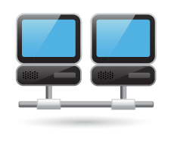

The Current Security Model
Network A
Edge Protection
Web Security
Controls
Network A
Edge Protection
Network C
Internet
Network B
Anti Virus and IPS

Slide 5
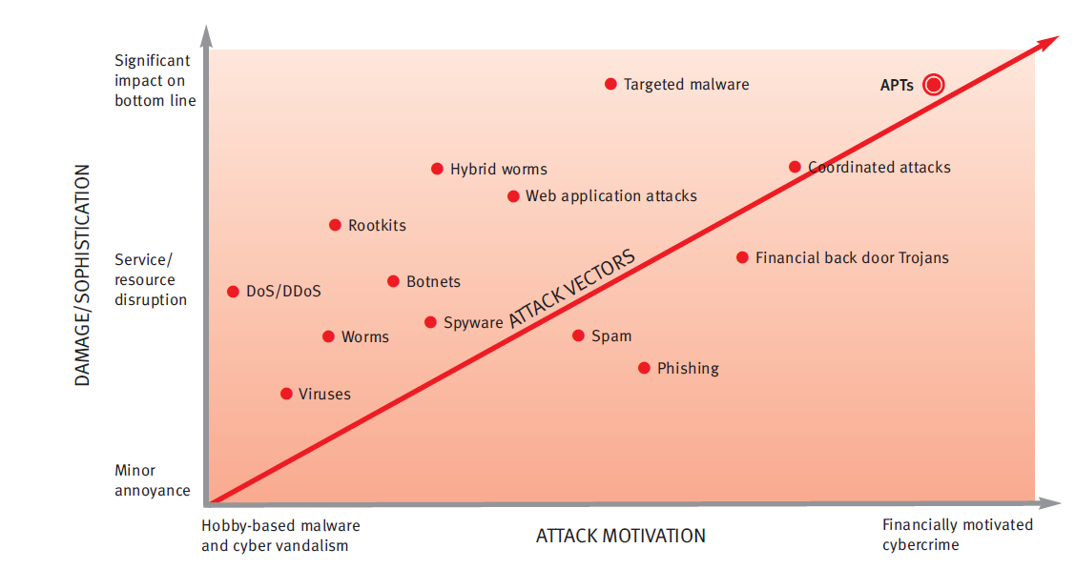
Advance Persistent Threats – (APT)
The Next Wave
APTs have a 100% penetration rate2
Solution Gap
Current Technologies FW/IPS/Web Security
5

Slide 6
Better Security Models
Understand the business and the important assets
Build a threat model
  Important assets, vulnerable elements, prioritized attacks
Ensure flexibility, ongoing management and communicate!

Slide 7
Protecting Assets
Application
security
controls
Applications
Firewalls,
antivirus,
IDS
Infrastructure
Access
Control,
encryption
Advanced
Attack
defense
Information

Slide 8
The Mobile Internet
The level of functionality and access to content from smart mobile devices will very soon equal that of stand alone computers
Mobile applications vs. browser access on PCs
Large scale malware attacks are certainly possible – although so far we have not experienced many
    Likely to be different from computer malware
Exposure of private, confidential and otherwise important data can be accomplished easily
The degree of connectivity to enterprise networks is still less than what computers can accomplish – but for how long?

Slide 9
Social Networking
In a very short time, interactions between individuals have changed – quite dramatically
These same individuals are, or soon will be, part of the work force
The social network paradigm is in fact quite suitable for business interactions – but with a better security model perhaps

Slide 10
Cloud Computing
Another movement to continue to lower the cost of implementing various applications
Time to market will in fact drive many businesses to pursue cloud implementations
Many efforts in the industry to provide guidance to secure cloud applications – but for the most part use existing techniques
Authentication and authorization will have to be correctly implemented

Slide 11
Connecting “Things”
Connecting “all home appliances” to the Internet provides for great utility to consumers
In this case we never really considered threats – unlike the early e-commerce days
Almost all the newly or the to-be connected devices are special purpose -- they run a very specific set of functions

Slide 12

Summary
This is only the beginning of a new world
The best way is to manage the change
Connectivity will change the world – yet again
Different applications need different security measures that address the specific threats
Managing security will continue to be a process – no silver bullets
Taking a different look maybe useful

Slide 13
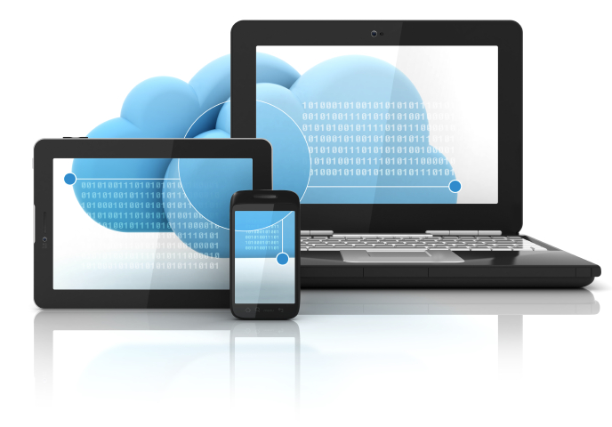
“There is no reason anyone would want a computer in their home.”
- Ken Olson, president, chairman and founder
of DEC, 1977

