Slide 1
Developing a Cybersecurity Strategy that Supports National Policy Goals
Dr. Frederick Wamala (Ph.D), CISSP®
“Regional Arab Forum on Cybersecurity,”
Giza (Smart Village)-Egypt, 18-20 December 2011

Slide 2
Quotations
“We are all in this
together, by ourselves,”
– Lily Tomlin, American Actress

Slide 3
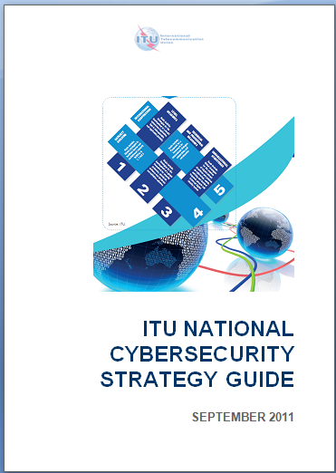
ITU National Cybersecurity Strategy Guide
Cybersecurity is a global issue. Thus, ITU Global Cybersecurity Agenda
Global action is as strong as the most insecure State
“Eating the Elephant”
National goals & interests
We use Ends-Ways-Means strategy reference model
Risk management driven
3
Notes:
3

Slide 4
ARB Regional Initiative 5: Cybersecurity
2012-2014 Expected Result
  Encourage the adoption of national frameworks and coordinated national and regional strategies against Cybercrime in the Arab region
Key Performance Indicators
  Number of National Strategies
ITU National Cybersecurity Strategy Guide
  The Guide covers issues to consider when devising or reviewing national cybersecurity strategies;
  A nationally-led, regionally and globally harmonised effort to build human and institutional capacity to prevent, detect, react and deter cyber threats

Slide 5
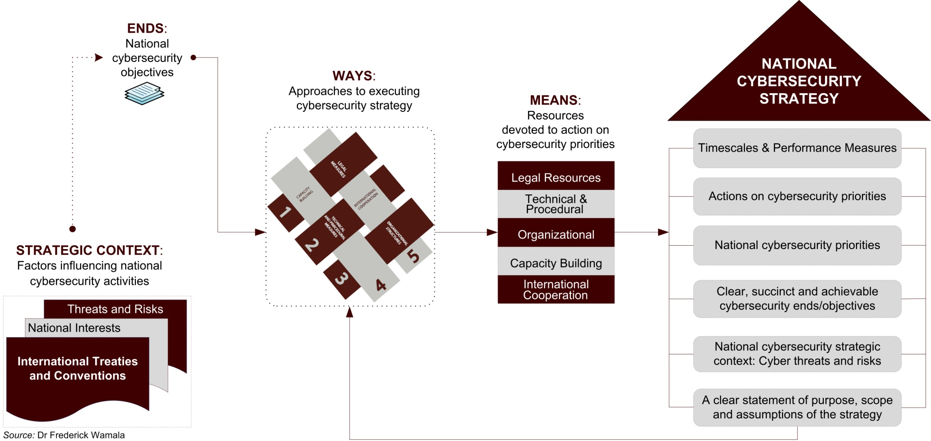
Cybersecurity Strategy Model

Slide 6
National Cybersecurity Context
Threat to critical national infrastructure
  Systems, services and functions vital to public health and safety, commerce, and national security
A national cybersecurity strategy:
  Treats cyberspace as a strategic domain
  Forms a basis for a national cybersecurity programme
Strategy requires all stakeholders to assume responsibility for and take steps to reduce risk
  Executive; Private Sector; Legislature; Judiciary; Law Enforcement; Intelligence; Citizens; Civil Society etc
Universal and national values as guiding principles

Slide 7
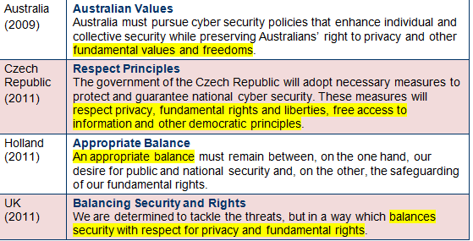
Guiding Principles: Examples
Universal: The UN Declaration of Human Rights
National core values/principles vital to cybersecurity

Slide 8
Ends – Why Devise National Strategies?
We are a poor developing country
with limited connectivity to Internet.
Cybersecurity is a problem for OECD
countries that have more systems.
The Arab region doesn’t have
anything electronic to steal. We
predominantly deal in commodities
such as oil. So why should we care?

Slide 9
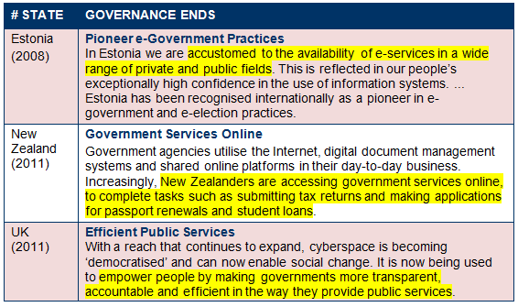
Ends – Governance

Slide 10
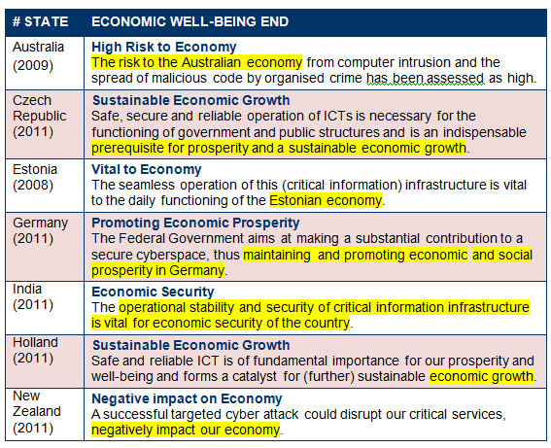
Ends – National Economy

Slide 11
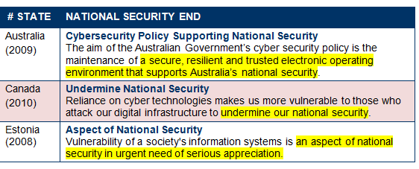
Ends – National Security

Slide 12
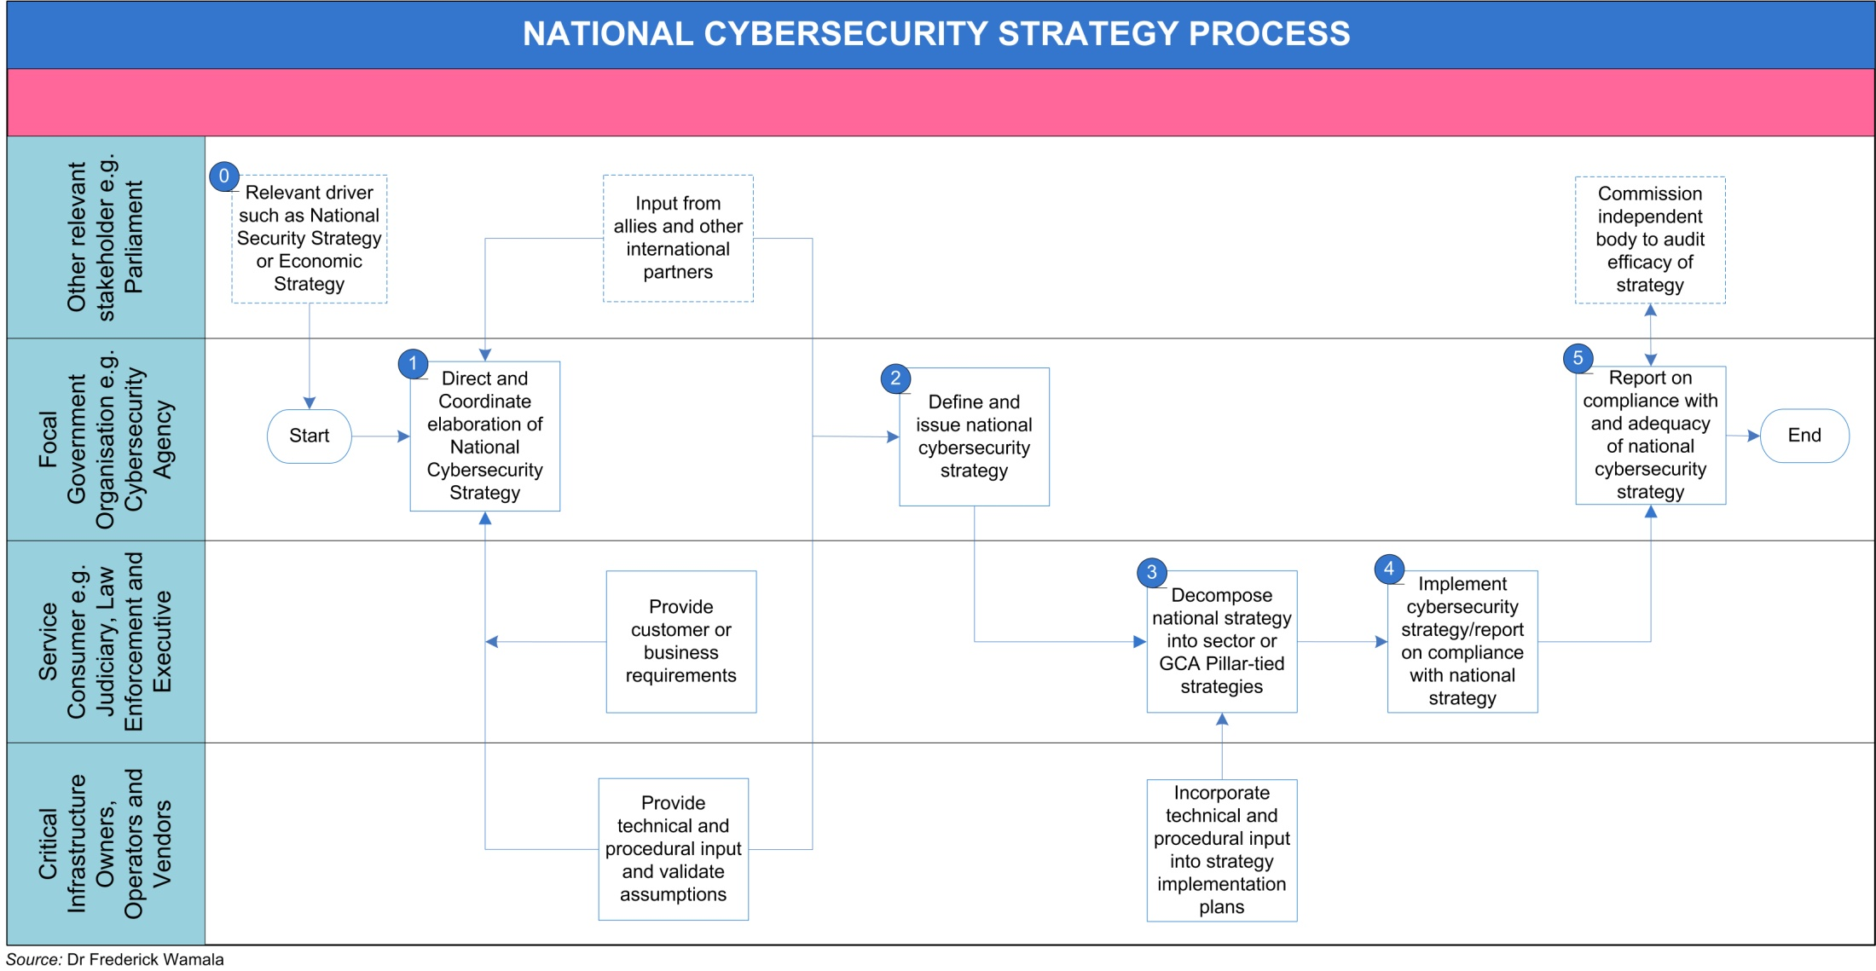
HOW: Strategy Elaboration Process
A high-level view of the process/Activities

Slide 13
National Strategy Elaboration Flowchart
Stage 0: Cybersecurity Strategic Driver
  Data leakages; Development plans; Security strategies
Stage 1: Direct and Coordinate elaboration
  Select lead agency, agree agenda and terms of reference
Stage 2: Define and Issue Strategy
  Publish strategy; Highlight roles and responsibilities
Stage 3: Sector or GCA-pillar specific strategies
  Create sector-specific strategies and action plans
Stage 4: Implement Cybersecurity Strategy
  Implement sector-specific actions plans; Monitor
Stage 5: Report on Compliance and Efficacy

Slide 14
Ways – Approaches to Executive Strategy
What actions should
we take to achieve the
Ends (objectives) of the
National Cybersecurity
Strategy?

Slide 15
Ways – Priority 1: Legal Measures
Legacy Measures Strategy
  Build capacity to regulate actions in cyberspace
Government Legal Authority
  Provide national governments legal authority to run coherent national cybersecurity programmes
Parliamentary Cybersecurity Process
  Simplify approach to handling cybercrime legislation
Law Enforcement Governance Framework
  Coordinate law enforcement, investigatory, policy and regulatory activities against cybercrime
Global Fight Against Cybercrime

Slide 16
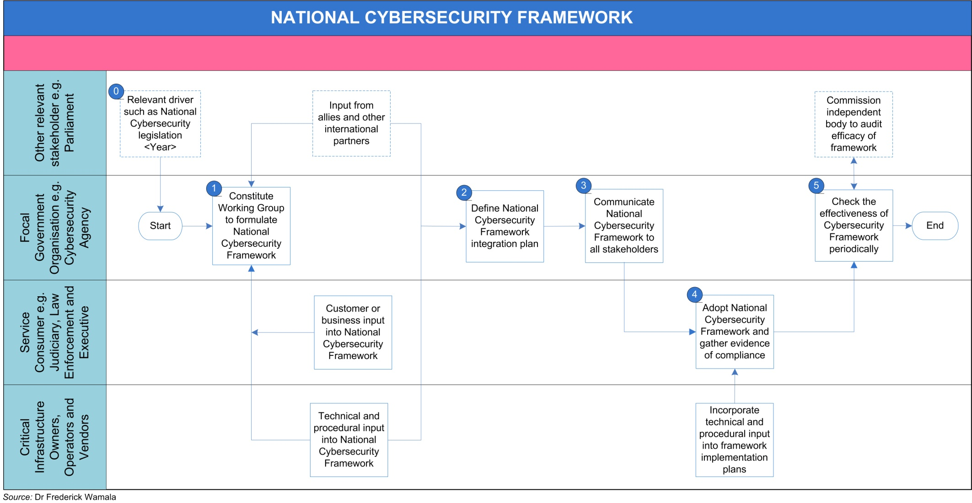
Priority 2 – Technical and Procedural
Cybersecurity Framework (ISO 27001 – ISMS)

Slide 17
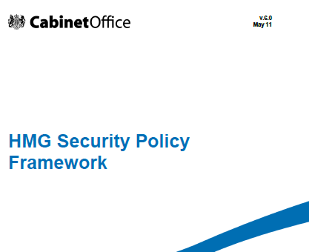
Example: UK Security Policy Framework

Slide 18
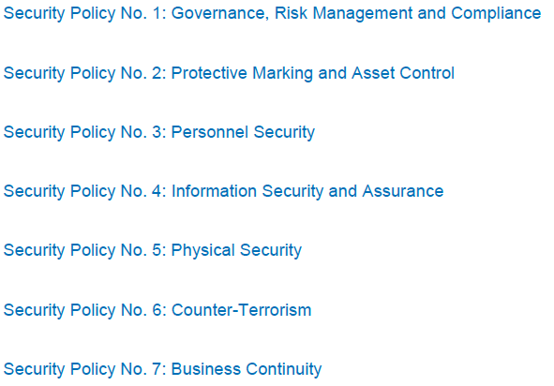
Example: UK Security Policy Framework

Slide 19
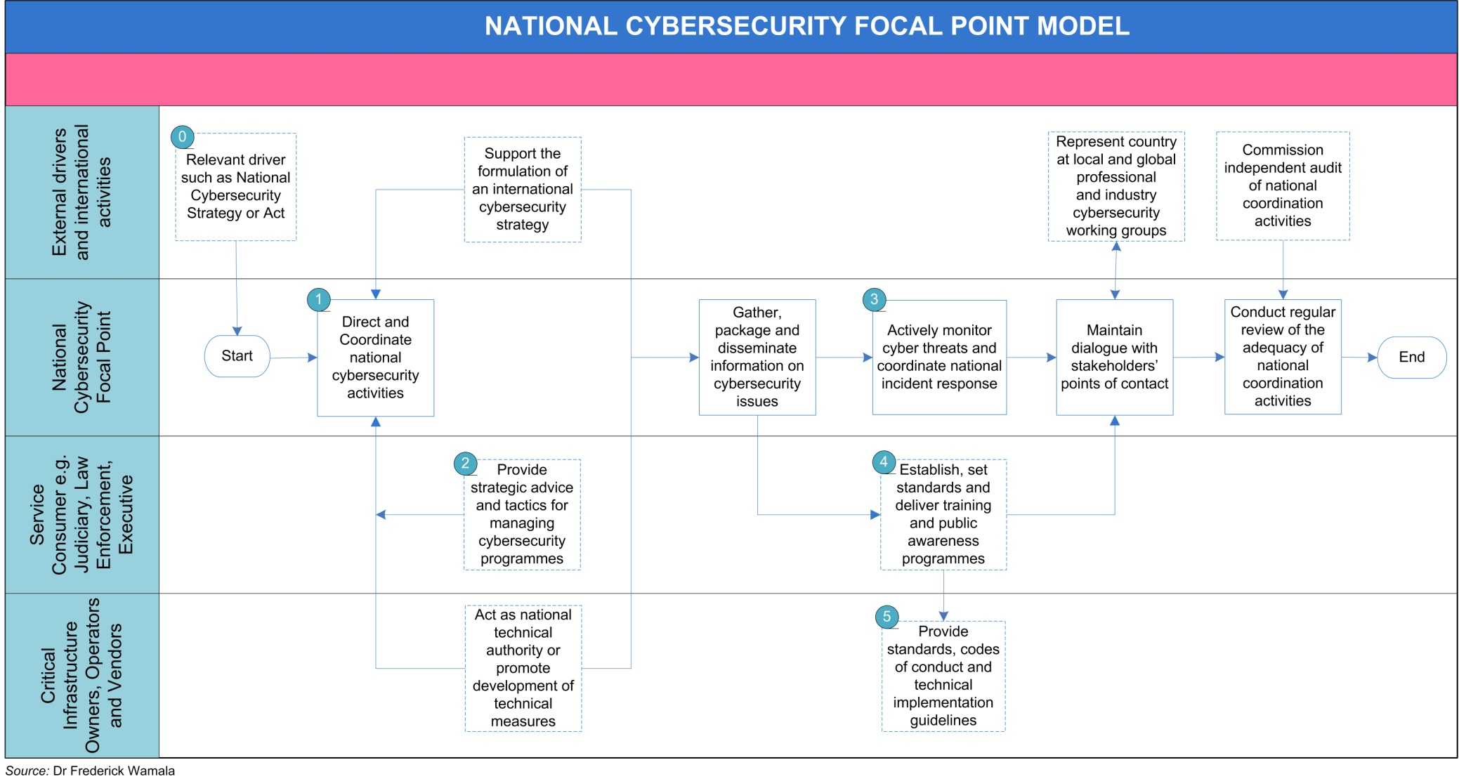
Priority 3 – Organisational Structures
Cybersecurity Focal Point e.g. DHS; OCSIA

Slide 20
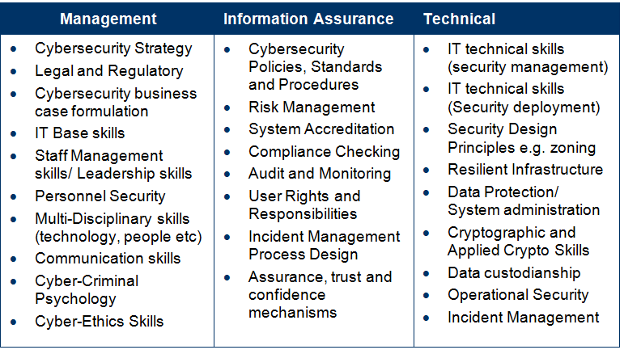
Priority 4 – Capacity Building
Cybersecurity Skills and Training

Slide 21
Priority 4 – Capacity Building
Judicial Capacity
  Improve judicial capacity to fight cybercrime;
  Short-term training and modifying legal curricula
National Culture of Cybersecurity
  Government-led holistic effort to develop a national cybersecurity culture e.g. DHS Awareness Month;
  Government, business, home and vulnerable users
Cybersecurity Innovation
  Enhance knowledge and foster innovation across sectors to defend cyberspace and use opportunities. For example, Federal R&D Program, December 2011

Slide 22
Priority 5 – International Cooperation
Cybersecurity is a global challenge
  A coordinated national and global response required
ITU Global Cybersecurity Agenda
  A widely adopted framework for global cooperation
Devise an international cybersecurity strategy
  Links all activities under the five GCA pillars
Bi-lateral Agreements in Priority Areas
  Allies may formulate focused agreements;
Assurance and monitoring
  The goal is to ensure that strategies meet objectives

Slide 23

Questions?
  Obtain a copy of the ITU National Cybersecurity Strategy Guide at:
  http://www.itu.int/ITU-D/cyb/cybersecurity/docs/ITUNationalCybersecurityStrategyGuide.pdf
  or contact cybmail@itu.int

