Slide 1
CIRT/CERT Baseline Capabilities
Anuj Singh, Director – Global Response Centre
Regional Arab Forum on Cybersecurity, Cairo, Egypt
19th December 2011

Slide 2
Agenda
Introduction
Need for a National CIRT
Benefits of a National CIRT
CIRT Framework
ITU-IMPACT Activities for member states
Baseline Capabilities
Cyber drill - ITU-IMPACT Alert

Slide 3


Introduction
What is a CIRT
A team that RESPONDS to cybersecurity incidents
Provides services to a defined constituency
Assist in effectively identifying threats, coordinate at national and regional levels, information dissemination
Act as a focal point for the constituency
Source: http://www.lakevalleyengineering.com/lve
3

Slide 4
The need for a National CIRT
To ensure the continuity of society in times of crisis
To protect essential services and critical national infrastructure
To improve resistance to disruption
To contain contagion effect
To restore control in information dissemination
To recover quickly back to original state of normalcy
4

Slide 5
Benefits of a National CIRT
Serves as a trusted focal point of contact within and beyond the national borders
Identifies and manages cyber threats that may have adverse effect on the country
Helps to systematically respond to cybersecurity incidents and takes appropriate actions
Helps the constituency to recover quickly and efficiently from security incidents
Minimises loss or theft of information and disruption of services
5

Slide 6
Benefits of a National CIRT
Better prepared against future incident handling based on lessons learned
Promotes or undertakes the development of education, awareness and training materials
Develops and encourages adoption of security best practices & standards
Knowledge exchange platform among constituencies
Deals effectively with legal issues
6

Slide 7
CIRT Framework
National CIRTs drive and promote
National Cybersecurity Strategies / Policies
Cyber Forensics Services
Governance / Legislations
Critical Information Infrastructure Protection
Cybersecurity Awareness, Training & Education
Cybersecurity Research
International Cooperation
Security Assurance

Slide 8
CIRT Services
Reactive Services
Proactive Services
SQM Services
Alerts, Warnings and Advisories
Incident Handling
Incident analysis
Incident response on site
Incident response support
Incident response coordination
Vulnerability Handling
Vulnerability analysis
Vulnerability response
Vulnerability response coordination
Artifact Handling
Artifact analysis
Artifact response
Artifact response coordination
Announcements
Technology Watch
Security-Related Information Dissemination
Security Audits or Assessments
Configuration and Maintenance of Security Tools, Applications, and Infrastructures
Development of Security Tools
Intrusion Detection Services
Risk Analysis
Business Continuity and Disaster Recovery Planning
Security Consulting
Awareness Building
Education/Training
Product Evaluation or Certification
Source: Handbook for CSIRTs – http://www.cert.org/archive/pdf/csirt-handbook.pdf

Slide 9
High-Level Process
Creating a National CIRT
Define the basic framework
Establish the fundamental policies / procedures
Train the staff
Launch the incident handling system
Announce the CIRT to the constituency
Establish contact with other parties

Slide 10
Institutional & Organisational Requirements
Mission Statement
Stakeholders
Sponsor
Facilitators
Constituents
Services to Constituents
Human Resources
Physical Premise
IT Infrastructure
Policies & Procedures
Promotional & Branding
Awareness Campaigns

Slide 11
Workshops & CIRT Deployment
To help partner countries assess of their readiness to implement a National CIRT.
IMPACT reports on key issues and analysis, recommending a phased implementation plan for National CIRT.
Three countries are moving ahead with the deployment of the National CIRT with the help from ITU-IMPACT
No. | Partner Countries | Assessment Status
1 | Afghanistan | Completed in October 2009
2 | Uganda, Tanzania, Kenya & Zambia | Completed in April 2010
3 | Nigeria, Burkina Faso, Ghana & Ivory Coast | Completed in May 2010
4 | Maldives, Bhutan, Nepal & Bangladesh | Completed in June 2010
5 | Serbia, Montenegro, Bosnia, Albania | Completed in November 2010
6 | Cameroon, Chad, Gabon, Congo | Completed in December 2010
7 | Armenia and Laos | Completed in November 2011
8 | Cambodia, Myanmar and Vietnam | Completed in November 2011
9 | Senegal, Togo, Gambia and Niger | Completed in November 2011

Slide 12
ITU-IMPACT Support for Member States
Proposed CIRT Model
ITU –IMPACT Support
Phase 1
6 – 8 months
Reactive CIRT services
Phase 2
9 – 18 months
Proactive CIRT services
Phase 3
19 – 24 months
Security Quality Management services

Slide 13
Baseline Capabilities
Defines a minimum set of CIRT capabilities that address the challenges and priorities for National CIRT
Mandate and Strategy
Service Portfolio
Co-operation
Operation

Slide 14
Mandate & Strategy
Requirements and Recommendations
National CIRTs need a clear mandate to serve a well-defined constituency
Their role should be embedded in the strategy for national cyber-security and established in an appropriate body with adequate funding.
Develop a strategic approach to cyber-security and CNI protection
The mandate for the national / governmental CIRT should clearly define the scale and scope of its activities

Slide 15
Service Portfolio
Requirements and Recommendations
CIRT services should be clearly defined in line with its mandate and strategy
Reduce the vulnerability of its constituency’s critical networks to cyber attacks and support effective responses to such attacks when they do occur.
Effective incident handling capabilities
Provide services to reduce the vulnerability of networks to cyber–attacks
Provide services to support an effective response to cyber–attacks
Notes:
Appropriate internal processes should also be implemented to support the external services.

Slide 16
Operation
Requirements and Recommendations
Must be able to respond to incidents developing across borders since cyber-security incidents happen on a global scale
Must have a reputation and competence in order to have the credibility which underpins its operational effectiveness.
Ensure that CIRT is sufficiently staffed with the required technical competence
Secure and resilient communication and information infrastructure
Located within physically secure premises and staff should be appropriately screened

Slide 17
Co-operation
Requirements and Recommendations
Effective cooperation between CIRTs at all levels is required
Requires trust and mutual respect between the bodies involved
Effective in building relationships
National CIRT should be enabled to invest time and resources in building cooperative relationships
Establish a clear framework for cooperation with national law enforcement agencies and stakeholders
All cooperative relationships should be supported by agreement
Notes:
1 - to facilitate the exchange of the information and knowledge needed to reduce vulnerability and provide effective responses to cyber incidents
3 - both on bilateral and multilateral basis.

Slide 18



ITU-IMPACT ALERT
(Applied Learning for Emergency Response Team)

Slide 19
Introduction to ALERT
(Applied Learning for Emergency Response Team)
Carried out on the 1st of December 2011 in Yangon, Myanmar
Focused exercise for four countries – Cambodia, Laos, Myanmar and Vietnam
Three scenarios were developed for the participants:
  Analysing SPAM
  Analysing defacement of a Website
  Analysing Malware and taking control of the Command and Control Server
Supported by F-Secure and Trend Micro

Slide 20
Objective
Evaluate the readiness of National CIRT in handling incident response
Enhance the CIRT’s incident response capabilities
Strengthening the national and international cooperation between countries in ensuring continued collective effort against cyber threats.

Slide 21
Conducting the Drill
Organiser sent the incident scenario to the participants in an email.
Participant performed their investigation/analysis on the incident and come out with the solution.
The participants submitted the solution in an advisory back to the organiser via email.

Slide 22
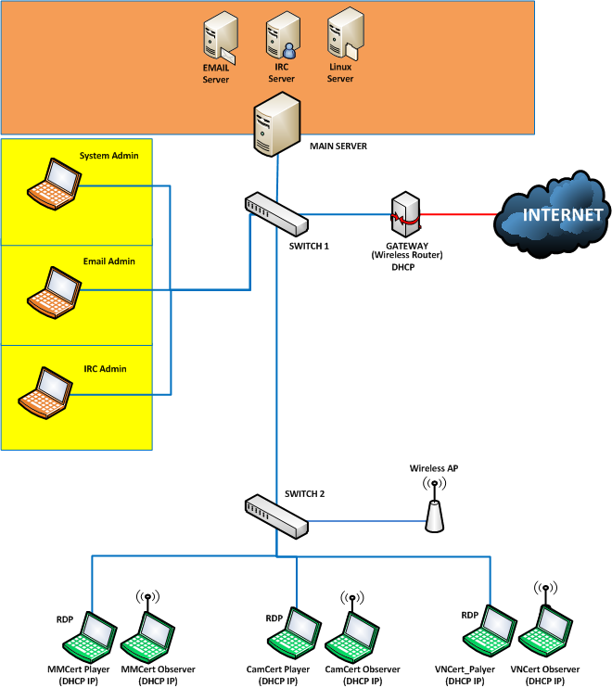
Drill Setup
Mail Server
All formal communication between the organizer and participants went through this mail server
IRC Server
Informal communication such as questions or tips regarding the drill to solve the scenario
Ad-hoc notifications from the organizer
Collaborate with other participating CIRT teams
Linux Server
Linux server was made available to the participants to perform their analysis.

Slide 23
References
http://www.enisa.europa.eu/act/cert/support/baseline-capabilities
http://www.enisa.europa.eu/act/cert/support/files/baseline-capabilities-of-national-governmental-certs-policy-recommendations
http://www.enisa.europa.eu/act/cert/support/files/baseline-capabilities-for-national-governmental-certs
http://cert.org

Slide 24

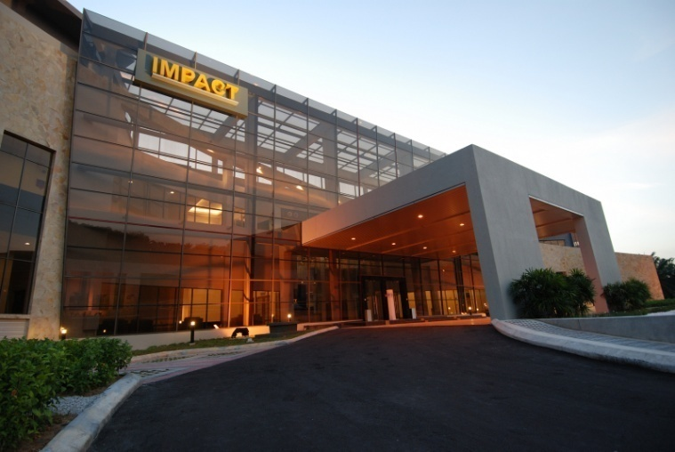
Thank you
www.facebook.com/impactalliance

