Slide 1
Cybersecurity and eTrust in the ESCWA Region
Matthew Perkins
19 December 2011

Slide 2
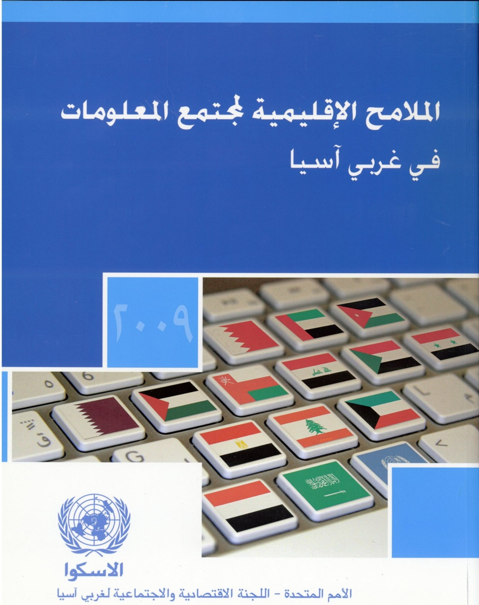
Regional Profile

Slide 3
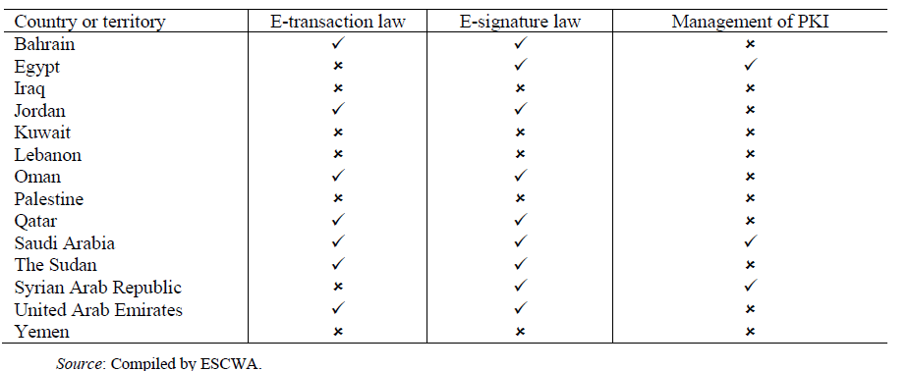
Regional Analysis
AVAILABILITY OF AN E-TRANSACTION LAW, E-SIGNATURE LAW AND OF INFRASTRUCTURE FOR THE MANAGEMENT OF PUBLIC-KEY INFRASTRUCTURE (PKI) IN THE ESCWA REGION, 2011

Slide 4
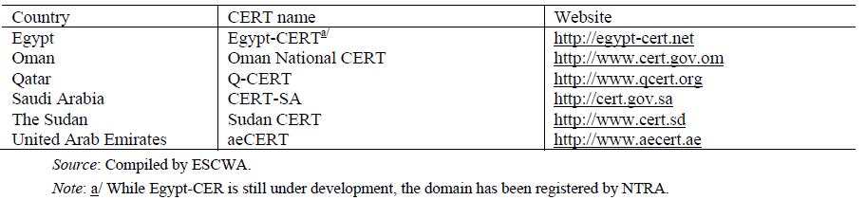
Regional Analysis
AVAILABILITY OF NATIONAL COMPUTER EMERGENCY RESPONSE TEAMS IN THE ESCWA REGION, 2011

Slide 5
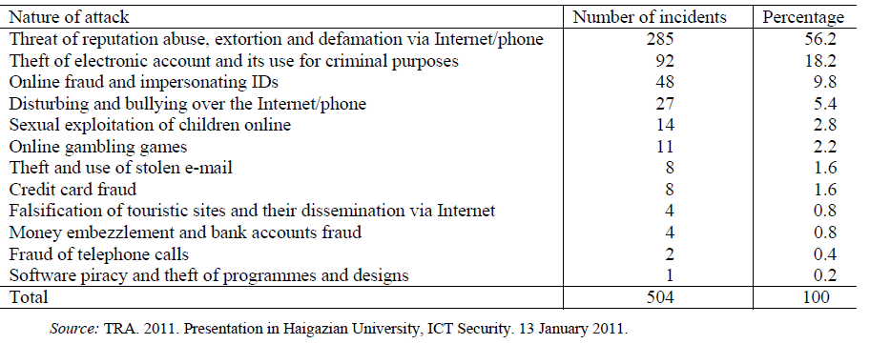
Regional Analysis
CYBERCRIMES REPORTED IN LEBANON
(Ranked by number of incidents)

Slide 6

Building Trust in Arabic eServices
Notes:
This study provides a review of the problematic aspects of cyberspace, which affect the confidence of users in electronic services, and proposes appropriate solutions. It also prescribes the policies needed for building confidence in cyberspace and electronic services, with a view to advancing the information society and achieving socio-economic development.

Slide 7
Building Trust in Arabic eServices
ESCWA prepared a study and published in 2009, that:
In collaboration with a number of experts in the region
Using the results of some studies of international organizations such as ITU, EU, OECD, ...
Must take into consideration a number of case studies in the United Arab Emirates, Saudi Arabia, Tunisia, Malaysia, Australia, Denmark and Hungary
Illustrated the different dimensions and problems that affect the confidence of users of electronic services
Proposed appropriate solutions to address these issues
Provided the appropriate frameworks and policies necessary to build confidence cyber space

Slide 8
Building Trust in Arabic eServices
Axes of the study
Building trust in the digital environment
Issues related to infrastructure and information systems (Security of information systems)
Issues related to legal frameworks
Institutional weakness in cybersecuirty
Weakness in human resources
Notes:
Building trust in the digital environment
Issues related to infrastructure and information systems (Security of information systems)
Issues related to legal frameworks
Institutional weakness in cybersecuirty
Weakness in human resources

Slide 9
Recommendations
Share best practices from existing CERTs among ESCWA member countries for promoting the establishment of an incident management capability with national responsibilities;
Support the activities of CERTs by providing them with the latest technological solutions and standards in the field of security and protection of cyberspace, and making them the national points of reference in all technical matters related to the protection of ICTs;
Encourage cooperation between public and private sectors in order to maintain the protection and security of networks and information systems and that of the national cyberspace, including the application of the tightest security measures for local networks and computer systems connected to the Internet, which are firewalls, anti-virus applications and spyware;

Slide 10
Measuring Cybersecurity
How can security issues be effectively measured and reported?

Slide 11
Indicator #1
1- Secure Internet servers per million of population: refers to the number of secure internet /web servers per thousand web servers each country.
Secure internet / web server is a web server that features a digital certificate signed by a licensed, external certifying authority. Self-signed certificates will be excluded. HTTPS protocols implemented on standard port assignments(443) only with be included. Availability of secured services is considered a proxy variable for the provision of reliable e-commerce services.

Slide 12
Pros/Cons
Pro:
  Easy to measure
  Standardized definition
  Time series available
Cons:
  Measures hosts, not user behavior
  Difficult to count at the national level
Notes:
HDI scores used in scientific research on facial attractiveness, testosterone sensitivity and development

Slide 13
Indicator #2
2- Number of Botnet infections per million PC users: refers to a specific type of malicious software identified as a reasonable proxy variable for tracking the health of secure computing in an online community expressed as a level of infection per million PC users.
Botnet infections refers to the number of personal computers infected with one or more pieces of malicious software which communicate among themselves in a peer to peer fashion, respond to remote command and control input, and undertake malicious action.

Slide 14
Pros/Cons
Pro:
  Very relevant to the security ecosystem
  Timely
  One of the most common malware issues
Cons:
  Difficult to track
  Data not normally collected by national authorities
Notes:
HDI scores used in scientific research on facial attractiveness, testosterone sensitivity and development

Slide 15
Indicator #3
3- Existence of a national ICT security policy: refers to whether the country has established a national ICT security policy or not.
National ICT security policy should address the risks to the critical national information which comprises the networked information systems of many critical sectors like National Defense and Security, Banking and Finance, Information and Communications, Energy, Transportation, Water, Health Services, Government, Emergency services, Food and Agriculture. This policy should also present solutions and suggest security measures and procedures to be applied.

Slide 16
Pros/Cons
Pro:
  Boolean indicator
  Easy collection
  Correlates to positive outcomes
Cons:
  Maturity of policy highly relevant
  Implementation of policy must be considered
Notes:
HDI scores used in scientific research on facial attractiveness, testosterone sensitivity and development

Slide 17
Indicator #4
4- Existence of cyber laws related to cybercrime and digital signature: refers to whether the country has enacted cybercrime and digital signature laws or not.
Cyber laws related to cybercrime and digital signature are all national laws regulating the various legal aspects related to cybercrimes and related legal issues including security of e-transactions, e-commerce and e-signature.

Slide 18
Pros/Cons
Pro:
  Cyberlegislation very important enabler for IS growth
  Enacted at National level
Cons:
  Baseline efficiency of institutions highly relevant
  Regional and global harmonization very important
  Quality of cyberlaws must be considered
Notes:
HDI scores used in scientific research on facial attractiveness, testosterone sensitivity and development

Slide 19
Indicator #5
5- Existence of Computer Emergency Response Team (CERT): refers to whether the country has established a CERT or not.
Computer Emergency Response Team (CERT) is a group of people in an organization who coordinate responses to breaches of security or other computer emergencies such as breakdowns and disasters. Other similar terms are CSIRT (Computer Security Incident Response Team), CIRT (Computer Incident Response Team) and IRT (Incident Response Team).

Slide 20
Pros/Cons
Pro:
  Easy to measure
  Typically not expensive, tend to be good value for money
  Largely a legislative/policy issue
Cons:
  Most threats are transnational
  Capacity of CERT to function is more relevant
  This is an input indicator, not a result indicator
Notes:
HDI scores used in scientific research on facial attractiveness, testosterone sensitivity and development

Slide 21
Additional Options
Proportion of protected devices.
Proportion of connected devices by type of protection:
  Anti-virus, (b) Firewall, (c) Anti-spam, (d) others.
Proportion of Internet devices which experienced a serious attack in the last 12 months.
Proportion of Internet users who used on-line payment in the last 12 months.

Slide 22
Social Media and Trust
How does social media use effect trust?

Slide 23
Social Isolation and New Technology
The odds of having a cross‐race or ethnicity confidant are 94% higher for those who maintain a blog.
compared to those who do not use the internet, those who use the internet have more diverse social networks.
Higher levels of diversity associated with internet use are independent of participation in neighborhood social networks, voluntary associations, and public and semipublic spaces.
Pew, 2009

Slide 24
Social Isolation and New Technology
Social networking sites and our lives
  How people’s trust, personal relationships, and civic and political involvement are connected to their use of social networking sites and other technologies, 2011

Slide 25
Social Isolation and New Technology
“…when we control for demographic factors and types of technology use, we find that there is a significant relationship between the use of SNS and trust, but only for those who use Facebook – not other SNS platforms. A Facebook user who uses the service multiple times per day is 43% more likely than other internet users, or three times (3.07x) more likely than a non-internet user, to feel that “most people can be trusted.”
Pew, 2011
Notes:
when we control for demographic characteristics we found that internet users and Facebook users in particular, were more likely to be politically involved than similar Americans

Slide 26
Social Isolation and New Technology
“…when we control for demographic characteristics we found that internet users and Facebook users in particular, were more likely to be politically involved than similar Americans .”
Pew, 2011
Notes:
when we control for demographic characteristics we found that internet users and Facebook users in particular, were more likely to be politically involved than similar Americans

Slide 27
Thank You

