Slide 1
Information Security & Cybercrime status and way forward
(writing on the wall)
Sherif El-Kassas
CTO SecureMisr
December 20, 2011

Slide 2
Outline
Information Security Overview
Technology and Trust
(local perspective)
Way forward:
  Societal directions
  R&D directions

Slide 3
Cybercrime

Slide 4
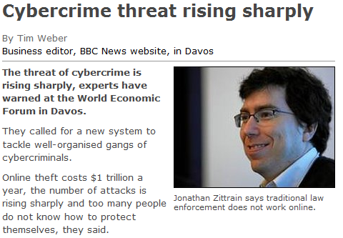
http://news.bbc.co.uk/2/hi/business/davos/7862549.stm

Slide 5
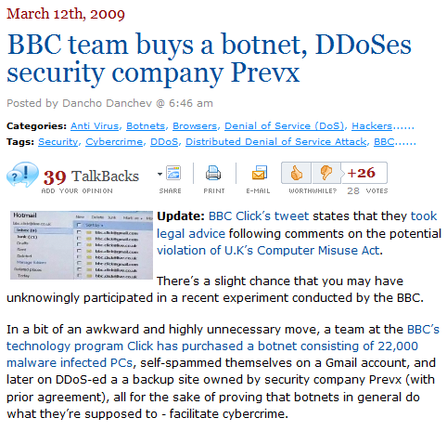
http://blogs.zdnet.com/security/?p=2868&tag=nl.e539

Slide 6
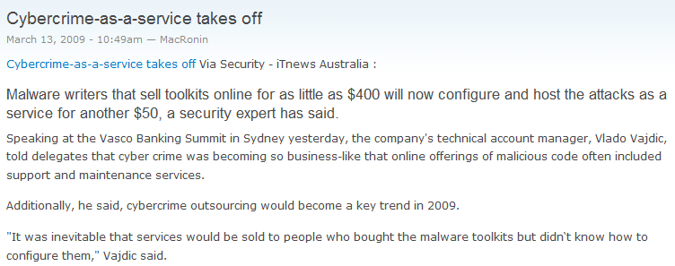
http://www.privacydigest.com/2009/03/13/cybercrime+service+takes

Slide 7
Information Security News
Our Region

Slide 8
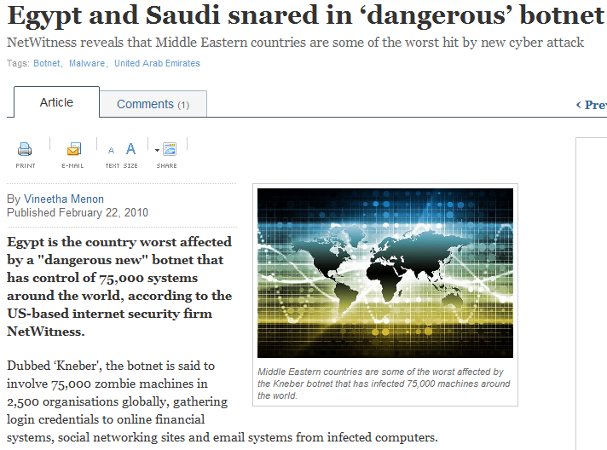
http://www.itp.net/579360-egypt-and-saudi-snared-in-dangerous-botnet

Slide 9
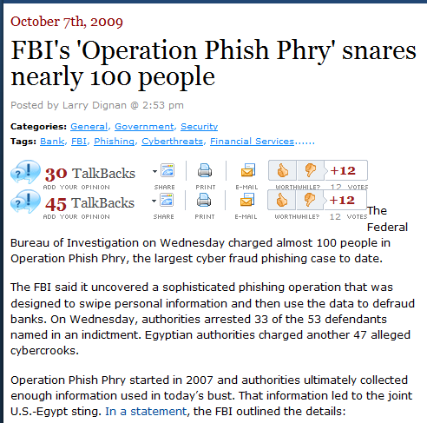
http://www.zdnet.com/

Slide 10
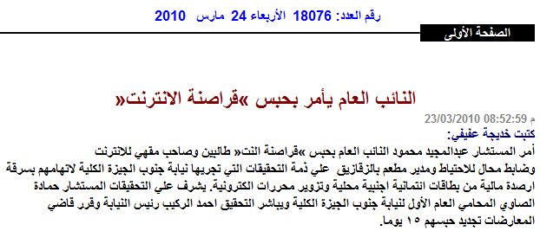
Egyptian DA orders the arrest of “Internet Pirates”
http://www.akhbarelyom.org.eg/elakhbar/issues/18076/detailze3fad.html

Slide 11
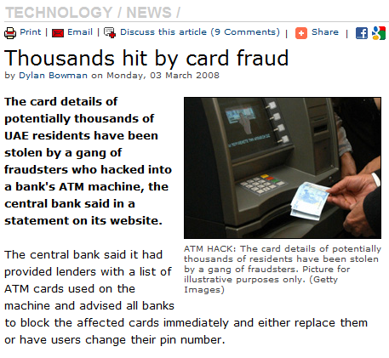
http://www.arabianbusiness.com/512710-thousands-hit-by-card-fraud

Slide 12
Security Trends & News
in the region
Countries Generating Most Online fraud
Nir Kshetri, “The Simple Economics of Cybercrimes,” IEEE Security & Privacy, January/February 2006

Slide 13
Elsewhere

Slide 14
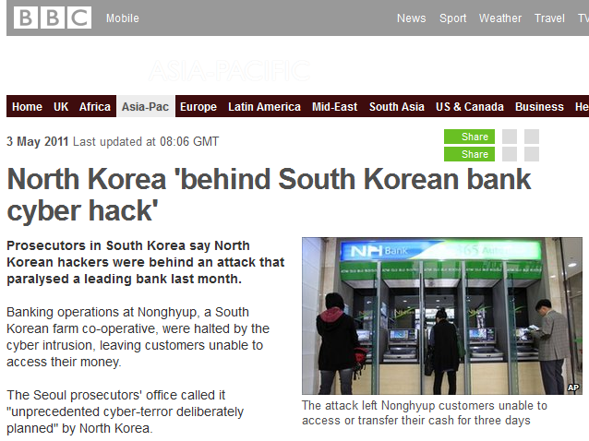

Slide 15
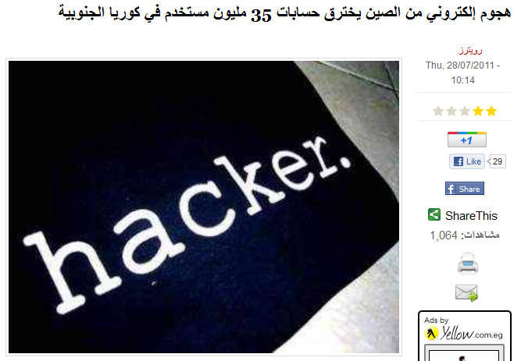
http://www.almasryalyoum.com/node/481121

Slide 16
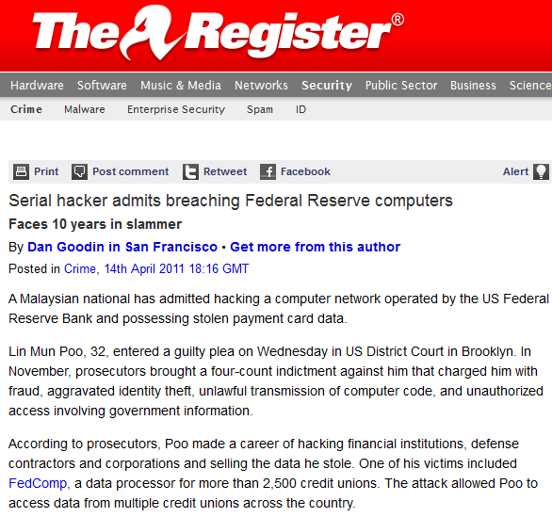

Slide 17
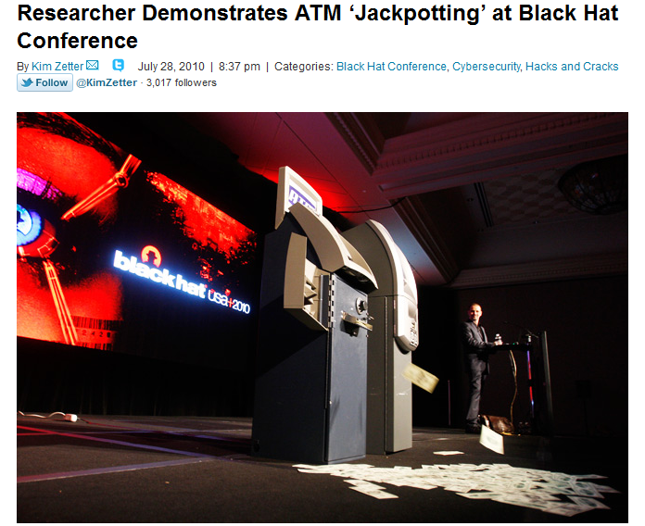
http://www.wired.com/threatlevel/2010/07/atms-jackpotted/

Slide 18
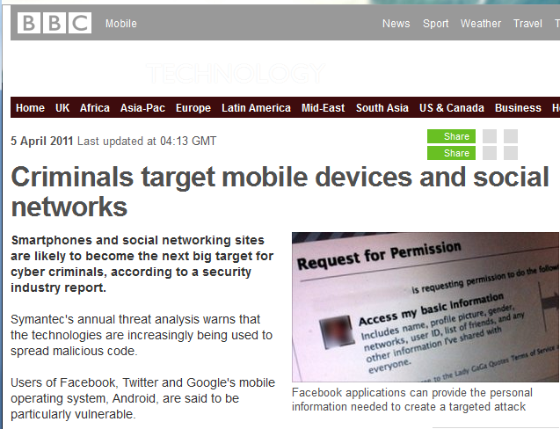

Slide 19
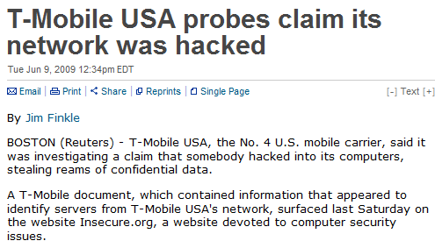
http://www.reuters.com/article/technologyNews/idUSTRE5584CA20090609

Slide 20
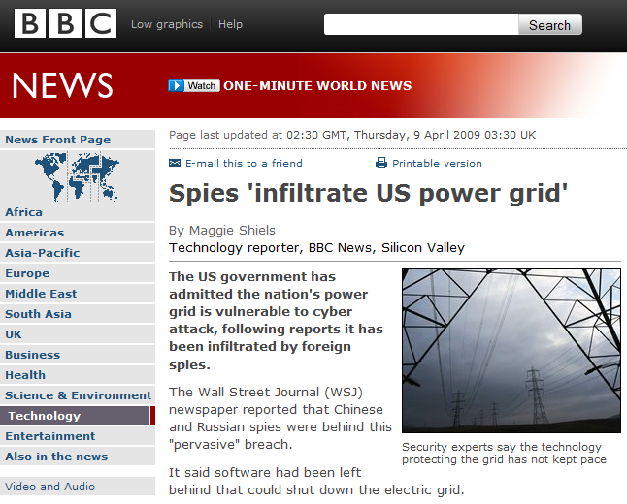
http://news.bbc.co.uk/2/hi/technology/7990997.stm

Slide 21
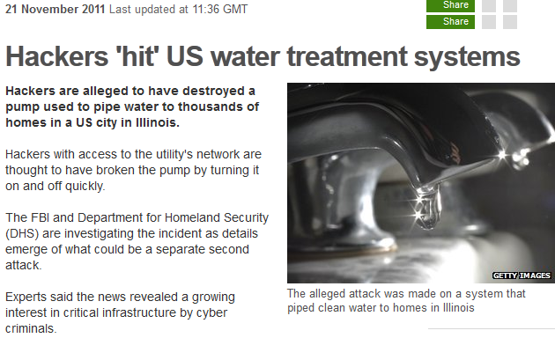
http://www.bbc.co.uk/news/technology-15817335

Slide 22
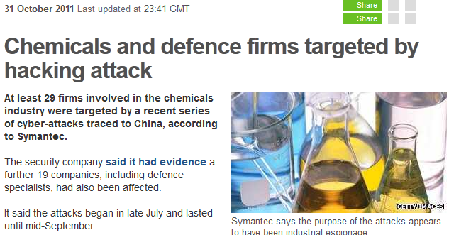
http://www.bbc.co.uk/news/technology-15529930

Slide 23
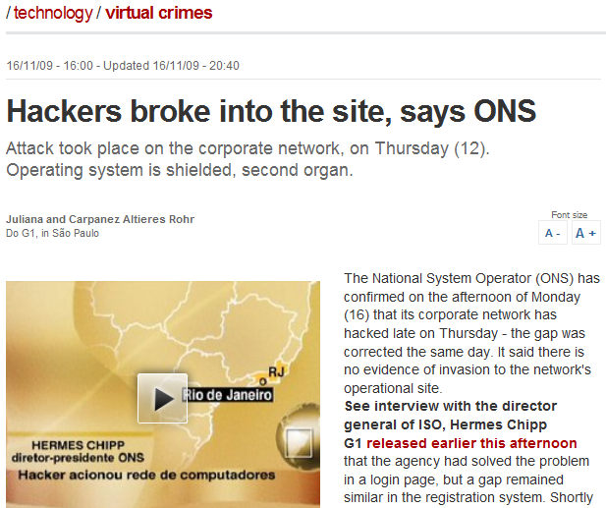
Hackers Broke Into Brazil Grid Last Thursday
http://news.slashdot.org/story/09/11/17/2245241/Hackers-Broke-Into-Brazil-Grid-Last-Thursday

Slide 24
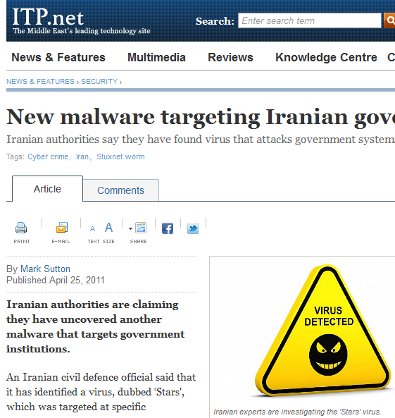
http://www.itp.net/584600-new-malware-targeting-iranian-government

Slide 25
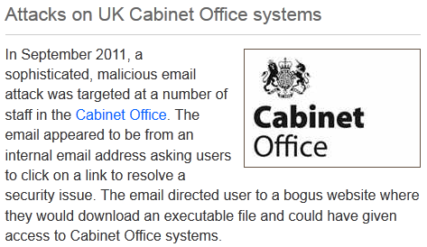
http://www.fco.gov.uk/en/global-issues/london-conference-cyberspace/cyber-crime/case-studies/cyber-attacks-cabo

Slide 26
“on trusting trust”
a local perspective

Slide 27
Conspiracy Theories!

Slide 28
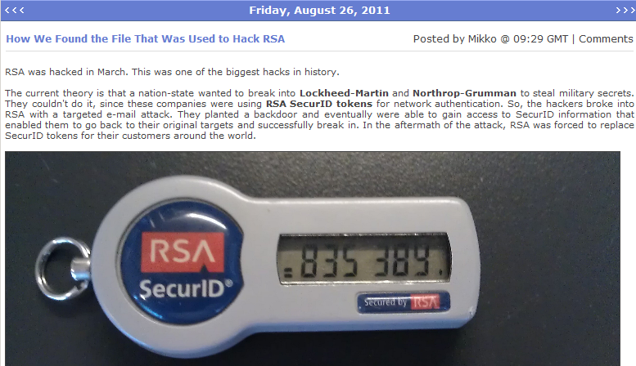
http://www.f-secure.com/weblog/archives/00002226.html
Nation-State
Lockheed-martin
RSA secureID

Slide 29
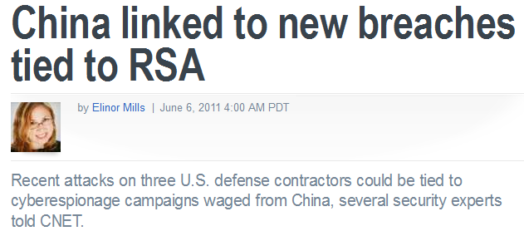
http://news.cnet.com/8301-27080_3-20068836-245/china-linked-to-new-breaches-tied-to-rsa/

Slide 30
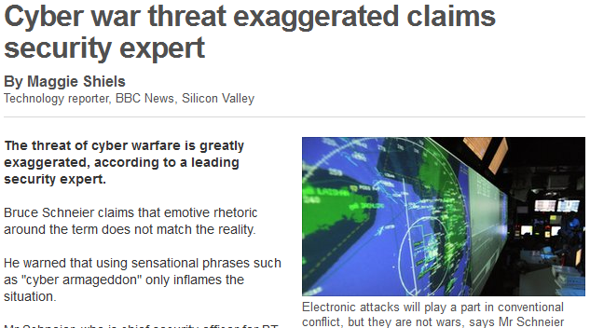
http://www.bbc.co.uk/news/technology-12473809

Slide 31
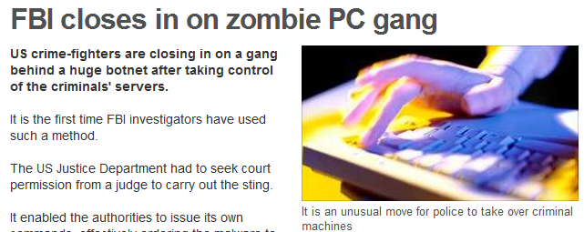
http://www.bbc.co.uk/news/technology-13078297

Slide 32
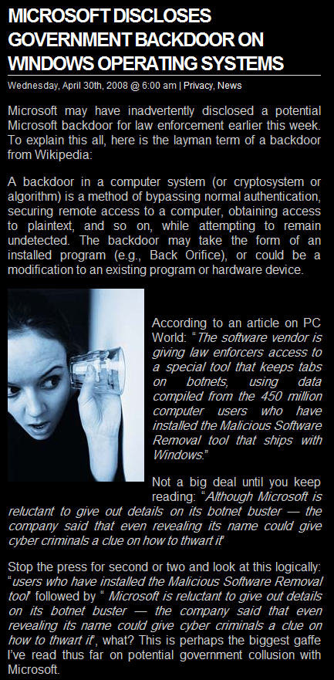
http://newsworldwide.wordpress.com/2008/05/02/microsoft-discloses-government-backdoor-on-windows-operating-systems/

Slide 33
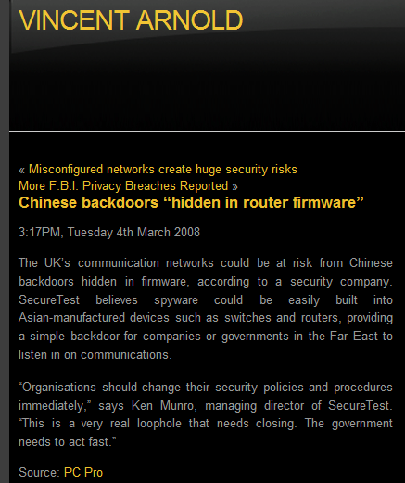
http://vincentarnold.com/blog/chinese-backdoors-hidden-in-router-firmware/

Slide 34
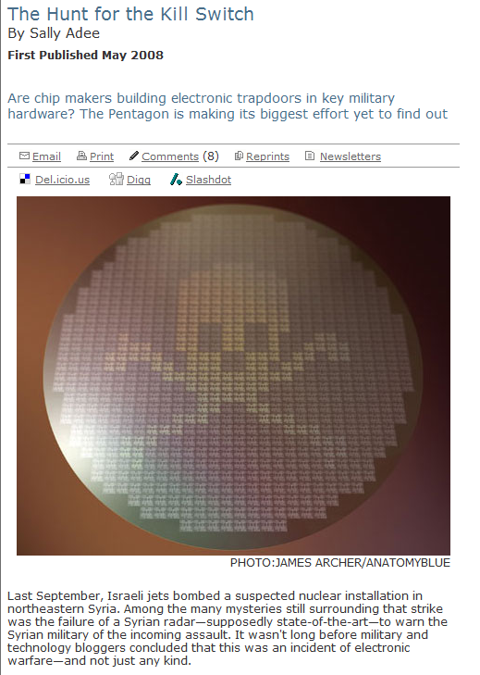
www.spectrum.ieee.org/may08/6171

Slide 35

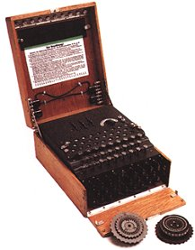
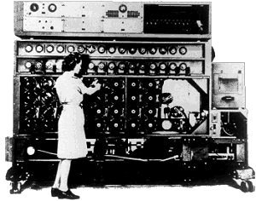
http://www.iwm.org.uk/online/enigma/eni-intro.htm

Slide 36
People!

Slide 37
employee1
employee2
Sorry!
Can’t Fax out
Please fax me
“Confidential
Information.”
Hacker

Slide 38
“Confidential
Information”
employee2
employee1
“Confidential
Information”
fax to emp2
“Confidential
Information.”
Please forward
the fax you’ve
just received.
Hacker

Slide 39
Seeking answers

Slide 40
Some Perspective

Slide 41
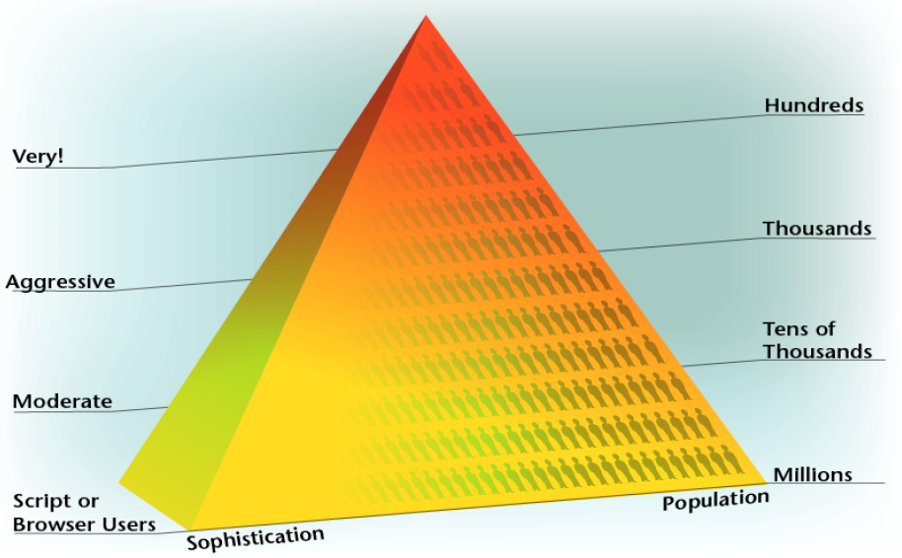
cert.org

Slide 42
Security is
Socio-technical & Physical!
Security ≠ Technological Security

Slide 43
Business Risks
Security Risks
Technological
Networks
Systems
Applications
Data & Information
People

Slide 44
research agenda

Slide 45
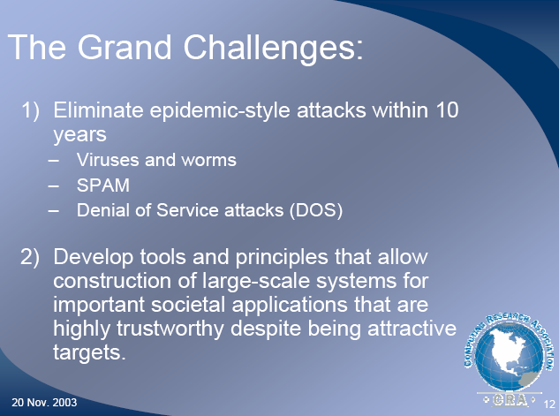
http://www.cra.org/

Slide 46
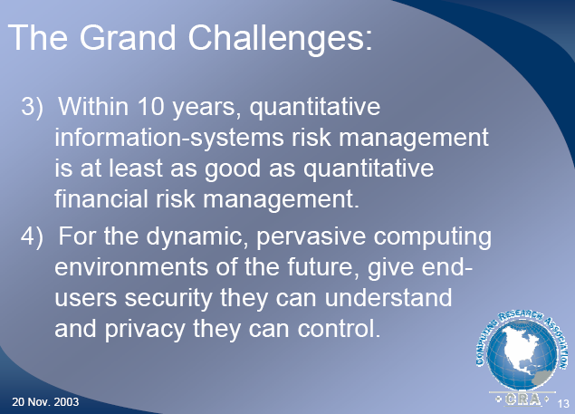
http://www.cra.org/

Slide 47
development agenda

Slide 48
The need for trustworthy technology
  One possible approach
    Build your own
    Start from OSS to save time
    Strong certification program to ensure quality
Invest in people
  The true asset
Standards to ensure no short cuts are taken

Slide 49
Conclusions
Information Security is a huge challenge
Appears to be a loosing battle at the moment
We need to education ourselves and understand the significance of infosec
Trustworthy technology and people at the right place
Invest in R&D

Slide 50
Thank you
Question?

Slide 51
The bot-net trade

Slide 52
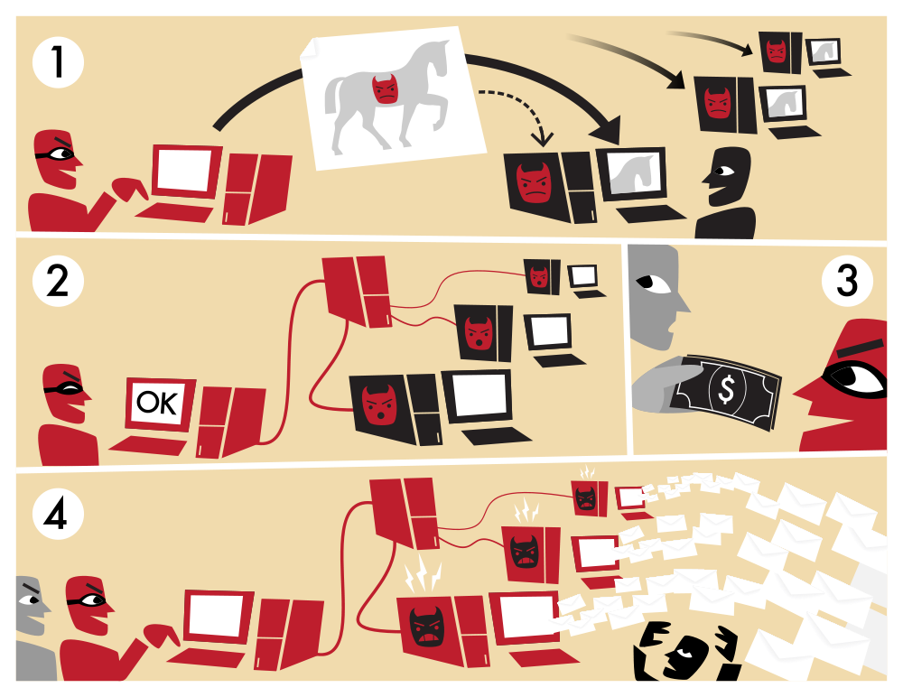
http://en.wikipedia.org/wiki/File:Botnet.svg

Slide 53
Types of attacks

Slide 54
Types of Threats & Attacks
Technical
  Using technological means to break into an organization's network and systems
Physical
  Physically access and attack the enterprise
Social
  Social engineering attacks

Slide 55
simple technical attacks
field experience
How easy is it?

Slide 56
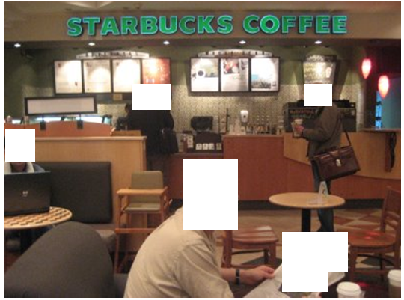

Slide 57
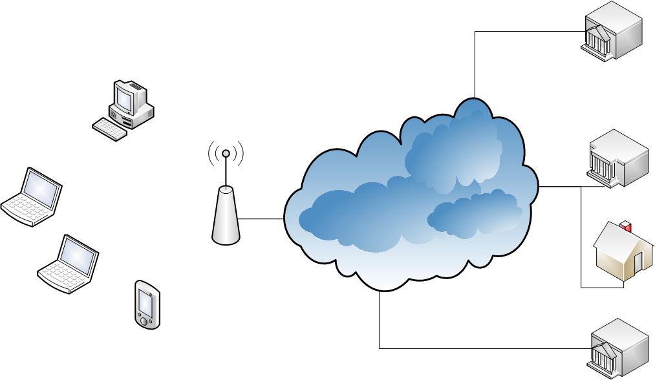

Slide 58
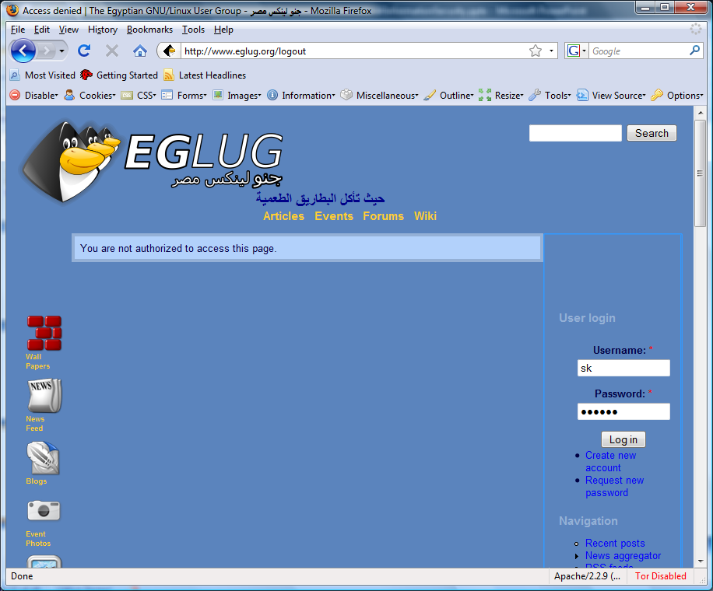

Slide 59
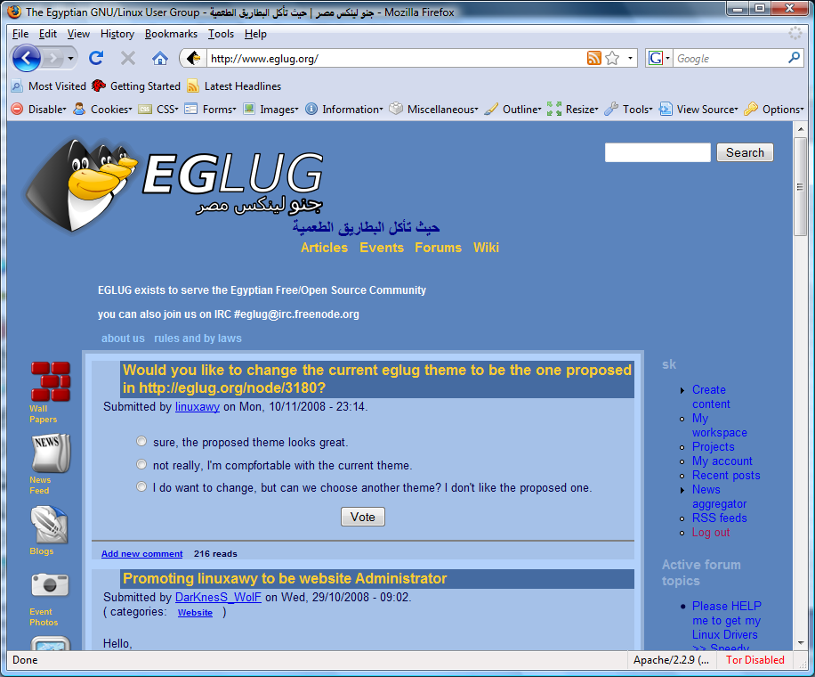

Slide 60
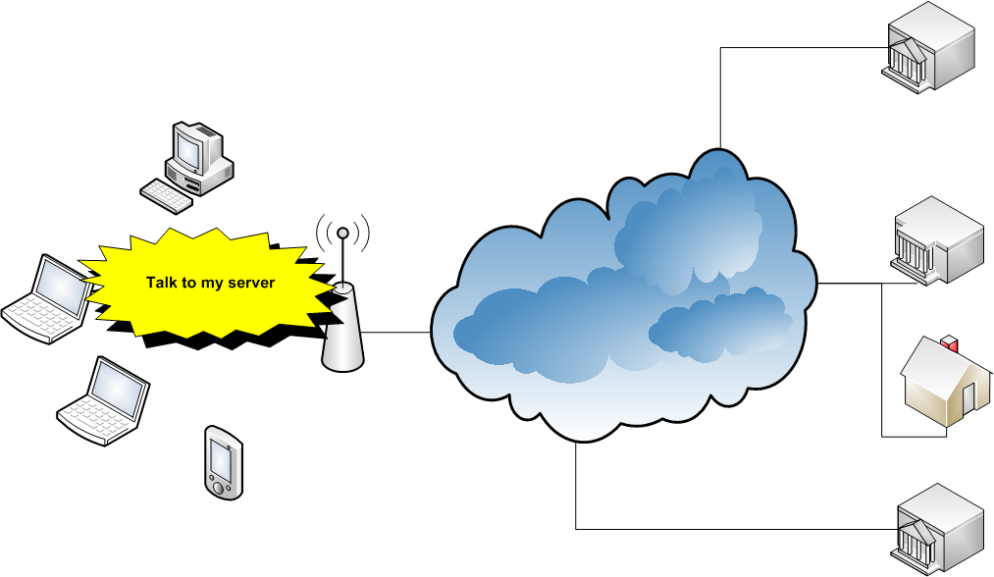

Slide 61
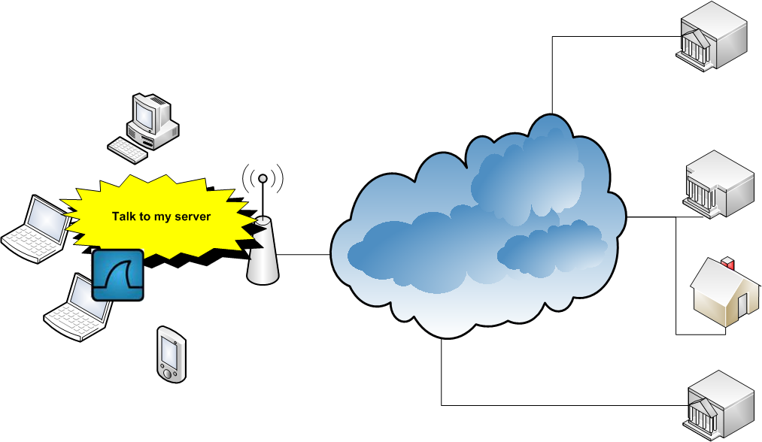

Slide 62
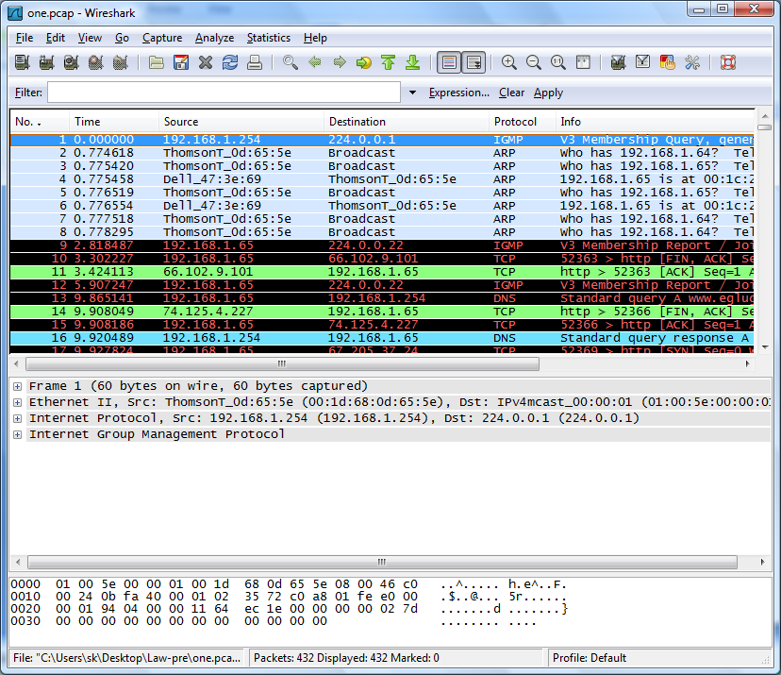

Slide 63
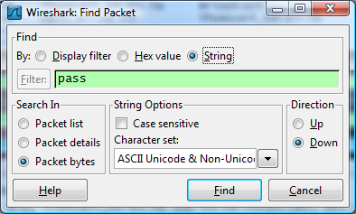

Slide 64
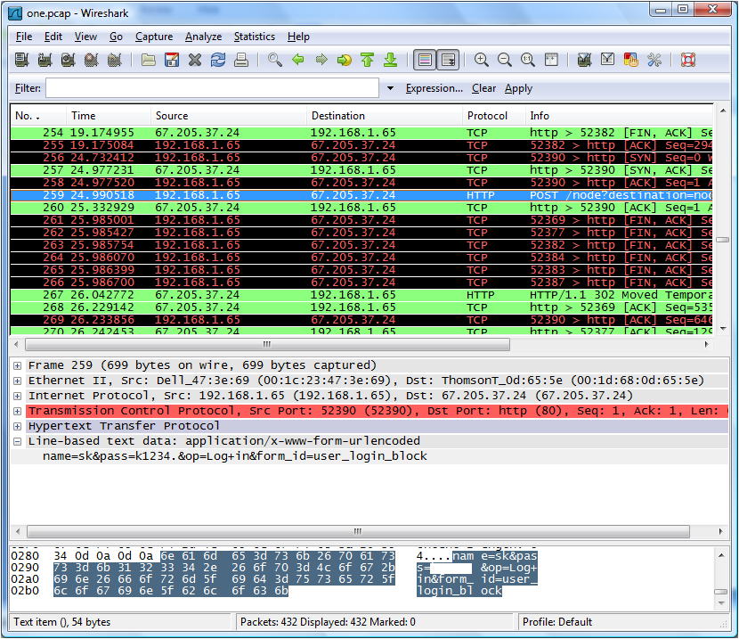

Slide 65
name=sk
pass=Linux4ever

Slide 66
More field experience
Google is a friend!

Slide 67
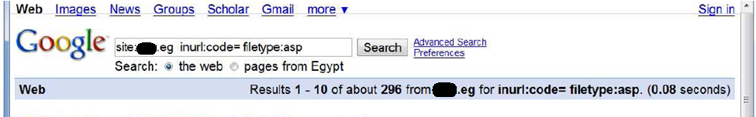
Google for:
site:XYZ.eg inurl:code= filetype:asp

Slide 68
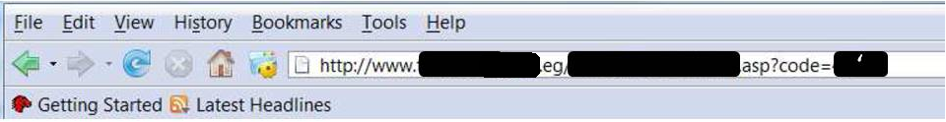
Programming 101: Check inputs!

Slide 69
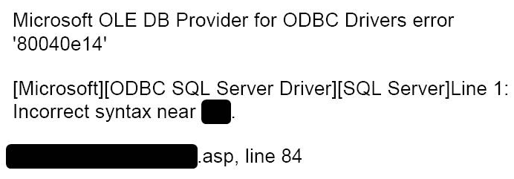
Direct from the Database!

Slide 70
More field experience:
Phishing

Slide 71
Email & Phishing

Slide 72
Email & Phishing

Slide 73
physical attacks

Slide 74
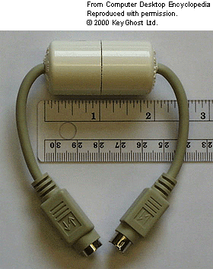
http://www.answers.com/topic/keystroke-logger?cat=technology

Slide 75
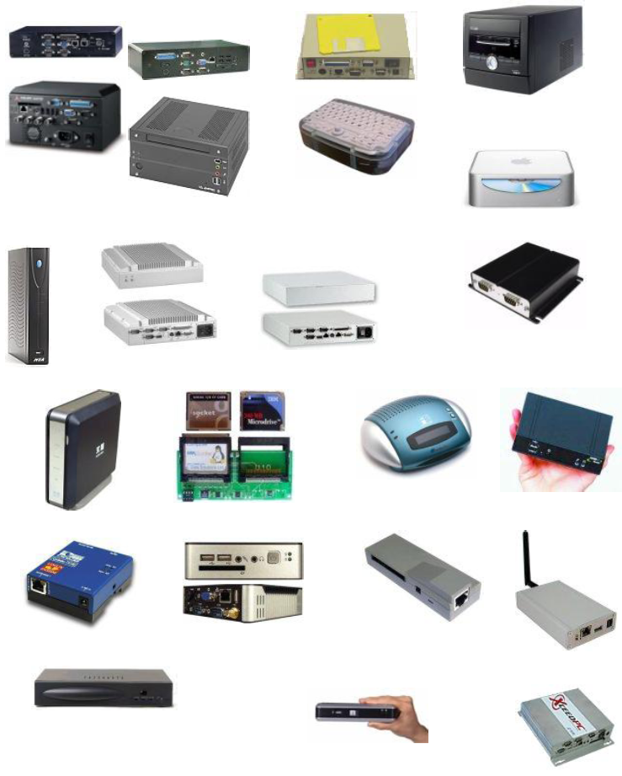
http://www.linuxdevices.com/articles/AT2016997232.html

