Slide 1


Slide 2


Slide 3


Slide 4


Slide 5


Slide 6
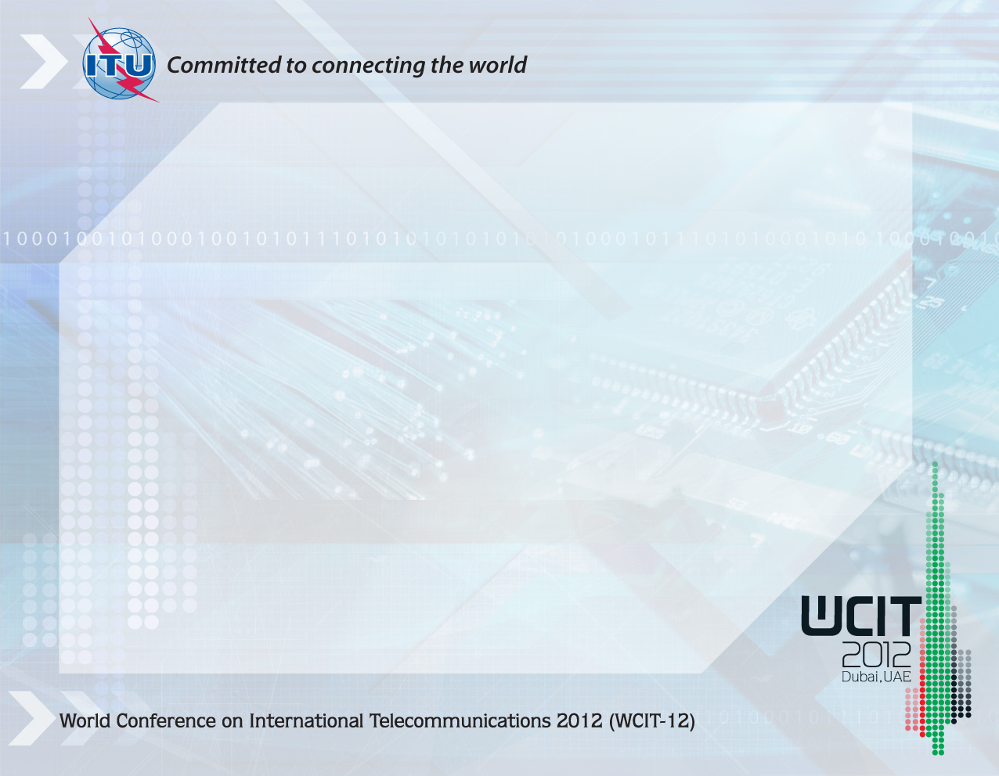
Background
Why the ITRs are important
The need to revise the ITRs
Preparatory process
Some key proposals
Expectations for WCIT-12
Useful information and links

Slide 7
Background 1/2
The International Telecommunication Regulations (ITRs) define the general principles for the provision and operation of international telecommunications
1865
1879
1906
1932
1938
1949
1958
1973
1988
2012
Regulations for international service of the Telegraph Convention
(1865- last modified in 1973)
Telegraph Regulations
(1932 - last modified in 1973)
ITRs
(came into force in 1990)
Telephone Regulations
(1932 - last modified in 1973)
Radio Regulations
(first version 1906 – last modified in 2007)
ITRs succeeded the Telegraph Regulations (1973) and Telephone Regulations (1973) in a new treaty adopted at WATTC-88 (Melbourne)

Slide 8
Background 2/2
The current version of ITRs was adopted in 1988 in Melbourne, Australia, by WATTC-88
ITRs came into force in 1990, and are one of the four
treaties of ITU.
Signed by 178 countries, ITRs are a truly global treaty applied around the world
Constitution | Convention | Radio Regulations | ITRs

Slide 9
Background
Why the ITRs are important
The need to revise the ITRs
Preparatory process
Some key proposals
Expectations for WCIT-12
Useful information and links

Slide 10
Why the ITRs are important
The ITRs …
Establish general principles relating to the provision and operation of international telecoms
Facilitate global interconnection and interoperability
Underpin harmonious development and efficient operation of technical facilities
Promote efficiency, usefulness, and availability of international telecommunication services
Treaty-level provisions are required with respect to international telecommunication networks and services

Slide 11
Background
Why the ITRs are important
The need to revise the ITRs
Preparatory process
Some key proposals
Expectations for WCIT-12
Useful information and links

Slide 12
The need to revise the ITRs 1/2
The current version of the ITRS has
remained unchanged since 1988.
  At that time:
  there were very few countries with
  a liberalized market
  most operators were a monopoly regime, under government or
  state control
1988 2012
ITRs
(came into force in 1990)

Slide 13
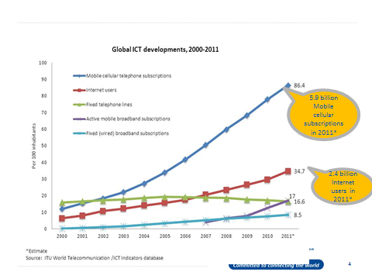
The need to revise the ITRs 2/2
The international telecom environment has significantly evolved, both from the technical
and policy perspectives, and continues to evolve rapidly
Advances in technology mean an increased use of IP-enabled infrastructure and applications: opportunities and challenges
for the ICT sector
As technology evolves, Member States are evaluating their policy and regulatory approaches to ensure an enabling environment
Shift from fixed to mobile, from voice to data as the drivers of traffic and main sources of revenue

Slide 14
Background
Why the ITRs are important
The need to revise the ITRs
Preparatory process
Some key proposals
Expectations for WCIT-12
Useful information and links

Slide 15
Preparatory Process – WORK PLAN 1/1
Council Working Group to Prepare for the WCIT 12 (CWG-WCIT12) held three meetings in 2010, two in 2011, and three in 2012 (in February, April and June)
Regional preparatory meetings were held in Asia Pacific, Africa, Arab region, RCC (CIS Countries), Europe, and Americas - open also to Sector Members
124 input documents were submitted by
ITU membership

Slide 16
Background
Why the ITRs are important
The need to revise the ITRs
Preparatory process
Some key proposals
Expectations for WCIT-12
Useful information and links

Slide 17
Proposals made during the preparatory process
Proposals made could be grouped as follows:
2
1
3
6
5
7
8
4
Human right to
access to
communication
(including nation’s right to
access intl. communication infrastructure and fair/equitable access/usage of network/services)
Security in the use of ICT (including privacy
and unsolicited electronic communication), &
Protection of critical national resources
of national significance and interest, or of national public interest
International
frameworks
Charging and accounting- including Taxation
(Market-based costing, Liberalization of international gateways, Transparency obligations on ROAs)
Interconnection and interoperability
Quality of Service
Convergence
Enforcement measures
(including possible binding effect of
certain ITU Recommendations)

Slide 18
Key Issues
Key issues raised:
  What core principles should guide discussions?
  Do some provisions belong elsewhere? (e.g. ITU Constitution/Convention, ITU-T Recommendations)
  What provisions should be added to cover new issues?

Slide 19
Some key proposals
  Mobile roaming
  Misuse and fraud
  Taxation
  Transparency of routing
  New general principles on economic issues
  Allowing differentiated traffic management
  Cooperation on cybersecurity
  Cooperation to combat spam
  All to be implemented by national authorities

Slide 20
Proposals: Mobile Roaming
  Transparency of prices for users
  Price levels
  Draft ITU-T Recommendation D.98
  OECD Recommendations

Slide 21
Proposals: Misuse and Fraud
  Preventing misuse/hijacking of numbering resources
    According to GSMA, numbering resource misuse is a key factor in fraud perpetrated against mobile networks and their customers
    It is used for fraudulent and artificial inflation of traffic
  Combating fraud
    Transmission of calling party identification/origin identification

Slide 22
Proposals: Taxation
  Clarify existing provision to prevent international double taxation
  Prevent or discourage taxation of incoming international calls
  Delicate issue because there is a tradeoff between raising revenue and encouraging the use of telecommunications

Slide 23
Proposals: new general principles 1/2
  Price transparency
  Cost orientation, presumably cost intended to include:
    Return on investment
    (including dividends to stock owners)
    Taxes
    Creation of reserves for
    future investments
    Risk premiums
    Etc.

Slide 24
Proposals: new general principles 2/2
  Foster investment in high-bandwidth infrastructure
  Adequate return on investment in infrastructure
  Compensation for traffic carried
  Compensation for traffic terminated

Slide 25
Proposals: implementation
  No proposals to create new international regulatory agencies or mechanisms
  Proposals that national authorities should implement the provisions of the ITRs
    First, ratification of new ITRs in accordance with national procedures
    Then, transposition into national laws and regulations
  Possibly, new or revised ITU-T Recommendations

Slide 26
Background
Why the ITRs are important
The need to revise the ITRs
Preparatory process
Some key proposals
Expectations for WCIT-12
Useful information and links

Slide 27
Expectations for WCIT-12
  WCIT-12 presents key opportunities to increase positive collaboration between countries
  Help countries to reach new levels of economic and social development by means of efficient ICT services
  Make ITRs relevant, and valuable to the full membership, so that they address and alleviate many current concerns
  Sector Members usually participate as part of national delegations

Slide 28
Background
Why the ITRs are important
The need to revise the ITRs
Preparatory process
Some proposals of potential interest to ETNO
Expectations for WCIT-12
Useful information and links

Slide 29
Useful information and links
Further information available at:
WCIT Newsroom:
http://www.itu.int/en/wcit-12/Pages/newsroom.aspx
CWG-WCIT12:
http://www.itu.int/council/groups/cwg-wcit12/index.html
2007 Background document:
http://www.itu.int/md/T05-ITR.EG-INF-0002/en

Slide 30
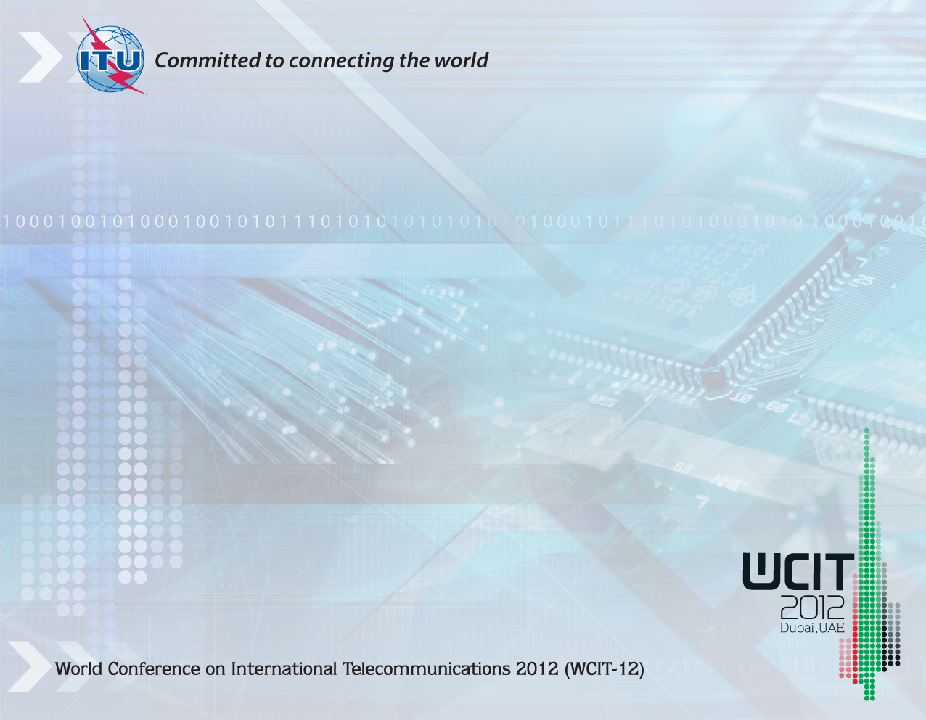
THANKS
Paul Conneally
Head, Communications & Partnership Promotion
paul.conneally@itu.int

