Slide 1
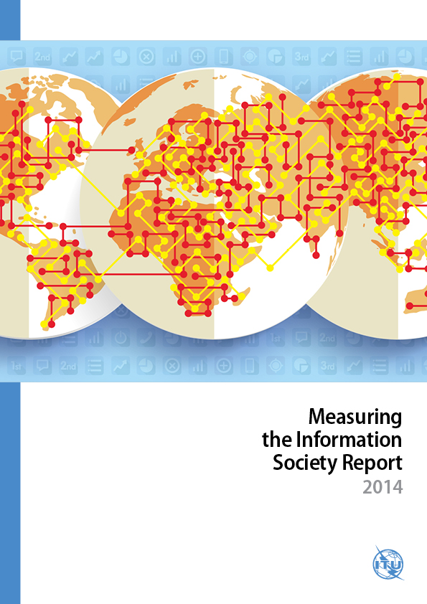
Measuring
the Information
Society Report
24 November 2014
Notes:
This is the 6th edition of the ITU Measuring the Information Society (MIS) Report, the ITU flagship annual analytical report on the state of ICT use, access and affordability worldwide. The report features the latest ITU data and analysis of market developments. It includes the latest ICT Development Index (IDI), an analysis of the relationship between ICT development (as measured by the IDI) and the MDGs, new mobile-broadband price data for over 140 economies and a statistical approach to measure the relationship between affordability and income inequality, competition and regulation. The Report also examines the possible role of ICT big data for monitoring and development, and proposes new ICT data sources for measurement.

Slide 2
MIS Report 2014 statistical highlights
Mobile broadband is driving ICT growth
Global mobile-broadband penetration increased from 9% to 32% in the last five years
Africa stands out with a mobile-broadband growth rate of over 40% in 2014
3G progressing in developing countries, and mobile-broadband penetration 21%
3G+ techs driving mobile-broadband penetration in developed countries: 84% in 2014
Internet access and use growing steadily
Almost 44 per cent of the world’s households have Internet access at home
Growth driven by developing countries in 2014: 14% as against 4% in developed countries
Internet users doubled in five years to reach 3 billion, 2/3 live in developing countries
Mobile-cellular and fixed-broadband uptake slowing down
Growth in mobile penetration slows to a ten-year low of 2.6%
Mobile markets have reached saturation with almost 7 billion subscriptions
Fixed-broadband growth rates have dropped to 6% in developing countries, despite penetration remaining low (6%) in the developing world
Fixed broadband has reached mature levels in developed countries: 27.5% penetration and continuous low growth (3.4%)
Notes:
Some of the key statistical highlights of this year’s MIS Report are:

Slide 3
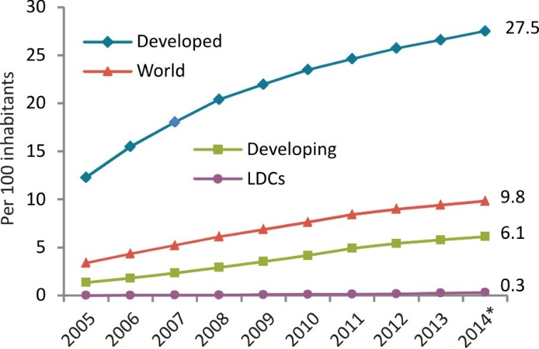
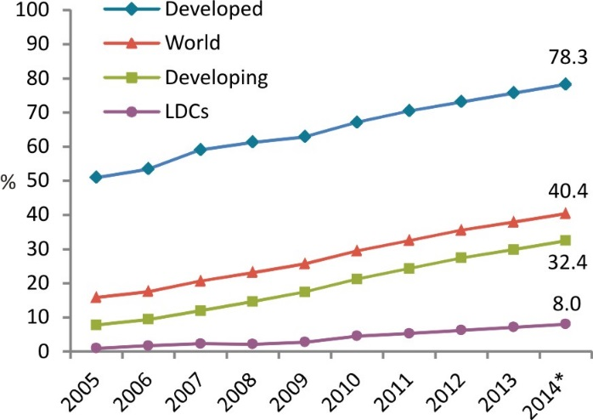
The digital divides
Fixed (wired)-broadband subscriptions, 2005-2014*
450 million people worldwide without access to mobile services
<1% fixed-broadband penetration in least developed countries (LDCs)
Rural-urban divide: lower 3G coverage, smaller proportion of households with Internet access and fewer enterprises and schools connected in rural areas.
4.3 billion people worldwide are not yet using the Internet, 90% live in the developing world
Individuals using the Internet, 2005-2014*
Source: ITU MIS Report 2014, * Estimate
Notes:
Despite the progress achieved in terms of ICT developments worldwide, there are large segments of the global population that are left behind the global information society and that require particular policy attention.
For instance, some people are still excluded from access to mobile services. Even though rural population coverage for mobile-cellular services is very high, at 87 per cent globally, at end 2012 around 450 million people worldwide still lived out of reach of a mobile signal. Furthermore, high mobile-cellular penetration does not imply that everyone owns or is using a mobile phone: according to GSMA estimates, unique mobile subscribers account for about half of mobile-cellular subscriptions, which would translate into a penetration rate of around 48 per cent globally.
Another trend that deserves policy attention is the slow down in fixed-broadband growth in developing countries (from 18 per cent in 2011 to 6 per cent in 2014). This is indeed an alarming trend in view of the persisting low fixed-broadband penetration levels in developing countries (6% on average) and, particularly, in least developed countries (LDCs), where fixed-broadband infrastructure and uptake have not (yet) materialized and fixed-broadband penetration is below 1%.
The figures also show that there is a pressing need to address the urban-rural digital divide that prevails in many developing countries. Although by 2013 mobile-cellular coverage for rural populations has reached a stage where almost 90 per cent of the world’s rural inhabitants are covered by a 2G mobile-cellular signal, 3G mobile-cellular coverage remains comparatively low for rural populations. Internet connectivity in schools and enterprises is also significantly lower in rural than in urban areas. In countries where data are available, rural Internet household access falls far below urban household access, with differences ranging from 4 per cent (that is, household Internet penetration in urban areas is 4 per cent higher than in rural areas) in highly developed countries to up to 35 per cent in developing countries.
Finally, despite the progress achieved in promoting Internet access and use, there are still 4.3 billion people worldwide who are not yet using the Internet, 90 per cent of whom live in the developing world. Moreover, the overall growth in Internet usage has been accompanied by a parallel, steep growth in the volume of Internet content, the large majority of which still originates from content providers in developed countries. For example, domain name registrations from developed countries accounted for over 80 per cent of the total in 2013.
While the future international development goals have not yet been defined, ICTs will continue to play a major role in facilitating access to information, knowledge and key services, and the digital divides will need to be bridged.

Slide 4
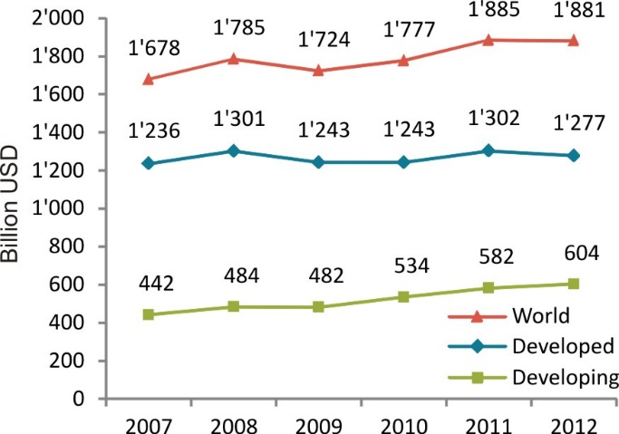
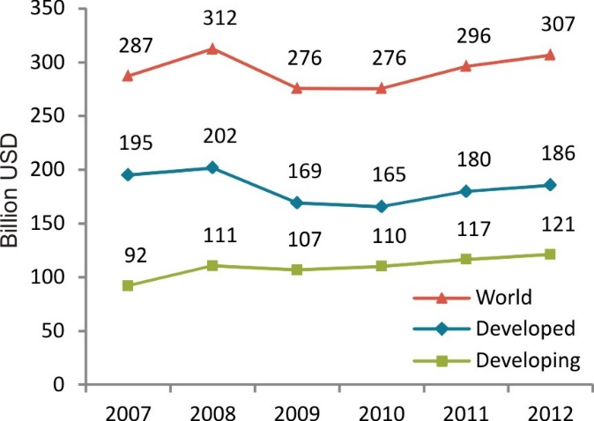
Investment and revenue trends
Total telecommunication revenues have stagnated at USD 1.88 trillion, 2.7% of world GDP
The sector returned to negative growth in developed countries, whereas revenues in developing countries increased by 4% in 2012
Global investment in telecommunications grew by 4% to reach USD 307 billion in 2012
The developing countries’ share in total investment reached almost 40% and an all-time high value of USD 121 billion
Telecommunication revenues, 2007-2012
Investment by telecommunication operators, 2007-2012
Source: ITU MIS Report 2014
Notes:
In 2012, total telecommunication revenue stagnated at around USD 1.88 trillion, or 2.7 per cent of world GDP (Chart 1.5). After the slump experienced during the financial crisis in 2008-2009, in developed countries the sector saw some signs of recovery in 2011, but returned to negative growth in 2012. In contrast, developing countries saw a 4 per cent growth in telecommunication revenues in 2012, hence mitigating the global decrease in revenues experienced in 2012.
As a result, the developing countries’ share of total telecommunication revenues increased from 26 per cent in 2007 to 32 per cent in 2012, thus approaching their share of global GDP, which amounts to 36 per cent. This testifies to the growing importance of the telecommunication sector in the economic growth of the developing world.
In 2012, investment in telecommunications grew by 4 per cent to USD 307 billion globally. Despite the continuous growth since 2010, the 2008 investment levels have not been restored. Recovery has been hampered by the situation in developed countries, where the downturn experienced in 2008 was strongest and the reduction in telecommunication investment persisted in 2009.
In developing countries, investment in telecommunication infrastructure and services has been more stable. This led to the 2008 investment levels being restored by 2011, and an all-time high of USD 121 billion at end 2012. The developing countries’ share in total investment was almost 40 per cent in 2012.

Slide 5
The ICT Development Index (IDI)
11 indicators, covering 3 areas:
ICT access, use and skills
166 economies
Comparison of data from 2013 and 2012
Regional analysis
Assessment of the relationship between geography and population and IDI performance
Analysis of the link between IDI and the MDGs
Notes:
The MIS Report includes the ICT Development Index, a global benchmarking tool that ranks countries according to their ICT achievements. The IDI combines 11 indicators into a single measure, covering the 3 areas of ICT access, ICT use and skills. This year’s IDI covers 166 economies. It highlights top performers and those countries that have made the greatest progress between 2012 and 2013 (data reference year). The IDI is also used to track and monitor the digital divide and to make regional comparisons.
This year´s MIS Report also analyses the underlying factors that can have an influence on ICT development and IDI performance across countries, such as geography, population, size and economic development of a country. Besides the relationship between economic and ICT development (already highlighted in previous MIS Reports), the analysis shows that the higher a country’s share of population living in urban areas, the higher the values reached on the IDI, thus confirming need to address the urban-rural digital divide that prevails in many developing countries. Other factors, such as population size or density, or a country’s land area, are not linked with IDI performance.
In addition, this year´s MIS Report examines the relationship between ICT development (as measured by the IDI) and the MDGs, thus contributing to the ongoing discussions on the potential of ICTs as development enablers.

Slide 6
Almost all countries improved in the IDI but Least Connected Countries lag behind
IDI 2013 top ten
Key findings
Denmark
Korea (Rep.)
Sweden
Iceland
United Kingdom
Norway
Netherlands
Finland
Hong Kong, China
Luxembourg
Top IDI performers have high income levels, competitive markets and a skilled population
Effective implementation of policies to achieve ambitious ICT targets help drive national information economies
Some 2.5 billion people living in the world’s least connected countries (LCCs) need targeted policies for improved access to ICTs
Notes:
The IDI results show that between 2012 and 2013 nearly all countries, at the top as well as at the bottom, increased their IDI values. While this points to a continued increase in access to and use of ICTs, the results also highlight that current levels of ICT development differ widely across the globe.
Denmark leads the IDI ranking with the highest IDI 2013 value, replacing long-time front runner the Republic of Korea, which follows very closely. The remaining top ten IDI countries are predominantly European (Sweden, Iceland, United Kingdom, Norway, Netherlands, Finland and Luxembourg), together with an additional economy from Asia and the Pacific (Hong Kong, China).
The top IDI performers share a number of common characteristics that help to explain their high levels of ICT access and use. All have highly liberalized and competitive ICT markets that are at the forefront of innovation, are technology-driven and benefit from a highly skilled population to make effective use of ICTs. Furthermore, there is a strong link between countries’ national income levels and their IDI values, all of the top ten countries being relatively high-income economies.
The countries displaying the highest IDI achievements have governments that recognize ICTs as a major driver for growth, innovation and economic development. To spur the information economy, they have set ambitious ICT targets, including to provide ultra-high speed Internet access to a large part of the (and sometimes the entire) population, to encourage the development of wireless-broadband access (including LTE), and to bring ICTs to homes. The effective implementation of policy and regulatory measures to achieve these targets is critical for driving national ICT developments.
The 42 countries in the low group of the IDI, termed the “least connected countries” (LCCs), where levels of ICT access and usage are extremely low, are home to 2.5 billion people. Targeted policies should be directed towards connecting people in LCCs, because they are most in need of improved access to ICTs and could benefit most from the impact of ICTs to advance socio-economic development.

Slide 7
Wireless broadband drives IDI progress in dynamic countries, most of which are from the developing world
Most dynamic countries - changes between IDI 2013 and 2012
Note: * In the access sub-index, Mali, Mexico, Nepal, Nigeria, the Russian Federation and Uruguay also went up four places between 2012 and 2013. **In the use sub-index, Belarus and Oman also went up seven places.
Source: ITU MIS Report 2014
Notes:
The report identifies a number of “dynamic” countries that registered the highest increases in overall IDI, IDI access sub-index and/or IDI use sub-index rank from 2012 to 2013. This group of dynamic countries predominantly includes developing countries from all regions.
The Table shows that the use sub-index is much more dynamic than the access sub-index. The indicator that witnessed the largest increases from 2012 to 2013, spurring most of the IDI rank increase, is wireless-broadband subscriptions. Globally, the number of mobile-broadband subscriptions grew by 24 per cent from 2012 to 2013. Developing countries recorded the strongest growth, at 37 per cent. The dynamic countries’ increase in IDI use sub-index value far exceeds the average relative change in the use sub-index value between 2012 and 2013.

Slide 8
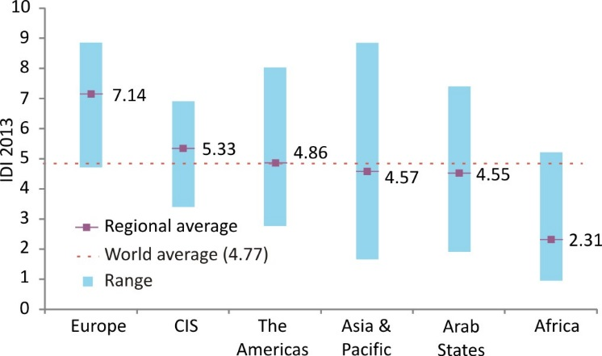
Regional IDI
IDI ranges and averages, by region and compared to world average, 2013
Source: ITU MIS Report 2014
Notes:
A regional analysis of the IDI highlights that major regional differences in ICT uptake persist.
IDI values in Europe, CIS and the Americas lie above the world average. Europe displays by far the highest average IDI value of 7.14. The regional IDI values of the CIS (5.33), the Americas (4.86), Asia and the Pacific (4.57) and Arab States (4.55) are relatively close to each other. However, they fall either side of an important benchmark, as only the CIS and the Americas regional averages exceed the world average of 4.77, while Asia and the Pacific and Arab States remain below that value. Africa has by far the lowest regional IDI of 2.31, less than one-third of the European average.
Differences in IDI values within the regions are decreasing in Europe and Asia-Pacific, and increasing in CIS, Africa and the Arab States.

Slide 9
Top five per region
The top five economies in each region and their ranking in the global IDI, 2013
Source: ITU MIS Report 2014
Notes:
A comparison of the global and regional ranking of the top five countries in each region further highlights global differences in ICT development and regional divides .
(Each region may highlight top five countries and highlight how they rank globally)

Slide 10
There is a strong relationship between the IDI and many MDG indicators
IDI
Goal 1: Eradicate extreme poverty and hunger
1.1 Proportion of population below $1 (PPP) per day
1.1 Population below national poverty line
1.2 Poverty gap ratio
1.6 Proportion of employed people living below 1$ per day
1.9 Proportion of population below minimum level of dietary energy consumption
Goal 4: Reduce child mortality
4.1 Under-five mortality
rate
4.2 Infant mortality rate
4.3 Proportion of 1 year-old children immunized against measles
Goal 6: Combat HIV/AIDS, malaria and other diseases
6.1 HIV prevalence among population aged 15-49 years old
6.9 Incidence, prevalence and death rates associated with tuberculosis
6.10 Proportion of tuberculosis cases detected and cured under directly observed treatment short course
Goal 7: Ensure environmental sustainability
7.2 CO2 emissions, metric tons of CO2 per capita
7.8 Proportion of population using an improved drinking water source
7.9 Proportion of population using improved sanitation facility
Goal 5: Improve maternal health
5.1 Maternal mortality ratio
5.2 Proportion of births attended by skilled health personnel
5.4 Adolescent birth rate
5.5 Antenatal care coverage (at least one visit and at least four visits)
Significant partial correlations between IDI and MDG indicators
Notes:
Since the Millennium Declaration was issued in 2000, ICTs have grown unprecedentedly, a trend which has underscored their potential for enabling socio-economic development. In this context, and as a contribution to the ongoing debate, a correlation analysis was carried out to quantify the relationship between ICT development (as measured by the IDI) and the Millennium Development Goals (MDGs).
The analysis revealed that there is a significant correlation between IDI values and 20 of the 38 MDG indicators for which data were available. The results show an important relationship between ICT development and selected development indicators, in particular in the areas of poverty reduction (MDG 1), health (MDGs 4, 5 and 6) and environmental sustainability (MDG 7).
There is a significant negative correlation between IDI and the proportion of people whose income is less than one dollar a day, as well as the percentage of population that is undernourished. High IDI levels are thus associated with lower percentages of undernourished population and lower proportions of population living below the poverty line. Higher IDI levels are also associated with lower maternal and child mortality rates and low incidence and prevalence of malaria and tuberculosis.
This analysis should be understood as a starting point for further quantitative research linking ICT development with social and economic development.

Slide 11
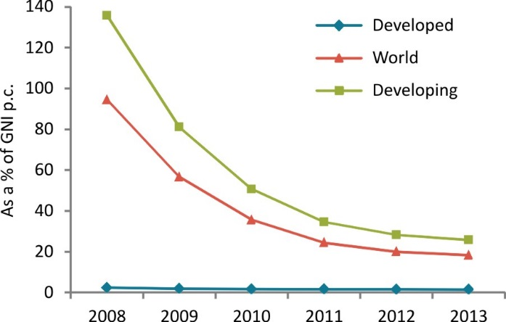
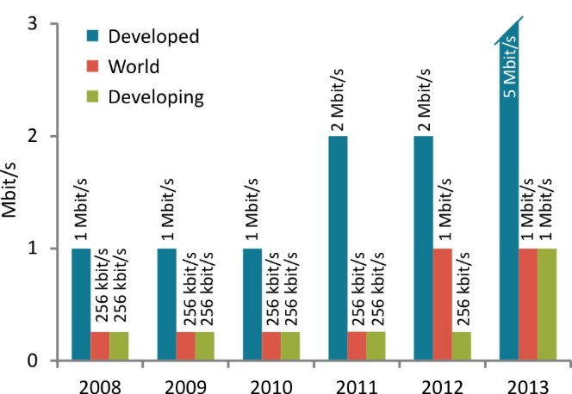
Fixed-broadband prices continue to decrease and entry-level speeds are increasing
From 2008 to 2012, entry-level fixed-broadband prices decreased by 20% per year on average in developing countries
In 2013, there was a slowdown: price in developing countries decreased by only 4%
1 Mbit/s was the most common entry-level speed in 2013, compared with 256 kbit/s in 2008
But:
The price of a basic plan corresponds to >5% GNI p.c. in most developing countries
Fixed-broadband prices as a % of GNI p.c.
Most common entry-level fixed-broadband speed
Source: ITU MIS Report 2014
Notes:
The price of ICT services constitutes a determining factor for ICT uptake and, as such, continues to be a focus of attention for regulators and policy-makers.
In the period 2008-2013, the price of an entry-level fixed-broadband plan decreased by almost 70 per cent globally. In parallel with the reduction in prices, there was a notable increase in the advertised speed for fixed-broadband plans: 256 kbit/s was the most common entry-level speed in 2008, compared with 1 Mbit/s in 2013.
The decrease in fixed-broadband prices was remarkable in developing countries in the period 2008-2012, with the average price in developing countries declining by more than 20 per cent per year. In 2013, there was a slowdown, with the average entry-level fixed-broadband price in developing countries decreasing by only 4 per cent.
Entry-level fixed-broadband prices remained much more stable in developed countries, and registered only a slight decrease in the period 2008-2013. Fixed-broadband services in the developed world were already affordable in 2008, and the almost flat evolution suggests that competition in the market is centred around higher-end users contracting higher speeds and/or fixed broadband bundled with other services.
Despite the progress made in improving the affordability of fixed-broadband services, the average price for an entry-level fixed-broadband plan still represented 26 per cent of GNI p.c. in the developing world at end 2013. Moreover, in most developing countries the price of fixed-broadband services corresponds to more than 5 per cent of GNI p.c., which is the affordability target set by the Broadband Commission (broadband prices should correspond to less than 5 per cent of monthly GNI p.c. by 2015).

Slide 12
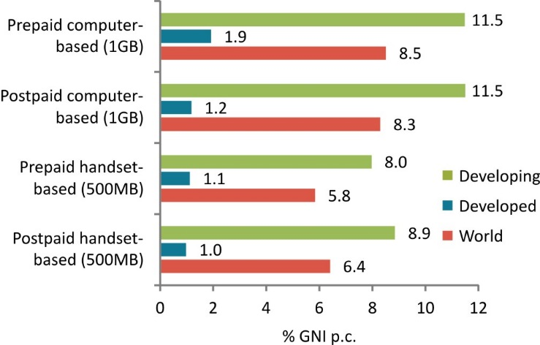
Mobile-broadband prices in developed countries six times more affordable than in developing countries
The number of developing countries offering mobile-broadband plans increased by 20% from 2012 to 2013
The price of mobile-broadband plans corresponds on average to >5% of GNI p.c. in the developing world
But:
In almost half of the African countries, mobile-broadband is more than USD 10 per month cheaper than fixed broadband
Mobile-broadband prices as a % of GNI p.c.
Source: ITU MIS Report 2014
Notes:
Mobile-broadband plans are becoming more and more available, particularly in developing countries, where around 20 per cent more countries were offering mobile-broadband plans in 2013 than in 2012. Prepaid plans are slightly more available than postpaid plans in developing countries, whereas the opposite is true in developed countries.
There are large differences in the affordability of mobile-broadband services between developed and developing countries. Indeed, handset-based mobile-broadband plans with a monthly data allowance of 500 MB are about eight times more affordable in developed countries than in developing countries, on average. Computer-based services with a monthly allowance of 1 GB are about six times more affordable in developed countries, on average.
Mobile-broadband plans cost on overage more than 5% of GNI p.c. (the Broadband Commission target for affordable broadband services) in developing countries. However, entry-level mobile broadband is cheaper than fixed broadband in many countries, in particular in Africa. Indeed, in almost half of the African countries for which price data are available, mobile-broadband services were more than USD 10 cheaper per month than entry-level fixed-broadband services. Taking into account the income levels in Africa, such price savings could make the difference between a service being affordable or not.
In the Arab States and the CIS, there are almost as many countries where mobile broadband is cheaper than entry-level fixed broadband as vice versa. In Asia and the Pacific and the Americas, mobile-broadband prices are significantly cheaper than entry-level fixed-broadband plans in selected countries.

Slide 13
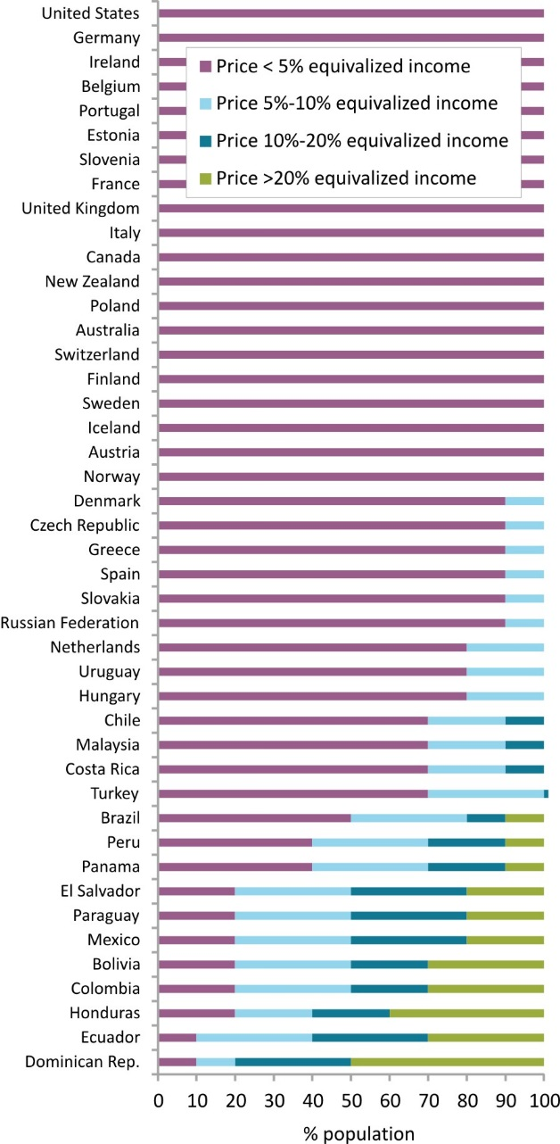
Income inequalities contribute to making broadband unaffordable
Prepaid handset-based mobile-broadband prices as % of equivalized household income
Fixed-broadband is affordable for the 20% households with highest income in most developing countries
but unaffordable for the 20% households with lowest incomes in almost all developing countries
Handset-based mobile-broadband prices are affordable for almost all households in the developed world
but unaffordable for some segments of the population in the developing world
Source: ITU MIS Report 2014
Notes:
This year’s MIS Report provides an additional analysis on the affordability of broadband prices in view of income inequalities within and across countries.
The results show that household income and expenditure inequalities within countries greatly influence the affordability of fixed-broadband services. The smallest differences were found in Iceland, where
an entry-level fixed-broadband plan is 3.5 times more affordable for the richest 20 per cent of the population than for the poorest 20 per cent. Differences are much wider in several developing countries, where fixed broadband is more than 20 times more affordable for the richest 20 per cent of the population than for the poorest 20 per cent.
Thus, partly owing to household income inequalities, in almost all developing countries for which data are available a basic fixed-broadband subscription represents more than 5 per cent of household income/expenditure for the 20% households with lowest incomes, and therefore it is rather unaffordable for these sectors of the population. However, for the 20% households with highest income in these same countries it represents less than 5% of their household income/expenditure, and therefore it is affordable.
Data show that handset-based mobile-broadband prices (with a 500 MB monthly allowance) are affordable for a majority of the population in developed countries, but much less so in developing countries. However, a comparison of fixed-broadband and prepaid handset-based mobile-broadband prices shows that mobile broadband may be the only affordable alternative for low-income households in several developing countries. In other developing countries where fixed-broadband services are affordable for most of the population, mobile broadband may help to connect the 20-30 per cent of households with the lowest incomes, for which a fixed-broadband plan may be unaffordable, but which could afford a mobile-broadband plan.

Slide 14
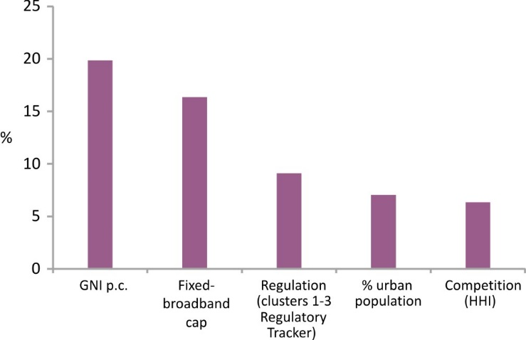
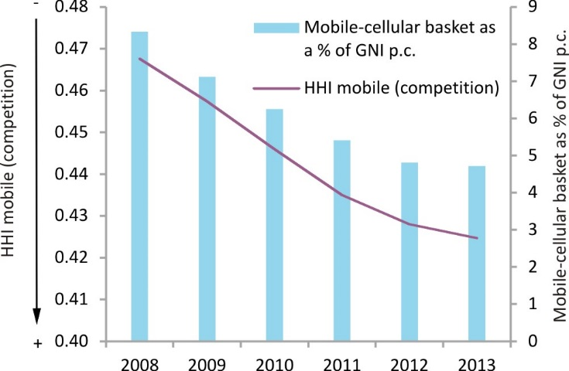
Competition and regulation are key drivers of affordable ICT prices
Variation in fixed-brodband prices explained by each factor
Fixed-broadband prices could be reduced by 10% if competition and the regulatory framework in developing countries improved
An increase in competition in developing countries could lead to a 5% reduction in mobile-cellular prices
International regulatory best practices, such as the ones adopted at the ITU Global Symposium for Regulators, may serve as guidelines for effective regulatory frameworks
Competition and mobile-cellular prices
Source: ITU MIS Report 2014, HHI data sourced from Informa
Notes:
This year’s MIS Report also presents an econometric model to measure the relationship between affordability and income inequality based on ITU price and regulatory data for up to 144 countries in the period 2008-2013.
Based on the econometric model, it can be concluded that factors that are purely attributable to the telecommunication sector, such as operators’ strategies on data caps, competition in the fixed-broadband market and the ICT regulatory environment, are together more of a determinant for fixed-broadband prices than exogenous factors, such as overall levels of economic development.
According to the results of the econometric model, if fixed-broadband markets in developing countries were to achieve the competition levels of developed countries, entry-level fixed-broadband prices could be reduced by as much as 10 per cent in the developing world. Furthermore, if the regulatory framework in developing countries converged on that prevailing in developed countries, fixed-broadband prices could be reduced by as much as 9.7 per cent.
This highlights the importance of an enabling regulatory environment for affordable fixed-broadband prices. Although there is no one-size-fits-all approach, international regulatory best practices, such as
the ones adopted by the global community of regulators at meetings of the ITU Global Symposium for Regulators (GSR), may serve as a guideline for effective regulatory frameworks which can lay the foundations for affordable fixed-broadband services.
Differences in mobile-cellular prices across countries are smaller than differences in fixed-broadband prices, and competition is stronger in mobile-cellular markets. Nevertheless, according to the results of the econometric model, if mobile-cellular markets in developing countries were to achieve the competition levels prevailing in developed countries, mobile-cellular prices could be reduced by up to 5 per cent in the developing world.
Regulatory efforts should be focused on ensuring that higher levels of competition are achieved, particularly in those countries where dominant operators still hold market shares of over 60 per cent, thus limiting the possible benefits that competition may yield in terms of more affordable prices for customers.

Slide 15
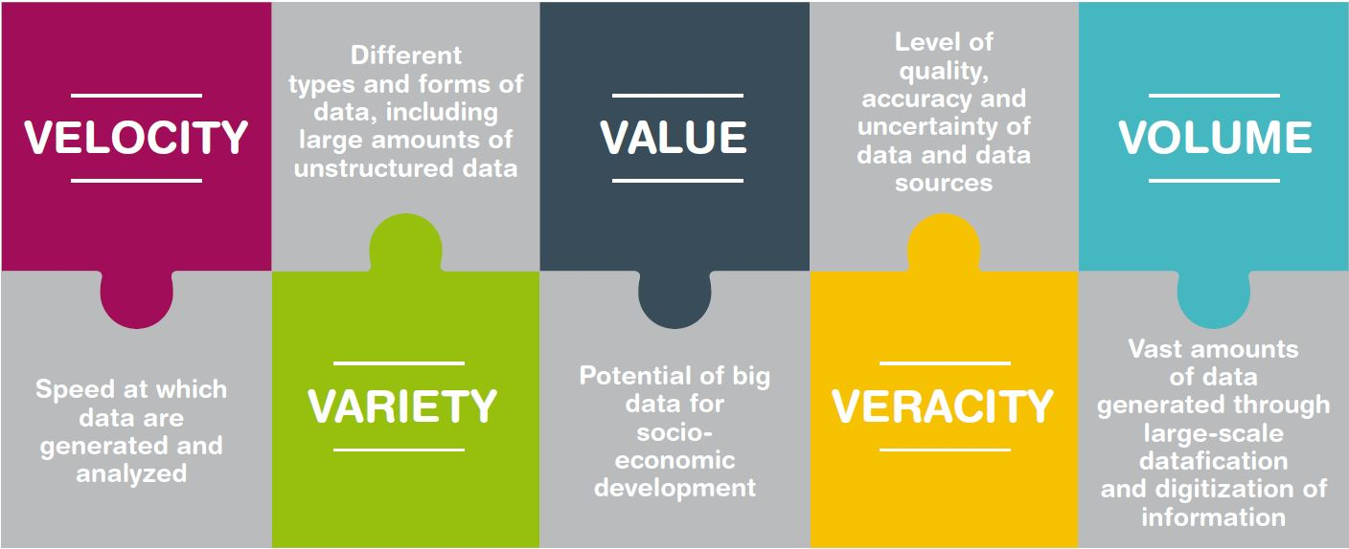
Big data for development
Big data are the result of an increasingly digitized world
Big data hold great promise for improving the timeliness and completeness of official statistics
Big data can be used for formulating social and economic development policy
Source: ITU MIS Report 2014
Notes:
The term “big data” usually refers to datasets whose volume, velocity or variety is very high compared to the kinds of datasets that have traditionally been used. In an increasingly digitized world, big data are generated in digital form from a number of sources. They include administrative records (for example, bank or electronic medical records), commercial transactions between two entities (such as online purchases or credit card transactions), sensors and tracking devices (for example, mobile phones and GPS devices), and activities carried out by users on the Internet (including searches and social media content). Apart from volume, velocity and variety, big data characteristics also include veracity linked to aspects of data quality and uncertainty, as well as value, which refers to the potentially high socioeconomic value that it may generate.
Big data have great potential to help produce new and insightful information, and there is a growing debate on how businesses, governments and citizens can maximize the benefits of big data. The United Nations Statistical Commission and national statistical offices are looking into ways of using big data sources for official statistics.
Big data from the ICT services industry are already helping to produce development insights of relevance to public policy, such as understanding socio-economic well-being and poverty, forecasting unemployment and analysing societal ties.

Slide 16
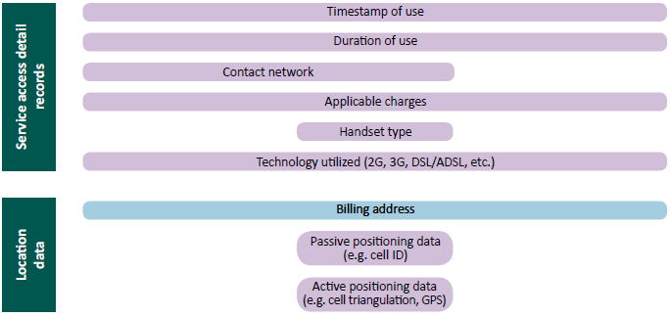
Big data from the ICT sector
The ICT sector is one of the richest sources of big data
Data from mobile operators are real-time and low-cost, and are an area with huge development potential
+
…
Source: ITU, adapted from Naef et al. (2014).
Notes:
One of the richest sources of big data is the data captured through the use of ICTs. This broadly includes data captured directly by telecommunication operators, as well as by Internet companies and by content providers
such as Google, Facebook, Twitter, etc.
Data from mobile operators offer a low-cost, high-resolution and real-time view of an individual’s behaviour. Since the service with the widest coverage and greatest uptake and popularity is the mobile-cellular service, data from mobile operators have the greatest potential to produce representative results and reveal developmental insights on the population, including in developing countries and, increasingly, low-income areas.
Each time a user interacts with a mobile operator, many details of the interaction are captured, creating a rich dataset relating to the consumer. Topping up airtime, making calls and sending SMSs, downloading applications or using value-added services are all examples of interactions for which the time, location, device, user and other detailed information are captured in the operator’s system. From these interactions, information about a subscriber’s identity, movement patterns, social relationships, finances and even ambient environmental conditions can be extracted.

Slide 17
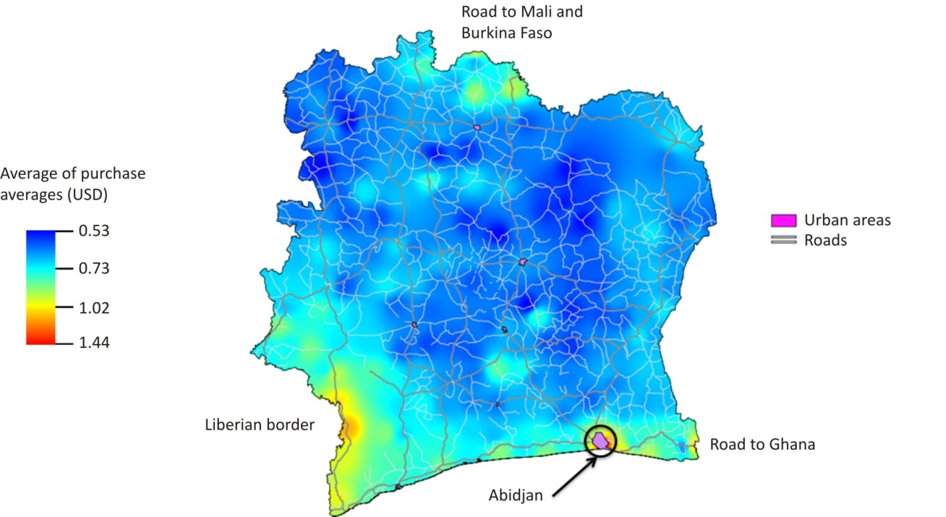
Use of big data from mobile operators
Moibile data can reveal new insights into the digital divide
Mobile data can reveal socio-economic information about mobile users
Example: Poverty mapping in Côte d’Ivoire using mobile-network data
Source: Gutierrez et al. (2013).
Notes:
In today’s hyperconnected digital world, there is a case to be made for analysing big data from the ICT sector to improve monitoring of the information society.
Mobile subscription data provide mobility profiles, and could be further broken down to understand the utilization of services over time.
Data from mobile operators could, potentially reveal Internet and VAS usage patterns between rural and urban areas. Combined with individual subscriber characteristics, this information could yield new and rich insights into the digital divide, and help understand usage patterns, including intensity of use, by gender, socio-economic status and also location.
One example is that of poverty mapping in Côte d’Ivoire using mobile-network data. Researchers used mobile-network data to estimate the relative income of individuals, as well as the diversity and inequality of income levels. The research helped to understand socio-economic segregation at a fine-grained level for Côte d’Ivoire, with the following map showing poor areas (in blue) in relation to the areas of high economic activity (yellow to red areas).

Slide 18
Big data from the ICT sector: development potential and challenges
Potential
Telecommunication operators, Internet companies and content providers are a rich source for big data
Data from mobile operators are real-time and low-cost, and are an area with huge development potential
Big data could reveal new insights into the digital divide
Challenges
Privacy issues remain the biggest challenge
Public-private partnerships are required to harness the potential of big data
Cooperation among international stakeholders
Notes:
In conclusions, the MIS Report highlights the following points on the potential of big data [read points above], but also points to a series of challenges that need to be met [read points above]

Slide 19
For further information:
indicators[at]itu.int
www.itu.int/ict
Notes:
Thank you.

