Slide 1
Creating and Enabling Environment to Connect the Unconnected
Dominique Lazanski, October, 2016

Slide 2
Mobile for Development: Leveraging the Power of Mobile to Accelerate Socioeconomic Impact
Connected Society
Address access and usage barriers to the mobile internet
Mobile Money
Accelerate the ecosystem for the underserved
Digital Identity
Build the official identity ecosystem for those without ID
Ecosystem Accelerator
Identify, nurture and promote early-stage services to reach scale
M4D Utilities — Support mobile-enabled energy, water and sanitation innovations
Connected Women — Accelerate women’s digital and financial inclusion
Disaster Response — Ensure network resilience in times of humanitarian crises
mNutrition — Improve the productivity of smallholder farmers and nutritional outcomes for mothers

Slide 3
GSMA’s Connected Society Programme
Supporting the mobile industry to increase internet adoption for the underserved by tackling key barriers: network coverage, affordability, digital skills and locally relevant content.

Slide 4
Mobile connectivity in developing countries
3.2b out of 6b connected to
mobile internet
2.1b using
mobile broadband (3G/4G)
2.5b covered, but not using
mobile broadband (3G/4G)
1.6b not covered(3G/4G)
% of population not covered by 3G/4G, vs. covered but not using the mobile internet
Source: GSMA Intelligence

Slide 5
Digital Inclusion: sharing the benefits of the internet across the world
Rural populations account for 64% of the unconnected population
Global internet connectivity is estimated to be 43%, meaning that there are still 4.2 billion people without access to the internet
Rural populations account for 64% of the unconnected population
There are currently 3.8 billion mobile subscribers, over half the world’s population, and this is expected to rise to 4.6 billion by 2020
Digital inclusion
3G/4G mobile internet subscribers will be 3 times the number of 2G mobile internet users by 2020
Digital inclusion – The benefits of ICT should be available regardless of location or socio-economic status.
Why is this important? – An increasingly digital world there are still many, especially in developing countries, with whom the benefits of digitalisation are not being shared.
Why mobile? Mobile is the most cost effective way to deliver connectivity in the developing world where people need cheap and easily accessible technology.
Through the Connected Society programme the GSMA supports the industry to connect an additional 2 billion people to mobile internet by 2020

Slide 6
Barriers to Digital Inclusion
Local content ecosystems are undeveloped
Affordability issues compromise the ability to connect, especially for low-income groups.
The digitally excluded either do not know how to access the Internet, have the misconception that the Internet is only useful for entertainment and therefore not of value

Slide 7
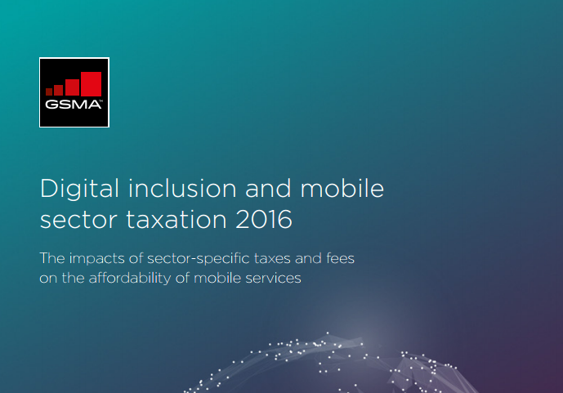
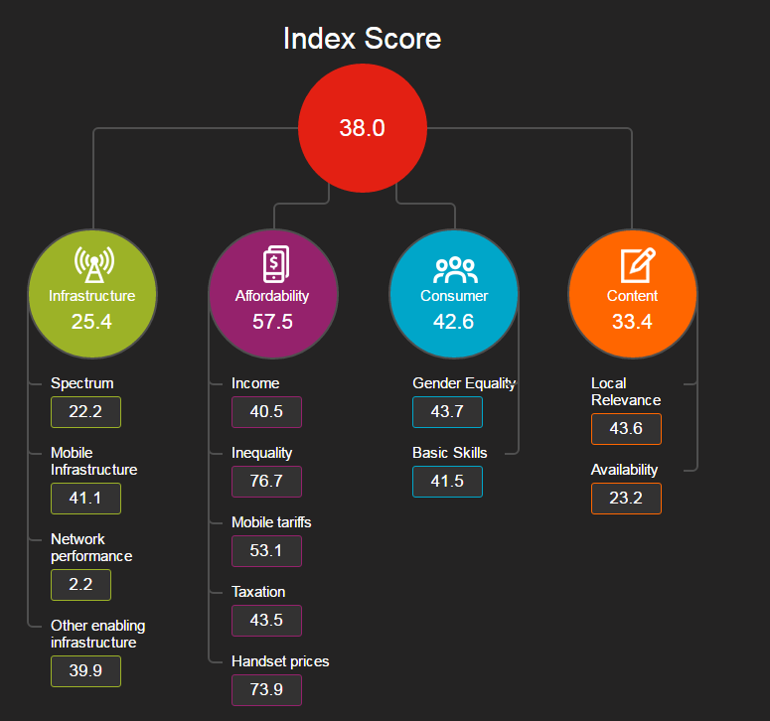
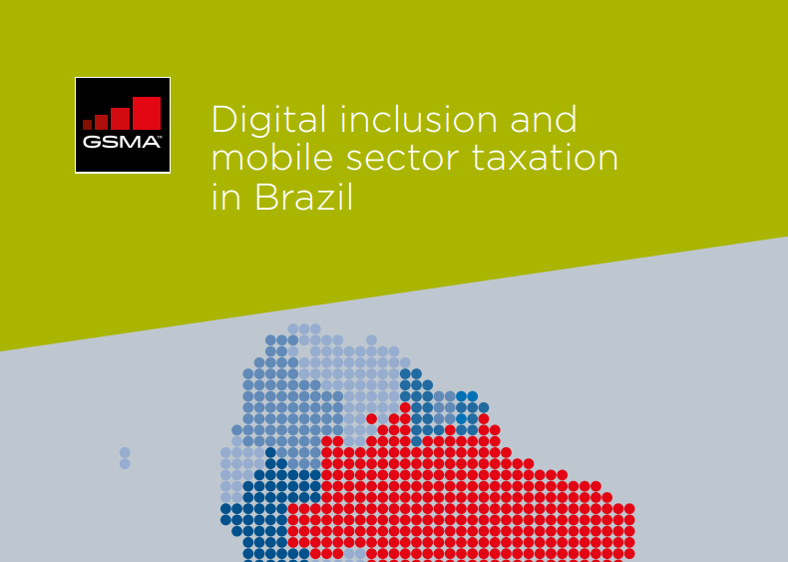
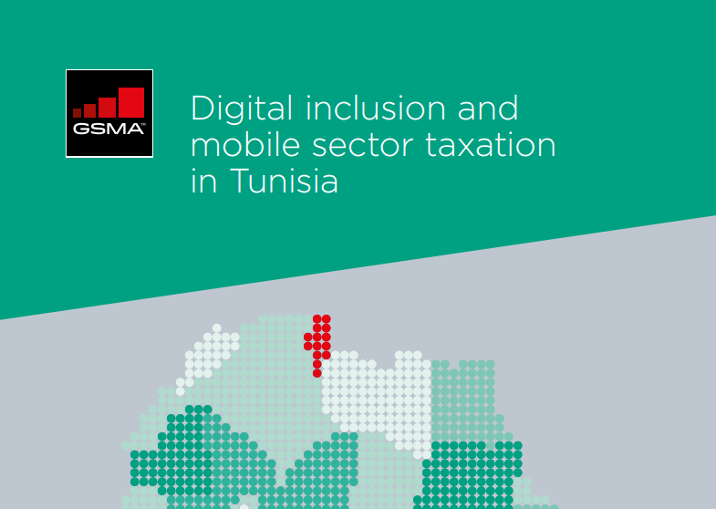
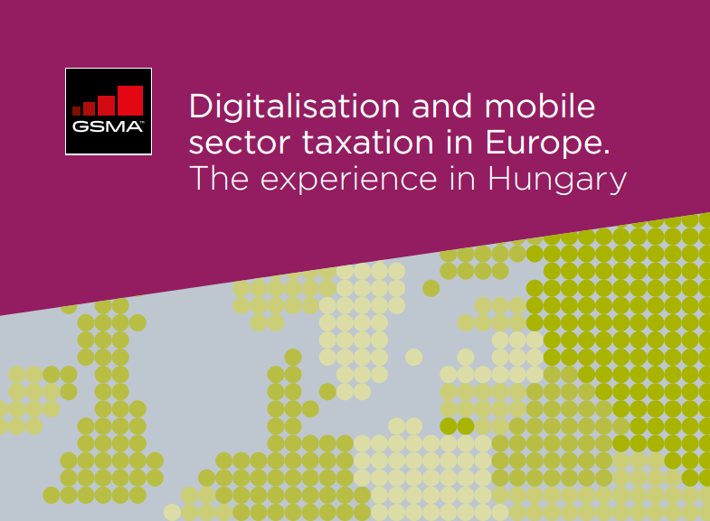
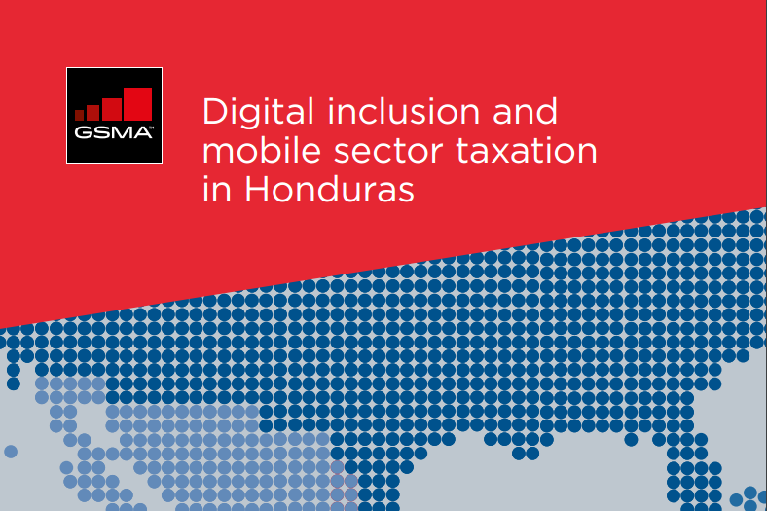
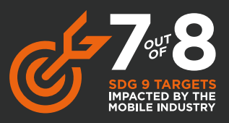
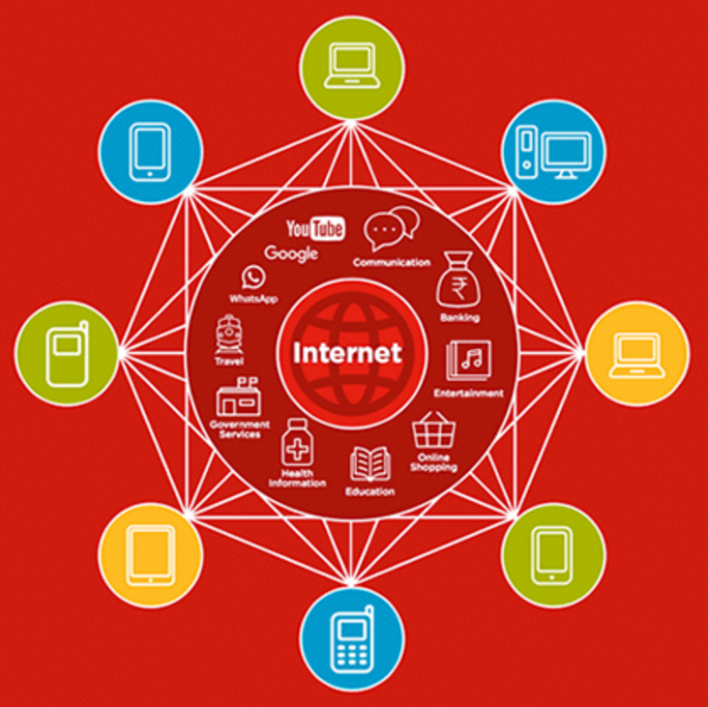
Connected Society’s approach to closing the digital inclusion gap
Insights
Advocacy
Projects
Affordability
Network Coverage
Digital Literacy
Locally Relevant Content

Slide 8
Connected Society’s presence worldwide
Mobile network expansion efforts
Tanzania
Indonesia
Bangladesh
Chad
Mobile internet skills training and research
India
Kenya
Indonesia
Mobile taxation impact studies
Brazil
Honduras
Tunisia
Hungary
Mexico
DRC
Tanzania
Pakistan
Ghana
Bangladesh
Jordan

Slide 9
Thinking around the programme’s focus ahead
Affordability - Promoting policy best practice and commercial innovation to help make mobile services more affordable to more people, especially at the bottom of the pyramid
Sustainable business models for affordable handsets
In-country tax campaigns
Global research of consumers’ ability and willingness to pay for mobile internet
Local content - Promoting the development of online content and services that are relevant to local populations
Entrepreneurs and start-ups Innovation Fund
Better data on local consumer content preferences
Network coverage - Supporting the Mobile Industry to develop and implement commercially sustainable solutions to rural mobile network coverage expansion
Closer collaboration with connectivity innovators
Rural coverage expansion best-practice and advocacy
Digital skills - Supporting the Mobile Industry and broader ecosystem to develop and deliver best-in-class digital skills training programmes and raise awareness of the benefits from getting online.
Impact of digital skills on connectivity adoption – advocacy to policy-makers

Slide 10
Thank you http://www.gsma.com/mobilefordevelopment/programmes/connected-society http://www.mobileconnectivityindex.com

