Slide 2
ITC: unique development agency
Operates under the joint mandate of the UN and the WTO
Works with the private sector to support private sector development
Operates at government, TSI and SME level to promote trade
Focus on helping SMEs internationalise

Slide 3
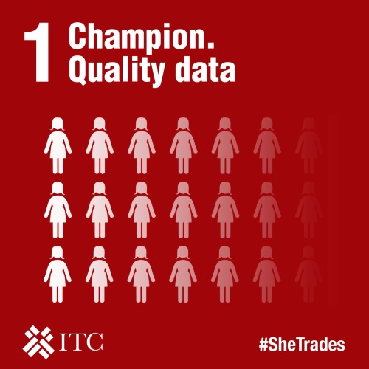
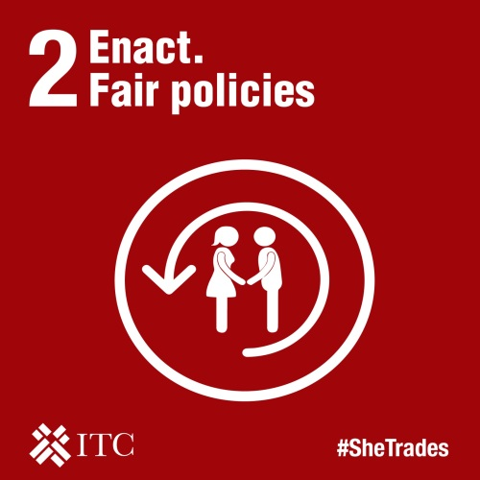
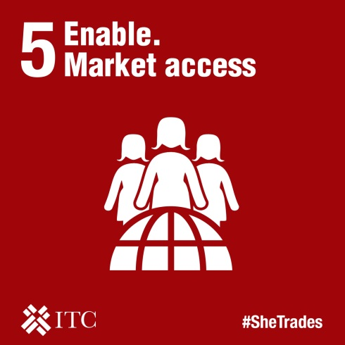
7 Actions to unlock markets for women owned SMEs

Slide 4
Why technology matters
Women entrepreneurs face particular challenges to trade, which technology can help to address including gender related obstacles
High-tech companies which women build are more capital efficient: venture-backed companies run by a woman have annual revenues which are 12% higher, using an average of one-third less committed capital
Women-owned businesses are more likely to survive the transition from raw start-up to stablished company than the average
This means that investing more in female entrepreneurs in the ICT sector will improve the bottom-line performance of our economy, and measures for stimulating tech start-ups which are inclusive for women will arouse economic and job growth

Slide 5
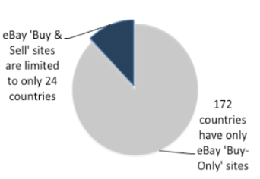
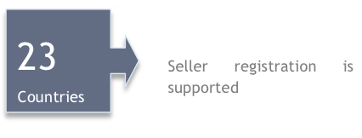
Some challenges …
Factors holding women back
In 2013 there were 200 million fewer women online. In 2016 – the gap has grown to 257 million
Tech creators cannot monetise their products
SMEs cannot sell online
6% of App developers are women
: 24 countries only
Only 20 to 52 countries can charge for their Apps
23 countries only

Slide 6
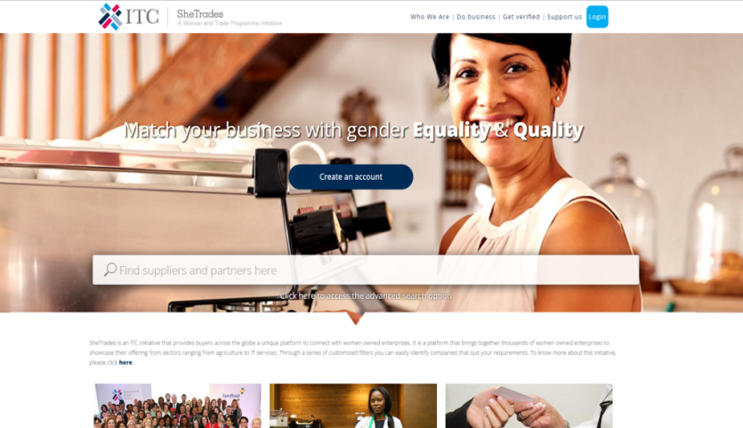
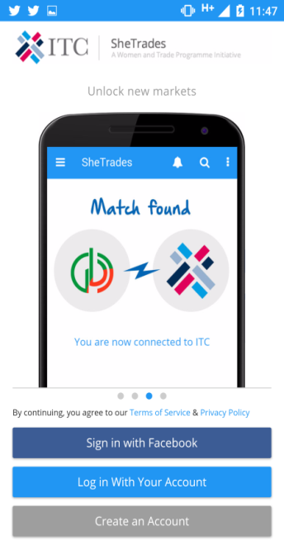
Channel for services
#SheTrades
Platform
Capturing SheTrades impact
2) New markets
SheTrades platform offers:
Visibility
Networking
Matchmaking

Slide 7
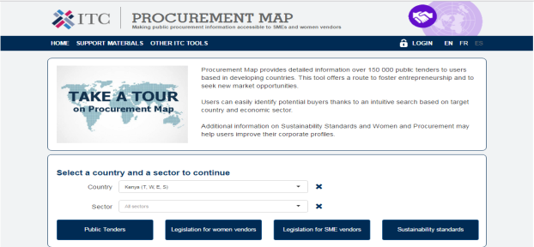
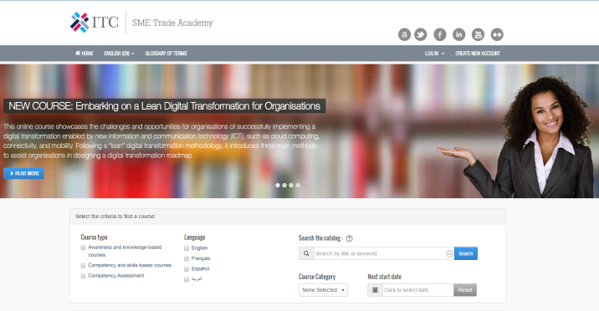
Channel for services
Procurement Map
http://procurementmap.intracen.org
MAR Tools
More than 150.000 daily
public tenders in the world
Specific legislation for WBEs, SMEs and Standards
Global Public Goods:
Trade Map
Market Access Map
Investment Map
Standards Map
SME Academy
http://learning.intracen.org
Capacity Building:
Using tools & research methods to analyse markets
Around 40 e-learning courses (e.g. Export Markets, Supply Chains, Crossborder IT, Standards and Certifications in IT & ITES)
Awareness and knowledge-based courses
Competency and skills-based courses
Competency Assessment

Slide 8
Connecting to markets
ITC E-Commerce Solution
Selecting products & target markets
E-Fulfilment solution
Marketing and CRM
Getting online (eMall, VMPs, social media)
Payment solutions
1
3
5
7
9
Producer
Awareness raising
Manage & adapt
Customer
2
4
6
8
It provides:
International payment solutions
Compliance & due diligence
Full logistics solutions
Fiscal Representation
Access to Virtual Market Places
Returns logistics management
Fiscal representation
Export logistics
Labelling & consolidation
Preparing content
Mercado Público - e-marketplace where 90% of the companies that sell their products and services are micro or small enterprises
36% of companies selling products and services to the government are owned by women

Slide 9
Making opportunities for women to create
Tech is a growth sector, with more jobs than qualified candidates
ITC supports women entrepreneurs in ICT through:
Increase the number of women at IT public events
Promote the visibility of role models using real inspiring women
Training - e-learning, webinars and face to face workshops
Coaching and mentoring from large tech companies
Market linkages – Trade fairs and B2B meetings
ITC project case study: https://www.youtube.com/watch?v=omsDtNQ1XoE

Slide 10
ITC’s SheTrades Initiative is Supported by:

