Slide 1
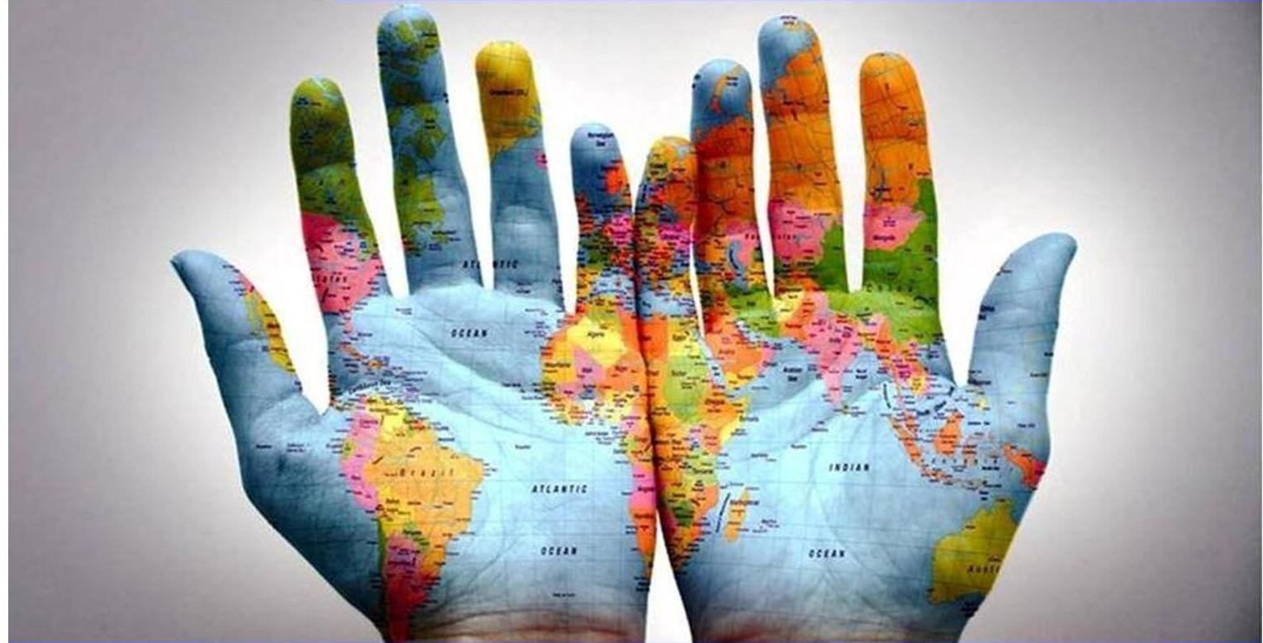
Access to the Internet for Deaf People
Beat Kleeb, Dr. Phil Harper
Expert Group on Accessibility and Technology
World Federation of the Deaf WFD

Slide 2
70,000,000 deaf people
80% live in
developing
countries

Slide 3
Sign languages are the natural languages of deaf people. Recognition of sign languages is critical in the movement for deaf rights.
A key factor to accessibility is the right to sign language interpreting.
Deaf children are best instructed in subjects through national sign language, along with the written form of the national language. Thus a bilingual approach in education for deaf children is crucial.
For deaf people, accessibility often rests upon the availability of sign language interpreters.
Deaf People and Human Rights, by Ms Hilde Haualand and Mr Colin Allen for the World Federation of the Deaf and the Swedish National Association of the Deaf, 2009

Slide 4
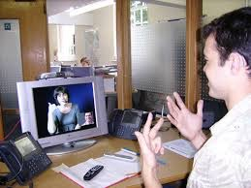
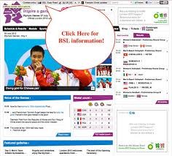
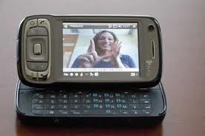
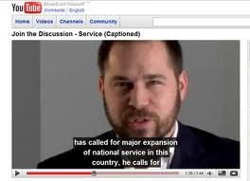
UN Convention for the Rights of Persons with Disabilities (CRPD)
"...all persons with all types of disabilities must enjoy all human rights and fundamental freedoms...."
EXAMPLES
Article 9:
Accessibility
obligations ...
Article 21:
Sign language,
captions, braille,
Zoom Text
options for
access ...
Video Telephone Relay
Accessible Websites
Video chat
TV and Movie Captions
Notes:
With the UN CRPD, many articles make reference to where countries and governments who have ratifies the Convention, are committed to create service and products that meet these obligations across all facets in community life: education, community, work, home, media, communication, etc.

Slide 5
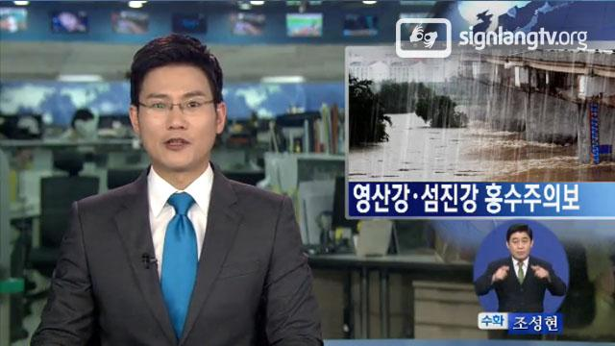
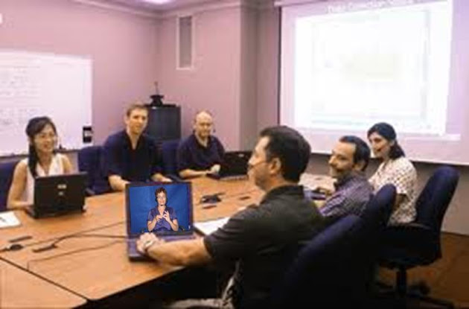
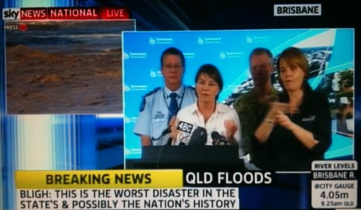
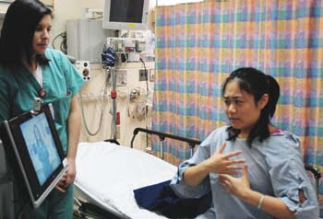
2020 Vision Accessibility - Communication
TV - sign interpreting
Work - Video Relay
Emergencies -
full access
Health - Video Relay
Movies captioned

Slide 6
WFD Recommendations
Official recognition of National Sign Languages and adequate support
Accessibility features and services to be included in all Government laws, regulations, licenses, etc.
.... and enforced as per UN CRPD!
Do not just work FOR Persons with Disabilities,
work WITH them and use their resources
Work - Relay
Emergencies -
full access
Movies captioned

Slide 7
Further Information: WFD Working Document on Adoption and Adaptation of Technologies and Accessibility :
http://wfdeaf.org/wp-content/uploads/2015/02/Working-Document-on-Adoption-and-Adaptation-of-Technologies-and-Accessibility-October-2014

