Slide 1
9th International Conference “Keeping children and young people safe online”
Szymon Wójcik
Nobody’s Children Foundation
Warsaw, Poland

Slide 2
Polish Safer Internet Centre
Awareness Centre
Helpline
Hotline

Slide 3
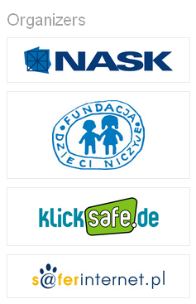
International Conference “Keeping children and young people safe online”
Since 2007 annually in Warsaw
Open and free admission
Held in Polish and English
International speakers

Slide 4
2015 edition of the Conference
Synergy

Slide 5
2015 edition of the Conference
The conference was organised by the Polish and German Safer Internet Centres, which work together within the European Commission’s Connecting Europe Facility Programme together with Internationa Telecommunication Union
The main partner of the event wasOrange Foundation.
Partners were Facebook and National Board of Television and Radio
The conference washeld under the honorary patronage of:
Ministry of National Education
Ministry of Administration and Digitization
Office of Electronic Communication
Children’s Ombudsman Office

Slide 6
9th International Conference
22-23 Sep 2015
Warsaw Airport Hotel
More than 600
participants
Live online streaming

Slide 7
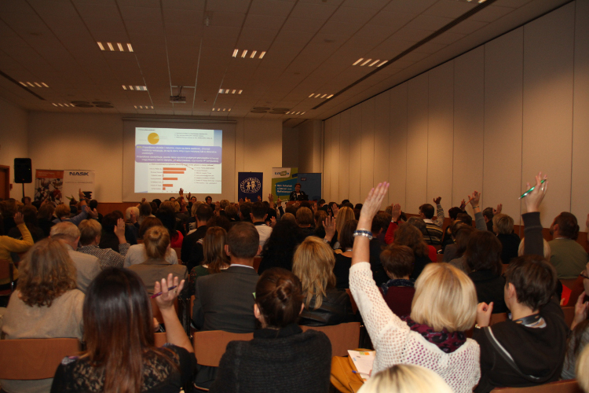
International Conference “Keeping children and young people safe online”
Presentations
2 plennary sessions
7 parallel sessions

Slide 8
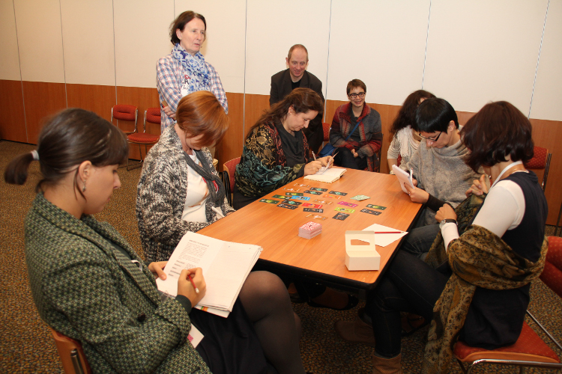
International Conference “Keeping children and young people safe online”
3 Workshops

Slide 9
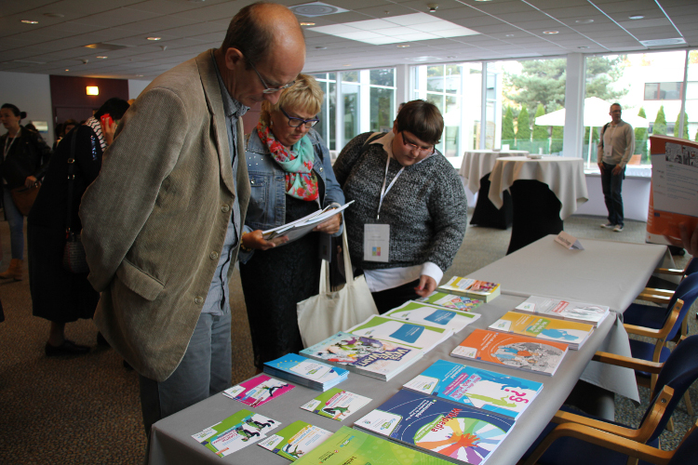
International Conference “Keeping children and young people safe online”
Materials and booths
Open debate
at the end

Slide 10
Overview of agenda
Hurtful behaviour online: cyberbullying and hate speech
Risky content online: problems and remedies
Teenagers and their sexuality online
Youngest children and new media
How to protect young people’s privacy online?
Educational tools for safer and better internet

Slide 11
Results of the conference
Serving one of the key targets of the RI-EUR4 with regard to “providing a platform to raise awareness on child online protection (COP) and safety issues”, the conference provided valuable insights to educators and law enforcement in terms of a variety of risks posed to children online.
National experiences and efforts were presented by representatives of governments, national hotlines and law enforcement agencies.
Expert organizations- including ITU, FOSI, Insafe, CoE, Europol etc.- shared best practices and useful tools developed for building capacity among children, parents and educators.
Participants had the opportunity to exchange their views and experiences in formal and informal discussion

Slide 12
Key points of discussion 1
With regard to dangerous online content, the dissemination of child sexual abuse content online and the access of minors to inappropriate content (i.e. adult pornography, self-harm websites, gambling websites etc.) were of particular concern among the participants.
The aspect of children’s online risky behaviour, especially in view of new technologies and Social Media, was identified as an important issue that requires constructive awareness efforts among all involved stakeholders. Some of the topics tackled were: cyberbullying, online self-portrayal and cyber-ethics.
The issue of online privacy and Big Data and its implications on children and teenagers received special focus during the discussions, with the debate revolving around the role of the ICT industry (ISPs, Host Providers etc.) and the need for stronger regulation or public-private collaboration in this domain.

Slide 13
Key points of discussion 2
In the age of wide availability of electronic devices ever younger children (0-6) start to use new media – especially tablets and smartphones. This constitutes new challenges in education of parents and awareness raising which were discussed on a speciall session
Digital ethics was proposed as a suitable framework for thinking and acting about child online protection. We should consider acting online with the sema ethical attention as acting offline. A roadmap for such ethical thinking was presented.
It was also pointed that the „paradigm of risk” dominated long in the discussions about children safety online – nowadays we should be also able to adopt „the paradigm of chance” – i.e. to see also the opportunites that the internet provide for yout.

Slide 14
Key takeaways for future action of the Group
Strengthening efforts in providing awareness and building capacity in different countries of the Europe Region- especially involving children, parents and educators.
Promoting best practice and experience sharing, as well as constructive cooperation among the countries of the Region.
Encouraging the alignment of efforts among relevant international and regional organizations, as well as other international stakeholders, for the provision of expert support to countries.

Slide 15
Thank you very much!
Szymon Wójcik (szymon.wojcik@fdn.pl)

