Slide 1


Child Online Protection in Iran
Activities and Suggestions
Seyyed Ali Araghchi
COP Expert

Slide 2


Viewpoint and Approaches
Broad definition of Child Online Protection Includes
  Crimes against the children like child pornography
  Harmful to Minors Materials (adult pornography)
  Contacts which threat children safety
Approaches
  Public Awareness and Family Empowerment
  Prohibition and restriction

Slide 3
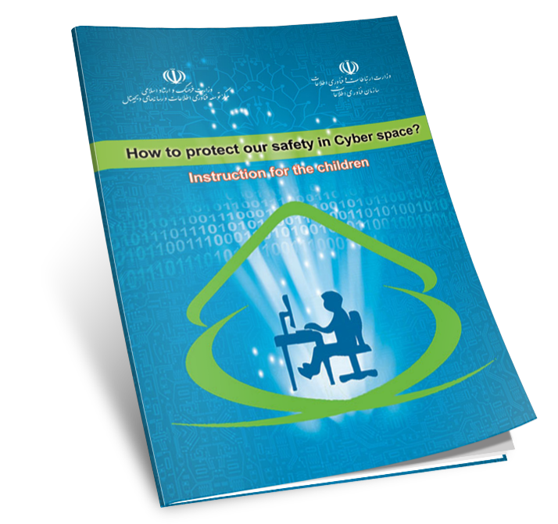
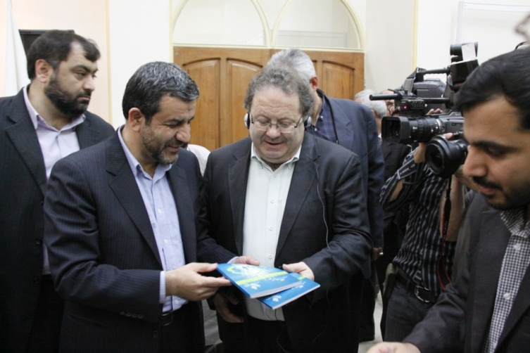

Public Campaign
Educational books
educational books for kids, children, youths, parents and educators by ITDMDC, ITO, Cyber Police, etc

Slide 4
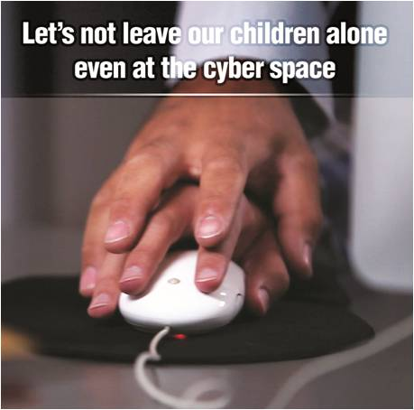
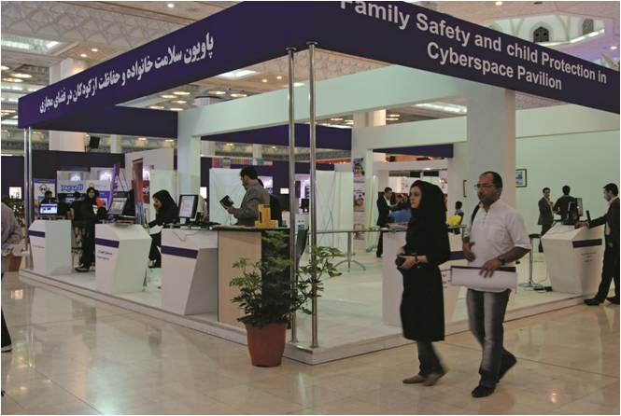
Public Campaign
Video Clips & Animation
Production of 150 minutes animation and about 15 video clips which were broadcasted by Iran’s Natinal TV (IRIB)
Events
Family Safety and Child Protection in Cyber Space Pavilion in International Digital Media Fair (IDMF 2012)

Slide 5
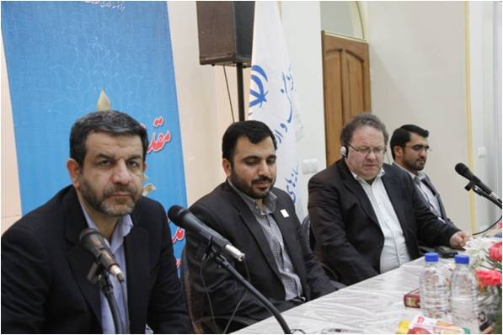
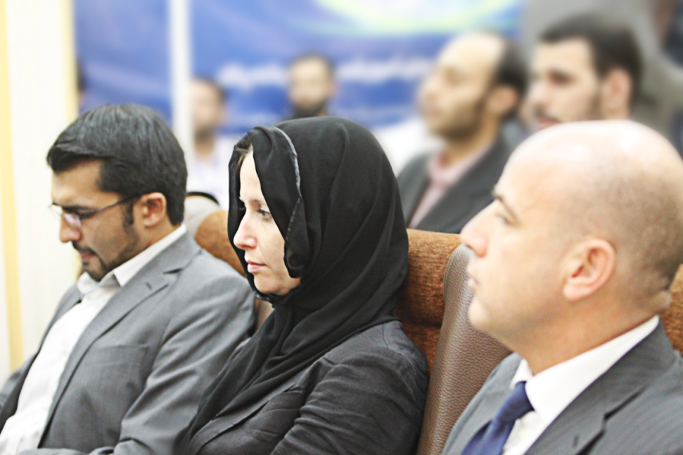
Knowledge sharing
international workshops and panels
with panelists from GSMA, IPMACT, ECPAT, Cybersecurity Malaysia, etc

Slide 6
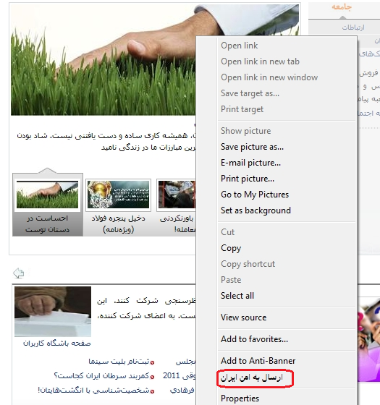
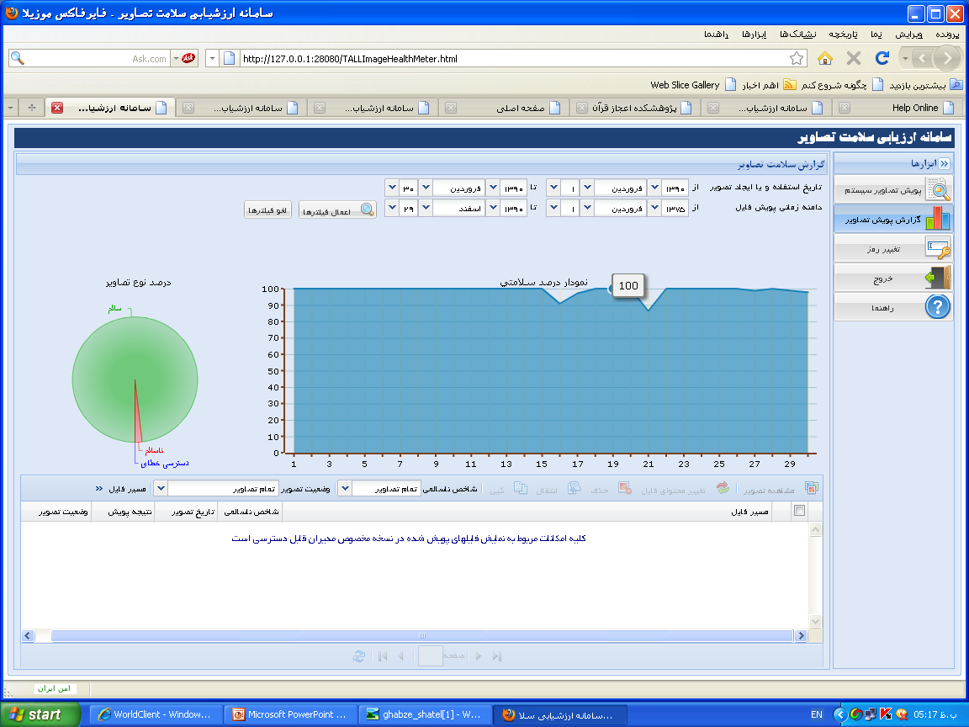
Tools Development
Presenting smart and precautionary tools by Tebyan Institute. By creating a safety profile of digital content, these tools give controllable observation to school principals and parents.
Using smart technologies for recognizing the inappropriate content ( Including texts, pictures and movies).
Using the social networks and users’ potential to recognize the inappropriate content and introduce it to the smart system

Slide 7
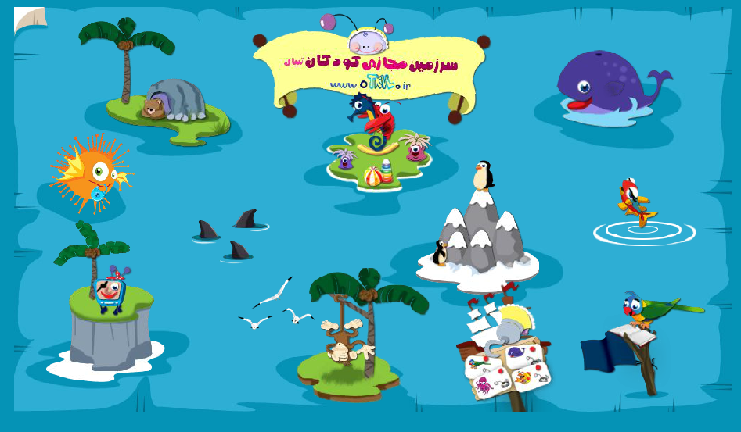
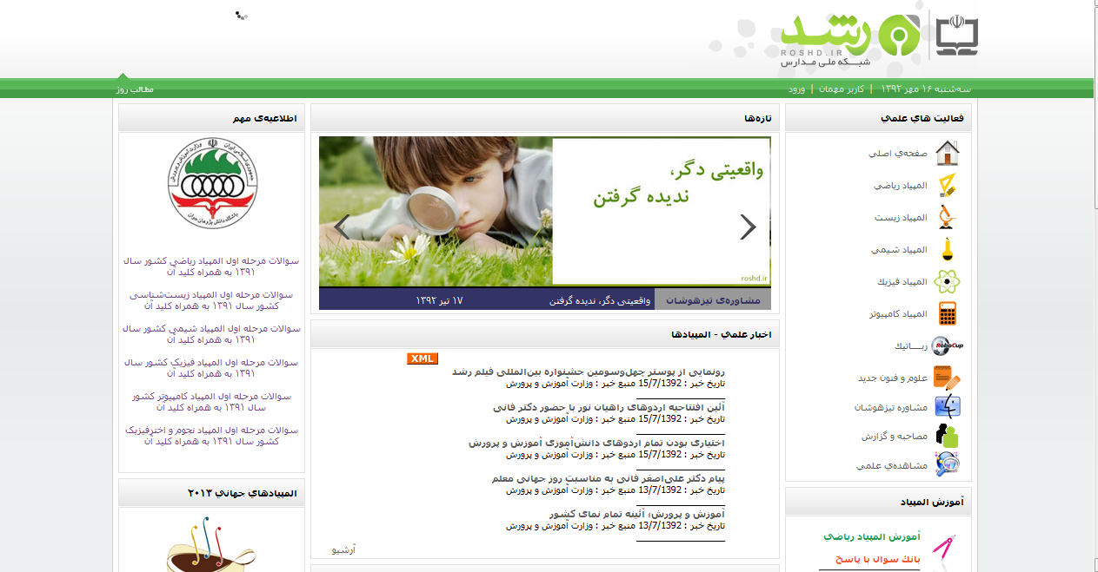
Green Zones for kids
Tebyan kids Virtual Land: a well known online walled garden for Iranian kids, in three age classes: under 6 years, 6 to 9 years, and 9 to 12 years
Roshd Network: The Ministry of education developed the network which is accessible through National School Network in all of the Iran’s schools for educational content.

Slide 8
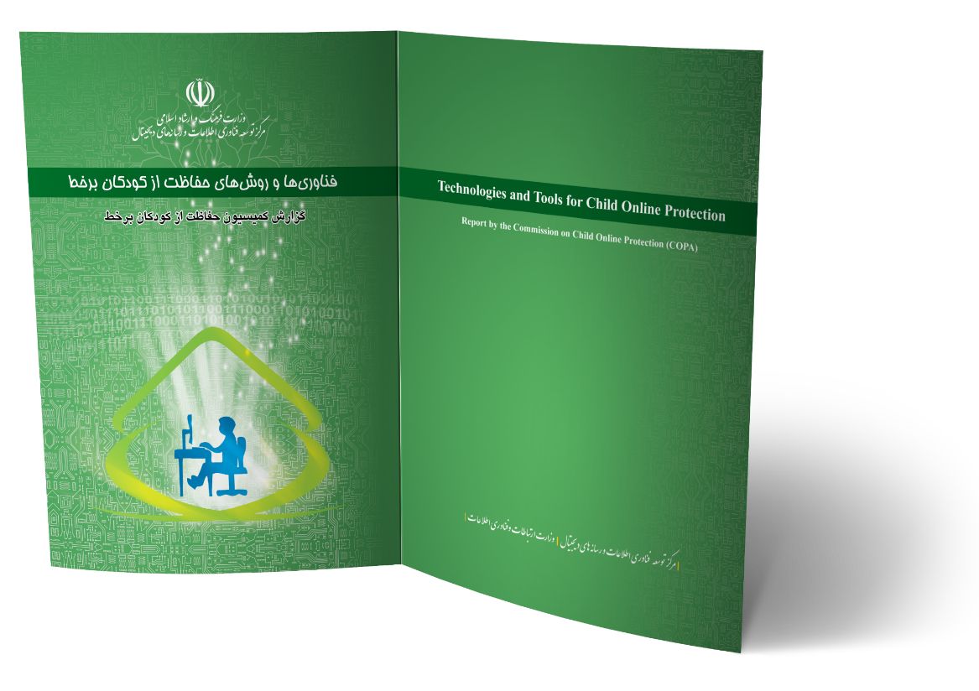
Policy making
Cooperation an workgroups
Translation and compilation of some of the COP documents like "COPA report" and "ITU COP guidelines “
Establishment of a working group in Ministry of Education consists of the ITDMDC, Cyber Police and Tebyan, etc.
Cooperation between ITDMDC and Iran's Telecommunication Regulatory Authority to enhance ISPs and Operators responsibility

Slide 9
Legal Framework
Law on Quality of Punishment of those commit unauthorized audio-visual activities (2008 )
To prohibit duplication and distribution of pornographic CD, DVD.
Computer Crime Law (2009)
To define and prohibit all kind of pornographic content and harmful materials in cyber space
To authorize the Iranian courts to prosecute the crimes when the victim is minor (under 18) globally
The Law does not define and criminalize child pornography or child abuse in particular

Slide 10
Legal Framework
Children and Adolescents' Protection Bill
reviewing by Iran's Parliament :
This law will be passed to provide legal base for Iran's commitment to the “UN Convention on the Rights of the Child" and its optional 1st and 2nd optional protocols.
to define crimes against the child in real world and cyber space
To adopt necessary measures to protect children in real world and cyberspace

Slide 11
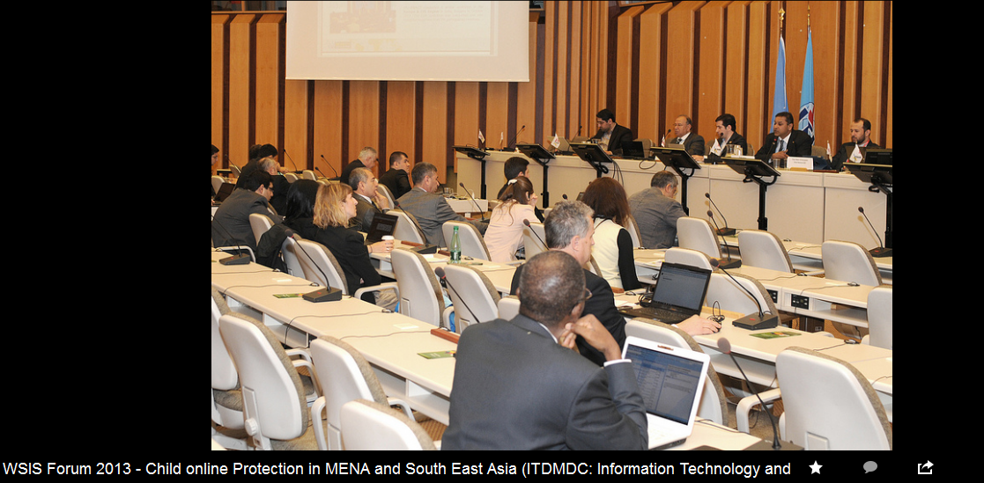
COP Activities
in MENA and South East Asia
ITDMDC organized the panel during WSIS Forum 2013 with cooperation of Oman CERT, Malaysia Cyber Security, IMPACT
E-WWG, Turkey Regulatory Authority, Tebyan Institute

Slide 12
Suggestions for WSIS+10
Geneva Declaration of Principles and Action Lines
Suggestions for WSIS+10
1. Safety has not mention under title 5 of : “Building confidence and security in the use of ICTs”
2. Insufficient attention to Family safety and Child Protection in provisions 57 and 59 of Declaration and C10-c
3. No attention to Family safety and Child Protection in C4 and C5
1. Adding Safety beside Security and Confidentiality as a main pillar of Action Line 5
2. Adding commitments of UN Convention on the Rights of Child and related Optional protocol to the new Documents
3. Encouraging establishment of COP workgroups at all level (International, Regional and national)

Slide 13
Child Online Protection in MENA and South East Asia Outcome
Suggestions and Recommendations for WSIS+10 Process
Inserting "safety" in cyberspace, particularly Child Online Protection (COP) , in the WSIS+10 documents. It means that “safety” should be added to the revised version of the Principles and Action Lines as a main pillar of Action Line 5 beside security and confidentiality.
Some phrases should be added which insist on the governments commitments and private sector responsibilities to provide a safer internet for families and children and to fulfill their obligations based on the UN Convention on the Rights of Child and its optional protocols.
Establishment of COP workgroup to harmonize the related activities at regional and national level should be added to the WSIS+10 documents.
As a complementary part of the Tunis agenda which says “incorporating regulatory, self-regulatory, and other effective policies and frameworks to protect children and young people from abuse and exploitation through ICTs into national plans of action and e-strategies” (par. 90.q.), we recommend adding COP as a component of cyber law and the other related laws.
Providing fund and the other technical assistance for less developed countries by the UN or developed countries to implement their commitment to the Tunis Agenda which insists on Helpline -“We encourage countries, and all other interested parties, to make available child helplines, taking into account the need for mobilization of appropriate resources. For this purpose, easy-to-remember numbers, accessible from all phones and free of charge, should be made available.”(par. 92.)

