Slide 1

Child Online Protecion in Latin American mobile industry

Slide 2
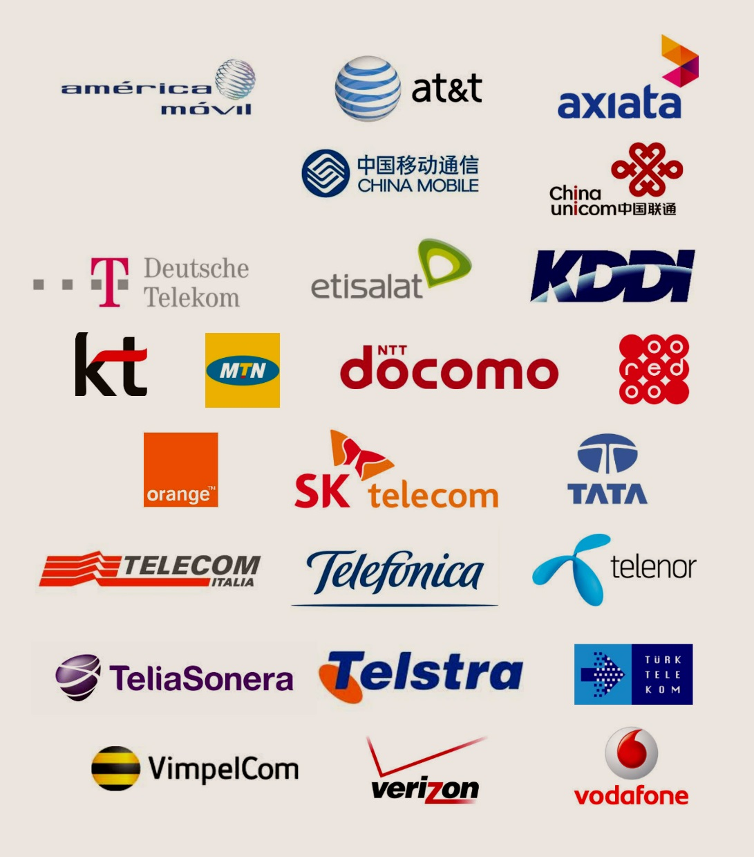
The GSMA
200
800
250
Compañías del ecosistema móvil

Slide 3
CSR and Sustainability Task Force
Created on mid 2013
More than 130 executives working on CSR and Environment
More than 40 MNOs from 21 countries
Priorities: COP and eWaste

Slide 4

eWaste in Latin America
Case study report (May 2014):
Position Paper
New report with United Nations University coming soon…
“Children are especially vulnerable to the health risks that may result from e-waste exposure and, therefore, need more specific protection” - WHO

Slide 5
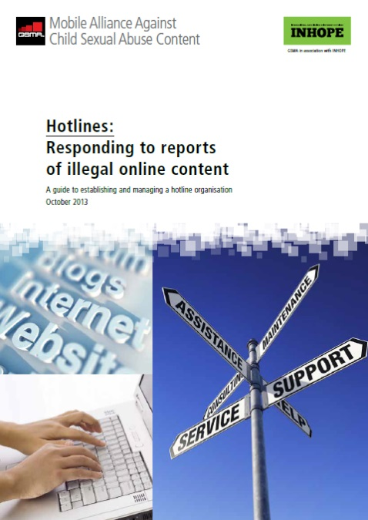
Trabajando de forma asociada
La colaboración entre la industria, las autoridades y las organizaciones de Líneas de Denuncia Online (hotlines) permiten una acción coordinada y efectiva para combater el contenido de abuso infantil online.
La GSMA trabaja de cerca con una serie de organizaciones y grupos de interés que combaten el contenido de abuso infantil online:
  Unión Internacional de Telecomunicaciones (UIT)
  Internet Watch Foundation (IWF)
  International Association of Internet Hotlines (INHOPE)
  International Centre for Missing and Exploited Children (ICMEC)
  Child Helpline International (CHI)

Slide 6
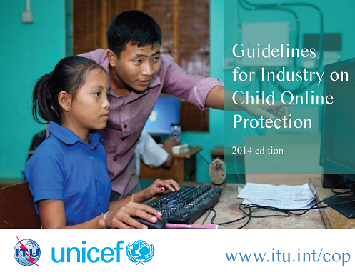


GSMA-UNICEF colaboration
To promote within the mobile operators of Latin America:
“Guidelines for Industry on Child Online Protection”

Slide 7
ITU/UNICEF CHILD ONLINE PROTECTION GUIDELINES
The Guidelines outline five key areas for protecting and promoting children’s rights in the online environment
Policies and management processes
Child sexual abuse material
Safer and age appropriate environment
Educate children, parents and teachers
Promote positive use of ICTS
Integrate children’s rights in policies and management processes
Develop processes for handling child sexual abuse material
Develop safer and age appropriate online environments
Educate children, parents and teachers on children’s safety
Promote digital technology as a mode to further civic engagement
Purpose of document is to provide:
A blueprint that can be adapted locally for various industry players
Establish a benchmark for recommended actions
Guidance on identifying, prevent and mitigating risks
Guidance on supporting children’s rights
Notes:
The Child Online Protection (COP) Initiative is a multi-stakeholder initiative launched by the International Telecommunication Union (ITU) to promote awareness of child safety in the online world and to develop practical tools to assist governments, industry and educators. As part of the initiative, in 2009 ITU published a set of four COP Guidelines for Children, Parents, Guardians and Educators, Industry, and Policy Makers. The Guidelines for Industry on Child Online Protection aimed at establishing the foundation for safer and more secure use of Internet-based services and associated technologies for today’s children and future generations. In response to substantial advances in technology and convergence, ITU, UNICEF and the COP partners have developed and updated the guidelines for the broad range of companies that develop, provide or make use of telecommunications or related activities in the delivery of their products and services.
For more information, see, ITU ‘Child Online Protection’, www.itu.int/cop.

Slide 8
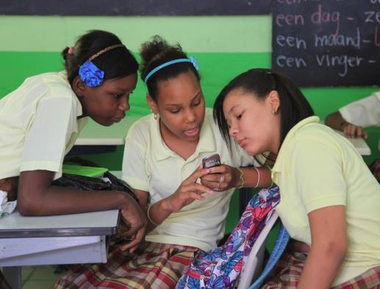

Guidelines for Industry on Child Online Protection
1. Policies and management processes
UNICEF and Millicom have formally agreed to a three-year alliance to improve respect for children’s rights in the telecommunication sector.
Map the risks to and opportunities for children’s rights in the telecommunication sector and in specific operational settings.
Millicom was one of the first companies to pilot UNICEF’s child rights check list.
Notes:
Integrating child rights considerations requires that companies take adequate measures to identify, prevent, mitigate and, where appropriate, remediate potential and actual adverse impacts on children’s rights. The United Nations Guiding Principles on Business and Human Rights call on all businesses to put in place appropriate policies and processes to meet their responsibility to respect human rights.

Slide 9



Guidelines for Industry on Child Online Protection
2. Child sexual abuse material
MNOs support regional hotlines
Notes:
While many governments are tackling the dissemination and distribution of child sexual abuse material by enacting legislation, pursuing and prosecuting abusers, raising awareness, and supporting children to recover from abuse or exploitation, many countries do not yet have adequate systems in place.
Responsible companies are taking a number of steps to help prevent their networks and services from being misused to disseminate child sexual abuse material. These include placing language in terms and conditions or codes of conduct that explicitly forbid such content; developing robust notice and takedown processes; and working with and supporting national hotlines. It should be noted that inappropriate user conduct is not limited to child sexual abuse material and that any type of inappropriate behaviour or content should be handled accordingly by the company.

Slide 10


Guidelines for Industry on Child Online Protection
3. Safer and age appropriate environment
Promote Parental Controls
Notes:
Very few things in life can be considered absolutely safe and risk free all of the time. Even in cities where the movement of traffic is highly regulated and closely controlled, accidents still happen. By the same token, cyberspace is not without risks, especially for children. Children can be thought of as receivers, participants and actors in their online environment. The risks that they face can be categorized into three areas:
• Inappropriate content – Children may stumble upon questionable content while searching for something else by clicking a presumably innocuous link in an instant message, on a blog or when sharing files. Children may also seek out and share questionable material. What is considered harmful content varies from country to country, yet examples include content that promotes substance abuse, racial hatred, risk-taking behaviour or suicide, anorexia or violence.
• Inappropriate conduct – Children and adults may use the Internet to harass or even exploit other people. Children may sometimes broadcast hurtful comments or embarrassing images or may steal content or infringe on copyrights.
• Inappropriate contact – Both adults and young people can use the Internet to seek out children or other young people who are vulnerable. Frequently, their goal is to convince the target that they have developed a meaningful relationship, but the underlying purpose is manipulative. They may seek to persuade the child to perform sexual or other abusive acts online, using a webcam or other recording device, or they will try to arrange an in-person meeting and physical contact. This process is often referred to as ‘grooming’.
Online safety is a community challenge and an opportunity for industry, government and civil society to work together to establish safety principles and practices. Industry can offer an array of technical approaches, tools and services for parents and children. These can include offering tools to develop new age-verification systems or to place restrictions on children’s consumption of content and services, or to restrict the people with whom children might have contact or the times at which they may go online.
Livingstone, S., and L. Haddon, ‘EU Kids Online: Final report’, EU Kids Online, London School of Economics and Political Science, London (EC Safer Internet Plus Programme Deliverable D6.5), June 2009, p. 10.
Facebook Privacy Controls:
Control who you share with. That can be a single person in a message, a small group, with friends, or with the world.
Each time you share a status update, you choose the audience you want to share with.

Slide 11
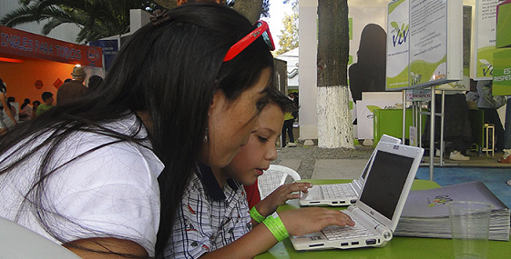

Guidelines for Industry on Child Online Protection
4. Educate children, parents and teachers
Fundación Estás Vivo de Viva y la Fundación Redes capacitaron para prevenir la violencia digital y el tráfico de personas a casi 5 mil estudiantes de las unidades educativas donde la Fundación Estás Vivo proporciona Internet gratuito en las ciudades de La Paz, Cochabamba, Santa Cruz y El Alto.
Notes:
Although companies have an important role in ensuring that children use ICTs in the most responsible and safest possible way, this responsibility is shared with parents, schools, and children.
Many companies are investing in educational programmes designed to enable users to make informed decisions about content and services. Companies are assisting parents, caregivers and teachers in guiding children and adolescents towards safer, more responsible and appropriate online and mobile phone experiences. This includes signposting age-sensitive content and ensuring that information on items such as content prices, subscription terms and how to cancel subscriptions, is clearly communicated.

Slide 12

Guidelines for Industry on Child Online Protection
5. Promote positive use of ICTS
Protección de Niños migrantes en México:
Desde 2008, Nextel Fundación colabora con el Instituto Nacional de Migración (INM) para proteger los derechos de los niños, niñas y adolescentes migrantes no acompañados.
A través de una llamada gratuita, los niños migrantes no acompañados pueden comunicarse con sus padres o familiares cercanos en donde sea que se encuentren para que el proceso de repatriación y retorno sea lo menos traumático posible.
Más de 60 Oficiales de Protección a la Infancia fueron capacitados y se brindaron 45 aparatos y líneas telefónicas en estaciones migratorias para la realización de llamadas nacionales o internacionales gratuitas.
Nextel Fundación asume el costo de la instalación y uso de las líneas telefónicas para las diferentes estaciones migratorias, así como la realización de hasta 18,000 llamadas anuales.
Notes:
The Convention on the Rights of the Child, in article 13, states that “the child shall have the right to freedom of expression; this right shall include freedom to seek, receive and impart information and ideas of all kinds, regardless of frontiers, either orally, in writing or in print, in the form of art, or through any other media of the child’s choice.” Companies can fulfil their respect for children’s civil and political rights by ensuring that technology, legislation and policies developed to protect children from online harm do not have the unintended consequences of supressing their right to participation and expression or preventing them from accessing information that is important to their well-being.
At the same time, businesses can also support children’s rights by offering mechanisms and tools to facilitate youth participation. They can emphasize the Internet’s capacity to facilitate positive engagement in broader civic life, drive social progress, and influence the sustainability and resiliency of communities, for example, by participating in social and environmental campaigns and holding those in charge accountable. With the right tools and information, children and young people are better placed to access opportunities for health care, education and employment, and to voice their opinions and needs in schools, communities and countries. They can access information about their rights and make demands for information, whether in terms of the right to information on matters that affect them, such as their sexual health, or political and government accountability.

Slide 13
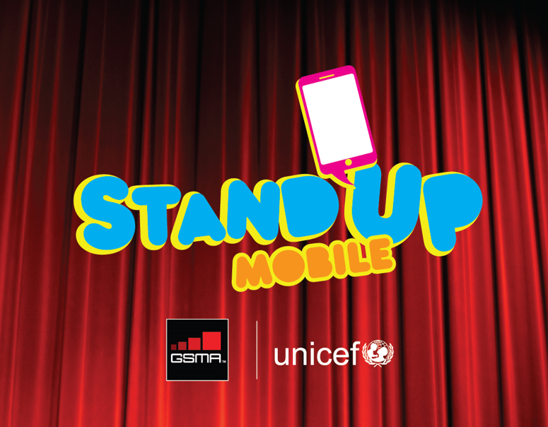

Slide 14
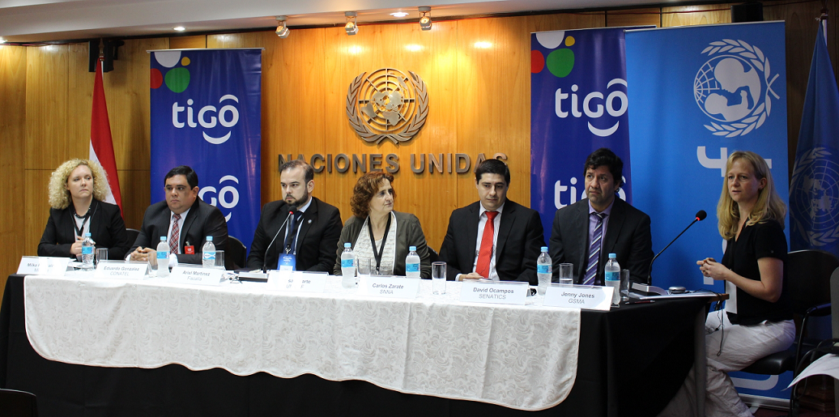
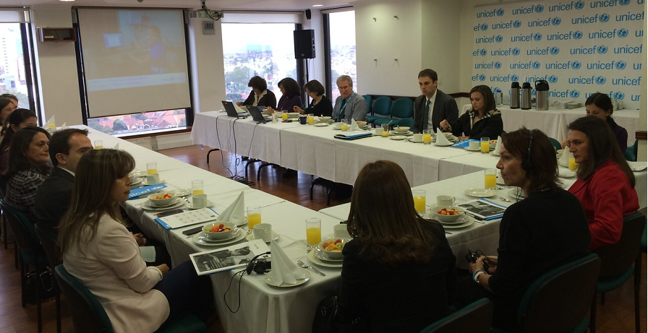
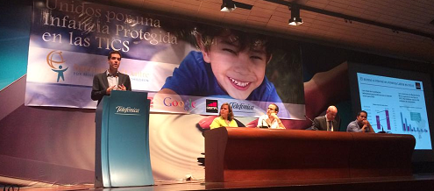
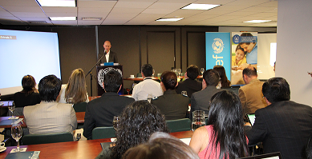
COP Workshops in Latam
Colombia, Paraguay (Oct 2014), Perú, Bolivia, Ecuador & Argentina (April 2015), El Salvador & Costa Rica (Sept 2015)

Slide 15





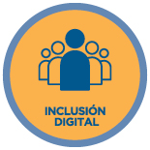





We Care: regional campaign to adress social issues with the mobile industry

Slide 16














The WeCare campaign in Latam
Colombia
México
El Salvador
Nicaragua
Brasil
Costa Rica

Slide 17

COP within the WeCare campaign
Mexico: Agreement with Alianza por la Seguridad en Internet (ASI)
El Salvador: promotion of the Alerta Angel Desaparecido (missing children) programme of the Attorney General
Brazil: support and SMS promotion of SaferNet and Dial 100
Nicaragua: support and SMS promotion of the child helpline133 from the Family, Adolescence and Childhood Ministry
Costa Rica: promotion and free calls to the 1147 helpline from the Patronato de la Infancia

Slide 18
How the GSMA is working to promote COP Guidelines in the Latam mobile industry
Awareness
  Seminars and Workshops
Actions
  WeCare campaign
Good Practices
  Compile and spread the good industry practices in Latam
Colaboration
  Jointly work with mobile industry and organizations like CHI, INHOPE, ICMEC and ITU

Slide 19
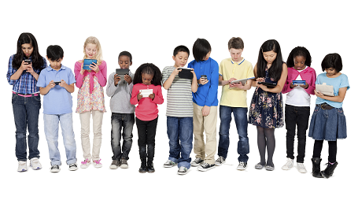
Thanks!
Mauro Accurso - Communications & Sustainability Manager, GSMA Latam – maccurso@gsma.com

