Slide 1
Digital Object Architecture (DOA)
Information session
Friday 27 May 2016 12:00-13:00 Room Popov

Slide 2
1
  Overview of the DOA

Slide 3
Why the DOA?
The Digital Object Architecture’s goal is to provide a solution to
the following digital information management issues:
  Provide standard access to heterogeneous information and services.
    Identification
    Description, search and retrieval
    Security, integrity, and trust
    Typing of data and services
  Interoperability across heterogeneous information systems.
    Independent of the specific underlying technologies that host and serve the information.
  Interoperability over long periods of time.
    10 – 100 – 10000 years?
    Active management of the systems that the information resides on.
  Very large level of scalability.
    Distributed architecture
    Open architecture framework
    Standard protocols and procedures

Slide 4
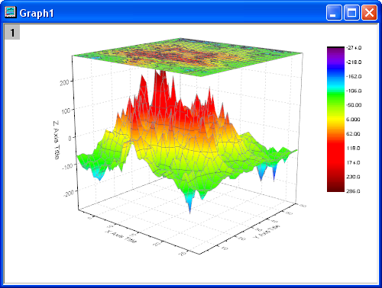
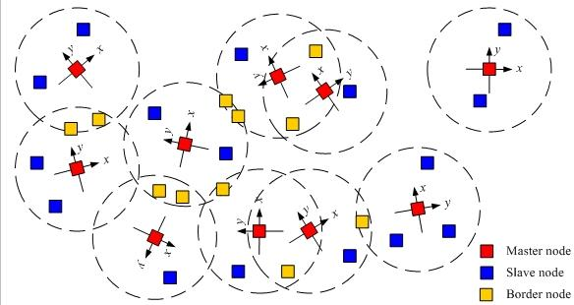


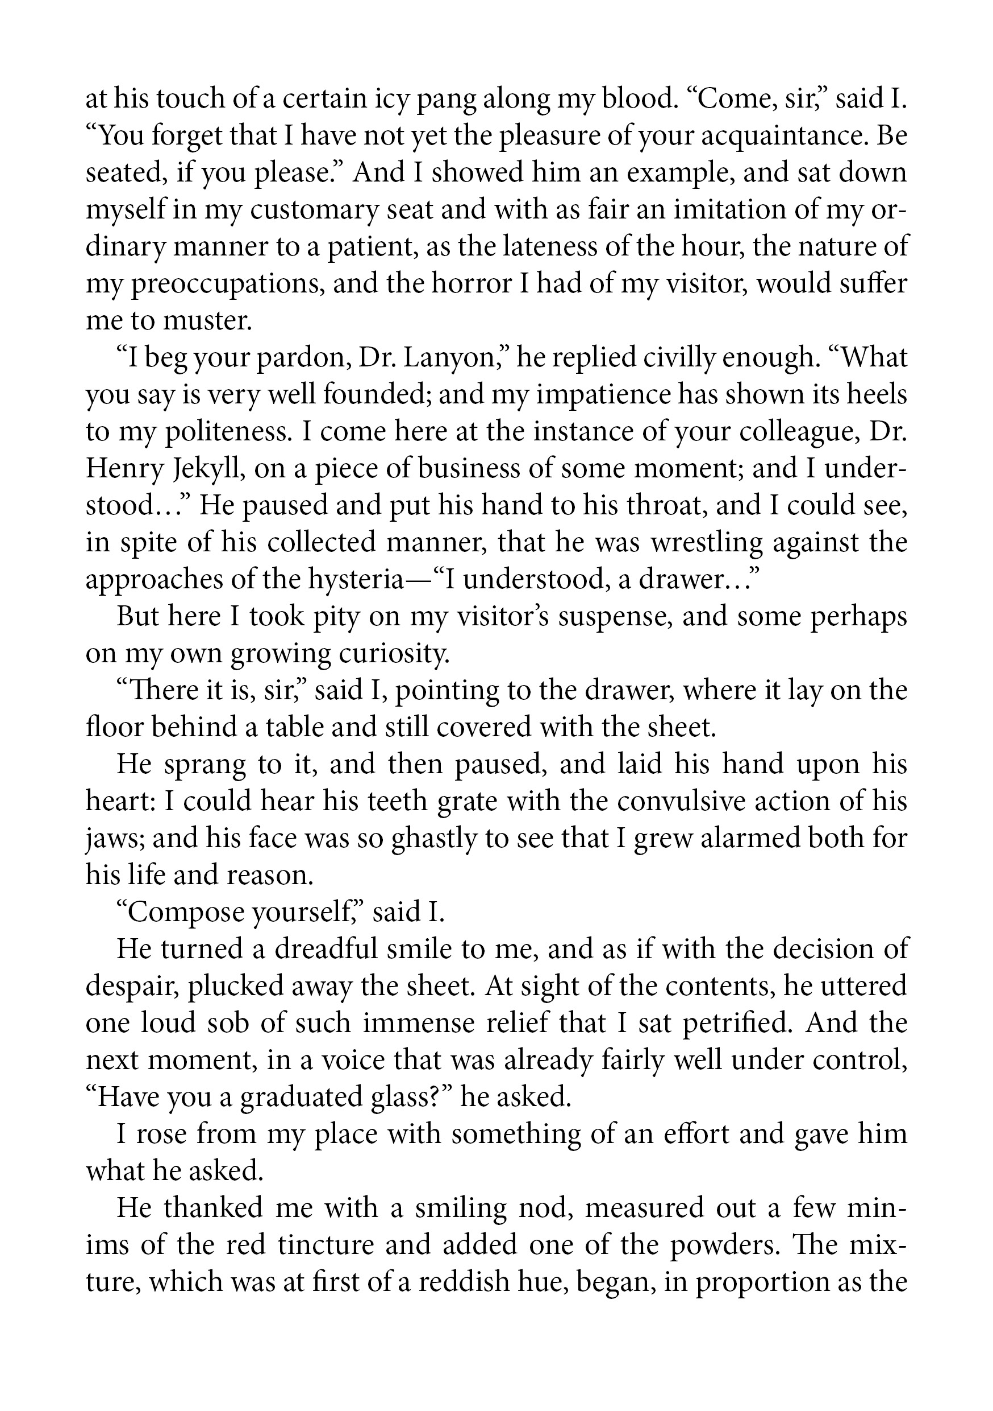
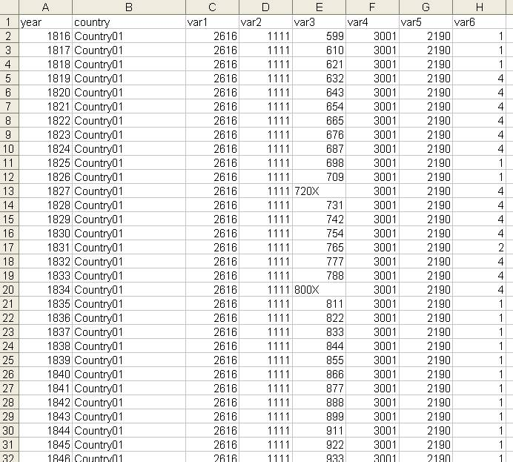

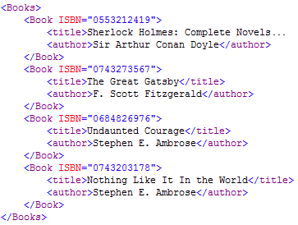
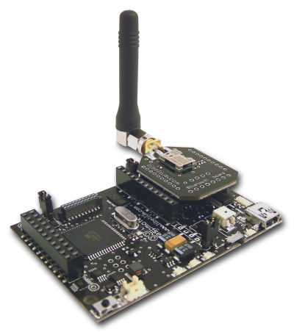





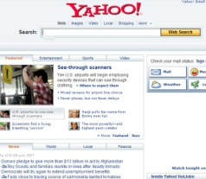
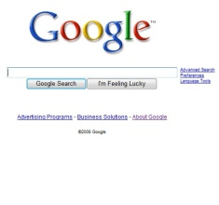
DOA- Information Management on Networks
Client
Repositories
Identifier Resolution Service
Resource Discovery
Search Engines, Metadata Databases, Catalogues, Registries, etc.

Slide 5


DOA
The DOA is an advanced and open architecture that provides a means for enhanced information management. Used in more than 75 countries in all continents, the DOA provides secure, global and decentralized methods of advanced information management and provides an conducive platform for the development of IoT-based applications and services. One of the components of the DOA includes the environment to interoperate with heterogeneous IDM and to manage (allocate and resolve) these global identifiers which are called Handle IDs.
THING
DIGITAL OBJECT comprises of:
Unique and persistent Identifier (global resource)
A built-in Resolution system resolves the ID of the entity, returns the state information contained in the state record and provides a seamless mechanism to connect “things” through linking the information about them.
1
associated with
2
State Record of the “Thing”
Car | Horse
Manufacturer | Breed
Production date | Stud book
Engine | Farm| Land
Chassis Number | Date of birth
Model | Vaccines

Slide 6
What is a Handle?
11.1002/12345678
Prefix
Suffix
Naming Authority
Item ID
(any format)
A Handle is a globally unique and resolvable identifier
  Prefix is resolvable by the Global Handle Registry to a Local Handle System (LHS).
  The identifier is resolvable by Local Handle System into set of typed values.
Character Set: Unicode 2.0
Encoding: UTF-8
Prefix: Currently allocating only numeric values.
Suffix: No restrictions.

Slide 7
Handle Resolution
MPA 2
MPA 4
MPA 1
DONA
ITU
MPA 3
MPA 6
Resolution request
For 11.1002/59.5.9
Global
Handle
Registry
Local
Handle
Service
Local
Handle
Service
Local
Handle
Service
Local
Handle
Service
The Handle System is
a collection of Handle
Services, each of which
consists of one or more
replicated sites, each of
which may have one or
more servers.
Site 2
Site 1
Site 2
Site 1
Site 3
…...
Site n
#1
#2
#1
#2
#3
#4
...
#n
11.1002/59.5.9
URL
4
http://www.itu.int/ITU-T/
URL
20
http://www.itu.int/ITU-R

Slide 8
2
  DOA and ITU-T X.1255

Slide 9
DOA in the Framework of ITU-T X.1255
Rec. ITU-T X.1255, approved pursuant to TAP: § 9.5 of Resolution 1, is a framework for discovery of identity management information.
Describes an open architecture framework which is based on the Digital Object Architecture with a generic digital entity data model.
One of the main components of the Digital Object Architecture is the Handle System.
The framework can be complemented by one or more general-purpose identifier/resolution systems and one or more metadata registries.
ITU-T X.1255 is therefore a framework for interoperability of heterogeneous identity management systems.

Slide 10
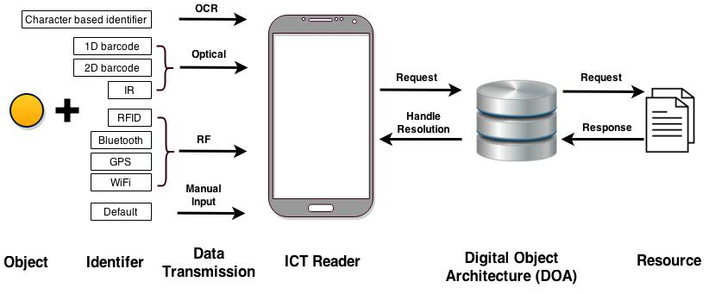
Platform Architectural Components
Identifier: Alphanumeric identifiers, barcodes, ucode, text, RF
Reader: Optical, RF
Transmission: IP networks, proprietary protocols
Resolution: Handle System

Slide 11
Benefits of the Platform for Interoperability
Interoperable with existing resolution systems
Unique persistent identification and multilingual support
Decentralized technical management system for IoT
Enhanced search capabilities and indexing
Recursive resolution possible
Systemic organization of data
Type value pair capabilities
Defining new type value pairs enabling advanced data management of Handle Record
Linking IDs of objects to other objects possible
X.1255 based on DOA
Security
Resolution
Flexibility
Privacy
Handle Record permission control and management
Owner of the Handle Record can set public and private access
Owner can delegate who can read, write, delete and create type value pairs
Public Key Infrastructure regime (PKI)
Enabling data authenticity, confidentiality and integrity
Safety feature (passphrase)

Slide 12
3
  Uses of DOA in ITU

Slide 13
Key Service Areas
Resolution System
  Global: Multi-Primary Global Handle Registry (MP-GHR)
  Local: Local Handle Services (LHS)
Development environment: environment hosting applications for staging and development, before going live.
Production environment: environment hosting operational applications and web services; accessible to external users and developers.

Slide 14
Resolution Service Provider (RSP): GHR/LHS
ITU creates and manages its own prefixes under prefix 11.
Prefixes created in ITU so far:
11.1001 -> ITU-R
11.1002 -> ITU-T
11.1003 -> ITU-D
11.1004 -> General Secretariat of ITU
11.1234 -> staging / development
11.1000 -> prefix 11 community
11.oid -> Object Identifiers (OID) interoperability
Prefix 11
Root

Slide 15
DO Architecture Initiatives @ITU
More than 1M handle identifiers have been already assigned to various ITU digital objects, such as:
ITU History Portal (webpages and documents) [~3k digital objects]
ITU-T Recommendations and its respective patent statements and copyrights [~95k digital objects]
Different collections of ITU-T databases and working groups [~200k digital objects]
Ship stations from ITU-R maritime database [~800k digital objects]

Slide 16
Applications Developed
Handle Bridge: tool for administrators for managing prefixes & suffixes and connect external applications to the handle system.
Indexing tool: application for storing and searching Digital Objects on LHS.
Handle Web Client: web application for end-users for displaying, creating and modifying Digital Objects.
Synchronization tool: Application Programming Interface (API) to automate synchronization between local databases and the Handle System.
Anti-counterfeit applications: prototype for using Handle IDs to validate products, tools: registration API, verification server and QR application reader.
Handle Ubuntu Client: application with native support for resolving identifiers; available in Ubuntu OS / Linux distribution.

Slide 17
DOA in ITU for Advanced Information Management
Set policies to name digital objects using the Handle IDs for persistent identification.
Increase Reach, indexing and cataloging objects for safer and better external access.
Provide interoperable platform for heterogeneous systems, using open standard protocols to communicate and resolve Handle IDs.
Multilingual support for all official UN languages.
Different security levels and privacy controls to access .
Multiple resolution system to access objects, different languages and media types.

Slide 18



Before: ITU-T resources scattered
Rec. info
Test signals
Terminology
Resolutions and opinions
Rec. files
Technical papers
Handbook

Slide 19



After: Centralized Information System
ITU-T databases
Others: Email, websites, …
ITU-T files and media content
DOA
Handle System
Search on metadata, keywords and file content

Slide 20
4
  ITU and DONA Foundation

Slide 21


Framework for the Management of the DOA
Digital Object Architecture (DOA)
CNRI
Founder
(Chairman of the Board )
DONA
Foundation
Project Partner
(Oversight Review)
GHR License Rights
GHR License Rights
(Voluntary Contribution)
CNRI (USA)
ETRI, CDI & CHC (China)
GWDG (Germany)
IDF Foundation
(USA|UK)
GHR Services ITU and UN
MPA 1
MPA 2
MPA 3
MPA 4

Slide 22
ITU’s Role in GHR Services
Management of ITU’s own information and infrastructure within the mandate of ITU.
ITU uses an earlier agreement with CNRI (prefix 11 Agreement) to run its own Global Handle Registry (GHR) services.
ITU ensures for LHS to hold the associated handle records for identifiers that start with prefixes derived from Prefix 11.

Slide 23
In case of a Reconstitution
ITU acts as facilitator to ensure the continued uninterrupted operation of the GHR.
The interaction between the MoU and Articles 8 and 16 the DONA Foundation Statutes should also be taken into account in this context.
The DONA Foundation itself would be subject to reconstitution, not the GHR.

Slide 24
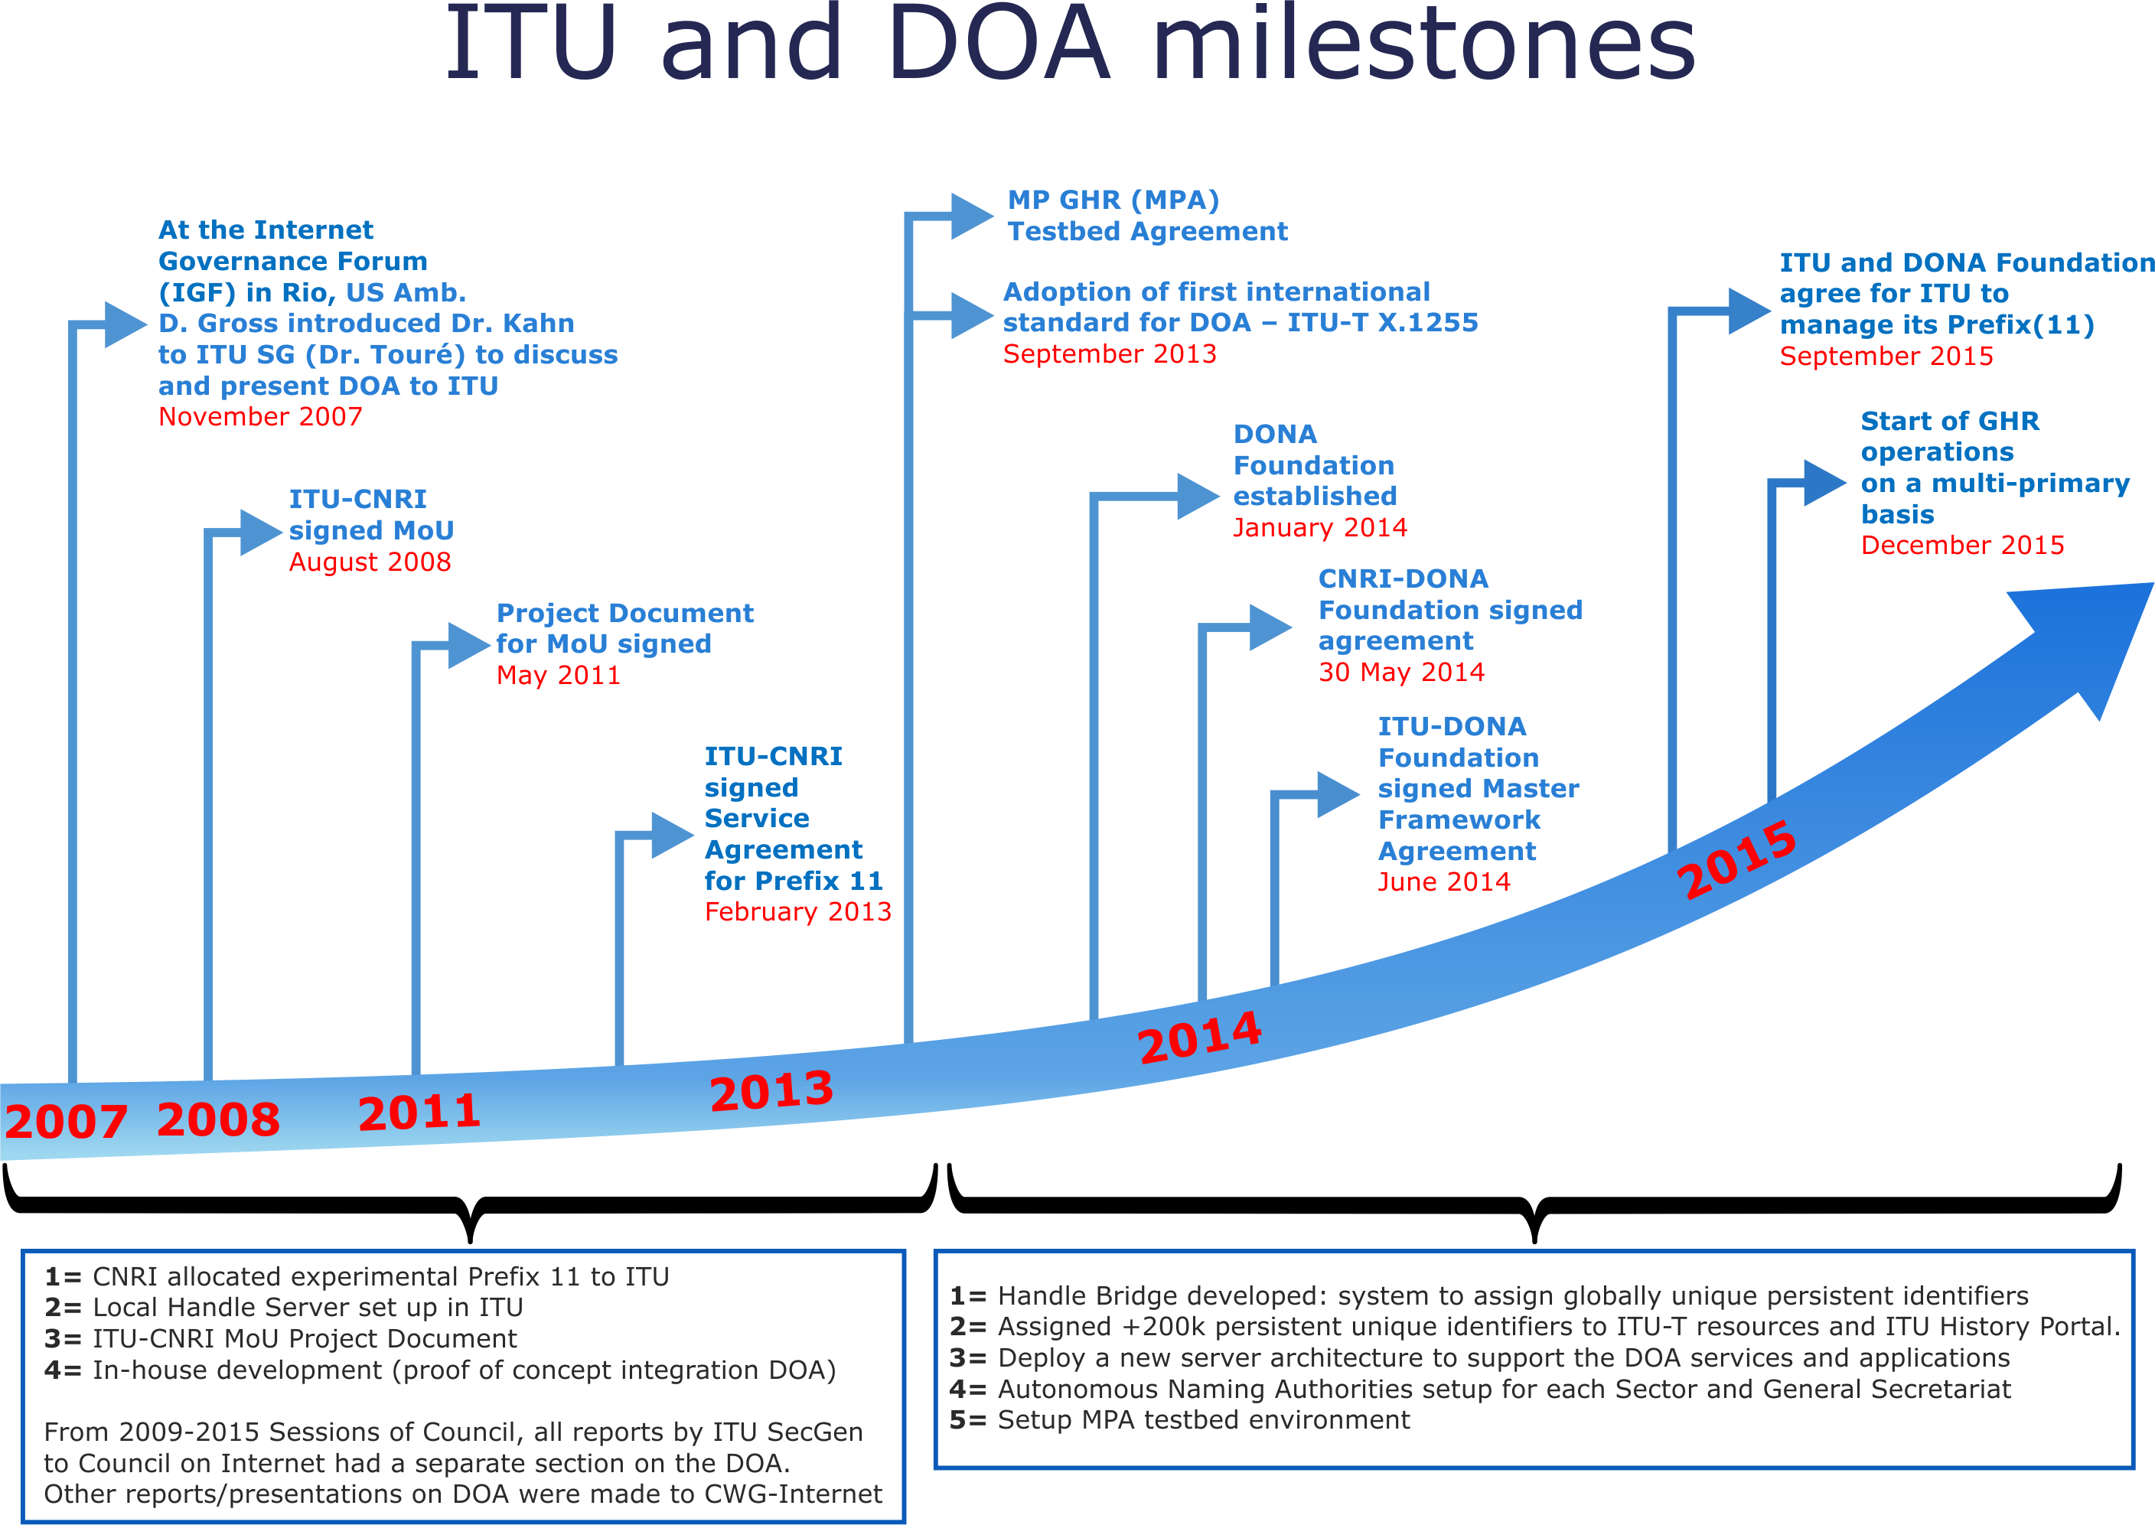

Slide 25
Questions & Answers

