Slide 1
Standards Bodies’ Approach to Security, Privacy & Trust
Karen McCabe
Senior Director of Technology Policy and International Affairs, IEEE Standards Association
GSS16, 24 October 2016
Notes:
GSS Theme:
“Security, Privacy and Trust in Standardization”

Slide 2






About IEEE
World’s Largest Professional Association Advancing Technology for Humanity
420,000+
Members
46
Technical Societies & Councils
160
Countries
1,600
Annual Conferences
3,900,000+
Technical Documents
175+
Top-cited Periodicals

Slide 3

IEEE Standards Association
Mission: Provide a high quality, market-relevant standardization environment, respected worldwide
An independent global community with an open standards development process
  Proven process produces results that reflect the collective, consensus view of participants and enables industry to achieve specific objectives and solutions
  Widely respected and aligns with the WTO and OpenStand principles
IEEE Standards span a broad spectrum of technologies, such as
Aerospace Electronics
Broadband Over Power Lines
Broadcast Technology
Clean Technology
Cognitive Radio
Design Automation
Aerospace Electronics
Broadband Over Power Lines
Broadcast Technology
Clean Technology
Cognitive Radio
Design Automation
Aerospace Electronics
Broadband Over Power Lines
Broadcast Technology
Clean Technology
Cognitive Radio
Design Automation

Slide 4
Open Standards Development
Standards have a critical role in helping to ensure security and privacy and enabling trust in ICTs
To enable this role, a best practice is to work within a set of principles that provide a worldwide community for voluntary cooperation among interested parties and stakeholders, and enable technical excellence, global interoperability and innovation
Principles
Direct Participation Due Process
Broad Consensus Balance
Transparency Universal Openness
Coherence Development Dimension

Slide 5
Value of Open Processes & Open Standards
Open processes are a good practice from a security perspective as the review of multiple experts can discover potential flaws and improve the standards in development
The transparency of open standards development promotes trust in platforms, services and products built upon and adhering to these standards
Open standards enable privacy-and security-enhancing technologies to gain wide spread adoption as the promote interoperability
Open standards fuel innovation that can advance solutions to the challenges of security, privacy and trust
Notes:
As we look our collective efforts to address security, privacy and trust challenges through the lens of standardization, to note is the value and impact of open standardization processes and open standards developed through these processes.

Slide 6
Path Forward
Core functionality should be standardized to enable permissionless innovation above and below the standard
Include a new generation of privacy, security and ethics professionals from across multi-disciplines in open standards development
Build privacy, security and ethics into the open standards themselves to contribute to trust in ICTs and our growing global digital future
Embrace a globally open and inclusive paradigm that will help ensure strong integration, interoperability and increased synergies along the innovation chain across national and regional boundaries
Establish an integrated standards ecosystem framework that takes into account the current and anticipated future state of technology and its impact, the entry of developing economies and the impact of standards on policy and policy on standards

Slide 7
IEEE Standards Work in Security, Privacy and Trust

Slide 8
IEEE 802 Series
IEEE 802.1ARce Secure Device Identity: Amendment 1: SHA-384 and P-384 Elliptic Curve
IEEE 802.1AEcg MAC Security: Ethernet Data Encryption Devices
IEEE P802E: Recommended Practice for Privacy Considerations for IEEE 802 Technologies
IEEE 802.1Xbx Port-Based Network Access Control Amendment 1: MAC Security Key Agreement protocol (MKA) extensions

Slide 9
IEEE 1363 Series
IEEE's center of cryptographic expertise, with a particular focus on public key algorithms
Traditional Public-Key Cryptography (IEEE 1363 & IEEE 1363a)
  This includes digital signature and key establishment schemes
Lattice-Based Public-Key Cryptography (IEEE 1363.1)
  This includes encryption (e.g. NTRUEncrypt) and digital signature (e.g. NTRUSign) schemes
Password-Based Public Key Cryptography (IEEE 1363.2)
  This includes password-authenticated key agreement (e.g. EKE, SPEKE, SRP) and password-authenticated key retrieval (e.g. Ford & Kaliski) schemes
Identity-Based Public Key Cryptography using Pairings (IEEE 1363.3)
  This includes techniques for identity-based cryptography using pairings
Identity-Based Cryptographic Techniques Using Pairings (IEEE P1363.3/Cor 1)
  This includes techniques for algorithms to compute the pairings and specification of recommended elliptic curves

Slide 10
IEEE 1619 Series
This family of standards specifies the XTS cryptographic mode of operation for the AES block cipher and an XML-based key archive format for block-oriented storage devices
IEEE 1619 IEEE Standard for Cryptographic Protection of Data on Block-Oriented Storage Devices
IEEE 1619.1 IEEE Standard for Authenticated Encryption with Length Expansion for Storage Devices
IEEE 1619.2 IEEE Standard for Wide-Block Encryption for Shared Storage Media

Slide 11
IEEE 2600 Series
The IEEE 2600 family of standards address the security needs of hardcopy devices using a generic compliance methodology (IEEE 2600) and using a Common Criteria based compliance methodology (IEEE 2600.1, 2600.2, 2600.3 and 2600.4)
  Intended to be used by hardcopy device manufacturers, purchasers, administrators, and end users
  More than 100 individuals from over three dozen organizations have participated in working group meetings, teleconferences, and email discussions

Slide 12
Many Others
IEEE 1609.2 Standard for Wireless Access in Vehicular Environments--Security Services for Applications and Management Messages - Certificate Management
IEEE P1609.2a Standard for Wireless Access in Vehicular Environments--Security Services for Applications and Management Messages Amendment - Certificate Management
IEEE 1667 Discovery, Authentication and Authorization in Host Attachments of Storage Devices
IEEE 1735 Recommended Practice for Encryption and Management of Electronic Design Intellectual Property (IP)
IEEE 1735/Cor 1 Recommended Practice for Encryption and Management of Electronic Design Intellectual Property (IP) - Corrigendum 1: Correction to Rights Digest Description
IEEE PC37.249 Guide for Categorizing Security Needs for Protection and Automation Related Data Files

Slide 13
Industry Connections
Security Group (ICSG)
Malware MetaData Exchange Format (MMDEF) XML schema
  V1.2: Describes files containing malware, as well as clean files
  MMDEF-B: Describes behavioral aspects of malware
Software Taggant System for identifying malware creators
  Cryptographically secure marker added to obfuscated files created by commercial software distribution packaging programs (packers)
  Legitimate packers often abused by malware creators to create many, difficult-to-detect variants of their malware
  Taggants identify specific packer users’ license keys, enabling blacklisting of malicious packer users (malware creators)
  System components:
    Open source software library
    Public Key Infrastructure (PKI) management service
    Blacklist of malicious packer users

Slide 14
ICSG, continued
Clean-file Metadata Exchange (CMX)
  Shared, continually growing repository of information (metadata) related to clean software files
  New metadata added by software developers, even prior to release of the corresponding software
  Helps reduce number of false positives detected by anti-virus software when more aggressively searching for malware
IEEE Anti-Malware Support Service (AMSS)
  Provides shared services supporting the entire computer security industry
  Enables individual security companies and the industry as a whole to respond more effectively and efficiently to contemporary malware threats
  Initially consists of two main services: CMX and Taggant System
  Managed and administered by IEEE-SA (Professional Services)

Slide 15

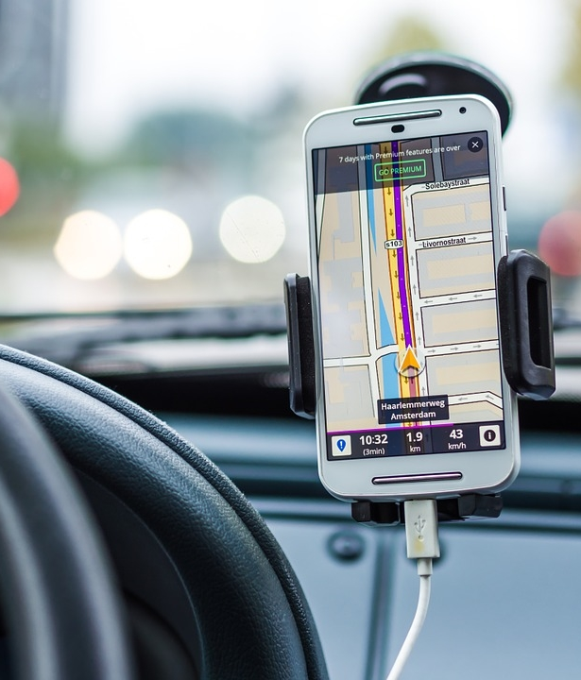


IEEE Internet Initiative Mission
To provide a collaborative platform for advancing solutions and informing global technology policymaking through a consensus of sound technical and scientific knowledge in the areas of Internet governance, cybersecurity, and privacy.
Notes:
SEGUE to 3i (background for creation of Ethics Programs)

Slide 16
IEEE Internet Initiative
A multi-domain and multi-discipline community that connects technologists and policymakers from around the world to foster a better understanding of, and to improve decisions affecting, Internet governance, cybersecurity, and privacy issues.
Provides a neutral, respected forum to help ensure trustworthy technology solutions and best practices in guiding Internet policymaking.
Focused on building trust and confidence in the internet and its technology underpinnings, and advancing solutions to provide meaningful and ethical internet access and use to all the world’s citizens.
Notes:
The IEEE Internet Initiative is rooted in IEEE’s mission to advance technology for the benefit of humanity. Its focus is on the development, adoption and use of trustworthy technologies and solutions that enable digital inclusion and the internet to foster innovation for economic and societal growth, and to promote participation of technologists, policy makers and other stakeholders in a global “internet policy partnership.”
Launched in 2014, it served as the inspiration and launch point for the AI and ethics in technology work at the IEEE—noting that to ensure trustworthy technologies—their development and use—that it is imperative to address the critical dimensions of ethical and human values as we work to find and advance solutions for providing meaningful internet access and use that are safe, secure and ethical.

Slide 17
IEEE Focus on Technology Ethics
A Dual Effort Initially Focused on AI/Autonomous Systems
Ethics, Society & Technology (EST) Ad Hoc Committee
IEEE TechEthics™ program oversight
Broad charter to consider tech ethics concerns across all technologies
Focused on debate and discussion with output being events, articles, white papers, etc. to inform good policy and decision making
This is the opening up and widening of the discussion, bringing in all voices in the conversation
Global Initiative for Ethical Considerations in the Design of Autonomous Systems
IEEE Industry Connections group
Develop consensus among participants
Develop Standards
This is narrowing of the discussion, driving towards consensus, delivering tangible outputs that directly shape behavior, practice, policy and more
Notes:
Focus will be on a variety of technology areas. First area of focus is AI/autonomous systems.
TechEthics is about expanding the discussion to include all viewpoints, with particular attention to all possible audiences, including general public. Complementary SA activity is about engaging industry and others to narrow the conversation to achieve consensus on key points that might lead to standards and other such items.

Slide 18
IEEE-SA Global Ethics Initiative
Notes:
-Mention GIECDAS, re: more specific focus on standards and ethical tech

Slide 19
IEEE P7000™
Notes:
Segue to P7000 to provide a specific example of Standardization in the Ethics space for technology
-This is the first Standard of its kind, re: ethics for IEEE since the org began, etc

Slide 20
Thank You
Karen McCabe k.mccabe@ieee.org

