Slide 1
A Win-Win Situation
Helmut Schink
Technology and Strategy, Industry Environment
Head of Telco Standards
Nov 22, 2012

Slide 2





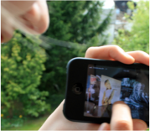

Key requirements towards 2020
Make networks self-aware, self-adaptable, and intelligent
Reduce latency to milliseconds
Manage up to 10 times more users
Improve energy efficiency
Support up to 1000 times more traffic
Enable Gbps peak speeds
Deliver safe
superior customer experience
Transport network must support increased traffic and latency of B4G systems

Slide 3
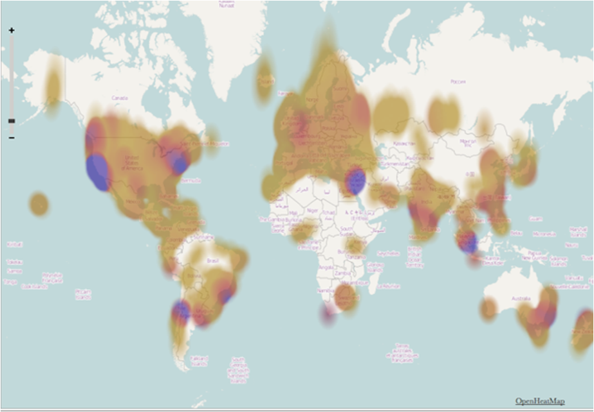

Where does it happen?
World’s top technology startup ecosystems
[Source: Startup Genome, 2012]
Silicon Valley
New York City
London
Toronto
Tel Aviv
Los Angeles
Singapore
Sao Paulo
Bangalore
Moscow
Paris
Santiago
…
Part of NSN Smart Lab framework:
Study mobile broadband application and device use cases in our lab, customer cooperation
Promote 3G and LTE capabilities for accelerated application and device innovation

Slide 4
























Focused Cooperation with Universities and Research Institutes

Slide 5
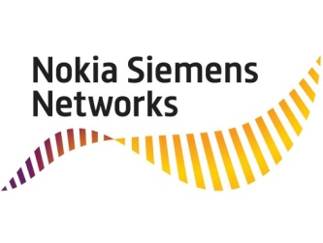
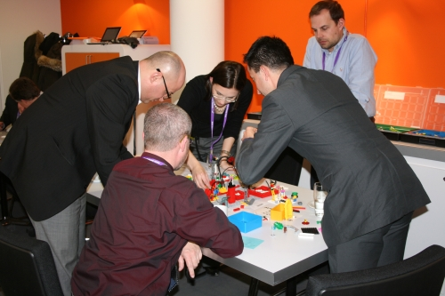
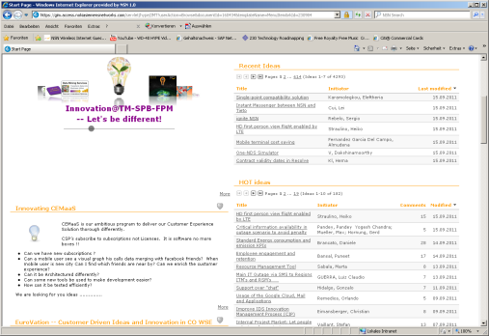
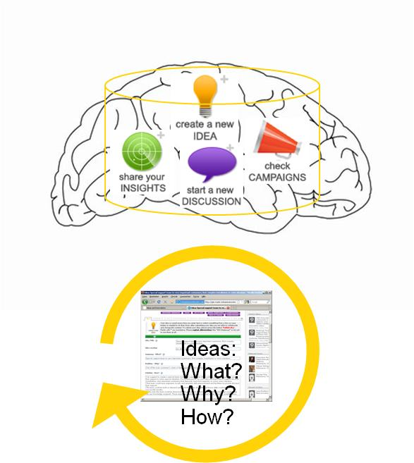

Let’s link our brains…
Joint Think Tank
Selected
Customer
Vision
Pain Points
Global Expertise
Joint ideas
Directive Workshop Sessions
Exclusive Joint Social Web Style Ideation
Joint projects
Notes:
Recently we also added to the innovation mall the idea of joint think tanks with customers, and I think this part is quite interesting and perhaps unique.
It is essentially bringing the customer in to our innovation systems and vice versa, bringing our people‘s knowledge to our customers.
This is new and our first trial is with O2.

Slide 6
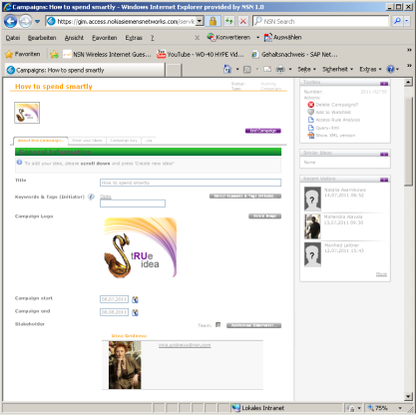

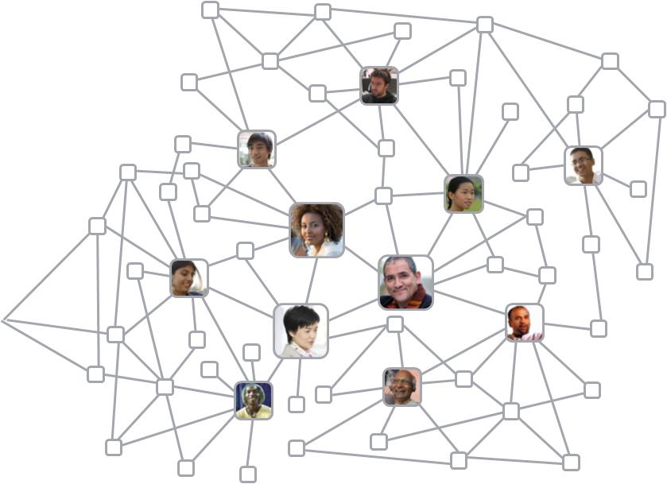
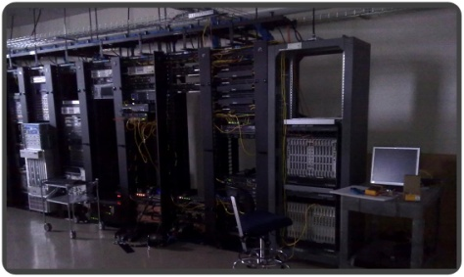
Do the Right Things!
Focus
Engagement
Incubation
adequate
Execution
Do the Things Right!

Slide 7
Setting the scene
Bridging the gap: Network APIs aka Telco2Web
CSP exposes his network assets via APIs to external developers in a secure, authorizable, billable way
ideally, a broker ensures simplicity and scale of access spanning multiple CSPs
revenue share between developer, operator (and broker) creates an interesting market
CSP
has valuable assets (SMS, MMS, Location, Click-to-call, Payment) inside his complex networks
has so far been slow/unsuccessful to deliver interesting Internet applications
looks for ways to monetize these assets in apps business
over-the-top revenue share models (e.g. Apple Store) bypass the CSPs
Web application developer
wants to distribute applications
wants easy(!) access to broad user base
wants to get paid
dynamic, creative
may use telco assets only if onboarding is easy
?

Slide 8
Business Innovation
CSPs open their walled gardens to external developers.
A big addition to the value chain
CSPs try to on-board large numbers of independent software vendors
lowering the traditionally high entry barrier into the Telco world
(„zeo financial risk for developers“)
telcos adopt revenue share models known from Internet
Telco Network APIs start to be taken seriously
  Twitter recently adopted the BlueVia messaging API to connect phones via SMS/MMS to the Twitter platform

Slide 9


One likely business model: Broker with revenue sharing in a multi-CSP scenario
Need for standardization
to be interoperable
Developers
End Users
Contract
R&D Services (testing, libs, tools, doc, forum,
Apps
%€
End Users
API discovery
(optional)
End Users
Broker
„one face to the developer“
%€
Contract
%€
Use Apps
accessing APIs
Apps
Use Apps
accessing APIs
€
Apps
Contract
€
%€
CSP 1
CSP n
%€

Slide 10
Win – Win ?
Healthy eco system
Involvement of multiple stakeholders
Fair and reasonable share in revenue and IPR
Applications
End-User
Operator
Vendor

