Slide 1
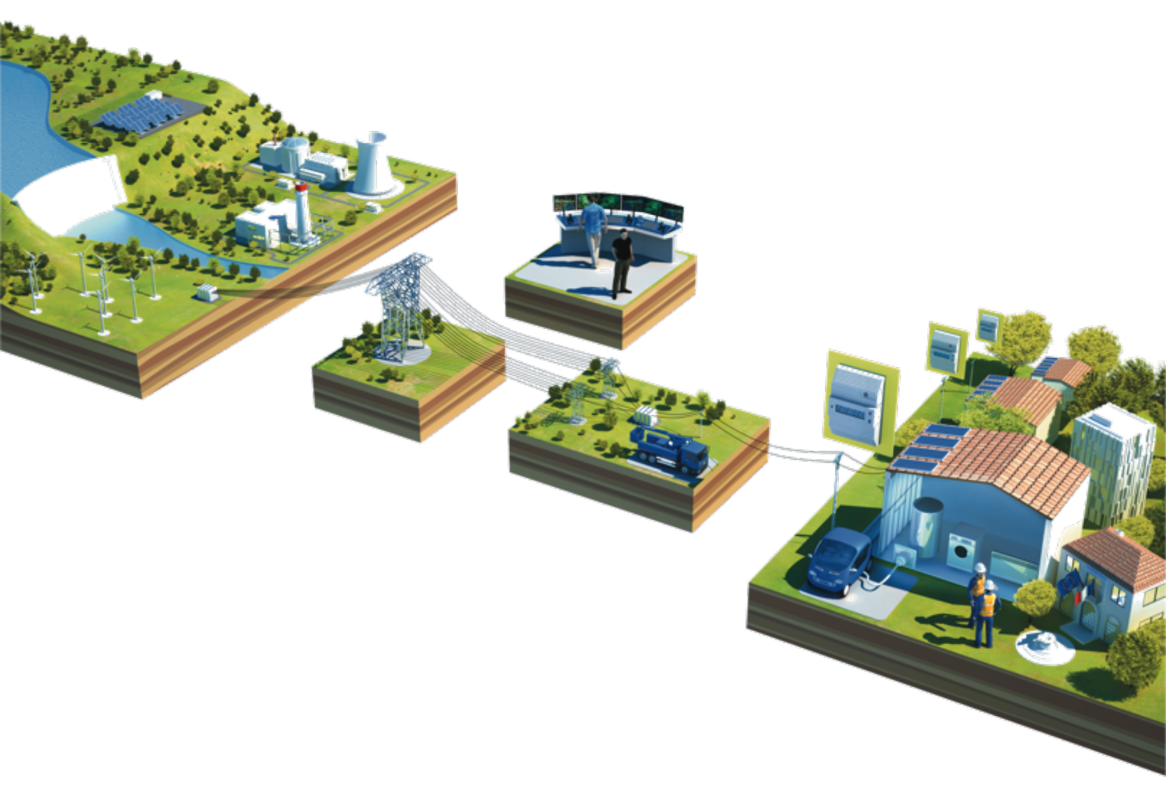

Perspective from large Energy Utilities
Global Standards Challenges
ITU – GSS – Dubai UAE – Nov 19th, 2012
V6

Slide 2
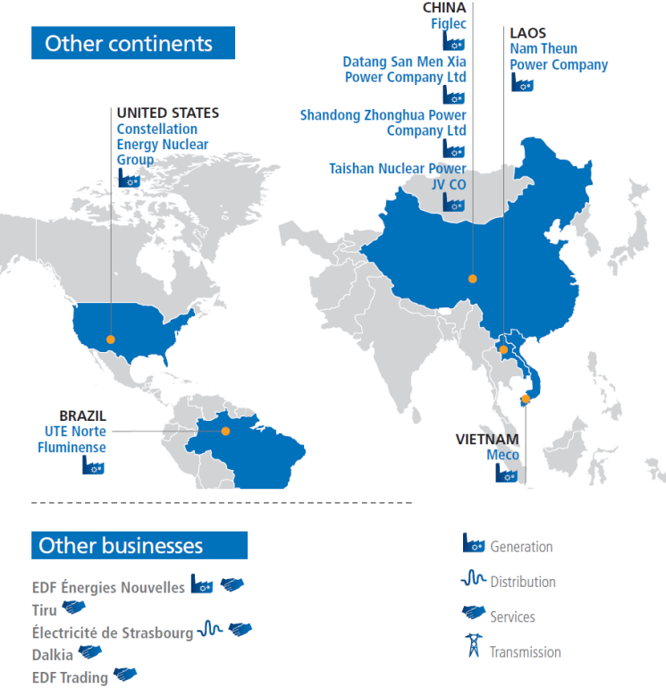
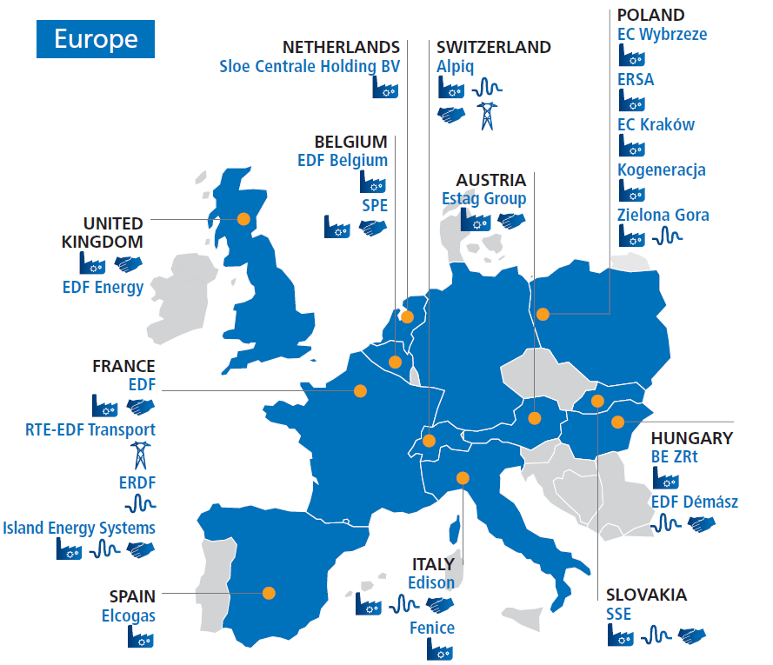
EDF in brief : a global energy leader
37 million
customers worldwide
630TWh
electricity generation
€65 billion
in sales (40% out of France)
109g of CO₂
per kWh generated
160,000
employees worldwide
Notes:
67% of world electricity generated with fossil fuels in 20101
2/3 world electricity generated with carbon-free energies: 2050 target (UN)
(CO₂ emissions from EDF Group electricity and heat generation)

Slide 3
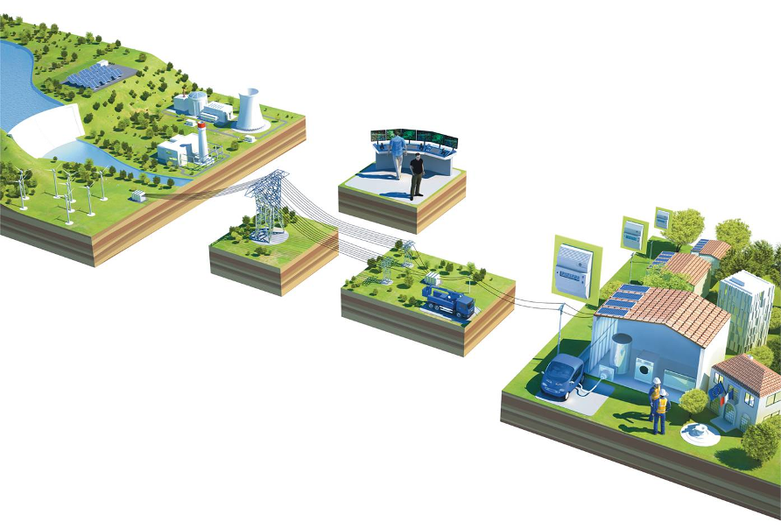

A bright outlook for smart grids
NETWORKS
Lower consumption peaks mean less
dependence on high-carbon generation
Clearer information
to raise awareness of energy saving strategies
Decarbonization of the energy mix
through a smoother integration
of renewable energies into networks
Billing based on actual
consumption
Smart
meter
Reduction in network losses to boost
competitivity of the system
Precision in targeted investments
for the maintenance
and modernization of networks
More efficient repairs to networks after extreme weather events
Promoting the development of electric transportation that emits fewer green house gases
New energy uses (e.g. electric mobility, storage, etc.)
Notes:
EDF is committed to developing smart grids
Changes in the distribution market are making it necessary for networks to become smart grids by integrating information and communication technologies. The idea is to create meshed networks equipped with remote control systems and software that can identify parts of the network that have been damaged and compensate for failures, or possibly optimize electricity distribution. Smart meters will be a key building block.
The Group’s distribution companies are helping to develop these new grids. ERDF participated with other European distributors in the launch of the EDSO for Smart Grids association, a forum for sharing experience and defining standards. In 2010, testing began in France with 300,000 Linky smart meters developed by ERDF. IES is coordinating the MILLENER project which tests smart systems integrating renewable energy generation on islands.
In the PACA region, Premio has become the first smart grid demonstration project on France’s low-voltage network. Managed by the Capenergies competitiveness cluster and co-financed by EDF (40%), this project involves having some 50 customers test technical solutions developed by local companies and laboratories. Premio relies on an innovative control unit, the algorithms for which were developed by EDF R&D. It controls a wide range of installations (small generating plants using renewable energy, heat pumps, public lighting, storage systems, etc.).
Individual smart meters are a key component of smart grids, but must send information under optimal conditions. For its Linky meter, ERDF opted to use power line communication (PLC) technology.

Slide 4
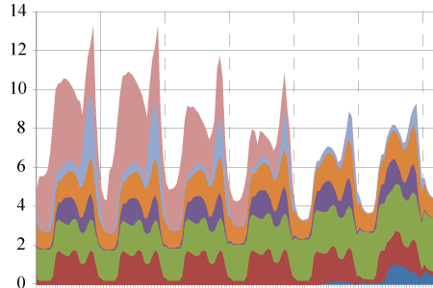
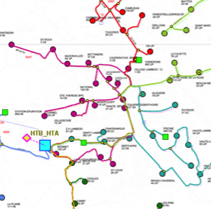
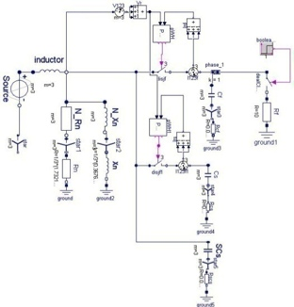
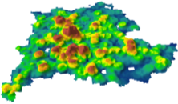
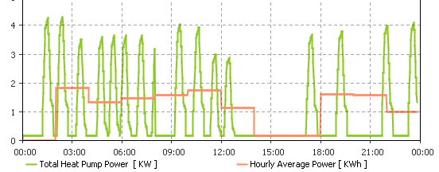
Needs are modeled and assessed on pilot projects
A portfolio of projects addressing parts of the « smart-grid puzzle »
  STANDARDIZED APPROACHES
    Description of the tested functions/processes (terminology, Use case, role model,…)
    Data exchange model and data collection
    Evaluation methods
    Scaling to full system size (set of hypothesis, methods, …)
  MODELING AND SIMULATION
    Extrapolation of field results
    Exploration beyond the scope of the field-test (new DR scenarii, # of customers, …)
    Consolidation of theorical models to work (beyond the pilots) on options for the power system new challenges

Slide 5
World market – what « investors » want
interoperability
common data
common
language
common behaviour
Equipment
Vendor A
Equipment
Vendor B
interchangeability
from specifications, not from blueprints
to allow competition for innovation !

Slide 6
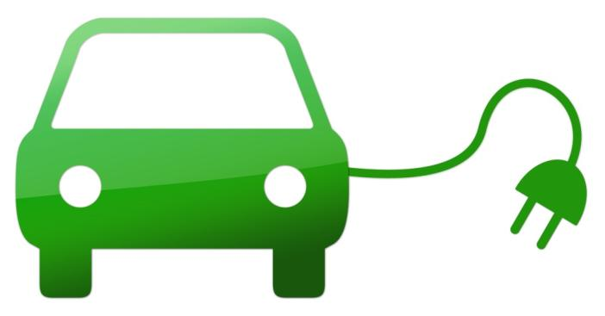
Overcoming the « ecosystems collision »
Entertainement
Telco
Home
Automation
Energy

Slide 7
Highways vs Gateways conundrum?
Electric
sector
Consumer device
Consumer device
Data
Consumer device
Consumer device
Consumer device
Consumer device
Consumer
device
Gateway
Gateway
Electric
sector
Gateway
Consumer device
Consumer device
Consumer device
Consumer device
Consumer device
Consumer device
Consumer device

Slide 8
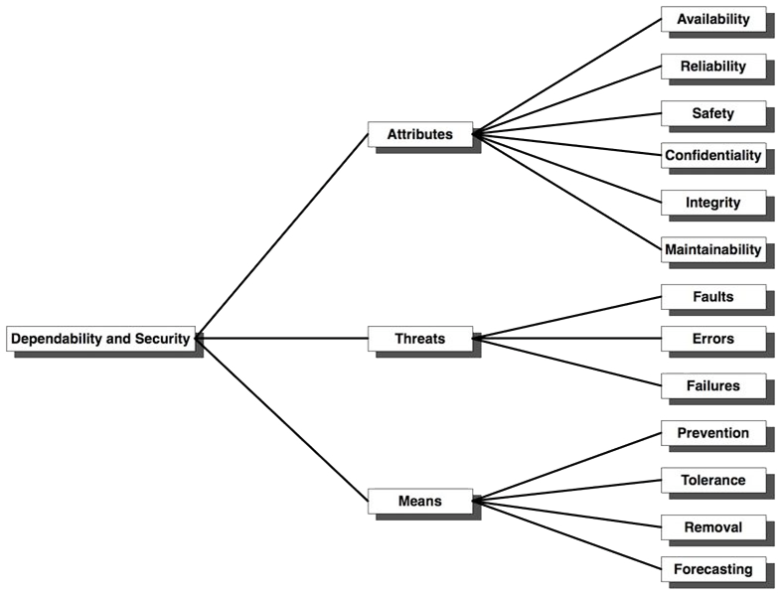
“The perfect is the enemy of the good”
(Voltaire 1764)
Dependability “just as needed” by design
IEC IEV 191-02-03
IEC TC 56

Slide 9
Conclusion
Diverse systems and infrastructures critical for consumers and the society have been developing independently
Value will be delivered only if the established ecosystems at least avoid colliding, but much better manage « smart » integration and convergence
Smart tradeoffs need to be managed taking into account the legacy and respecting the investments already made, while enabling reasonable incremental transitions towards dependable solutions
The never-ending evolution of ICT technologies provides increased capabilities for decreasing costs that enable incredibly more data for hopefully much more « intelligence » and new value

Slide 10





“SMART
GRIDS”
pilot projects
Thank you
"Representatives from ERDF may optionally be associated to the works, on condition that their attendance or participation in the debates is not conflicting with the principles (1) set out by laws and regulation enacted to ensure the independance of system operators.
(1) Particularly, governance, objectivity, non-discrimination, protection of commercial sensitive information and independance of the activities of distribution of system operators in comparison with the activities of production/supply."
10

