Slide 1
SG17 Tutorial session Introduction to ASTAP Expert Group Security (EG IS)
Miho Naganuma
Chairman, EG IS, ASTAP
LAC Co., Ltd.
4 September 2012

Slide 2
Standard works
OASIS
IETF
MITRE
FIRST
CSA
Etc.

Slide 3
APT
http://www.aptsec.org
founded on the joint initiatives of the United Nations Economic and Social Commission for Asia and the Pacific (UNESCAP) and ITU
Established in July 1979 as an Intergovernmental Organization operates in conjunction with telecom service providers, manufacturers of communications equipment, and research and development organizations active in the field of communication, information and innovation technologies
covers 38 member countries, with 4 associate members and 130 affiliate members
inputs for the preparation of Global conferences such as ITU Plenipotentiary Conference (PP), World Telecommunication Development Conference (WTDC), World Radiocommunication Conference (WRC), World Summit on the Information Society (WSIS), World Telecommunication Standardization Assembly (WTSA) and the ITU meetings

Slide 4
ASTAP
Asia-Pacific Telecommunity standardization Program
Objectives
to establish regional cooperation on standardization
to harmonize standardization activities in the region
to share knowledge and experience among APT members
to assist APT members to develop the skills in telecommunications/ICT areas
to enhance the level of expertise on standardization for telecommunications/ICT areas
to foster appropriate institutional arrangements for promotion

Slide 5
Structure
Working Group
Joint Coordination Group
Organization and Working Methods (OWM)
Industry relations (IR)
Strategic Plan (SP)
ITU-T Issues (ITU-T)
Service & System Operation (SSO)
Infrastructure & Network (I&N)
Policies, Regulatory and Strategies (PRS)
ICT & Climate Change (ICTCC)
Smart Grid (SG)
Bridging the Standardi-zation Gap (BSG)
IT Application & User related Issues (ITAU)

Slide 6
Security
JCG on IT Application & User related Issues (ITAU)
Expert Group on Security (IS)
Recommendations Reports
Expert Group on Next Generation Web (NGW)
Expert Group on Speech and Natural Language Processing (SNLP)
ITU-T
SG13 (Future Network) SG16 (Multimedia) SG17 (Security)
Expert Group on Accessibility and Usability (AU)
Chair: M Naganuma (Japan) Vice Chair: Dr. Heuisu Ryu (R.of Korea)

Slide 7
Activities
Survey of security issues
Promotion of exchange of views and strong relationships on Information Security
Contribution to standardization activities on Information Security in international standardization organizations such as ITU-T
Provide assistance to the lead Study Group of Security, ITU-T SG17.
NGN
Cybersecurity
Telebiometrics
Secure application services
Security aspects of ubiquitous telecommunication services
Malware

Slide 8
The 20th meeting result (July 2012)
34 contributions from Korea and ETRI
Report of the Questionnaire on information security
Input for Plan of Action on “Bali Statement of the Asia-Pacific Ministers on Strengthening Regional Collaboration towards a Broadband Economy in the Asia-Pacific”
At the Asia Pacific Ministerial Meeting on strengthening regional collaboration towards Broadband Economy in November 2009
Future work – Security handbook based on the result of questionnaire

Slide 9
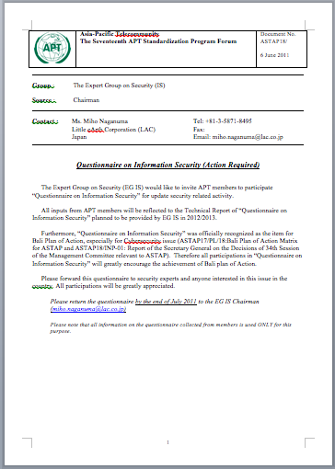
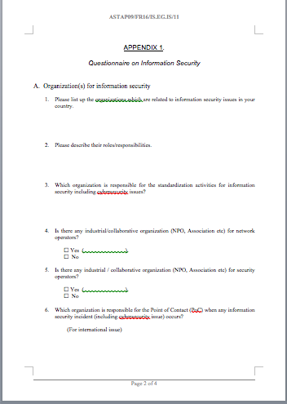
Questionnaire on Information Security
Started in 2010 to enhance mutual understanding and exchange practices on countermeasures/actions in the Region
Input from 8 sector members
Contribution for Bali Plan of Action
Will be distributed to APT members
Will be used for effective outputs at EG IS

Slide 10
Questionnaire
Purpose
To understand efforts and countermeasures in each APT member and to identify the issues and topics which needs to be standardized or to be brought to discussions in ASTAP by collecting and sharing related information.
2 sections
Organization(s) of information security
EG IS activities in ASTAP

Slide 11
Questionnaire – section A
Please list up the organizations which are related to information security issues in your country.
Please describe their roles/responsibilities.
Which organization is responsible for the standardization activities for information security including cybersecurity issue
Is there any industrial/collaborative organization (NPO, Association etc) for network operators?
Is there any industrial / collaborative organization (NPO, Association etc) for security operators?

Slide 12
Questionnaire – section A (cont.)
Which organization is responsible for the Point of Contact (PoC) when any information security incident (including cybersecurity issue) occurs? (For international issue)(For domestic issue)
What areas of security issue/technology (technologies) are concerned in your country?
Is there any special project, countermeasure, campaign for information security at the national level?
If yes, please describe details (owner, aim, timeline, detailed actions etc).
Please specify the contact point/enquire for this questionnaire by ASTAP.

Slide 13
Questionnaire – Section A (cont.)
Is there any participant in EG IS/ASTAP from your country?
If not, is there any particular reason for that?
◻ Lack of resources
◻ No need to consider security issue
◻ Other (Please specify)
There is a Mailing List in EG IS for some topics related information security and cybersecurity. Is it possible to add someone to the EG IS ML and to join discussions from your country? If yes, please indicate the expert.

Slide 14
A.1 Organizations
Typical 5 patterns for dealing with security issues
mainly dealt by national computer incident response team (N-CIRT),
mainly dealt by ministries in the government,
dealt by government, police and N-CIRT
dealt by combination of governments including ministries, police, N-CIRT and non-government organizations mainly for telecommunications
dealt by combination of governments including ministries, police, N-CIRT, and non-government organizations for various industrial (not only for telecommunication but also for security industry including CERT/CC)

Slide 15
A.1 Organizations
organization structure will include various stakeholders and organizations as security issues become complex.
Since pattern 4) onwards, both public and private sector are also included and such situations require balanced collaborations between both sectors.

Slide 16
A.2 Roles and responsibilities
Roles/responsibilities of the organizations clearly include;
Developing law, regulation and policy
Technical implementations
Incident handling / Investigation of cybercrime
1) is taken responsibilities by a government, 2) and 3) are taken by government only or combination with government and private sectors.
In many cases, 2) and 3) are monitored/implemented with private sector’s efforts, where necessary.

Slide 17
A.7 Security concerns
[Security issues]
Malware
Bot, Virus
SPAM
Phishing
Online fraud
DDos attack
[Security technologies]
Network monitoring
Ethical hacking
Digital forensic analysis
Penetration testing skills
IPS
Next generation F/W
Honey net
Incident handling tools
[Others]
Security countermeasures in SMEs
Computer crime
Network infrastructure
Regulation on information security
Technology misuse among young adults
Various certification scheme (ISMS, PCIDSS etc)

Slide 18
A.9 Security project
Special campaign day for secure and clean PC
Anti-bot measure project
National security programme
24/7 Internet security operation center (SOC)
Cyber Remediation System
Or
No specific project
4 countries have special occasion for information security or cybersecurity at the national level.
All countries take actions for raising security awareness to all citizens and in addition, 2 countries provides national campaign for BOTNET and malware countermeasures. 1 country operates a nation-wide network monitoring/alert system.

Slide 19
Considerations -1
Roles, responsibilities and capabilities
Organization structure
Sharing best practice.

Slide 20
Considerations -2
Clear roles, responsibilities and capabilities for information security and cybersecurity
Several types of organization structure in accordance with various conditions in each country
Necessity of collaborations between public and private sectors that strongly require balance collaborations among stakeholders within a country

Slide 21
Considerations -3
Facing to the same security, while the organization structure varies among the region
A place for sharing and discussion on the best practices (To identifying useful topics for standardization based on the discussion)
Keeping the surveys regularly for updating the information among the members

Slide 22
Next step: Challenges and opportunities
Resource allocation
Raise security (cybersecurity) level and awareness
Importance of regional collaboration
Enhance collaboration with SG17 ITU-T and it’s proof of concept, e.g. CYBEX
Developing Standards/Recommendation in local language
Developing document for specific topics as e.g Handbook

