Slide 1
ITU-T Study Group 17
Security
An overview for newcomers
Arkadiy Kremer
ITU-T SG17 chairman
8 September 2015

Slide 2
Contents
Importance of telecommunication/ICT security standardization
ITU Plenipotentiary Conference (PP-14) actions on ICT security
World Telecommunications Standardization Assembly (WTSA-12) mandate for Study Group 17
Study Group 17 overview
  SG17 current activities
Security Coordination
Future meetings
Useful references
  Backup – SG17 Security Recommendations

Slide 3
Importance of telecommunication/ICT security standardization (1/4)
  National laws are oftentimes inadequate to protect against attacks.
  They are insufficient from the timing perspective
  (i.e. laws cannot keep up with the pace of technological change),
  and, since attacks are often transnational, national laws may well be inapplicable anyway.
  What this means is that the defenses must be largely technical, procedural and administrative; i.e. those that can be addressed in standards.
  The development of standards in an open forum that comprises international specialists from a wide variety of environments and backgrounds provides the best possible opportunity to ensure relevant, complete and effective standards.
  SG17 provides the environment in which such standards can be, and are being, developed.

Slide 4
Importance of telecommunication/ICT security standardization (2/4)
  The primary challenges are the time it takes to develop a standard (compared to the speed of technological change and the emergence of new threats) and the shortage of skilled and available resources.
  We must work quickly to respond to the rapidly-evolving technical and threat environment but we must also ensure that the standards we produce are given sufficient consideration and review to ensure that they are complete and effective.
  We must recognize and respect the differences in developing countries respective environments: their telecom infrastructures may be at different levels of development from those of the developed countries; their ability to participate in, and contribute directly to the security standards work may be limited by economic and other considerations; and their needs and priorities may be quite different.

Slide 5
Importance of telecommunication/ICT security standardization (3/4)
  ITU-T can help the developing countries by fostering awareness of the work we are doing (and why we are doing it), by encouraging participation in the work particularly via the electronic communication facilities now being used (e.g. web based meetings and teleconferencing), and, most particularly, by encouraging the members from the developing countries to articulate their concerns and priorities regarding the telecommunication/ICT security.
  The members from the developed nations should not confuse their own needs with those of the developing countries, nor should they make assumptions about what the needs and priorities of the developing countries may be.

Slide 6
Importance of telecommunication/ICT security standardization (4/4)
  For on-going credibility, we need performance measures that provide some indication of the effectiveness of our standards. In the past there has been too much focus on quantity (i.e. how many standards are produced) than on the quality and effectiveness of the work.
  Going forward, we really need to know which standards are being used (and which are not being used), how widely they are used, and how effective they are.
  This is not going to be easy to determine but it would do much more to the ITU-T’s credibility if it could demonstrate the value and effectiveness of standards that have been developed rather than simply saying “we produced x number of standards”.
  The number of standards produced is irrelevant: what counts is the impact they have.

Slide 7
Importance of telecommunication/ICT security standardization
ITU Plenipotentiary Conference (PP-14) actions on ICT security
World Telecommunications Standardization Assembly (WTSA-12) mandate for Study Group 17
Study Group 17 overview
  SG17 current activities
Security Coordination
Future meetings
Useful references
  Backup – SG17 Security Recommendations

Slide 8
ITU Plenipotentiary Conference 2014 (1/2)
Strengthened the role of ITU in telecommunication/ICT security:
  Strengthening the role of ITU in building confidence and security in the use of information and communication technologies (Res. 130)
  The use of telecommunications/information and communication technologies for monitoring and management in emergency and disaster situations for early warning, prevention, mitigation and relief (Res. 136).
  ITU's role with regard to international public policy issues relating to the risk of illicit use of information and communication technologies (Res. 174)
  ITU role in organizing the work on technical aspects of telecommunication networks to support the Internet (Res. 178)
  ITU's role in child online protection (Res. 179)
  Definitions and terminology relating to building confidence and security in the use of information and communication technologies (Res. 181)

Slide 9
ITU Plenipotentiary Conference 2014 (2/2)
New Resolutions:
  Combating counterfeit telecommunication/ information and communication technology devices (Resolution 188)
  Assisting Member States to combat and deter mobile device theft (Resolution 189)
  Facilitating the Internet of Things to prepare for a globally connected world (Resolution 197)
  To promote efforts for capacity building on software-defined networking in developing countries (Resolution 199)
  Creating an enabling environment for the deployment and use of information and communication technology applications
  (Resolution 201)
  Connect 2020 Agenda for global telecommunication/ information and communication technology development (Resolution 200).

Slide 10
Importance of telecommunication/ICT security standardization
ITU Plenipotentiary Conference (PP-14) actions on telecommunication/ICT security
World Telecommunications Standardization Assembly (WTSA-12) mandate for Study Group 17
Study Group 17 overview
  SG17 current activities
Security Coordination
Future meetings
Useful references
  Backup – SG17 Security Recommendations

Slide 11
ITU-T SG17 mandate established by World Telecommunication Standardization Assembly (WTSA-12)
WTSA-12 decided the following for ITU-T Study Group 17:
Title: Security
  Responsible for building confidence and security in the use of information and communication technologies (ICTs). This includes studies relating to cybersecurity, security management, countering spam and identity management. It also includes security architecture and framework, protection of personally identifiable information, and security of applications and services for the Internet of things, smart grid, smartphone, IPTV, web services, social network, cloud computing, mobile financial system and telebiometrics. Also responsible for the application of open system communications including directory and object identifiers, and for technical languages, the method for their usage and other issues related to the software aspects of telecommunication systems, and for conformance testing to improve quality of Recommendations.
Lead Study Group for:
  Security
  Identity management
  Languages and description techniques
Responsible for specific E, F, X and Z series Recommendations
Responsible for 12 Questions

Slide 12
ITU-T SG17 Management Team
Chairman | Arkadiy KREMER | Russian Federation
Vice-Chairmen |  | United Arab Emirates
 | Mohamed M.K. ELHAJ | Sudan
 | Antonio GUIMARAES | Brazil
 | George LIN | P.R. China
 | Patrick MWESIGWA | Uganda
 | Koji NAKAO | Japan
 | Mario FROMOW RANGEL | Mexico
 | Sacid SARIKAYA | Turkey
 | Heung Youl YOUM | Korea (Republic of)

Slide 13
Importance of telecommunication/ICT security standardization
ITU Plenipotentiary Conference (PP-14) actions on telecommunication/ICT security
World Telecommunications Standardization Assembly (WTSA-12) mandate for Study Group 17
Study Group 17 overview
  SG17 current activities
Security Coordination
Future meetings
Useful references
  Backup – SG17 Security Recommendations

Slide 14
ITU-T Study Group 17 Overview
Primary focus is to build confidence and security in the use of Information and Communication Technologies (ICTs)
Meets twice a year. Last meeting had 147 participants from 28 Member States, 15 Sector Members, 3 Associates, and 5 Academia.
As of 8 September 2015, SG17 is responsible for 334 approved Recommendations, 22 approved Supplements and 3 approved Implementer’s Guides in the E, F, X and Z series.
Large program of work:
  8 new work items added to work program in 2015
  Results of April 2015 meeting: approval of 1 Recommendation,
  1 Amendment; 1 Supplements, 1 Implementer’s Guide,
  3 Recommendations in TAP;
  89 new or revised Recommendations and other texts are currently under development (+3 in TAP)
Work organized into 5 Working Parties with 12 Questions
4 Correspondence groups,
6 interim Rapporteur groups meetings took place.
See SG17 web page for more information
http://itu.int/ITU-T/go/sg17

Slide 15
ITU-T SG17, Security
Study Group 17
WP 1/17
Fundamental security
WP 2/17
Network and information security
WP 3/17
IdM + Cloud computing security
WP 4/17
Application security
WP 5/17
Formal languages
Q1/17
Telecom./ICT security coordination
Q4/17
Cybersecurity
Q8/17
Cloud Computing Security
Q6/17
Ubiquitous
services
Q11/17
Directory,
PKI, PMI, ODP, ASN.1, OID, OSI
Q2/17
Security architecture and framework
Q5/17
Countering spam
Q10/17
IdM
Q7/17
Applications
Q12/17
Languages + Testing
Q3/17
ISM
Q9/17
Telebiometrics

Slide 16
SG17, Working Party Structure
WP 1 “Fundamental security” Chairman: Koji NAKAO
  Q1/17 Telecommunication/ICT security coordination
  Q2/17 Security architecture and framework
  Q3/17 Telecommunication information security management
WP 2 “Network and information security” Chairman: Sacid SARIKAYA
  Q4/17 Cybersecurity
  Q5/17 Countering spam by technical means
WP 3 “Identity management and cloud computing security” Chairman: Heung Youl YOUM
  Q8/17 Cloud computing security
  Q10/17 Identity management architecture and mechanisms
WP 4 “Application security” Chairman: Antonio GUIMARAES
  Q6/17 Security aspects of ubiquitous telecommunication services
  Q7/17 Secure application services
  Q9/17 Telebiometrics
WP 5 “Formal languages” Chairman: George LIN
  Q11/17 Generic technologies to support secure applications
  Q12/17 Formal languages for telecommunication software and testing

Slide 17
Study Group 17 is the Lead Study Group on:
● Security
● Identity management (IdM)
● Languages and description techniques
A study group may be designated by WTSA or TSAG as the lead study group for ITU‑T studies forming a defined programme of work involving a number of study groups.
This lead study group is responsible for the study of the appropriate core Questions.
In addition, in consultation with the relevant study groups and in collaboration, where appropriate, with other standards bodies, the lead study group has the responsibility to define and maintain the overall framework and to coordinate, assign (recognizing the mandates of the study groups) and prioritize the studies to be carried out by the study groups, and to ensure the preparation of consistent, complete and timely Recommendations.
* Extracted from WTSA-12 Resolution 1

Slide 18
SG17 is “Parent” for Joint Coordination Activities (JCAs) on:
● Identity management
● Child online protection
A joint coordination activity (JCA) is a tool for management of the work programme of ITU-T when there is a need to address a broad subject covering the area of competence of more than one study group. A JCA may help to coordinate the planned work effort in terms of subject matter, time-frames for meetings, collocated meetings where necessary and publication goals including, where appropriate, release planning of the resulting Recommendations.
The establishment of a JCA aims mainly at improving coordination and planning. The work itself will continue to be conducted by the relevant study groups and the results are subject to the normal approval processes within each study group. A JCA may identify technical and strategic issues within the scope of its coordination role, but will not perform technical studies nor write Recommendations. A JCA may also address coordination of activities with recognized standards development organizations (SDOs) and forums, including periodic discussion of work plans and schedules of deliverables. The study groups take JCA suggestions into consideration as they carry out their work.
* Extracted from Recommendation ITU-T A.1

Slide 19
ITU-T Joint Coordination Activity on Child Online Protection (JCA-COP)
Purpose and objectives:
coordinates activity on COP across ITU-T study groups, in particular Study Groups 2, 9, 13, 15, 16 and 17, and coordinates with ITU-R, ITU-D and the Council Working Group on Child Online Protection
provides a visible contact point for COP in ITU-T
cooperates with external bodies working in the field of COP, and enables effective two-way communication with these bodies
Tasks:
Maintain a list of representatives for COP in each study group
Exchange information relevant to COP between all stakeholders; e.g. information from:
  Member States on their national efforts to develop COP related technical approaches and standards
  NGOs on their COP activities and on COP information repositories
  GSMA on an industry perspective on COP
Promote a coordinated approach towards any identified and necessary areas of standardization
Address coordination of activity with relevant SDOs and forums, including periodic discussion of work plans and schedules of deliverables on COP (if any)
JCA-COP co-chairmen:
  Ms Ashley Heineman, Mr Philip Rushton.

Slide 20




























Coordination on Child Online Protection
ITU-T JCA-COP
- ITU Member States
- ITU-SGx
- ITU CWG COP
- ITU-R, ITU-D

Slide 21
ITU-T Joint Coordination Activity on Identity Management (JCA-IdM)
Coordinates the ITU-T identity management (IdM) work.
Ensures that the ITU-T IdM work is progressed in a well-coordinated way between study groups, in particular with SG2, SG13 and SG17.
Analyzes IdM standardization items and coordinates an associated roadmap with ITU-T Q10/17.
Acts as a point of contact within ITU-T and with other SDOs/Fora on IdM in order to avoid duplication of work and assist in implementing the IdM tasks assigned by WTSA-12 Resolution 2 and in implementing GSC-17 Resolution 4 on identity management.
In carrying out the JCA-IdM’s external collaboration role, representatives from other relevant recognized SDOs/Fora and regional/national organizations may be invited to join the JCA-IdM.
Maintains IdM roadmap and landscape document/WIKI.
JCA-IdM co-chairmen:
Mr Abbie Barbir, Mr Hiroshi Takechi.

Slide 22




















IdM Coordination with other bodies
ITU-T JCA-IdM
ITU-SGx

Slide 23
Importance of telecommunication/ICT security standardization
ITU Plenipotentiary Conference (PP-14) actions on telecommunication/ICT security
World Telecommunications Standardization Assembly (WTSA-12) mandate for Study Group 17
Study Group 17 overview
  SG17 current activities
Security Coordination
Future meetings
Useful references
  Backup – SG17 Security Recommendations

Slide 24
Working Party 1/17
Fundamental security
Chairman: Koji NAKAO
Q1/17 Telecommunication/ICT security coordination
Q2/17 Security architecture and framework
Q3/17 Telecommunication information security management

Slide 25
Question 1/17
Telecommunication/ICT security coordination
Security Coordination
  Coordinate security matters within SG17, with ITU-T SGs, ITU-D, ITU-R and externally with other SDOs
  Maintain reference information on LSG security webpage
ICT Security Standards Roadmap
  Searchable database of approved ICT security standards from ITU-T, ISO/IEC, ETSI and others
Security Compendium
  Catalogue of approved security-related Recommendations and security definitions extracted from approved Recommendations
ITU-T Security Manual
  5th edition was published in January 2013
  X.TRSM6ed, Technical Report 6th edition under development
X.TRsuss, Technical Report on the successful use of security standards
Promotion (ITU-T security work and attract participation)
Security Workshops
For agreement

Slide 26
Question 1/17 (cnt’d)
Telecommunication/ICT security coordination
SG17 Strategic Plan / Vision for SG17
Internal SG17 Coordination
  Terminology issues that impact users of Recommendations
  References in Recommendations to withdrawn standards
  Guidelines for correspondence groups
  Quality of standards
  Regional and sub-regional coordinators for SG17
  Actions/achievements in support of WTSA, PP, WTDC Resolutions
Bridging the standardization gap
Rapporteur: Mr Mohamed M.K. ELHAJ
26/117

Slide 27
Question 2/17
Security Architecture and Framework
Responsible for general security architecture and framework for telecommunication systems
2 Recommendations and 4 Supplements approved in last study period
1 Recommendation and 1 Supplement approved in this study period
Recommendations currently under study include:
  X.gsiiso, Guidelines on security of the individual information service for
  operators
  X.sdnsec-2, Security requirements and reference architecture for
  Software-Defined Networking
  X.tigsc, Technical implementation guidelines for ITU-T X.805
  X.sgmvno, Supplement to ITU-T X.805 – Security guideline for mobile
  virtual network operator (MVNO)
Relationships with ISO/IEC JTC 1 SCs 27 and 37, IEC TC 25, ISO TC 12, IETF, ATIS, ETSI, 3GPP, 3GPP2
Rapporteur: Mr Patrick MWESIGWA

Slide 28
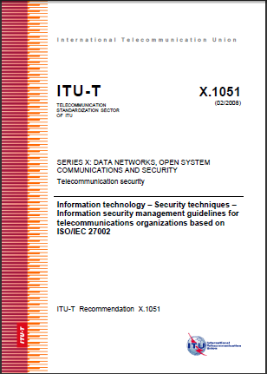
Question 3/17
Telecommunication information security management
Responsible for information security management - X.1051, etc.
5 Recommendations approved in last study period
Developing specific guidelines including:
  X.1051rev, Information technology – Security techniques – Information
  security management guidelines for telecommunications
  organizations based on ISO/IEC 27002
  X.gpim, Code of practice for personally identifiable information protection
  (common text with ISO/IEC 29151)
  X.sgsm, Information security management guidelines
  for small and medium telecommunication
  organizations
  X.sup-gpim, Supplement to ITU-T X.gpim
  Code of practice for personally identifiable
  information protection based on
  ITU-T X.gpim for telecommunications organizations
Close collaboration with ISO/IEC JTC 1/SC 27
Rapporteur: Ms Miho NAGANUMA

Slide 29
Working Party 2/17
Network and information security
Chairman: Sacid SARIKAYA
Q4/17 Cybersecurity
Q5/17 Countering spam by technical means

Slide 30
Question 4/17
Cybersecurity
Cybersecurity by design no longer possible; a new paradigm:
  know your weaknesses → minimize the vulnerabilities
  know your attacks → share the heuristics within trust communities
Current work program (6 Recommendations under development)
  X.1500 suite: Cybersecurity Information Exchange (CYBEX) – non-prescriptive, extensible, complementary techniques for the new paradigm
    Weakness, vulnerability and state
    Event, incident, and heuristics
    Information exchange policy
    Identification, discovery, and query
    Identity assurance
    Exchange protocols
  Non-CYBEX deliverables include compendiums and guidelines for
    Abnormal traffic detection
    Botnet mitigation
    Attack source attribution (including traceback)
Extensive relationships with many external bodies
Rapporteur: Mr Youki KADOBAYASHI

Slide 31
Question 4/17 (cnt’d)
Cybersecurity
16 Recommendations and 3 Supplements approved in last study period
12 Recommendations and 3 Supplements approved in this study period
Recommendation in TAP approval process

Slide 32
Question 4/17 (cnt’d)
Cybersecurity
Recommendations on CYBEX currently under study include:
  X.1500 Amd.8, Overview of cybersecurity information exchange –
  Amendment 8 - Revised structured cybersecurity
  information exchange techniques
  X.nessa, Access control models for incidents exchange networks
  X.simef, Session information message exchange format (SIMEF)
Recommendations (non-CYBEX) currently under study include:
  X.cogent, Design considerations for improved end-user perception of trustworthiness indicators
  X.samtn, Security assessment techniques in telecommunication/ICT
  networks
  X.sbb, Security capability requirements for countering smartphone-based botnets
For agreement

Slide 33
Question 5/17
Countering spam by technical means
Lead group in ITU-T on countering spam by technical means in support of WTSA-12 Resolution 52 (Countering and combating spam)
3 Recommendations and 4 Supplements approved in last study period
Recommendations currently under study include (see structure in next slide):
  X.1246 (X.ticvs), Technologies involved in countering voice spam in
  telecommunication organizations
  X.cspim, Technical requirements for countering instant messaging spam
  (SPIM)
  X.tfcmm, Technical framework for countering mobile messaging spam
  X.gcsfmpd, Supplement to Rec. ITU-T X.1231 on guidance of countering
  spam for mobile phone developers
  X.gcspi, Supplement to ITU-T X.1242 – Guideline for countermeasures
  against short message service (SMS) phishing incidents
  X.ticsc, Supplement to ITU-T X.1245 – Technical measures and mechanism
  on countering the spoofed call in the visited network of VoLTE
Effective cooperation with ITU-D, IETF, ISO/IEC JTC 1, 3GPP, OECD, M3AAWG, ENISA and other organizations
Rapporteur: Mr Hongwei LUO
For approval
For determ

Slide 34
Question 5/17 (cnt’d)
Countering spam by technical means
Technical strategies on countering spam
(X.1231)
Technologies involved in countering e-mail spam
(X.1240)
Overall aspects of countering spam in IP-based multimedia applications
(X.1244)
Overall aspects of countering mobile messaging spam
(X-series Supplement 12 to ITU-T X.1240)
Technical framework for countering e-mail spam
(X.1241)
Framework for countering IP multimedia spam
(X.1245)
Framework based on real-time blocking list (RBL) for countering VoIP spam
(X-series Supplement 11 to ITU-T X.1245)
Technical framework for countering mobile messaging spam
(X.tfcmm)
Technical requirements for countering instant messaging spam (SPIM)
(X.cspim)
A practical reference model for countering e-mail spam using botnet information
(X-series Supplement 14 to ITU-T X.1243)
Technologies involved in countering voice spam in telecommunication organizations
(X.ticvs)
Supplement to ITU-T X.1245, Technical measures and mechanism on countering the spoofed call in the visited network of VoLTE
(X.ticsc)
Short message service (SMS) spam filtering system based on user-specified rules
(X.1242)
Supplement to ITU-T X.1242, Guideline for countermeasures against short message service (SMS) phishing incidents
(X.gcspi)
Interactive gateway system for countering spam
(X.1243)
Supplement on countering spam and associated threats
(X-series Supplement 6 to ITU-T X.1240 series)
34/117

Slide 35
Working Party 3/17
Identity management and cloud computing security
Q8/17 Cloud computing security
Q10/17 Identity management architecture and mechanisms

Slide 36
Question 8/17
Cloud computing security
2 Recommendations approved in this study period.
Recommendations currently under study include:
  Security aspects of cloud computing
    X.1601rev, Security framework for cloud computing
    X.CSCDataSec, Guidelines for cloud service customer data security
    X.goscc, Guidelines of operational security for cloud computing
  Security aspects of service oriented architecture
    X.sfcsc, Security functional requirements for SaaS application
    environment
Working closely with ITU-T SG 13, JCA-Cloud, ISO/IEC JTC 1/SCs 27 and 38, and Cloud Security Alliance on cloud computing
Rapporteur: Mr Liang WEI
For determ
For determ
For determ

Slide 37
Question 8/17
Cloud computing security
Structure of Q8/17 Recommendations
Overview
X.1601: Security framework for cloud computing
Security
design
X.1602 - X.1619
Security requirements
(e.g. X.sfcse), Security capabilities
X.1620 - X.1629
Trust models
Security architectures/ functions
X.1630 - X.1639
Security controls (e.g. X.cc-control)
Best practices
and guidelines
X.1640 - X.1659
Best practices / guidelines (e.g. X.goscc)
Security
implementation
X.1660 - X.1669
Security solutions
Security mechanisms
X.1670 - X.1679
Incident management,
disaster recovery
Security assessment and audit
Others
X.1680 - X.1699
Others
37/117

Slide 38
Question 10/17
Identity Management (IdM)
Identity Management (IdM)
  IdM is a security enabler by providing trust in the identity of both parties to an e-transaction
  IdM also provides network operators an opportunity to increase revenues by offering advanced identity-based services
  The focus of ITU-T’s IdM work is on global trust and interoperability of diverse IdM capabilities in telecommunication.
  Work is focused on leveraging and bridging existing solutions
  This Question is dedicated to the vision setting and the coordination and organization of the entire range of IdM activities within ITU-T
Key focus
  Adoption of interoperable federated identity frameworks that use a variety of authentication methods with well understood security and privacy
  Encourage the use of authentication methods resistant to known and projected threats
  Provide a general trust model for making trust-based authentication decisions between two or more parties
  Ensure security of online transactions with focus on end-to-end identification and authentication of the participants and components involved in conducting the transaction, including people, devices, and services
8 Recommendations and 1 Supplement approved in last study period.
1 Recommendation approved in this study period

Slide 39
Question 10/17 (cnt’d)
Identity Management (IdM)
Recommendations under development:
  X.authi, Guideline to implement the authentication integration of the network layer and the
  service layer.
  X.eaaa, Enhanced entity authentication based on aggregated attributes
  X.iamt, Identity and access management taxonomy
  X.1255sup, Supplement to Recommendation ITU-T X.1255 – Proposed conceptual models
  based on ITU-T X.1255 frameworks
Engagement
  JCA-IdM
  Related standardization bodies: ISO/IEC JTC 1 SCs 6, 27 and 37; IETF; ATIS;
  ETSI INS ISG, OASIS; Kantara Initiative; OMA; NIST; 3GPP; 3GPP2; Eclipse;
  OpenID Foundation; OIX etc.
Rapporteur: Mr Abbie BARBIR
For determ
For determ
For agreement

Slide 40
Working Party 4/17
Application Security
Q6/17 Security aspects of ubiquitous telecommunication services
Q7/17 Secure application services
Q9/17 Telebiometrics

Slide 41
Question 6/17
Security aspects of ubiquitous telecommunication services
Responsible for multicast security, home network security, mobile security, networked ID security, IPTV security, ubiquitous sensor network security, intelligent transport system security, and smart grid security
13 Recommendations approved in last study period.
2 Recommendations and 2 Supplements approved in this study period.
Recommendations currently under study include:
  X.iotsec-1, Simple encryption procedure for IoT device security
  X.iotsec-2, Security framework for Internet of Things
  X.itssec-1, Software update capability for ITS communications devices
  X.itssec-2, Security guidelines for V2X communication systems
  X.msec-7, Guidelines on the management of infected terminals in mobile networks
  X.msec-9, Functional security requirements and architecture for mobile phone
  anti-theft measures
  X.sdnsec-1, Requirements for security services based on software-defined
  networking
  X.sgsec-1, Security functional architecture for smart grid services using
  telecommunication network
  X.sgsec-2, Security guidelines for home area network (HAN) devices in smart grid
  systems
  X.unsec-1, Security requirements and framework of ubiquitous networking
Close relationship with JCA-IPTV and ISO/IEC JTC 1/SC 6/WG 7
Rapporteur: Mr Jonghyun BAEK
For consent
For consent

Slide 42
Question 7/17
Secure application services
Responsible for web security, security protocols, peer-to-peer security
2 Recommendations, and 1 Supplement approved in last study period
7 Recommendations, and 2 Supplements approved in this study period
Recommendations currently under study include:
  X.1157 (X.sap-7), Technical capabilities of fraud detection and response for services with
  high assurance level requirements
  X.sap-5, Guideline on local linkable anonymous authentication for electronic services
  X.websec-6, Security framework and requirements for open capabilities of
  telecommunication services
  X.websec-7, Reference monitor for online analytics services
Relationships include: OASIS, OMA, W3C, ISO/IEC JTC 1/SC 27,
Kantara Initiative
Rapporteur: Mr Jae Hoon NAH
For approval
For consent

Slide 43
Question 9/17
Telebiometrics
Current focus:
  Security requirements and guidelines for applications of telebiometrics
  Requirements for evaluating security, conformance and interoperability with privacy protection techniques for applications of telebiometrics
  Requirements for telebiometric applications in a high functionality network
  Requirements for telebiometric multi-factor authentication techniques based on biometric data protection and biometric encryption
  Requirements for appropriate generic protocols providing safety, security, privacy protection, and consent “for manipulating biometric data” in applications of telebiometrics, e.g., e-health, telemedicine
11 Recommendations approved in last study period.
1 Recommendation approved in this study period.

Slide 44
Question 9/17 (cnt’d)
Telebiometrics
Recommendations under development:
  X.bhsm, Information technology – Security Techniques – Telebiometric
  authentication framework using biometric hardware security module
  X.pbact, Privacy-based access control in Telebiometrics
  X.tam, A guideline to technical and operational countermeasures for telebiometric
  applications using mobile devices
  X.th-series, e-Health and world-wide telemedicines
    X.th2, Telebiometrics related to physics
    X.th3, Telebiometrics related to chemistry
    X.th4, Telebiometrics related to biology
    X.th5, Telebiometrics related to culturology
    X.th6, Telebiometrics related to psychology
    X.th13, Holosphere to biosphere secure data acquisition and telecommunication protocol
Close working relationship with ISO/IEC JTC 1/SCs 17, 27 and 37, ISO TCs 12, 68 and 215, IEC TC 25, IETF, IEEE
Rapporteur: Mr John CARAS

Slide 45
Working Party 5/17
Formal languages
Chairman: George LIN
Q11/17 Generic technologies to support secure applications
Q12/17 Formal languages for telecommunication software and testing

Slide 46
Question 11/17
Generic technologies to support secure applications
Q11/17 consists of four main parts:
  X.500 directory, Public-Key Infrastructure (PKI), Privilege Management Infrastructure (PMI)
  Abstract Syntax Notation 1 (ASN.1), Object Identifier (OID)
  Open Distributed Processing (ODP)
  Open Systems Interconnection (OSI)
Rapporteur: Mr Erik ANDERSEN

Slide 47
Question 11/17
Generic technologies to support secure applications
(parts: Directory, PKI, PMI)
Three Directory Projects:
  ITU-T X.500 Series of Recommendations | ISO/IEC 9594 - all parts – The Directory
  ITU-T E.115 - Computerized directory assistance
  ITU-T F.511 - Directory Service - Support of tag-based identification services
X.500 series is a specification for a highly secure, versatile and distributed directory
X.500 work is collaborative with ISO/IEC JTC 1/SC 6/WG 10
20 Recommendations and many Corrigenda approved in last study period.

Slide 48
Question 11/17
Generic technologies to support secure applications
(parts: Directory, PKI, PMI)
Recommendations under development:
  X.500rev (8th ed), Information technology – Open Systems Interconnection – The Directory: Overview of
  concepts, models and services
  X.501rev (8th ed), Information technology – Open Systems Interconnection – The Directory – Models
  X.509rev (8th ed), Information technology – Open Systems Interconnection – The Directory – Public-key and
  attribute certificate frameworks
  X.511rev (8th ed), Information technology – Open Systems Interconnection – The Directory – Abstract
  Service Definition
  X.518rev (8th ed), Information technology – Open Systems Interconnection – The Directory – Procedures for
  Distributed Operations
  X.519rev (8th ed), Information technology – Open Systems Interconnection – The Directory – Protocols
  X.520rev (8th ed), Information technology – Open Systems Interconnection – The Directory – Selected
  Attribute Types
  X.521rev (8th ed), Information technology – Open Systems Interconnection – The Directory – Selected object
  classes
  X.525rev (8th ed), Information technology – Open Systems Interconnection – The Directory – Replication
  X.1341 (X.cmail), Certified mail transport and certified post office protocols
  X.pki-em, Information Technology - Public-Key Infrastructure: Establishment and maintenance
  X.pki-prof, Information Technology - Public-Key Infrastructure: Profile
For approval
Notes:
X.509 Technical Corrigendum

Slide 49
Question 11/17
Generic technologies to support secure applications
(parts: Directory, PKI, PMI)
ITU-T X.509 on public-key/attribute certificates is the cornerstone for security:
  Base specification for public-key certificates and for attribute certificates
  Has a versatile extension feature allowing additions of new fields to certificates
  Basic architecture for revocation
  Base specification for Public-Key Infrastructure (PKI)
  Base specifications for Privilege Management Infrastructure (PMI)
ITU-T X.509 is used in many different areas:
  Basis for eGovernment, eBusiness, etc. all over the world
  Used for IPsec, cloud computing, and many other areas
  Is the base specification for many other groups
  (PKIX in IETF, ESI in ETSI, CA Browser Forum, etc.)

Slide 50
Question 11/17
Generic technologies to support secure applications
(parts: ASN.1, OID)
Developing and maintaining the heavily used Abstract Syntax Notation One (ASN.1) and Object Identifier (OID) specifications
Recommendations are in the X.680 (ASN.1), X.690 ( ASN.1 Encoding Rules), X.660/X.670 (OID Registration), and X.890 (Generic Applications, such as Fast Infoset, Fast Web services, etc) series
13 Recommendations and several Corrigenda approved in last study period
Giving advice on the management of OID Registration Authorities, particularly within developing countries, through the OID Project Leader Olivier Dubuisson
Approving new top arcs of the Object Identifier tree as necessary
Promoting use of OID resolution system by other groups such as SG16
Repository of OID allocations and a database of ASN.1 modules
Promoting the term “description and encoding of structured data” as what ASN.1 is actually about
ASN.1 Packed Encoding Rules reduces the bandwidth required for communication thus conserving energy (e.g., compared with XML)
Recommendations under development:
  X.cms, Cryptographic Message Syntax (CMS)
  X.oiddev, Information technology – Use of object identifiers to identify devices in the Internet of Things
  X.oid-iot, Supplement to ITU-T X-series – ITU-T X.660 - Guidelines for using object identifiers for the
  Internet of Things
Work is collaborative with ISO/IEC JTC 1/SC 6/WG 10
For consent

Slide 51
Question 11/17
Generic technologies to support secure applications
(part: ODP)
Open Distributed Processing (ODP)
  ODP (X.900 series in collaboration with ISO/IEC JTC 1/SC 7/WG 19)
  Two revised Recommendations approved in this study period
Work is carried out in collaboration with ISO/IEC JTC 1

Slide 52
Question 11/17
Generic technologies to support secure applications
(part: OSI)
Ongoing maintenance of the OSI X-series Recommendations and the OSI Implementer’s Guide:
  OSI Architecture
  Message Handling
  Transaction Processing
  Commitment, Concurrency and Recovery (CCR)
  Remote Operations
  Reliable Transfer
  Quality of Service
  Upper layers – Application, Presentation, and Session
  Lower Layers – Transport, Network, Data Link, and Physical
109 approved Recommendations (from former study periods)
Work is carried out in collaboration with ISO/IEC JTC 1

Slide 53
Question 12/17
Formal languages for telecommunication software and testing
Languages and methods for requirements, specification implementation
Q12/17 consists of three parts:
  Formal languages for telecommunication software
  Methodology using formal languages for telecommunication software
  Testing languages
18 Recommendations, 1 Amendment, 1 Implementer’s Guide approved in last study period.
4 new and 9 revised Recommendations, 1 Implementer’s Guide, 1 Supplement approved in this study period.
Rapporteur: Mr Dieter HOGREFE

Slide 54
Question 12/17
Formal languages for telecommunication software and testing
(part: Formal languages for telecommunication software)
Languages and methods for requirements, specification implementation
Recommendations for:
  Specification and Description Language (Z.100 series)
  Message Sequence Chart (Z.120 series)
  User Requirements Notation (Z.150 series)
  Framework and profiles for Unified Modeling Language, as well as use of languages
  (Z.110, Z.111, Z.400, Z.450).
These techniques enable high quality Recommendations to be written from which formal tests can be derived, and products to be cost effectively developed.
Relationship with SDL Forum Society

Slide 55
Question 12/17
Formal languages for telecommunication software and testing
(part: Methodology using formal languages for telecommunication software)
Covers the use of formal ITU system design languages (ASN.1, SDL, MSC, URN, TTCN, CHILL) to define the requirements, architecture, and behaviour of telecommunications systems: requirements languages, data description, behaviour specification, testing and implementation languages.
The formal languages for these areas of engineering are widely used in industry and ITU‑T and commercial tools support them. The languages can be applied collectively or individually for specification of standards and the realization of products, but in all cases a framework and methodology is essential for effective use.
Responsible for formal languages methodology Recommendations: Z.110, Z.400, Z.450, Z.600, Z.601, and Z.Supp1.

Slide 56
Question 12/17
Formal languages for telecommunication software and testing (1/2)
(part: Testing languages)
Testing and Test Control Notation version 3 (TTCN-3) under development:
  Z.161rev, Testing and Test Control Notation version 3: TTCN-3 core language
  Z.161.1rev, Testing and Test Control Notation version 3: TTCN-3 language extensions: Support of
  interfaces with continuous signals
  Z.161.2rev, Testing and Test Control Notation version 3: TTCN-3 language extensions: Configuration and
  deployment support
  Z.161.3rev, Testing and Test Control Notation version 3: TTCN-3 language extensions: Advanced
  parameterization
  Z.161.4rev, Testing and Test Control Notation version 3: TTCN-3 Language Extensions: Behaviour Types
  Z.161.5rev, Testing and Test Control Notation version 3: TTCN-3 Language extensions: Performance and
  real time testing
  Z.164rev, Testing and Test Control Notation version 3: TTCN-3 operational semantics
  Z.165rev, Testing and Test Control Notation version 3: TTCN-3 runtime interface (TRI)
  Z.165.1rev, Testing and Test Control Notation version 3: TTCN-3 extension package: Extended TRI
  Z.166rev, Testing and Test Control Notation version 3: TTCN-3 control interface (TCI)
  Z.167rev, Testing and Test Control Notation version 3: Using ASN.1 with TTCN-3
  Z.168rev, Testing and Test Control Notation version 3: The IDL to TTCN-3 mapping
  Z.169rev, Testing and Test Control Notation version 3: Using XML schema with TTCN-3
  Z.170rev, Testing and Test Control Notation version 3: TTCN-3 documentation comment specification
For consent
For consent
For consent
For consent
For consent
For consent
For consent
For consent
For consent
For consent
For consent

Slide 57
Question 12/17
Formal languages for telecommunication software and testing (2/2)
(part: Testing languages)
Provides support for WTSA-12 Resolution 76 on conformance and interoperability testing
Close liaisons with SG11, JCA-CIT and ETSI.

Slide 58
Importance of telecommunication/ICT security standardization
ITU Plenipotentiary Conference (PP-14) actions on telecommunication/ICT security
World Telecommunications Standardization Assembly (WTSA-12) mandate for Study Group 17
Study Group 17 overview
  SG17 current activities
Security Coordination
Future meetings
Useful references
  Backup – SG17 Security Recommendations

Slide 59
Security Coordination
Security activities in other ITU-T Study Groups
ITU-T SG2 Operational aspects & TMN
  International Emergency Preference Scheme, ETS/TDR
  Disaster Relief Systems, Network Resilience and Recovery
  Network and service operations and maintenance procedures, E.408
  TMN security, TMN PKI,
ITU-T SG5 Environment and climate change
  protection from lightning damage, from Electromagnetic Compatibility (EMC) issues and also the effects of High-Altitude Electromagnetic Pulse (HEMP) and High Power Electromagnetic (HPEM) attack and Intentional Electromagnetic Interference (IEMI)
ITU-T SG9 Integrated broadband cable and TV
  Conditional access, copy protection, HDLC privacy,
  DOCSIS privacy/security
  IPCablecom 2 (IMS w. security), MediaHomeNet security gateway, DRM,
ITU-T SG11 Signaling Protocols and Testing
  EAP-AKA for NGN
  methodology for security testing and test specification related to security testing
ITU-T SG13 Future networks including cloud computing, mobile, NGN, SDN
  Security and identity management in evolving managed networks
  Deep packet inspection
ITU-T SG15 Networks and infrastructures for transport, access and home
  Reliability, availability, Ethernet/MPLS protection switching
ITU-T SG16 Multimedia
  Secure VoIP and multimedia security (H.233, H.234, H.235, H.323, JPEG2000)

Slide 60














Coordination with other bodies
Study Group 17
ITU-D, ITU-R, xyz…

Slide 61
SG17 collaborative work with ISO/IEC JTC 1
Existing relationships having collaborative (joint) projects:
JTC 1 | SG 17 Question | Subject
SC 6/WG 7 | Q6/17 | Ubiquitous networking
SC 6/WG 10 | Q11/17 | Directory, ASN.1, OIDs, and Registration
SC 7/WG 19 | Q11/17 | Open Distributed Processing (ODP)
SC 27/WG 1 | Q3/17 | Information Security Management System (ISMS)
SC 27/WG 3 | Q2/17 | Security architecture
SC 27/WG 5 | Q10/17 | Identity Management (IdM)
SC 37 | Q9/17 | Telebiometrics
Note – In addition to collaborative work, extensive communications and liaison relationships exist with the following JTC 1 SCs: 6, 7, 17, 22, 27, 31, 37 and 38 on a wide range of topics. All SG17 Questions are involved.

Slide 62
SG17 collaborative work with ISO/IEC JTC 1 (cnt’d)
Guide for ITU-T and ISO/IEC JTC 1 Cooperation
  http://itu.int/rec/T-REC-A.23-201002-I!AnnA
Listing of common text and technically aligned Recommendations | International Standards
  http://www.itu.int/en/ITU-T/studygroups/2013-2016/17/Documents/reference-info/Common-and-aligned-Rec-ISO.docx
  Mapping between ISO/IEC International Standards and ITU-T Recommendations
  http://www.itu.int/en/ITU-T/studygroups/2013-2016/17/Documents/reference-info/ISO-Rec-mapping-01-15.docx
Relationships of SG17 Questions with JTC 1 SCs
that categorizes the nature of relationships as:
  joint work (e.g., common texts or twin texts)
  technical collaboration by liaison mechanism
  informational liaison
  http://itu.int/en/ITU-T/studygroups/com17/Pages/relationships.aspx

Slide 63
Importance of telecommunication/ICT security standardization
ITU Plenipotentiary Conference (PP-14) actions on telecommunication/ICT security
World Telecommunications Standardization Assembly (WTSA-12) mandate for Study Group 17
Study Group 17 overview
  SG17 current activities
Security Coordination
Future meetings
Useful references
  Backup – SG17 Security Recommendations

Slide 64
Future Study Group 17 Meetings
For 2016, two Study Group 17 meetings have been scheduled for:
14 – 23 March 2016, Geneva, Switzerland (tbc)
31 August – 9 September 2016, Geneva, Switzerland (tbc).

Slide 65
Thank you very much
for your attention!

Slide 66
ICT Discovery Museum
Located at ITU HQs, 2nd floor Montbrillant building
Showcases the evolution of ICTs through the ages with interactive exhibitions and educational programmes
Free guided tours available in all 6 UN languages (to be reserved in advance)
Open Monday to Friday, 10:00 to 17:00
info@ictdiscovery.org +41 22 730 6155

Slide 67
Importance of telecommunication/ICT security standardization
ITU Plenipotentiary Conference (PP-14) actions on telecommunication/ICT security
World Telecommunications Standardization Assembly (WTSA-12) mandate for Study Group 17
Study Group 17 overview
  SG17 current activities
Security Coordination
Future meetings
Useful references
  Backup – SG17 Security Recommendations

Slide 68
Reference links
Webpage for ITU-T Study Group 17
  http://itu.int/ITU-T/studygroups/com17
Webpage on ICT security standard roadmap
  http://itu.int/ITU-T/studygroups/com17/ict
Webpage on ICT cybersecurity organizations
  http://itu.int/ITU-T/studygroups/com17/nfvo
Webpage for JCA on identity management
  http://www.itu.int/en/ITU-T/jca/idm
Webpage for JCA on child online protection
  http://www.itu.int/en/ITU-T/jca/COP
Webpage on lead study group on security
  http://itu.int/en/ITU-T/studygroups/com17/Pages/telesecurity.aspx
Webpage on lead study group on identity management
  http://itu.int/en/ITU-T/studygroups/com17/Pages/idm.aspx
Webpage on lead study group on languages and description techniques
  http://itu.int/en/ITU-T/studygroups/com17/Pages/ldt.aspx
ITU Security Manual: Security in Telecommunications and Information Technology
  http://www.itu.int/pub/publications.aspx?lang=en&parent=T-HDB-SEC.05-2011

Slide 69
Importance of telecommunication/ICT security standardization
ITU Plenipotentiary Conference (PP-14) actions on telecommunication/ICT security
World Telecommunications Standardization Assembly (WTSA-12) mandate for Study Group 17
Study Group 17 overview
  SG17 current activities
Security Coordination
Future meetings
Useful references
  Backup – SG17 Security Recommendations

Slide 70
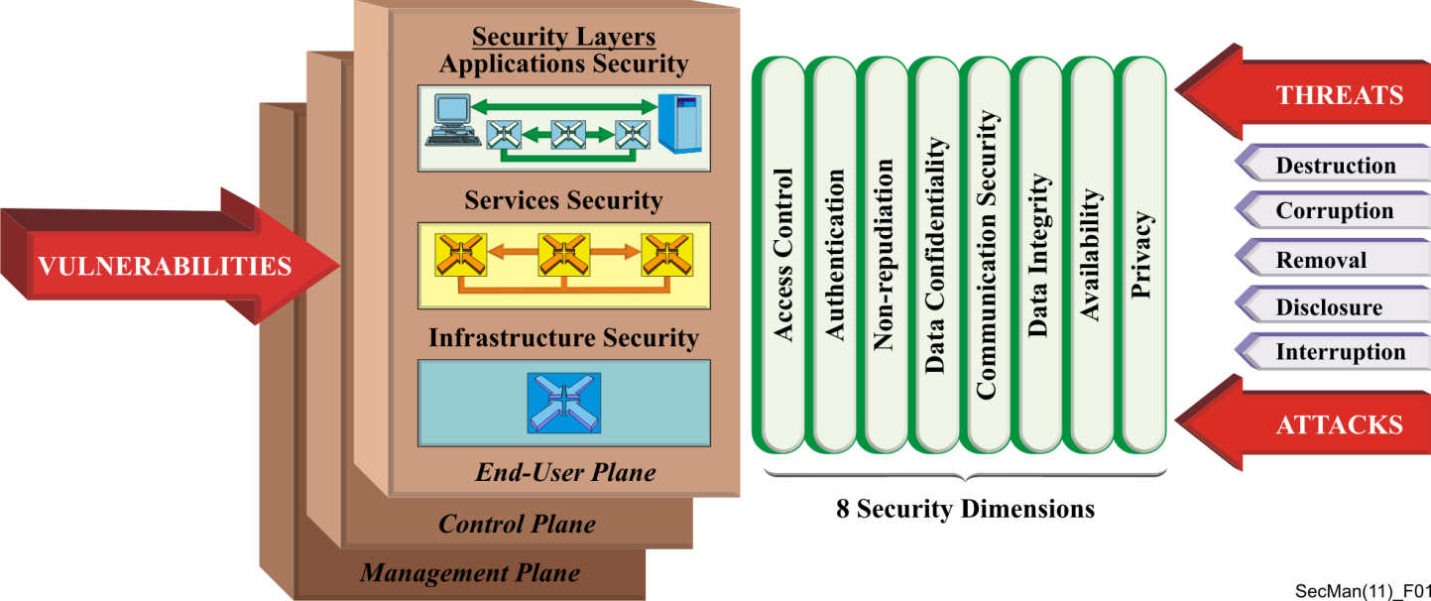
ITU-T SG17 Security Recommendations
Security architecture
  Security architecture for systems providing end-to-end communications (Rec. ITU-T X.805)
  Defines a general network security architecture for providing end-to-end network security
  For a systematic security design of products.
  Rec. ITU-T X.805 - Security architectural elements

Slide 71
Security architecture
OSI security architecture (Rec. ITU-T X.800)
OSI security models
(Recs. ITU-T X.802, X.803, X.830, X.831, X.832, X.833, X.834, X.835)
OSI security frameworks for open systems
(Recs. ITU-T X.810, X.811, X.812, X.813, X.814, X.815, X.816, X.841)
Security architecture for systems providing end-to-end communications (Rec. ITU-T X.805)
Security architecture aspects (Recs. ITU-T X.1031, X.1032)
IP-based telecommunication network security system (TNSS) (Rec. ITU-T X.1032)

Slide 72
Fast Info Set
Public Key Infrastructure and Trusted Third Party Services
Fast infoset security (Rec. ITU-T X.893)
Public Key Infrastructure and Trusted Third Party Services:
  Public-key and attribute certificate frameworks (Rec. ITU-T X.509)
  Guidelines for the use of Trusted Third Party services
  (Rec. ITU-T X.842)
  Specification of TTP services to support the application of digital signatures (Rec. ITU-T X.843)

Slide 73
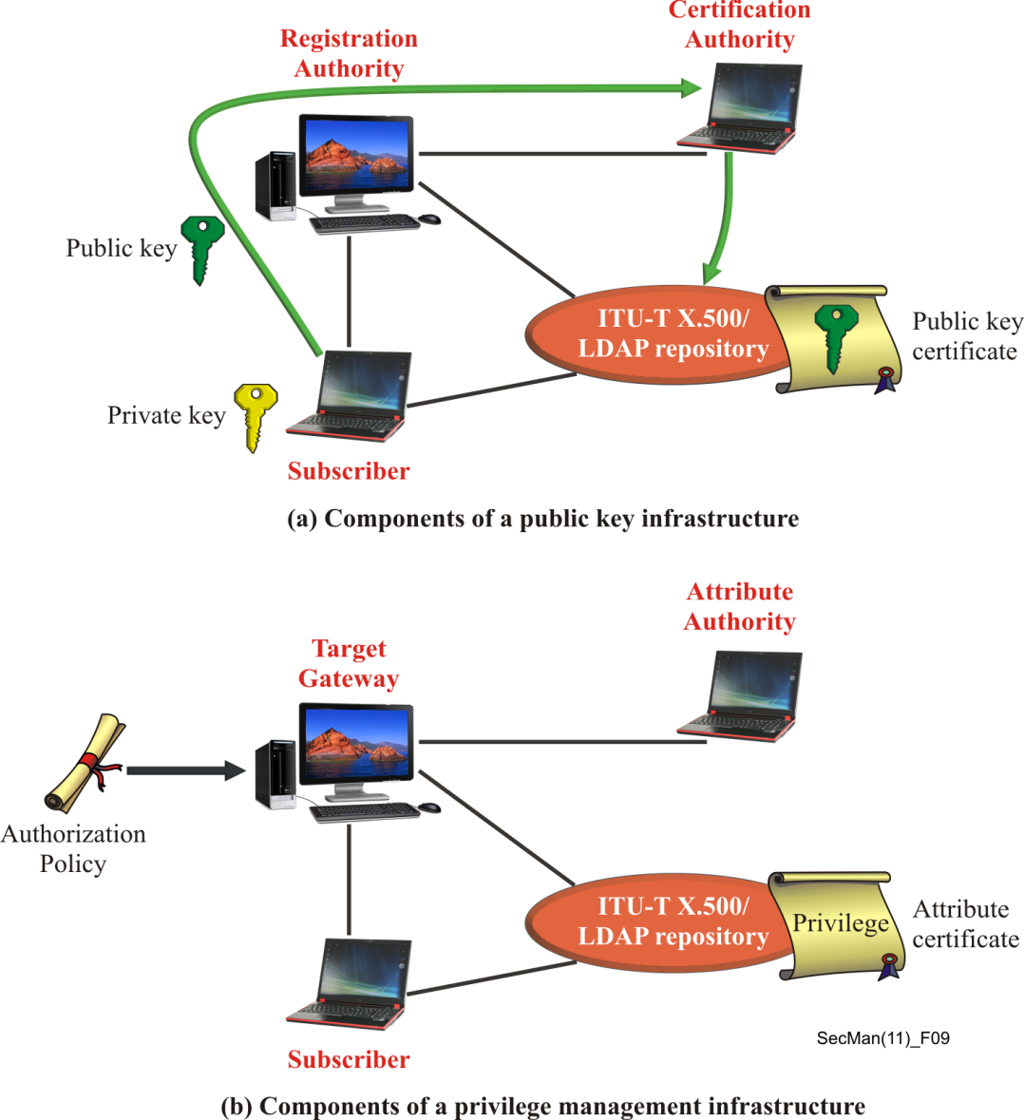
Public Key Infrastructure
  Rec. ITU-T X.509 – Certification path
  Rec. ITU-T X.509 - Components of PKI and PMI
  Rec. ITU-T X.509 – digital certificate

Slide 74
Security protocols
EAP guideline (Rec. ITU-T X.1034)
Password authenticated key exchange protocol (Rec. ITU-T X.1035)
Technical security guideline on deploying IPv6 (Rec. ITU-T X.1037)
Guideline on secure password-based authentication protocol with key exchange (Rec. ITU-T X.1151)
Secure end-to-end data communication techniques using trusted third party services (Rec. ITU-T X.1152)
Management framework of a one time password-based authentication service
(Rec. ITU-T X.1153)
General framework of combined authentication on multiple identity service provider environments (Rec. ITU-T X.1154)
Non-repudiation framework based on a one time password (Rec. ITU-T X.1156)
Delegated non-repudiation architecture based on ITU-T X.813
(Rec. ITU-T X.1159)
OSI Network + transport layer security protocol (Recs. ITU-T X.273, X.274)

Slide 75
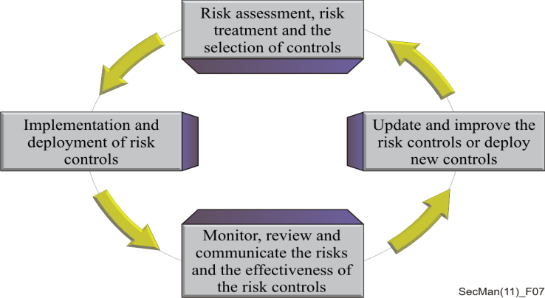
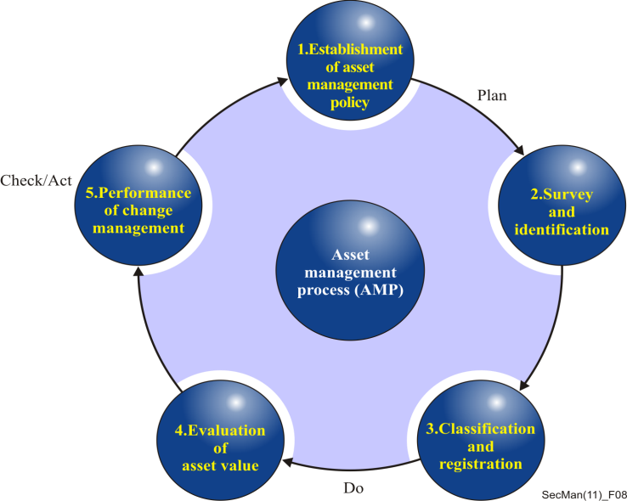
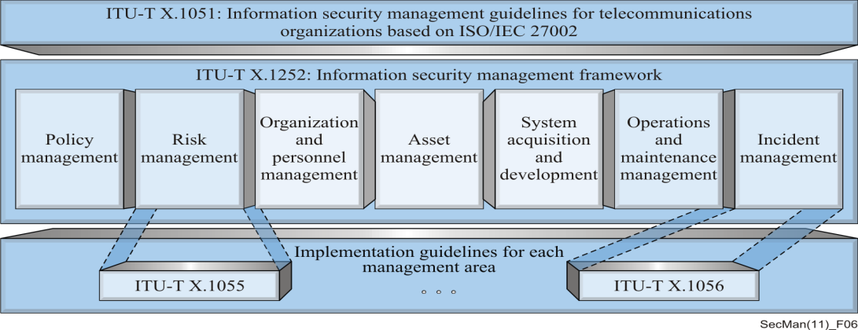
Information Security Management
Information security management guidelines for telecommunications organizations based on ISO/IEC 27002 (Rec. ITU-T X.1051)
Information Security Management System (Rec. ITU-T X.1052)
Governance of information security (Rec. ITU-T X.1054)
Risk management and risk profile guidelines (Rec. ITU-T X.1055)
Security incident management guidelines (Rec. ITU-T X.1056)
Asset management guidelines (Rec. ITU-T X.1057)
  Rec. ITU-T X.1055 - Risk management process
  Rec. ITU-T X.1052 - Information Security Management
  Rec. ITU-T X.1057 - Asset management process

Slide 76
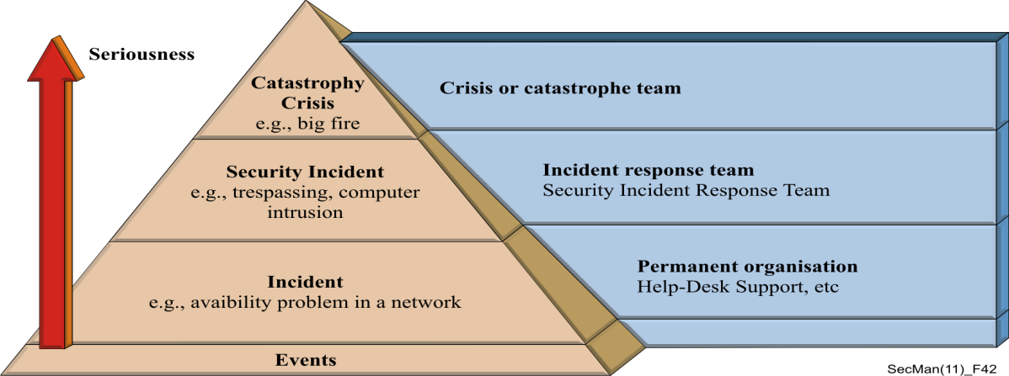
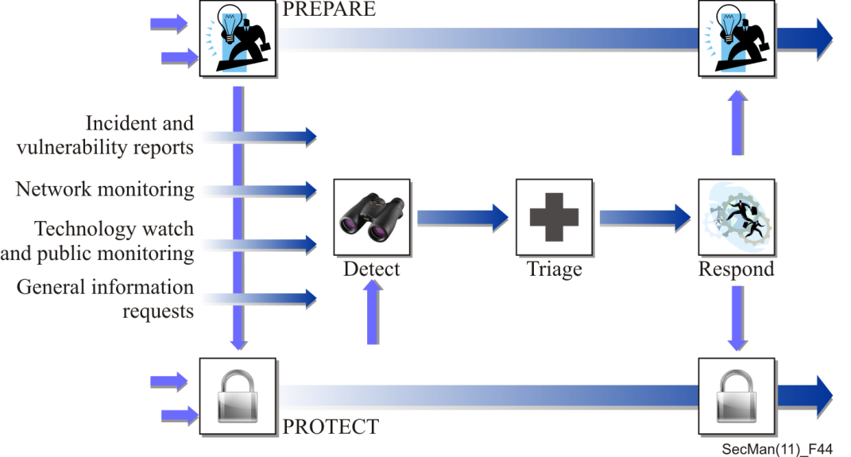
Incident organization and security incident handling
Incident organization and security incident handling: Guidelines for telecommunication organizations (Rec. ITU-T E.409)
Rec. ITU-T E.409 - pyramid of events and incidents
Rec. ITU-T X.1056 - Five high-level incident management processes

Slide 77
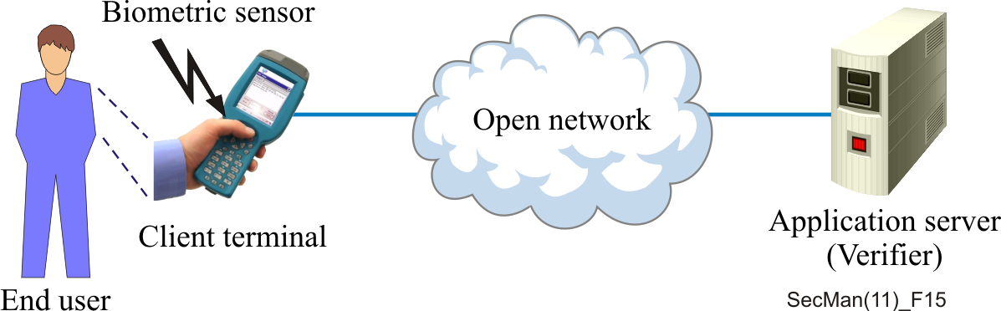
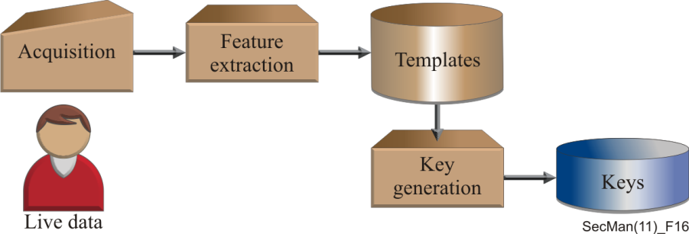
Telebiometrics
e-Health generic telecommunication protocol (Rec. ITU-T X.1081.1)
Telebiometric multimodal framework model (Rec. ITU-T X.1081)
BioAPI interworking protocol (Rec. ITU-T X.1083)
General biometric authentication protocol (Recs. ITU-T X.1084, X.1088)
Telebiometrics authentication infrastructure (Rec. ITU-T X.1089)
A guideline for evaluating telebiometric template protection techniques
(Rec. ITU-T X.1091)
Integrated framework for telebiometric data protection in e-health and telemedicine (Rec. ITU-T X.1092)
Telebiometric authentication
of an end user
Biometric-key generation

Slide 78
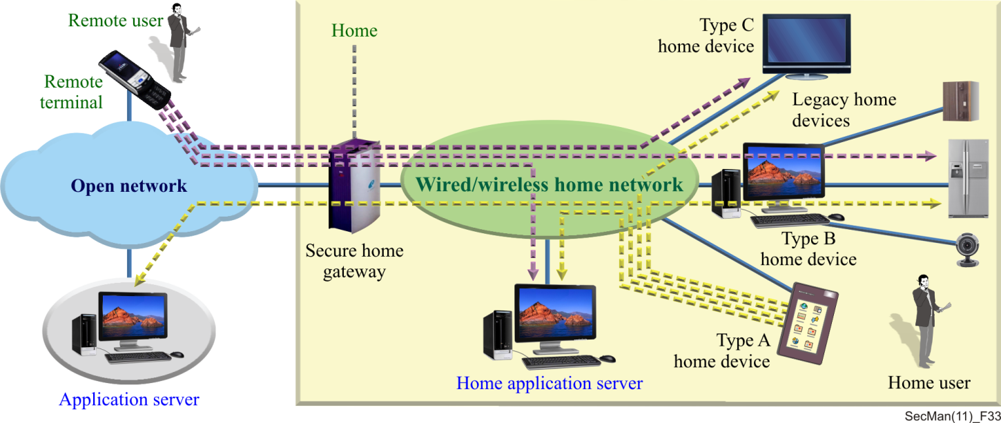
Peer-to-peer security
IPTV security and content protection
Multicast security requirements (Rec. ITU-T X.1101)
Home network security
(Recs. ITU-T X.1111, X.1112, X.1113, X.1114)
Rec. ITU-T X.1113 - Authentication service flows for the home network

Slide 79
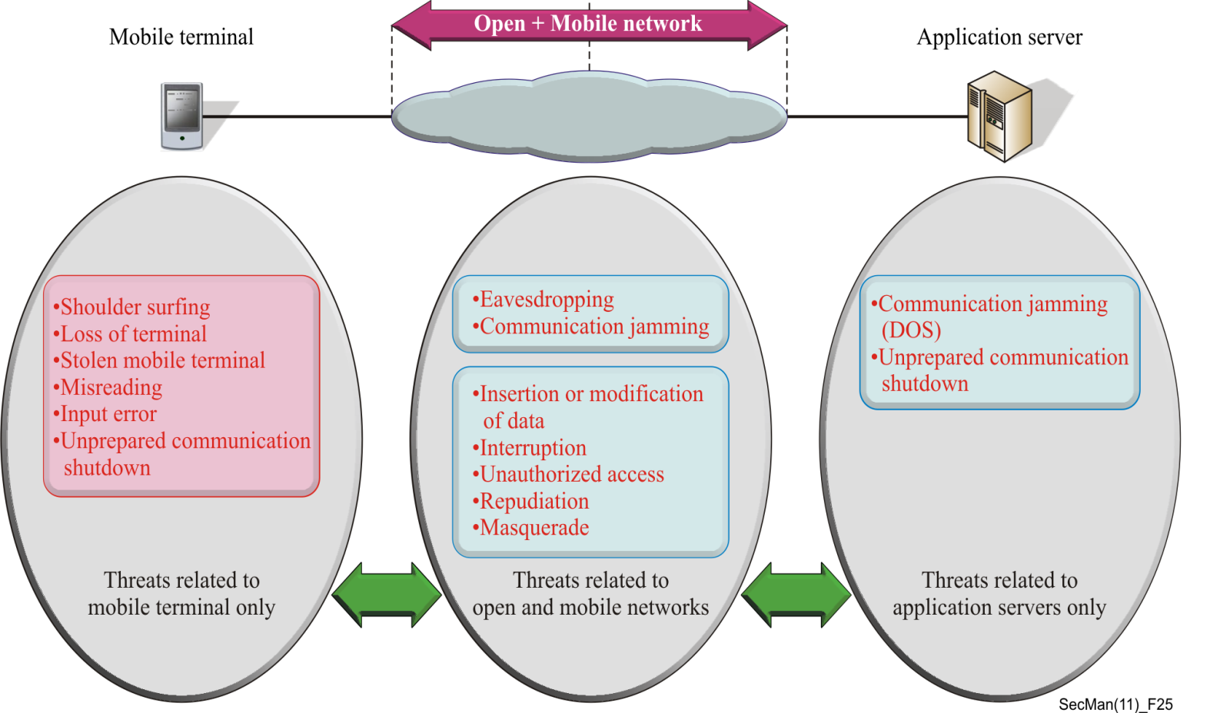
Secure mobile systems
(Recs. ITU-T X.1121, X.1122, X.1123, X.1124, X.1125, X.1158)
Rec. ITU-T X.1121 - Threats in the mobile end-to-end communications

Slide 80
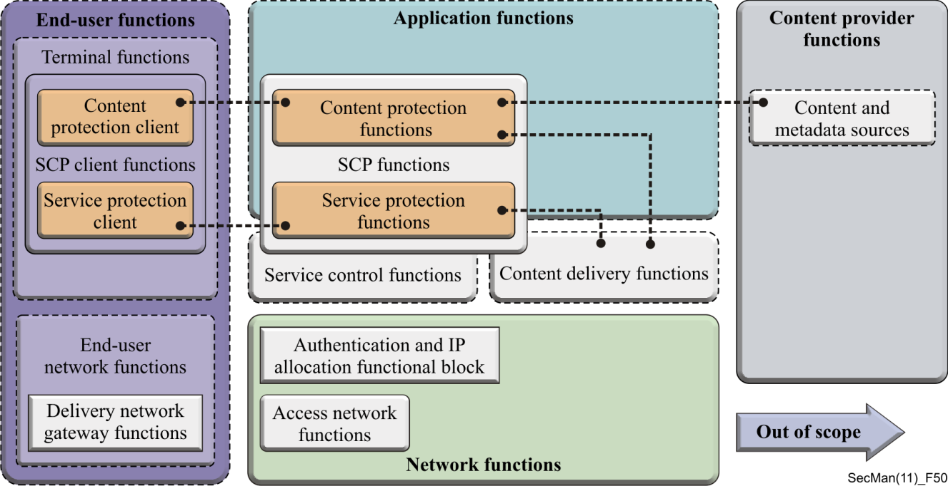
Peer-to-peer security
IPTV security and content protection
Peer-to-peer security (Recs. ITU-T X.1161, X.1162, X.1164)
IPTV security and content protection (Recs. ITU-T X.1191, X.1192, X.1193, X.1194, X.1195, X.1196, X.1197, X.1198)
Rec. ITU-T X.1191 - General security architecture for IPTV

Slide 81
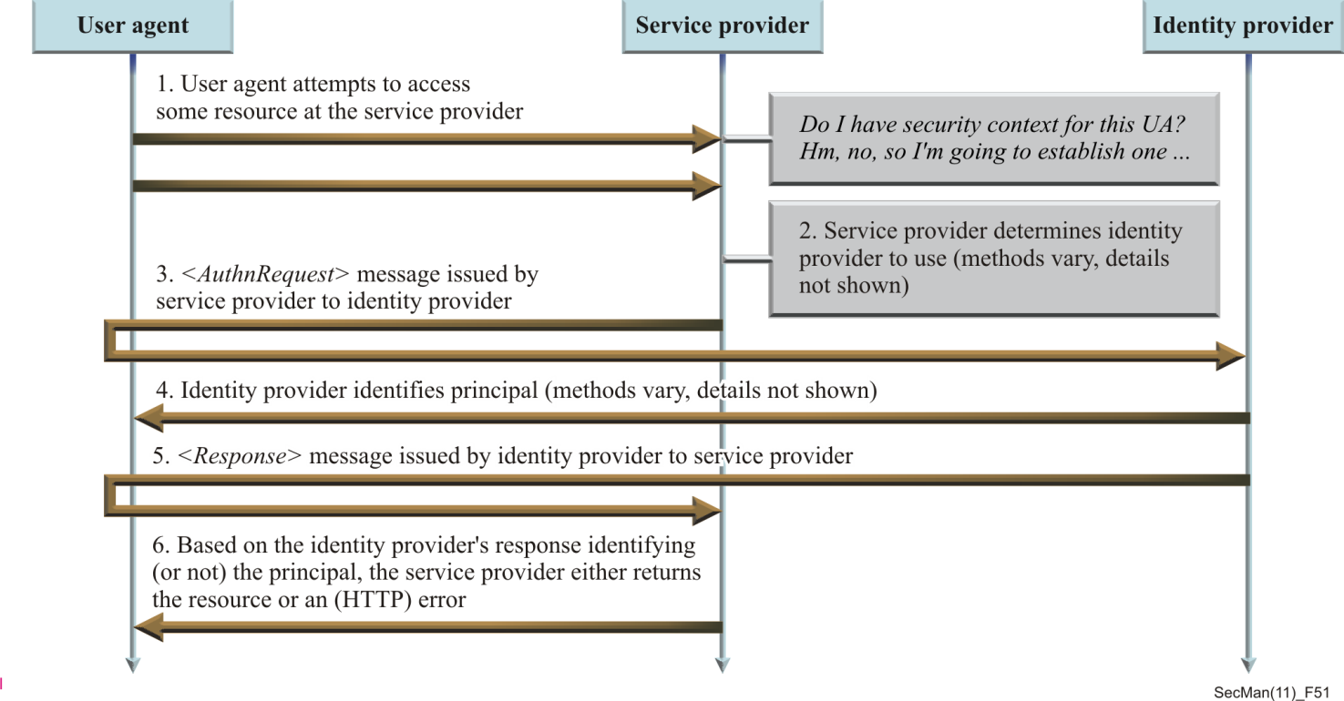
Web Security
Security Assertion Markup Language (SAML)
Access Control Markup Language (XACML)
Security Assertion Markup Language (Rec. ITU-T X.1141)
eXtensible Access Control Markup Language
(Recs. ITU-T X.1142, X.1144)
Security architecture for message security in mobile web services
(Rec. ITU-T X.1143)
Rec. ITU-T X.1141 - Basic template for achieving SSO

Slide 82
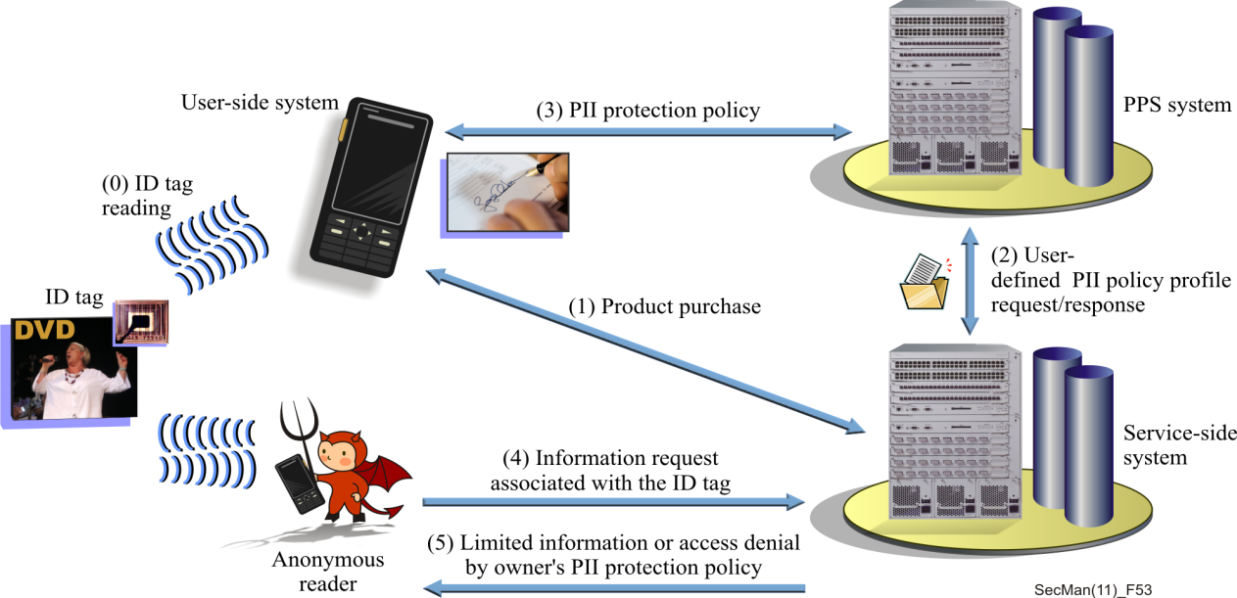
Networked ID security
Threats and requirements for protection of personally identifiable information in applications using tag-based identification (Rec. ITU-T X.1171)
Rec. ITU-T X.1171 - PII infringement through information leakage
Rec. ITU-T X.1171 - General PII protection service (PPS) service flow

Slide 83
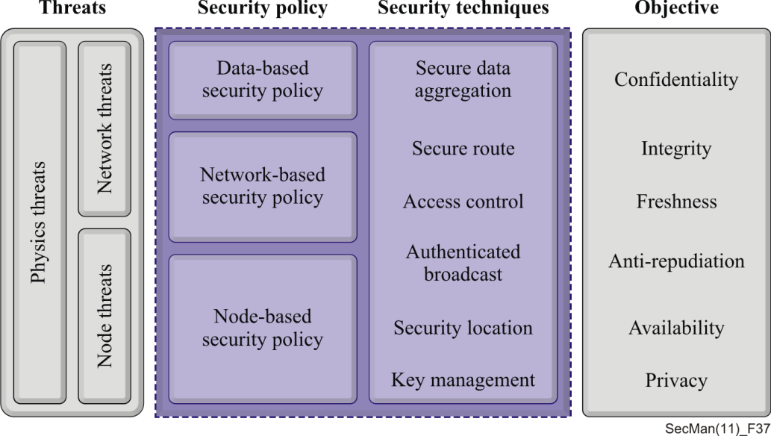
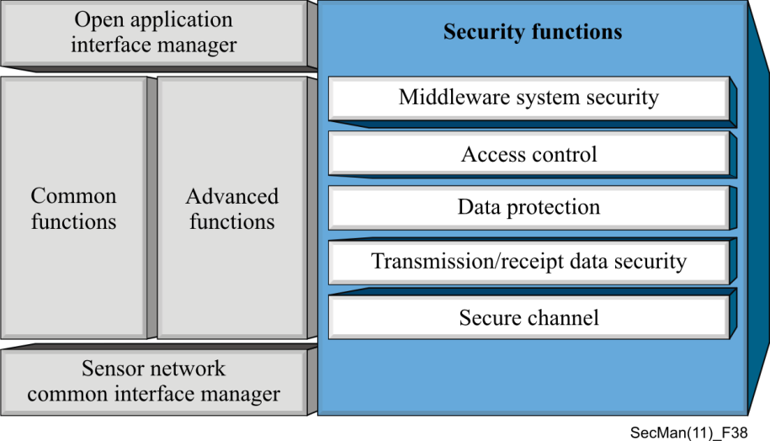
Ubiquitous sensor network security
Information technology – Security framework for ubiquitous sensor networks (Rec. ITU-T X.1311)
Ubiquitous sensor network middleware security guidelines
(Rec. ITU-T X.1312)
Security requirements for wireless sensor network routing
(Rec. ITU-T X.1313)
Security requirements and framework of ubiquitous networking
(Rec. ITU-T X.1314)
Rec. ITU-T X.1311 - Security model for USN
Rec. ITU-T X.1312 - Security functions
for USN middleware

Slide 84
CYBERSPACE SECURITY – Cybersecurity
Overview of cybersecurity (Rec. ITU-T X.1205)
A vendor-neutral framework for automatic notification of security related information and dissemination of updates
(Rec. ITU-T X.1206)
Guidelines for telecommunication service providers for addressing the risk of spyware and potentially unwanted software (Rec. ITU-T X.1207)
A cybersecurity indicator of risk to enhance confidence and security in the use of telecommunication/information and communication technologies (Rec. ITU-T X.1208)
Capabilities and their context scenarios for cybersecurity information sharing and exchange (Rec. ITU-T X.1209)
Overview of source-based security troubleshooting mechanisms for Internet protocol-based networks
(Rec. ITU-T X.1210)

Slide 85
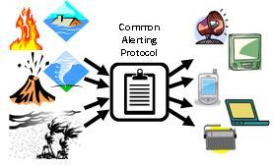
Emergency communications
Common alerting protocol (CAP 1.1) (Rec. ITU-T X.1303)
Common alerting protocol (CAP 1.2) (Rec. ITU-T X.1303bis)
CAP is a simple but general format for exchanging all-hazard emergency alerts and public warnings over all kinds of networks.
CAP allows a consistent warning message to be disseminated simultaneously over many different warning systems.

Slide 86
Definition of Cybersecurity
Definition of Cybersecurity
(ref. Rec. ITU-T X.1205, Overview of cybersecurity):
Cybersecurity is the collection of tools, policies, security concepts, security safeguards, guidelines, risk management approaches, actions, training, best practices, assurance and technologies that can be used to protect the cyber environment and organization and user’s assets.
Organization and user’s assets include connected computing devices, personnel, infrastructure, applications, services, telecommunications systems, and the totality of transmitted and/or stored information in the cyber environment.
Cybersecurity strives to ensure the attainment and maintenance of the security properties of the organization and user’s assets against relevant security risks in the cyber environment.
The general security objectives comprise the following:
  Availability
  Integrity, which may include authenticity and non-repudiation
  Confidentiality.

Slide 87
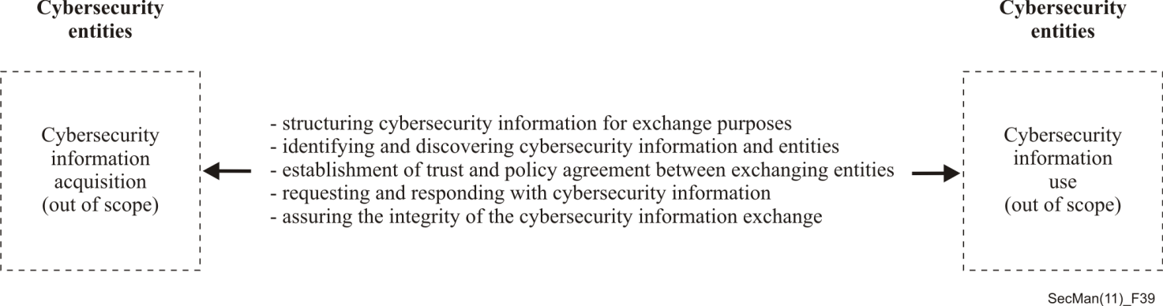
CYBERSECURITY INFORMATION EXCHANGE (CYBEX)
Overview of cybersecurity information exchange
(Rec. ITU-T X.1500)
Procedures for the registration of arcs under the object identifier arc for cybersecurity information exchange
(Rec. ITU-T X.1500.1)
Rec. ITU-T X.1500 - CYBEX model

Slide 88
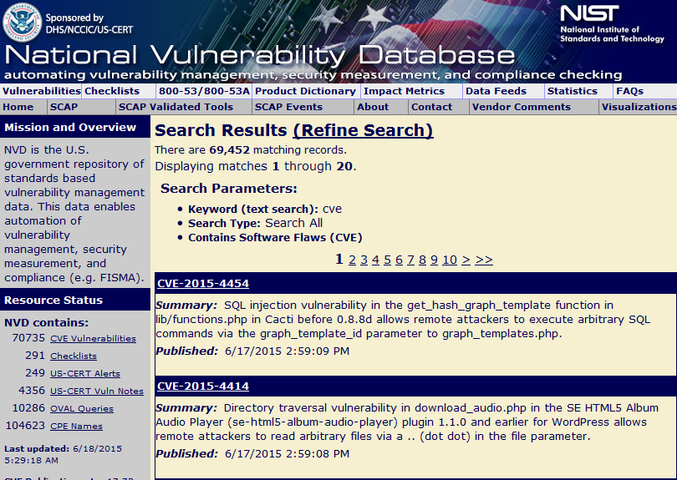
Common vulnerabilities and exposures (CVE)
Rec. ITU-T X.1520
contains the standard identifier number with status indicator,
a brief description and references to related vulnerability reports and advisories
applicable to vulnerability databases.

Slide 89
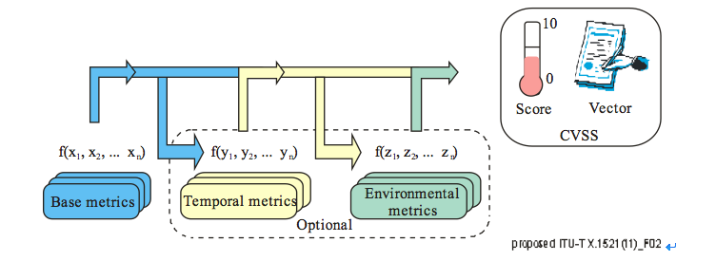
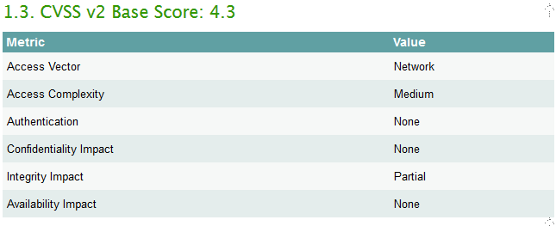
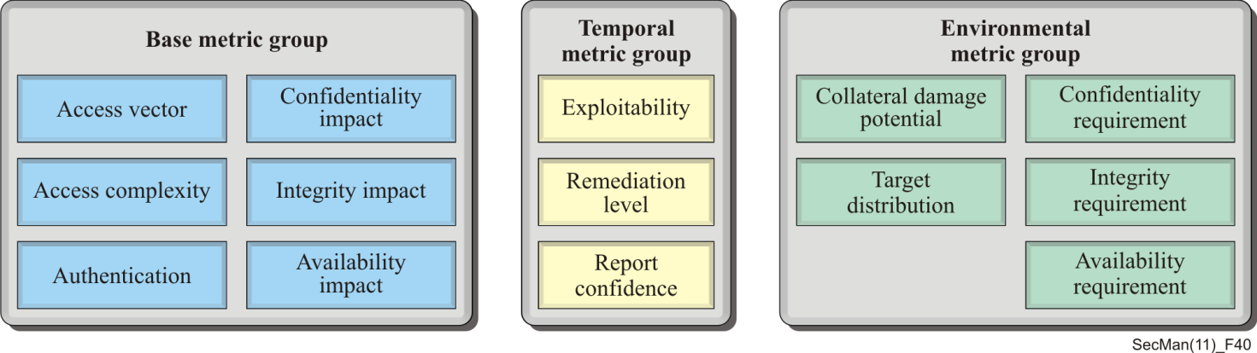
Common vulnerability scoring system (CVSS)
Rec. ITU-T X.1521
Quantification of vulnerabilities facilitates prioritization during vulnerability management
Base metrics: constant over time and across user environments
Temporal metrics: reflects vulnerability landscape
Rec. ITU-T X.1521 - CVSS metric groups

Slide 90
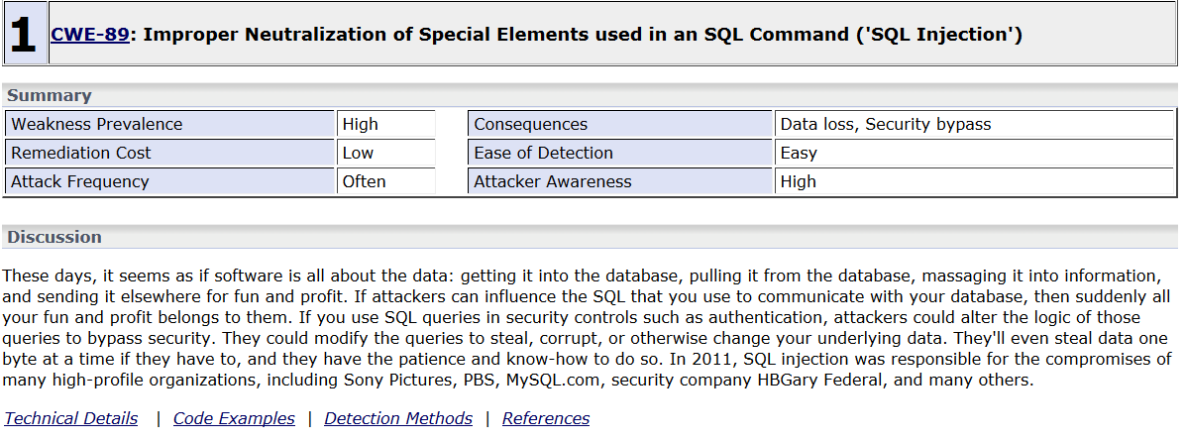
Common Weakness Enumeration (CWE)
Rec. ITU-T X.1524
Group same kind of vulnerabilities into a weakness, and give it a distinct number
Provides common names for publicly known problems in the commercial or open source software
Intended for security tools and services that can find weaknesses in source code and operational systems
Helps better understand and manage software weaknesses related to architecture and design

Slide 91
CYBEX vulnerability/state exchange
Common weakness scoring system (CWSS) (Rec. ITU-T X.1525)
Rec. ITU-T X.1525 - CWSS metric groups

Slide 92
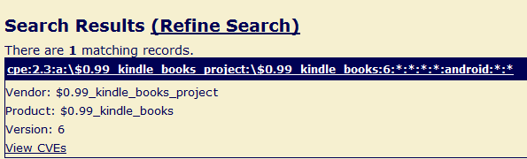
CYBEX vulnerability/state exchange
Language for the open definition of vulnerabilities and for the assessment of a system state (OVAL) (Rec. ITU-T X.1526)
    for assessment and reporting of machine state of computer systems.
    OVAL includes a language to encode system details, and an assortment of content repositories held throughout the community.
Common platform enumeration (CPE)
(Recs. ITU-T X.1528, X.1528.1, X.1528.2, X.1528.3, X.1528.4)

Slide 93
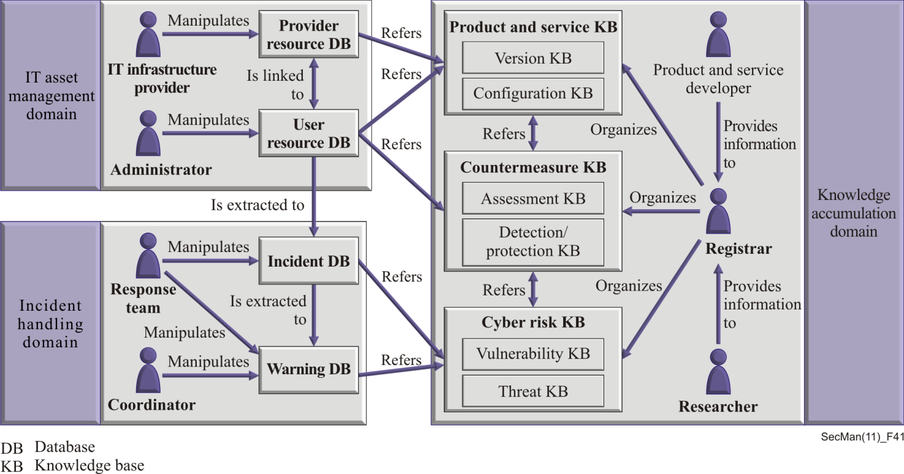
CYBEX identification and discovery
Discovery mechanisms in the exchange of cybersecurity information (Rec. ITU-T X.1570)
Rec. ITU-T X.1570 - Cybersecurity operational information ontology

Slide 94
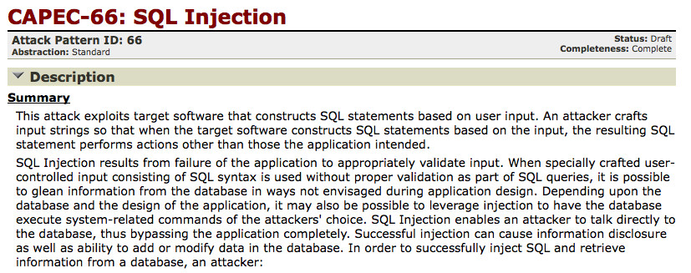
CYBEX event/incident/heuristics exchange
Incident object description exchange format (IODEF)
(Rec. ITU-T X.1541)
Common attack pattern enumeration and classification (CAPEC)
(Rec. ITU-T X.1544)
  Dictionary of attack patterns, solutions & mitigations
  Facilitates communication of incidents, issues, as well as validation techniques and mitigation strategies

Slide 95
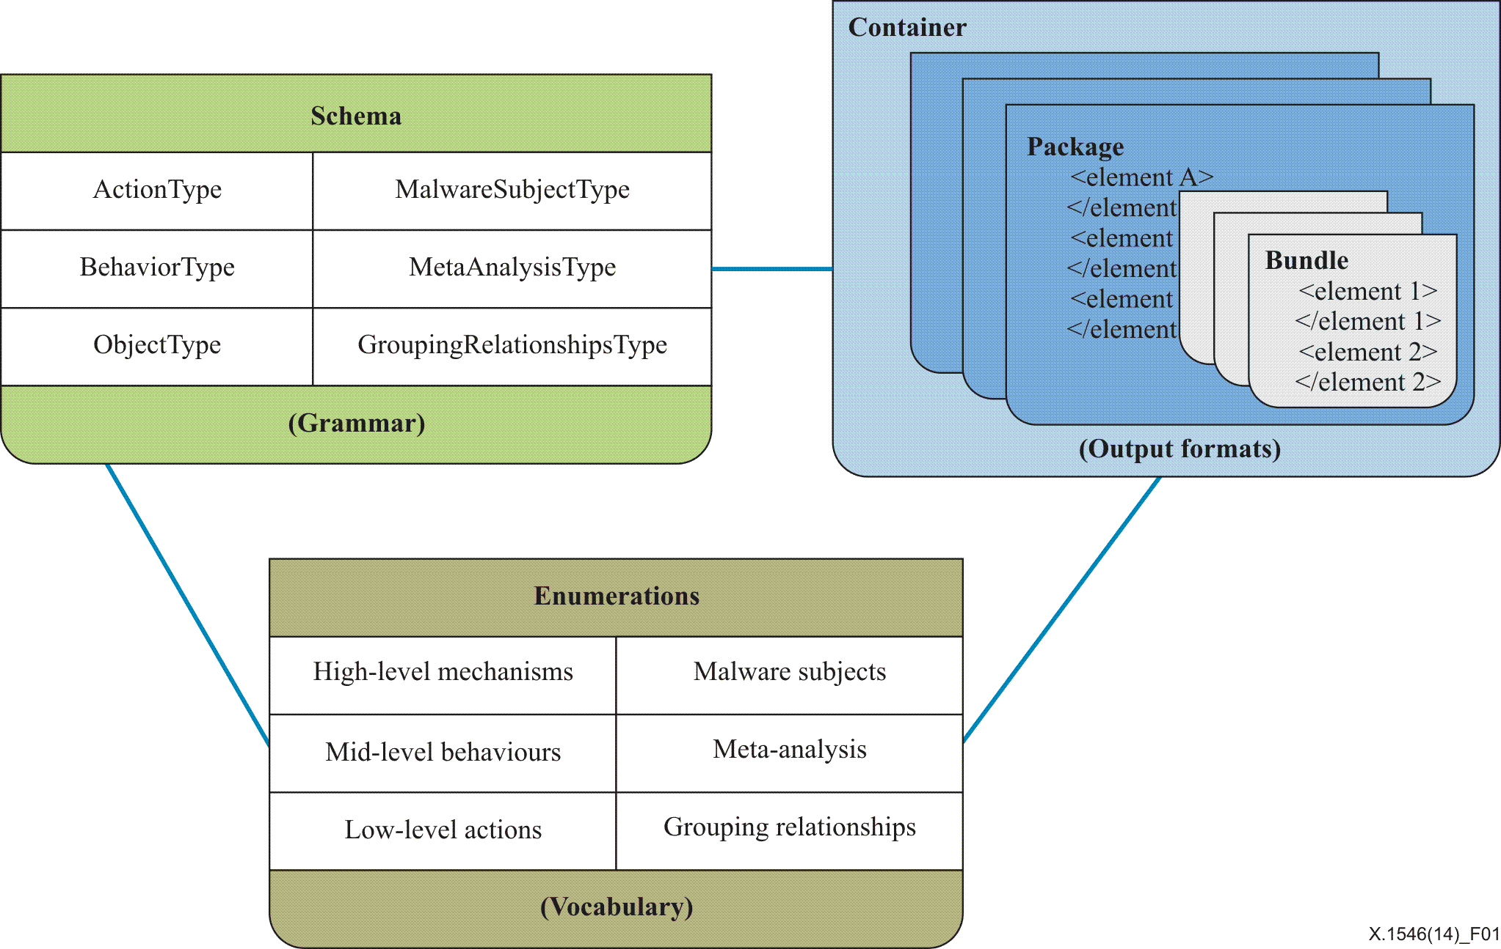
CYBEX event/incident/heuristics exchange
Malware attribute enumeration and classification (MAEC)
(Rec. ITU-T X.1546)
Rec. ITU-T X.1546 – High-level MAEC overview

Slide 96
CYBEX assured exchange
CYBEX assured exchange:
  Real-time inter-network defence (RID) (Rec. ITU-T X.1580)
  Transport of real-time inter-network defence messages
  (Rec. ITU-T X.1581)
  Transport protocols supporting cybersecurity information exchange
  (Rec. ITU-T X.1582)

Slide 97
Countering spam
Technical strategies for countering spam (Rec. ITU-T X.1231)
Technologies involved in countering email spam
(Rec. ITU-T X.1240)
Technical framework for countering email spam
(Rec. ITU-T X.1241)
Short message service (SMS) spam filtering system based on user-specified rules (Rec. ITU-T X.1242)
Interactive gateway system for countering spam
(Rec. ITU-T X.1243)
Overall aspects of countering spam in IP-based multimedia applications (Rec. ITU-T X.1244)
Framework for countering spam in IP-based multimedia applications (Rec. ITU-T X.1245)
  Note: These Recommendations do not address the content-related aspects
  of telecommunications (ref. ITR 2012).

Slide 98
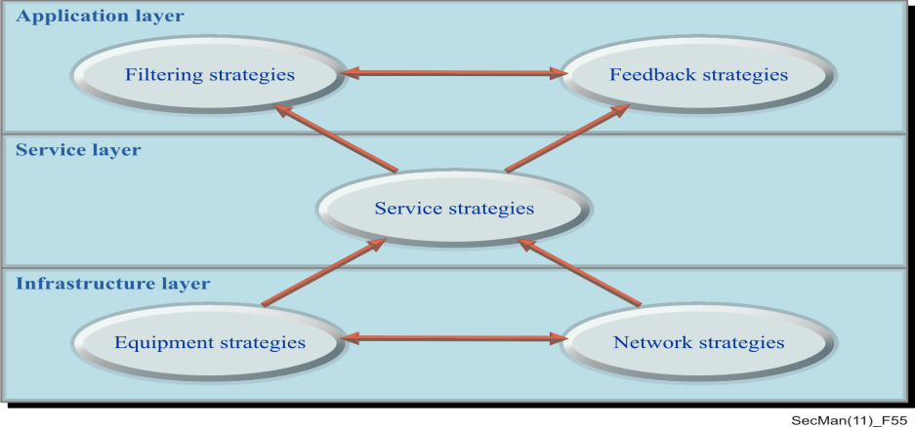
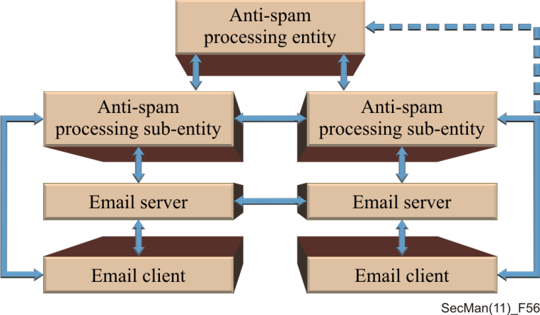
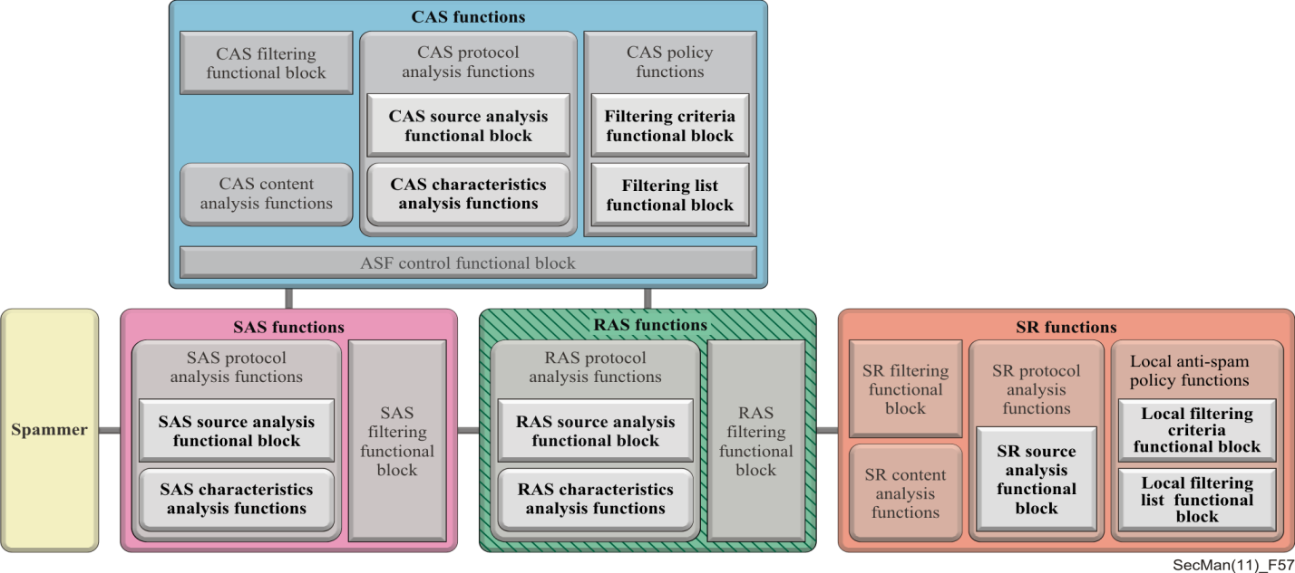
Countering spam
Rec. ITU-T X.1231 - General model
for countering spam
Rec. ITU-T X.1241 - General structure of
e-mail anti-spam processing domain
Rec. ITU-T X.1245 - Framework for countering IP media spam

Slide 99
Identity Management (IdM)
Baseline capabilities for enhanced global identity management and interoperability (Rec. ITU-T X.1250)
A framework for user control of digital identity
(Rec. ITU-T X.1251)
Baseline identity management terms and definitions
(Rec. ITU-T X.1252)
Security guidelines for identity management systems
(Rec. ITU-T X.1253)
Entity authentication assurance framework (Rec. ITU-T X.1254)
Framework for discovery of identity management information
(Rec. ITU-T X.1255)
Guidelines on protection of personally identifiable information in the application of RFID technology (Rec. ITU-T X.1275)

Slide 100
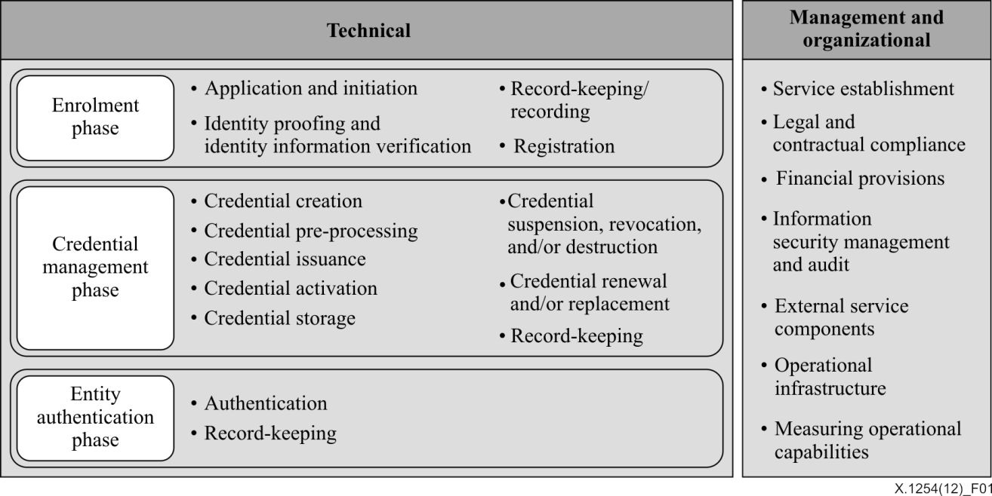
Entity authentication assurance framework
Rec. ITU-T X.1254 - Overview of the entity authentication assurance framework
Level | Description
1 – Low | Little or no confidence in the claimed or asserted identity
2 – Medium | Some confidence in the claimed or asserted identity
3 – High | High confidence in the claimed or asserted identity
4 – Very high | Very high confidence in the claimed or asserted identity
Rec. ITU-T X.1254 - Levels of assurance

Slide 101
Digital Entity
DIGITAL ENTITY
ID
84321/ab5
Intrinsic
attributes
DATE MODIFIED
04/11/2007
DATE CREATED
04/11/2007
PERMISSION SCHEME A
84321/ab5
User-defined
attributes
OBJECT TYPE
89754/123
More…
ELEMENT
ELEMENT
ELEMENT
Intrinsic attributes
User-defined attributes
DATA
Rec. ITU-T X.1255 - Illustrative example of a digital entity

Slide 102
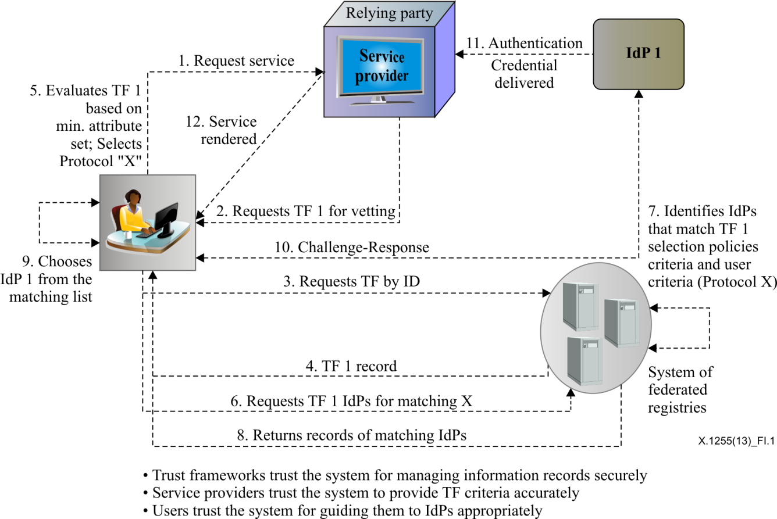
Authentication involving trust frameworks
Rec. ITU-T X.1255 - Authentication involving trust frameworks

Slide 103
Cloud computing security
Security framework for cloud computing (Rec. ITU-T X.1601)
Code of practice for information security controls based on ISO/IEC 27002 for cloud services (Rec. ITU-T X.1631)
Security capabilities
Identity and access management (IAM),
authentication, authorization, and transaction audit
Physical security
Interface security
Trust model
Security
threats
Security
challenges
Incident management
Service security
assessment and audit
Computing virtualization security
Disaster recovery
Network security
Supply chain security
Interoperability, portability
and reversibility
Data isolation, protection
and privacy protection
Operational security
Security coordination
Rec. ITU-T X.1601 - Security framework for cloud computing

Slide 104
ITU-T X.500 series on Directory
Overview of concepts, models and services (Rec. ITU-T X.500)
Models (Rec. ITU-T X.501)
Public-key and attribute certificate frameworks
(Rec. ITU-T X.509)
Abstract service definition (Rec. ITU-T X.511)
Procedures for distributed operation (Rec. ITU-T X.518)
Protocol specifications (Rec. ITU-T X.519)
Selected attribute types (Rec. ITU-T X.520)
Selected object classes (Rec. ITU-T X.521)
Replication (Rec. ITU-T X.525)
Use of systems management for administration of the Directory) (Rec. ITU-T X.530)
Notes:
Information technology – Open Systems Interconnection – The Directory:

Slide 105
Abstract Syntax Notation 1 (ASN.1)
Specification of basic notation (Rec. ITU-T X.680)
Information object specification (Rec. ITU-T X.681)
Constraint specification (Rec. ITU-T X.682)
Parameterization of ASN.1 specifications (Rec. ITU-T X.683)
-- public-key certificate definition
Certificate ::= SIGNED{TBSCertificate}
TBSCertificate ::= SEQUENCE {
version [0] Version DEFAULT v1,
serialNumber CertificateSerialNumber,
signature AlgorithmIdentifier{{SupportedAlgorithms}},
issuer Name,
validity Validity,
subject Name,
subjectPublicKeyInfo SubjectPublicKeyInfo,
issuerUniqueIdentifier [1] IMPLICIT UniqueIdentifier OPTIONAL,
...,
[[2: -- if present, version shall be v2 or v3
subjectUniqueIdentifier [2] IMPLICIT UniqueIdentifier OPTIONAL]],
[[3: -- if present, version shall be v2 or v3
extensions [3] Extensions OPTIONAL]]
-- If present, version shall be v3]]
}
Example: X.509 certificate
encoded in ASN.1

Slide 106
ASN.1 encoding rules
Specification of Basic Encoding Rules (BER), Canonical Encoding Rules (CER) and Distinguished Encoding Rules (DER)
(Rec. ITU-T X.690)
Specification of Packed Encoding Rules (PER) (Rec. ITU-T X.691)
Specification of Encoding Control Notation (ECN)
(Rec. ITU-T X.692)
XML Encoding Rules (XER) (Rec. ITU-T X.693)
Mapping W3C XML schema definitions into ASN.1
(Rec. ITU-T X.694)
Registration and application of PER encoding instructions
(Rec. ITU-T X.695)
Specification of Octet Encoding Rules (OER) (Rec. ITU-T X.696)

Slide 107
Object Identifier (OID)
Basic Reference Model: Naming and addressing
(Rec. ITU-T X.650)
Procedures for the operation of object identifier registration authorities: General procedures and top arcs of the international object identifier tree (Rec. ITU-T X.660)
Procedures for the operation of OSI Registration Authorities: Registration of object identifier arcs beneath the top-level arc jointly administered by ISO and ITU-T (Rec. ITU-T X.662)
Procedures for the operation of OSI Registration Authorities: Registration of application processes and application entities (Rec. ITU-T X.665)
Procedures for the operation of OSI Registration Authorities: Joint ISO and ITU-T registration of international organizations (Rec. ITU-T X.666)

Slide 108
Object Identifier (OID)
Procedures for the operation of object identifier registration authorities: Generation of universally unique identifiers and their use in object identifiers (Rec. ITU-T X.667)
Procedures for the operation of OSI Registration Authorities: Registration of object identifier arcs for applications and services using tag-based identification (Rec. ITU-T X.668)
Procedures for ITU-T registration of identified organizations (Rec. ITU-T X.669)
Use of registration agents to register names subordinate to country names in the X.660 RH-name-tree (Rec. ITU-T X.670)
Procedures for a Registration Authority operating on behalf of countries to register organization names subordinate to country names in the X.660 RH-name-tree (Rec. ITU-T X.671)
Object identifier resolution system (ORS) (Rec. ITU-T X.672)
Procedures for the registration of arcs under the Alerting object identifier arc (Rec. ITU-T X.674)
OID-based resolution framework for heterogeneous identifiers and locators (Rec. ITU-T X.675)

Slide 109
Open Distributed Processing (ODP)
Reference Model: Overview (Rec. ITU-T X.901)
Reference model: Foundations (Rec. ITU-T X.902)
Reference model: Architecture (Rec. ITU-T X.903)
Reference Model: Architectural Semantics (Rec. ITU-T X.904)
Use of UML for ODP system specifications (Rec. ITU-T X.906)
Naming framework (Rec. ITU-T X.910)
Reference model – Enterprise language (Rec. ITU-T X.911)
Interface Definition Language (Rec. ITU-T X.920)
Interface references and binding (Rec. ITU-T X.930)
Protocol support for computational interactions (Rec. ITU-T X.931)
Trading Function: Specification (Rec. ITU-T X.950)
Trading function: Provision of trading function using OSI Directory service (Rec. ITU-T X.952)
Type repository function (Rec. ITU-T X.960)

Slide 110
Specification and Description Language (SDL-2010)
  Specification and Description Language (SDL-2010, Recs. ITU-T Z.100 – Z.109)
  For unambiguous specification and description of telecommunication
  systems.
  Allows the description of
  behaviour of systems using
  extended finite state machines communicating by messages
  For specification of reactive systems
  The range of application is from requirement description to
  implementation

Slide 111
Specification and Description Language (SDL-2010)
Overview of SDL-2010 (Rec. ITU-T Z.100)
Basic SDL-2010 (Rec. ITU-T Z.101)
Comprehensive SDL-2010 (Rec. ITU-T Z.102)
Shorthand notation and annotation in SDL-2010 (Rec. ITU-T Z.103)
Data and action language in SDL-2010 (Rec. ITU-T Z.104)
SDL-2010 combined with ASN.1 modules (Rec. ITU-T Z.105)
Common interchange format for SDL-2010 (Rec. ITU-T Z.106)
Object-oriented data in SDL-2010 (Rec. ITU-T Z.107)
Unified modeling language profile for SDL-2010 (Rec. ITU-T Z.109)

Slide 112
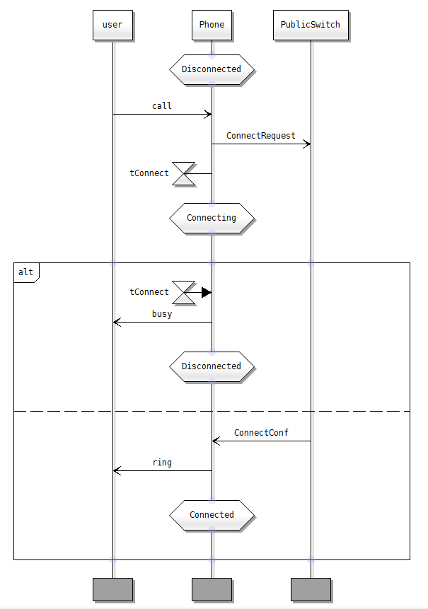
Message Sequence Chart (MSC)
  Rec. ITU-T Z.120
  Provides a trace language with graphical representation for the specification and description of the communication behaviour of system components and their environment by means of message interchange
  Suitable for specification of the
  communication behaviour for real time
  systems, in particular telecommunication switching systems
  For requirement specification, interface specification, simulation and validation,
  test case specification and documentation
  of real time systems

Slide 113
Message Sequence Chart (MSC)
User Requirements Notation (URN)
Application of formal description techniques:
  Criteria for use of formal description techniques by ITU-T (Rec. ITU-T Z.110)
  Notations and guidelines for the definition of ITU-T languages (Rec. ITU-T Z.111)
  Guidelines for UML profile design (Rec. ITU-T Z.119)
  Message Sequence Chart (MSC):
  Message Sequence Chart (MSC) (Rec. ITU-T Z.120)
  Specification and Description Language (SDL) data binding to Message Sequence Charts (MSC) (Rec. ITU-T Z.121)
  User Requirements Notation (URN):
  User Requirements Notation (URN) – Language requirements and framework (Rec. ITU-T Z.150)
  User Requirements Notation (URN) - Language definition (Rec. ITU-T Z.151)

Slide 114
User Requirements Notation (URN)
Recs. ITU-T Z.150, Z.151
URN is the first and currently only standard which explicitly addresses goals (non-functional requirements with GRL) in addition to scenarios (functional requirements with UCMs) in a graphical way in one unified language
For the elicitation, analysis, specification, and validation of requirements
URN combines modelling concepts and notations for goals (mainly for non-functional requirements and quality attributes) and scenarios (mainly for operational requirements, functional requirements, and performance and architectural reasoning).

Slide 115
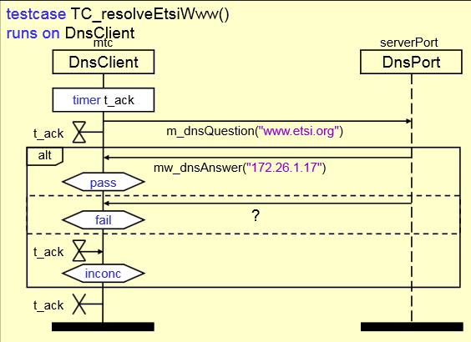
Testing and Test Control Notation version 3 (TTCN-3)
Recs. ITU-T Z.160 - Z.170
For specification of test suites that are independent of platforms, test methods, protocol layers and protocols.
TTCN-3 can be used for specification of all types of reactive system tests over a variety of communication ports.
Typical areas of application are protocol testing (including mobile and Internet protocols), service testing (including supplementary services), module testing, testing of CORBA‑based platforms and APIs.

Slide 116
Testing and Test Control Notation version 3 (TTCN-3)
TTCN-3 core language (Rec. ITU-T Z.161)
TTCN-3 language extensions: Support of interfaces with continuous signals (Rec. ITU-T Z.161.1)
TTCN-3 language extensions: Configuration and deployment support (Rec. ITU-T Z.161.2)
TTCN-3 language extensions: Advanced parameterization
(Rec. ITU-T Z.161.3)
TTCN-3 language extensions: Behaviour types (Rec. ITU-T Z.161.4)
TTCN-3 Language extensions: Performance and real time testing
(Rec. ITU-T Z.161.5)
TTCN-3 tabular presentation format (TFT) (Rec. ITU-T Z.162)
TTCN-3 graphical presentation format (GFT) (Rec. ITU-T Z.163)

Slide 117
Testing and Test Control Notation version 3 (TTCN-3)
TTCN-3 operational semantics (Rec. ITU-T Z.164)
TTCN-3 runtime interface (TRI) (Rec. ITU-T Z.165)
TTCN-3 language extensions: Extended TRI (Rec. ITU-T Z.165.1)
TTCN-3 control interface (TCI) (Rec. ITU-T Z.166)
Using ASN.1 with TTCN-3 (Rec. ITU-T Z.167)
The IDL to TTCN-3 mapping (Rec. ITU-T Z.168)
Using XML schema with TTCN-3 (Rec. ITU-T Z.169)
TTCN-3 documentation comment specification (Rec. ITU-T Z.170)

