Slide 1

The ITU-T SG 17
Q10/17 IdM standardization activity
Notes:
http://www.eid-ssedic.eu/index.php?option=com_content&view=article&id=117

Slide 2
Contents
Overview of ITU-T SG 17
Q 10/17
JCA-IdM
Examples of Recommendations
Challenges
Conclusions
Reference links

Slide 3
Overview of ITU-T SG 17
Primary focus is to build confidence and security in the use of ICTs
Meets twice a year
Is responsible for 312 approved Recommendations and 18 approved Supplements
Large program of work:
  April 2013 meeting: approved 3 Recommendations, and 3 Supplements; 9 new work items added to work program in 2013
  101 new or revised Recommendations and other texts are under development for approval in September 2013 or later
Lead Study Group on:
● Security
● Identity management (IdM)
● Languages and description techniques
Work organized into 5 Working Parties with 12 Questions

Slide 4
Overview of ITU-T SG 17 (cont.)
Study Group 17
WP 1/17
Fundamental security
WP 2/17
Network and information security
WP 3/17
IdM + Cloud Computing Security
WP 4/17
Application security
WP 5/17
Formal languages
Q1/17
Telecom/ICT security coordination
Q4/17
Cybersecurity
Q8/17
Cloud Computing Security
Q6/17
Ubiquitous
services
Q11/17
Directory,
PKI, PMI, ODP, ASN.1, OID, OSI
Q2/17
Security architecture and framework
Q5/17
Countering spam
Q10/17
IdM
Q7/17
Applications
Q12/17
Languages and Testing
Q3/17
ISM
Q9/17
Telebiometrics

Slide 5
Q10/17
IdM Landscape Background
IdM is the management of the life cycle and use (creation, maintenance, utilization, provisioning, and revocation) of credentials, identifiers, attributes, authentication, attestation, and patterns by which entities (e.g., service providers, end-user, social networks, organizations, network devices, applications and services) are known with some level of trust
Depending on the context, multiple identities may exist for a single entity at differing security requirements, and at multiple locations
In public networks, IdM supports trusted information exchange between authorized entities that is based on validation and assertion of identities across distributed systems in multiple service providers and open service environment
IdM also enables the protection of information and ensures that only authorized information is disseminated. IdM is a key component to the proper operations of telecommunication/ICT networks, e.g. cloud and mobile computing, services, and products because it supports establishing and maintaining trusted communications
It not only supports authentication of an entity’s identity, it also permits authorization of privileges, easy change of privileges when an entity’s role changes, delegation, nomadicity, and other significant identity-based services

Slide 6
Q10/17
IdM Landscape Motivation
IdM is a critical component in managing network security and enabling the nomadic, on-demand access to networks and e-services that end-users expect today
Along with other defensive mechanisms, IdM helps to prevent fraud and identity theft and thereby increases users’ confidence that e-transactions are secure and reliable, e.g. cloud and mobile computing system that are not directly controlled by the user organization
National/regional specific IdM specifications and solutions will exist and continue to evolve. Harmonization of the different national/regional IdM approaches, specifications and solutions is very important for global communications
In order to accomplish this objective, IdM standards that utilize developer friendly environments, promotes the wide scale development of applications and tools using various web technologies (i.e. HTTP, JSON, OAUTH, OpenID Connect etc.) tools i.e. HTML are needed

Slide 7
Q10/17
IdM Landscape Study Items
Functional concepts for a common IdM infrastructure
Appropriate IdM model that is independent of network technologies, supports user-centric involvement, represents IdM information and supports the secure exchange of IdM information between involved entities (e.g., users, relying parties and identity providers) based on policies
Components to bring social, mobile and enterprise IdM together in way to promote safer transactions
Functional aspects of an IdM graph
Components of a generic framework and requirements for IdM
Specific IdM requirements of service providers
Requirements, capabilities and possible strategies for achieving interoperability between different IdM systems (e.g., identity assurance, inter-working)
Candidate mechanisms for IdM interoperability to include identifying and defining applicable profiles to minimize interoperability issues
Requirements and mechanisms for protection and disclosure of personally identifiable information (PII)
Requirements to protect IdM systems from cyber attacks
IdM capabilities to be used against cyber attacks
Integration of IdM with advanced security technologies
Unique IdM requirements associated with cloud computing, and mobile computing
Integration of strong authentication technologies in IdM systems

Slide 8
Q10/17
IdM Landscape Tasks
Specify an IdM framework that supports discovery, policy and trust model, authentication and authorization, assertions, and credential lifecycle management required for IdM
Define functional IdM architectural concepts to include IdM bridging between networks and among IdM systems taking into account advanced security technologies
Specify requirements (and propose mechanisms) for identity assurance, and mapping/interworking between different identity assurance methods that might be adopted in various networks. In this context, identity assurance includes identity patterns and reputation
Define interfaces for interoperability of IdM systems
Define requirements (and propose mechanisms) for protection and disclosure of identity information
Define requirements (and propose mechanisms) to protect IdM systems including how to use IdM capabilities as a means for service providers to coordinate and exchange information regarding cyber attacks
Maintain and coordinate IdM terminology and definitions living list and to continue the on-going work
Study and define IdM security risks and threats
Study and define the concept of “world ready” IdM framework
Study and define the concept of “developer ready” that is simple developer IdM framework to promote a more viral adoption

Slide 9
Q10/17,
Identity Management architecture and mechanisms
Key vision of Q10/17
  Security enabler by providing trust in the identity of parties to an e-transaction
  Providing network operators an opportunity to increase revenues by offering advanced identity-based services
  Providing global trust and interoperability of diverse IdM capabilities in telecommunication on the base of leveraging and bridging existing solutions
  The vision setting, and coordination, and organization of the entire range of IdM activities within the ITU-T
Key focus of Q10/17
  Adoption of interoperable federated identity frameworks that use a variety of authentication methods with well understood security and privacy
  Encourage the use of authentication methods resistant to known and projected threats
  Providing a general trust model for making trust-based authentication decisions between two or more parties
  Ensure security of online transactions with focus on end-to-end identification and authentication of the participants and components involved in conducting the transaction, including people, devices, and services
9/40

Slide 10
JCA-IdM
SG17 is “Parent” for Joint Coordination Activity (JCA) on
Identity Management
JCA is a tool for managing the work programme of ITU-T when there is a need to address a broad subject covering the area of competence of more than one study group. JCA helps to coordinate the planned work effort in terms of subject matter, time-frames for meetings, collocated meetings where necessary and publication goals including, where appropriate, release planning of the resulting Recommendations

Slide 11













JCA-IdM
Coordination with other bodies
NSTIC
ITU-T Joint coordination activity on IdM (JCA-IdM)

Slide 12
Examples of Recommendations
X.1251 - A framework for user control of digital identity
Defines a framework to enhance user control and exchange of their digital identity related information
Defines capabilities for the digital identity information exchange
Provides with the ability to control the release of personally identifiable information

Slide 13
X.1252
Baseline Identity Management Terms and Definitions
Provides 70 definitions of key terms used in identity management (IdM)
6.30 identity: A representation of an entity in the form of one or more attributes that allow the entity or entities to be sufficiently distinguished within context. For identity management (IdM) purposes, the term identity is understood as contextual identity (subset of attributes), i.e., the variety of attributes is limited by a framework with defined boundary conditions (the context) in which the entity exists and interacts.
NOTE – Each entity is represented by one holistic identity that comprises all possible information elements characterizing such entity (the attributes). However, this holistic identity is a theoretical issue and eludes any description and practical usage because the number of all possible attributes is indefinite

Slide 14
X.1252 (cont.)
Baseline Identity Management Terms and Definitions
Relationships between entity, identities and attributes

Slide 15
X.1253
Security guidelines for identity management systems
Provides security guidelines
  for IdM systems
  how an IdM system should be deployed and operated for secure identity services in a next generation network (NGN) or cyberspace environment
  with advice on how to employ various security mechanisms to protect a general IdM system
  the required proper security procedures when two IdM systems interoperate
Identifies security threats in IdM systems
Provides security guidelines for IdM systems how to manage security when a general IdM system is deployed and operated

Slide 16
X.1254
Entity Authentication Assurance Framework
Standardizes Levels of Assurance (LoAs) to promote trust, improve
interoperability, and facilitate identity federation across organizations.
Provides a framework for managing entity authentication assurance in a given
context. In particular, it:
  specifies four levels of entity authentication assurance;
  specifies criteria and guidelines for each of the four levels of entity authentication assurance
  provides guidance concerning controls that should be used to mitigate authentication threats
  provides guidance for mapping the four levels of assurance to other authentication assurance schemes
  provides guidance for exchanging the results of authentication that are based on the four levels of assurance
Level | Description
1 | Little confidence the asserted identity
2 | Some confidence in the asserted identity
3 | High confidence in asserted identity
4 | Very High confidence in asserted identity

Slide 17
X.1171
Threats and requirements for protection of personally identifiable information in applications using tag-based identification
Basic model of a B2C application using tag-based identification

Slide 18
X.1171 (cont.)
Requirements | Infringements
 | Leakage of information associated with the identifier | Leakage of historical context data
Control of PII by ID tag user and/or ID terminal user | X
Authentication for ID tag user and/or ID terminal user | X | X
Access control to the PII of an ID tag user in an application server | X
Data confidentiality of information associated to an ID tag | X | X
Consent for collection of PII |  | X
Technical safeguards for the application servers | X | X
Relationship between the requirements and PII infringements

Slide 19
X.1275
Policies and procedures
Restriction on recording PII
Information, consent, right of access, rectification, right to oppose
Restriction on collecting and linking PII
Deactivation of the RFID tag once the purpose is fulfilled
Information about service providers and data controllers
Organizational and technical measures for protecting PII
incl. risk analysis, privacy threat analysis and privacy impact assessment;
Assessment of the privacy impact of the RFID system
Appointment of a data protection official

Slide 20
X.1275
Guidelines on protection of personally identifiable information in the application of RFID technology
Field | Typical applications | Information in RFID tag | Possible privacy threats
Supply chain | Inventory management | Product | Tracking, profiling of persons performing of inventory
 | Retail (e.g., supermarket) | Product | Tracking, profiling (after purchasing good)
Transportation and logistics | Public transportation ticket | User's ID, charging, etc. | Tracking, profiling
 | Highway toll | User's ID, charging, etc. | Tracking, profiling
 | Vehicle tracking | Product | Tracking, profiling
 | Fleet/container management | Product | Tracking, profiling of persons handling of containers
Healthcare | Tracking patients | Patient's ID, medical history, etc. | Tracking, profiling, invisibility
 | Preventing medication errors | Patient's ID, medical history, prescription, etc. | Tracking, profiling
 | Blood or medicines tracking for anti-counterfeiting | Product | ×
e-government | e-passport | People's ID, nationality, biometric | Tracking, profiling, counterfeiting PII
Information services | Smart poster | Product | ×
Typical RFID applications and possible threats to PII

Slide 21
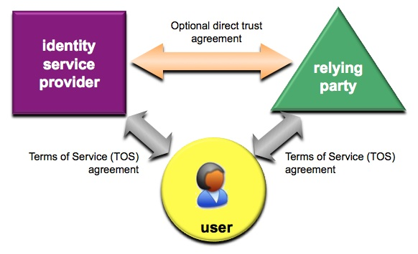
Challenges
Current Basic “Trust Triangle”
21/40

Slide 22
Challenges (cont.)
How to Achieve Digital Trust
Current General Access Control Model are static
Toward Context based Adaptive Access Control Models
Resource
Guard
Principle
Action
Authentication
Adaptive
Authentication
Authorization
Context Data
Need To add
22/40
Notes:
Current authentication systems and authorization rules are static
However, in order to enable better security and mobility, the need for repeated authentication (dynamic) capabilities is needed to ensure proper and enhanced security.
Context based authentication and authorization will ne core capabilities in future global trust frameworks
22

Slide 23
Challenges (cont.)
Privacy – Security – IdM
They are all intertwined
Data Protection
Privacy
Information
Security
Confidentiality
Authentication
IdM
Integrity
Safety
Availability
Non-
Repudiation
23/40

Slide 24
Challenges (cont.)
IdM Standardization
Trend is towards the support of strong authentication in online transaction. A major challenge is how to enable the use of strong authentication techniques and best practices in an interoperable and secure fashion
Identity Federations based on standardized trust model and global interoperability of diverse identity management schemas are major inhibitors to wide scale deployment of IdM capabilities
Development of just in time secure cloud standards for identity provisioning, de-provisioning and the control of fine grain authorizations
Enhance online trust, reducing fraud and identity theft while protecting PII

Slide 25
Challenges (cont.)
Draft X.discovery, Framework for discovery of IdM information
Provides an open architecture framework in which identity management information can be discovered
The core components of the framework set forth in this Recommendation include:
a digital object data model
a digital object interface protocol
one or more identifier/resolution systems and
one or more metadata registries
These components form the basis of the open architecture framework
Digital object architecture consists of a
  Digital Object Repository
  Resolution System
  Digital Object Registry

Slide 26
Challenges (cont.)
Draft X.atag, Attribute aggregation framework
Attribute aggregation is the process whereby a relying party obtains multiple attribute assertions for a subject , which have been issued by different SoAs, whilst the subject has
Attribute Aggregation Models
  Attribute aggregation can be performed by three different entities: the end user (client software), a trusted third party and the RP only needed to authenticate once to the system

Slide 27
Challenges (cont.)
Draft X.idmts, Framework for the interoperable exchange of trusted services
This Recommendation provides for a gap analysis to assess the necessity of a framework for the invocation of services in a trusted fashion across IdM domains
The gap analysis would assess requirements for the trusted exchange of services with known assurance levels across IdM systems (e.g., e-banking, e-health)

Slide 28
Challenges (cont.)
Draft X.authi, Guideline to implement the authentication integration of the network layer and the service layer
Provides mechanisms and specifications for telecom operators to implement integrated authentication at the network layer and at the service layer
Defines the requirements, scenarios, technical frameworks and solutions for integrated authentication
When placing an integrated authentication between the service layer and network layer, the service layer can identify a user by using the authentication information from the network layer. Such integrated authentication allows a user to be authenticated just once at the network and at the service layer (i.e., single sign-on)

Slide 29
Challenges (cont.)
Draft X.giim, Mechanisms to support interoperability across different IdM services
Generic identity management (IdM) interoperability mechanisms aim to simplify the complicated process of interaction among different identity management (IdM) systems
Describes the level of federation trust, trust framework for interoperability and introduces four typical identity management (IdM) interoperability scenarios
IdP
IdP
Trust Establishment
Identity information
discovery
Authentication/
Authorization/
Attribute Exchange
Trust Establishment/
Identity information
discovery
RP
RP
Trust
Establishment/
Identity
information discovery

Slide 30
Challenges (cont.)
Draft X.idmcc, Requirements for IdM in cloud computing
Provides requirements for the harmonization of the telecommunication services in the cloud computing environment
Identifies use-case and requirements
How to harmonize the telecommunication services and the Internet services based on a common identity management method in the cloud computing environment
Applies common IdM model onto the multiple cloud computing environment, which would be more heterogeneously overlap of the carrier and pure ICT cloud

Slide 31
Challenges (cont.)
Draft X.iamt, Identity and access management taxonomy
Develops a formal taxonomy to express identity and access management domain element relationships with a corresponding control vocabulary based on existing ITU-T and other SDOs Identity and Access Management (IAM) definitions
Purpose is to improve the quality of IAM data element definitions, as well as improve the ability to find, analyse, and reference accurate and consistent IAM data elements throughout the IAM lifecycle

Slide 32
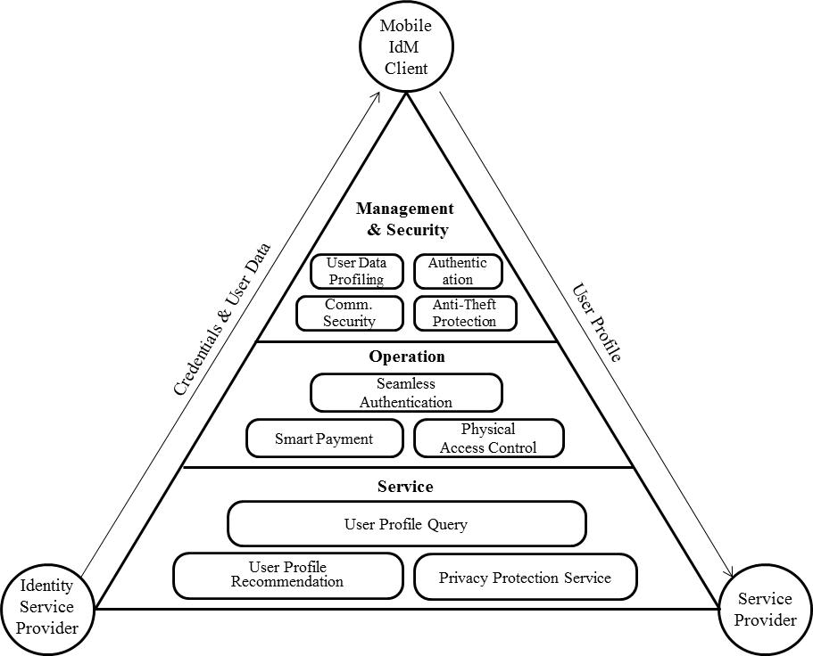
Challenges (cont.)
Draft X.mob-id, Baseline capabilities and mechanisms of IdM for mobile applications and environment
Specifies baseline capabilities and mechanisms of identity management (IdM) for mobile applications and environments.
The capabilities can include authentication, payment and personalization requirements to meet the functional aspects of IdM in a mobile context.
Specifies mechanisms of IdM in a mobile context to be satisfied when an application in a mobile environment is
developed.
Provides a reference framework that can incorporate specified baseline capabilities of IdM to be used in mobile applications and environments.

Slide 33
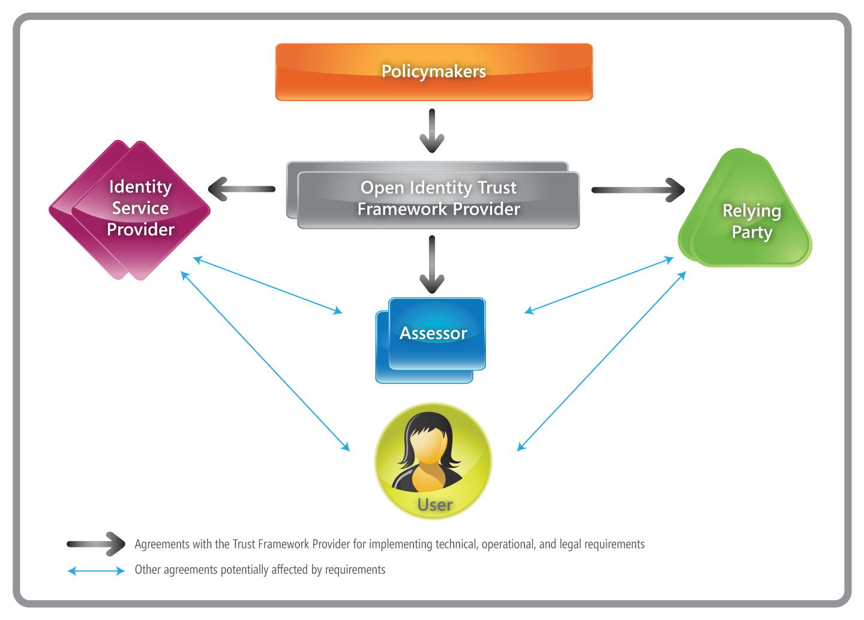
Challenges (cont.)
Draft X.oitf, Open identity trust framework
Specifies minimum requirements for the development and use of open, interoperable trust frameworks
Includes roles and relationships of parties, implementation mechanisms,
and the Principles of Openness
The participants in an OITF for identity information

Slide 34
Challenges (cont.)
Draft X.scim-use, Application of system for cross identity management (SCIM) in telecommunication environments
Develops telecom specific use cases of SCIM within a telecom environment
The use cases can be used to derive requirements for further development of SCIM protocol and to evaluate the SCIM protocol and associated schema in light of ongoing efforts in IdM

Slide 35
Challenges (cont.)
Draft F.5xx, Directory Service: Support of Tag-based Identification Services
Provides guidance for providing directory services for tag-based identification applications by reference to the directory capabilities as specified in the ITU-T X.500 Series of Recommendations | ISO/IEC 9594-All Parts and in the Lightweight Directory Access Protocol (IETF LDAP) specifications
  Case 1: the identifier is used as a whole to access a centralised directory
  Case 2: the structure of the identifier is explored to access distributed directory systems, when it is not feasible for a specific environment to hold all relevant information in a single directory
The primary focus is on Radio Frequency Identification (RFID) tags as specified within the GS1 EPCglobal specifications and within ISO and ISO/IEC International Standards
Use of Directory technology for Automatic Identification and Data Capture (AIDC)

Slide 36
Challenges (cont.)
Draft X.pki-em, Public-Key Infrastructure: Establishment and maintenance
Specifies the procedures for establishing and maintaining a PKI.
Only those aspects relevant for interworking among different PKI domains are considered
A use case could be the Smart Grid environment
Smart grids require:
  fast response time
  limited bandwidth
  Short commands may experience a significant PKI overhead, etc.
Includes generation of asymmetric keys, generation and distribution of public-key certificates, establishment of Trust Anchor information

Slide 37
Challenges (cont.)
Draft X.pki-prof, Public-Key Infrastructure: Profile
Specifies how PKI may be adapted to allow interworking among different PKI domains
May consist of different parts specifying profiles for various environments.
  One instantiation could be a PKI profile for the smart (electric) grid environment
Profiles the use of public-key certificates, suggested naming structure, what certificate extensions are relevant, details on validation of public-key certificates, revocation principles and the principle for strong authentication

Slide 38
Conclusions
Identity based services is a key technology for cloud based SaaS
Online transaction requires means for identification of all parties involved in a transaction
There need for open interoperable trust frameworks for IdM
Identity Management continue to be a key security enabler for mobile and wireless interactions
Protection of Personally Identifiable Identifiers (PII) is a required capability for IdM systems

Slide 39
Reference links
Webpage for ITU-T Study Group 17
  http://itu.int/ITU-T/studygroups/com17
Webpage on ICT security standard roadmap
  http://itu.int/ITU-T/studygroups/com17/ict
Webpage on ICT cybersecurity organizations
  http://itu.int/ITU-T/studygroups/com17/nfvo
Webpage for JCA on identity management
  http://www.itu.int/en/ITU-T/jca/idm
Webpage for JCA on child online protection
  http://www.itu.int/en/ITU-T/jca/COP
Webpage on lead study group on security
  http://itu.int/en/ITU-T/studygroups/com17/Pages/telesecurity.aspx
Webpage on lead study group on identity management
  http://itu.int/en/ITU-T/studygroups/com17/Pages/idm.aspx
Webpage on lead study group on languages and description techniques
  http://itu.int/en/ITU-T/studygroups/com17/Pages/ldt.aspx

Slide 40
Thank you!
40/40

