Slide 1


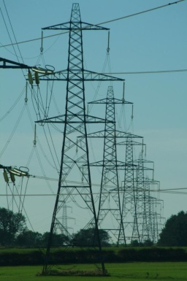
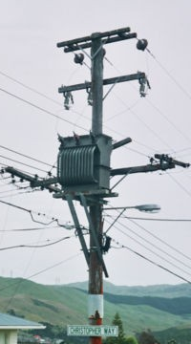


Smart Grid Standardization Activities
Document No: | GSC16-PLEN-35
Source: | TIA
Contact: | David Su (david.su@nist.gov) Jane Brownley (jane.brownley@alcatel-lucent.com) Mike Lynch (MJLynch@mjlallc.com)
GSC Session: | PLENARY
Agenda Item: | 6.10
David Su, TIA, NIST

Slide 2
Priority Areas for Standards
Demand Response and Consumer Energy Efficiency: Mechanisms and incentives for business and residential customers to cut energy use during times of peak demand.
Wide Area Situational Awareness: Monitoring and display of power-system components and performance across interconnections and wide geographic areas in near real-time
Electric Storage: Means of storing electric power, directly or indirectly
Electric Transportation: Enabling large-scale of plug-in electric vehicles (PEVs)
Advanced Metering Infrastructure: Means for utilities to interact with meters at customer sites
Distribution Grid Management: Maximizing performance of feeders, transformers, and other components of networked distribution systems and integrating with transmission systems and customer operations.
Cyber Security: Cyber security for smart grid systems and networks
Network Communications: Networking infrastructure for above functions

Slide 3



Smart Grid Interoperability Panel
Governing Board
SGIP Officers
NIST
SGIP Administrator
Priority Action Plan Teams
Test & Certification
Architecture
PAP 1
PAP 2
PAP 3
Committee
Committee
(SGTCC)
(SGAC)
PAP 4
PAP …
PAP 17
Cyber Security
Working Group
(CSWG)
Standing Committees &
Domain Expert Working Groups
Working Groups
BnP
H2G
B2G
TnD
I2G
PEV2G
Program
Comm.
Bylaws &
Mgmt
Marketing
Operating
Electromagnetic Interoperability Issues
Office
Education
Procedures
(PMO)
(CME)
(BOP)
Coordination Functions
SGIP Membership
Notes:
3

Slide 4















Standards Come from Many Developers
International
Global
Consortia
Regional and
National

Slide 5
Filling Gaps in the Standards
Priority Action Plans (1)
Main Focus: Communications for smart grid applications – networking, data models, representations, and semantics.
PAPs supporting smart grid communications, and networking:
  Guidelines for the Use of IP Protocol Suite in the Smart Grid (PAP 01);
  Guidelines for the Use of Wireless Communications (PAP 02);
  Harmonize Power Line Carrier Standards for Appliance Communications in the Home (PAP 15)
PAPs supporting metering:
  Meter Upgradeability Standard (PAP 00);
  Standard Meter Data Profiles (PAP 05)
PAPs supporting enhanced customer interactions with the smart grid:
  Standards for Energy Usage Information (PAP 10,PAP17);
  Standard Demand Response Signals (PAP 09);
  Develop Common Specification for Price and Product Definition (PAP 03);
  Develop Common Scheduling Communication for Energy Transactions (PAP 04)
5

Slide 6
Filling Gaps in the Standards
Priority Action Plans (2)
PAPs supporting distribution and transmission:
  Develop Common Information Model (CIM) for Distribution Grid Management (PAP 08);
  Transmission and Distribution Power Systems Model Mapping (PAP 14);
  IEC 61850 Objects/DNP3 Mapping (PAP 12);
  Harmonization of IEEE C37.118 with IEC 61850 and Precision Time Synchronization (PAP13)
PAPs supporting new smart grid technologies:
  Energy Storage Interconnection Guidelines (PAP 07);
  Interoperability Standards to Support Plug-in Electric Vehicles (PAP 11)
  Wind Power Communications (PAP16)
PAPs for smart grid application profiles.
  Migration path for Zigbee Alliance Smart Energy Profile 1.x to 2.0 (PAP18)
6

Slide 7
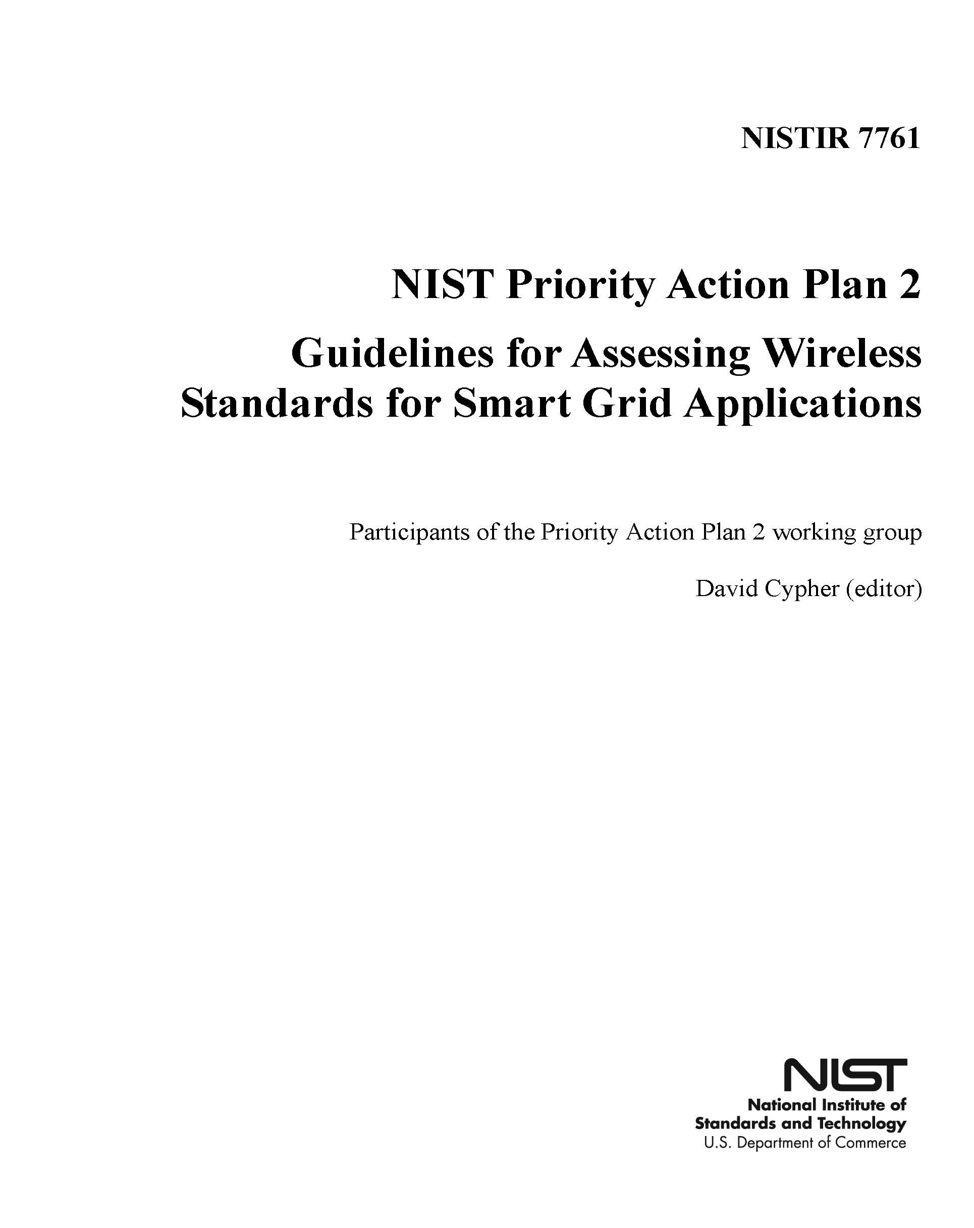
Networking & Communications Standards (PAP 1, 2, 15)
Reached a consensus on the use of IP-based network for Smart Grid networks (PAP01, RFC 6272, Internet Protocols for the Smart Grid)
Produced a Guideline for Assessing Wireless Standards for Grid Applications (PAP02 NISTIR 7761)
For a revision of NISTIR 7761, PAP02 continues to evaluate the performance of wireless protocols using the parameters specific to smart grid applications and their environments
Harmonized power line communications protocols (PLC) and their coexistence mechanisms (PAP15).
7

Slide 8

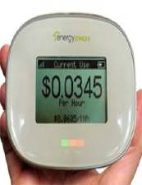
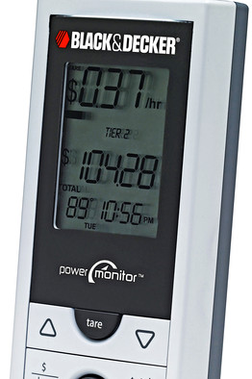
Energy Usage Information Standards (PAP10)
Standardizes data elements available to consumers or authorized 3rd party application providers
Energy usage information -Standard developed and published by NAESB - December 2010
8

Slide 9

Electric Vehicle Charging Standards (PAP11)
Data model & Information exchange protocols - “SAE J2836/1 Enables Electric Vehicle, Power Grid Communication.”
Fast charging connector standard - “SAE J1772 Electric Vehicle and Plug in Hybrid Electric Vehicle Conductive Charge Coupler.”
9

Slide 10
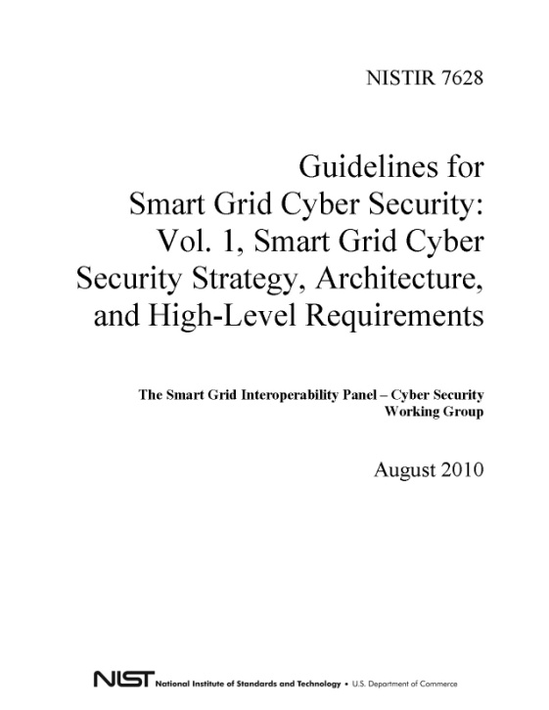
Guidelines for Smart Grid Cyber Security
(Cyber Security Working Group)
Building cyber security in from the start has been a paramount concern
Permanent Working Group
  Over 650 public and private sector participants
August 2010 NIST publishes: Guidelines for Smart Grid Cyber Security
Guideline includes:
  Risk assessment guidance for implementers
  Recommended security requirements
  Privacy recommendations
Notes:
10

Slide 11
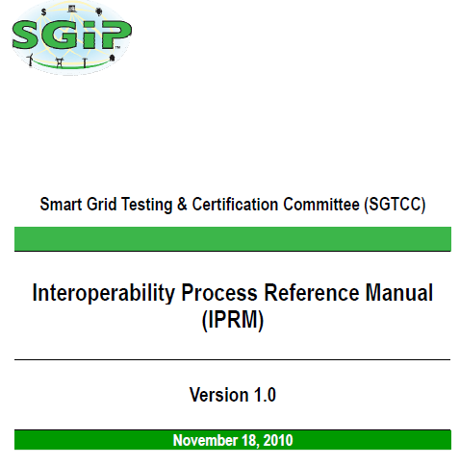
Testing and Certification Framework
Defined in SGIP Interoperability Process Reference Manual (IPRM)
SGIP Testing and Certification Committee
Interoperability Testing and Certification Authorities
Certification Bodies
Test Labs
SGIP IPRM documents requirements and best practices for ITCAs, CBs and TLs
ITCAs establish T&C schemes for specific domains/use cases and accredit CBs and TLs
Initially-identified ITCAs: NEMA, UCAIug 61850, OpenADR, and Multispeak
Certify test results
Perform conformance and/or interoperability testing to specified test cases

Slide 12
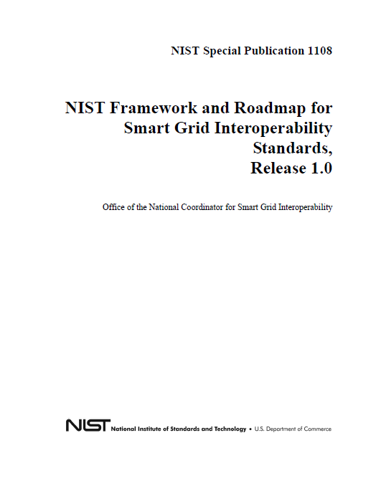
NIST Smart Grid Framework and Roadmap 2.0
Release 2 draft has gone through reviews by SGIP Working Groups and PAPs
  Final draft to be published on Federal Register Notice for public review soon
Contains updates to:
  list of standards and their status
  output of Priority Action Plan Projects and Working Groups
  cyber security strategy, privacy, and reliability issues
2.0
http://www.nist.gov/smartgrid/

Slide 13
TIA TR45.5 Smart Grid Activities
Together with other wireless technology standards development organizations (SDOs) and the utilities industry, TR45.5 has been participating in the Smart Grid Interoperability Panel’s Priority Action 2 (Wireless Technologies for Smart Grid) since early 2010
SGIP PAP2 approved its first document NIST Interagency Report 1776 “Guidelines for Assessing Wireless Standards for Smart Grid Applications” in January 2011
  This was published by NIST as an Interagency Report
PAP2 has been working on the second version of 1776 since early 2011 to further enhance the evaluation of wireless technologies

Slide 14
TIA TR50 &TR51 Smart Grid Activities
TR-50 (Smart Device Communications) and TR-41 (User Premises Telecommunications Requirement) are engaged in standards development related to smart grid devices and communications, more specifically M2M communications.
TR-51 is developing access standards for Smart Utility Networks
  Addresses OSI Layers 1 – 4
  Facilitate a set of wireless solutions allowing:
    Use of IEEE 802.15.4g PHY information as appropriate (subcommittee TR-51.1)
    Participation by compatible industries - e.g. electric and other utility providers

Slide 15
Proposed Resolution on Smart Grid
Propose that GSC-16 reaffirms Resolution GSC-15/29 on Smart Grid.

Slide 16
Supplementary Slides

Slide 17
NIST Standardization Process Design
NIST’s role is to coordinate development of standards, NIST will not itself develop the standards or conduct testing/certification – SDOs, test labs and certification bodies will do this and their deliverables will be referenced by NIST.
NIST publishes a smart Grid framework and roadmap document to guide the process. a will periodically revise the framework until work is complete. The Release 1 framework was developed through a phase 1 process involving public workshops and public review and comment of documents.
NIST established a permanent organization – the SGIP – which provides an institutionalized process to evolve and maintain the SG framework, as well as developing process for testing/certification.
Our vision is that the SGIP will evolve from a US-initiated organization to a fully international organization in much same was as IAB and ICANN evolved. We envision that SGIP’s role continues to be coordination and high-level architecture, and does not get into standards development.

Slide 18
Smart Grid Stakeholders
1 | Appliance and consumer electronics providers
2 | Commercial and industrial equipment manufacturers and automation vendors
3 | Consumers – Residential, commercial, and industrial
4 | Electric transportation industry Stakeholders
5 | Electric utility companies – Investor Owned Utilities (IOU)
6 | Electric utility companies - Municipal (MUNI)
7 | Electric utility companies - Rural Electric Association (REA)
8 | Electricity and financial market traders (includes aggregators)
9 | Independent power producers
10 | Information and communication technologies (ICT) Infrastructure and Service Providers
11 | Information technology (IT) application developers and integrators
12 | Power equipment manufacturers and vendors
13 | Professional societies, users groups, and industry consortia
14 | R&D organizations and academia
15 | Relevant Federal Government Agencies
16 | Renewable Power Producers
17 | Retail Service Providers
18 | Standard and specification development organizations (SDOs)
19 | State and local regulators
20 | Testing and Certification Vendors
21 | Transmission Operators and Independent System Operators
22 | Venture Capital

Slide 19
SGIP Membership
As of July 2011
Total # of Member Organizations: 680
  # of Participating Member Organizations: 372
  # of Observing Member Organizations: 308
  # of Organizations who joined in May & June: 9
Total # of Individual Members*: 1,794
# of Organizations by Country
USA: 604
Europe: 22
Asia: 18
Oceania: 5
North America
(non-US): 29
South America: 1
Africa: 1
# of Participating Member Organizations by Declared Stakeholder Category
* Omits non-active Signatory Authorities.
Stakeholder Categories
Notes:
Companies that joined since the beginning of 2011 include State Grid Corporation of China, Solairedirect (France), Airspan Networks, OMG,Certicom, Korea Electrotechnology Research Institute (KERI) and Canterbury University, Dept Computer Science (New Zealand).

Slide 20
Catalog of Standards
SGIP produces and maintains the Catalog of Standards (CoS) relevant for the development and deployment of a robust and interoperable Smart Grid
  The wireless portion of the CoS
The standards in CoS has to have:
  Standards Information Form
  Development Process Statement: what SSO does relative to:
    Openness.
    Balance of interest
    Due process
    An appeals process
    Consensus
  Criteria and Analysis Report: recommendation to add to CoS standards that are not emerging from Priority Action Plans (PAPs)
    Produced by individual DEWG or Standing Committee assigned by SGIP Plenary Leadership
    Relevancy
    Community Acceptance
    Deployment Suitability
    Interface Characterization
    Document Maintenance
    CSWG Analysis
    SGAC Analysis
    SGTCC Analysis
The objective is to have TIA standards as part of the Catalog of Standards
20

Slide 21
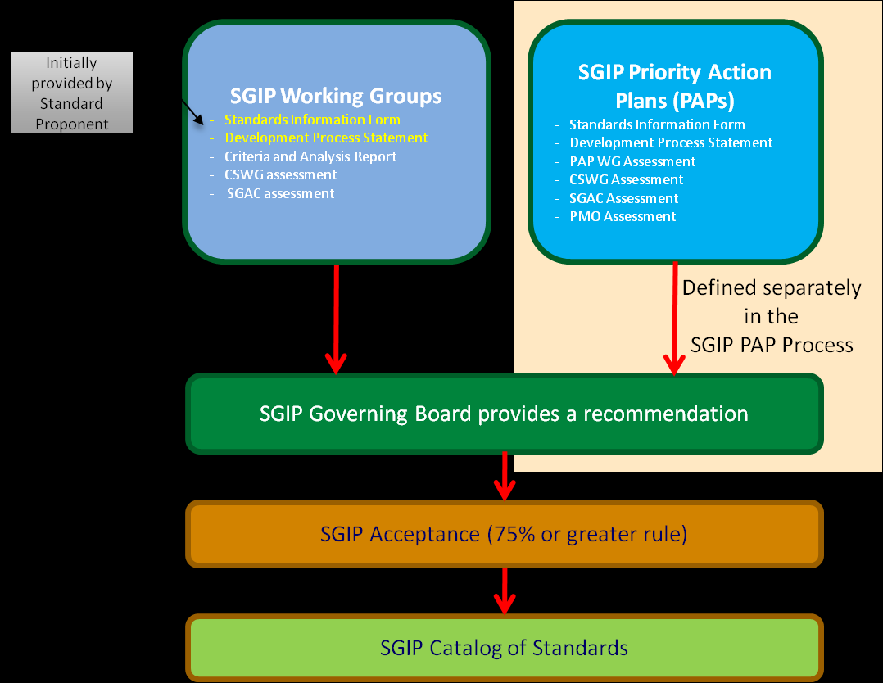
The CoS Process

Slide 22
TIA TR45.5 Evaluation of Protocols
An SDO subcommittee was formed in PAP2 to produce more evaluation details
Using Version 5 of the SG Net group in OpenSG document describing messages, transmission characteristics (e.g., frequency of transmission) and messaging requirements (e.g., latency requirements) in a smart grid network, the group is furthering its evaluation on:
  Path loss models, link budgets, and system throughputs
  Proposed text changes and additions to the NISTIR 7761 document
  A link budget tool for various wireless technologies based on S/(N+I) necessary for various data and code rates and other operating conditions.
The objective is to have a successful evaluation that includes TIA inputs
22

Slide 23
TR-51
TIA created a new committee - TR-51
  Exclusively for Smart Utility Networks (SUN) and similar applications
  Addresses OSI Layers 1 – 4
  Facilitate a set of wireless solutions allowing:
    Use of IEEE 802.15.4g PHY information as appropriate (subcommittee TR-51.1)
    Participation by compatible industries - e.g. electric and other utility providers
  Complement architecture work being done in TR-50

Slide 24
TR-51 Focus
OSI L1 – L4 and interoperability
Protocols optimized for Smart Utility Networks applications
Unique customer requirements
    Overlay networks for fault reporting, control and metering
    High reliability
Low duty cycle

Slide 25
TR-51 Timeline Summary
2 year timeframe (2011 – 2013)
  4 Face-to-Face meetings per year
  Bi-weekly conference calls or as needed
Documentation
  PHY Layer document
  MAC Layer document
  Network Layer document
  Transport Layer document
  Test and/or conformance documents

