Slide 1

Smart and sustainable cities:
The importance of indicators and metrics in policymaking and policy assessment
ITU Workshop on
“Smart Sustainable Cities in Latin America”
São Paulo, Brazil, 30 July 2013
Alexandre F. Barbosa, PhD
Manager, Regional Center for the Development of Information Society – CETIC.br
barbosa.afb@nic.br

Slide 2
Agenda
Part I: Challenges to policymaking
Part II: Importance of indicators and metrics in policymaking and policy assessment: key initiatives
Part III: Multistakeholder approach in producing ICT4D statistics in Brazil
Part IV: Facts and figures about ICT access by households and individuals in Brazil

Slide 3
Smart and Sustainable Cities Implementing the SSC concept
Smart Societies I&KS
Public Services
Environmental Education
Energy Management
SSC
ICT
Transport and Mobility
Smart Buildings
Waste Management
Water Management
Challenges for policymaking

Slide 4
Smart Sustainable Cities
Challenges to evidence-based policymaking
SSC
Political Agenda
ICT Policies
Impacts
ICT
Policy assessment
Social
Economic
Environmental
Framework
Indicators and metrics
Quality and internationally comparable data.

Slide 5
Smart Sustainable Cities
Challenges to evidence-based policymaking
How to design effective policies to address the challenges posed by the implementation of the concept of SSC?
Measurement matters: evidence-based !
Methodology matters !

Slide 6
Importance of statistics in policymaking and policy assessment
“Good policy requires good statistics at different stages of the policymaking process.”
(Scott, 2005)
“The impact of policy can be measured with good statistics. If policy cannot be measured it is not good policy.”
(Othman, 2005)
Reliable
Policy relevant
Timely (to inform policy decisions)
Accessible to all key stakeholders
Cost-effective
Interdisciplinary enough to address cross-cutting issues
ICT-related statistics
Survey data in policymaking

Slide 7





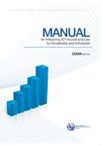


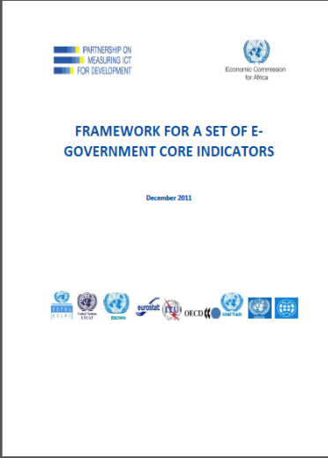

ICT Survey Models
ICT core indicators
International common framework: methodology, core indicators definition, questionnaire.
  ICT Households and Individuals
  ICT Enterprises
  ICT E-Government
  ICT in Education
  ICT in Health

Slide 8



Initiatives for measuring environmental impacts
Defining concepts and indicators
e-Waste (WEEE - waste electrical and electronic equipment)
e-Waste recycling
Green ICT
Green growth and sustainable development

Slide 9


Sustainable Development Indicators
EU Sustainable Development Strategy
Themes:
Socio-economic development
Sustainable consumption and production
Social inclusion
Demographic changes
Public health
Climate change and energy
Sustainable transport
Natural resources
Global partnership
Good governance
The Sustainable Development Indicators (SDIs) are used to monitor the EU Sustainable Development Strategy (EU SDS) in a report published by Eurostat every two years.
100 indicators.
11 indicators have been identified as headline indicators.

Slide 10






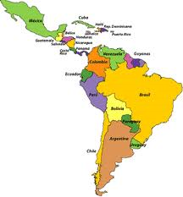
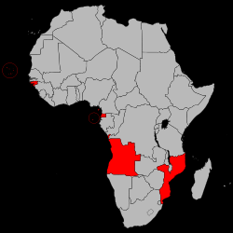
ICT4D statistics in Brazil
Multistakeholder approach
Brazilian Internet
Steering Committee
Brazilian Network
Information Center
Regional Centre of
Studies for the
Development of the
Information Society
Latin America and Portuguese speaking African countries

Slide 11
ICT Surveys in Brazil
Monitoring Information Society’s priority areas

Slide 12
Engaging stakeholders
ICT survey process

Slide 13
Engaging stakeholders
Data dissemination and use

Slide 14
Pillars of CETIC’s survey process
Articulation of productive partnerships: multistakeholder model

Slide 15
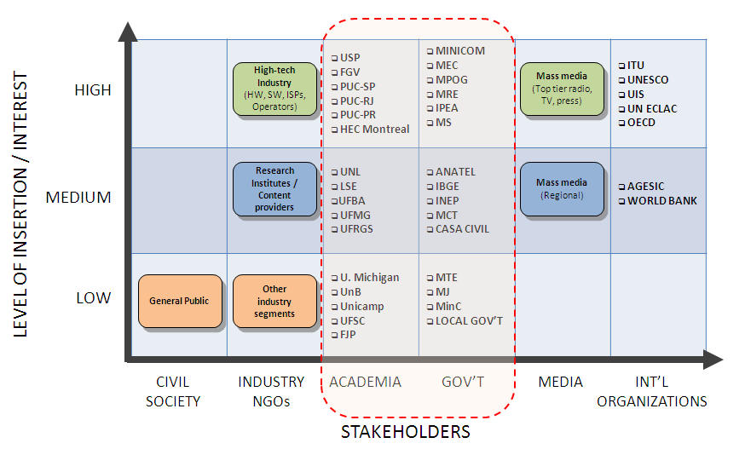
Matrix of ICT survey’s stakeholders
Level of interest / insertion

Slide 16
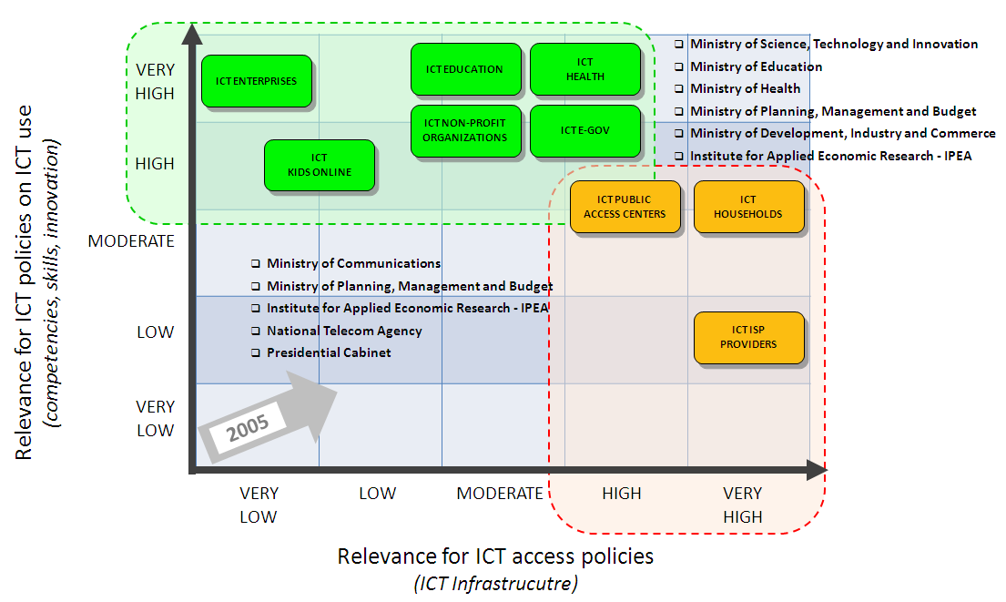
Matrix of relevance for ICT policies
Use of ICT survey data

Slide 17
Policies based on ICT survey data
Relevance for ICT policies
2005
Policy design and monitoring
2013
Tax Exemption Program for Computers (Computer for All Program)
Broadband National Plan
Low Cost Broadband Program (1Mbps at USD 15)
Act 12.715/2012: Tax exemption for telecom services in rural areas
Broadband for Rural Areas Program (450 MHz-2014)
Smart Cities
Telecentres
Tax Exemption Programs (Internet and smartphone)
Proinfo (Computer Labs in public schools)
Broadband in Schools Program
UCA (one laptop per child program)
E-Gov Action Plan
ICT Skills development programs
ICT impact assessment in the health sector

Slide 18
Brazil
Facts and Figures

Slide 19
Brazil
ICT access by households and individuals

Slide 20
Thank you !
ICT surveys available for download at
www.cetic.br/publicacoes

