Slide 1

QoE and QoS Monitoring / Measuring in Broadband Internet Networks
Workshop on “Monitoring Quality of
Service and Quality of Experience of Multimedia Services in Broadband/Internet Networks”
(Maputo, Mozambique, 14-16 April 2014)
Seppo Lohikko
Principal Consultant, Omnitele Ltd seppo.lohikko@omnitele.com

Slide 2

topics discussed
Omnitele
Introduction to QoS and QoE
QoS / QoE Monitoring and Management
Omnitele approach to measure end-user QoS / QoE
Summary

Slide 3
why we exist
Network strategy, design and quality management for maximised customer experience and minimised network cost.
track record
Founded in 1988 to set up world’s first GSM network. 1000+ projects in 80+ countries.
independent
Privately owned by telecom background Finnish shareholders, independent of all international operators and network infrastructure vendors.
omnitele way
Being Straightforward, Trusted and Intelligent ensures excellent Omnitele Experience.
www.omnitele.com
COMPETITIVE NETWORK BENCHMARK | SWEDEN | 2014

Slide 4
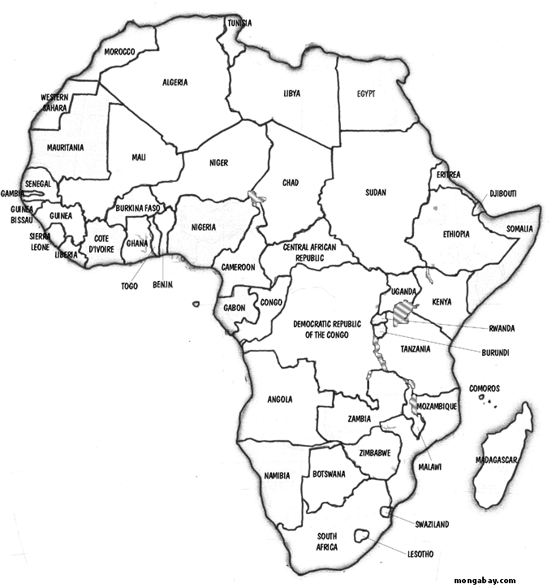
Omnitele footprint in Africa
Business Development Ongoing
Projects Completed
In total Omnitele has completed over 50 projects in Africa since 2007.

Slide 5
topics discussed
Omnitele
Introduction to QoS and QoE
QoS / QoE Monitoring and Management
Omnitele approach to measure end-user QoS / QoE
Summary

Slide 6
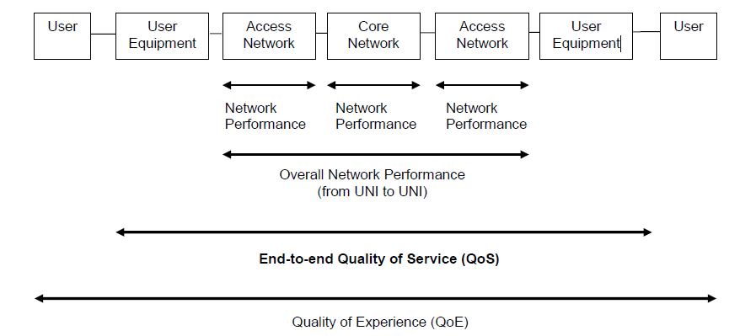
Quality of Service / Quality of Experience / voice
User
User
Equipment
Access
Network
Core
Network
Access
Network
User
Equipment
User
”MOS”

Slide 7
Quality of Service / Quality of Experience / data
Internet
User
User
Equipment
Access
Network
IP Trans
port
Core
Network
Network
performance
Network
performance
Network
performance
Network
performance
Network
performance
Total network performance
Quality of Service
Technical component of Quality of Experience

Slide 8


Paradigm Shift Required in QoS Measurements
Yesterday
Today
Two services: CS & PS
Few KPIs to capture overall QoS: Call Completion Rate, Bitrate
   NETWORK CENTRIC QOS REQUIREMENTS
A Generic PS service does not exist anymore
Instead WWW, Video, IM, VoIP…
   APPLICATION SPECIFIC QOS REQUIREMENTS
Throughput & Coverage measurements are obviously insufficient to capture the End-user QoS
Notes:
Game has changed: bitrate is no longer the only bottleneck of the end-user QoS. Different apps have different bottlenecks. Bitrate is important but it does not give the whole picture.

Slide 9












Application Performance is the Make It or Break It
END-USERS MIND SERVICE QUALITY, NOT NW PERFORMANCE
They consume VoIP, video, news, social networking, etc
They don’t consume average throughput
 focus on the services – not the networks

Slide 10





QoE of a soccer ball?
We just want a ball!
We just want a ball!
Any ball is good!
I want it with iPod dock and blue LEDs
If we cannot define the QoE of a soccer ball, how can we approach something as complex as a Telecom Service?
Balls are so expensive...
I want it to go easily into the goal…

Slide 11
what are QoS and QoE?
price
QoE
QOE DEPENDS ON…
expectations
branding
socio-economic background
price
customer care
provisioning
end-user QoS
our focus
QoS
network
brand
service
device
expectations

Slide 12

Diverging Promise, Delivery and Expectation
Promise | Operators are marketing with headline speeds
Delivery | End-user bitrate only fraction of the headline
Expectation | 10Mbit/s MBB = 10Mbit/s DSL
Frustration guaranteed!
*Based on Omnitele network simulations and analysis of real operator networks
Notes:
There are so many different bitrates, that nobody can be sure of nothing. The gap between the promise and the delivery is widening. Regulators should counteract the development.

Slide 13


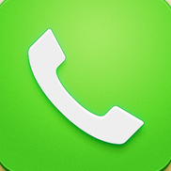



QoE, QoS and network performance quantified
  QUALITY OF EXPERIENCE
  How well service quality meets expectations?
  overall Satisfaction, e.g. 1-5 ”stars”
  Highly market dependent and user segment specific
  QUALITY OF SERVICE
  How well does a service perform
  Measured application/service KPIs
  product of one or more network performance factors
  NETWORK PERFORMANCE
  Technical measurements of the network
  e.g., delay, jitter, packet loss, throughput...
RSCP
Ec
/N0 latency jitter packet loss RSRP RLC throughput RSRQ
RAB setup success rate modulation coding TX power G
-
factor Channel C/I
Timing Advance Mobile TX Power Voice Codec Usage Handover Success Rate
MCS Usage Distribution Time Slot Utilization Block Error Ratio Active Set
Size SHO Success Rate ISHO Success Rate CQI E
-
DPDCH Throughput PDSCH
modulation MAC DL BLER MAC UL BLER MAC UL Retransmission Rate

Slide 14
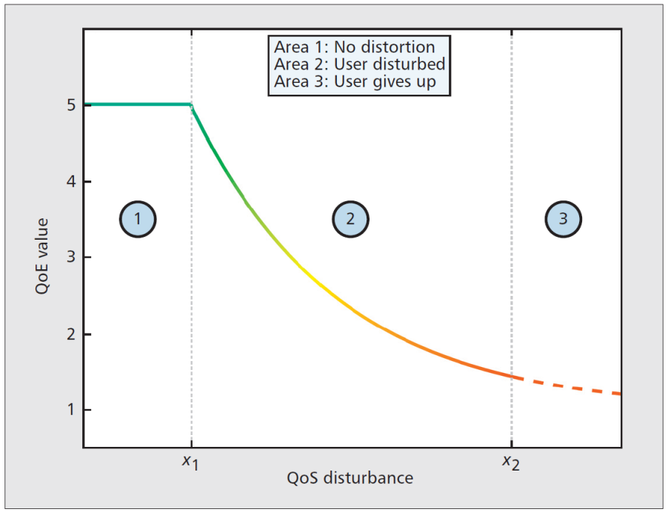
Generic relation of Qos and QoE
The contour shape is universal
Steep QoE decrease right after X₁
The actual values vary with respect to markets, services, segments, devices, price plans...
No ”one size fits all” exists – remember the soccer ball!
Source: A Generic Quantitative Relationship between Quality of Experience and Quality of Service. (Fiedler, Hossfeld, Tran-Gia)

Slide 15
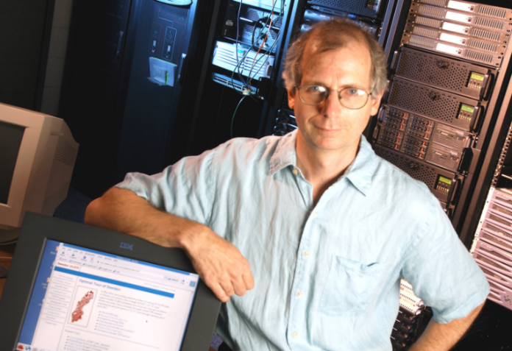



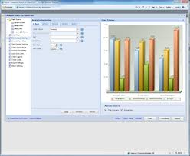
common operator challenge: “How is the business?”
???
“The network is excellent. RSCP, Ec/No, BLER aligned with targets”
“Churn is high, customers not satisfied, competitor has higher quality”
need to find right targets for acceptable QoE!

Slide 16

introduction | problem setting
1|
Technical organisation can easily measure and impact network performance but end-user’s care about QoE
2|
Need to find the right KPI target values giving sufficient QoE and optimise the network accordingly
3|
Improved End-user Satisfaction, Network Efficiency and Return on Investment
…In essence, this is what CEM is in technical context!

Slide 17
topics discussed
Omnitele
Introduction to QoS and QoE
QoS / QoE Monitoring and Management
Omnitele approach to measure end-user QoS / QoE
Summary

Slide 18
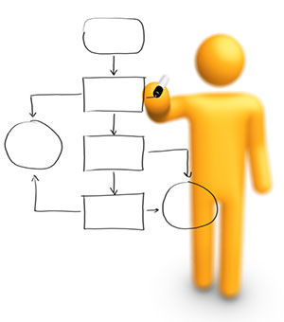
Let’s explore briefly some typical QoS / QoE tooling frameworks…

Slide 19
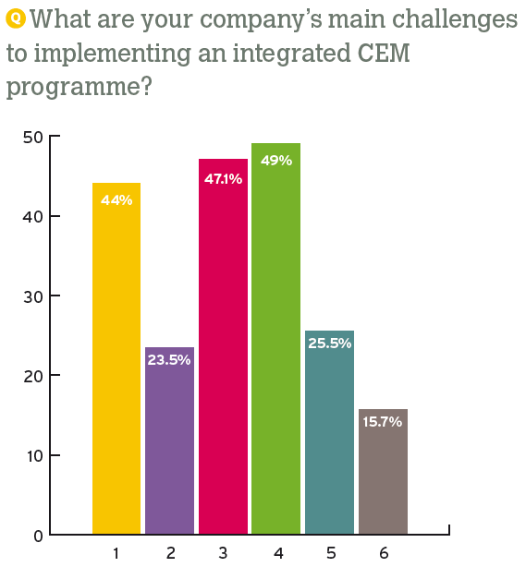
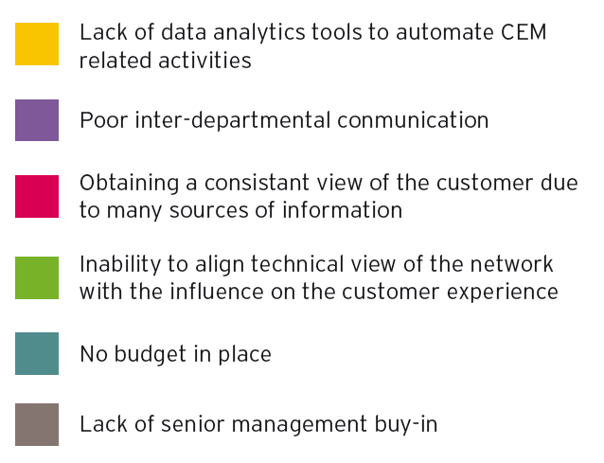
Typical operator challenges
Mobile operators’ CEM strategies: the market reality | telecoms intelligence survey report | Nov2013

Slide 20
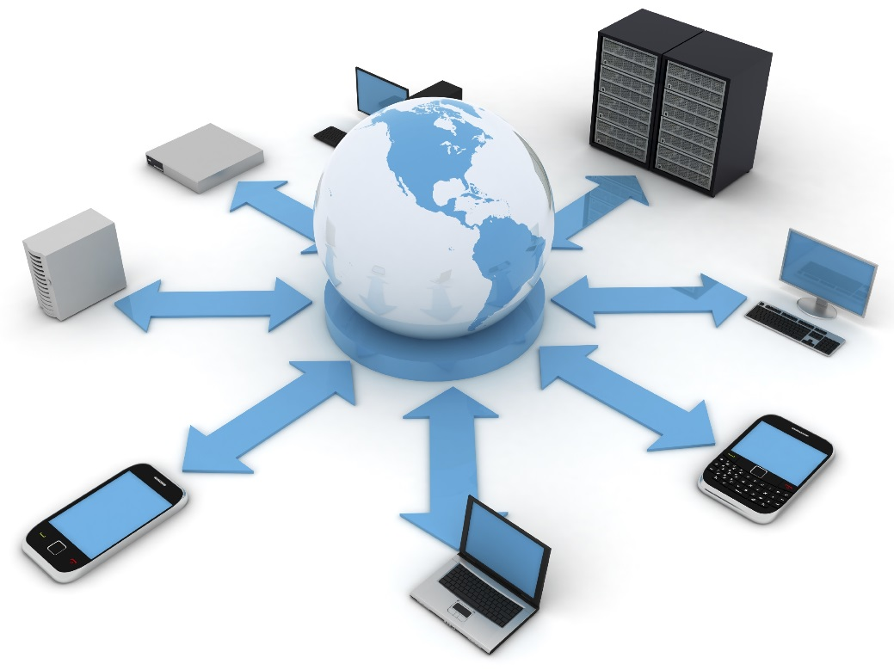

Network statistics & probes
Straightforward implementation, but not necessarily sufficiently detailed level of data
Complex integration to other BI systems (CDR, CRM)
Limited location accuracy: ~20% of cell radius
Cross-correlation to any QoE polls difficult
Cost efficient & easy rollout
Notes:
CDR = CRM, customer relationship managent

Slide 21
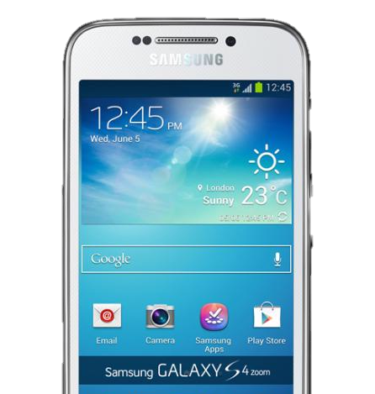
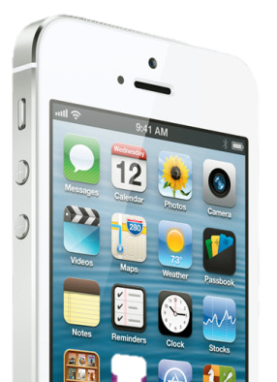

Smartphone QoS/QoE agents
Detailed data in high “resolution”, but rollout challenges expected
Accurate user, device, time, location and service context
QoE polls implemented with the agent software
QoE & QoS from same source: straightforward cross correlation
…CHALLENGING ROLLOUT (deployment cost, user sensitivity)

Slide 22

Example system with smartphone agent
QoE Server
Manage QoE client pool
Control QoS measurements and QoE queries
Data aggregation, KPI trending, QoE vs. QoS X-correlation
Config.
QoE?
QoS
QoE
Meta
QoE Client
QoS “agent” monitoring end-user behaviour and QoS
User interface for QoE polls and end-user feedback
Send KPI values and QoE poll answers to QoE server

Slide 23
Hybrid solution
PROBLEM SETTING:
Smartphone agents: sufficient detail but rollout challenges
NW probes: straightforward rollout but lack of detail
HOW ABOUT A HYBRID SOLUTION?
QoE–QoS modelling with smartphone agents in limited user group
Apply model in probe data to obtain network wide exposure to QoE

Slide 24

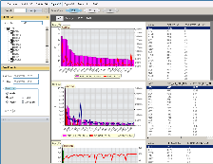

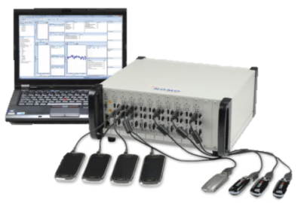
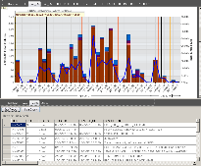
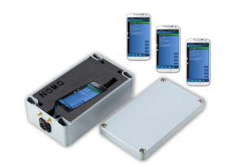

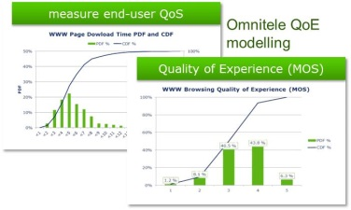
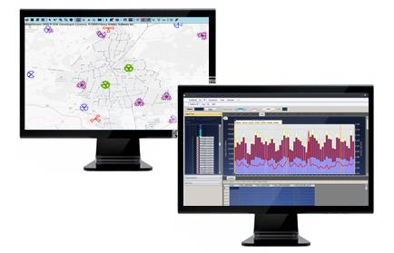
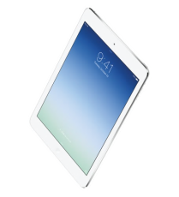
Example hybrid solution overview
Probes & statistics
International
Benchmarks
End-user Qos
Measurements
Automatic Service
Assurance Monitoring
Benchmark & Quality
Measurements
Apply QoE model to measured QoS results
Present QoS Results
QoE Modelling Surveys
QoE model
Customer Experience
Platform
Tune QoE
model based on
controlled
CE Measurement
Calculated
MOS score

Slide 25
topics discussed
Omnitele
Introduction to QoS and QoE
QoS / QoE Monitoring and Management
Omnitele approach to measure end-user QoS / QoE
Summary

Slide 26
Basics | QoS Framework Suggested by ETSI
Accessibility
Retainability
Integrity
The probability that a user can access a service when network is available
E.g. Call Setup Success Rate, Data session setup success rate
Probability that the service is not interrupted during the connection
E.g. Call drop rate, PDP context cut-off ratio
The service quality when service is in use, up and running
E.g. bitrate, voice quality, call setup time
Network Availability
Network Accessibility
Service Accessibility
Service Retainability
Service Integrity
Web
Radio
WWW
SMS
Email
VoIP
FTP
MMS
Y
Video
CS
Voice
X
Z
L1
L2
L3
L4
*TS 102 250-2
Conclusion | Need to define the corresponding ”reference levels” for all relevant L4 services and killer apps.

Slide 27
From KPIs to End-user QoS…
Omnitele QoS Framework following ETSI TS 102 250-2
Network Availability
Network Accessibility
Service Accessibility
Service Integrity
Service Retainability
Coverage Problems
Network Access Problems
Service Access Problems
Service Drops
Service Quality Problems
+
+
+
+
=
Total Problems
[Total Problems ] / [All attempts] = End-user QoS

Slide 28
WWW & Video dominate usage!
Which applications to measure
MOBILE DATA USE CASE POPULARITY AND DATA VOLUME
Source: Allot MobileTrends Report Q2/2013, CISCO VNI 2012

Slide 29
Bitrate impact on Web Browsing QoS
End-user QoS mainly defined by
  webpage waiting time and
  streaming video buffering time
Bitrate is important but its impact is highly non-linear
The higher the bitrate, the less important it becomes
Shape of the curve differs between networks  Bitrate measurements do not show the truth. Waiting time and buffering time do!
“Frustration”
“Acceptable”
“As good as it can get”
Notes:
The importance of bitrate improvement decreases while the bitrate increases. Instead of comparing the operators by bitrates, the benchmarks should measure more meaningful attributes, e.g. WWW page waiting time. WWW page waiting time is something that everyone understands, hence benchmarking it enables apples to apples comparison.

Slide 30

Let’s take a dive into WWW browsing Quality of Experience…
OPERATOR CASE: QoE FOR WWW BROWSING

Slide 31

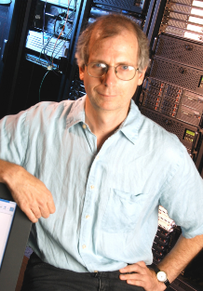
OBJECTIVE | sufficient web browsing experience for high value customers
1. QoE targets: define the desired WWW QoE level
2. QoS targets: measure QoE & QoS and cross-correlate to define the relation
3. NW performance targets: Link QoS with NW performance to find right network performance KPI targets

Slide 32

1. QoE TARGET | define the desired WWW QoE
QoE defined in 1 – 5 SCALE
Captured with end-user queries: “On 1-5 scale, what is your WWW browsing experience?”
SUFFICIENT
QoE TARGET
90% of customers ≥ 4
rating | QoE | Impairment
5 | Excellent | Imperceptible
4 | Good | Perceptible but not annoying
3 | Fair | Slightly Annoying
2 | Poor | Annoying
1 | Bad | Very Annoying

Slide 33
2. QoS TARGET | correlate QoS with QoE
unsatisfactory region
(MOS < 4)
QoE target ≥ 4
QoS target: WWW download time < 3s

Slide 34
3. CTO TARGETS | find required NW performance to deliver desired QoE
Duly noted!
unsatisfactory region
(www download time > 3s)
90% of subs get > 4,5 Mbit/s
CTO’s NW Performance Target:
accepted region
(www download time < 3s)
Notes:
Technology agnostic, device specific delays not taken into account

Slide 35
topics discussed
Omnitele
Introduction to QoS and QoE
QoS / QoE Monitoring and Management
Omnitele approach to measure end-user QoS / QoE
Summary

Slide 36

Session conclusions & key messages
1|
Challenge: CMO and CTO talk different language
2|
Proper CEM is imperative for securing good enough QoE
3|
Need to define the corresponding reference levels for all relevant L4 services and killer apps.
NW DEVELOPMENT SHOULD BE DRIVEN BY QoE
CMO team to set QoS/QoE targets based on demand & strategy (…and regulation?)
CTO team to deliver sufficient NW performance

Slide 37

End-User Quality Surveys
Wake up!
Periodic QoS measurement process is required to follow the quality trends
A proper methodology involves truly end-user centric approach: measure WWW, VoIP, video…not network
A holistic QoS process involves KPIs that really matter from customer perspective

Slide 38

End of Session …
Questions?

Slide 39

Any further enquiries:
Mr. Seppo Lohikko
Principal Consultant
Omnitele Ltd.
Mobile: +358 44 2793811
seppo.lohikko@omnitele.com
www.omnitele.com
Follow us at www.linkedin.com/company/omnitele
http://www.youtube.com/channel/UCyMeM3j2L9MQoB0qeDCev3g

