Slide 1
Bahrain Experience with
Broadband Quality of Service
Eric Dunand
2014

Slide 2
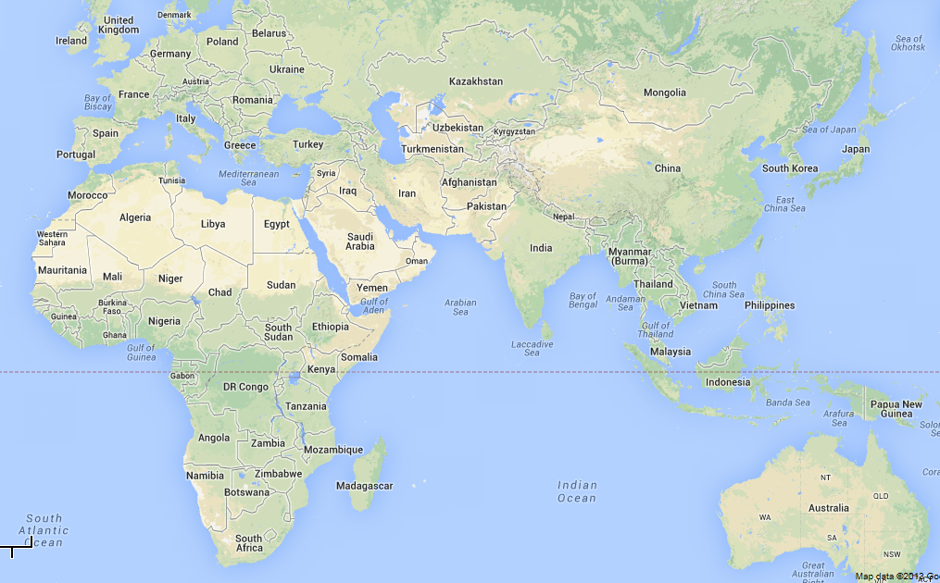
A small clarification before we start
Kingdom of Bahrain

Slide 3
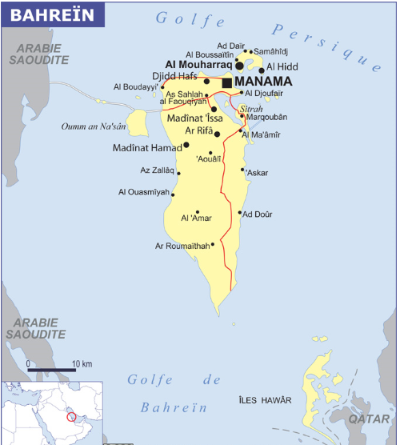
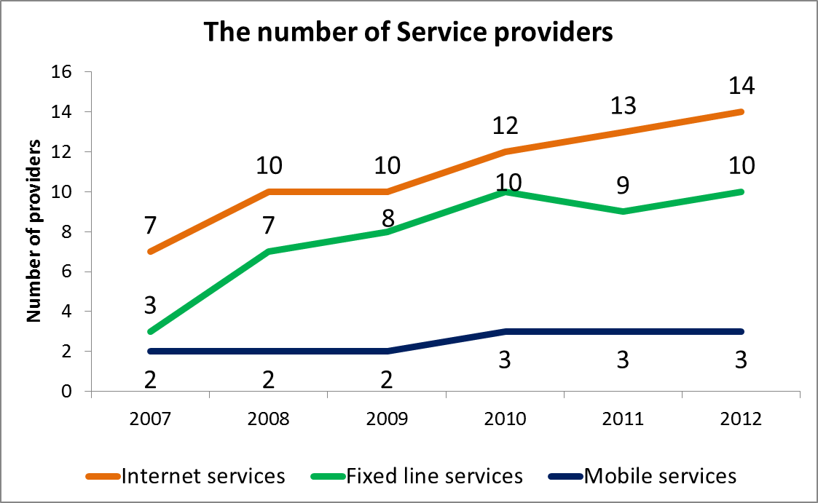
Some context information
765 Km2
1.2 Million inhabitants
11 Million visitors in 2012
Island = surrounded by water
& surrounded by neighbors
Average Temp 30 C (Peak 50 C)
Home US Navy 5th Fleet

Slide 4
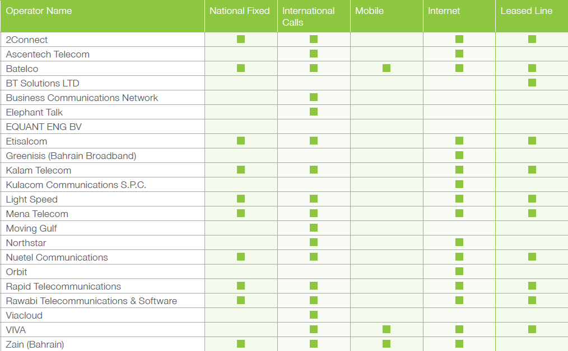
Telecom operators in the Kingdom of Bahrain
v
v
v

Slide 5
Fixed Broadband
Test methodology

Slide 6
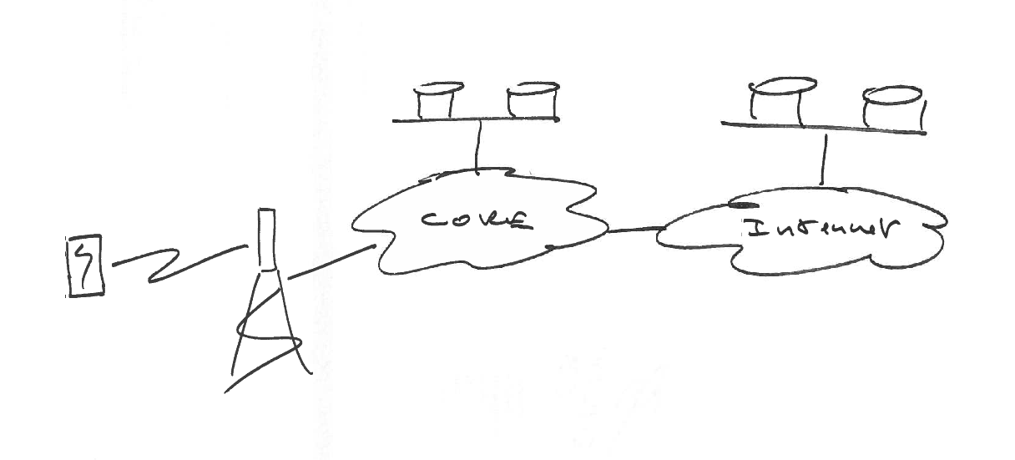
Service view
Service platforms
Service platforms
CPE
Access
Network

Slide 7
Test methodology
CPE
Service platforms
Service
Objective: Benchmark focused on qualitative assessment
of end to end services from an end user point of view

Slide 8
Test methodology (Fixed Broadband example)
Location 1
Local test
server
Remote test
server
Probe 1
Service 1
Public Internet
Probe 2
Service 2
Public server
Location 2
Tests covers: FTP Upload/Download, HTTP Cached / non Cached,
Echo reply (Ping) and DNS resolution time

Slide 9
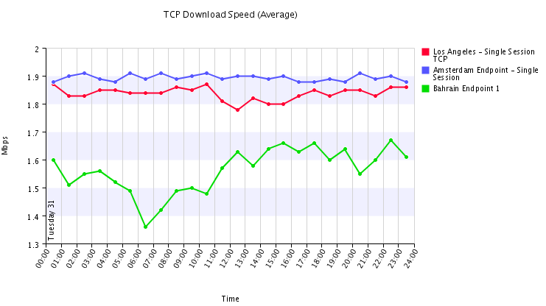
Test methodology – multiple test targets

Slide 10
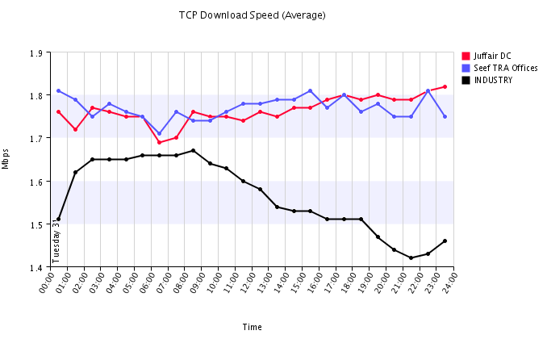
Test methodology – multiple tested services

Slide 11
Fixed Broadband
Measurements performed by the Authority

Slide 12
Performance of a 2 Mbps fixed Broadband service

Slide 13
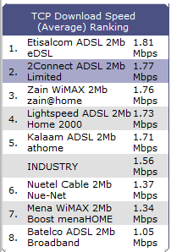
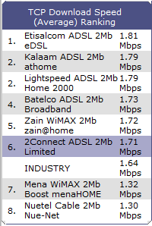
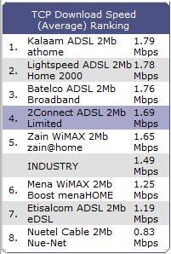
Performance of a 2 Mbps fixed Broadband service
January 2014
February 2014
March 2014
Performance is a dynamic phenomena

Slide 14
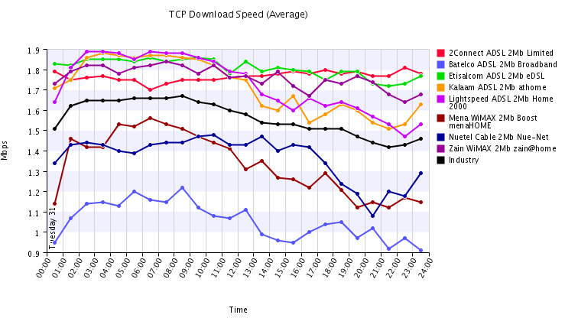
Performance of a 2 Mbps fixed Broadband service
January 2014
24h view

Slide 15
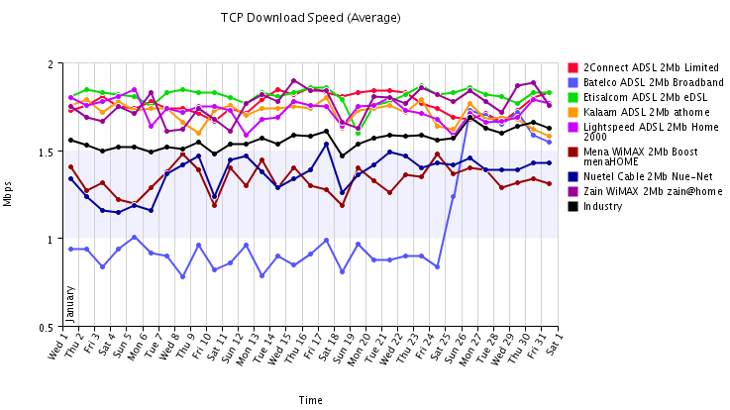
Performance of a 2 Mbps fixed Broadband service
January 2014
Continuous

Slide 16
Performance of a 2 Mbps fixed Broadband service
Choice of results presentation is very important

Slide 17
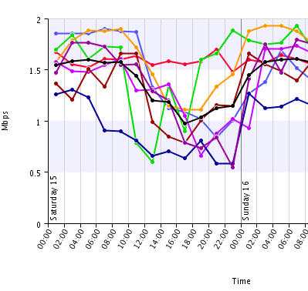
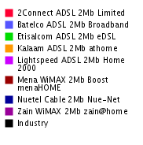
Performance of a 2 Mbps fixed Broadband service
Focus on
one day

Slide 18
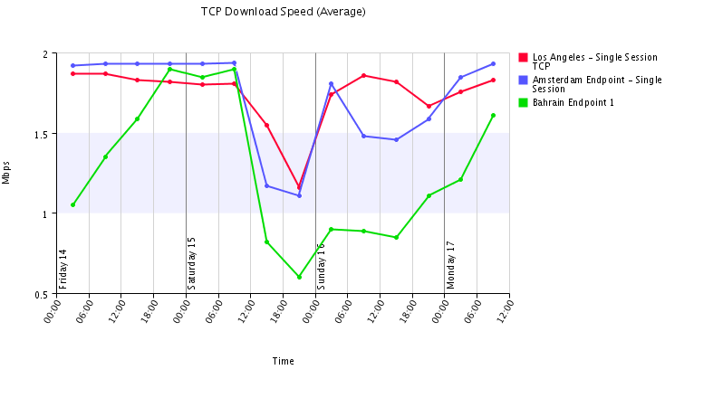
Performance of a 2 Mbps fixed Broadband service
Focus on
one day
FALCON cable fiber break between Egypt and
Oman about 10 Km from Cable Landing Station
Counter-intuitive performance can
be detected an analyzed

Slide 19
Fixed Broadband
Measurements provided by the Operators

Slide 20
Billing (ETSI EG 207 769 & 5.9)
Temporary peak linked with WiMax
radio network issue
Last two quarters increase is driven
by incumbent longer resolution time

Slide 21
Faults (ETSI EG 201 769 & 5.2)
Step due to WiMax fault rate
Industry average without
the ISP remains below 5%
Peak due to radio frequency issue
with one WiMax network

Slide 22
Service supply time (ETSI EG 769 & 5.3)
Volatility with WiMax technology change
and some radio frequency issues
Used as comparison

Slide 23
Telecom operators in the Kingdom of Bahrain

Slide 24
Mobile Broadband
Measurements performed by the Authority

Slide 25
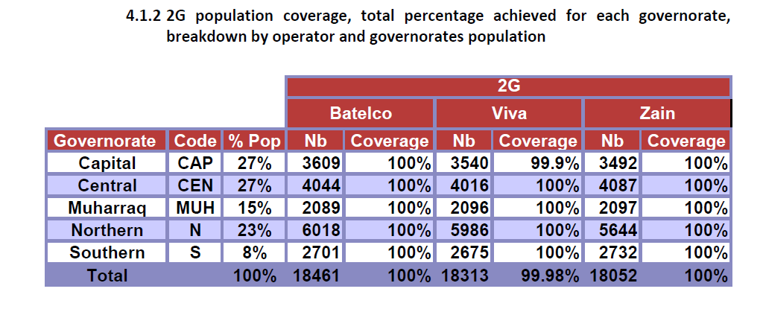
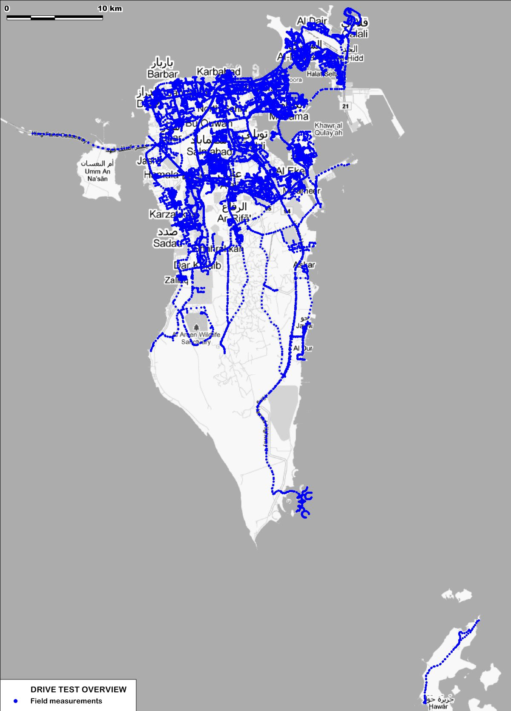
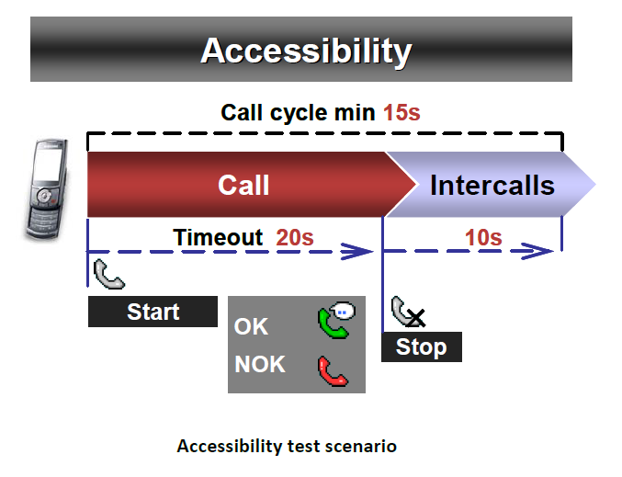
Mobile service coverage compliance
The audit consisted of a drive test throughout
pre-defined path to measure the outdoor
coverage of the population in the Kingdom via
an accessibility test.

Slide 26
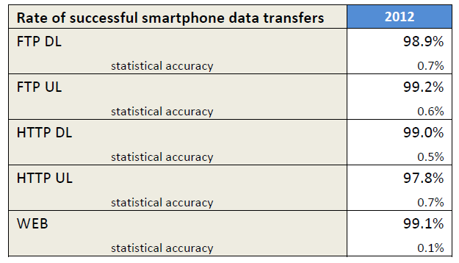
Mobile Broadband service access
Year on year data allows for
performance comparison

Slide 27
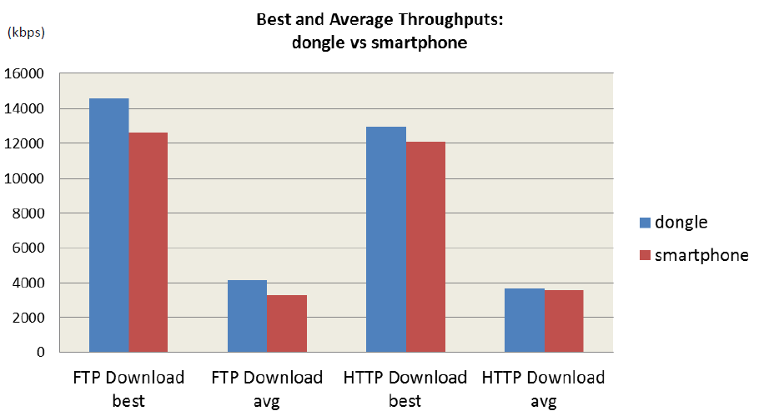
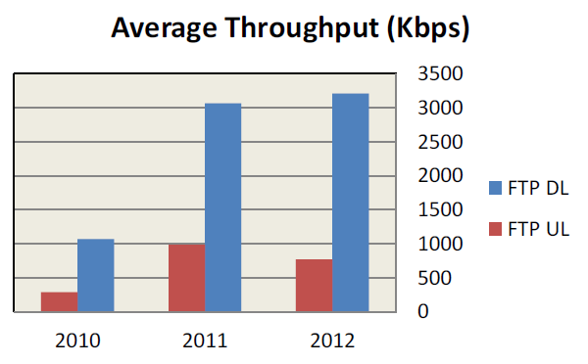
Mobile Broadband service performance
Performance is tested for HTTP and FTP also this is usually transparent to the end user

Slide 28
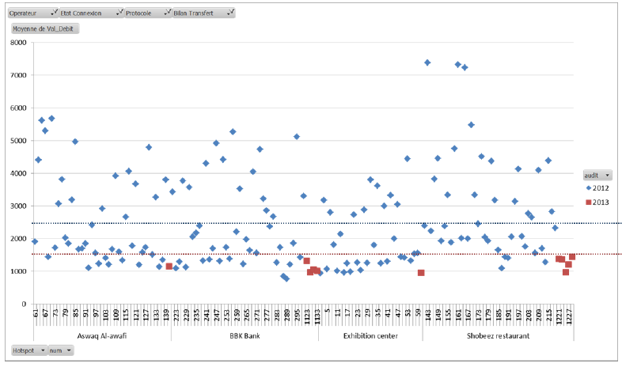
Mobile Broadband service performance
Dongle test performed to:
Server in Bahrain Blue
Server in India Red
No congestion on links or
Mobile network
Default dongle TCP window size used impacting performance due to increased latency
to reach server in India i.e. link idle while waiting acknowledgment packet.
Performance improved by increase of the TCP window size.
Test environment choice can lead to very different results

Slide 29
Mobile Broadband
Measurements provided by the Operators

Slide 30
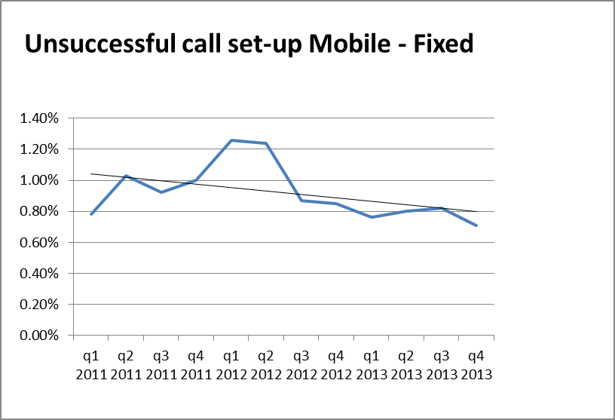
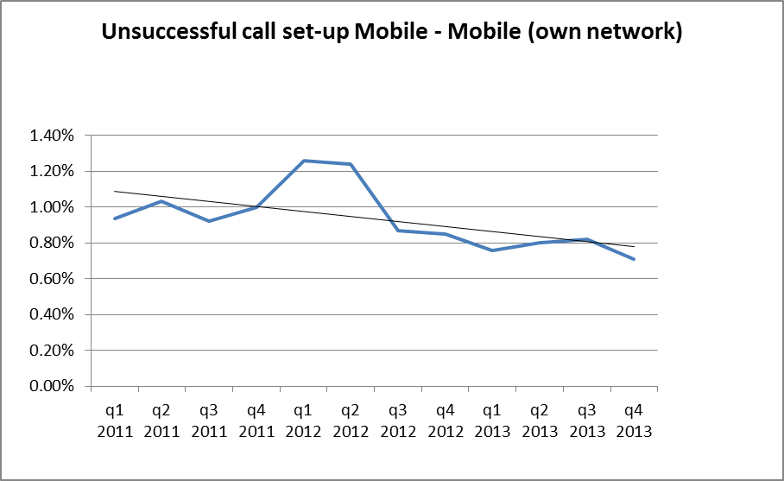
Unsuccessful call setup
Mobile to Fixe
Mobile to Mobile
The percentage of unsuccessful calls has decreased to become in average below 1%

Slide 31
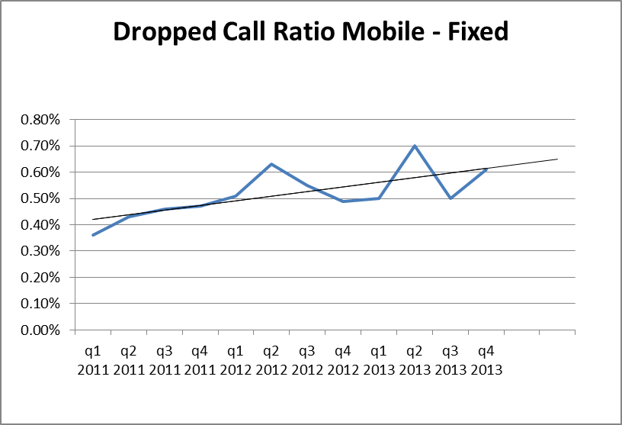
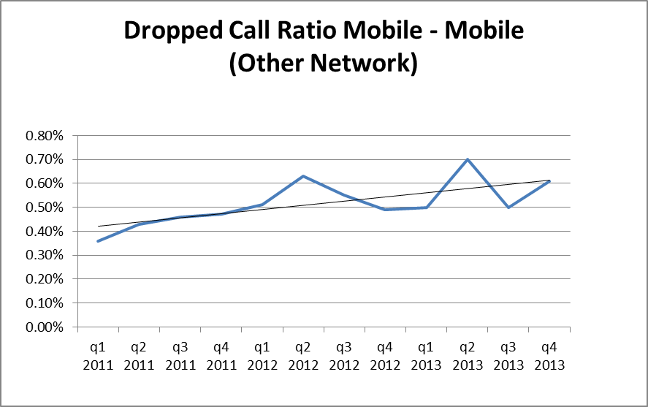
Dropped calls
Mobile to Fixe
Mobile to Mobile
The percentage of dropped calls is slightly higher however remains well below 1%

Slide 32
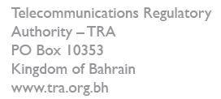

Slide 33
Thank You..!

