Slide 1
“Making media accessible to all”
ITU workshop – Geneva 24-25 October 2013
ACCESSIBLE TECHNOLOGIES FOR SPEECH MANAGEMENT

Slide 2
Cedat 85 - milestones
1985
Cedat 85 foundation
1995
Speech Recognition with Respeaking – IBM Viavoice
1998
Forum PA: Respeaking technology presentation
1999
Starting trial at Camera dei deputati with Respeaking technology
2002
Camera dei Deputati: introducing officially the Respeaking technology (CameraVox)
2005
Starting R&D on ASR Speaker Independent, Natural Language systems
2007
ASR Speaker Independent by Cedat 85
2008
Cedat 85 ASR system integrated with internal speech reporting work-flow
2009
Partnership with EML Gmbh on Speech Recognition Technologies
2010
Italian Ministry of Justice: trial for introducing the multimedia reporting
2011
+Voce Mediamonitor
Mobile App: Voicenote
Magnetofono
2012
Automatic Speaker Diarisation & Speaker Verification
ITU Workshop 2013 - Making media accessible to all

Slide 3
Cedat 85 – Technology and Services
Technology
Professional services
Call center applications
Media applications
Mobile applications
Applications for professional reporting
Excellence in professional reporting.
Building High Performance Speech-to-Text System.
Language and domain customization for speaker independent automatic speech recognition system.
Qualified training for professional use of speaker dependent speech recognition software.
ITU Workshop 2013 - Making media accessible to all

Slide 4
Cedat 85 - main customers
ITU Workshop 2013 - Making media accessible to all

Slide 5
Cedat 85 - ASR Technology
Speech-to-Text automatically transforms human conversations in text and makes unstructured speech content available for analysis, search, interaction
Functionality
Speaker independence
Natural Language
Very large vocabulary (300k+ words)
Robust speech recognition
Challenges
ITU Workshop 2013 - Making media accessible to all

Slide 6
Languages for ASR
Already available
ITU Workshop 2013 - Making media accessible to all

Slide 7
Cedat 85 Technology Applications
Speech Recognition
& Transcription
Embedded
Speech
Interaction
Technology
Cedat 85
Call Center Speech Analytics
Voice Messaging
Mobile applications
Markets
TV & Broadcast
Public sector
Assisted
Living
Quality
Moni-
toring, Customer Sat.
Bus.
Ana-
lytics
Cus-
tomer
Assistance
Applications
Social
Web
Mail
SMS
Search
Ana-
lytics
Re-
trieval
Sub-
titling
Media
Devices
Home
Control
ITU Workshop 2013 - Making media accessible to all

Slide 8
+VOCE Technology
Automatic Speech Recognition and
Advanced search engine and
Automatic Indexing and
Web technologies =
Ability to manage SPEECH as if it were TEXT!
ITU Workshop 2013 - Making media accessible to all

Slide 9
ITU Workshop 2013 - Making media accessible to all

Slide 10
How +VOCE MediaMonitor works
800+ hours of audio per day
13 national tv channels
15 national radio channels
5 web tv channels
~40 local tv channels
3 international tv channels
ITU Workshop 2013 - Making media accessible to all

Slide 11
Searching by metadata
ITU Workshop 2013 - Making media accessible to all

Slide 12
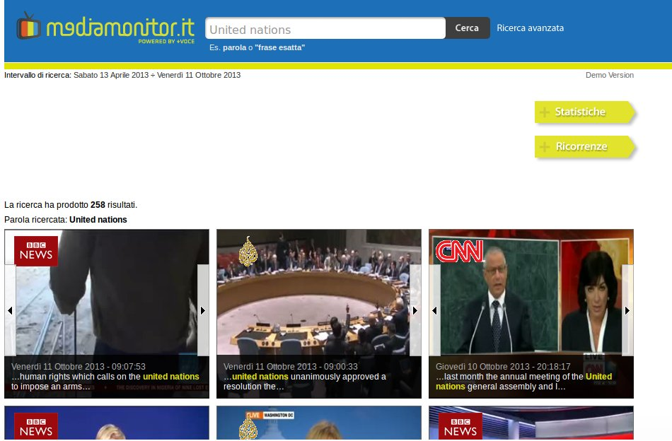
Full text search (not keyword only)
ITU Workshop 2013 - Making media accessible to all

Slide 13
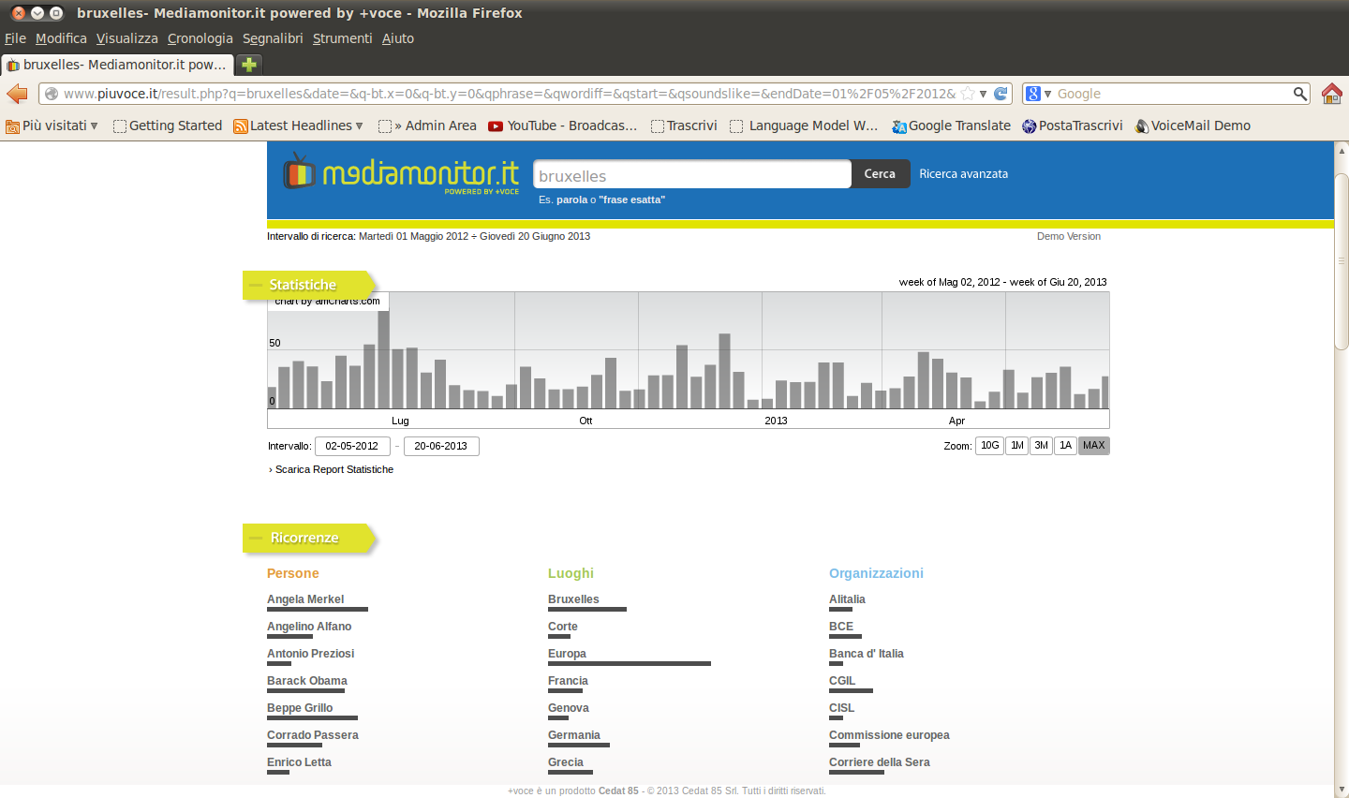
Statistics
the statistics give information about frequency of the word of interest and its distribution along time
ITU Workshop 2013 - Making media accessible to all

Slide 14
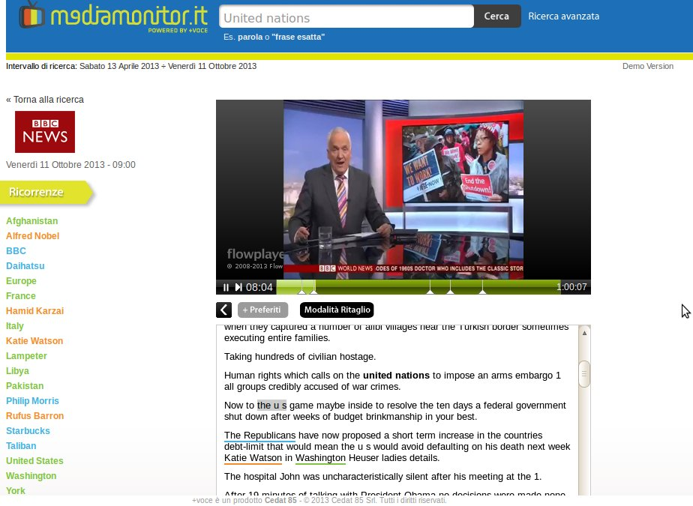
Aligned transcription with tracking
ITU Workshop 2013 - Making media accessible to all

Slide 15
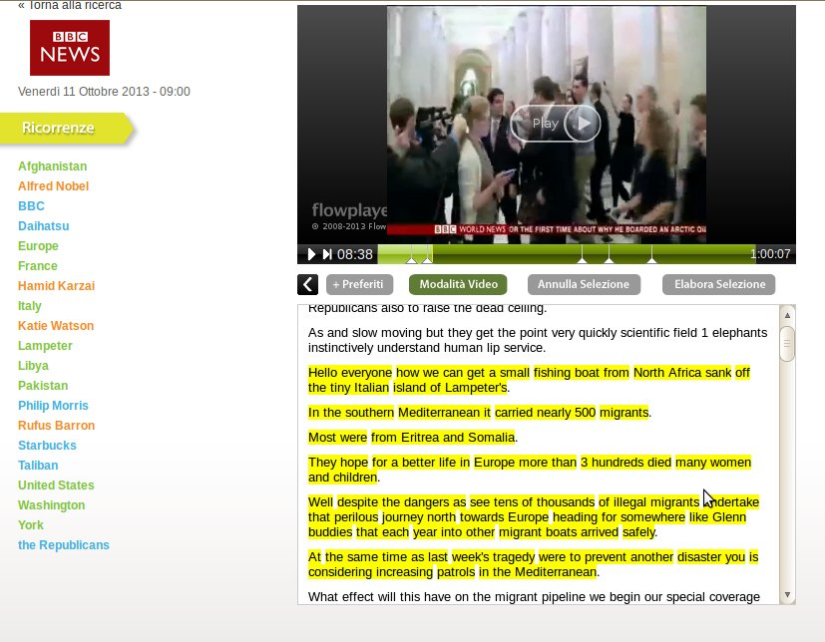
Online editing tool
Clicking on the starting and ending points on the text, it is possible to select and cut a chunk of video (and text), and to export it.
ITU Workshop 2013 - Making media accessible to all

Slide 16
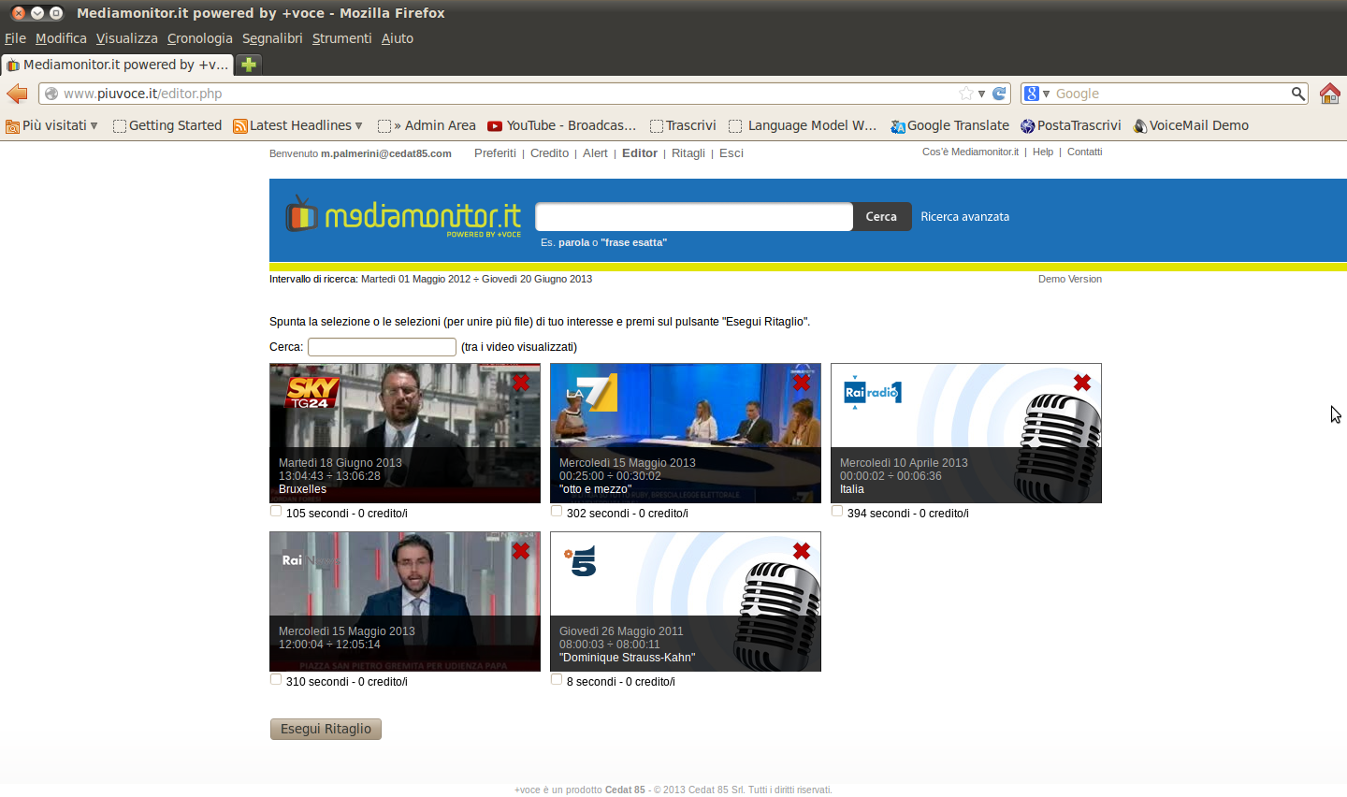
Personal archive
all the chunks can be stored in a personal area were it is possible to:
edit the transcription
add tags to the videos
merge some or all of them into one
in order to build a personal press review
ITU Workshop 2013 - Making media accessible to all

Slide 17
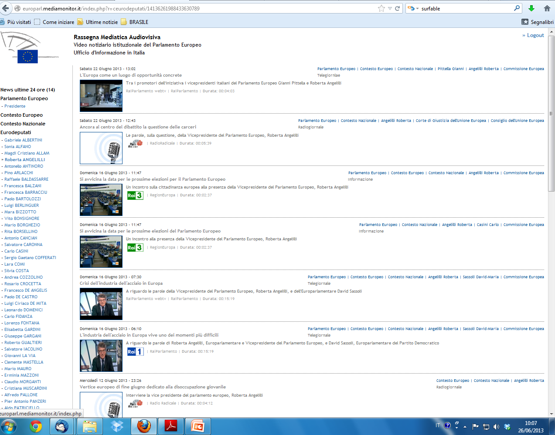
CASE STUDY
daily Media Press Review for European Parliament
personal press review on customized web interface
indexed and surfable chunks archive
chunks enriched with text (for exporting, printing or sharing)
alert service via email/sms
ITU Workshop 2013 - Making media accessible to all

Slide 18
Sentiment analysis
Semantic search
Machine Translation
Multilingual Media Monitoring
Multilingual subtitles
And what's the goal now?
ITU Workshop 2013 - Making media accessible to all

Slide 19
Thank you for your attention!
Contacts
Enrico Giannotti
Deputy General Manager
M. +39.348.1302376
e.giannotti@cedat85.com
www.mediamonitor.it
www.cedat85.com (corporate / company profile ENG)
ITU Workshop 2013 - Making media accessible to all

