Slide 1
Standardization as an Innovation Eco-system Enabler
ITU Workshop on
“ICT Innovations for Developing Countries”
(Geneva, Switzerland, 18 September 2013)
Ramy A. Fathy, PhD
Director, Digital Services Policies
National Telecom Regulatory Authority (NTRA) Egypt

Slide 2
Economic Functions of Standards
“A standards can be defined as a construct that results from reasoned, collective choice and enables agreement on solutions of recurrent problems”
“A striking balance between the requirements of users, the technological possibilities and associated costs of producers, and constraints imposed by governments for the benefit of society in general”
(Tassey 2000)

Slide 3
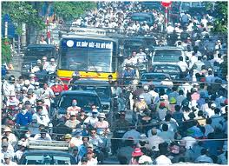
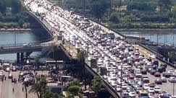
Needs of Developing Countries

Slide 4
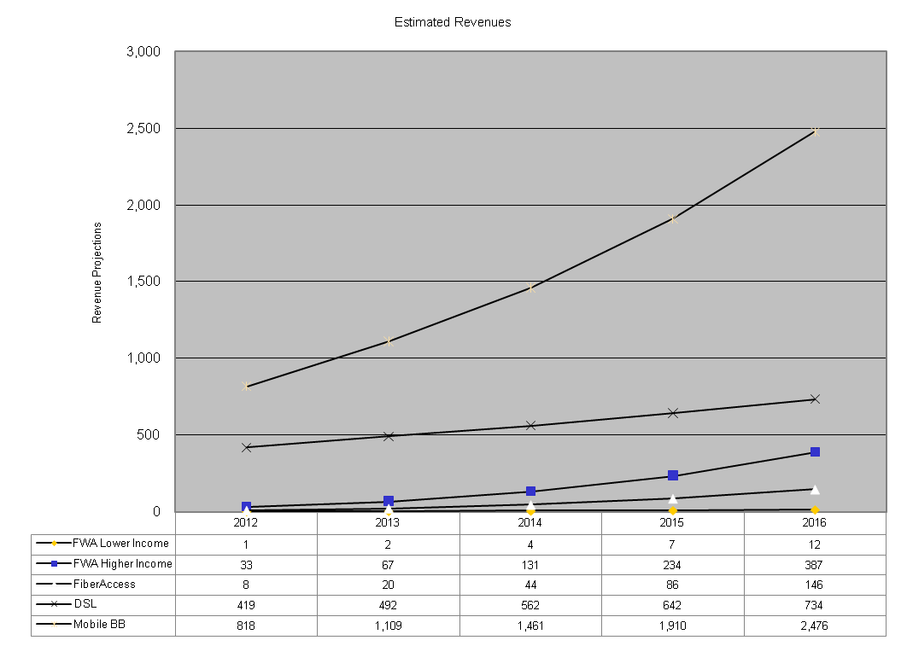
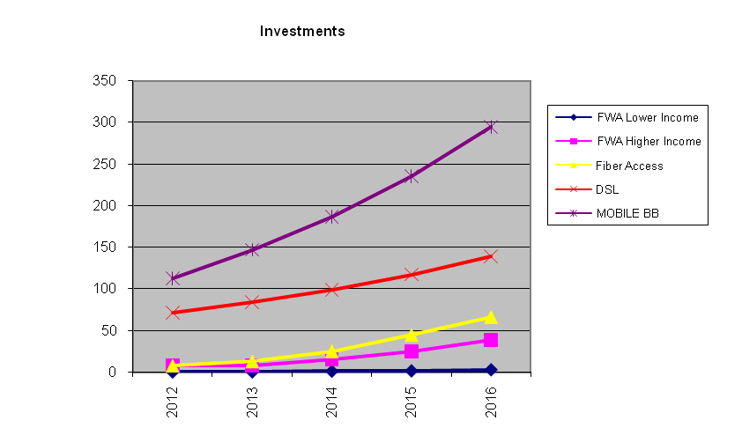
Telco Business Case vs. Standardization Pace
Revenues
(eMisr 2011)
Investments
Asset Lifetime is usually 5-10 yrs
Standardization pace is faster → Innovation is your solution

Slide 5
Standardization and Users’ Needs
Socio-Economic Demand
Standards
+ (Innovations)
Standards
Users’ Needs
Innovations preserve the balance
The balance might be lost!

Slide 6
Role of Innovation
Effective mechanism to bridge the standardization gap
Stimulate demand for ICT applications and services for a maximum global ICT market sustainability and development
i.e. Innovations that have a socio-economic impact (to satisfy the users’ demand)

Slide 7
Role of Innovation
“In terms of policy, it is a well-established result that market economies normally do not generate a socially optimal volume of knowledge creation, innovation and entrepreneurship”
However, there is no consensus concerning what institutional frameworks and policy measures that might generate such a social optimum given the imperfections in both the economic and the political markets.
(Braunerhjelm , 2010)
This has not stopped policy-makers from launching a large number of institutional changes and policy measures to stimulate knowledge creation, innovation and entrepreneurship.

Slide 8
Innovation Standardization Interaction
We know that Innovation affects the Standardization Process and the economy
Innovation
Knowledge Creation
?
Economy
Standardization

Slide 9
Source of Wealth
Economists have been searching for the sources of economic growth since the end of the 18th century.
For Adam Smith the division of labour and the accumulation of capital were causes for the increasing wealth of nations.
Austrian-American economist Joseph Alois Schumpeter further established that innovations in products and processes are prerequisites for economic growth.

Slide 10
Source of Wealth
»The fundamental drive that starts up the capitalist machine and keeps it running comes from the new consumer goods, the new production and transport methods, the new markets, the new forms of industrial organization, which capitalist entrepreneurship creates.«
(Schumpeter, 1980)

Slide 11
Formal Model of Economic Growth - Solow‘s Growth Theory
1950s: American Robert M. Solow developed the first formal mathematical model of economic growth.
Economic growth within the USA could be described by three determinants:
an increase in capital (e.g. machinery and infrastructure),
an increase in labour, and
technical progress.

Slide 12
Stimulating Economic Growth: Standardization Role
It is not sufficient to only create new knowledge through R&D.
Knowledge must be broadly disseminated so that many companies can make use of it.
Standards that are developed in consensus with the participation of companies are particularly suitable for disseminating technical knowledge.
Standardization experts record the current technological standard in documents, thus facilitating its broad diffusion in the market.
As opposed to information in patents, which are subject to IPRs, the information codified in standards is accessible to all → its dissemination is not restricted.

Slide 13
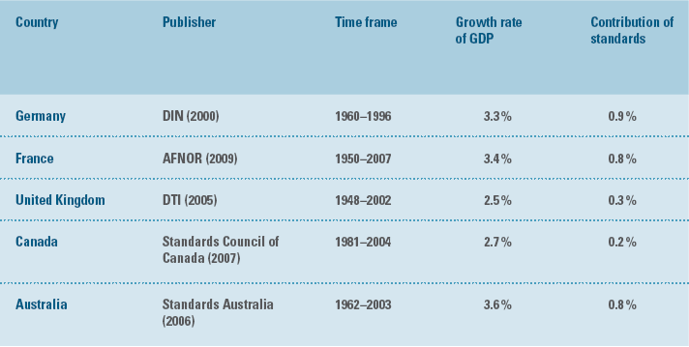
Stimulating Economic Growth: Role of Standards
The role of standards in the dissemination / diffusion of technical knowledge and their resulting contribution to continual economic growth have already been demonstrated in numerous studies

Slide 14
France (AFNOR 2009) - Model Adopted
In traditional growth models, growth depends on the pace of productive capital accumulation, employment trends and the rate of accumulation of knowledge.
The model demonstrated here is described by the traditional Cobb-Douglas equation:
where Y is production, K capital input, L labour input and A total factor productivity (TFP), which measures the proportion of productivity not accounted for by the contribution of production factors.
Assuming freely competing markets, the variables α and (1 - α) stand for the respective proportions of wages and profits in the value added.

Slide 15
France (AFNOR 2009) - Model Adopted
Taking the logarithms and differentiating with respect to time
This equation expresses the rate of growth of the economy in terms of growth in technical progress (total factor productivity) and variations in labour and capital input.
From this equation, we can deduce the labour productivity equation:
which expresses the growth rate of productivity of work in terms of technical progress growth and the variation of capitalistic intensity weighted by the proportion of profits in the value added.

Slide 16
France (AFNOR 2009) – Measuring the Impact of Standardization
To measure the impact of standardization on the economy, the work of the Canadian Council of Standards (2007) and the DTI in the UK (2005) has focused (from a macroeconomic point of view) on the effects of the stock of standards and its evolution on the productivity of work.
“opening” of the black box of total factor productivity (TFP).
For this purpose, the TFP is calculated and the following equation written:
Thus the growth of technical progress can be explained by the vitality of the portfolio of standards (knor), and of scientific and technological knowledge (kbrev) and other factors.

Slide 17
France (AFNOR 2009) – Comparison with the DIN Estimates
The contribution of standards to GDP growth during the period 1950-2007 is positive and statistically significant. It represents, on a yearly average, 0.81%, i.e. almost 25% of the GDP. This impact is comparable to that found by both the Germans and Australians.

Slide 18
France (AFNOR 2009) – Main Results
There is a close relationship between innovation and technical progress and their dissemination.
Dissemination can be proxied by the activity of standardization.
i.e. standardization (standards, technical documents, etc.) can be considered as a specific form of technology transfer.

Slide 19
Completing the Cycle
must be standardized
Innovation
Knowledge Creation
Economy Wealth
Business Case
Foundational ICT Infrastructure
Socio-Economic Needs
Standardization
Demand
CSSA
Standardizing demand stimulating technologies is the key + the Critical Success Standardization Activities (CSSA)
Standardization-Innovation Sustainability Model

Slide 20
Conclusions and Recommendations
Innovation alone are not sufficient to attain economic development
Standardization without the satisfaction of developing economies needs = Operators’ Revenue Squeeze + Market Saturation + Potential Failure in Producers-Consumers Chain

Slide 21
Conclusions and Recommendations
Standardizing demand stimulating technologies is the key + the Critical Success Standardization Activities (CSSA) + standardizing innovations (which have a socio-economic impact) → a sustainable economic growth + a sustainable innovation eco-system
Standardization-Innovation Sustainability Model
A possible new theory that links :
Demand + Innovation + Standards

Slide 22
References
[Schumpeter 1980] Schumpeter, Joseph Alois (1980): Kapitalismus, Sozialismus und Demokratie, (Capitalism, Socialism and Democracy). Munich: Francke, 5th ed.
[Tassey 2000] Tassey, G., Standardization in technology-based markets, Research Policy, Volume 29, Issues 4–5, April 2000, Pages 587-602, ISSN 0048-7333, 10.1016/S0048-7333(99)00091-8. (http://www.sciencedirect.com/science/article/pii/S0048733399000918)
[eMisr 2011] National Telecom Regulatory Authority (NTRA), Egypt National Broadband Plan, Nov. 2011. (http://www.tra.gov.eg/emisr/Presentations/Plan_En.pdf)
[Braunerhjelm 2010] Braunerhjelm, P., Entrepreneurship, Innovation and Economic Growth - past experience, current knowledge and policy implications, Working Paper Series in Economics and Institutions of Innovation 224, Royal Institute of Technology, CESIS - Centre of Excellence for Science and Innovation Studies, 2010.

Slide 23
Questions
rahmed@tra.gov.eg
+20235344182

