Slide 1
CIRCULAR ECONOMY
Life cycle extension an opportunity to all
Laura Reyes
March 2017

Slide 2
Agenda
What does Circular Economy mean?
Who have we applied the theory
What the results are… in practice
The Challenges
The opportunities
A Success Story: Mobile Carrier Buy-Back Program
About Belmont Trading Company

Slide 3
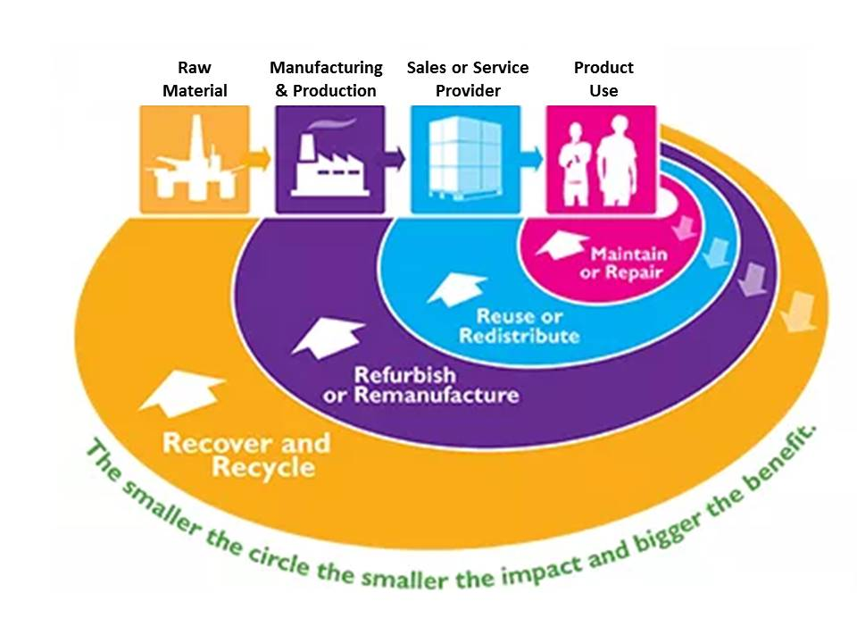
Circular Economy – A definition:
Maximizing Economic Value
Pursuing Sustainability Goals
Complying With Regulations
Protecting Private Data

Slide 4
…. Some concepts
Aiming to develop production models that reduce reliance on raw materials by continuously cycling materials back into supply chains.
Seeking long-term business and environmental sense, from "take-make-waste" linear economy to a more "circular" one that views waste as a way to “feed it”.
Challenges remain, including making the internal business case for it, updating antiquated public policies to promote circular strategies and educating consumers about the merits.
E-MATERIAL
E-WASTE
Generally implies material that is:
Beyond Economic Repair (BER) or End Of Life (EOL)
Destined for lower-value recycling/metals recovery
Any electronic product that is transitioning from one use to the next, such as:
New in box equipment that an OEM never sold as new
Resalable used equipment even if it requires repair or refurbishment to make it suitable for resale

Slide 5
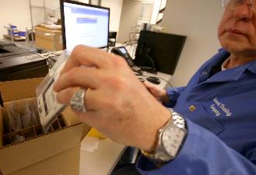
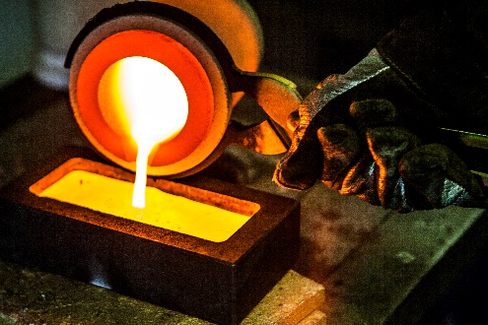
How have we apply the concept
Higher Recovery
Value
LEGAL COMPLIANCE(RISK)
ENVIRONMENTAL IMPACT
FINANCIAL SUSTAINABILITY
Remarketing Whole Units
Component Harvest & Resale
Scrapping & Recycling
Lower Recovery Value
Notes:
Left side: $1.92 per phone; right size: ~$200

Slide 6
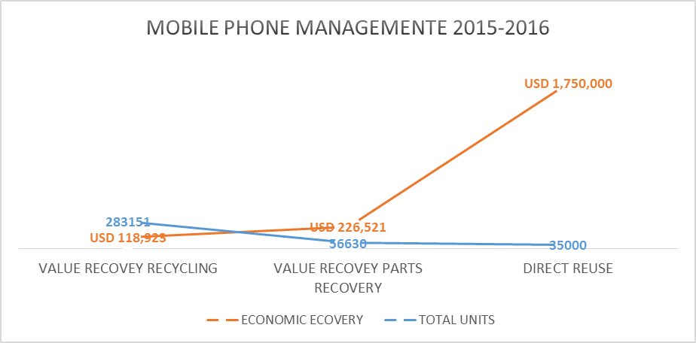
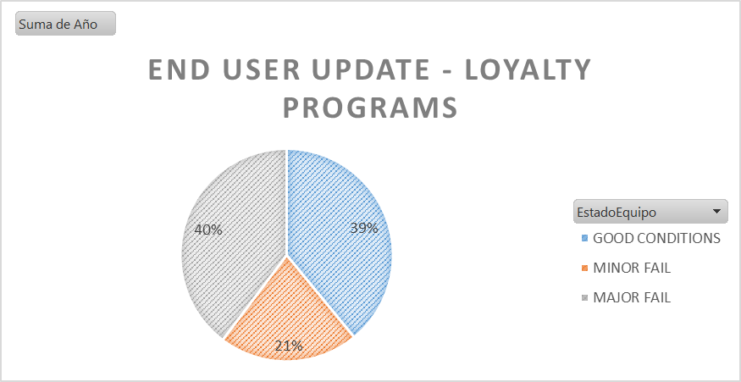
MANAGEMENT RESULTS: E-WASTE & E-MATERIAL

Slide 7
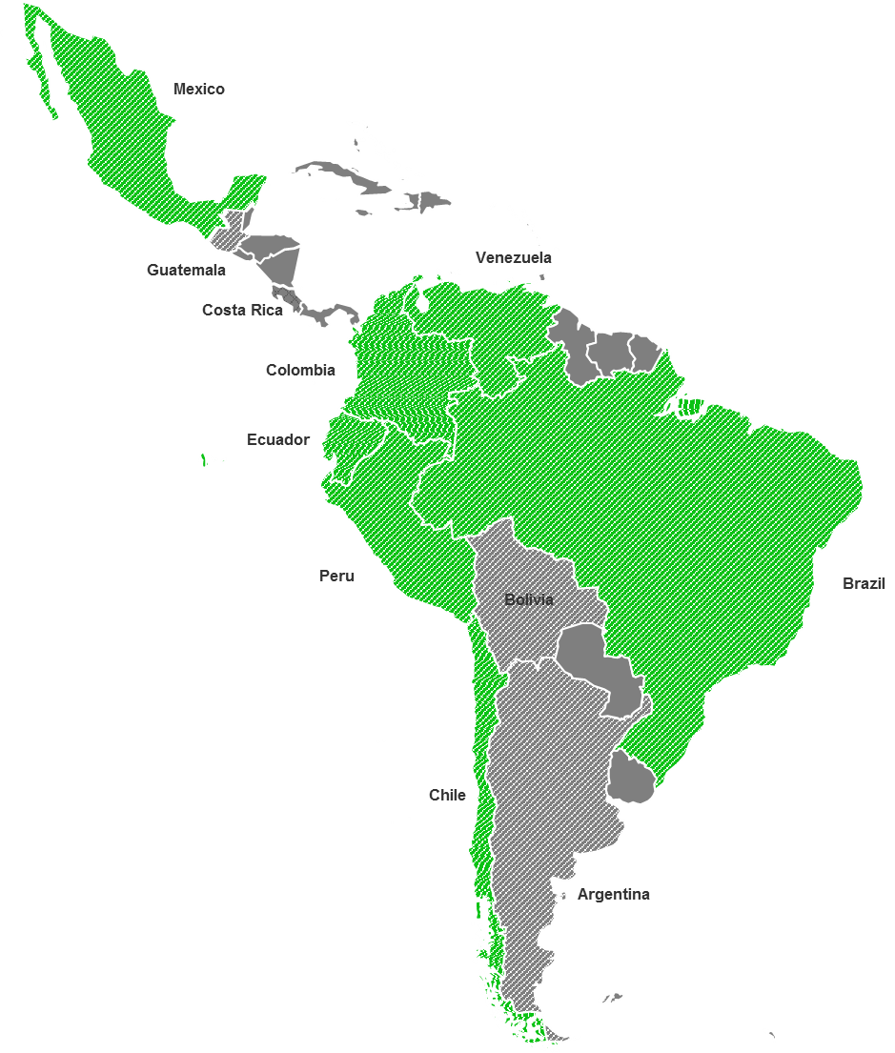
Challenges: LATAM Regulatory Environment
Commentary
Of the top 10 eWaste producing countries, 7 currently have regulations in place Since only 5 countries had regulations in 2014, this represents positive progress
Key:
Formal National Regulations in Place
No Formal National Regulations in Place
Top 10 eWaste Generator

Slide 8
Challenges: Communication, Logistics, Standards Adoption
Communication
Educating consumers: Hazards of eWaste in landfills Economic value of eMaterials Availability of recycling/reuse options Cost of educational campaigns; who pays?
Logistics
Security of e-material and e-waste Cost of moving material Other related legislation (Import declarations Vs WEEE Scheme programs) Import and export Establishing resale channels (B2B and B2C)
Standards Adoption
Common definitions of: Hazardous waste Scrap eWaste Etc NGO standards: R2 eStewards

Slide 9
Turning Challenges into Opportunities: Summary
Challenge
Regulatory Environment
Processing, Remarketing, Recycling Capacity
Educating Consumers
Logistics
Standards Adoption
Recommendation
Clear, consistent definition and application of rules in the regulations – Harmonised throught he region
We encourage the eMaterials processors to fare-trade economy in order to expand local capacity in countries in Latin America
Promote and communicate initiatives of recycling on a regular basis
In order to minimize the logistics cost we need to generate volumes to consolidate materials. How are we going to do that?
Work to standards toward adoption on the management of eMaterials to promote responsible recycling programs.

Slide 10
Case Study: Latin American Mobile Device Trade-In Program
Client
Leading LATAM mobile network operator Diversified service portfolio includes mobile phones, cable TV, broadband, mobile payments Operates online eCommerce site and a network of retail stores
Client Situation
Sought partner to run online and in-store mobile device trade-in program and provide: Maximum recovery value by selling phones in optimal markets (domestic or international) Maximum velocity of cash conversion Minimum environmental impact Compliance with strict Colombian regulations
Integrated Solution
Belmont partnered with client and in-store processor to develop end-to-end trade-in program Belmont manages all out-of-store logistics, leveraging Colombia facility for device collection & processing, Dubai and Hong Kong facilities for international remarketing, U.S. facility for recycling devices that can’t be remarketed
Business Value Delivered
Turn-key solution for mobile carrier Client’s end customers who trade in consume significantly more services and data than non-participating customers

Slide 11
About Belmont Trading Company

Slide 12
Belmont’s global processing and remarketing capacity and capabilities are extensive
With headquarters just outside of Chicago, IL and 10 facilities on 4 continents around the globe, Belmont Trading Company is a global leader in providing asset management and value recovery services for used electronic equipment
Global Processing Capacity
Mobile Devices | Network Telecom | Computing Equipment
1,000,000+ Units/Mo | 14,000+ Plug-in Units/Mo | 200,000+ Units/Mo
200+ Metric Tons/Mo | 400+ Metric Tons/Mo | 350+ Metric Tons/Mo
Asset Management
Value Recovery

Slide 13
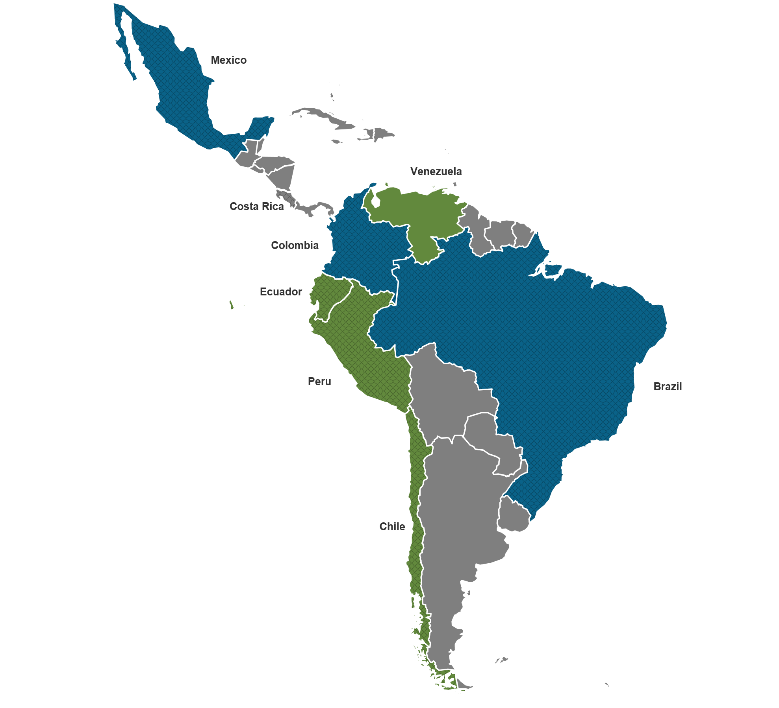
Belmont’s network in LATAM allows us to cover more than 80% of the eMaterials market
Belmont Facilities
Mexico
Colombia
Brazil
Belmont Partner Network
Chile
Ecuador
Peru
Venezuela

Slide 14
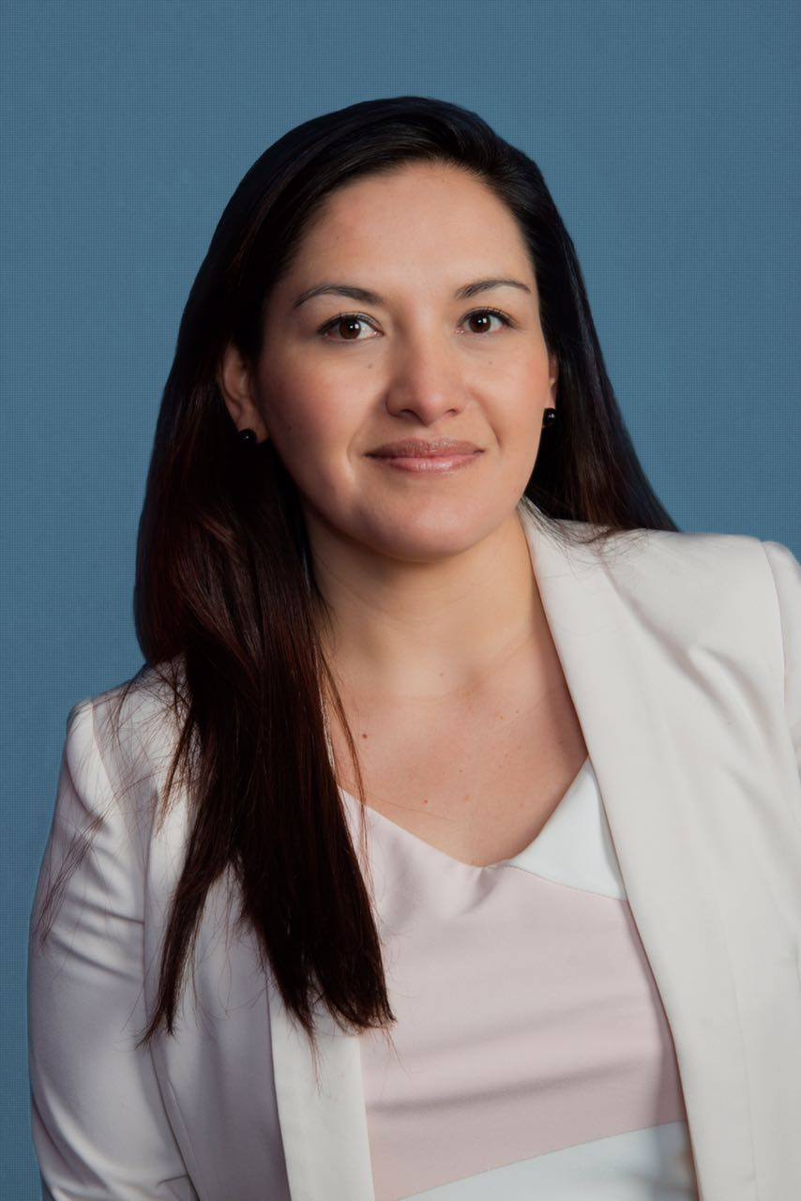
Thank You!
Laura Reyes
Business Development Manager - Colombia
laurar@belmont-trading.com
Belmont Trading Co., Inc.
ISO 9001, ISO 14001, OHSAS 18001, Responsible Recycling© (R2)
900 Corporate Grove Drive, Buffalo Grove, Illinois 60089 USA
www.belmont-trading.com
http://www.belmont-trading.com/mx.aspx
http://www.belmont-trading.com/co.aspx
http://www.belmont-trading.com/br.aspx
@BelmontTrading
@BelmontEspanol
@BelmontColombia
https://www.linkedin.com/company/belmont-trading
https://www.youtube.com/user/BelmontTrading

